Slide 1





UBND QUẬN DƯƠNG KINH
TRƯỜNG TIỂU HỌC ANH DŨNG
WELCOME
TO OUR CLASS

Slide 2


Fun Time 2
Period 2

Slide 3

TABLE OF CONTENTS
Activity 1
Warm-up and Review.
Activity 2
Guess and write. Then say.
Activity 3
Let’s play.
Activity 4
Fun corner and Wrap-up

Slide 4

Activity 1
Warm-up
and Review

Slide 5








Game: MISSING FLASHCARDS
quiz
box
fox
question

Slide 6

box
quiz
square
fox

Slide 7

ox
fox
square
quiz

Slide 8
box
question
square
ox

Slide 9

Good
job!
Keep moving!

Slide 10
Activity 2
Guess and write. Then say.

Slide 11




LOOK and SAY.
A: What’s she doing?
B: She’s doing a ………………

Slide 12
GUESS and WRITE.
A: What’s she doing?
quiz .
B: She’s doing a ………………

Slide 13
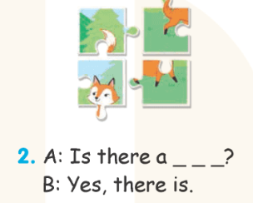
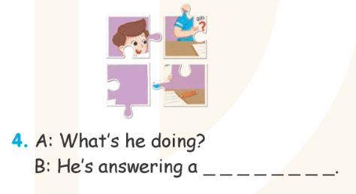
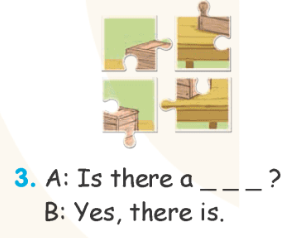
GUESS and WRITE.

Slide 14







Let’s check.
Work in pairs.

Slide 15


Let’s CHECK.
fox
A: Is there a ………………...?
B: Yes, there is.

Slide 16


Let’s CHECK.
box
A: Is there a ………………...?
B: Yes, there is.

Slide 17


Let’s CHECK.
A: What’s he doing?
B: He’s answering a
……………………………………………….
question .

Slide 18
Good
job!
Keep moving!

Slide 19
Activity 3
Let’s play.
SPELLING BEE

Slide 20
Game: SPELLING BEE
Q
U
I
Z

Slide 21
B
O
X

Slide 22
F
O
X

Slide 23
S
Q
U
A
R
E

Slide 24
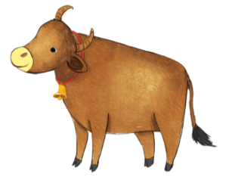
O
X

Slide 25
Q
U
E
S
T
I
O
N

Slide 26
Good
job!
Keep moving!

Slide 27
Activity 4
Fun corner
and Wrap-up

Slide 28
Game: WHISPER
fox

Slide 29
square

Slide 30
question

Slide 31
box

Slide 32
quiz

Slide 33
Good
job!

