Slide 1
Review 2
UBND QUẬN DƯƠNG KINH
TRƯỜNG TIỂU HỌC ANH DŨNG
Lesson 1 – Period 1

Slide 2

Table of contents
Warm up and Review
2. Activity 1: Listen and read.
3. Activity 2: Look again and circle.
4. Fun corner and Wrap-up

Slide 3

01
Warm-up
What and where
Options:
Easy
Advanced

Slide 4
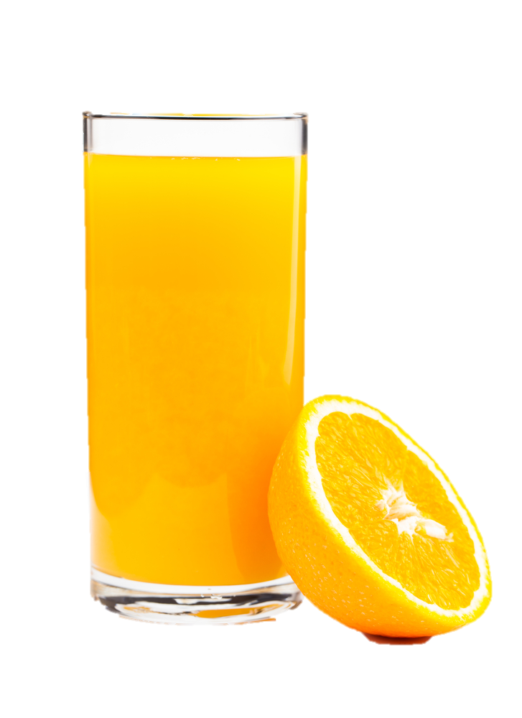
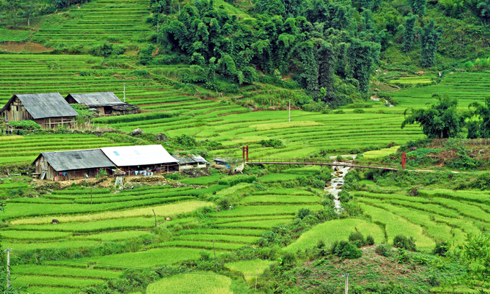
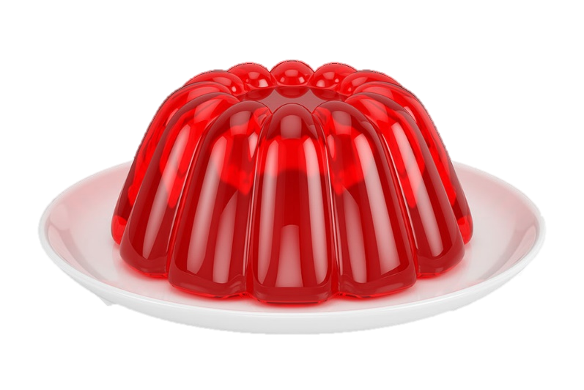
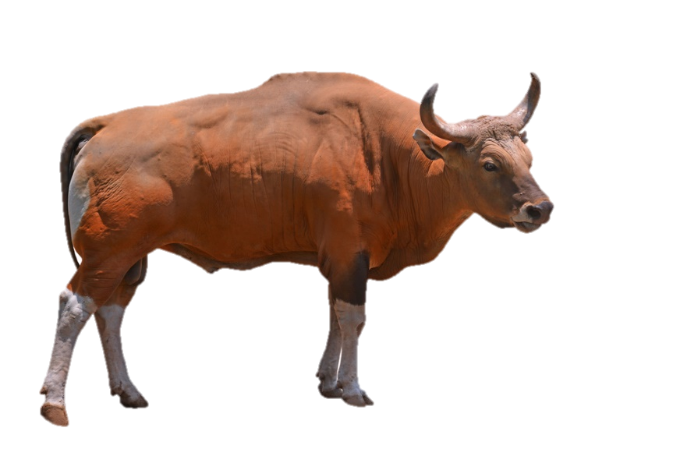




Notes:
- Look at the pictures in 5 seconds.
- Remember the picture is hidden and say it correctly.
- Check the answers as the class.

Slide 5



Slide 8




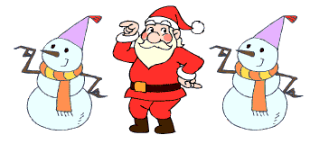

Slide 9

juice
village
ox
jelly

Slide 10
jelly
juice
village
ox

Slide 11
jelly
juice
village
ox

Slide 12
juice
ox
village
jelly

Slide 14

02
Activity 1
LISTEN AND READ.

Slide 15








Listen and read.
… and I’m Super Sue!
… and I’m Super Sue!
Hello, I’m Phonic Phil!
Hello, I’m Phonic Phil!

Slide 16



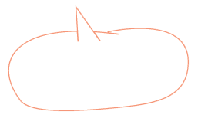
Let’s go to Ba’s village!
Let’s go to Ba’s village!
Great!
Great!

Slide 17
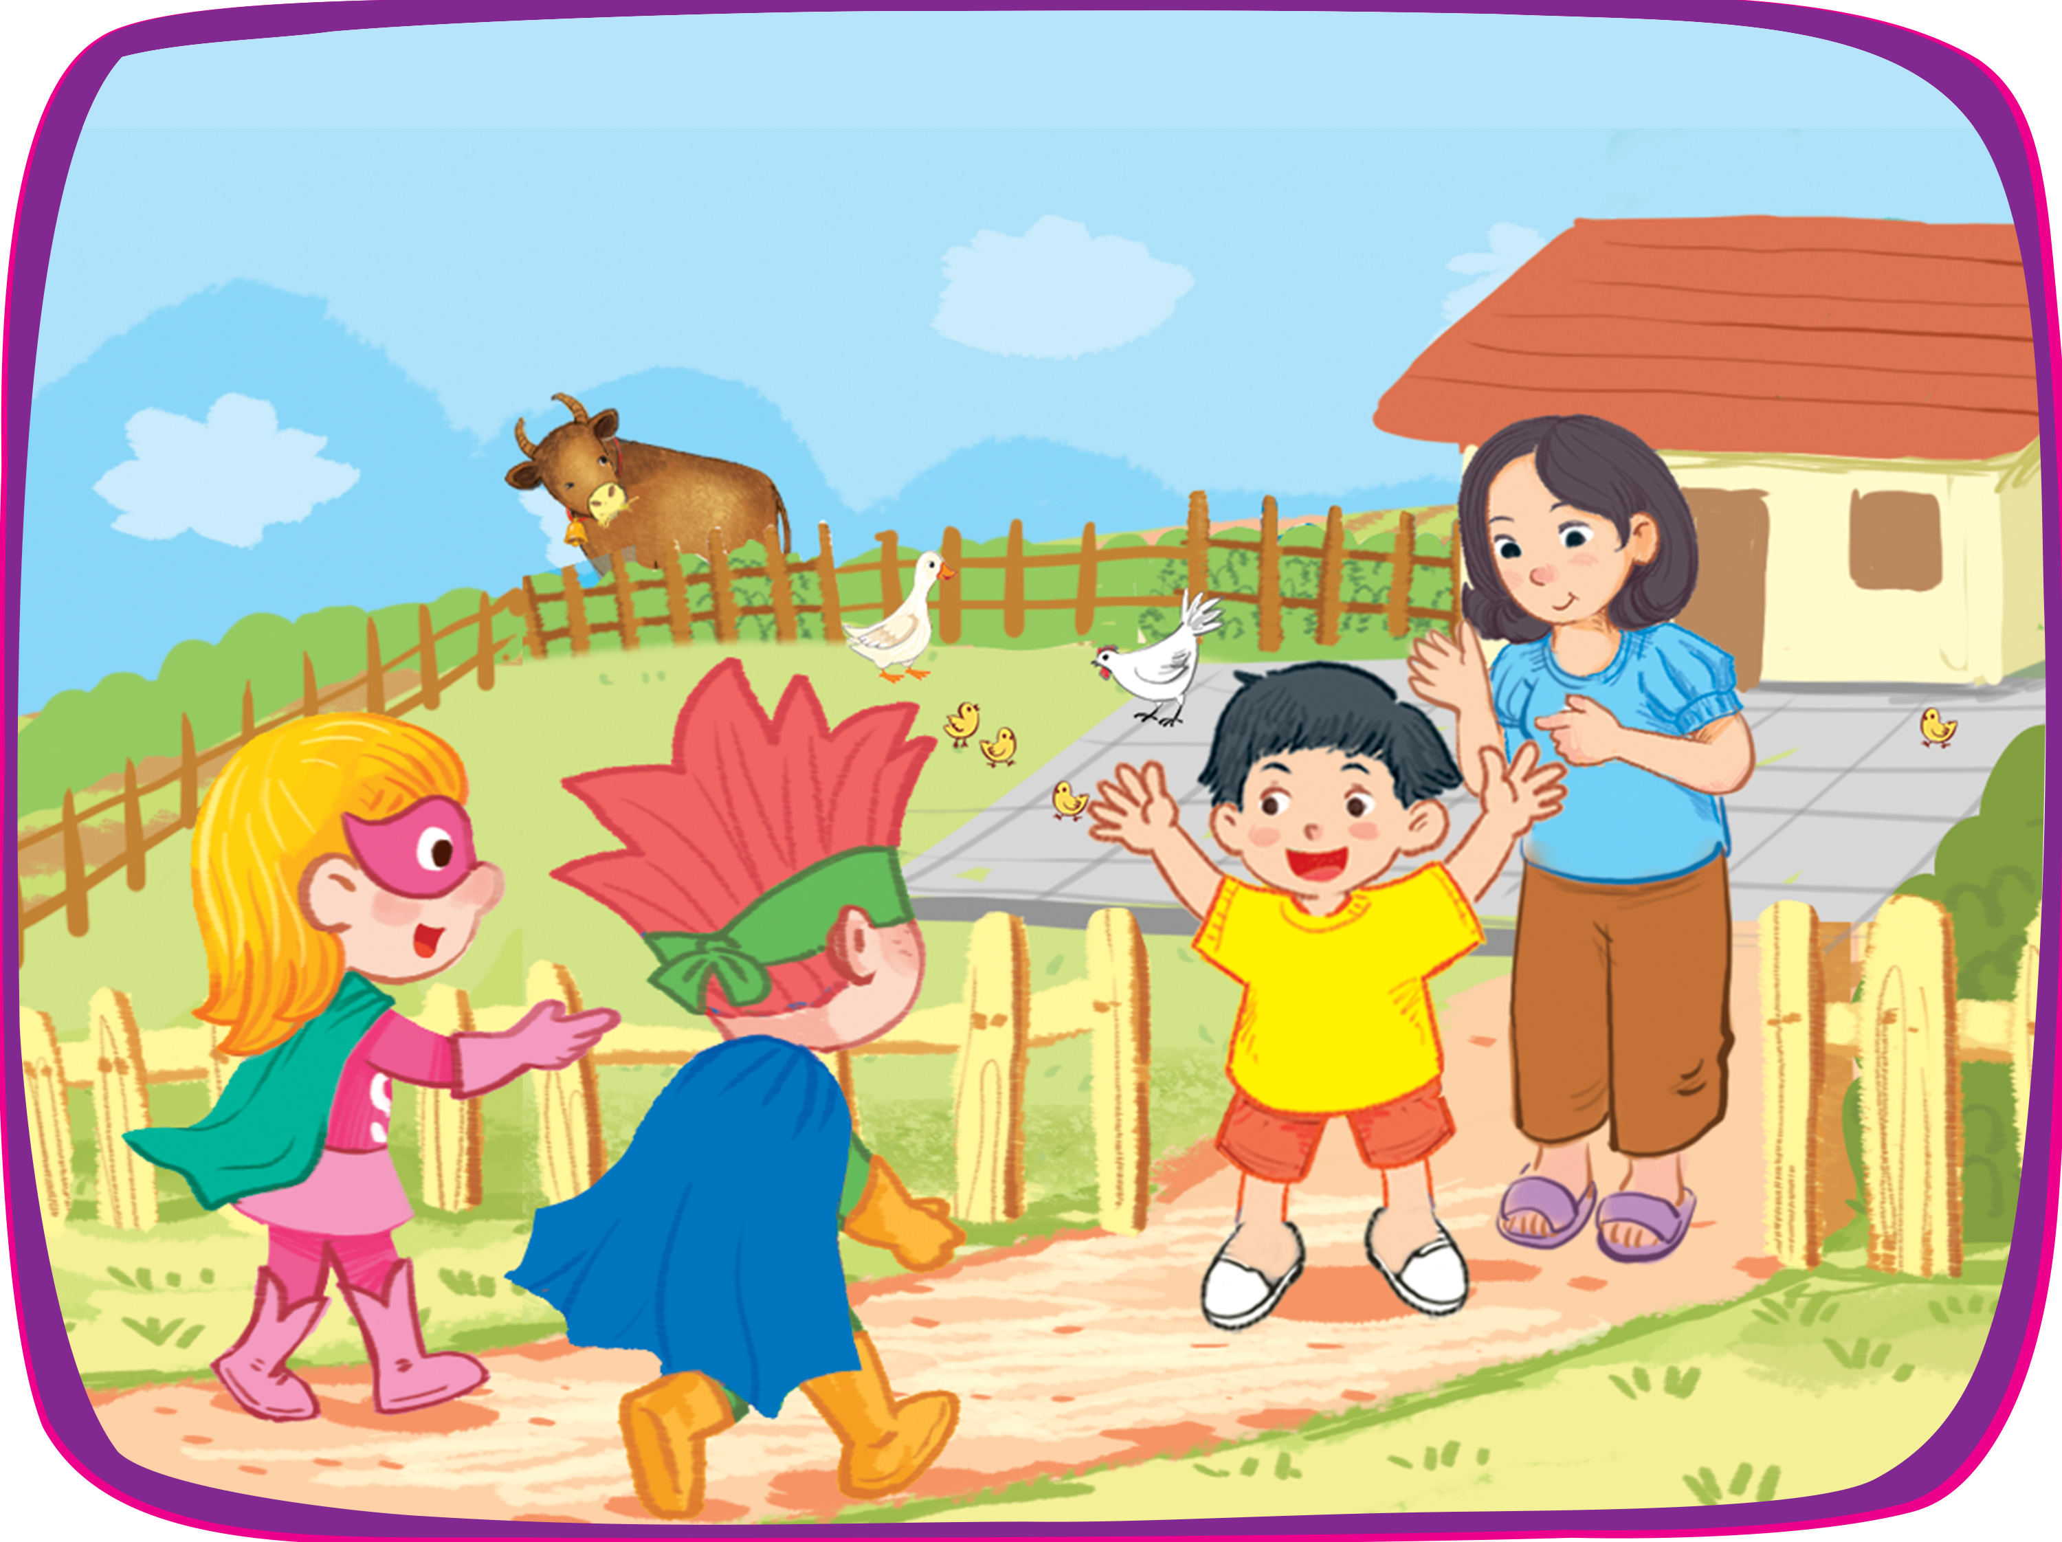




Hi, Phil and Sue.
Hi, Phil and Sue.
Hello, Ba. And hello,…
Hello, Ba. And hello,…
This is my mother.
This is my mother.

Slide 18





Pass me the juice, please.
Pass me the juice, please.
Thank you!
Thank you!
Here you are.
Here you are!

Slide 19


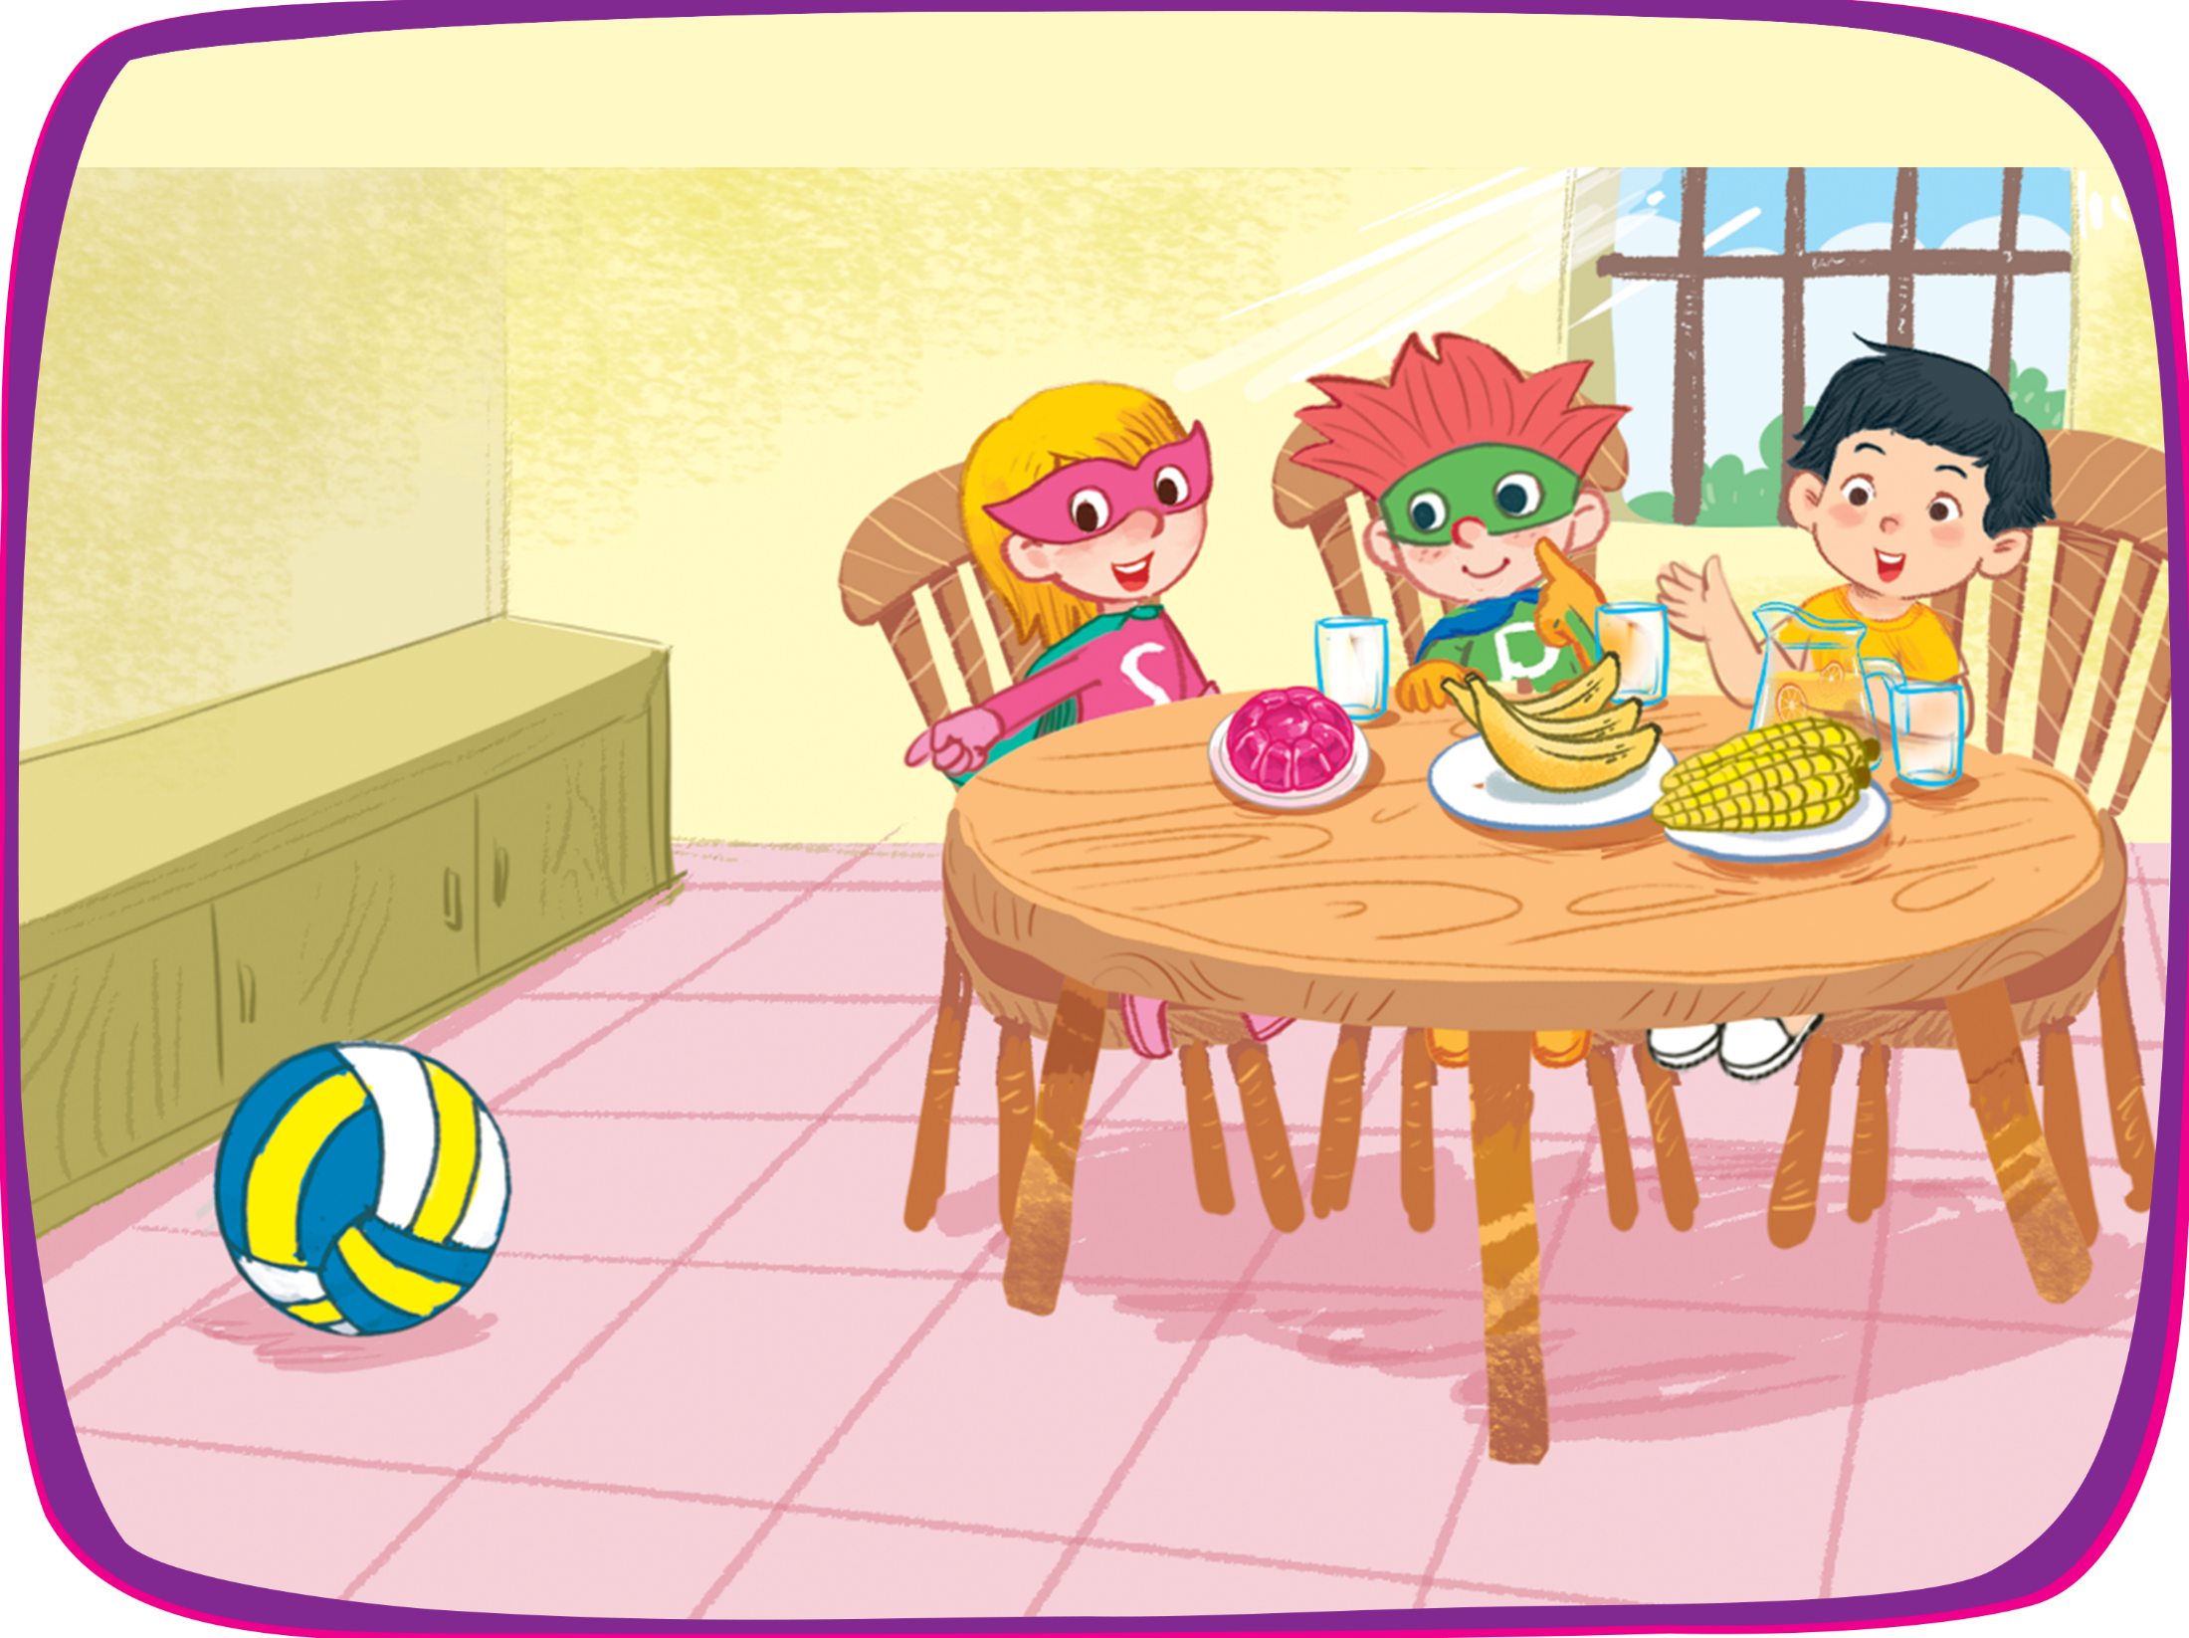


Let’s play!
Oh, there’s a volleyball.
Let’s play!
Oh, there’s a volleyball.
OK.
OK.

Slide 20
03
Activity 2
LOOK AGAIN AND CIRCLE.

Slide 21



Look again and circle.
quiz
square
box
juice
jelly
village
ox
van

Slide 22
04
Fun corner and wrap-up

Slide 23

Option 1
Option 2

Slide 24



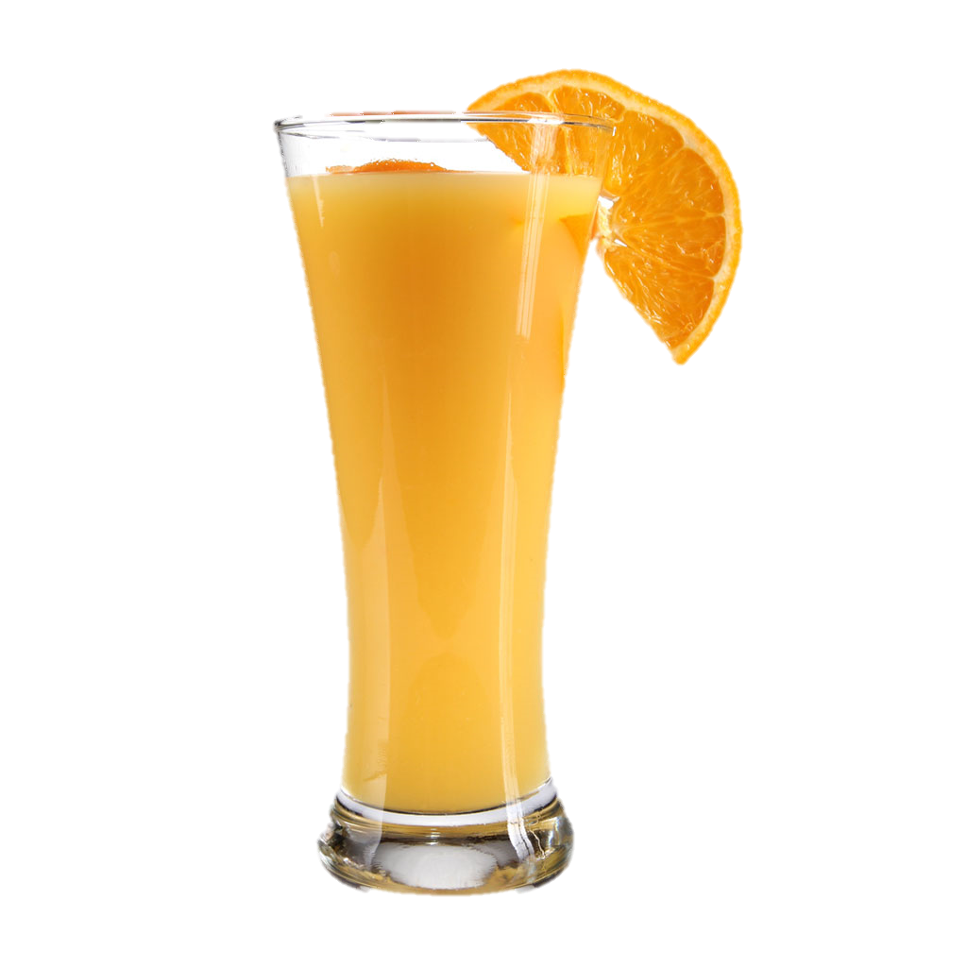





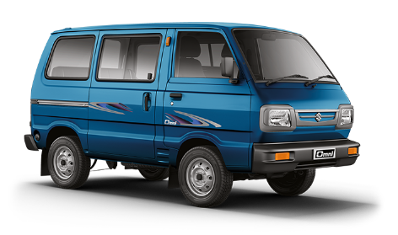
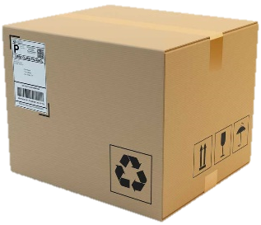
1
2
3
4
jelly
square
5
6
7
8
quizz
Pelmanism
9
10
11
12
village
13
14
15
16
van
box
juice
ox
Notes:
Put two sets of cards on the board (quiz, jelly, square, village, box, ox, juice, van).
- Tell pupils that they are going to match the words with the suitable pictures. Give an example to show how the game is played. Check comprehension.
- Put pupils into two teams.
- Ask each player in turn to select two cards and turn them face up. If the word matches the picture, the player wins and continues to turn over another pair. If the cards do not match, they are turned face down again and the next player has to go.
- The game ends when all the cards are gone. The team with more cards is the winner. Praise the winner.

Slide 25
1
2
3
4
jelly
square
5
6
7
8
quiz
9
10
11
12
village
13
14
15
16
van
box
juice
ox

Slide 26


Fast motion

Slide 27




quiz
Notes:
Use flashcards (quiz, jelly, square, village, box, ox, juice, van).
- Model the activity first.
- Hold the flashcard facing with the body so no one can see it.
- Very quickly show the flashcard to the class and hide it again.
- Have the pupil to guess the word on the flashcard.
- Who says first will get a sticker as a gift

Slide 28


ox

Slide 29


jelly

Slide 30


juice

Slide 31



village

Slide 32



box

Slide 33


square

Slide 34


van

