Slide 2
Review 2
Lesson 2 – Period 2

Slide 3

Table of contents
Warm up and Review
2. Activity 3: Listen and tick.
3. Activity 4: Listen and circle.
4. Activity 5: Write and say.
5. Fun corner and Wrap-up

Slide 4

01
Warm-up
Facing game
Options:
Easy
Advanced

Slide 5



Listen to a letter and choose the correct word:
question
van
fox
jelly
volleyball

Slide 6
Listen to a letter and choose the correct word:
van
juice
ox
jelly
village

Slide 7
Listen to a letter and choose the correct word:
quiz
village
ox
jam
van

Slide 8
Listen to a letter and choose the correct word:
quiz
volleyball
fox
juice
van

Slide 9
Listen to a letter and choose the correct word:
square
van
fox
jelly
volleyball

Slide 10
Listen to a letter and choose the correct word:
question
jam
fox
jelly
volleyball

Slide 11
Listen to a letter and choose the correct word:
volleyball
village
box
square
quiz

Slide 12
Listen to a letter and choose the correct word:
question
van
fox
jam
volleyball

Slide 13


Slide 14



Listen to a letter and say the correct word:

Slide 15
Listen to a letter and say the correct word:

Slide 16
Listen to a letter and say the correct word:

Slide 17
Listen to a letter and say the correct word:

Slide 19

02
Activity 3
LISTEN AND tick.

Slide 20











Listen and tick.
1
2
3

Slide 21



1


Slide 22


2


Slide 23


3


Slide 24
03
Activity 4
Listen AND CIRCLE.

Slide 25


Listen and circle.
1
q
v
2
x
j
3
x
q
4
v
j

Slide 26
04
Activity 5
Write and say.

Slide 27







Write and say.
1
fo
x
2
q
uestion
3
j
uice
4
v
illage

Slide 28
05
Fun corner and wrap-up

Slide 29

Option 1
Option 2

Slide 30












Slap the board
0
1
5
4
2
6
8
3
10
9
7
1
7
2
6
3
9
5
0
4
8
10
Notes:
- Khi kết thúc trò chơi, nhấp vào nút con ong để giành chiến thắng.

Slide 31




Slide 32

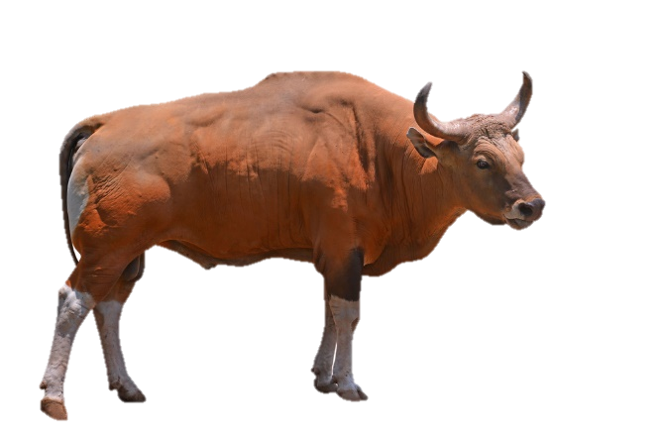



Slide 33


Slide 36


Slide 38
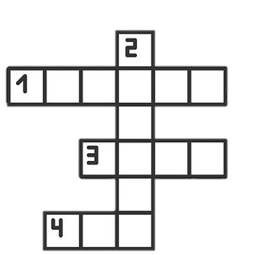

Slide 39



Slide 41


What is the odd one out ?
Notes:
Chuẩn bị một số hình ảnh về các từ của các chữ cái Q/q (/k/), X/x (/ks/), J/j (/dʒ/) và V/v (/v/).
- Dán ba bức tranh lên bảng và yêu cầu học sinh quyết định xem bức tranh nào mà các em cho là khác lạ.
ví dụ. box, van, fox (Đây có thể là “van” vì “box” và “fox” có âm là chữ X/x (/ks/).
- Tiếp tục trò chơi cho đến khi sử dụng hết các hình ảnh.

Slide 42

What is the odd one out ?

Slide 43

What is the odd one out ?

Slide 44
What is the odd one out ?

Slide 45

What is the odd one out ?

Slide 46
What is the odd one out ?

Slide 47

What is the odd one out ?

Slide 48

What is the odd one out ?

Slide 49

What is the odd one out ?

Slide 50
What is the odd one out ?

Slide 51
Website: hoclieu.vn
Fanpage: https://www.facebook.com/tienganhglobalsuccess.vn/

