Slide 1










UBND QUẬN DƯƠNG KINH
TRƯỜNG TIỂU HỌC ANH DŨNG
Hello and welcome to my English class

Slide 2







Unit 11
IN THE PLAYGROUND
Lesson 3

Slide 3
Class Rules

Slide 4



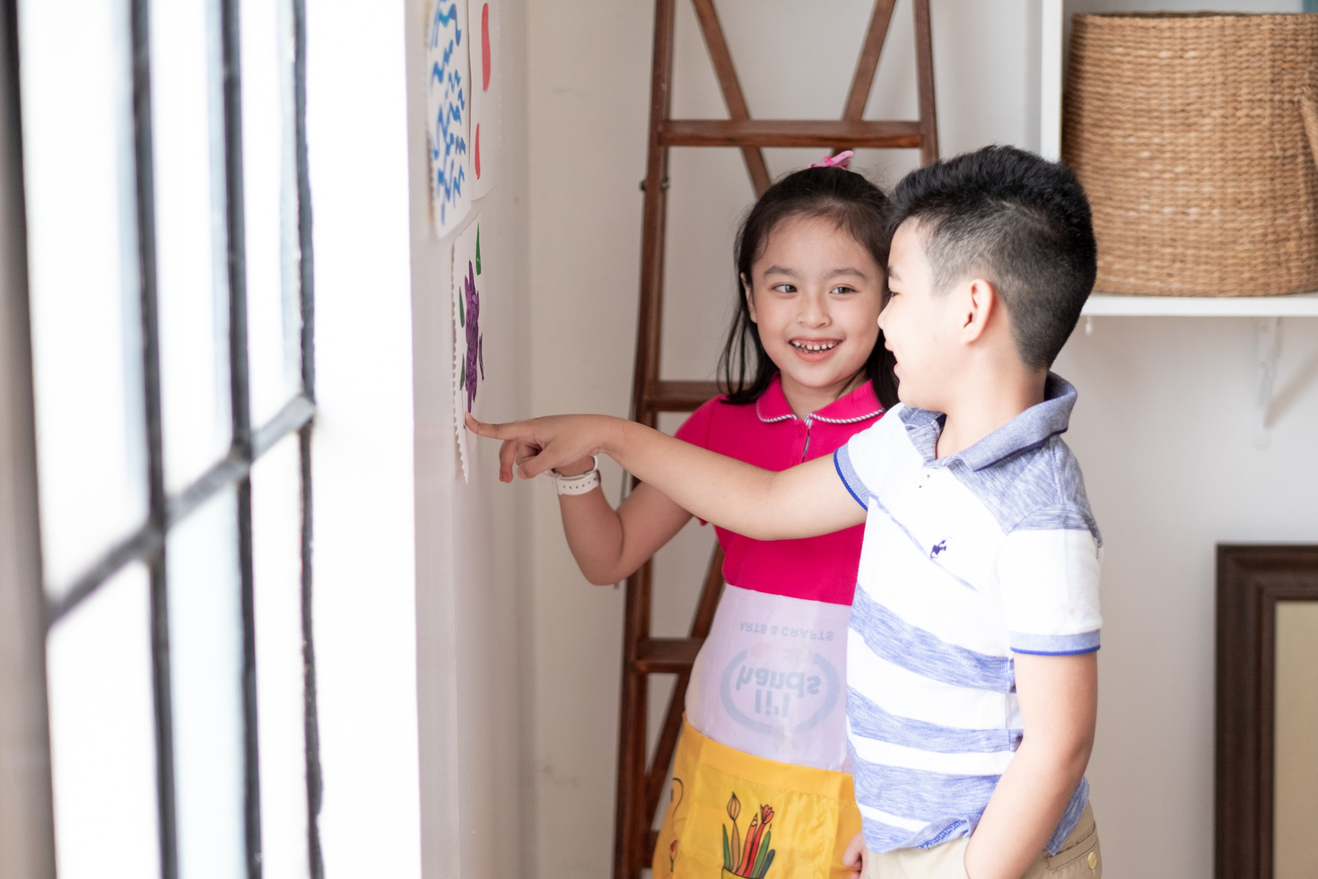



Rule 1
Listen to
your friend
talking in front.

Slide 5






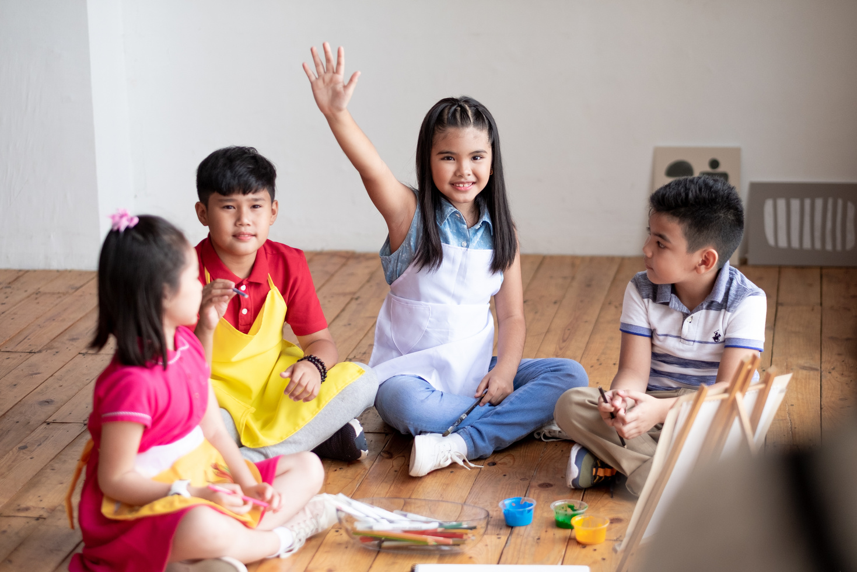

Rule 2
Raise your hand
if you have a question.

Slide 6




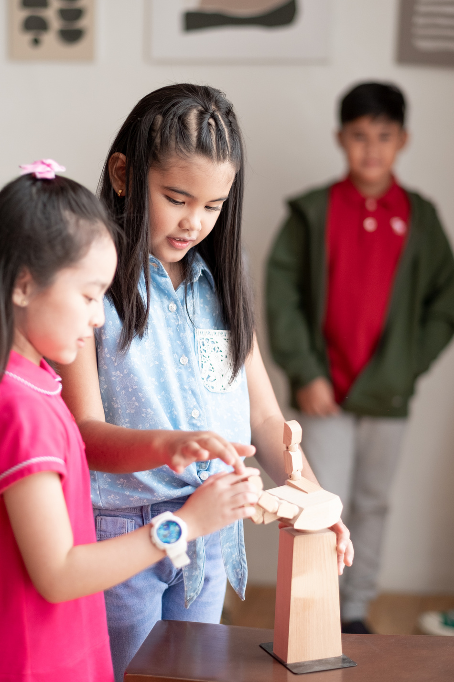


Rule 3
Wait for
your turn.

Slide 7
TABLE OF CONTENTS
Warm-up and review.
2. Activity 6: Listen and repeat.
3. Activity 7: Let’s talk.
4. Activity 8: Let’s sing.
5. Fun corner and wrap-up.

Slide 8
01
Warm-up
and review.

Slide 9



Game
Choose the correct answer.

Slide 10


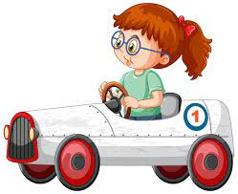
a. sliding
b. driving a car.
c. riding a bike.

Slide 11
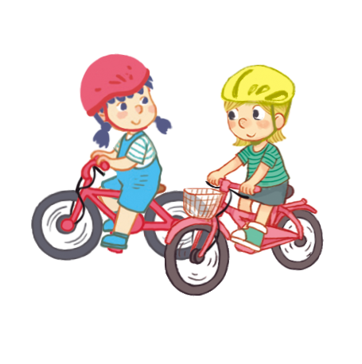
a. sliding
b. riding a bike.
c. driving a car.

Slide 12
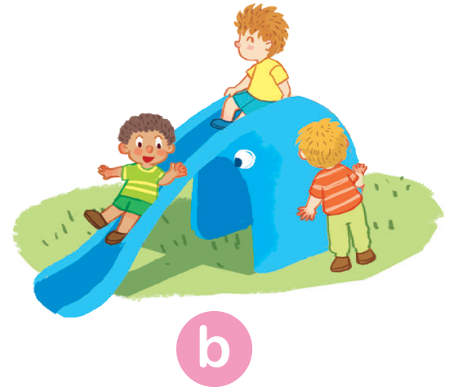
a. driving a car.
b. riding a bike.
c. sliding

Slide 13
02
Activity 6
Listen and repeat.

Slide 14
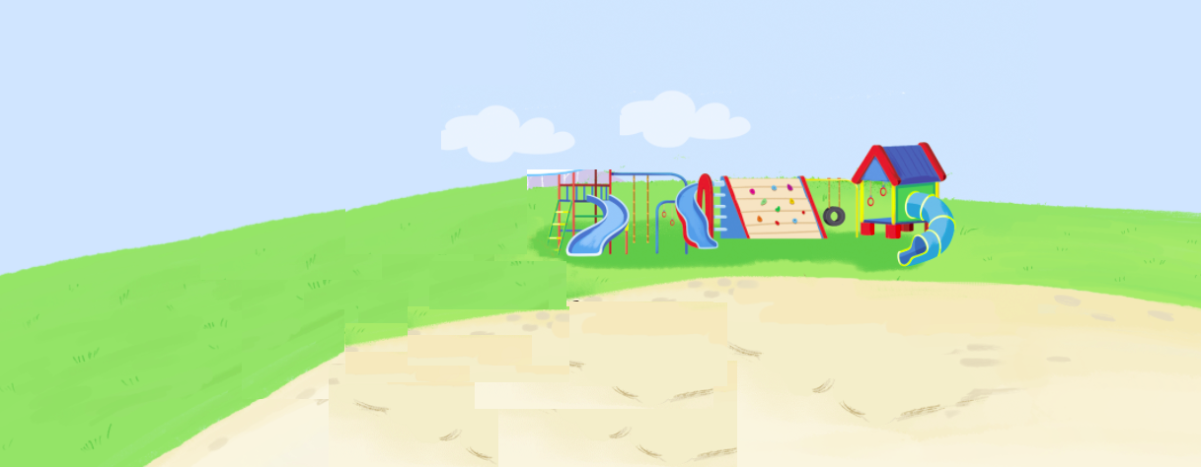






Listen and repeat.
They're driving cars.

Slide 15
03
Activity 7
Let’s talk.

Slide 16



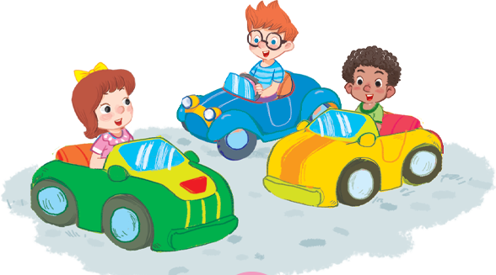
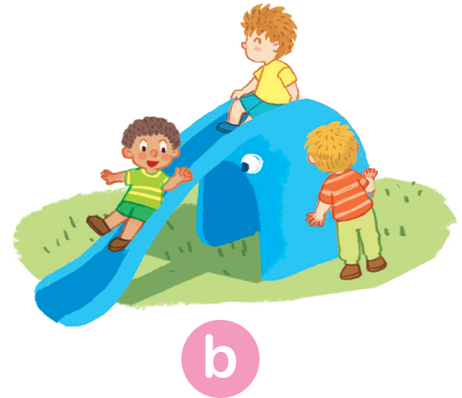
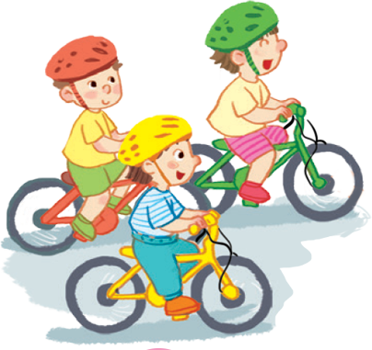
Let’s talk.
They're
a
b
c

Slide 17
They're
driving cars.
a

Slide 18
sliding.
They're
b

Slide 19
They're
riding bikes.
c

Slide 20
04
Activity 8
Let’s sing.

Slide 21

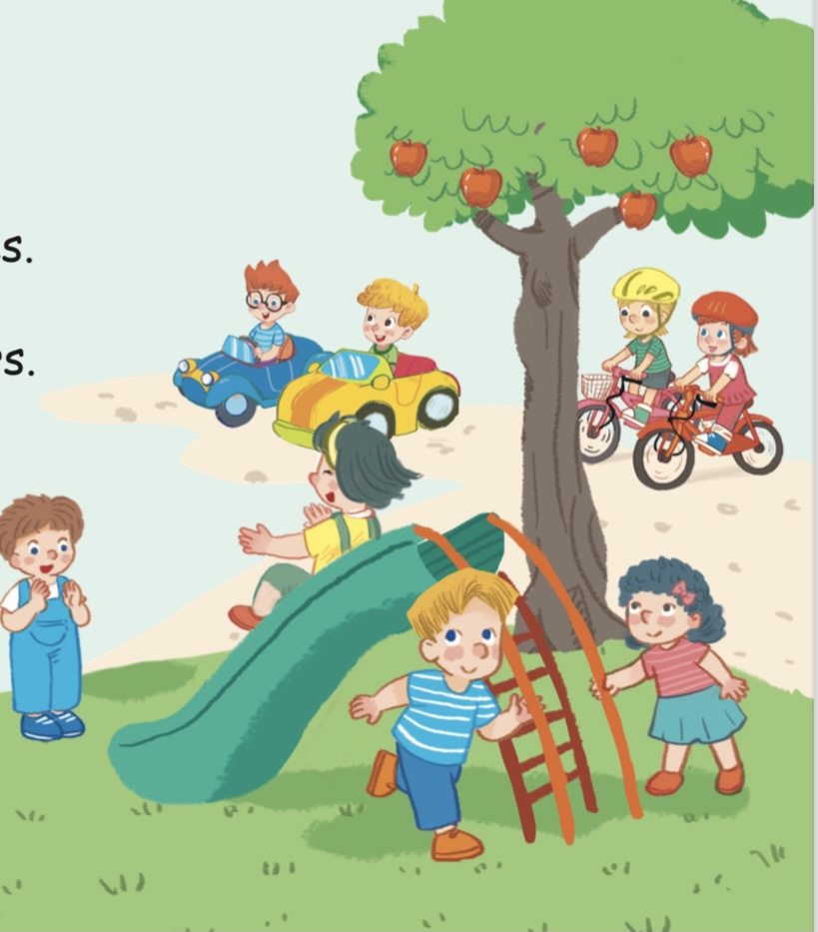

Let’s sing!
Now, sing!
Riding bikes, riding bikes.
They’re riding bikes.
Driving cars, driving cars.
They’re driving cars.
Sliding, sliding, sliding.
They’re sliding.
In the playground.
Notes:
Click từng dòng để nghe từng câu.
Click loa màu vàng để nghe cả bài.
Click loa màu xám để bật nhạc cho học sinh hát theo.

Slide 22
05
Fun corner
and wrap-up.

Slide 23
Game
Rolling the dice

Slide 24
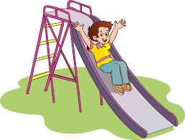
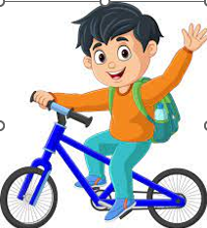
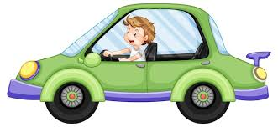
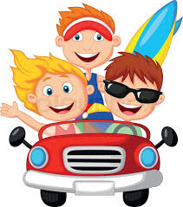
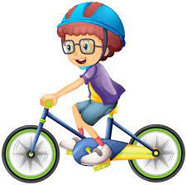
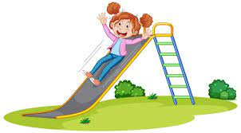
1
1
3
3
2
2
6
4
6
4
5
5

Slide 25
Game
Lucky gifts

Slide 26

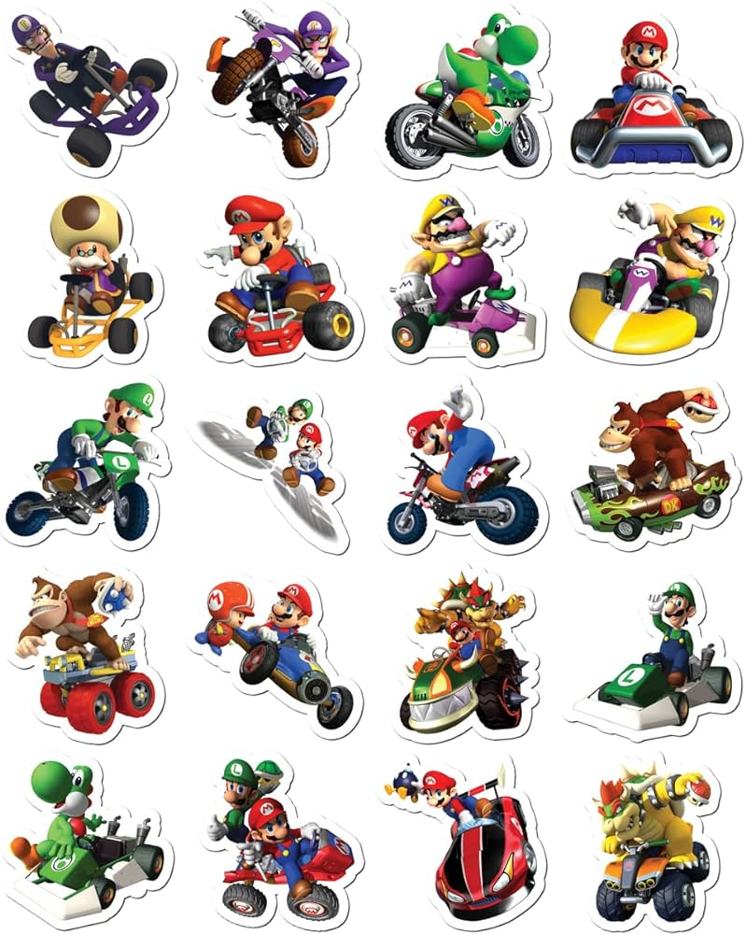


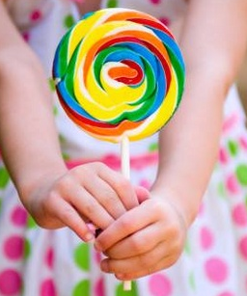

Lucky gifts
3
1
2
Notes:
Bấm vào số …có câu hỏi…………..Bấm vào mũi tên để về lại slide Lucky gifts và bấm tiếp vào hộp quà để nhận quà

Slide 27
Look at the picture and
say the action.

Slide 28
Look at the picture and
say the action.

Slide 29
Look at the picture and
say the action.

Slide 30

CONGRATULATIONS!

Slide 31






Goodbye!
See you soon!

