Slide 1


UBND QUẬN DƯƠNG KINH
TRƯỜNG TIỂU HỌC ANH DŨNG
WELCOME
To Our Class

Slide 2





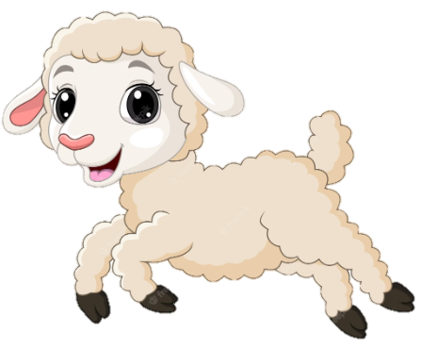
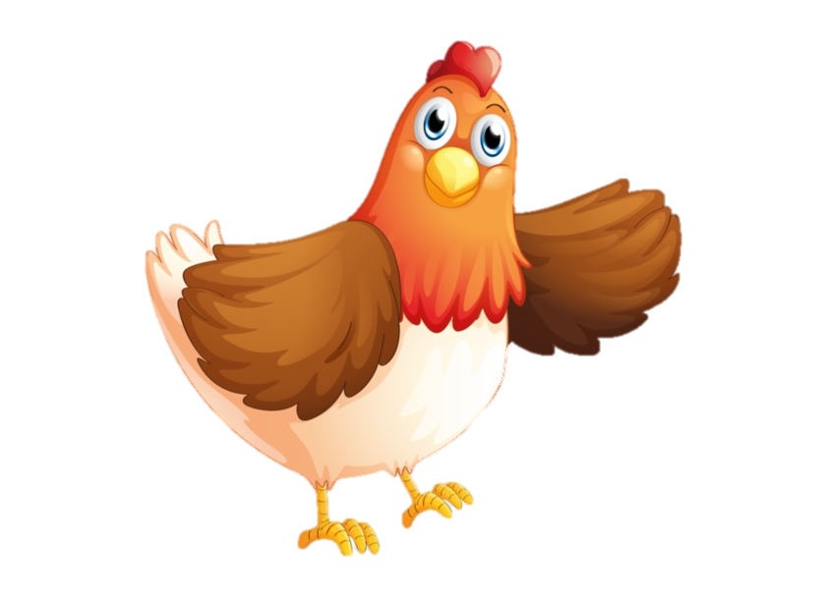


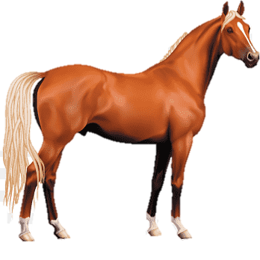
Unit 6 ON THE FARM
Lesson 3 - Period 3

Slide 3








TABLE OF CONTENTS
1
Warm-up and Review
2
Activity 6: Listen and repeat.
3
Activity 7: Let’s talk.
4
Activity 8: Let’s sing.
5
Fun corner and Wrap-up

Slide 4

01
Warm-up and Review

Slide 5
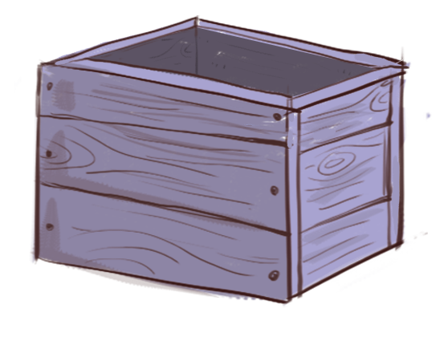

?
What’s this?
box
Notes:
- GV cho HS xem tranh sau đó che hình lại để HS trả lời.
- GV click vào hình dấu chấm hỏi để check đáp án.

Slide 6
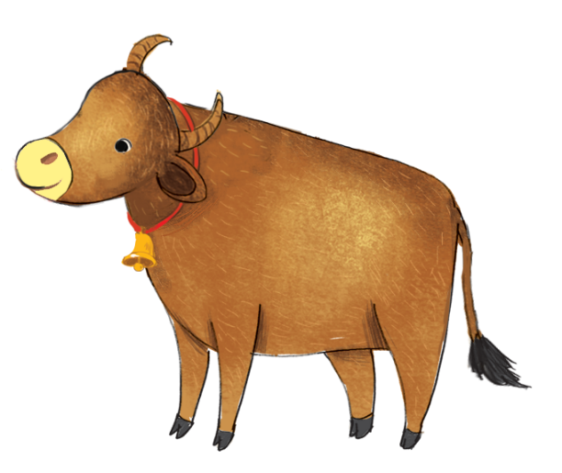
?
What’s this?
ox
Notes:
- GV cho HS xem tranh sau đó che hình lại để HS trả lời.
- GV click vào hình dấu chấm hỏi để check đáp án.

Slide 7

?
What’s this?
fox
Notes:
- GV cho HS xem tranh sau đó che hình lại để HS trả lời.
- GV click vào hình dấu chấm hỏi để check đáp án.

Slide 8


Well done

Slide 9


02 Activity 6 Listen and repeat.

Slide 10


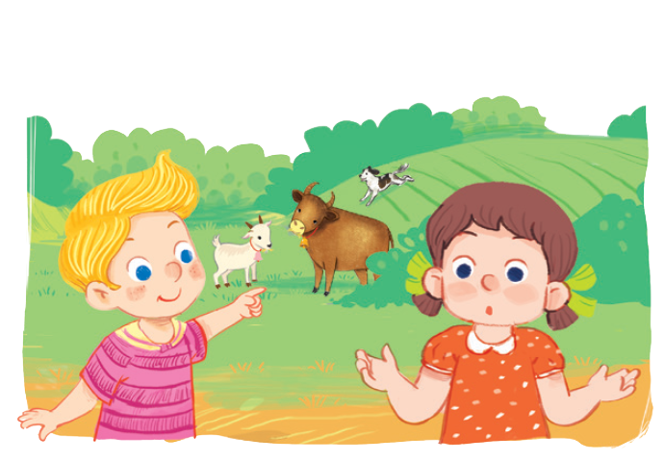

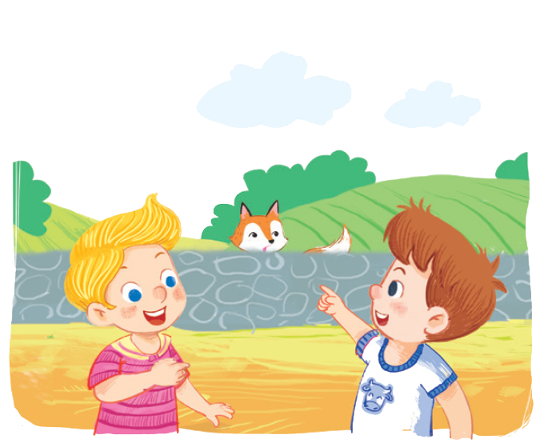


Is there a fox?
No, there isn’t.
Is there a fox?
Yes, there is.

Slide 11
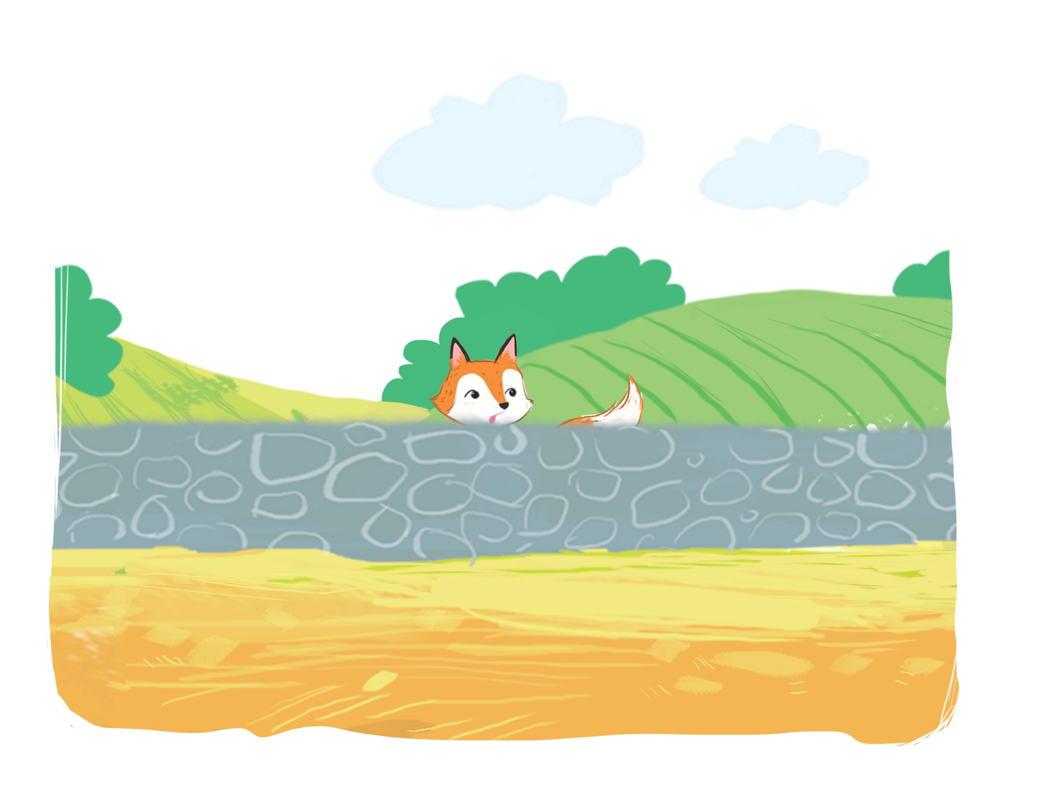
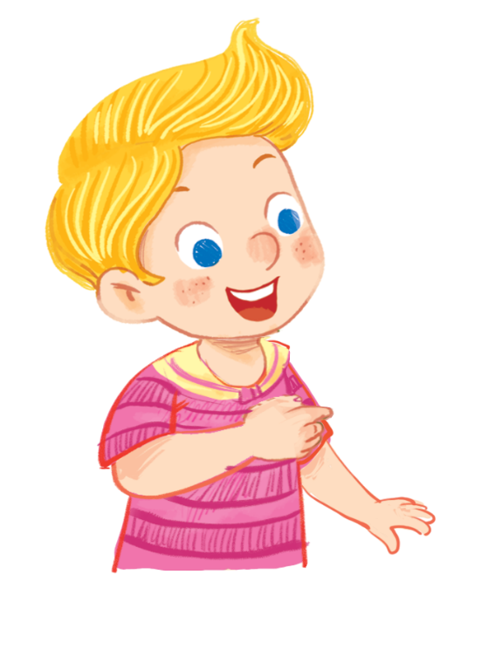
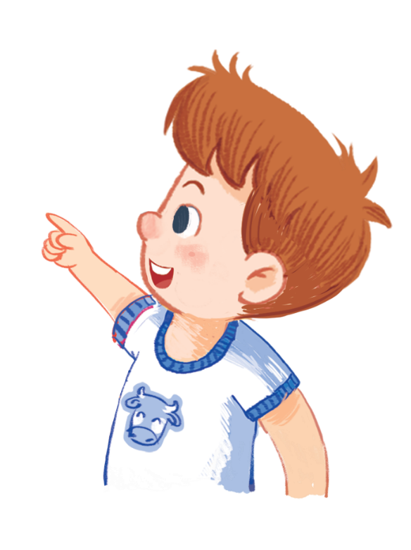
Is there a fox?
Is there a fox?
Is there a fox?
Is there a fox?
Yes, there is.
Yes, there is.
Yes, there is.
Yes, there is.

Slide 12
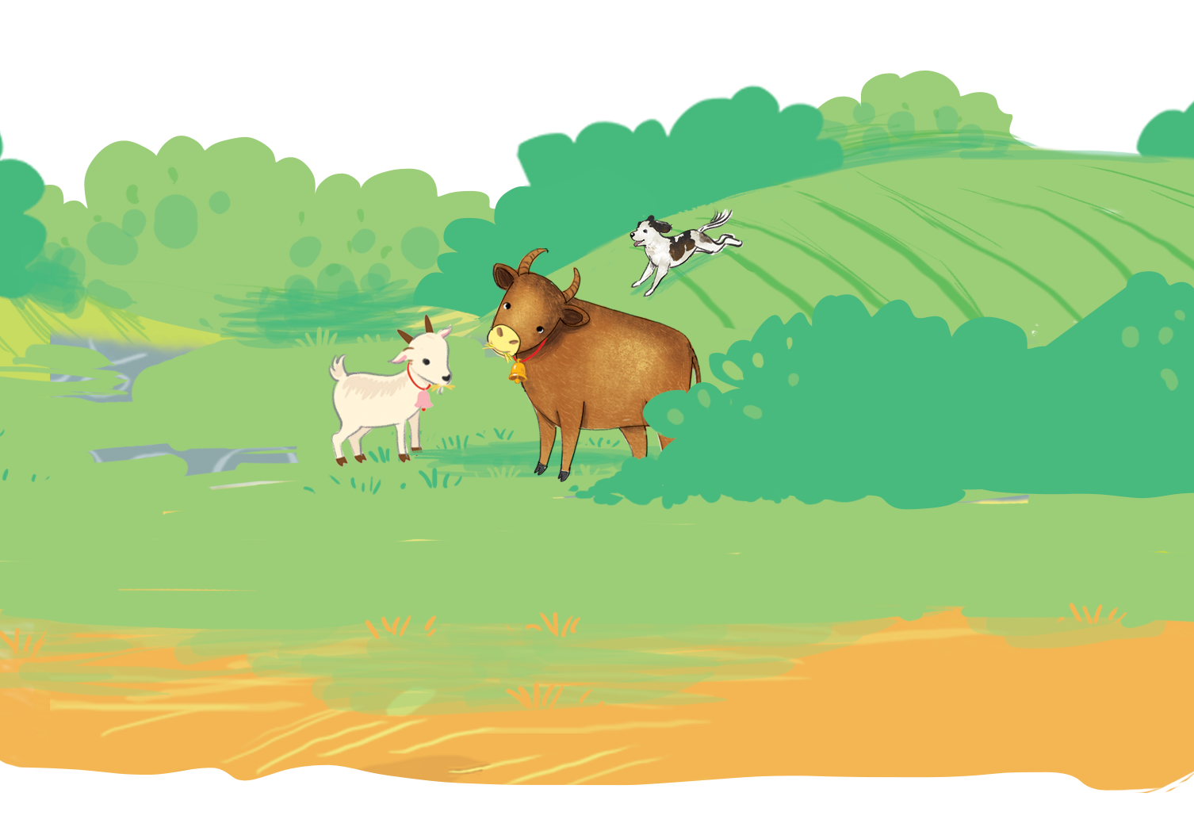
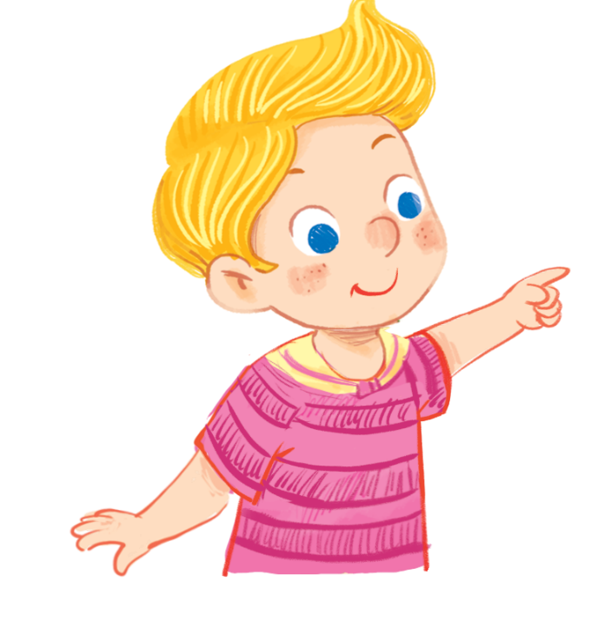

Is there a fox?
Is there a fox?
Is there a fox?
Is there a fox?
No, there isn’t.
No, there isn’t.
No, there isn’t.
No, there isn’t.

Slide 13

03 Activity 7 Let’s talk.

Slide 14


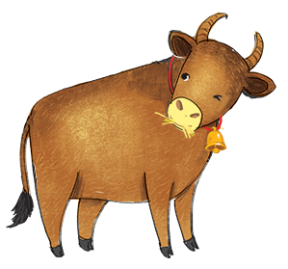
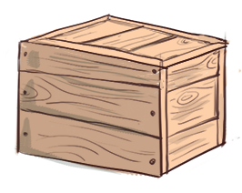
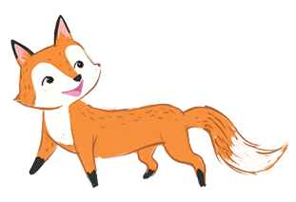
Is there a/ an ?
Yes, .
No, .
a
b
c

Slide 15

fox
Is there a ?
Yes, .
there isn’t
No, .
a

Slide 16

box
Is there a ?
there is
Yes, .
No, .
a

Slide 17

ox
Is there an ?
Yes, .
there isn’t
No, .
b

Slide 18
fox
Is there a ?
there is
No, .
Yes, .
b

Slide 19
box
Is there a ?
Yes, .
there isn’t
No, .
c

Slide 20
ox
Is there an ?
there is
No, .
Yes, .
c

Slide 21

04 Activity 8 Let’s sing.

Slide 22


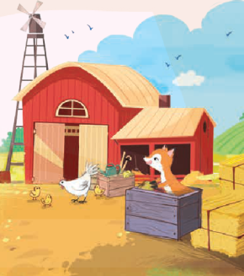
Is there a fox? Is there a fox?
Is there a fox? Is there a fox?
Is there a fox? Is there a fox?
Is there a fox? Is there a fox?
Yes, there is. Yes, there is.
Yes, there is. Yes, there is.
Yes, there is. Yes, there is.
Yes, there is. Yes, there is.
There’s a fox in the box.
There’s a fox in the box.
There’s a fox in the box.
There’s a fox in the box.
Is there an ox? Is there an ox?
Is there an ox? Is there an ox?
Is there an ox? Is there an ox?
Is there an ox? Is there an ox?
No, there isn’t. No, there isn’t.
No, there isn’t. No, there isn’t.
No, there isn’t. No, there isn’t.
No, there isn’t. No, there isn’t.
There isn’t an ox on the farm.
There isn’t an ox on the farm.
There isn’t an ox on the farm.
There isn’t an ox on the farm.

Slide 23


Option 1
Option 2

Slide 24






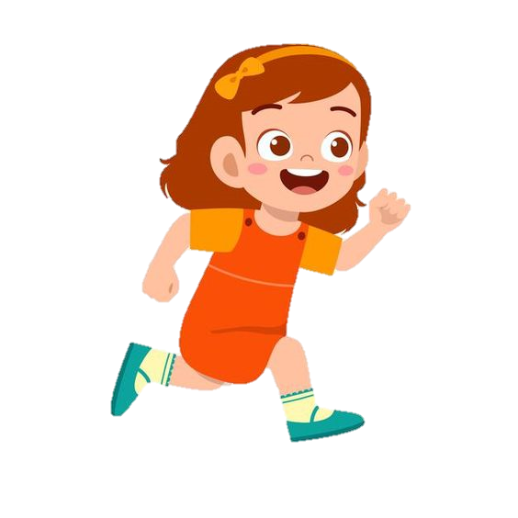
Listen and run
START
Notes:
- GV để các flashcard xung quanh lớp học, sau khi HS nghe xong từ sẽ chạy đi tìm đúng hình từ đã nghe và đem về cho GV.

Slide 25
Listen and run
ox

Slide 26
Listen and run
box

Slide 27
Listen and run
fox

Slide 28
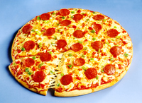
Listen and run
pizza

Slide 29

Listen and run
river

Slide 30


Slide 31

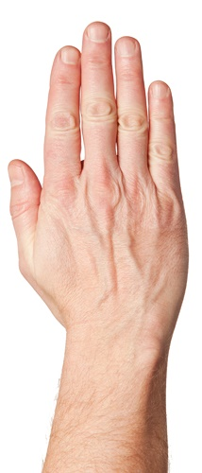

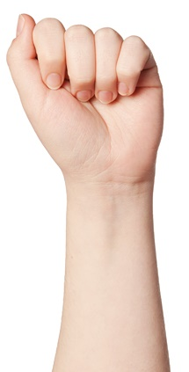






ROCK, PAPER, SCISSORS
20
19
18
17
16
15
14
13
12
11
10
9
8
7
6
5
4
3
2
1
0
20
19
18
17
16
15
14
13
12
11
10
9
8
7
6
5
4
3
2
1
0
START
1
2
3
4
5
1
2
3
4
5
Team A
Team B
Notes:
Chia 2 đội chơi. GV click vào START để bắt đầu cho HS của 2 đội chơi oẳn tù tì trên thực tế trước. Sau khi HS ra búa, kéo hay bao thì GV sẽ chọn vào biểu tượng tương ứng bên dưới trong vòng tròn đỏ. Đội nào thắng sẽ dành được quyền ưu tiên trả lời câu hỏi để ghi điểm trước. Đội nào nhiều điểm và trả lời hết các câu hỏi trước thì thắng.

Slide 32
_________.
Is there _____?

Slide 33
Is there ______?
___________.

Slide 34
Is there ______?
_________

Slide 35

___________
Is there _____?

Slide 36

Is there _______?
__________

