Slide 1




UBND QUẬN DƯƠNG KINH
TRƯỜNG TIỂU HỌC ANH DŨNG
HELLO AND WELCOME TO MY ENGLISH CLASS

Slide 2


Unit 7
In the kitchen
Lesson 1 - Period 1

Slide 3
TABLE OF CONTENTS
1
Warm-up and Review
2
Activity 1: Listen and repeat.
3
Activity 2: Point and say.
4
Fun corner and Wrap-up

Slide 4
01
Warm-up and Review

Slide 5
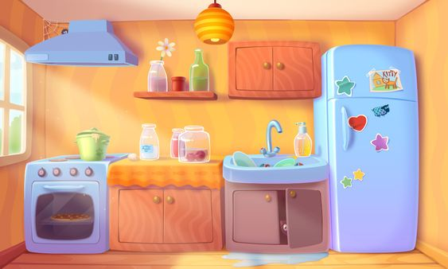

BEHIND THE BINOCULARS

Slide 6








cake

Slide 7



fish

Slide 8


chicken

Slide 9


chips

Slide 10


popcorn

Slide 11
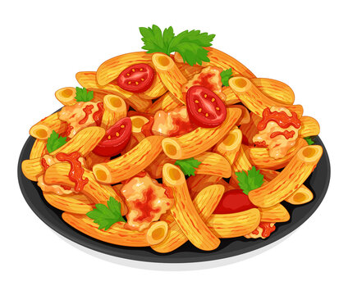
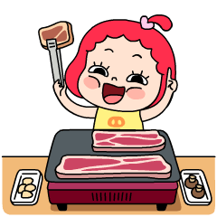
pasta

Slide 12
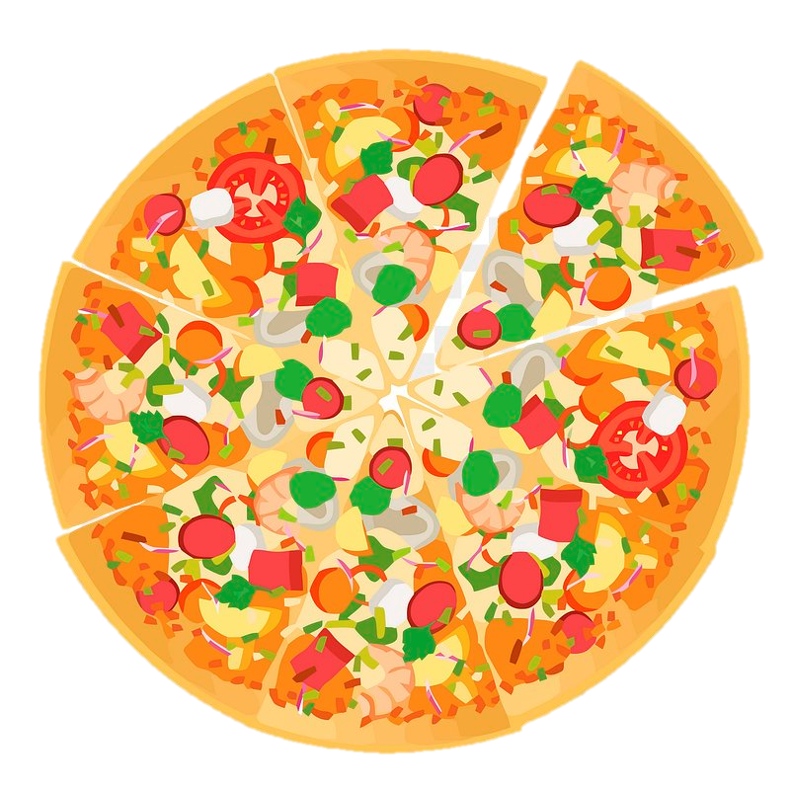

pizza

Slide 13


milk

Slide 14



water

Slide 15


Slide 16
02
Activity 1
Listen and repeat.

Slide 17


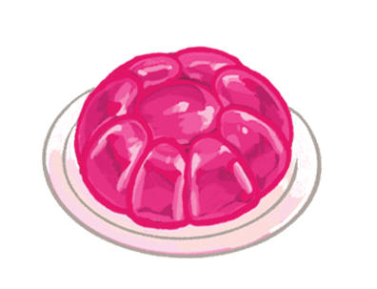


juice
jelly
jam
j

Slide 18




Listen and repeat.
juice
jelly
jam

Slide 19
03
Activity 2
Point and say.

Slide 20



Point and say.
juice
jelly
jam

Slide 21
04
Fun corner and Wrap-up

Slide 22



Slide 23

Slap the board
Level:
Easy
Advanced
Notes:
Chia thành 2 đội chơi. GV đọc từ để HS đập/ chỉ tay vào tranh hoặc từ. HS nào làm nhanh nhất sẽ ghi dc 1 điểm. Cuối giờ đội nào nhiều điểm nhất sẽ thắng.

Slide 24


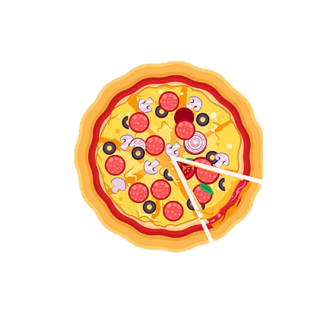

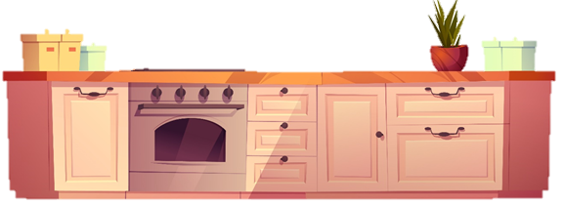
10
6
4
7
1
9
8
3
2
5
0
9
8
7
6
5
4
3
0
2
1
10

Slide 25
jelly
Jj
pizza
jam
milk
juice
10
6
4
7
1
9
8
3
2
5
0
9
8
7
6
5
4
3
0
2
1
10

Slide 26


Slide 27

Time to say goodbye!
j

