Slide 1
UNBD QUẬN DƯƠNG KINH
TRƯỜNG TIỂU HỌC ANH DŨNG
HELLO AND WELCOME TO MY ENGLISH CLASS

Slide 2

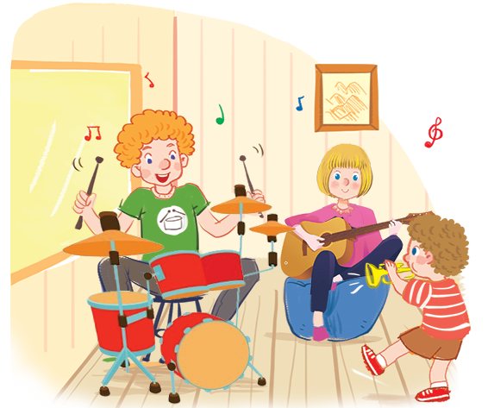

Listen and chant.
Er, er, sister.
Er, er, sister.
Er, er, sister.
Er, er, sister.
She’s my sister.
She’s my sister.
She’s my sister.
She’s my sister.
She’s sixteen.
She’s sixteen.
She’s sixteen.
She’s sixteen.
Er, er, brother.
Er, er, brother.
Er, er, brother.
Er, er, brother.
He’s my brother.
He’s my brother.
He’s my brother.
He’s my brother.
He’s nineteen.
He’s nineteen.
He’s nineteen.
He’s nineteen.

Slide 3







Unit
6. Listen and repeat.
7. Let’s talk.
8. Let’s sing.

Slide 4




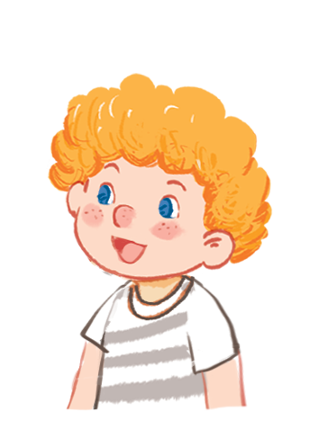
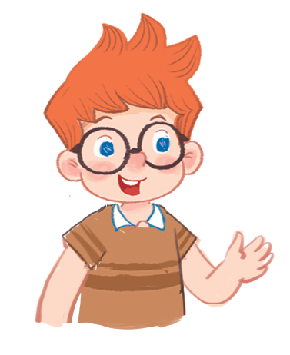
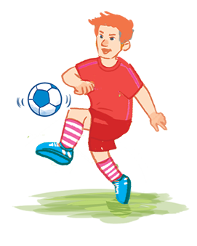
Listen and repeat.
How old is your brother?
How old is your brother?
How old is your brother?
He’s nineteen.
How old is your brother?
He’s nineteen.
He’s nineteen.
He’s nineteen.

Slide 5



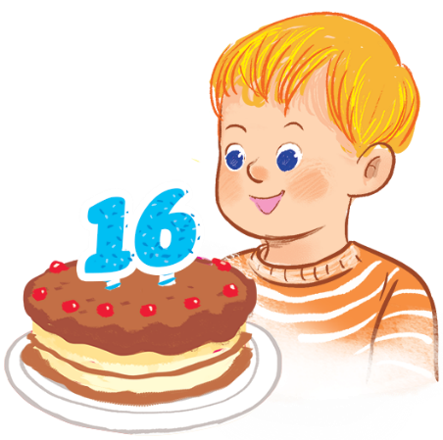
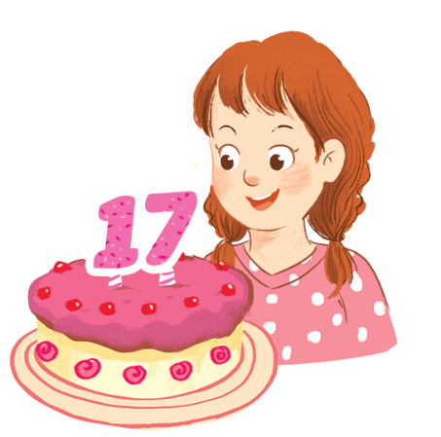
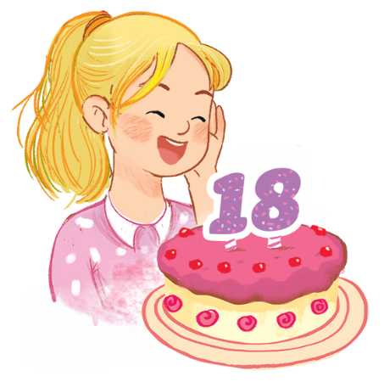
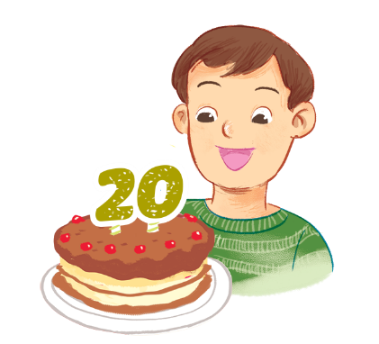
Let’s talk.
What number ?
.
a
b
c
d

Slide 6
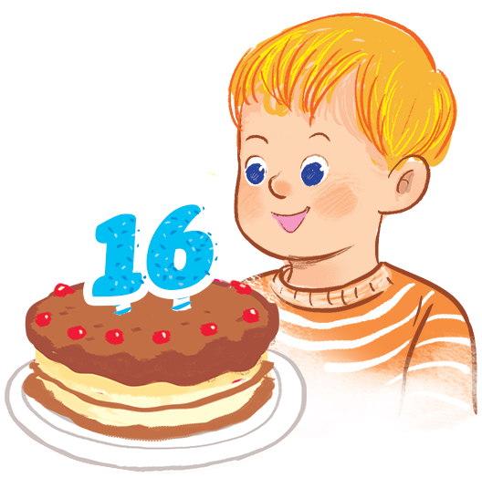
What number ?
.
a

Slide 7
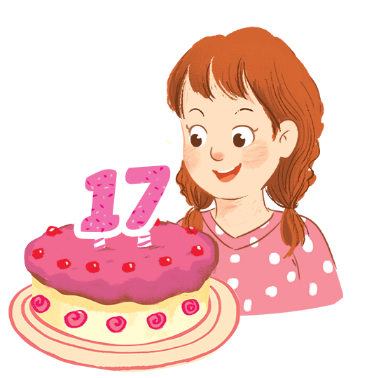
What number ?
.
b

Slide 8
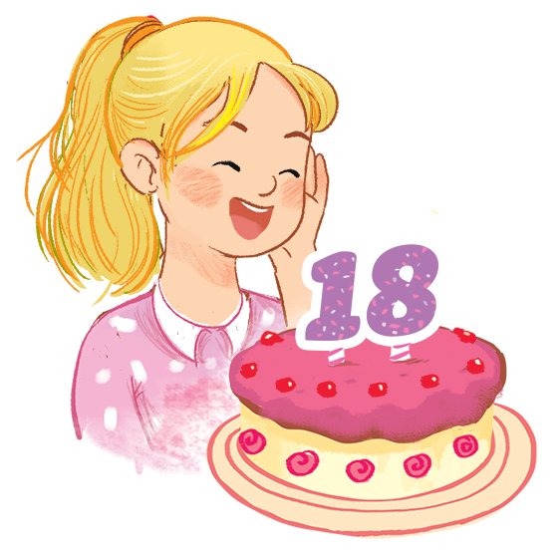
What number ?
.
c

Slide 9
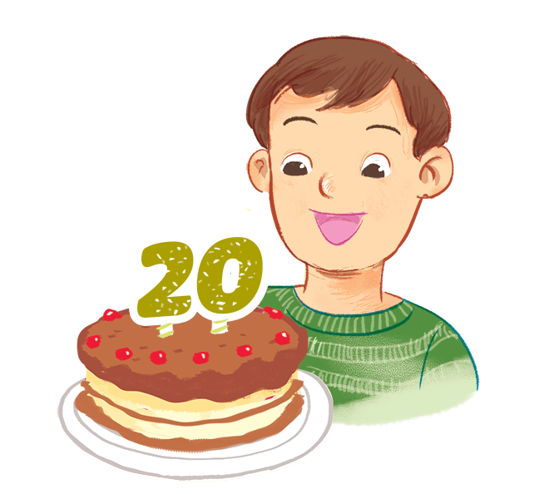
What number ?
.
d

Slide 10
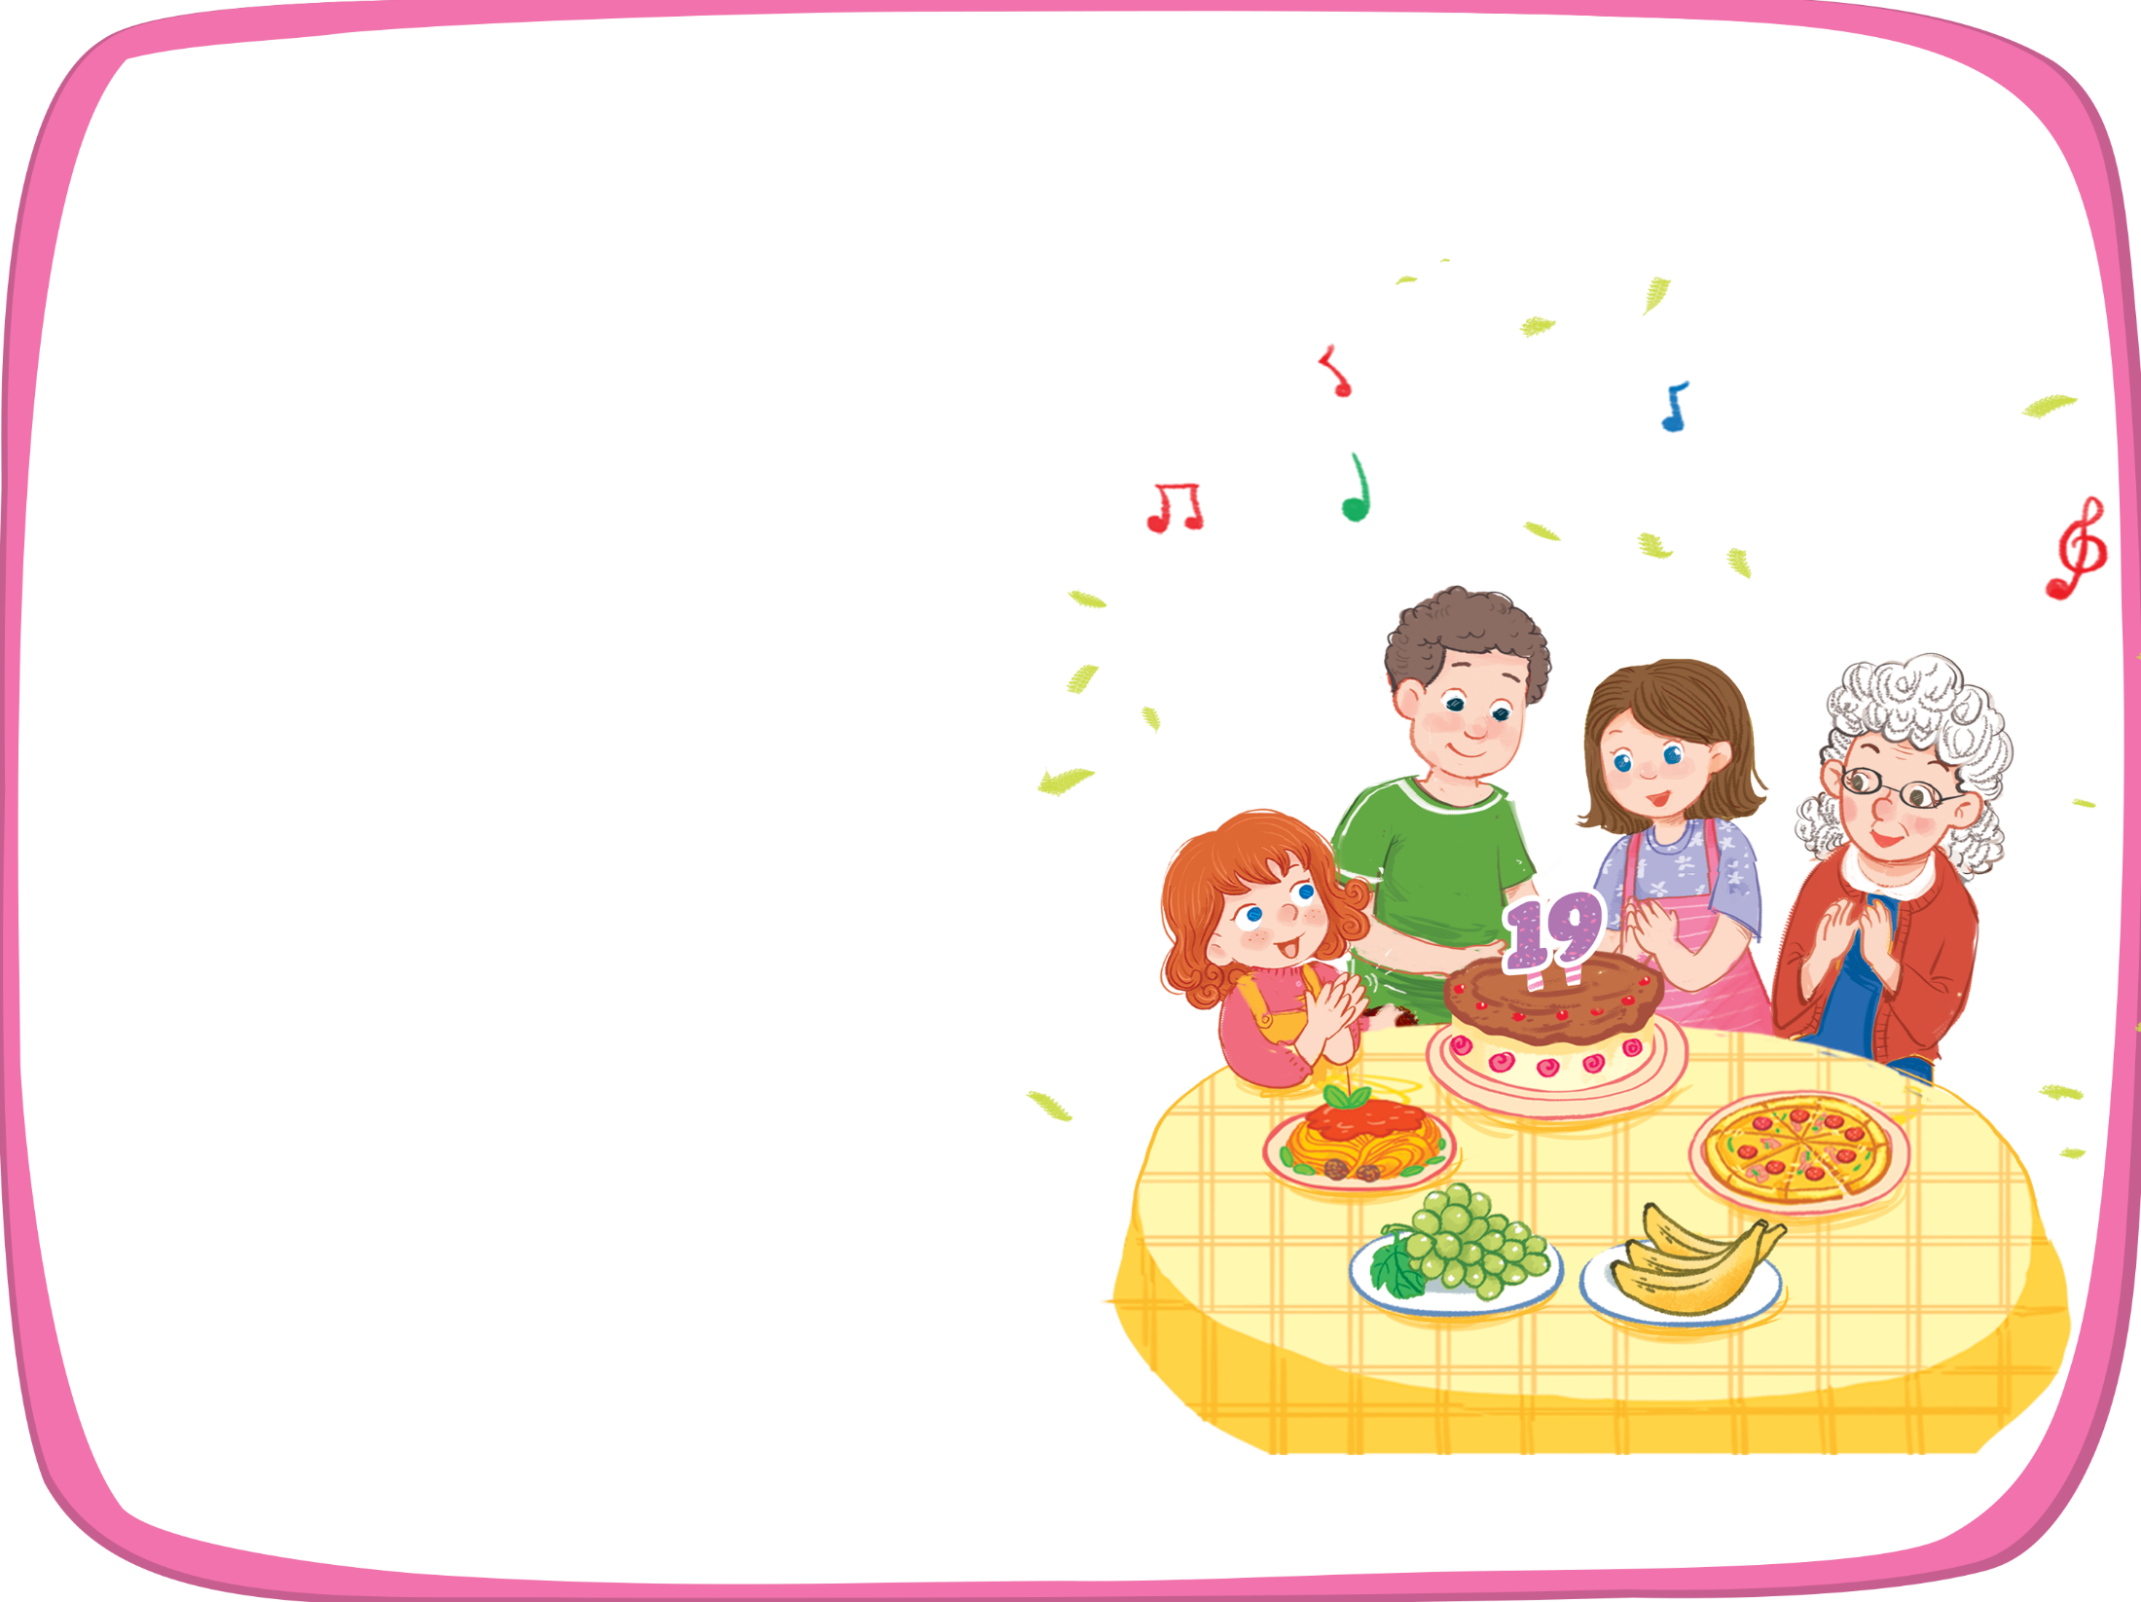


Let’s sing!
That’s my brother.
That’s my brother.
That’s my brother.
That’s my brother.
How old is he?
How old is he?
How old is he?
How old is he?
He’s nineteen.
He’s nineteen.
He’s nineteen.
He’s nineteen.
My grandmother is here.
My grandmother is here.
My grandmother is here.
My grandmother is here.
My sister is here.
My sister is here.
My sister is here.
My sister is here.
We are all here.
We are all here.
We are all here.
We are all here.
At his birthday party.
At his birthday party.
At his birthday party.
At his birthday party.

Slide 11
THANK FOR YOUR LISTENING

