Slide 1




UBND QUẬN DƯƠNG KINH
TRƯỜNG TIỂU HỌC ANH DŨNG
ENGLISH - GRADE 5
UNIT 2: OUR HOME
LESSON 1 (1, 2, 3)

Slide 2
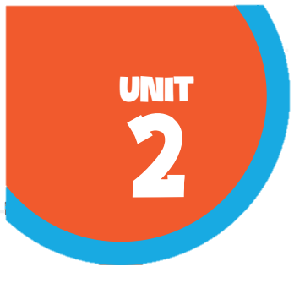








Our home
Lesson 1 - Period 1

Slide 3

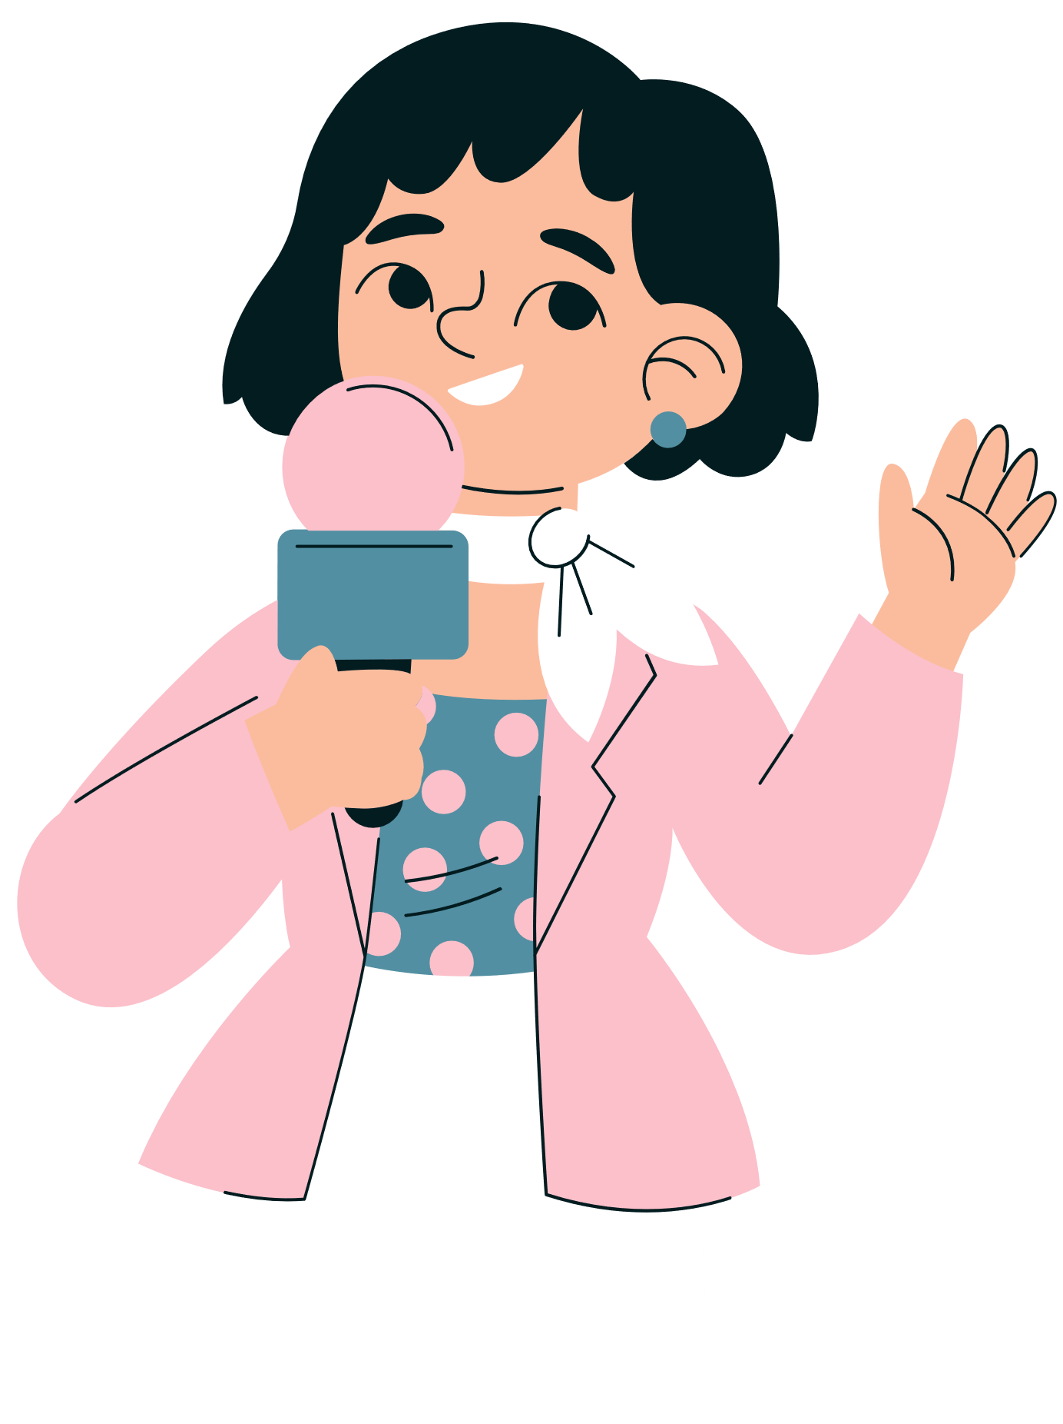

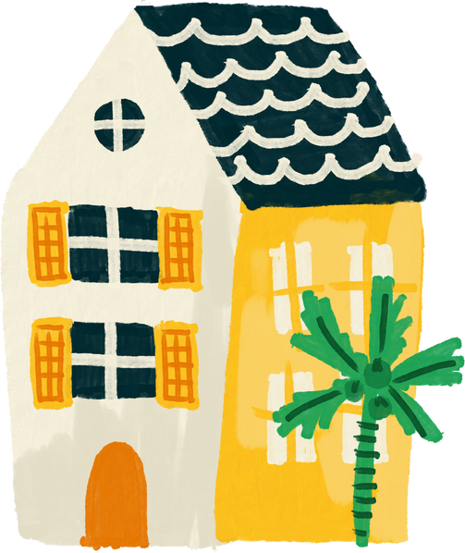
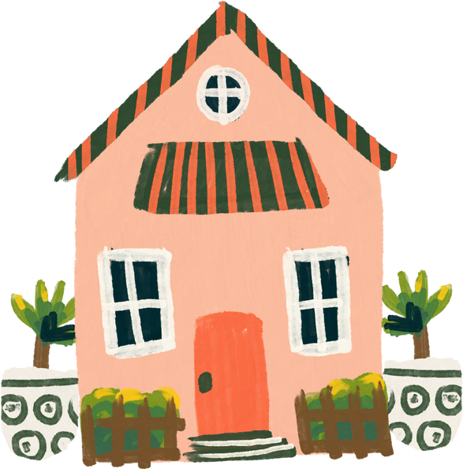
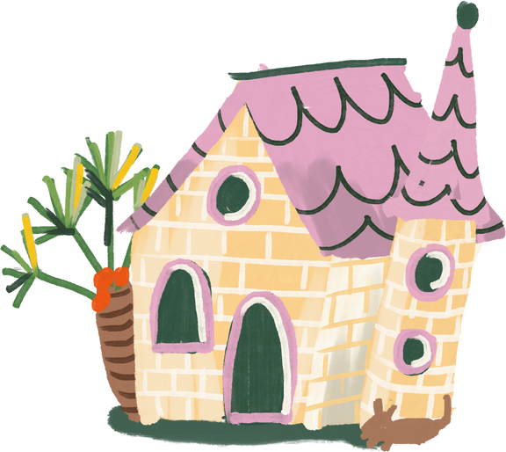
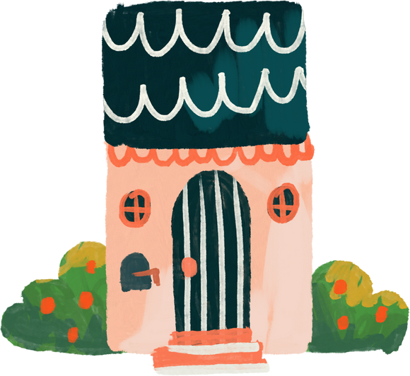
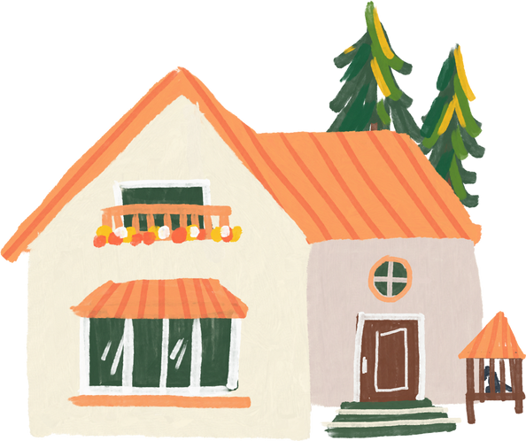
01
Warm-up and review

Slide 4


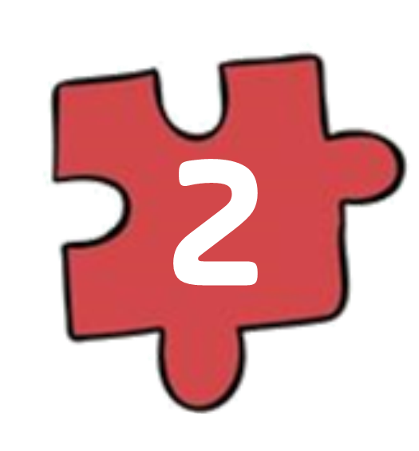
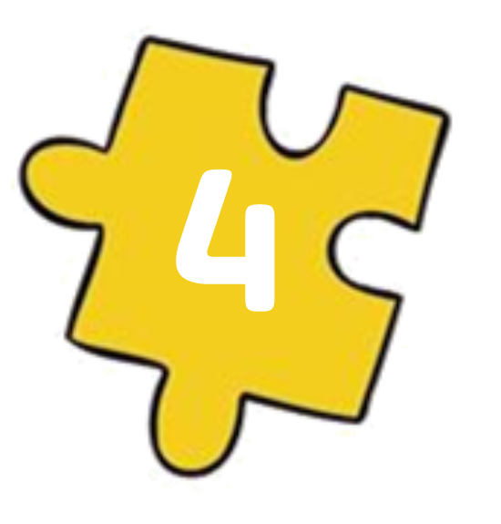
Guess the key word
Collect the letters.
E
O
HOME
M
H
Next Activity

Slide 5
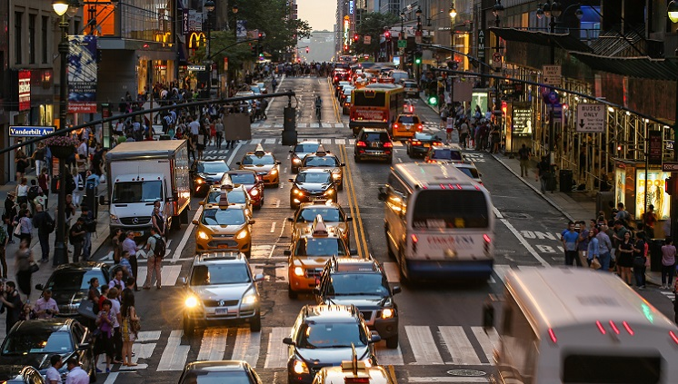
It's a busy .
st_ _e_
street

Slide 6
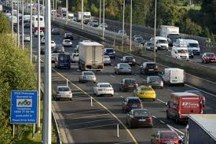
It's a noisy .
r_ _ _
road

Slide 7
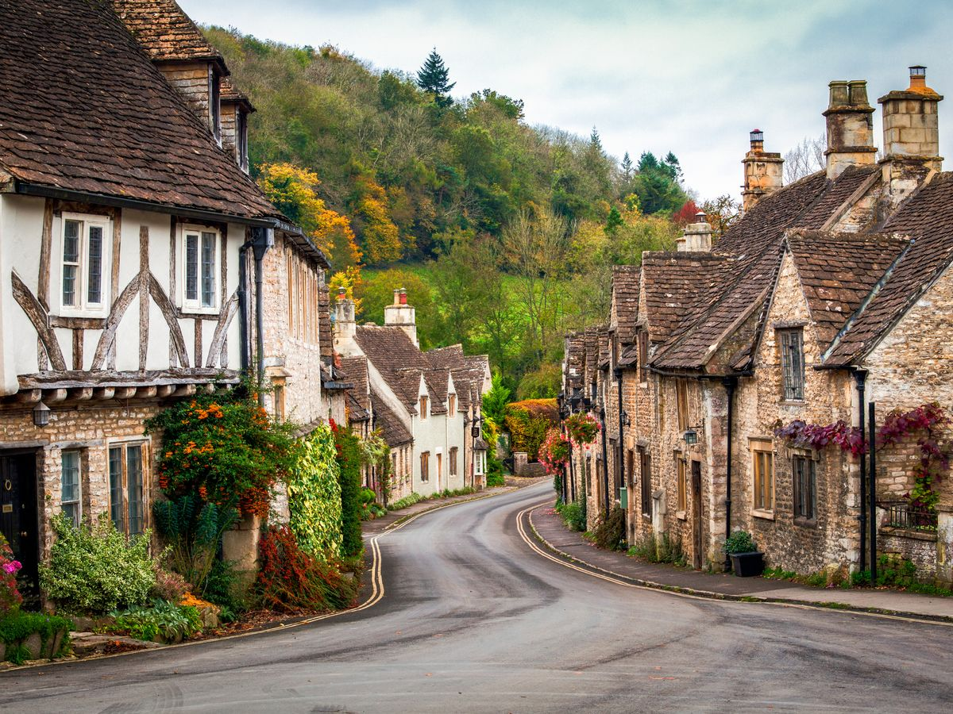
It's a quiet .
village
v_l_ag_

Slide 8

It's a big ..
c_ _y
city

Slide 9
02
Look, listen and repeat.

Slide 10
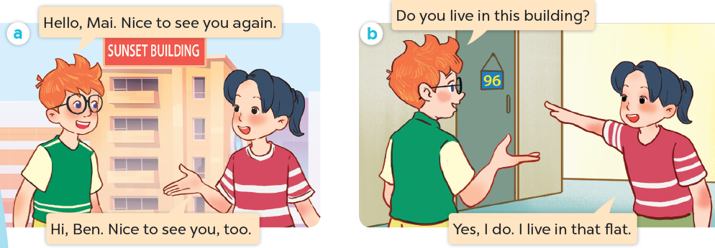
What are they talking about?
Where are they?
Who are they?

Slide 11

Look, listen and repeat.

Slide 12
Look, listen and repeat.

Slide 13
Look, listen and repeat.

Slide 14
03
Listen, point and say.

Slide 15
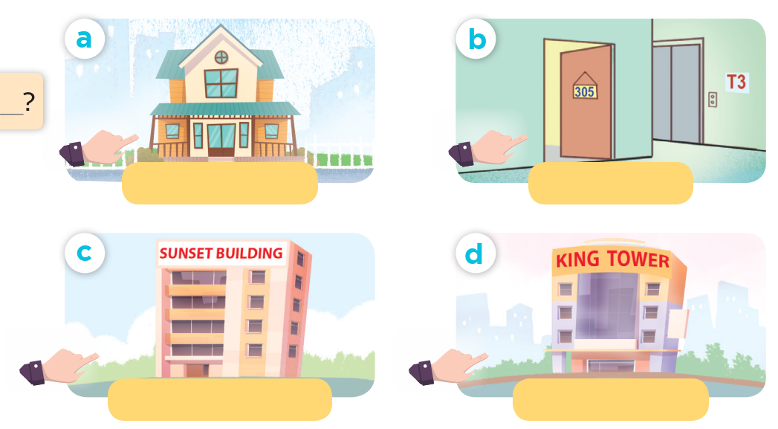
Look and say.

Slide 16
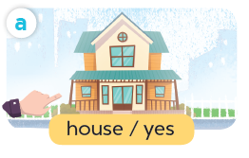
Listen, point and say.
house / yes

Slide 17
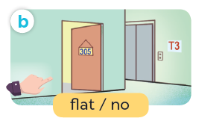
Listen, point and say.
flat / no

Slide 18
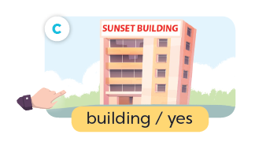
Listen, point and say.
building / yes

Slide 19
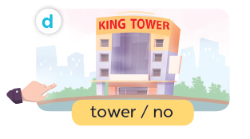
Listen, point and say.
tower / no

Slide 20
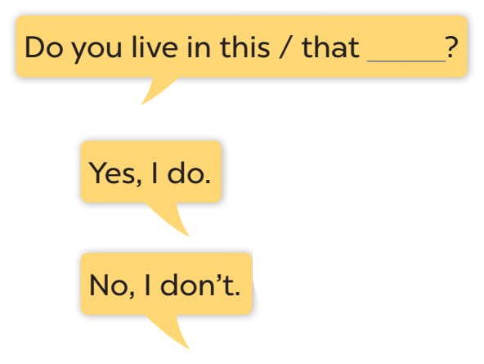




Slide 21
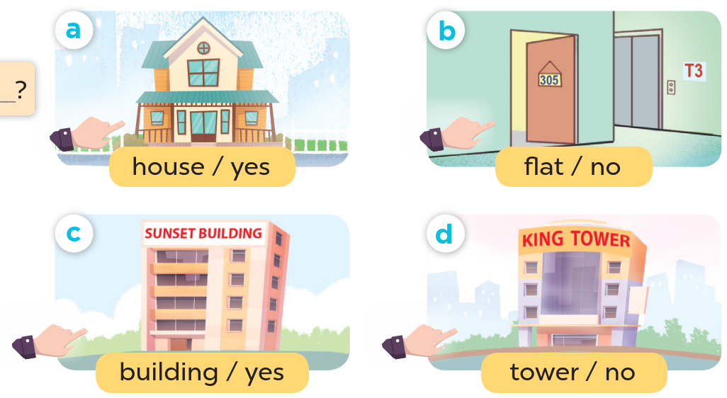
Look at the hands.

Slide 22
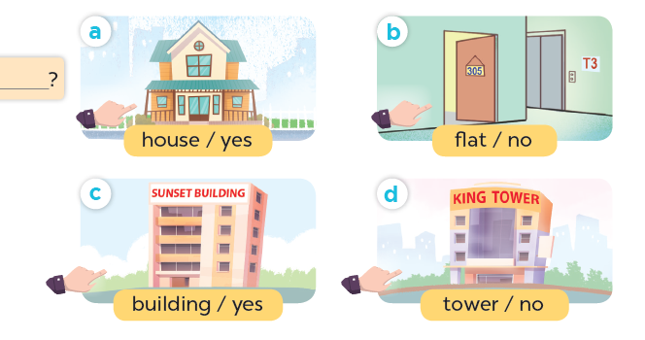
Listen, point and say.
Do you live in this house?
Yes, I do.
house / yes

Slide 23
Listen, point and say.
Do you live in this flat?
No, I don't.
flat / no

Slide 24
Listen, point and say.
Do you live in that building?
Yes, I do.
building / yes

Slide 25
Listen, point and say.
Do you live in that tower?
No, I don't.
tower / no

Slide 26
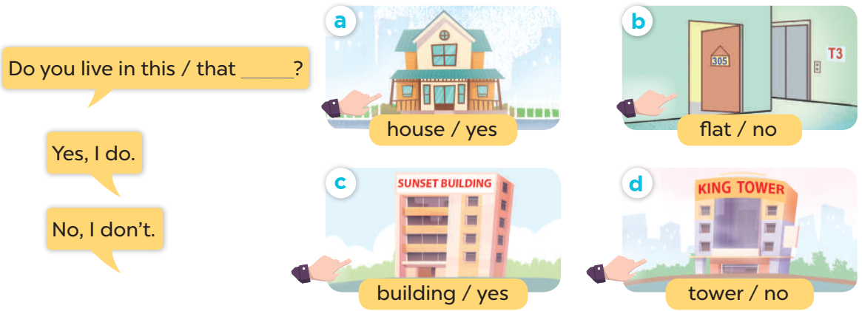
Work in pairs. Ask and answer.

Slide 27
04
Let's talk.

Slide 28
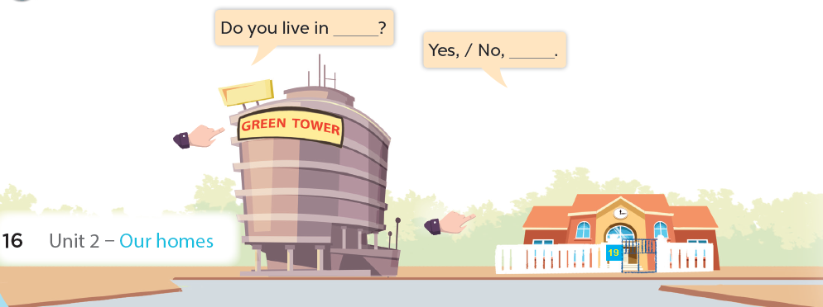

Slide 29
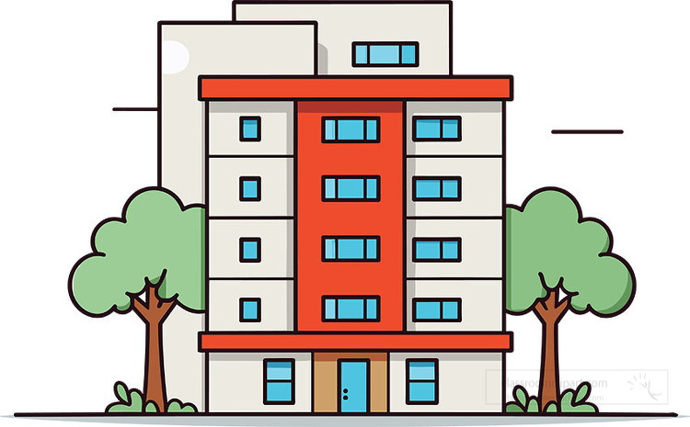


Do you live in that building?
No, I don't.

Slide 30

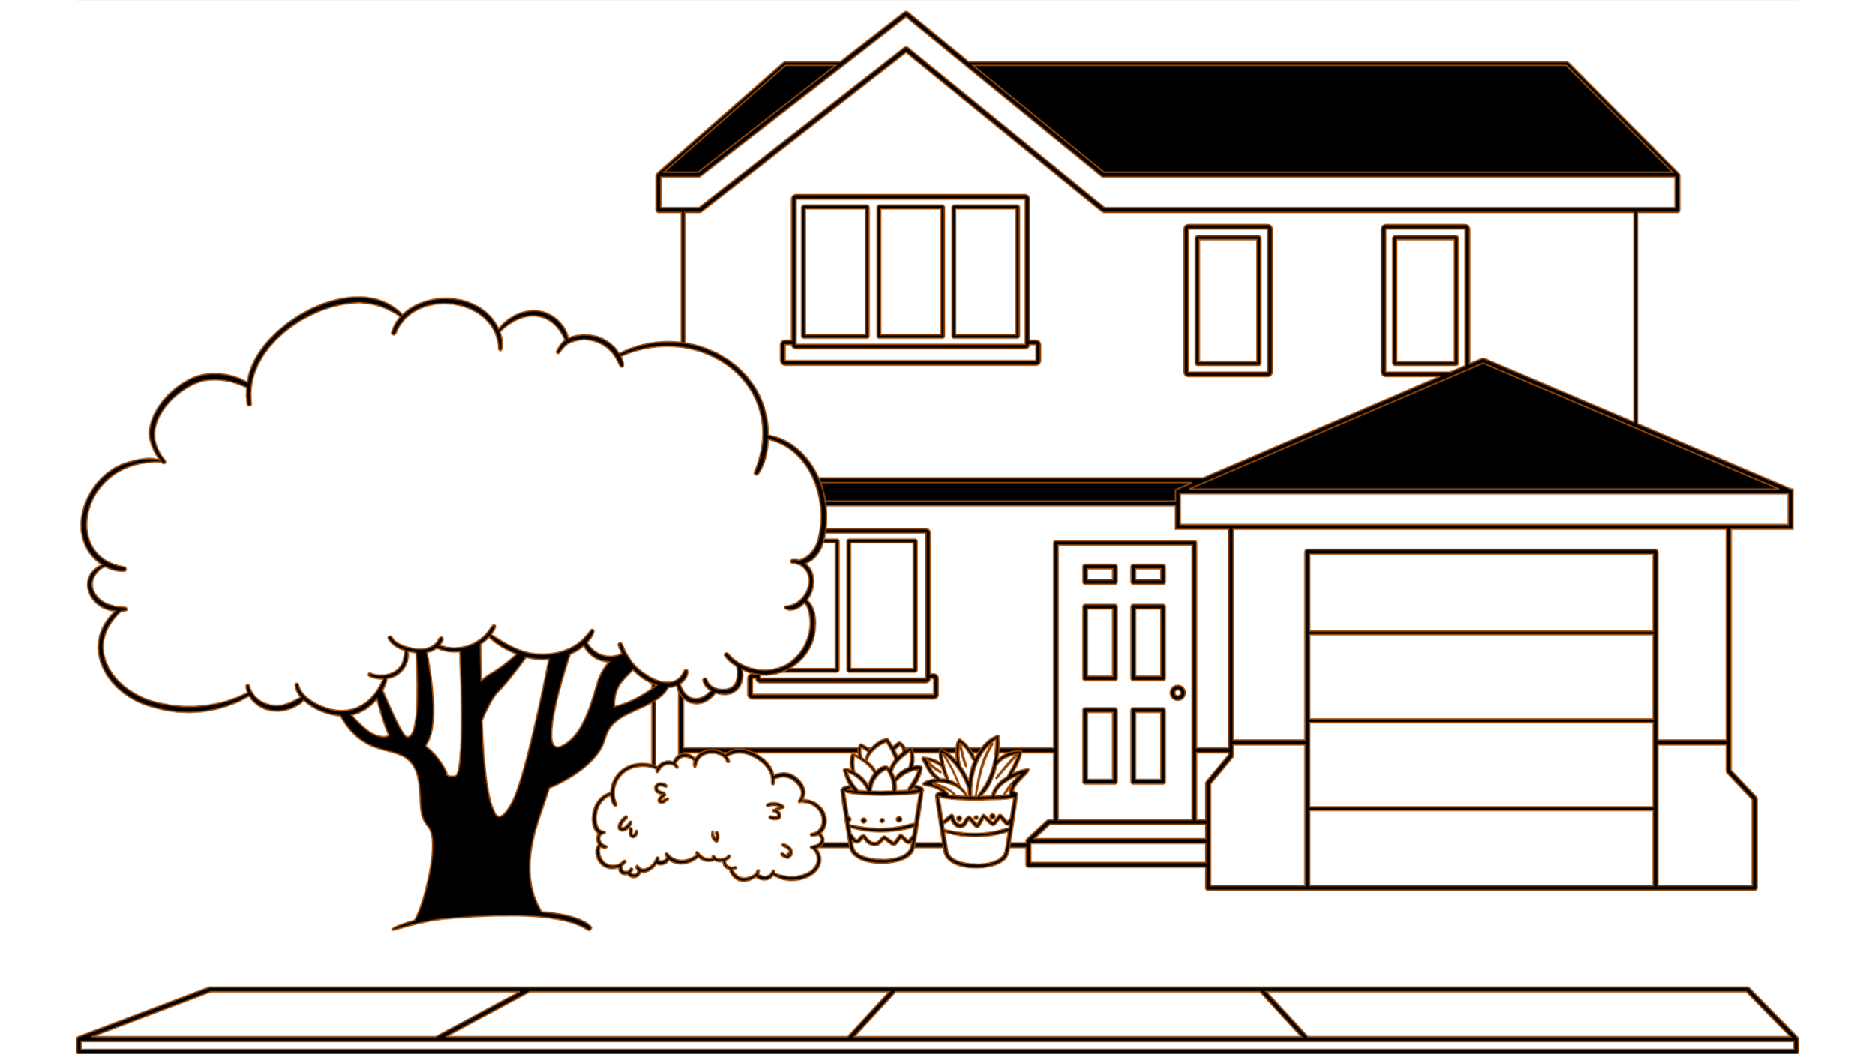
Do you live in this house?
Yes, I do.

Slide 31
05
Fun corner and wrap-up
Lucky letter

Slide 32

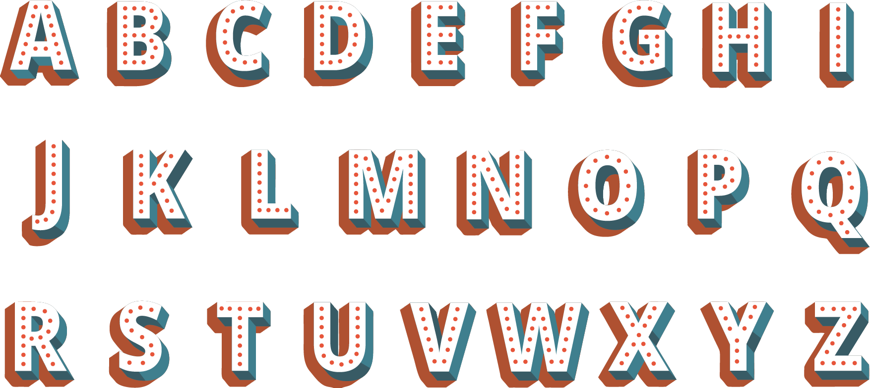
1
2
1
1
3
1
1
2

Slide 33
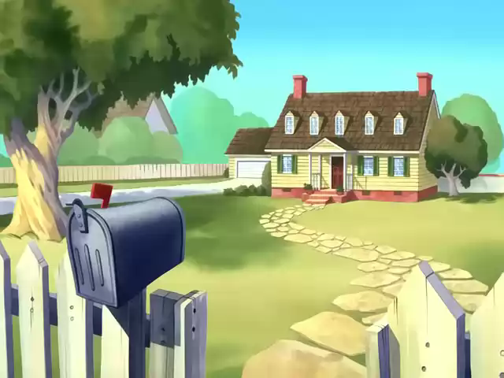

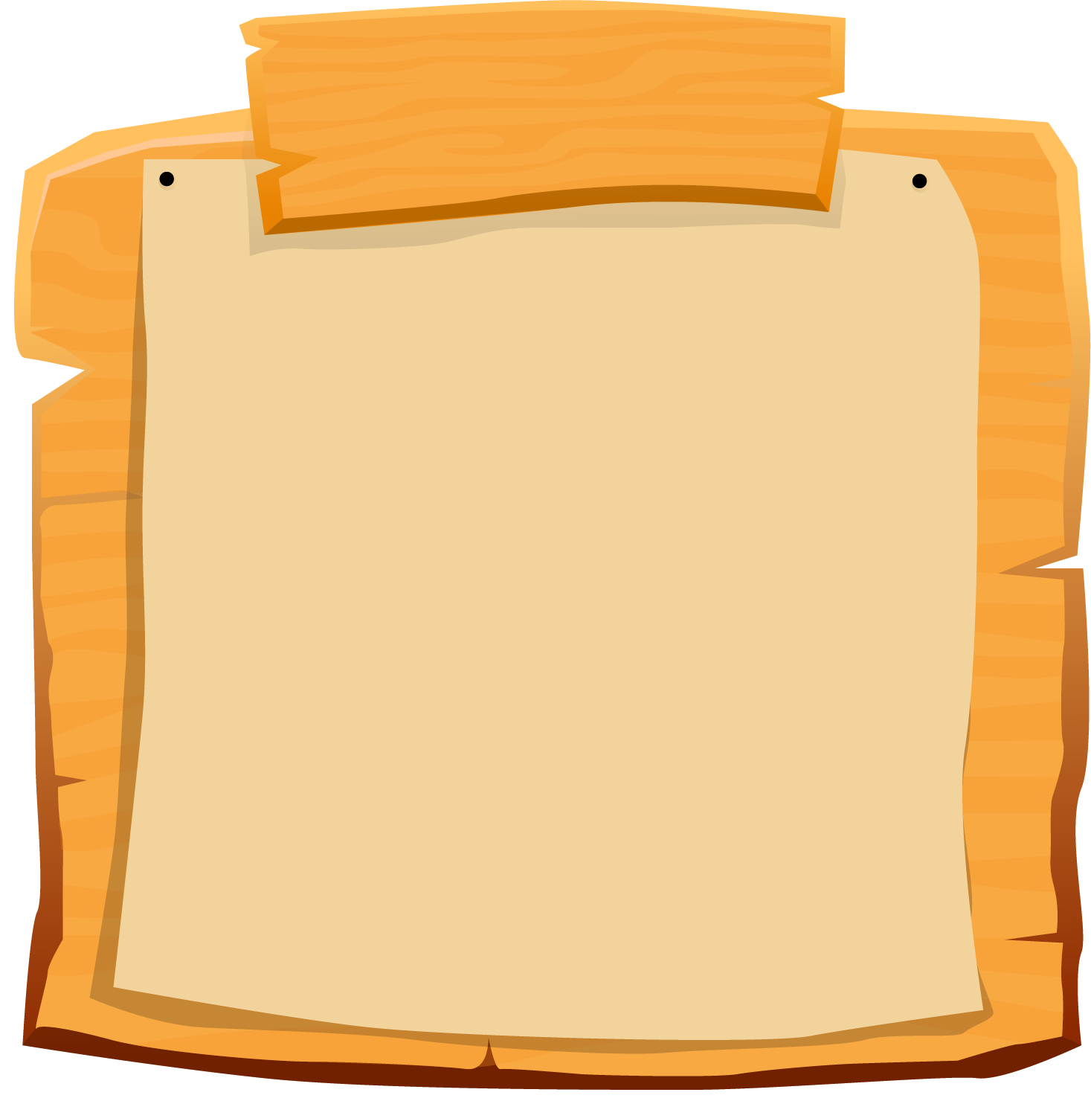

SCOREBOARD
Boys
Girls
0
1
2
3
4
5
6
7
8
9
0
1
2
3
4
5
6
7
8
9
Questions
Notes:
- Teacher clicks on each team's score board to add up on the score.
- Teacher click on the Questions sign to get back to the questions slide

Slide 34
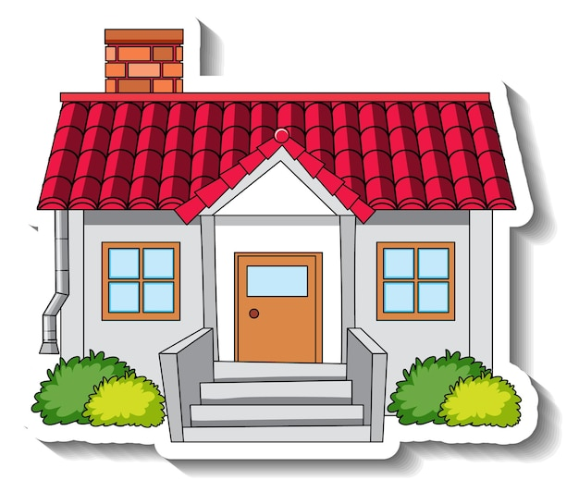
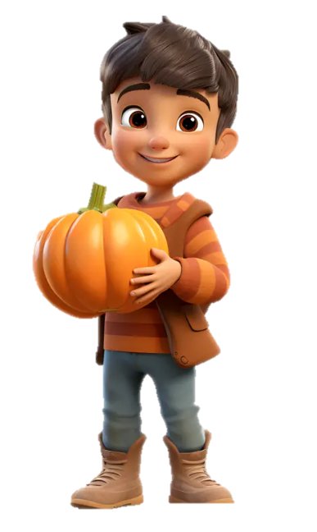

Do you live in this house?
Yes, I do.

Slide 35
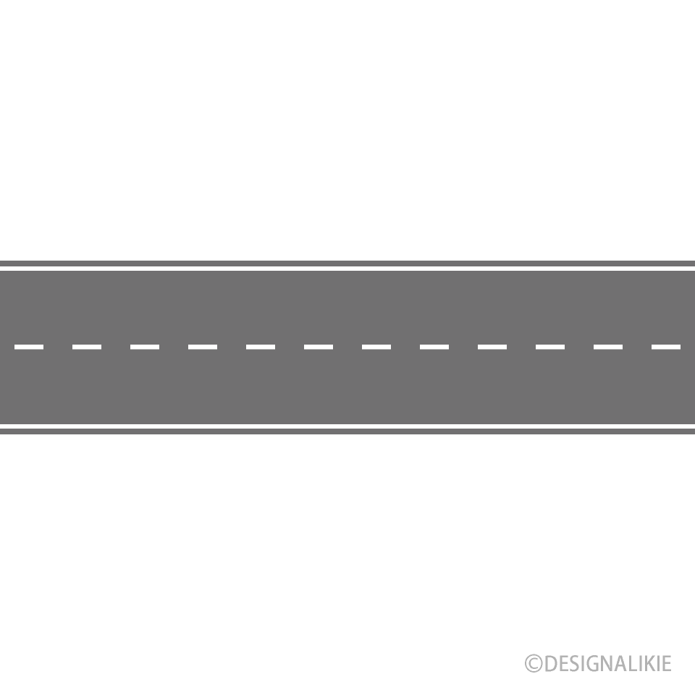



Do you live in that house?
Yes, I do.

Slide 36
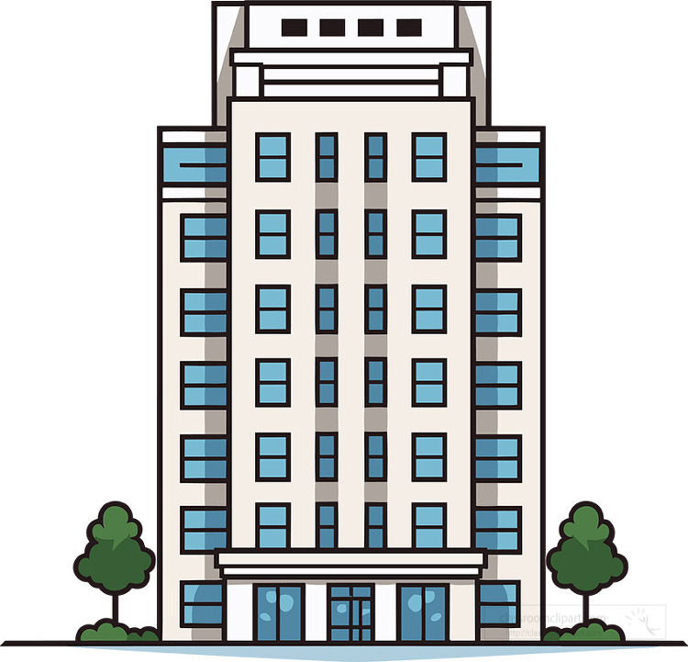
Moon Building
Do you live in this building?
No, I don't.

Slide 37
Moon Building
Do you live in that building?
No, I don't.

Slide 38

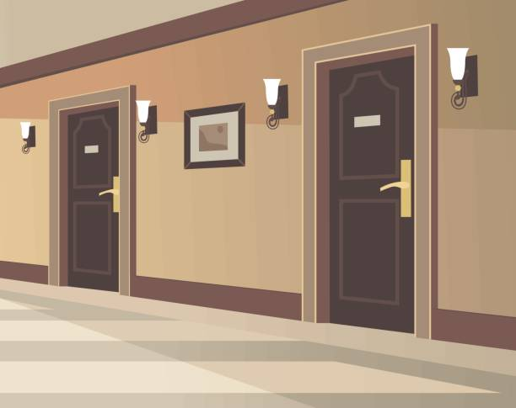


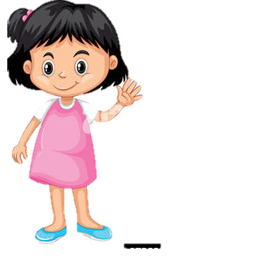
Do you live in this flat?
No, I don't.

Slide 39

Do you live in that flat?
Yes, I do.

Slide 40

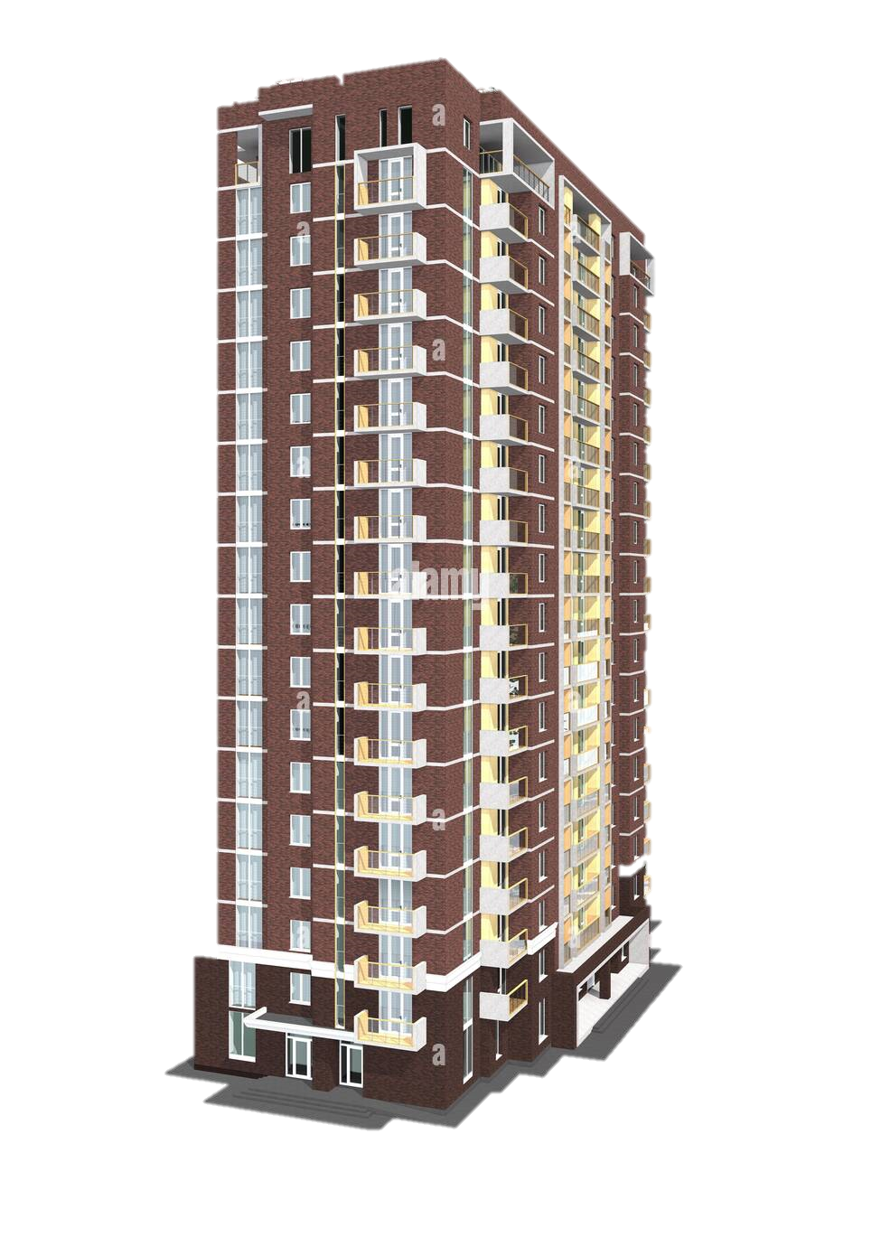
Do you live in this tower?
Yes, I do.
Queen Tower

Slide 41


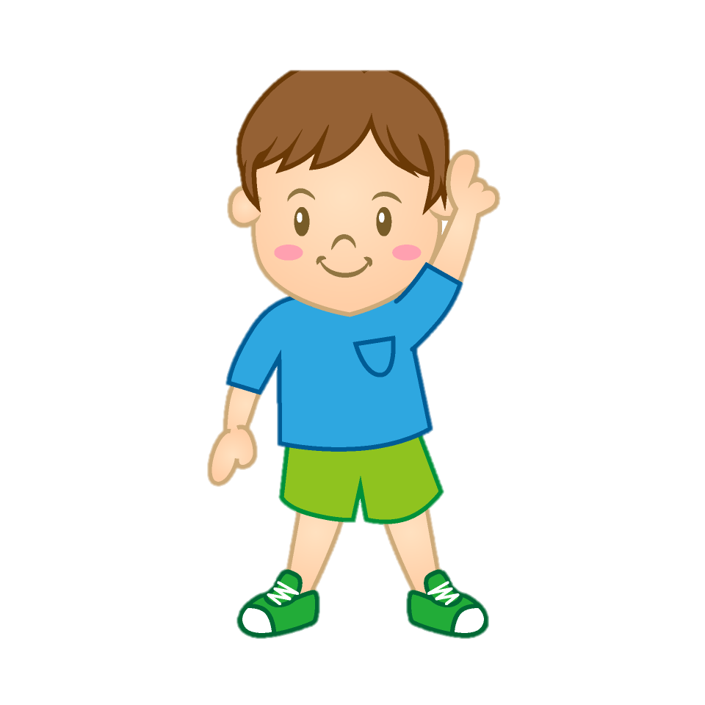
Prince Tower
Do you live in that tower?
No, I don't.

