Slide 1




UBND QUẬN DƯƠNG KINH
TRƯỜNG TIỂU HỌC ANH DŨNG
ENGLISH - GRADE 5
UNIT 3: MY FOREIGN FRIENDS
LESSON 1 (4, 5, 6)

Slide 2





My foreign friends
Unit 3
Lesson 1 – Period 2

Slide 3


01
Warm-up and Review

Slide 4

















Match the flags to the countries and tell the nationalities.
Australia
Singapore
Thailand
Malaysia
Viet Nam
Britain
Japan
America

Slide 5
Match the flags to the countries and tell the nationalities.
Britain
Australia
Viet Nam
Malaysia
Australia
Singapore
Thailand
Malaysia
Viet Nam
Britain
Japan
America
Thailand
Singapore
America
Japan

Slide 6
02
Listen and tick.

Slide 7



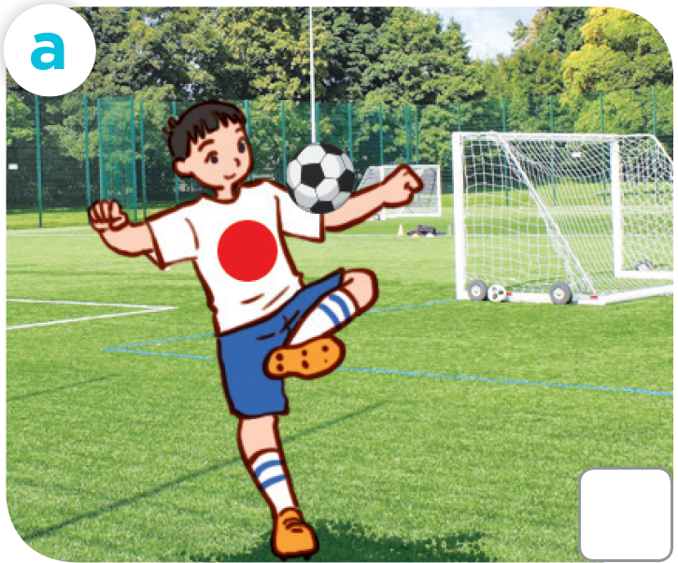
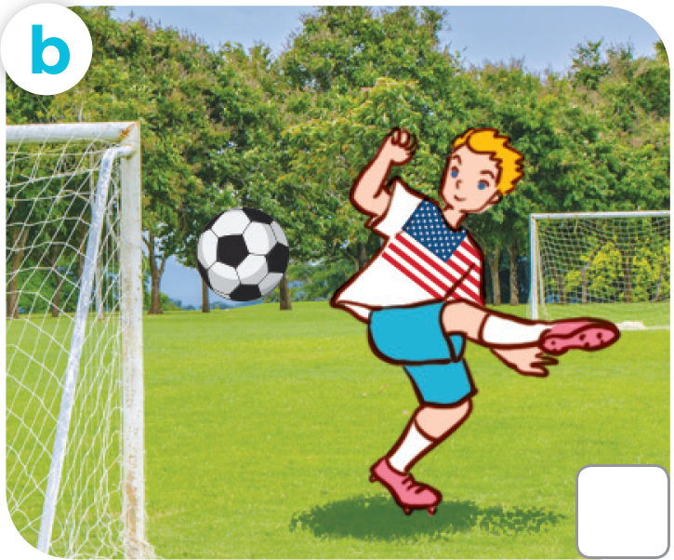
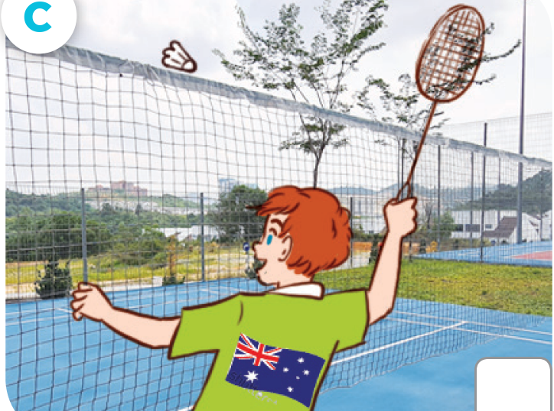


LOOK AND ANSWER.
Japanese
American
Australian

Slide 8



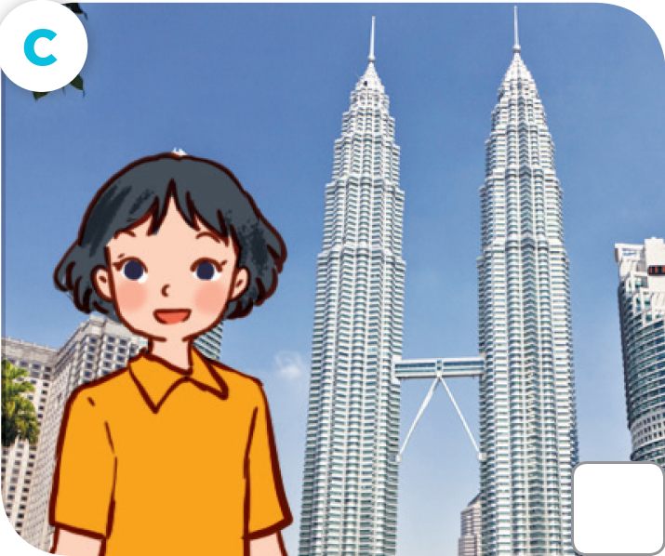
LOOK AND ANSWER.
British
Australian
Malaysian

Slide 9






LISTEN AND TICK.

Slide 10

CHECK YOUR ANSWERS.

Slide 11




Let's play!
sit down

Slide 12





Slide 13
03
Read and circle.

Slide 14



READ AND CIRCLE.
1. This is Sally. She’s from Britain / America.

Slide 15



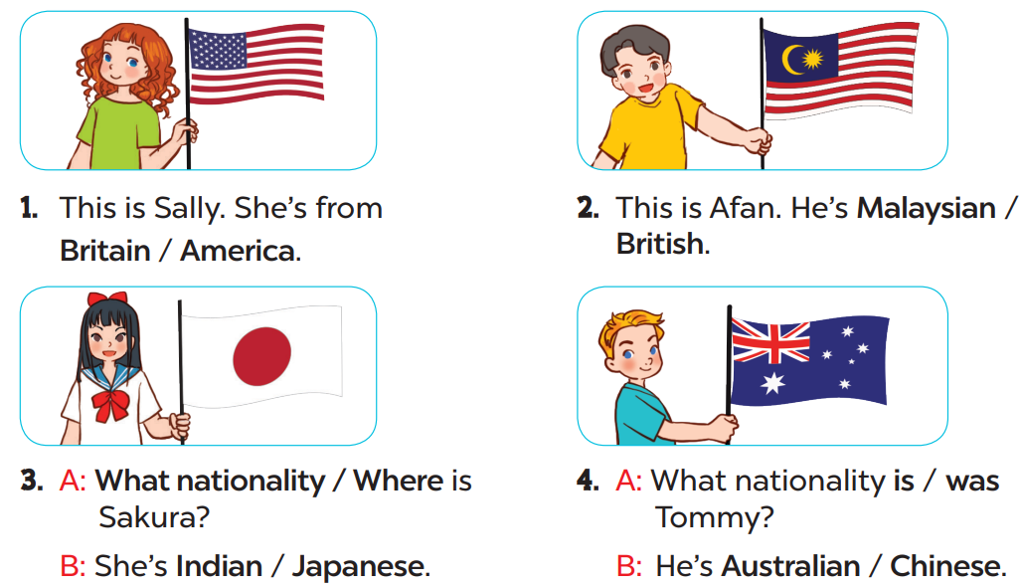


READ AND CIRCLE.
Page
23

Slide 16




SWAP YOUR BOOKS.

Slide 17



LET’S CHECK YOUR ANSWERS.
2. This is Afen. He’s Malaysian / British.

Slide 18


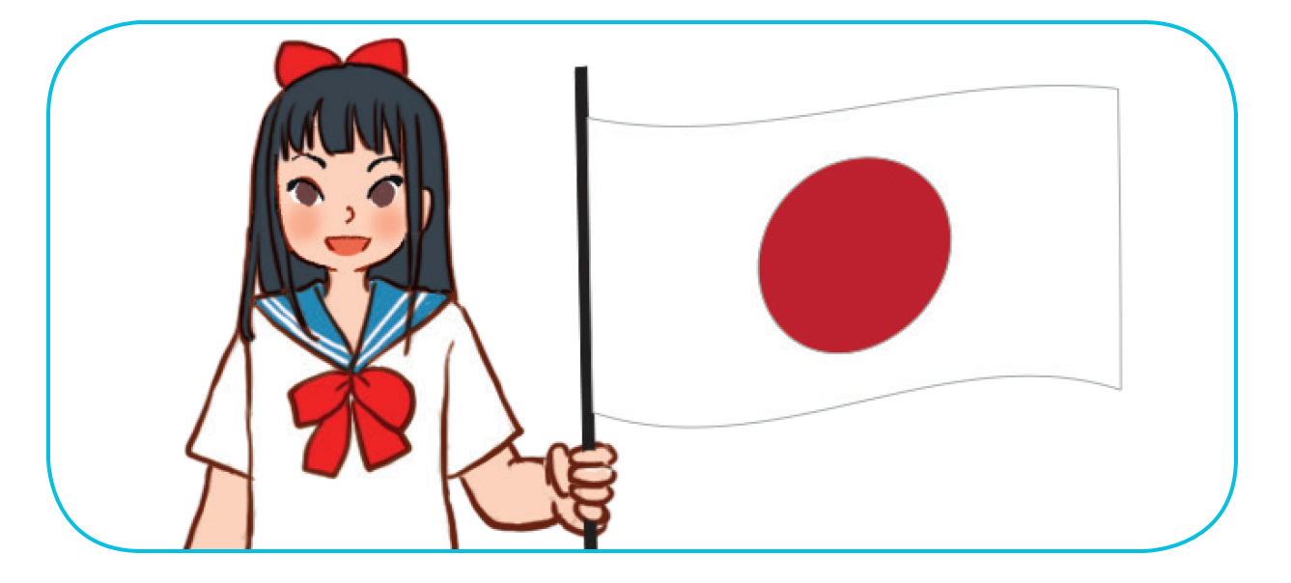

LET’S CHECK YOUR ANSWERS.
3. A: What nationality / Where is Sakura?
B: She’s Indian / Japanese.

Slide 19



LET’S CHECK YOUR ANSWERS.
4. A: What nationality is / was Tommy?
B: He’s Australian / Chinese.

Slide 20
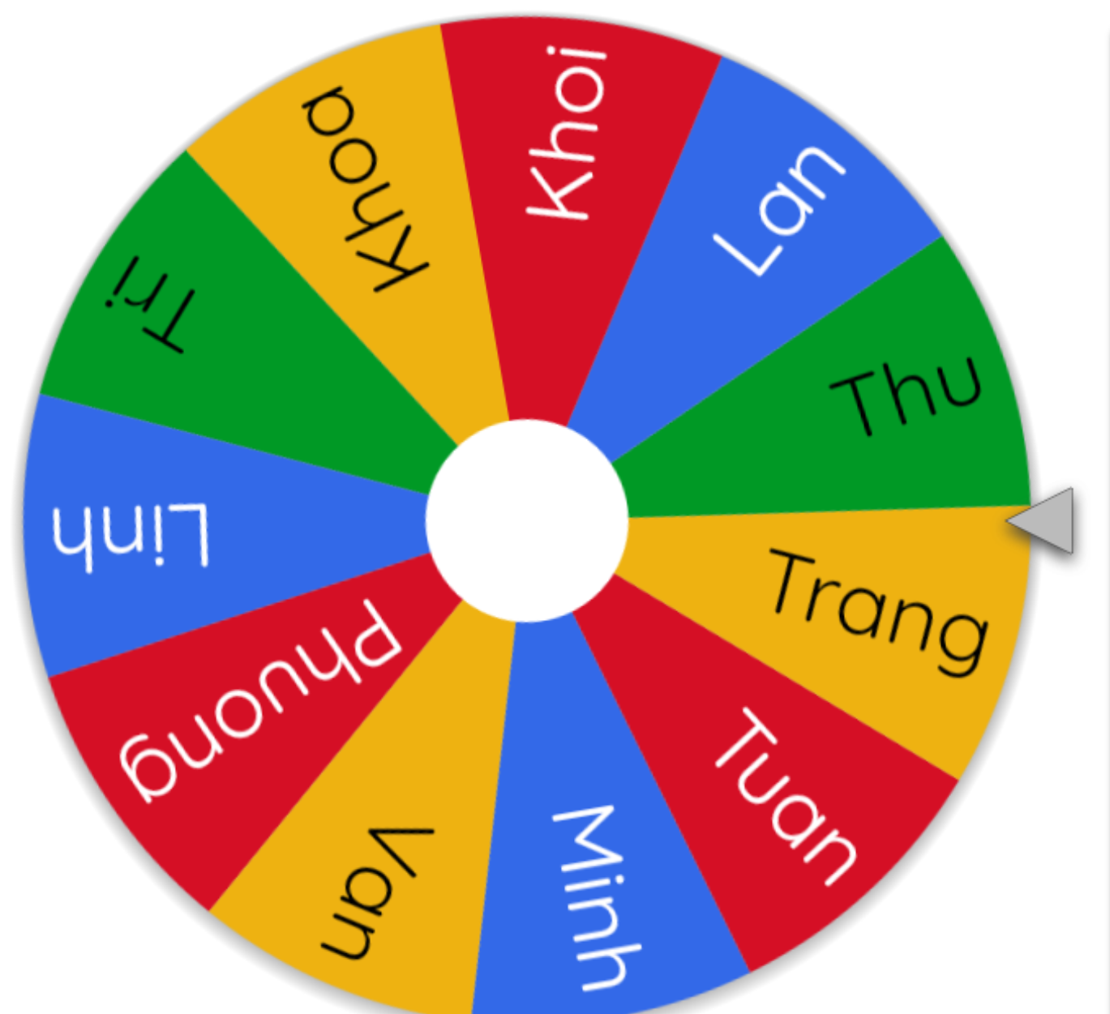
LET’S SPIN!
Notes:
Use this link to choose pupils in random: https://wheelofnames.com/

Slide 22
04
Let’s sing.

Slide 23
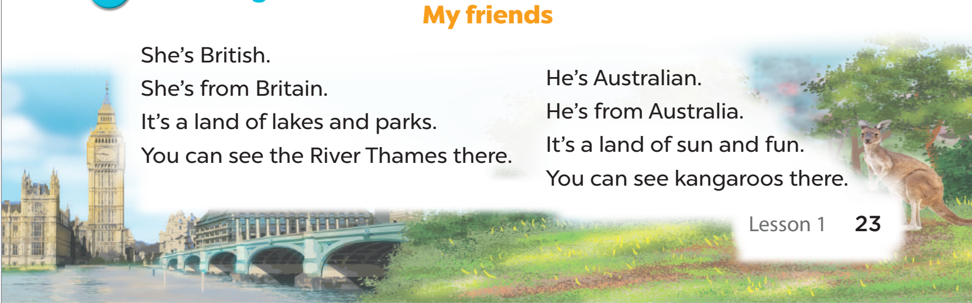

LOOK AND SAY.
My friends

Slide 24

LISTEN AND POINT.
My friends
Notes:
Link video hoạt hình: https://hoclieu.vn/hop-phan-bo-tro/video-hoat-hinh/203?gidzl=zOIHFJEOs53ncvauCu7VN_2QdJKkXTuBw9gNP7hKXGZloSLdBjo43hl9nJLorOnSiydFDZFmBN1VDvdPKm

Slide 25
LISTEN, SING AND CLAP.
My friends

Slide 26







Let’s SING in the front.

