Slide 1




UBND QUẬN DƯƠNG KINH
TRƯỜNG TIỂU HỌC ANH DŨNG
ENGLISH - GRADE 5
UNIT 3: MY FOREIGN FRIENDS
LESSON 1 (4, 5, 6)

Slide 2





My foreign friends
Unit 3
Lesson 2 – Period 3

Slide 3


01
Warm-up and Review

Slide 4
02
Look, listen and repeat.

Slide 5



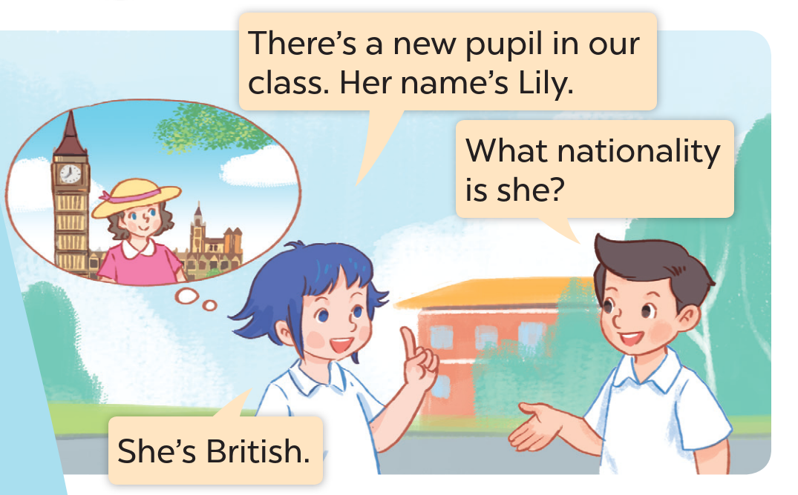
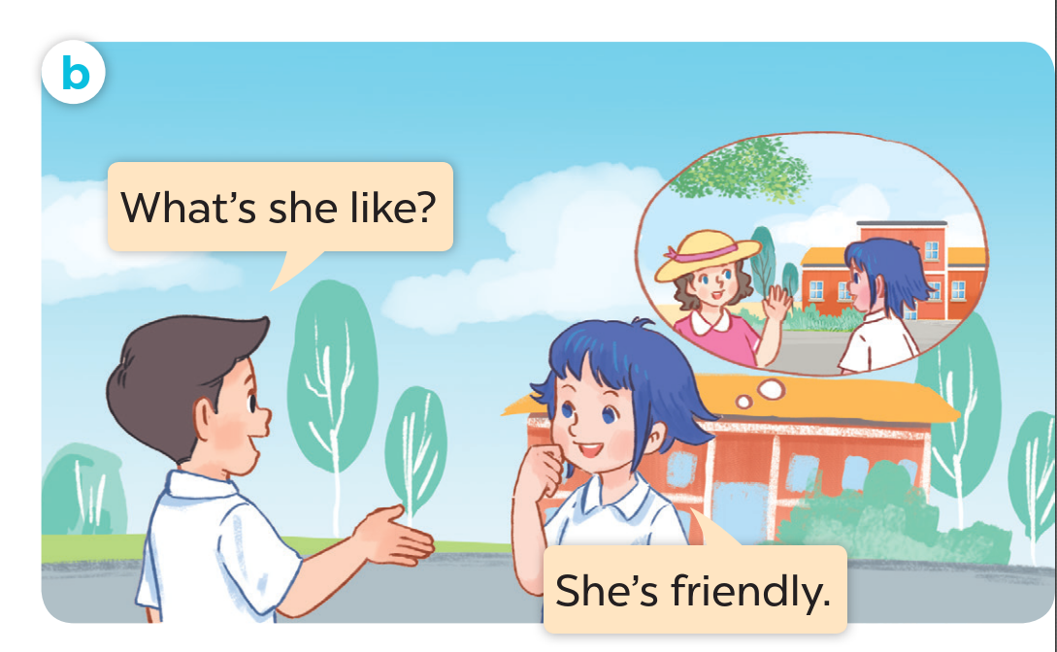


LISTEN AND SAY.

Slide 6



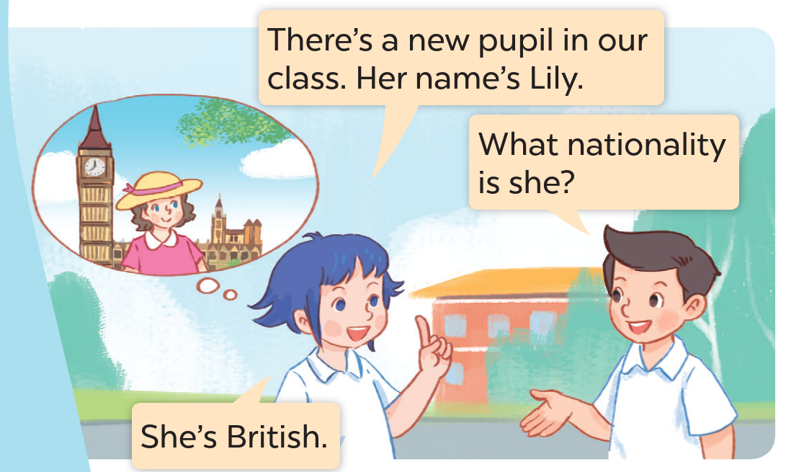




LISTEN, POINT AND REPEAT.

Slide 7


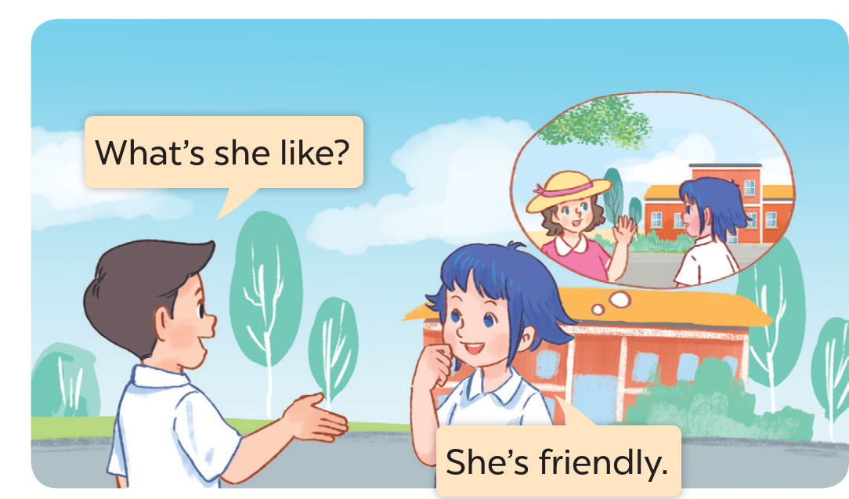


LISTEN, POINT AND REPEAT.
Notes:
.

Slide 8
03
Listen, point and say.

Slide 9









LOOK AND SAY.
friendly
helpful
clever
active

Slide 10

LISTEN AND REPEAT.

Slide 11

LISTEN AND REPEAT.

Slide 12

LISTEN AND REPEAT.

Slide 13

LISTEN AND REPEAT.

Slide 14





ASK AND ANSWER.

Slide 15
04
Let’s talk.

Slide 16

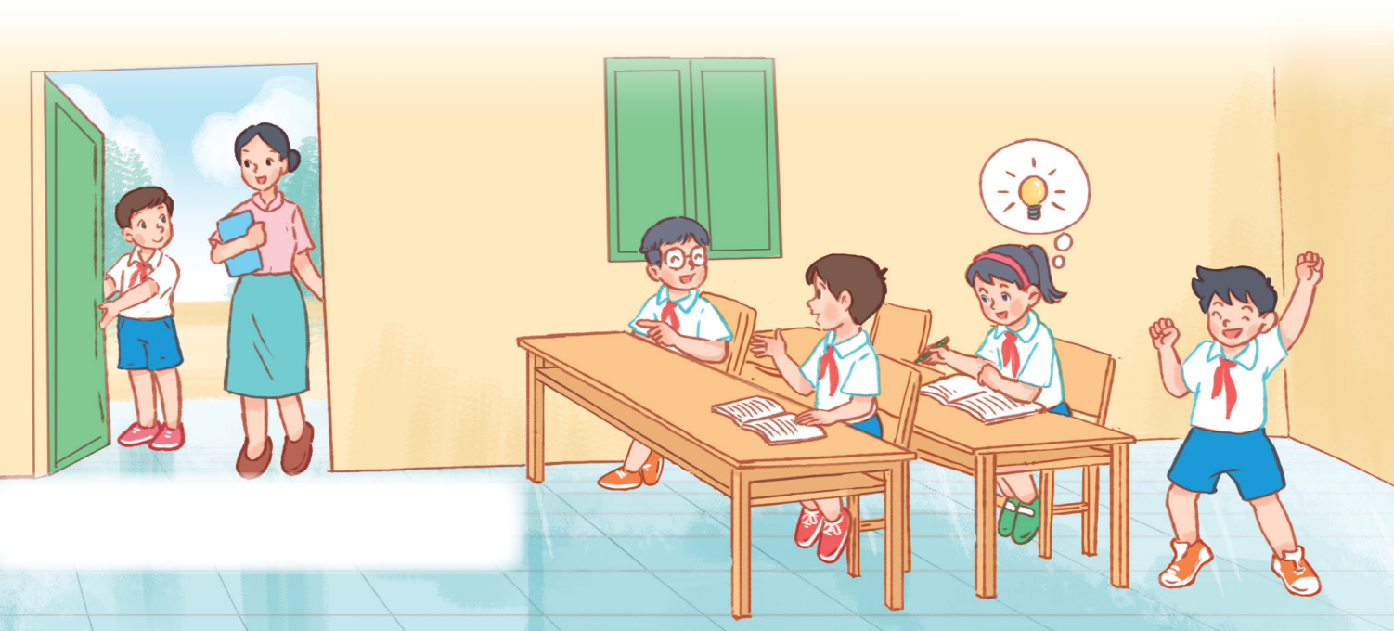
LOOK AND SAY.
clever
helpful
friendly
active

