Slide 1




UBND QUẬN DƯƠNG KINH
TRƯỜNG TIỂU HỌC ANH DŨNG
ENGLISH - GRADE 5
STARTER B

Slide 2








starter
Period 2 – Last summer

Slide 3
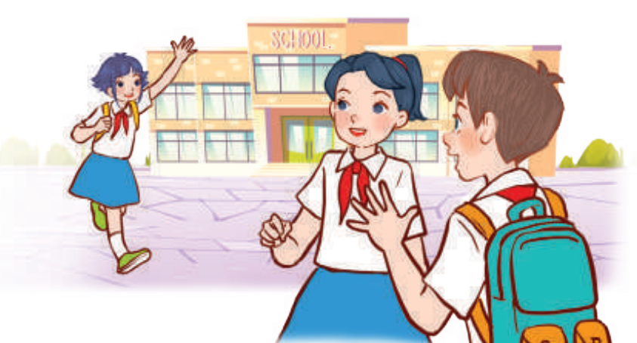

01
WARM-UP
and review

Slide 4
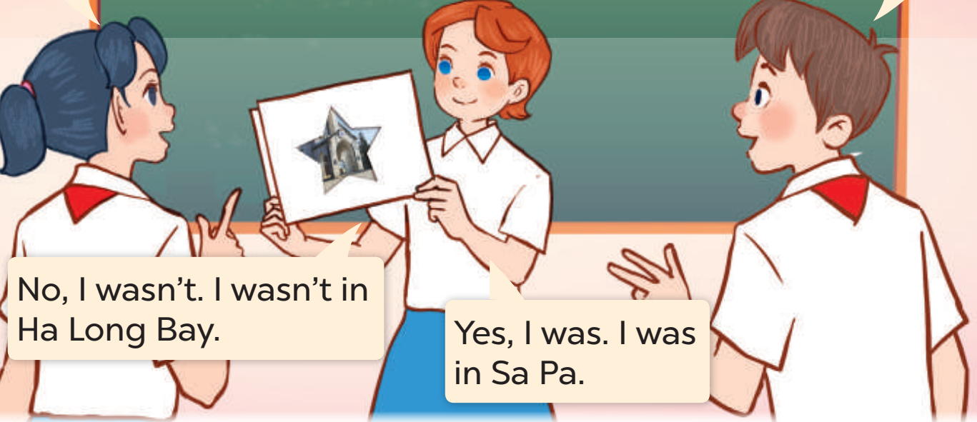
02
Let’s PLAY.

Slide 5

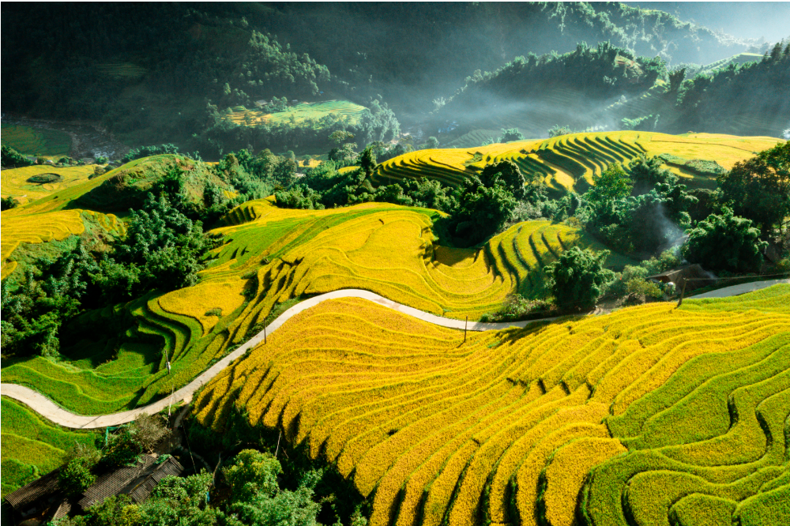
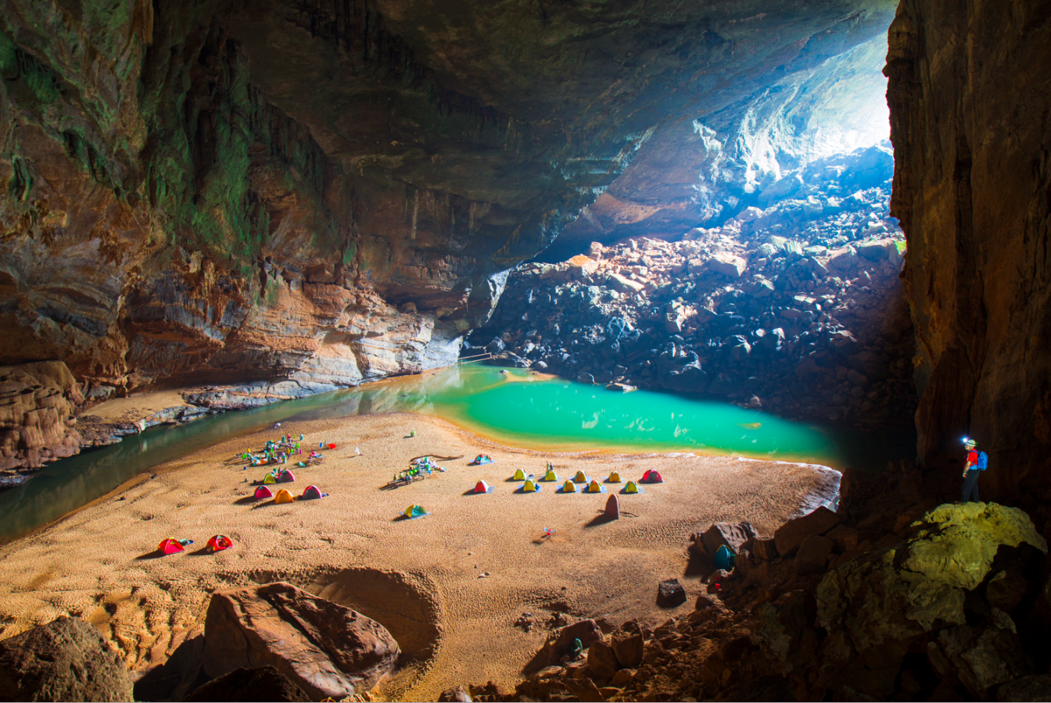
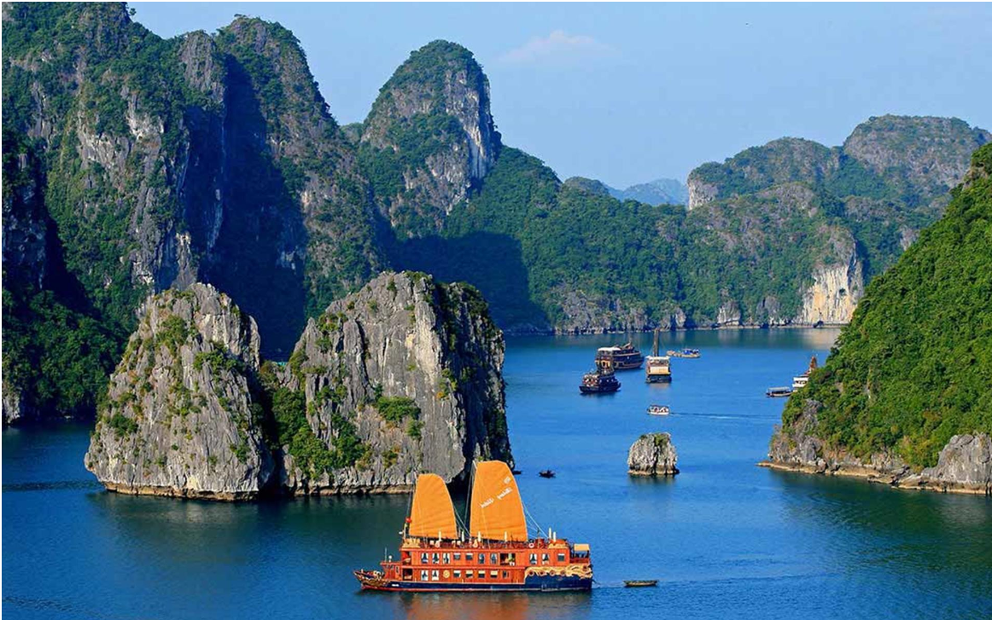
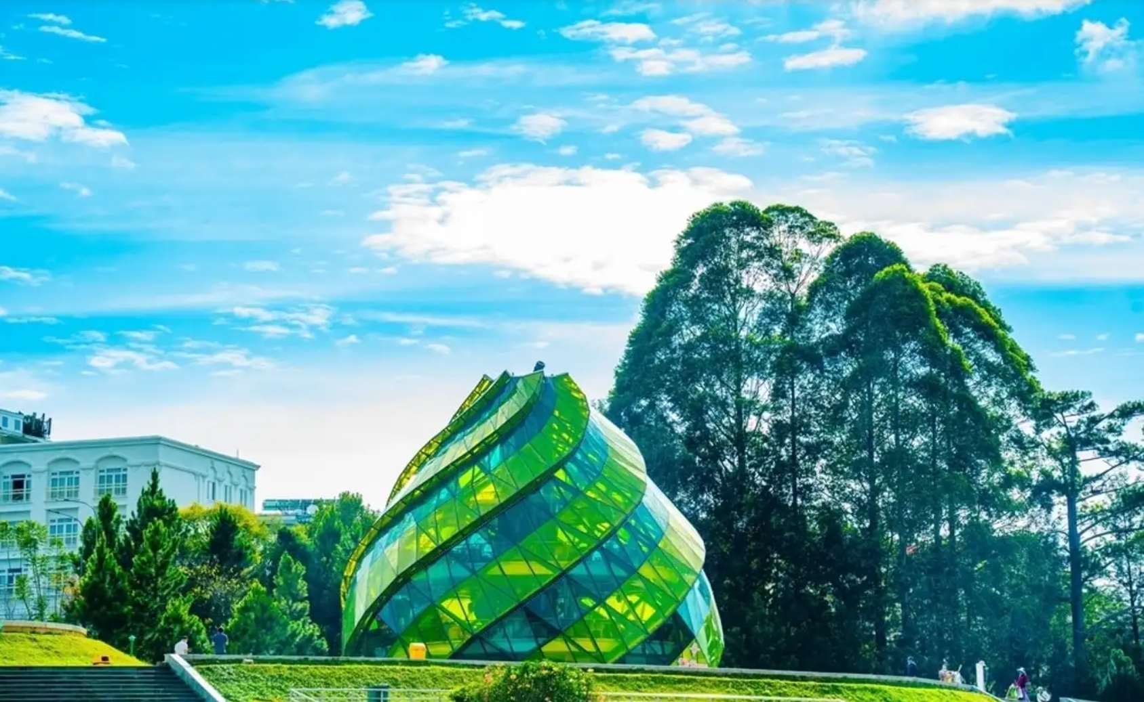
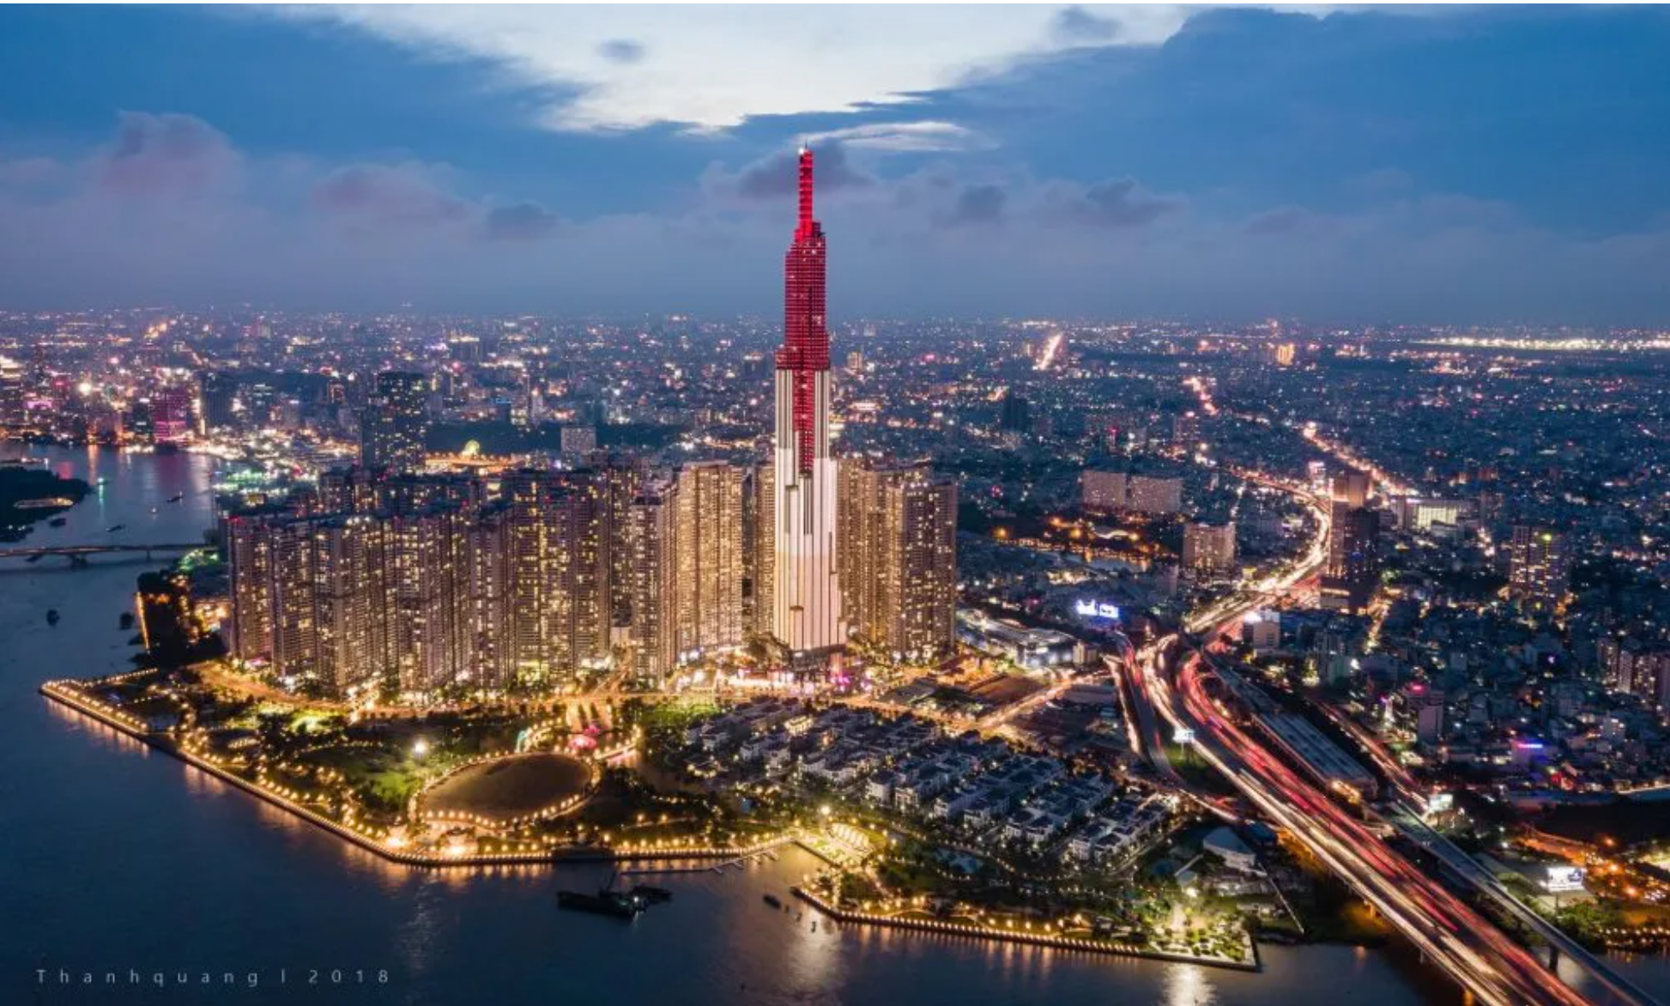
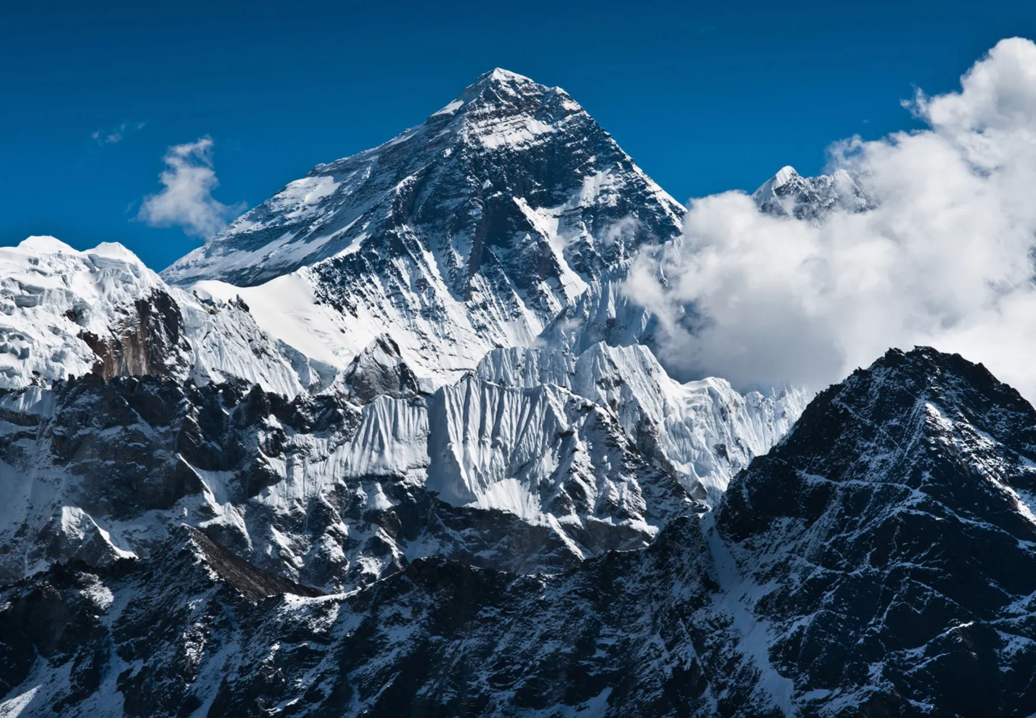
GUESSING GAME
2 teams
TEAM A
TEAM B
Notes:
Pupils work in 2 teams.
Ask pupils to look at the photos and guess where their friends visited last summer using Yes/No questions with simple past of verb “be”.

Slide 6
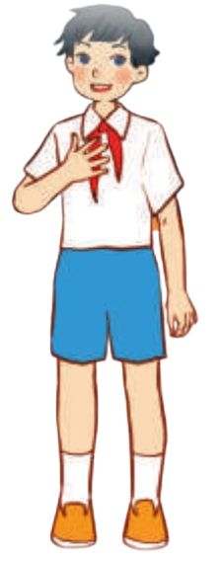



GUESSING GAME
Sa
Were you in Long An
last summer?
Yes, I was. I was in Sa Pa.

Slide 7
GUESSING GAME
Sa
Ha Long Bay

Slide 8
GUESSING GAME
Sa
Ho Chi Minh City

Slide 9


GUESSING GAME
Work in groups.
6 pupils
Each pupil prepares 1 photo.
Notes:
Pupils in each team prepare pictures of the places they were during their summertime (Pupils work in groups of six. Each pupil brings one photo of place where he/she had been to.)

Slide 10

03
LISTEN
AND MATCH.

Slide 11
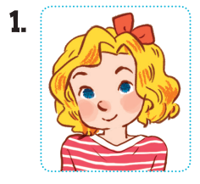
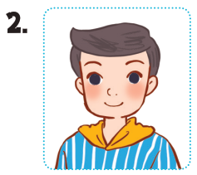
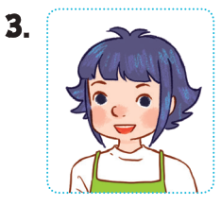
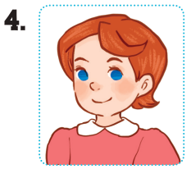




Look and Say.
Mary
Nam
Linh
Lucy
Tokyo
on a rainy day
Ha Long
Bay
Ho Chi Minh City
on a sunny day
mountains
Notes:
Step 1: Draw pupils’ attention to the pictures of the four characters, the places and weather. Identify them as a class.

Slide 12
LISTEN AND MATCH.
Notes:
Step 2: Play the recording for Exchange 1. Ask pupils to listen and identify the correct picture (a, b, c or d) and draw a line to match the character (Mary) to the correct place (Picture b).
Ask pupils to guess the answers for other sentences.

Slide 13

04
LET’S TALK.

Slide 14
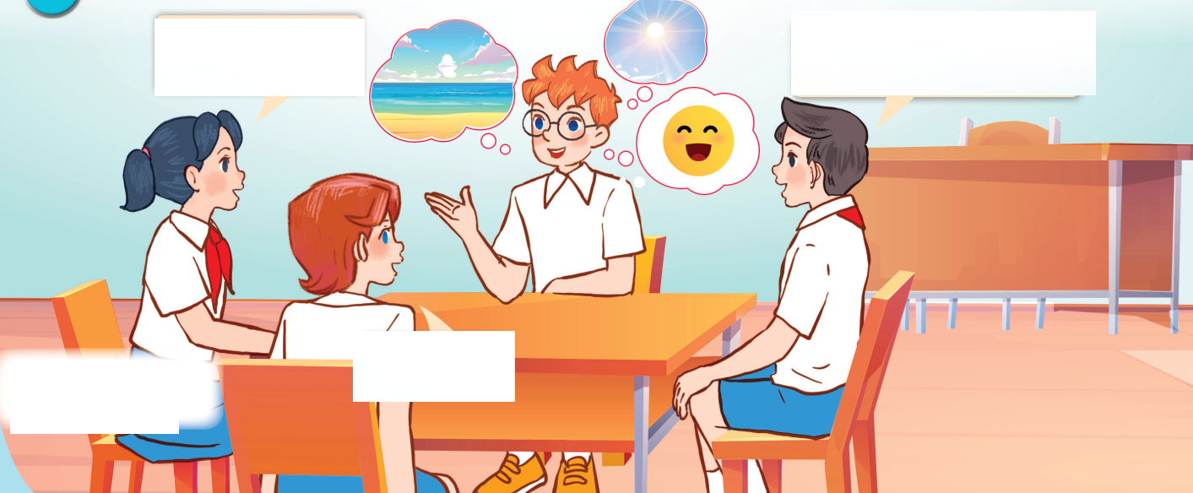
Look AND ANSWER.
Notes:
Step 1: Draw pupils’ attention to the picture. Ask questions to help them identify the context (see Input).

