Slide 1




UBND QUẬN DƯƠNG KINH
TRƯỜNG TIỂU HỌC ANH DŨNG
ENGLISH - GRADE 5
UNIT 1: ALL ABOUT ME
- LESSON 2 (4, 5, 6)

Slide 2
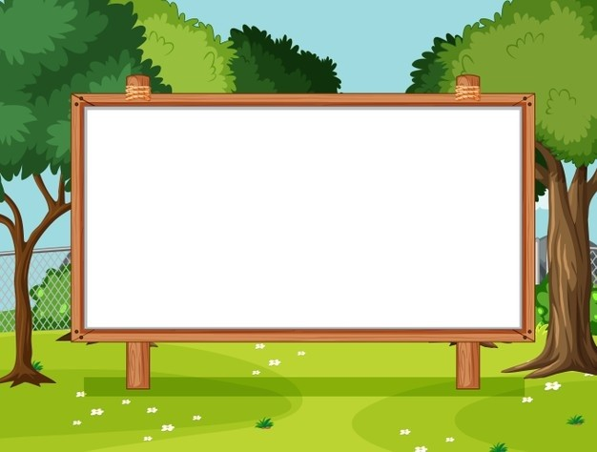
Unit 1. All about me!
Lesson 2 - Period 4

Slide 3


01
Warm-up and review

Slide 4
02
Listen and match.

Slide 5

Lucky Windows
Game

Slide 6

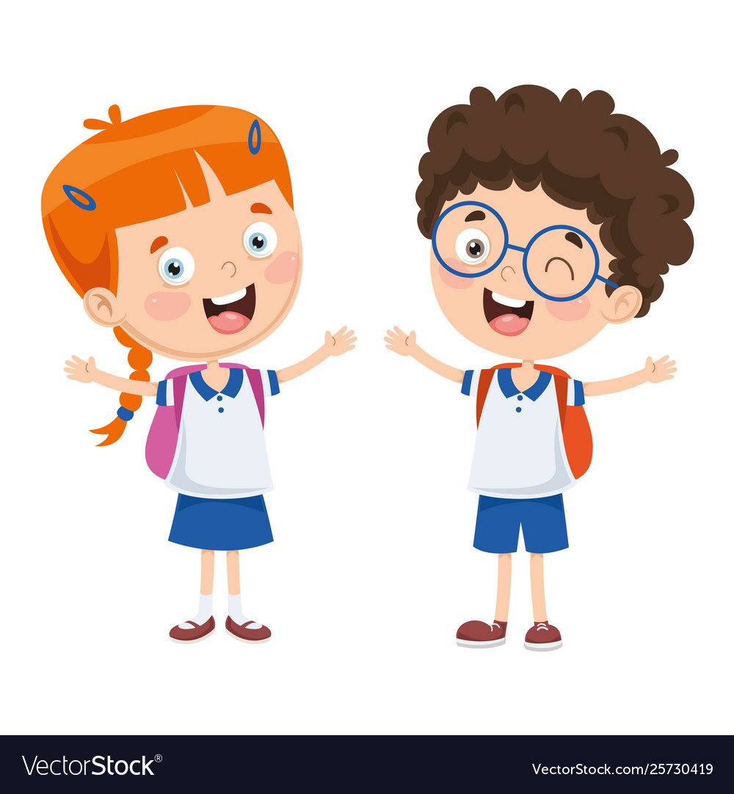
What’s your favourite ____?
It’s ____.

Slide 7
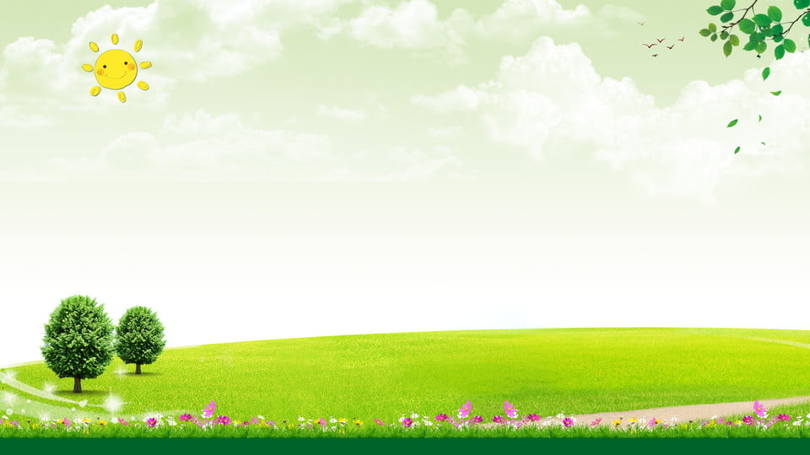
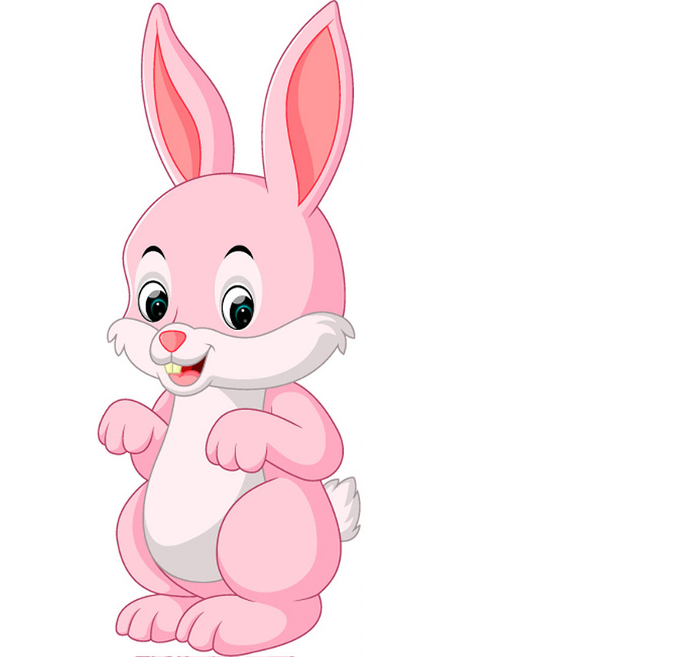
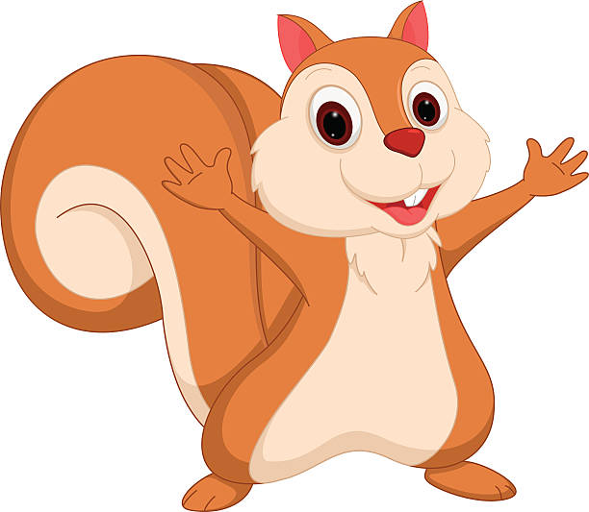
Team: Rabbit
Team: Squirrel

Slide 8


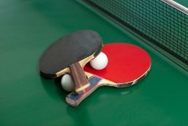

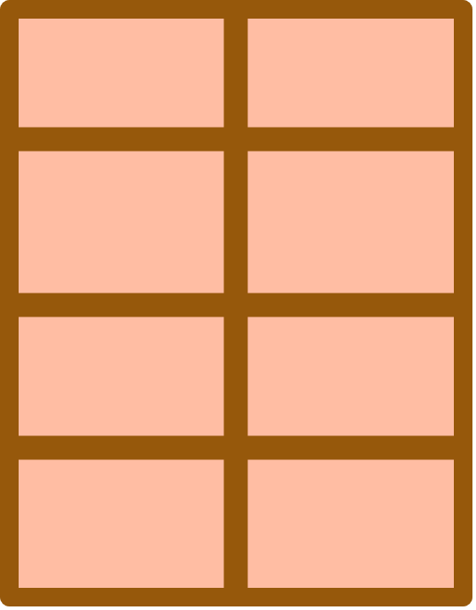

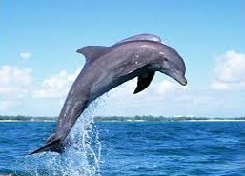
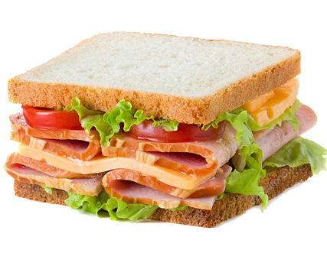
Notes:
Nháy vào cửa sổ để mở, nháy vào hình để đi tới Slide tương ứng.

Slide 9
What’s your favourite sport?
It’s table tennis.
Notes:
Click vào hình ảnh để xuất hiện mẫu câu

Slide 10
What’s your favourite colour?
It’s pink.
Notes:
Click vào hình ảnh để xuất hiện mẫu câu

Slide 11
What’s your favourite animal?
It’s a dolphin.
Notes:
Click vào hình ảnh để xuất hiện mẫu câu

Slide 12
What’s your favourite food?
It’s a sandwich.
Notes:
Click vào hình ảnh để xuất hiện mẫu câu

Slide 13

Summary
Team: Rabbit
Team: Squirrel
Notes:
GV nháy vào biểu tượng của đội chơi để tính điểm cho các đội. Mỗi lần nháy 1 ngôi sao xuất hiện.

Slide 14
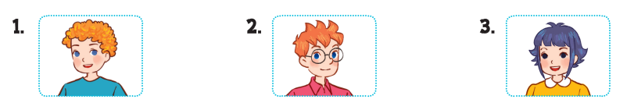
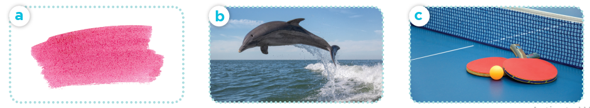
Listen and match.

Slide 15
03
Read and complete

Slide 16
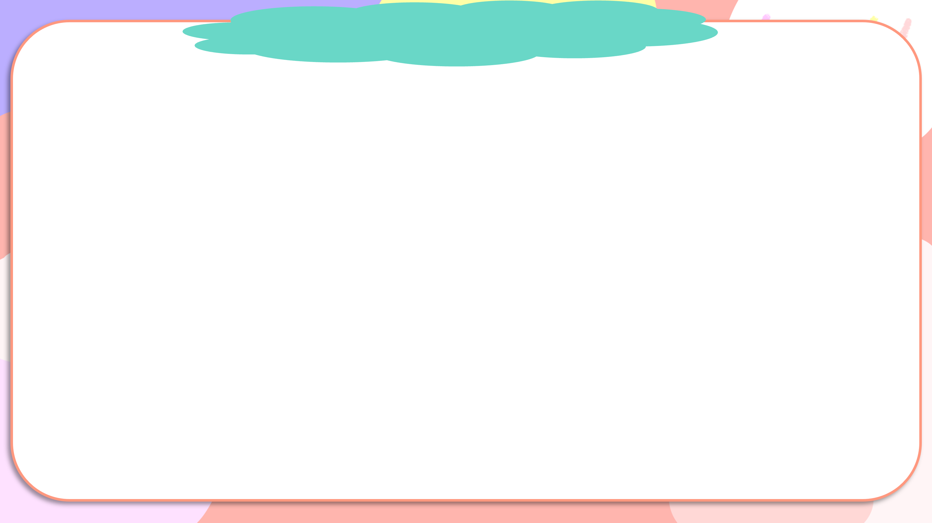
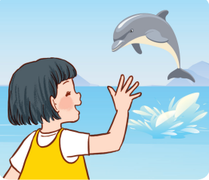
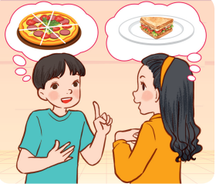
Read and complete.

Slide 17
Read and complete.
1.
A: Where were you yesterday?
B: I was at the zoo.
A: What’s your favourite animal?
B: It’s _________.
A: _____ do you like it?
B: Because it jumps and dances beautifully.
a dolphin
Why

Slide 18
Read and complete.
2.
pizza
A: My favourite food is ______.
Do you like pizza, too?
B: No, I _____.
A: What’s your favourite food?
B: It’s ___________.
A: A sandwich?
B: Yes. I love sandwiches.
don’t
a sandwich

Slide 19
Read and complete.
1.
A: Where were you yesterday?
B: I was at the zoo.
A: What’s your favourite animal?
B: It’s ________.
A: _____ do you like it?
B: Because it jumps and dances beautifully.
a dolphin
Why
2.
pizza
A: My favourite food is ______.
Do you like pizza, too?
B: No, I ______.
A: What’s your favourite food?
B: It’s ___________.
A: A sandwich?
B: Yes. I love sandwiches.
don’t
a sandwich

Slide 20
04
Let’s play.

Slide 21
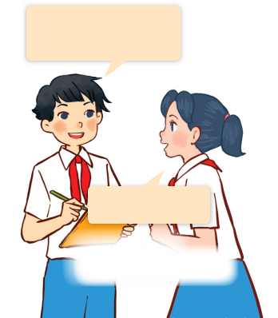
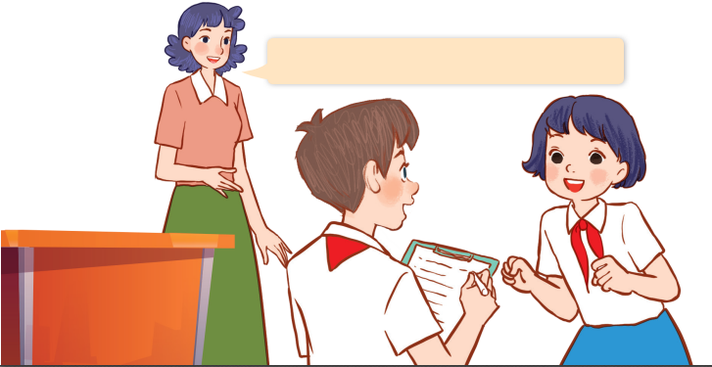
Let’s play.
Find someone who …
What’s your favourite animal?
Find someone who likes dolphins.
It’s a dolphin.

