Slide 1




UBND QUẬN DƯƠNG KINH
TRƯỜNG TIỂU HỌC ANH DŨNG
ENGLISH - GRADE 5
UNIT 2: OUR HOME
LESSON 1 (4, 5, 6)

Slide 2









Our home
Lesson 1 - Period 2

Slide 3







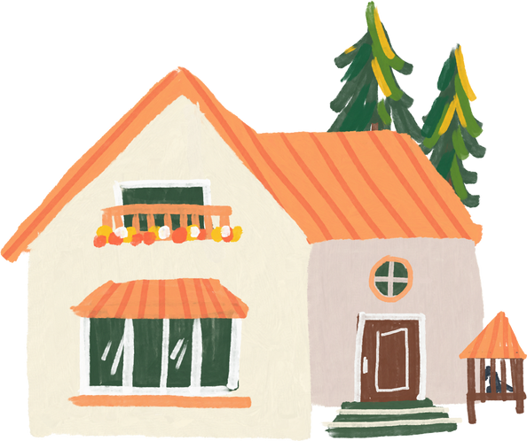
01
Warm-up and review

Slide 4
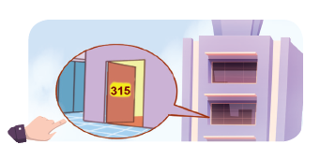
What's the missing letter?
FL__T
A
A
O
I
A
B
C

Slide 5
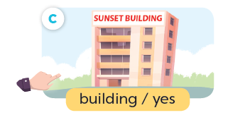
What's the missing letter?
BU__LDING
I
Y
E
I
A
B
C

Slide 6

What's the missing letter?
TO__ER
W
R
W
U
A
B
C

Slide 7

What's the missing letter?
HO__SE
U
U
O
W
A
B
C

Slide 8
Do you live in _____ tower?
that
that
this
A
B

Slide 9
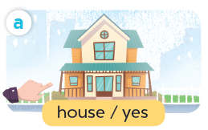
Do you live in _____ house?
this
that
this
A
B

Slide 10



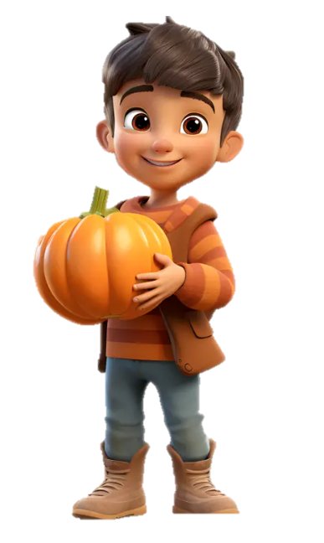
Do you live in this house?
___, I do.
Yes
Yes
No
A
B

Slide 11




Do you live in
that building?
Yes
No
___, I don’t.
No
A
B

Slide 12
02
Listen and number.

Slide 13
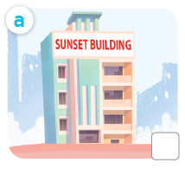
What is it?
building

Slide 14
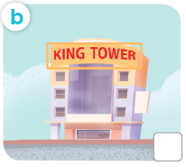
What is it?
tower

Slide 15

What is it?
house

Slide 16
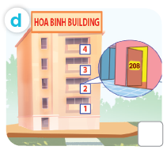
What is it?
flat

Slide 17

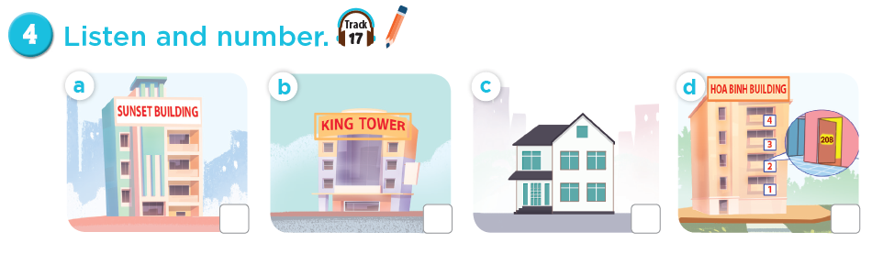
Listen and number.
4
3
1
2

Slide 18
03
Read and complete.

Slide 19


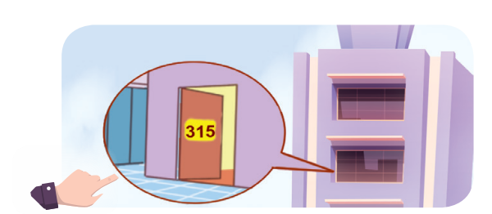


Slide 20

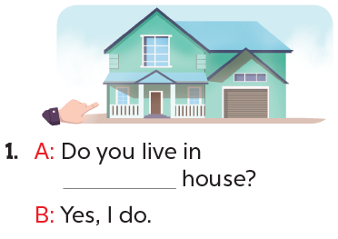
this

Slide 21
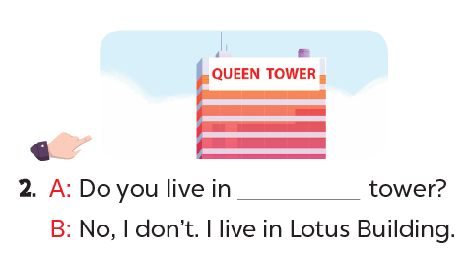
that

Slide 22
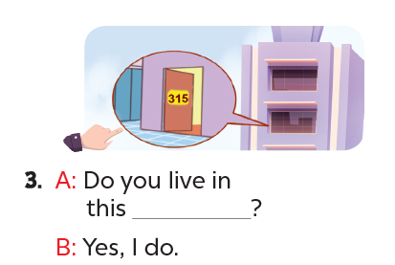
flat

Slide 23
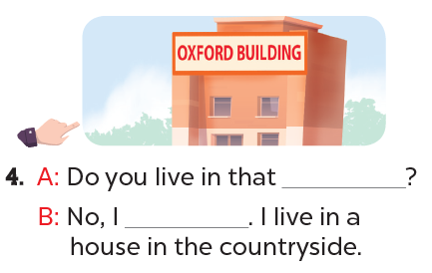
building
don’t

Slide 24
04
Let's play.

Slide 25
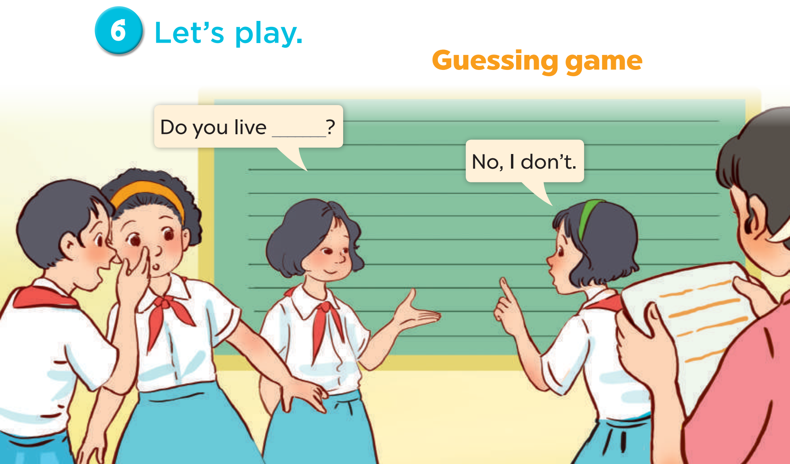
Notes:
Follow instructions in the lesson plan.

Slide 26
05
Fun corner and wrap-up

Slide 27

Zootopia

Slide 28




Explore Zootopia
and
catch the criminals!

Slide 29




WANTED
B
e
l
l
w
e
t
h
e
r
s
n
E
p
r
i
s
c
a
e
d
p
o
By the ZPD

Slide 30

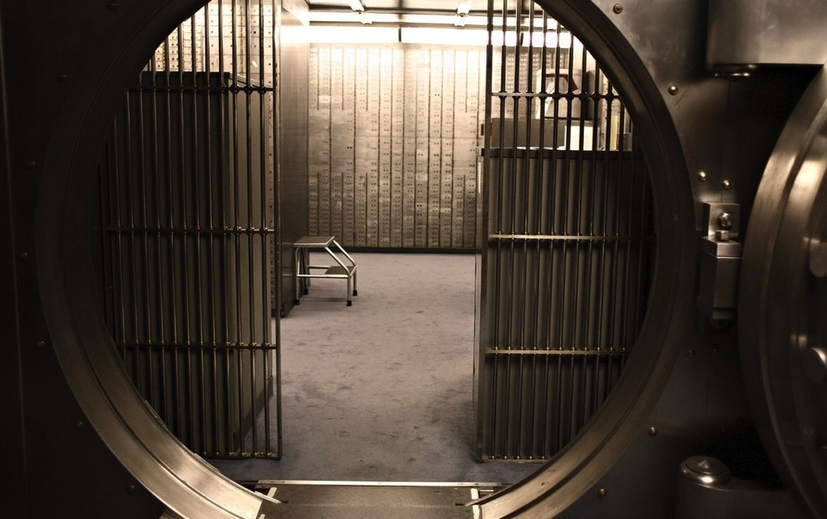



WANTED
F
i
n
n
i
c
k
o
b
a
a
R
b
e
d
b
n
k
By the ZPD

Slide 31

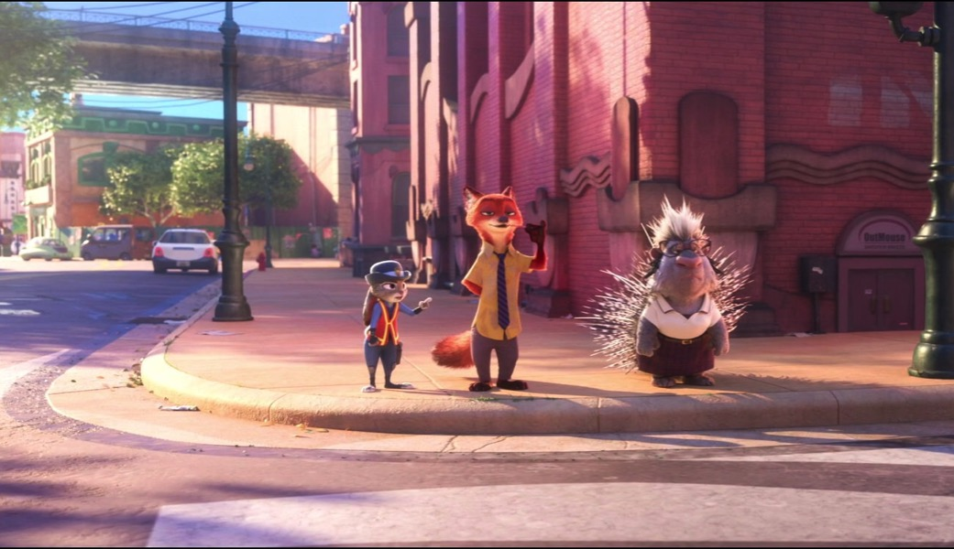
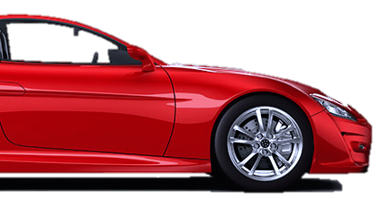

WANTED
F
l
a
s
h
l
t
o
e
r
S
a
c
a
By the ZPD

Slide 32




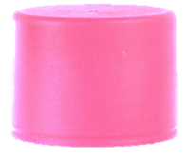


Minus points
+1
+5
Swap points
Steal

Slide 33





Let’s go!

Slide 34
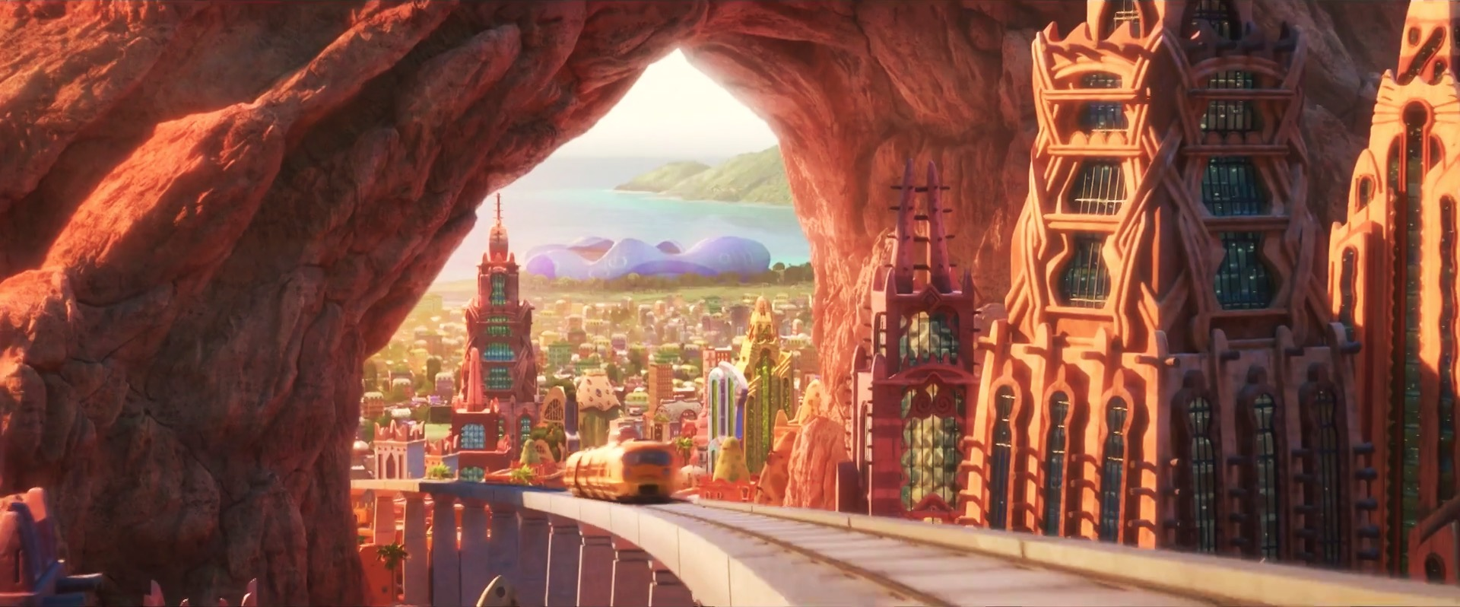


2
4
1
3
5
7
6
8
Notes:
CLICK THE ARROW IN THE BOTTOM RIGHT CORNER TO GO TO THE ENDING SLIDE

Slide 35




Do you live in this tower?
Queen Tower
No, I don’t.

Slide 36



+3
+3
Notes:
Click Judy to go to the home page

Slide 37
live / Do / this / you / builing / in / ?
Do you live in this building?

Slide 38

Choose!
Choose!
Left
Right

Slide 39

Rock paper scissors ...
Rock paper scissors...
Winner steal
Winner steal
2
2
Notes:
Click Judy to go to the home page

Slide 40
Trade
Swap points
Notes:
Click Judy to go to the home page

Slide 41


Queen Building
Yes, I do.
Do you live in this building?

Slide 42

+2
+2
Notes:
Click Judy to go to the home page

Slide 43
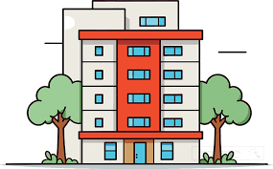
I live in that ____.
house
flat
building

Slide 44

+4
+1
Notes:
Click Judy to go to the home page

Slide 45
Do you live in that ________?
house

Slide 46
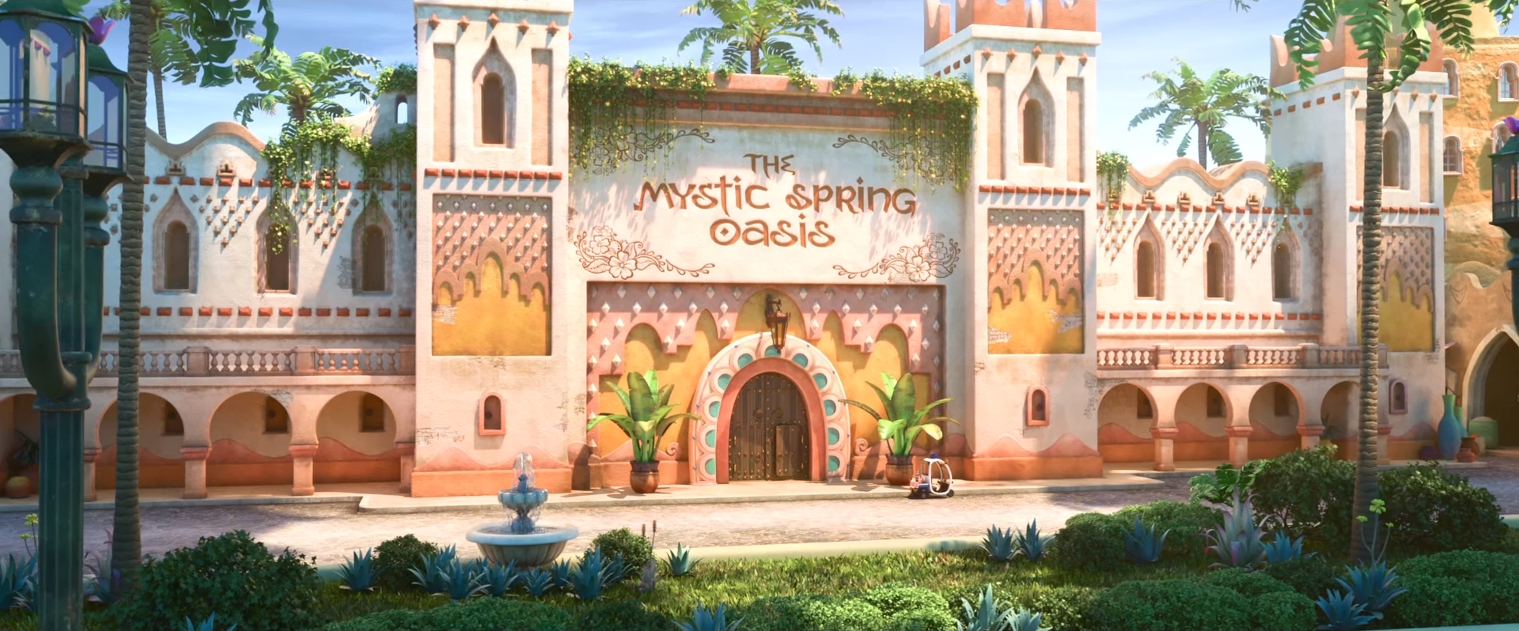
Go inside?
Go inside?
Yes
No

Slide 47
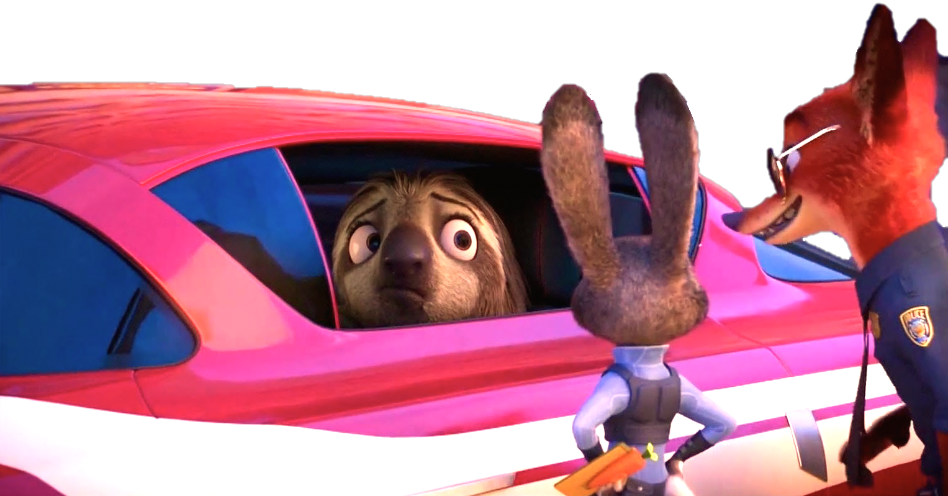
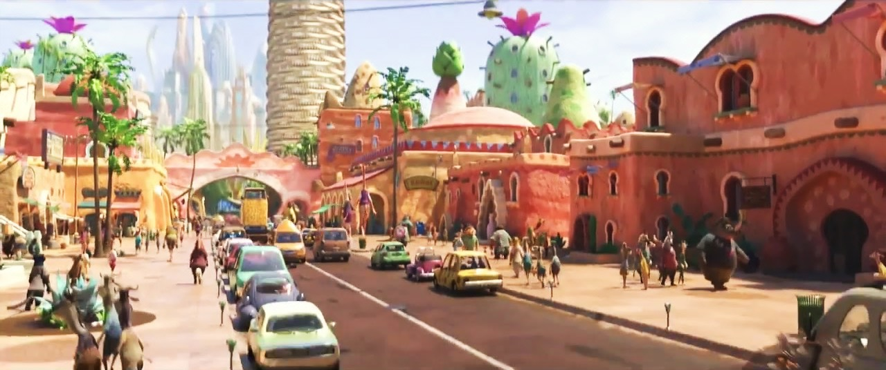
It’s
Flash!
It’s
Flash!

Slide 48




WANTED
+10
+15
By the ZPD
Flash
Notes:
Click Nick & Judy to go to the home page

Slide 49



Do you live in this flat?
No, I don’t.

Slide 50

+5
+5
Notes:
Click Judy to go to the home page

Slide 51
Yes, I do.
Do you live in that flat?

Slide 52
+6
Steal 4
Notes:
Click Judy to go to the home page

Slide 53

Complete:
you / live / this / tower?
Do you live in this tower?

Slide 54



Choose!
Choose!

Slide 55





-5
-3
Notes:
Click Judy to go to the home page

Slide 56
+10
+10
Notes:
Click Judy to go to the home page

Slide 57

-5
-5
Notes:
Click Nick to go to the home page

Slide 58
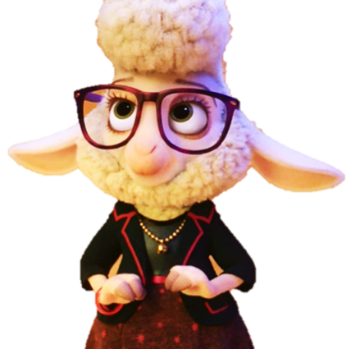





WANTED
WANTED
WANTED
WANTED
WANTED
By the ZPD
WANTED
By the ZPD
By the ZPD
By the ZPD
By the ZPD
By the ZPD
Bellwether
Bellwether
Flash
Flash
Finnick
Finnick

Slide 59

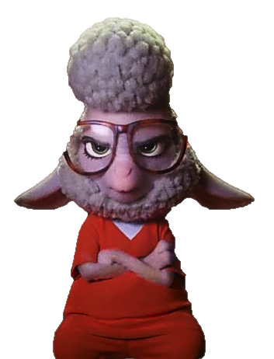







Good job!
Bellwether
Flash
Finnick

