Slide 1




UBND QUẬN DƯƠNG KINH
TRƯỜNG TIỂU HỌC ANH DŨNG
ENGLISH - GRADE 5
UNIT 1: ALL ABOUT ME
- LESSON 3 (1, 2, 3)

Slide 2

Unit 1. All about me!
Lesson 3 - Period 5

Slide 3


01
Warm-up and review

Slide 4
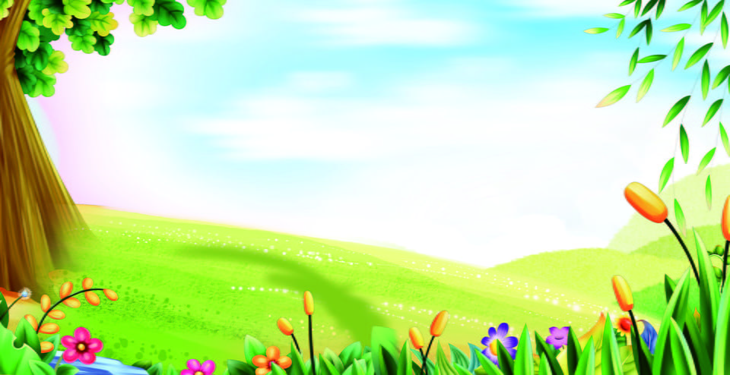
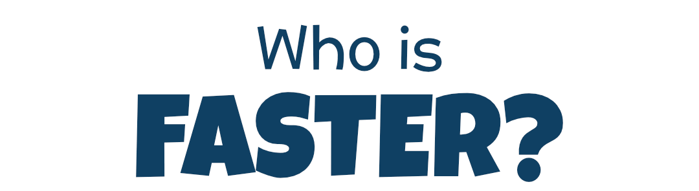
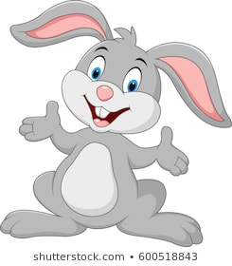
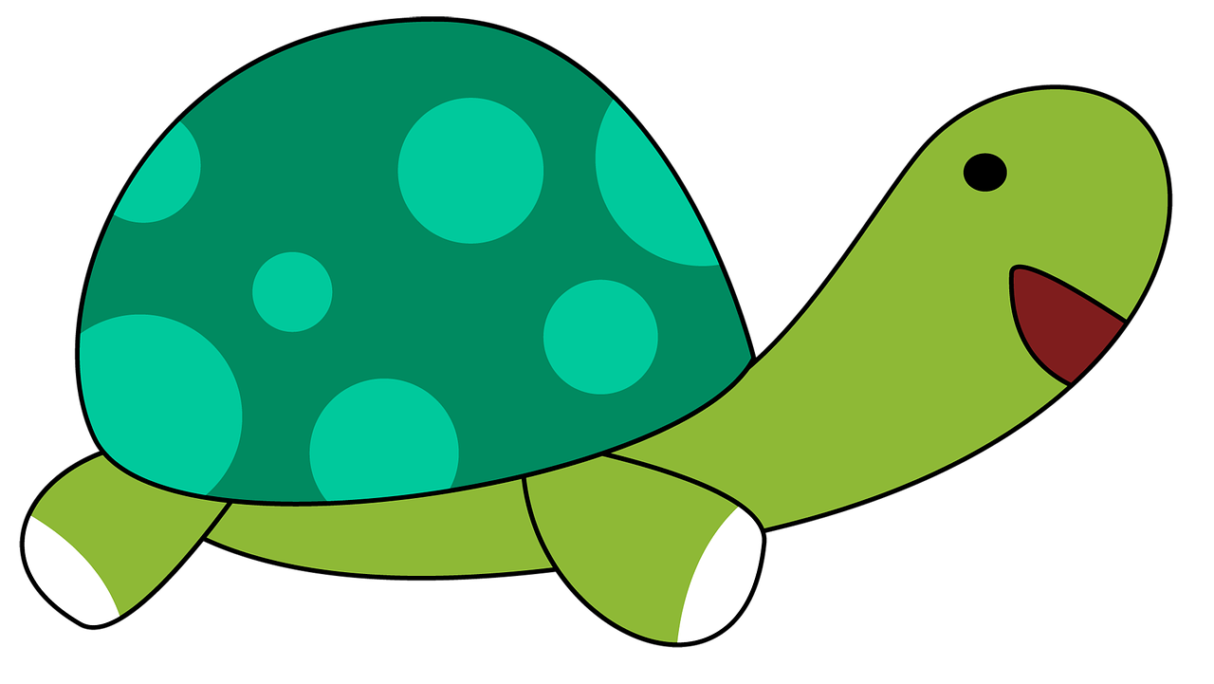
Team Turtle
Team Rabbit

Slide 5
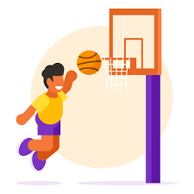
Choose the correct answer a,b or c.
A: What’s your favourite _______?
B: It’s basketball.
a
b
c
food
animal
sport

Slide 6
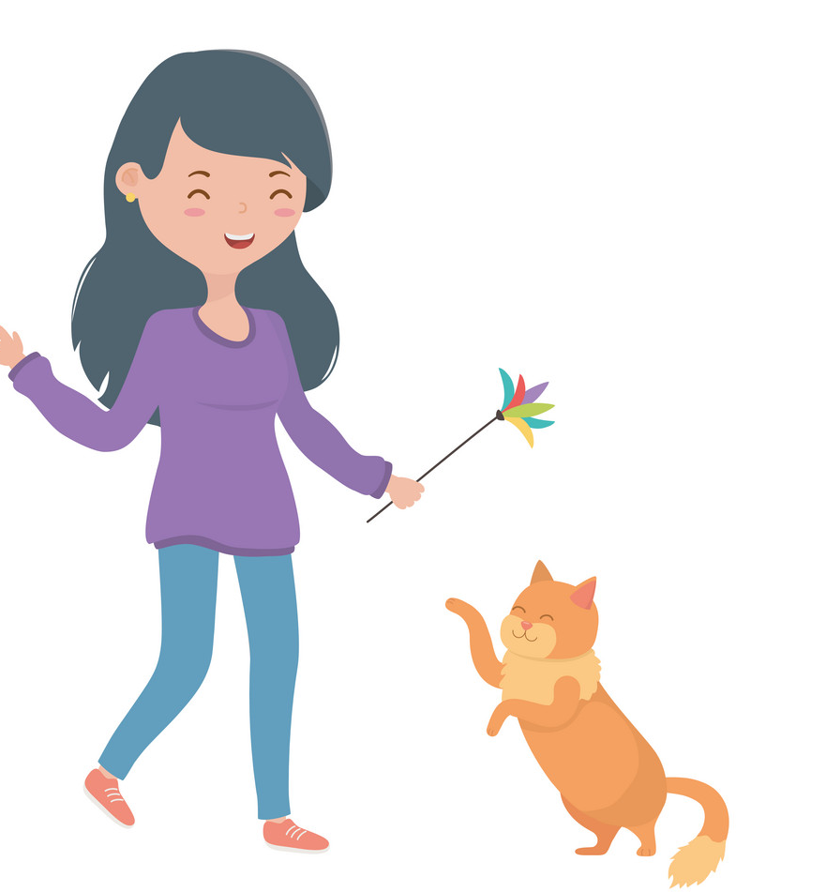
Choose the correct answer a,b or c.
A: What’s your favourite animal?
B: It’s _____.
a
b
c
cat
a cat
a dog

Slide 7

Choose the correct answer a,b or c.
A: What’s your favourite colour?
B: ___ red.
a
b
c
It
A
It’s

Slide 8
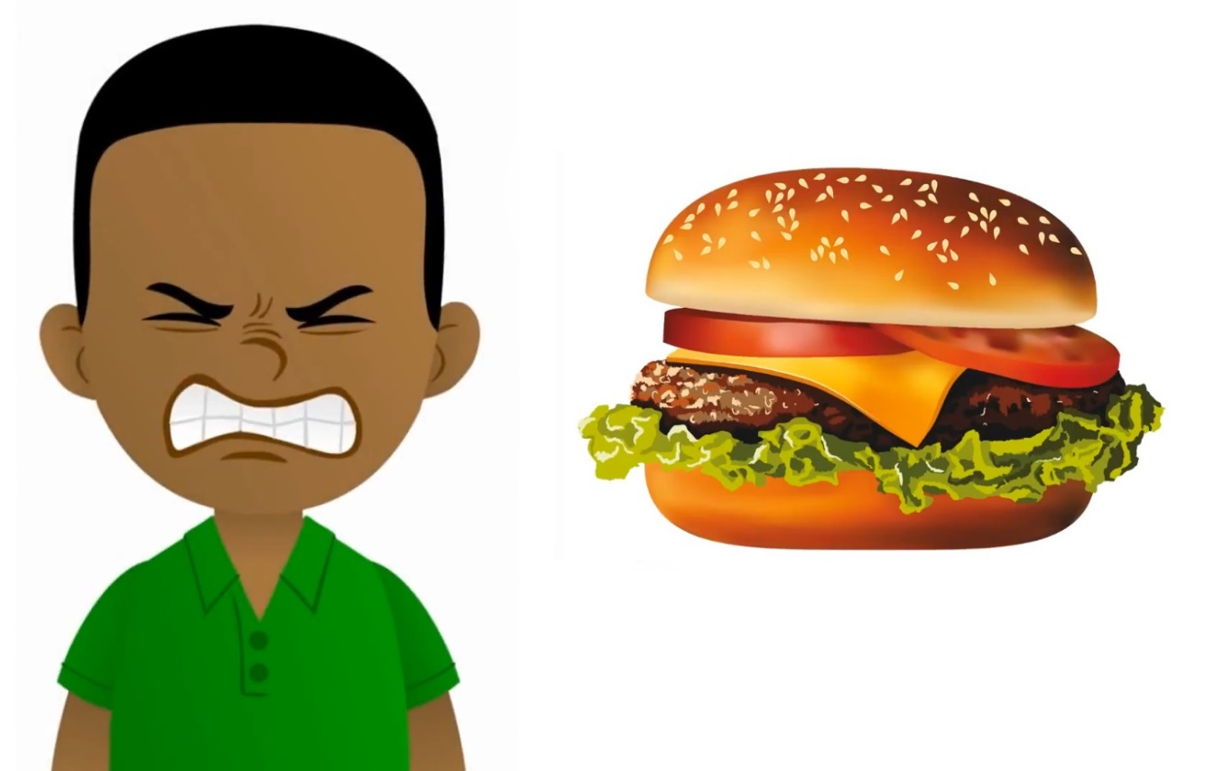
Choose the correct answer a,b or c.
A: My favourite food is hamburger.
Do you like hamburger, too?
B: No, I ____.
a
b
c
don’t
do
am

Slide 9

Summary
Notes:
GV nháy vào biểu tượng của đội chơi để tính điểm cho các đội. Mỗi lần nháy 1 ngôi sao xuất hiện.

Slide 10
02
Listen and repeat.

Slide 11

Listen and repeat.
'
I like dolphins.
dolphin
'

Slide 12
Listen and repeat.
'
'
tennis
He plays tennis on Sundays.

Slide 13
Listen and repeat.
'
'
dolphin
I like dolphins.
'
'
tennis
He plays tennis on Sundays.

Slide 14
03
Circle, listen and check.

Slide 15
Circle, listen and check.
1.
a. dolphin
b. giraffe
c. behind
2.
a. Japan
b. July
c. England
3.
a. tennis
b. hello
c. goodbye

Slide 16
Circle, listen and check.
1.
a. dolphin
b. giraffe
c. behind

Slide 17
Circle, listen and check.
2.
a. Japan
b. July
c. England

Slide 18
Circle, listen and check.
3.
a. tennis
b. hello
c. goodbye

Slide 19
Circle, listen and check.
1.
a. dolphin
b. giraffe
c. behind
2.
a. Japan
b. July
c. England
3.
a. tennis
b. hello
c. goodbye

Slide 20
04
Let’s chant.

Slide 21
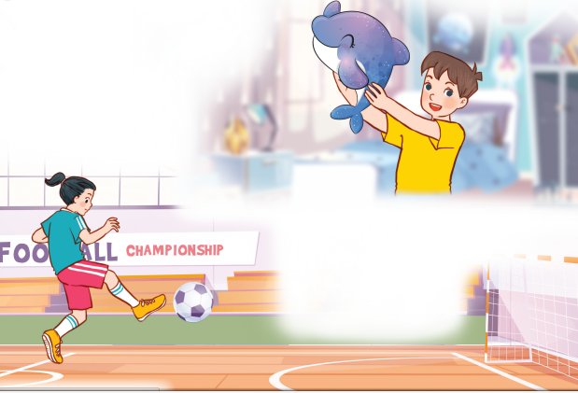
Let’s chant.
What’s your favourite animal?
Do you like pandas?
No, I don’t.
I don’t like pandas.
I like dolphins.
What’s your favourite sport?
Do you like tennis?
No, I don’t.
I don’t like tennis.
I like football.

Slide 22

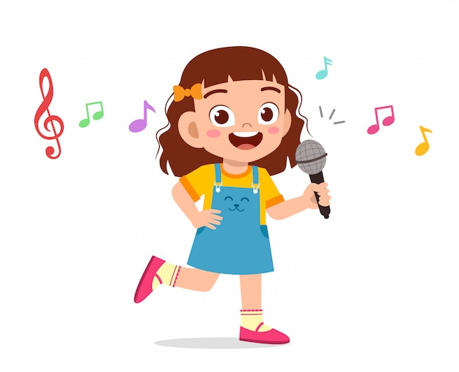
Let’s chant.
What’s your favourite animal?
Do you like pandas?
No, I don’t.
I don’t like pandas.
I like dolphins.
What’s your favourite sport?
Do you like tennis?
No, I don’t.
I don’t like tennis.
I like football.

Slide 23
05
Fun corner and wrap-up

Slide 24

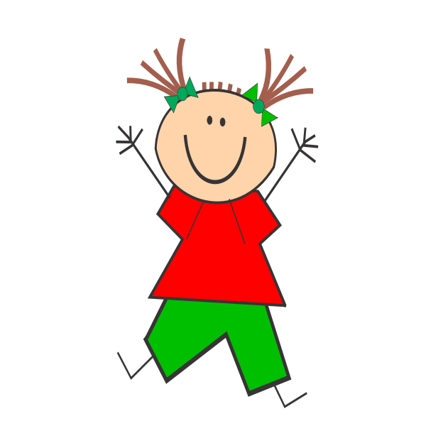
Jumping Games

Slide 25
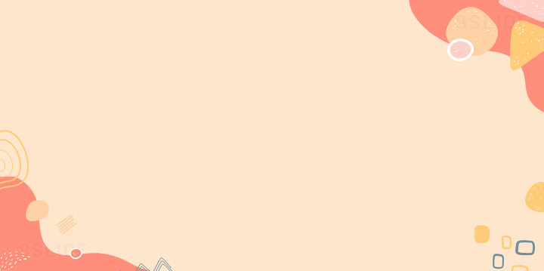
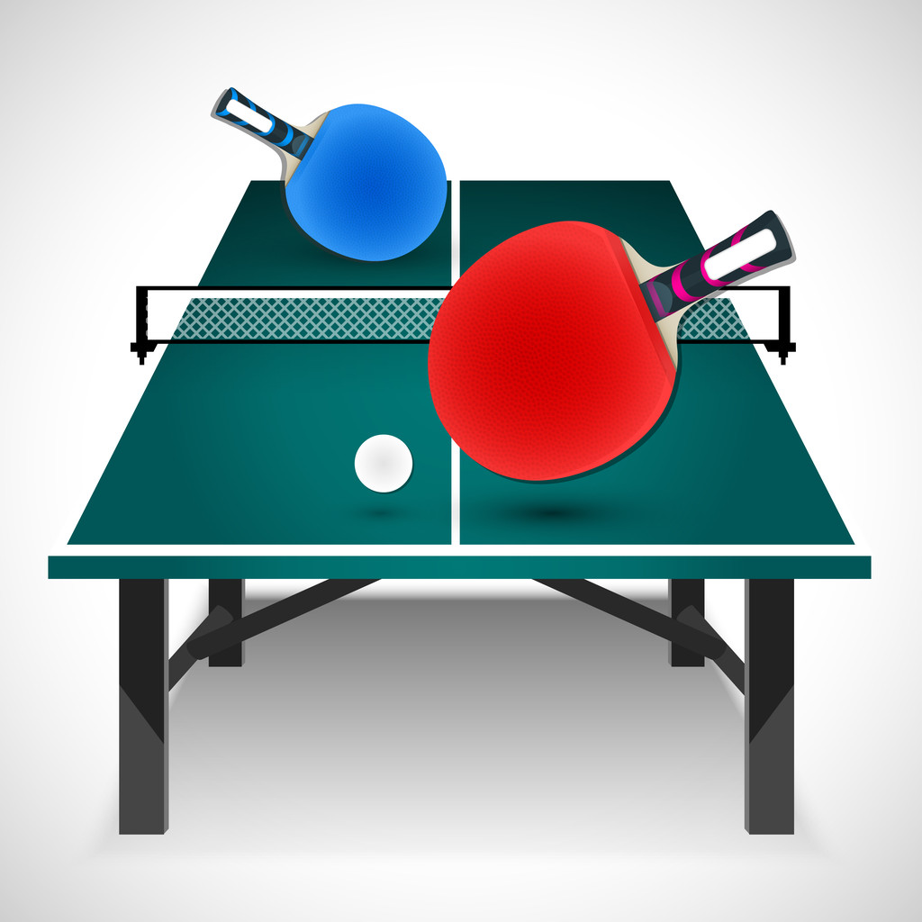
table tennis

Slide 26
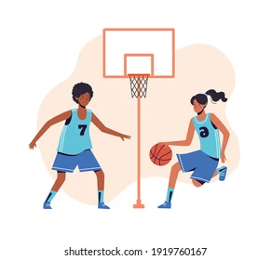
football

Slide 27

Japan

Slide 28
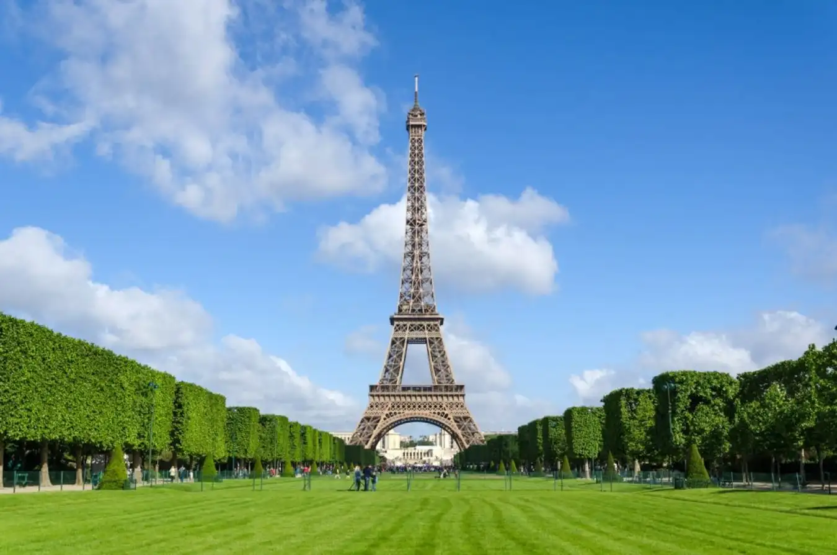
England

Slide 29
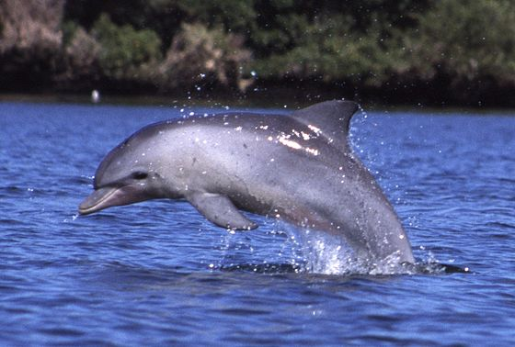
dolphin

Slide 30
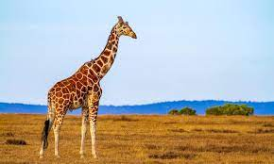
giraffe

