Slide 1




UBND QUẬN DƯƠNG KINH
TRƯỜNG TIỂU HỌC ANH DŨNG
ENGLISH - GRADE 5
UNIT 2: OUR HOME
LESSON 2 (4, 5, 6)

Slide 2









Our Home
Lesson 2 - Period 4

Slide 3



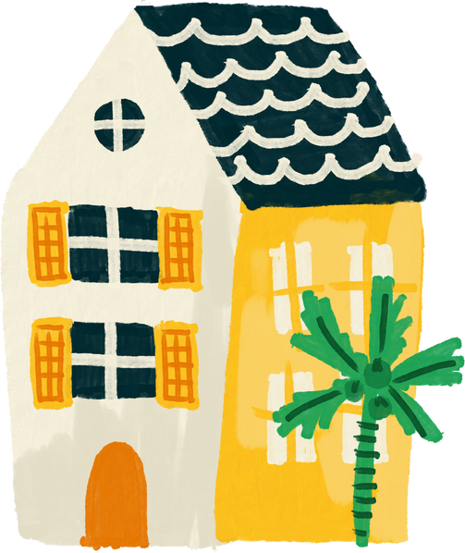


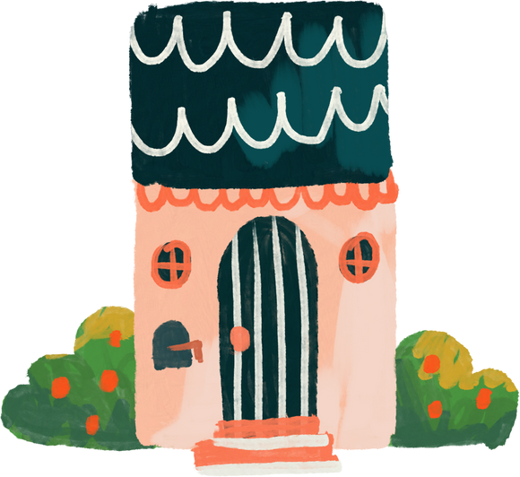
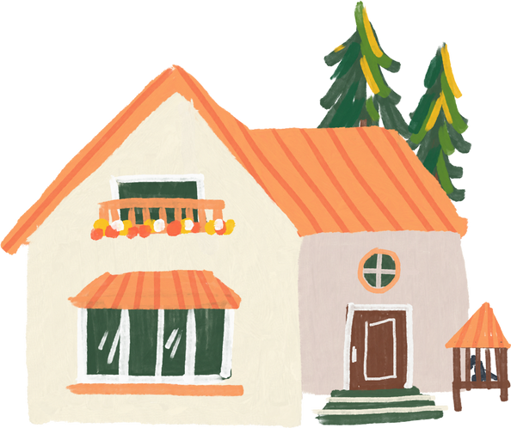
01
Warm-up and review

Slide 4


55
49
45

Slide 5
17
79
97

Slide 6
135
153
159

Slide 7
19
98
89

Slide 8
376
267
276

Slide 9
77
17
70

Slide 10
55
59
45

Slide 11
02
Listen and circle.

Slide 12
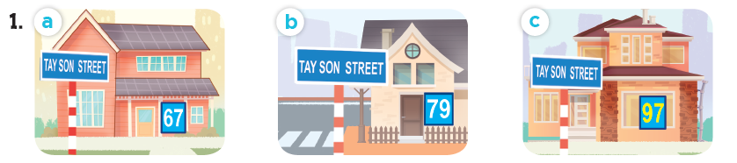
Look and say the number.
sixty-seven
seventy-nine
ninety-seven

Slide 13
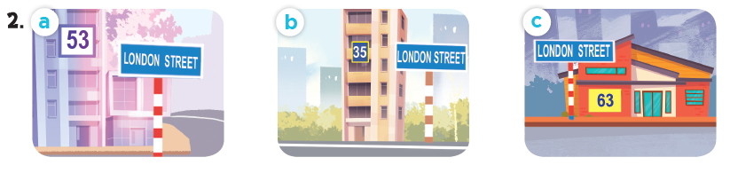
Look and say the number.
fifty-three
thirty-five
sixty-three

Slide 14
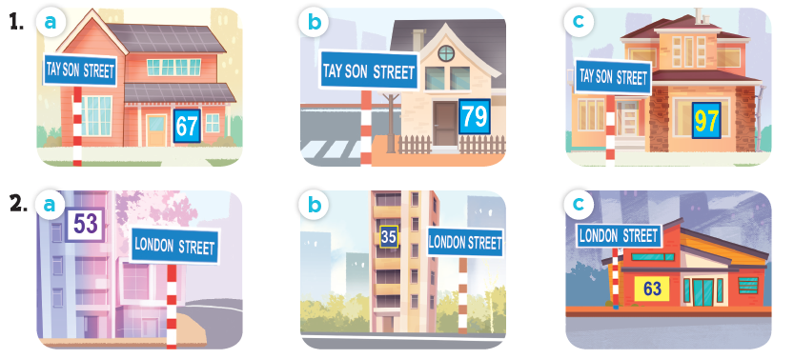
Listen and circle.

Slide 15
03
Read and complete.

Slide 16
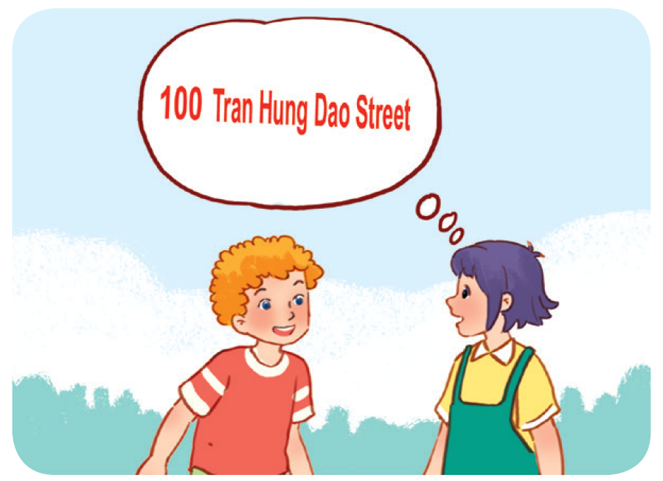
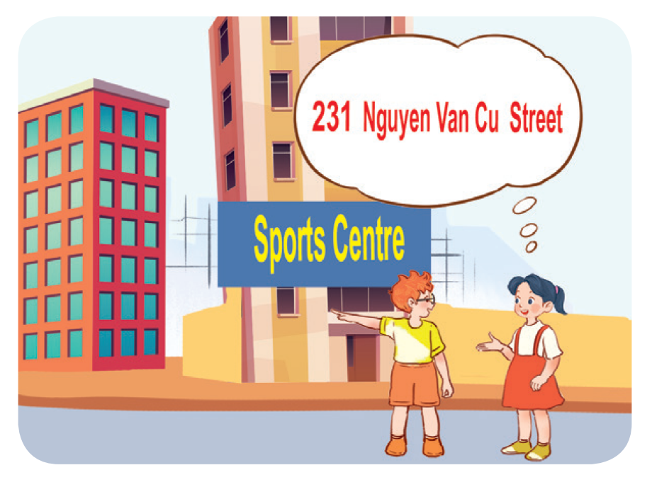
Work in pairs. Read and complete.
1. A: What’s your address?
B: It’s ________________.
A: Is it far ________________ here?
B: Yes, it is. It’s about ten kilometres from here.
2. A: I live in ________________ building over there.
B: Oh, it’s near the sports centre.
A: ________________ do you live?
B: I live far from here, in District 5.
A: ________________ your address?
B: It’s ________________.

Slide 17
Work in pairs. Read and complete.
1. A: What’s your address?
B: It’s ________________________.
A: Is it far ______ here?
B: Yes, it is. It’s about ten kilometres from here.
100 Tran Hung Dao Street
from

Slide 18
Work in pairs. Read and complete.
2. A: I live in ______________ building over there.
B: Oh, it’s near the sports centre.
A: _________ do you live?
B: I live far from here, in District 5.
A: ________ your address?
B: It’s _________________________.
that
Where
What’s
231 Nguyen Van Cu Street

Slide 19
04
Listen, complete and sing.

Slide 20

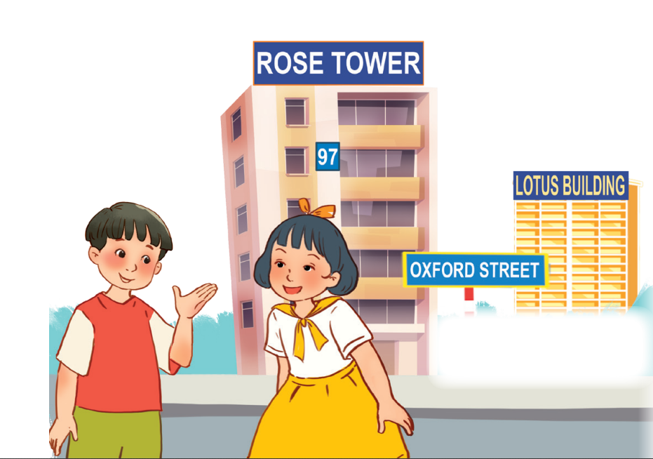
Let’s sing.
Look and read.
Listen and complete.
building
Do you live in that (1) _______?
No, I don’t.
Do you live in this (2) ______?
Yes, I do.
What’s your address?
It’s (3) _____ Oxford Street.
tower
19

Slide 21
05
Fun corner and wrap-up

Slide 22

Where do I live?

Slide 23













boys
girls
Notes:
Teacher can insert a picture of her/ his address behind the puzzles. After the game, students know teacher’s address.

Slide 24


______ is your address?
What
It’s 23 London Street.

Slide 25




Slide 26
I live in Sports Centre Building.
Where
______ do you live?

Slide 28

It’s 126 Tran Phu Street.
What is your _______?
address

Slide 30
No, it isn’t.
Is it far _____ here?
from

Slide 32
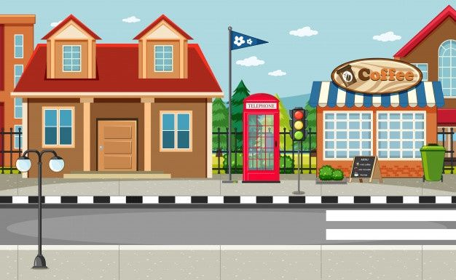

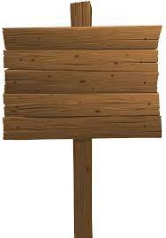
What’s your address?
32
Oxford
It’s _________________.
32 Oxford Street

Slide 34
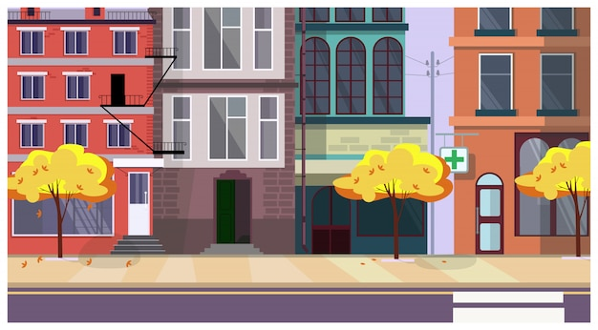
London
I live on London _______.
Street

