Slide 1




UBND QUẬN DƯƠNG KINH
TRƯỜNG TIỂU HỌC ANH DŨNG
ENGLISH - GRADE 5
UNIT 2: OUR HOME
LESSON 3 (1, 2, 3)

Slide 2









Our Home
Lesson 3 - Period 5

Slide 3

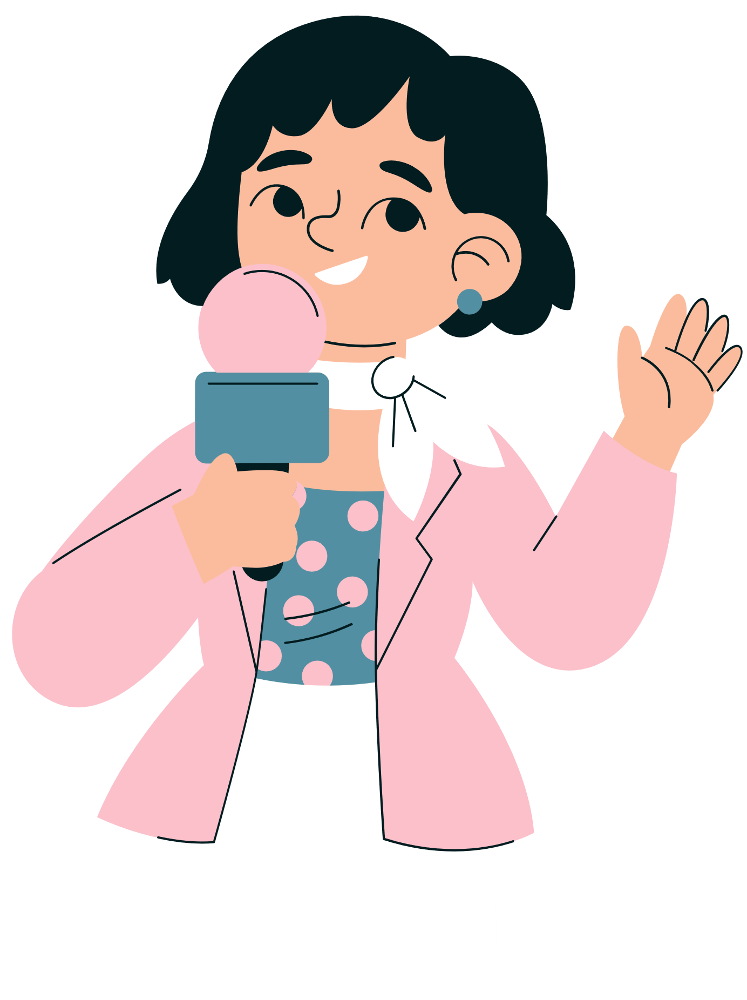



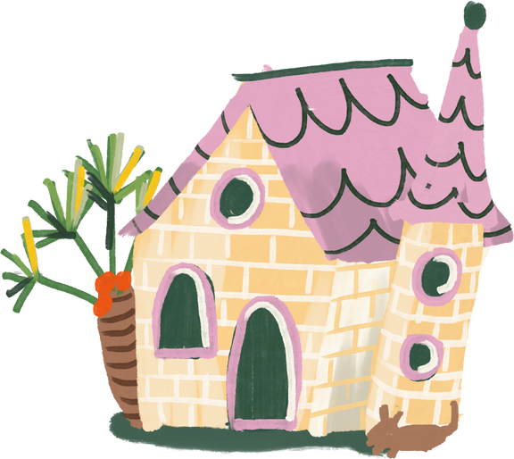
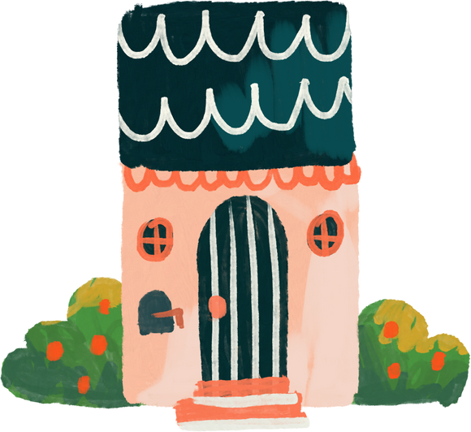
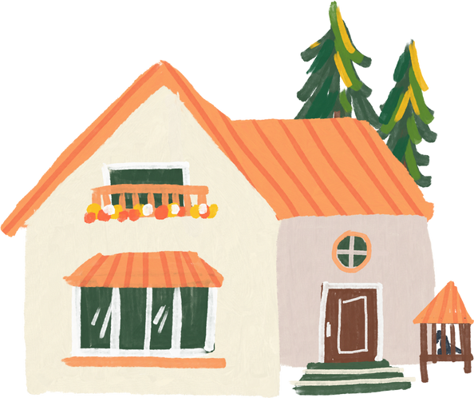
01
Warm-up and review
Notes:
- Sing "Big Number" Song
- Play Matching Game

Slide 4
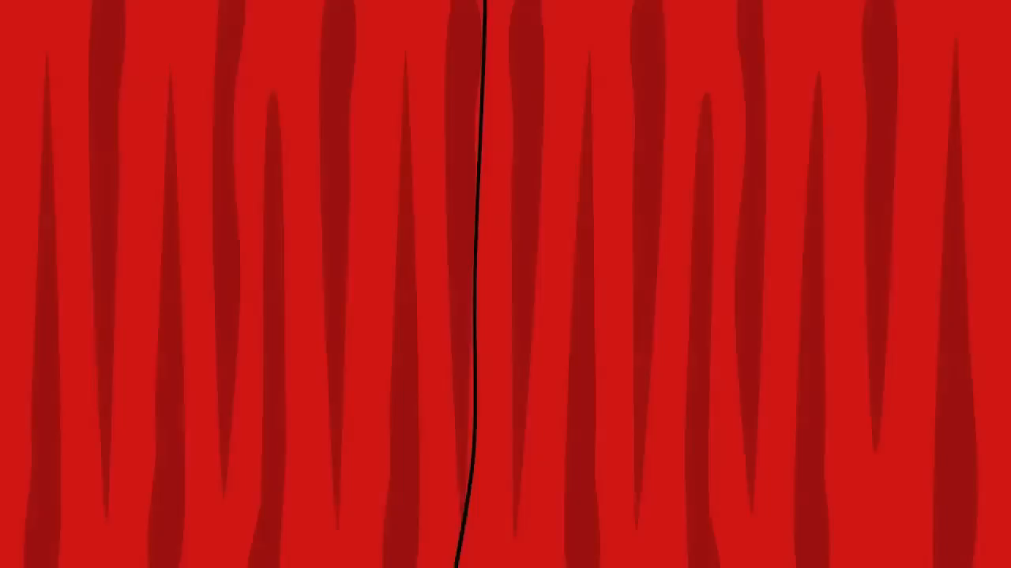
Notes:
Link: https://youtu.be/bGetqbqDVaA?si=1tjRIzMLx0WwKR6e

Slide 5
1
2
3
eighteen
eighty
fourteen
4
5
6
14
13
fifty
7
8
9
60
18
sixty
10
11
12
80
thirteen
50

Slide 6
02
Listen and repeat.

Slide 7


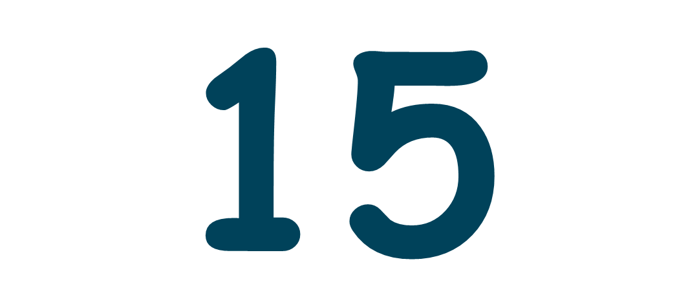
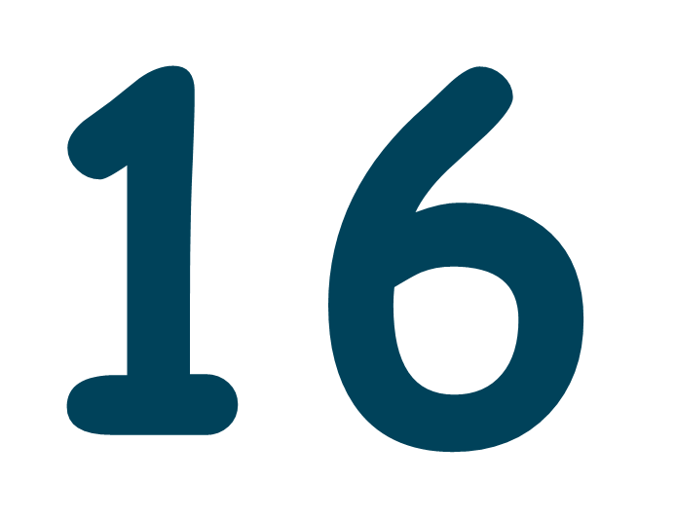
Listen and repeat.
fifteen
sixteen

Slide 8
Which part is stressed?
fif'teen
six'teen
fifteen
sixteen

Slide 9
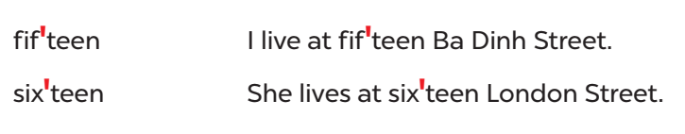
Listen and repeat.
Practice in pairs.

Slide 10
03
Circle, listen and check.

Slide 11
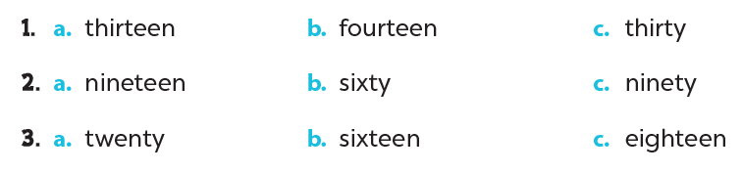
Odd one out. Circle.

Slide 12
Listen and check.

Slide 13
Word stress
13 thir'teen
14 four'teen
15 fif'teen
16 six'teen
17 seven'teen
18 eigh'teen
19 nine'teen
30 'thirty
40 'forty
50 'fifty
60 'sixty
70 'seventy
80 'eighty
90 'ninety

Slide 14
04
Let's chant.

Slide 15
