Slide 1




UBND QUẬN DƯƠNG KINH
TRƯỜNG TIỂU HỌC ANH DŨNG
ENGLISH - GRADE 5
UNIT 2: OUR HOME
LESSON 3 (4, 5, 6)

Slide 2









Our Home
Lesson 3 - Period 6

Slide 3






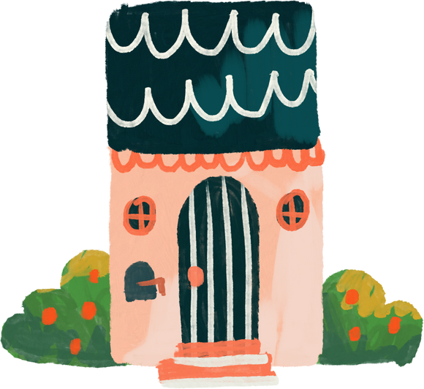

01
Warm-up and review

Slide 4

Who’s faster?

Slide 5

house

Slide 6

flat

Slide 7

tower

Slide 8

building

Slide 9
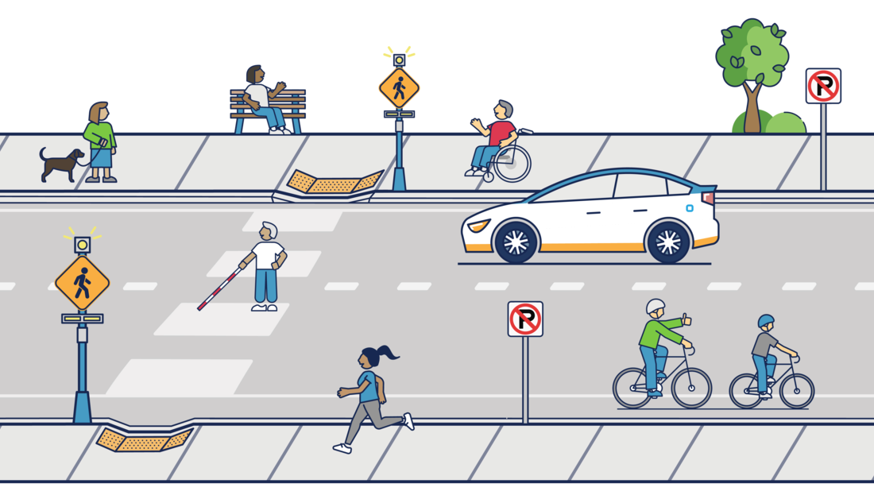
street

Slide 10
02
Read and tick True or False.

Slide 11
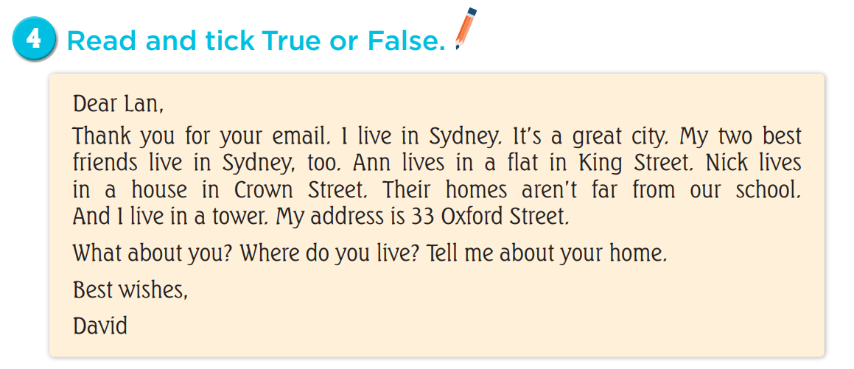

Slide 12
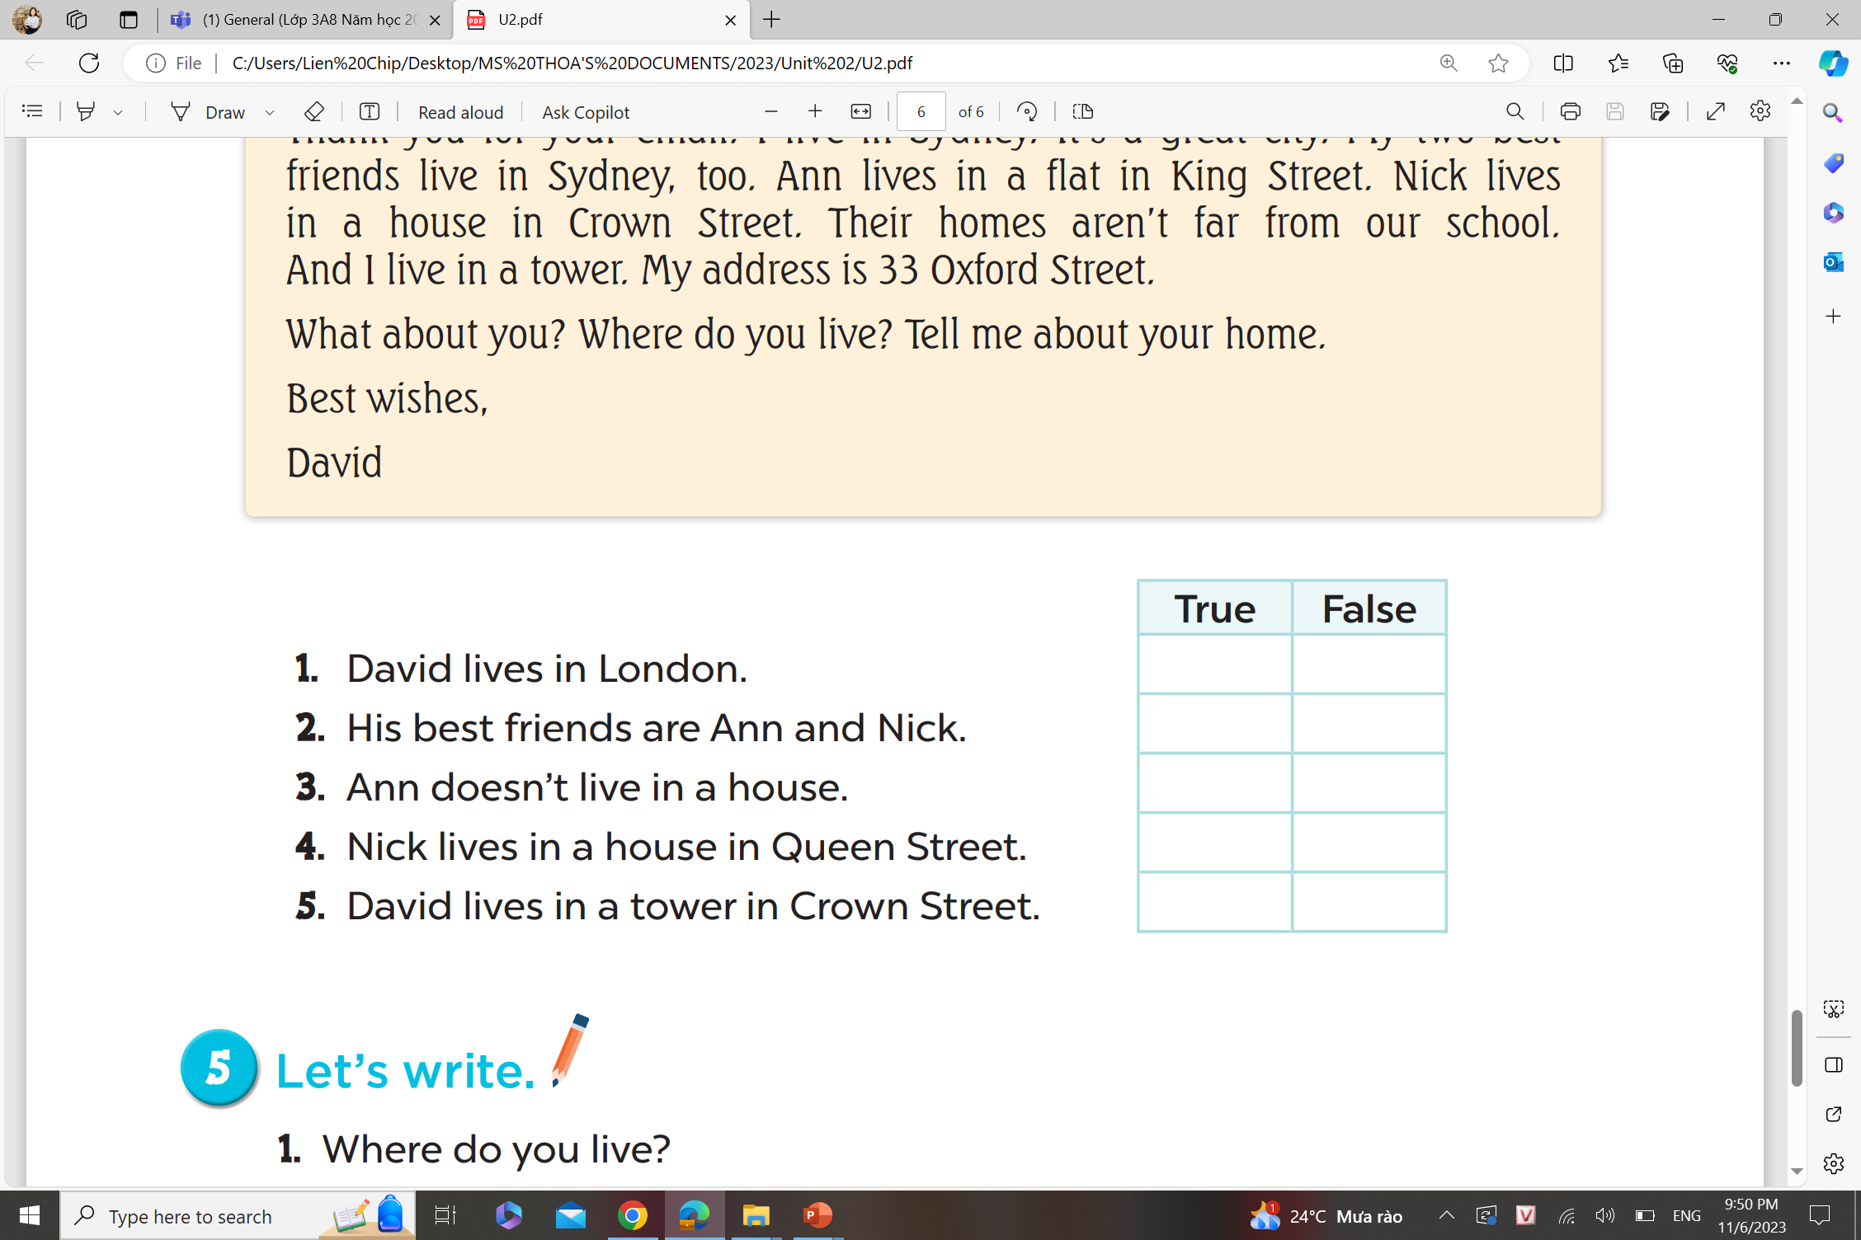


Slide 17
03
Let’s write.

Slide 18
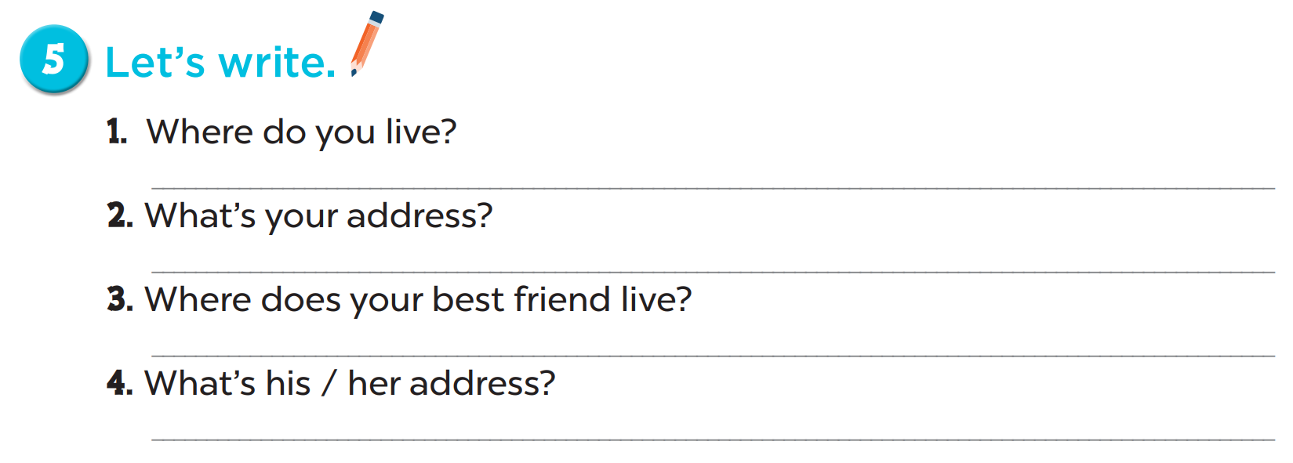

Slide 19
1. Where do you live?
2. What’s your address?
3. Where does your best friend live?
4. What’s his / her address?
I live in …
My address is …
He / She lives in …
Her / His address is …

Slide 20
04
Project

Slide 21
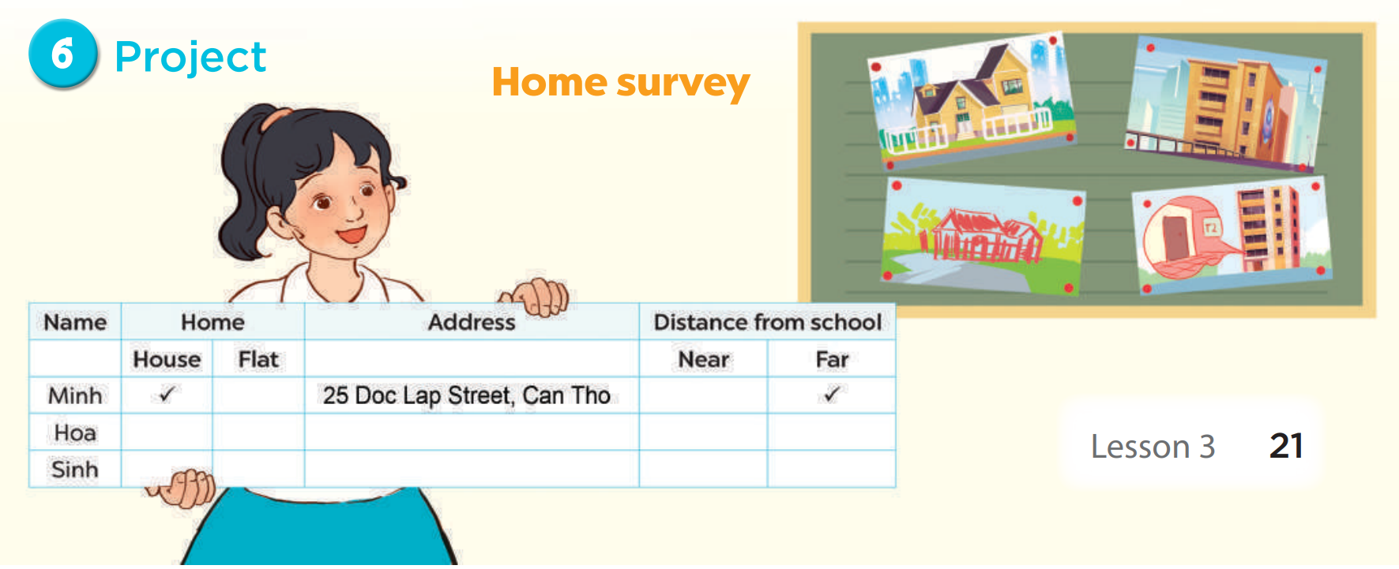

Slide 22
05
Fun corner and wrap-up

Slide 23

mystery box

Slide 24

Choose to keep the box
or give it to another team!

Slide 25











Slide 26



Do you live in that building?
Yes, I do.
Notes:
Press the spacebar or down arrow to reveal the answer.
Press the X to go back to the letter slide (wrong answer), press the question box to go the reward slide (correct answer).

Slide 27
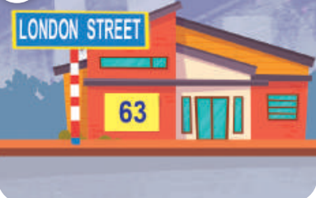
What is your address?
It’s 63 London Street.
Notes:
Press the spacebar or down arrow to reveal the answer.
Press the X to go back to the letter slide (wrong answer), press the question box to go the reward slide (correct answer).

Slide 28
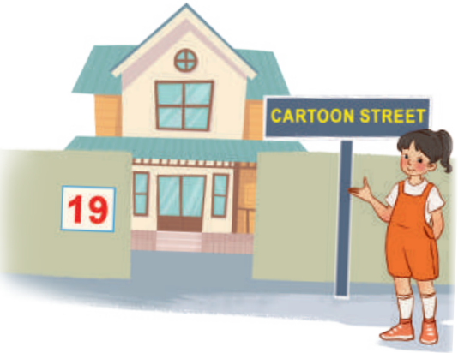
Where do you live?
I live at 19 Cartoon Street.
Notes:
Press the spacebar or down arrow to reveal the answer.
Press the X to go back to the letter slide (wrong answer), press the question box to go the reward slide (correct answer).

Slide 29
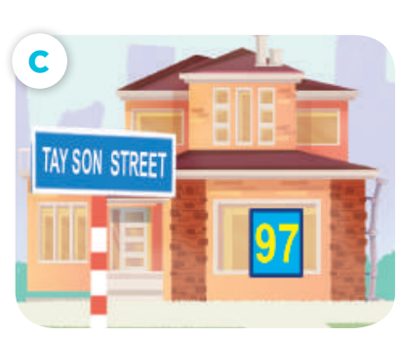
What is your address?
It’s 97 Tay Son Street.
Notes:
Press the spacebar or down arrow to reveal the answer.
Press the X to go back to the letter slide (wrong answer), press the question box to go the reward slide (correct answer).

Slide 30

Do you live in this house?
No, I don’t.
Notes:
Press the spacebar or down arrow to reveal the answer.
Press the X to go back to the letter slide (wrong answer), press the question box to go the reward slide (correct answer).

Slide 31

Where do you live?
I live at 15 Balloon Street.
Notes:
Press the spacebar or down arrow to reveal the answer.
Press the X to go back to the letter slide (wrong answer), press the question box to go the reward slide (correct answer).

Slide 32
Do you live in that tower?
No, I don’t.
Notes:
Press the spacebar or down arrow to reveal the answer.
Press the X to go back to the letter slide (wrong answer), press the question box to go the reward slide (correct answer).

Slide 33

Where do you live?
I live at 16 Cartoon Street.
Notes:
Press the spacebar or down arrow to reveal the answer.
Press the X to go back to the letter slide (wrong answer), press the question box to go the reward slide (correct answer).

Slide 34


Keep or give the mystery box?
+100
Notes:
Ask the student(s) if they want to keep the box or give it to another student/team.
Click the question block to reveal the reward/punishment.
Press the Mario icon in the corner to go back to the letter slide.

Slide 35
Keep or give the mystery box?
+200
Notes:
Ask the student(s) if they want to keep the box or give it to another student/team.
Click the question block to reveal the reward/punishment.
Press the Mario icon in the corner to go back to the letter slide.

Slide 36
Keep or give the mystery box?
+300
Notes:
Ask the student(s) if they want to keep the box or give it to another student/team.
Click the question block to reveal the reward/punishment.
Press the Mario icon in the corner to go back to the letter slide.

Slide 37
Keep or give the mystery box?
+400
Notes:
Ask the student(s) if they want to keep the box or give it to another student/team.
Click the question block to reveal the reward/punishment.
Press the Mario icon in the corner to go back to the letter slide.

Slide 38
Keep or give the mystery box?
+500
Notes:
Ask the student(s) if they want to keep the box or give it to another student/team.
Click the question block to reveal the reward/punishment.
Press the Mario icon in the corner to go back to the letter slide.

Slide 39
Keep or give the mystery box?
-100
Notes:
Ask the student(s) if they want to keep the box or give it to another student/team.
Click the question block to reveal the reward/punishment.
Press the Mario icon in the corner to go back to the letter slide.

Slide 40


Keep or give the mystery box?
Change points
Notes:
Ask the student(s) if they want to keep the box or give it to another student/team.
Click the question block to reveal the reward/punishment.
Press the Mario icon in the corner to go back to the letter slide.

Slide 41


Steal
200 pts!
Keep or give the mystery box?
Notes:
Ask the student(s) if they want to keep the box or give it to another student/team.
Click the question block to reveal the reward/punishment.
Press the Mario icon in the corner to go back to the letter slide.

