Slide 1




UBND QUẬN DƯƠNG KINH
TRƯỜNG TIỂU HỌC ANH DŨNG
ENGLISH - GRADE 5
UNIT 3: MY FOREIGN FRIENDS
LESSON 2 (4, 5, 6)

Slide 2





My foreign friends
Unit 3
Lesson 2 – Period 4

Slide 3


01
Warm-up and review

Slide 4


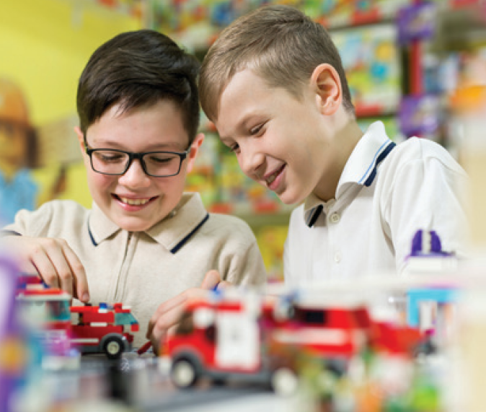
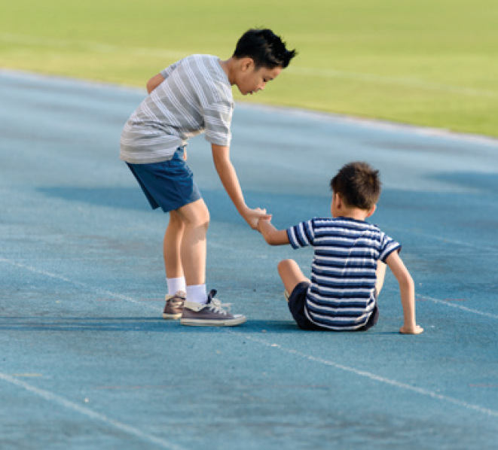

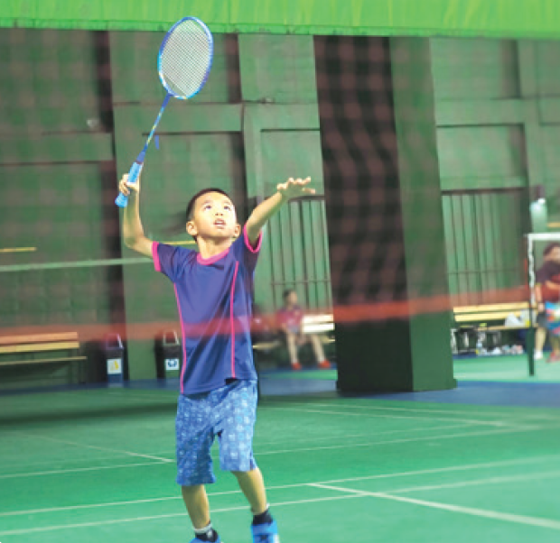


LISTEN AND CHECK.
2
1
4
3

Slide 5
03
Read and complete.

Slide 6

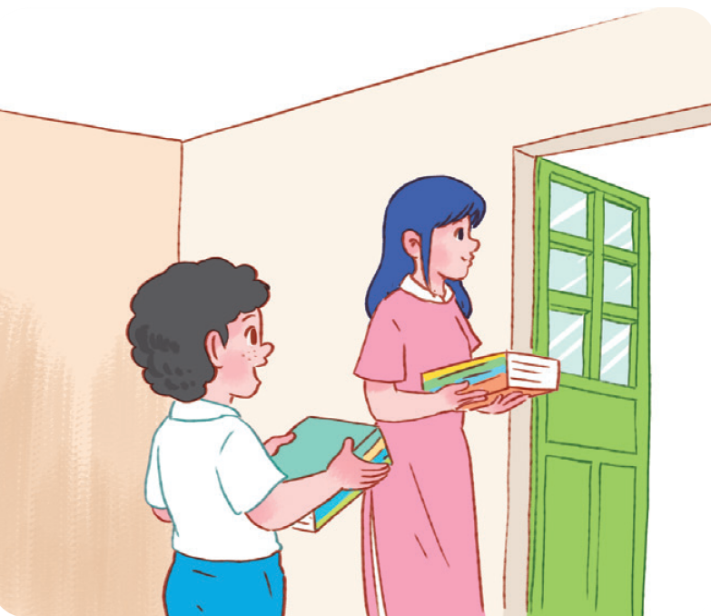




READ AND GUESS.
1. A: I have a new friend at school.
He’s Malaysian.
B: Really? I also have a friend from _____________. Is he from Kuala Lumpur?
A: Yes, he is.
B: What’s he like?
A: He’s _________. He likes helping others.
Malaysia
helpful

Slide 7

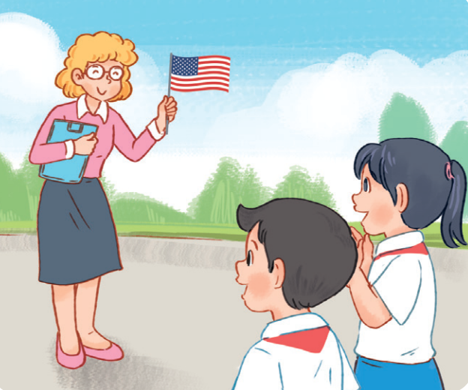


LET’S CHECK.
2. A: Do you have a new English teacher?
B: Yes, I do.
A: What nationality is she?
B: She’s ____________ .
A: What’s she _____?
B: She’s friendly.
American
like

Slide 8
04
Let’s play.

Slide 9


LOOK and WRITE.
active

Slide 10
LOOK and WRITE.
helpful

Slide 11
LOOK and WRITE.
clever

