Slide 1




UBND QUẬN DƯƠNG KINH
TRƯỜNG TIỂU HỌC ANH DŨNG
ENGLISH - GRADE 5
UNIT 3: MY FOREIGN FRIENDS
LESSON 1 (1, 2, 3)

Slide 2





My foreign friends
Unit 3
Lesson 3 – Period 6

Slide 3


01
Warm-up and Review

Slide 4


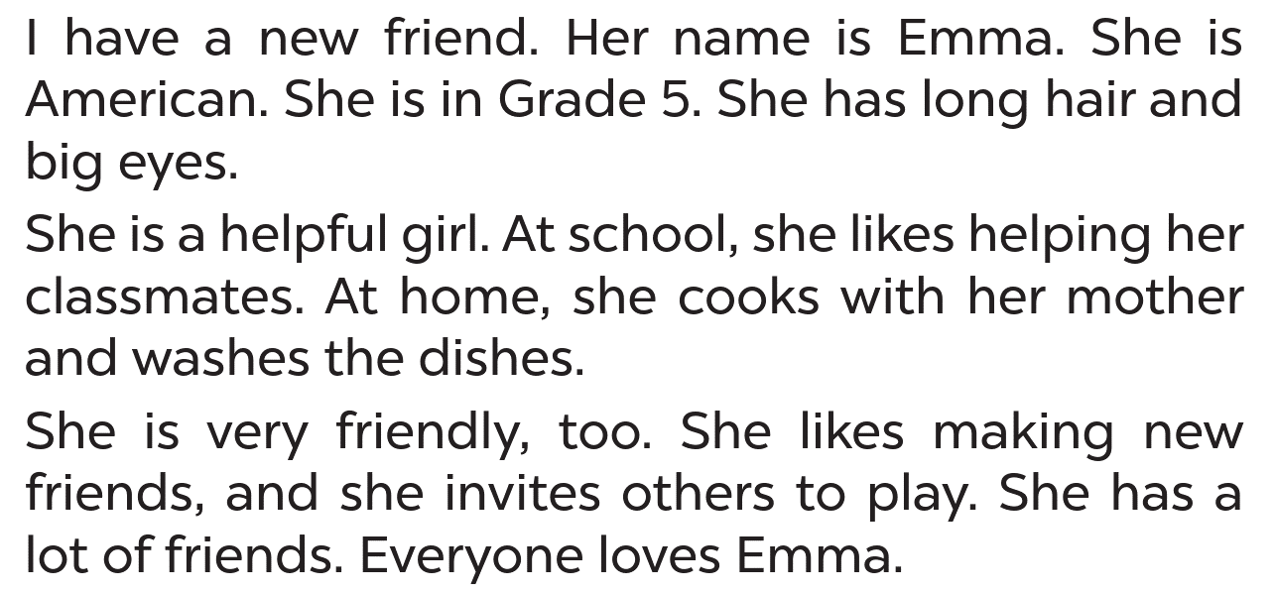



LISTEN AND READ
Emma

Slide 5



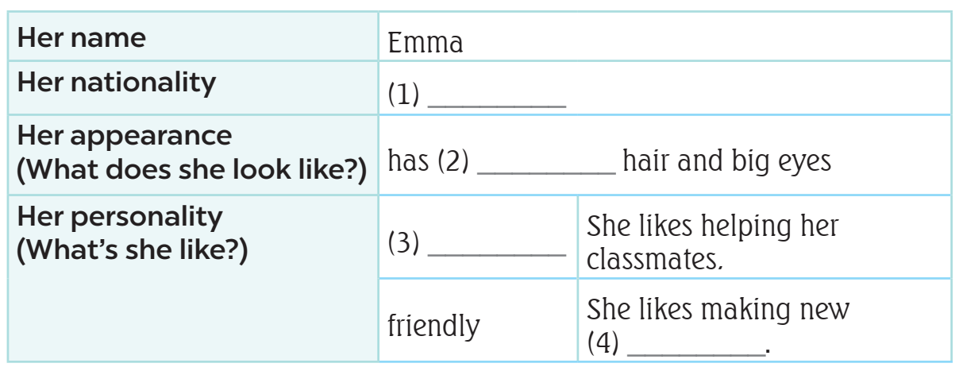


LISTEN AND READ
What’s
the information?
main
information

Slide 6





READ AND ANSWER.

Slide 7
READ AND ANSWER.
nationality
Emma

Slide 8

READ AND ANSWER.
American

Slide 9
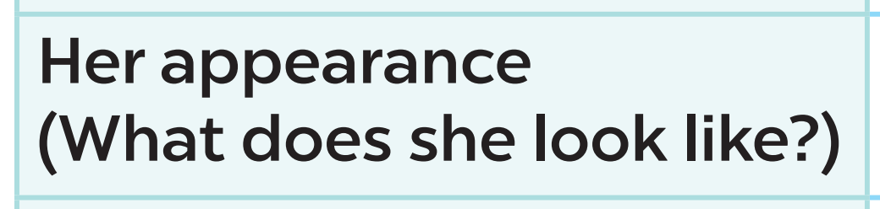
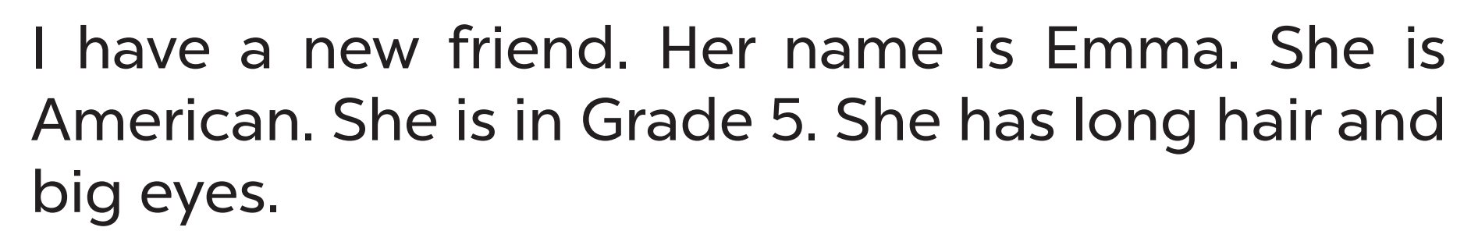
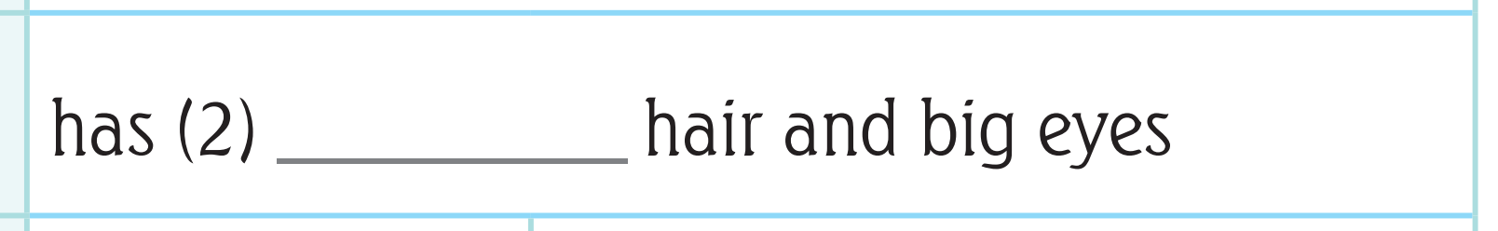


LET’S CHECK!
long

Slide 10
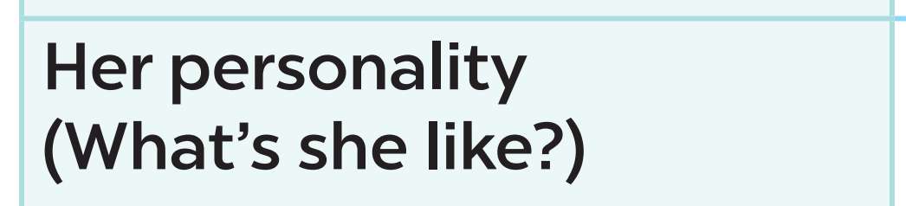
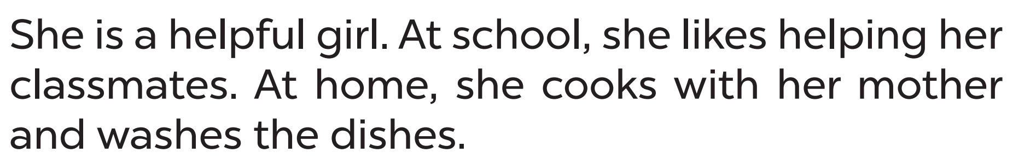
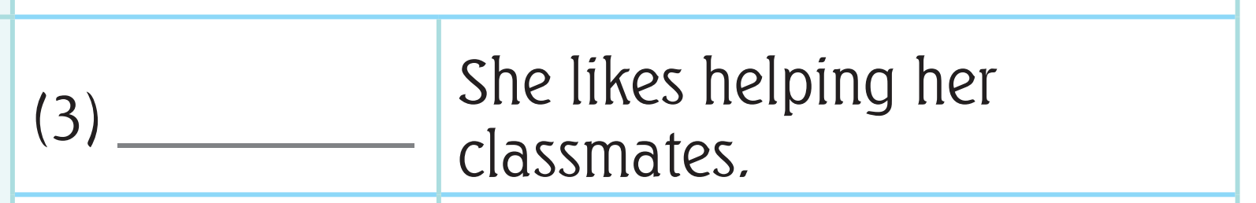



LET’S CHECK!
helpful

Slide 11
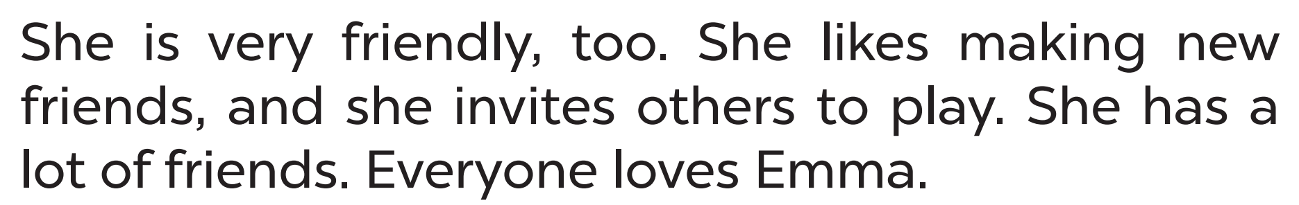
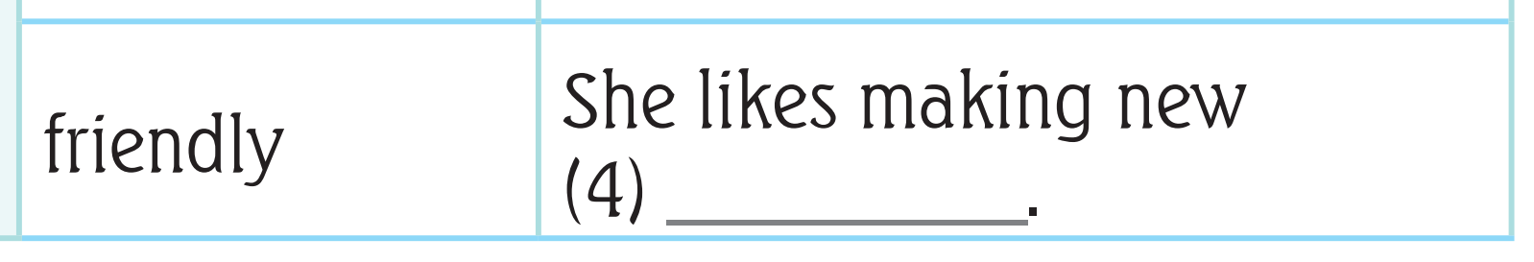


LET’S CHECK!
friends

Slide 12


ASK AND ANSWER ABOUT EMMA.
American
dishes
hair
friendly
classmate

Slide 13
03
Let’s write.

Slide 14

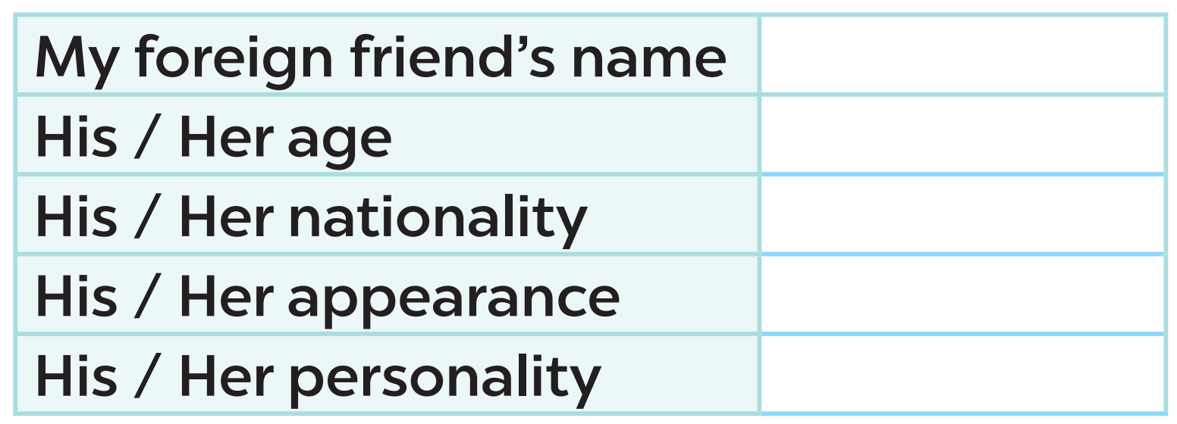

READ AND ANSWER

Slide 15
04
Project

Slide 16
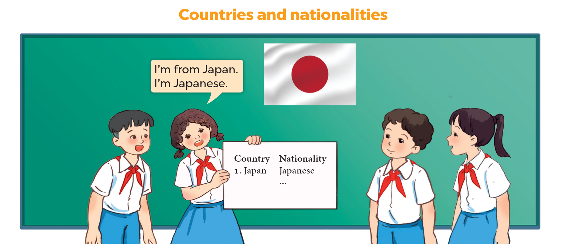
LET’S CHECK YOUR POSTERS!
5 countries
nationalities

Slide 17


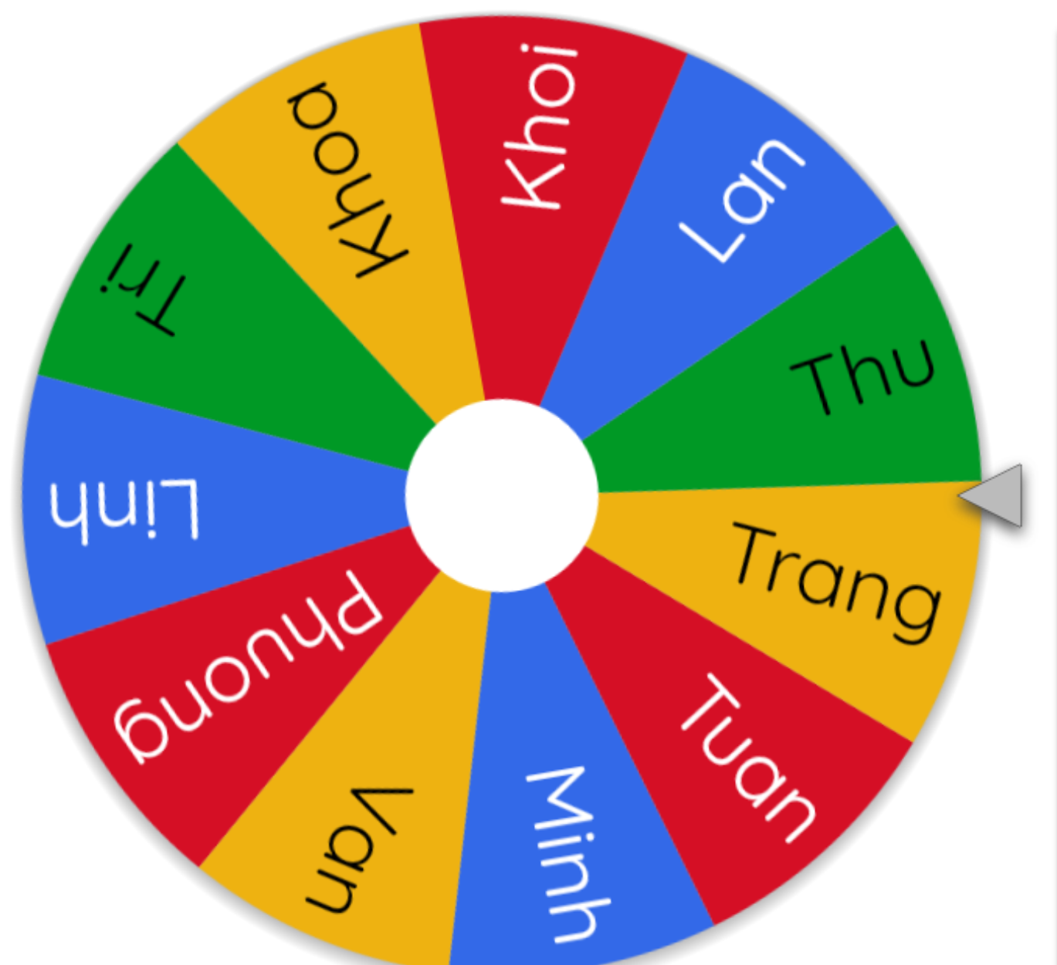


LET’S SPIN!
Notes:
Use this link https://wheelofnames.com/ to choose pupils in random.

