Slide 1




UBND QUẬN DƯƠNG KINH
TRƯỜNG TIỂU HỌC ANH DŨNG
ENGLISH - GRADE 5
UNIT 4: OUR FREE – TIME ACTIVITIES
LESSON 1 (1, 2, 3)

Slide 2








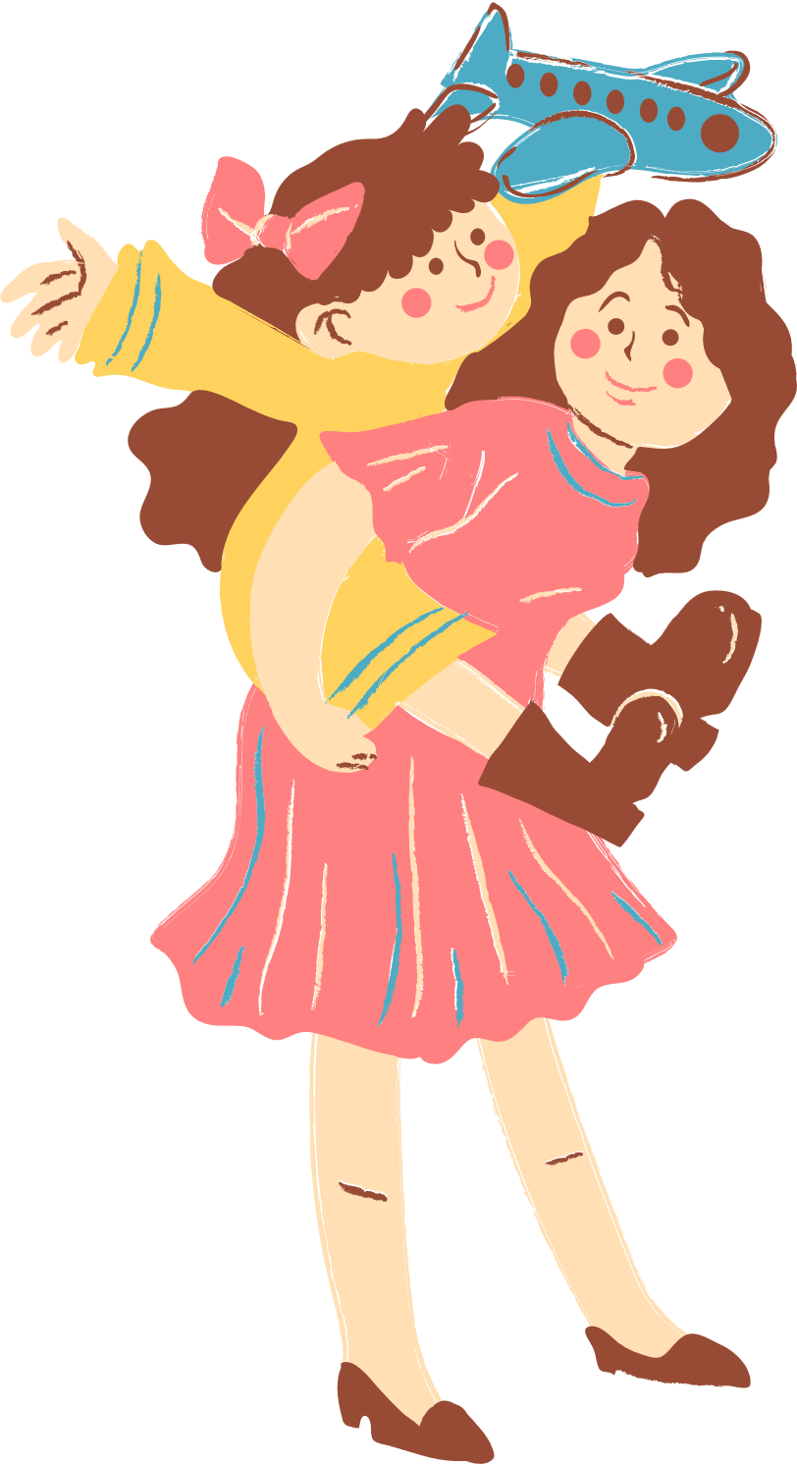
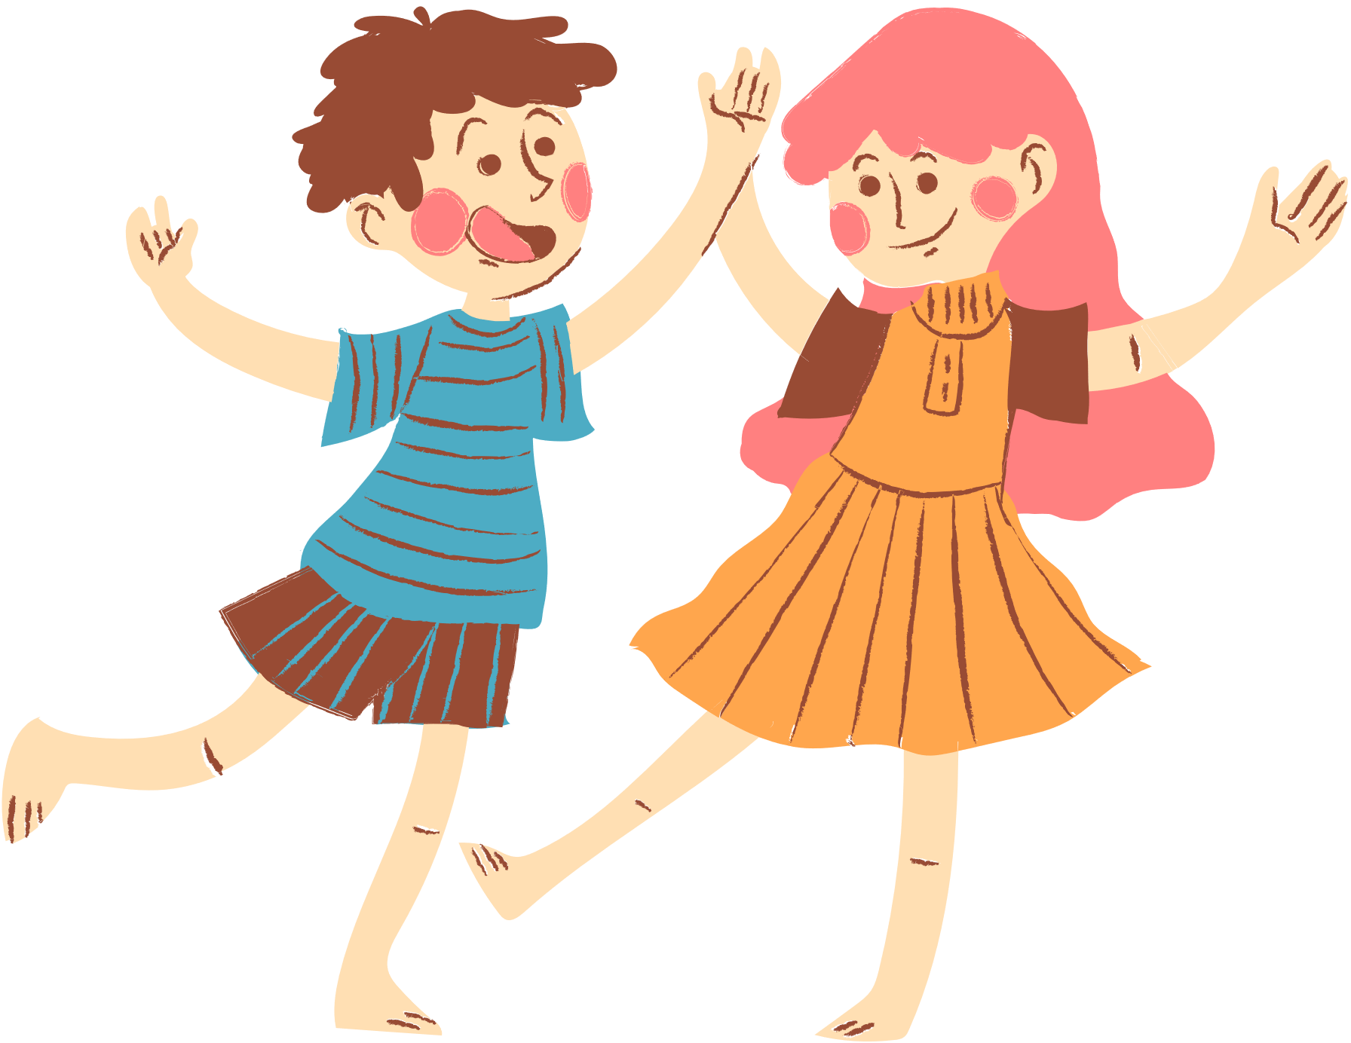
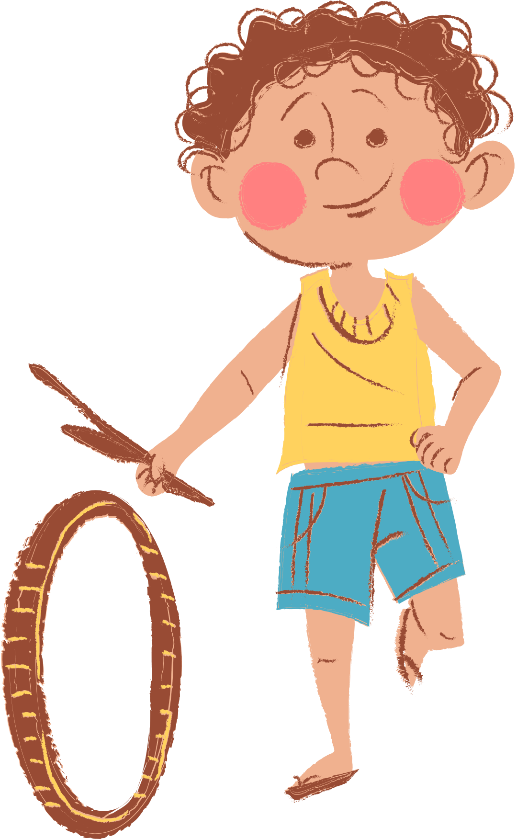
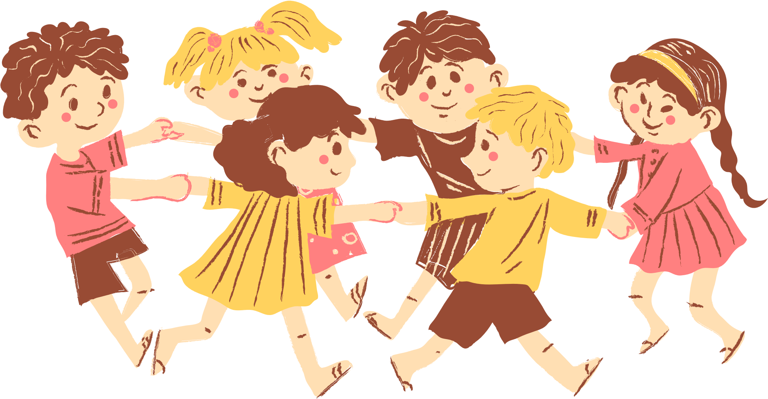
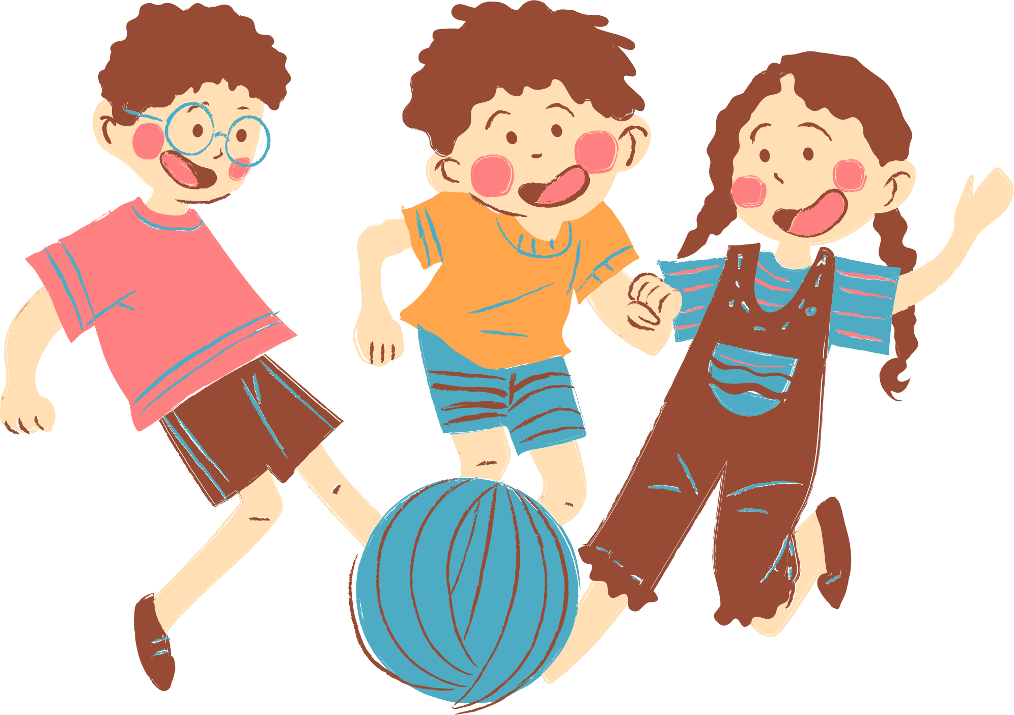
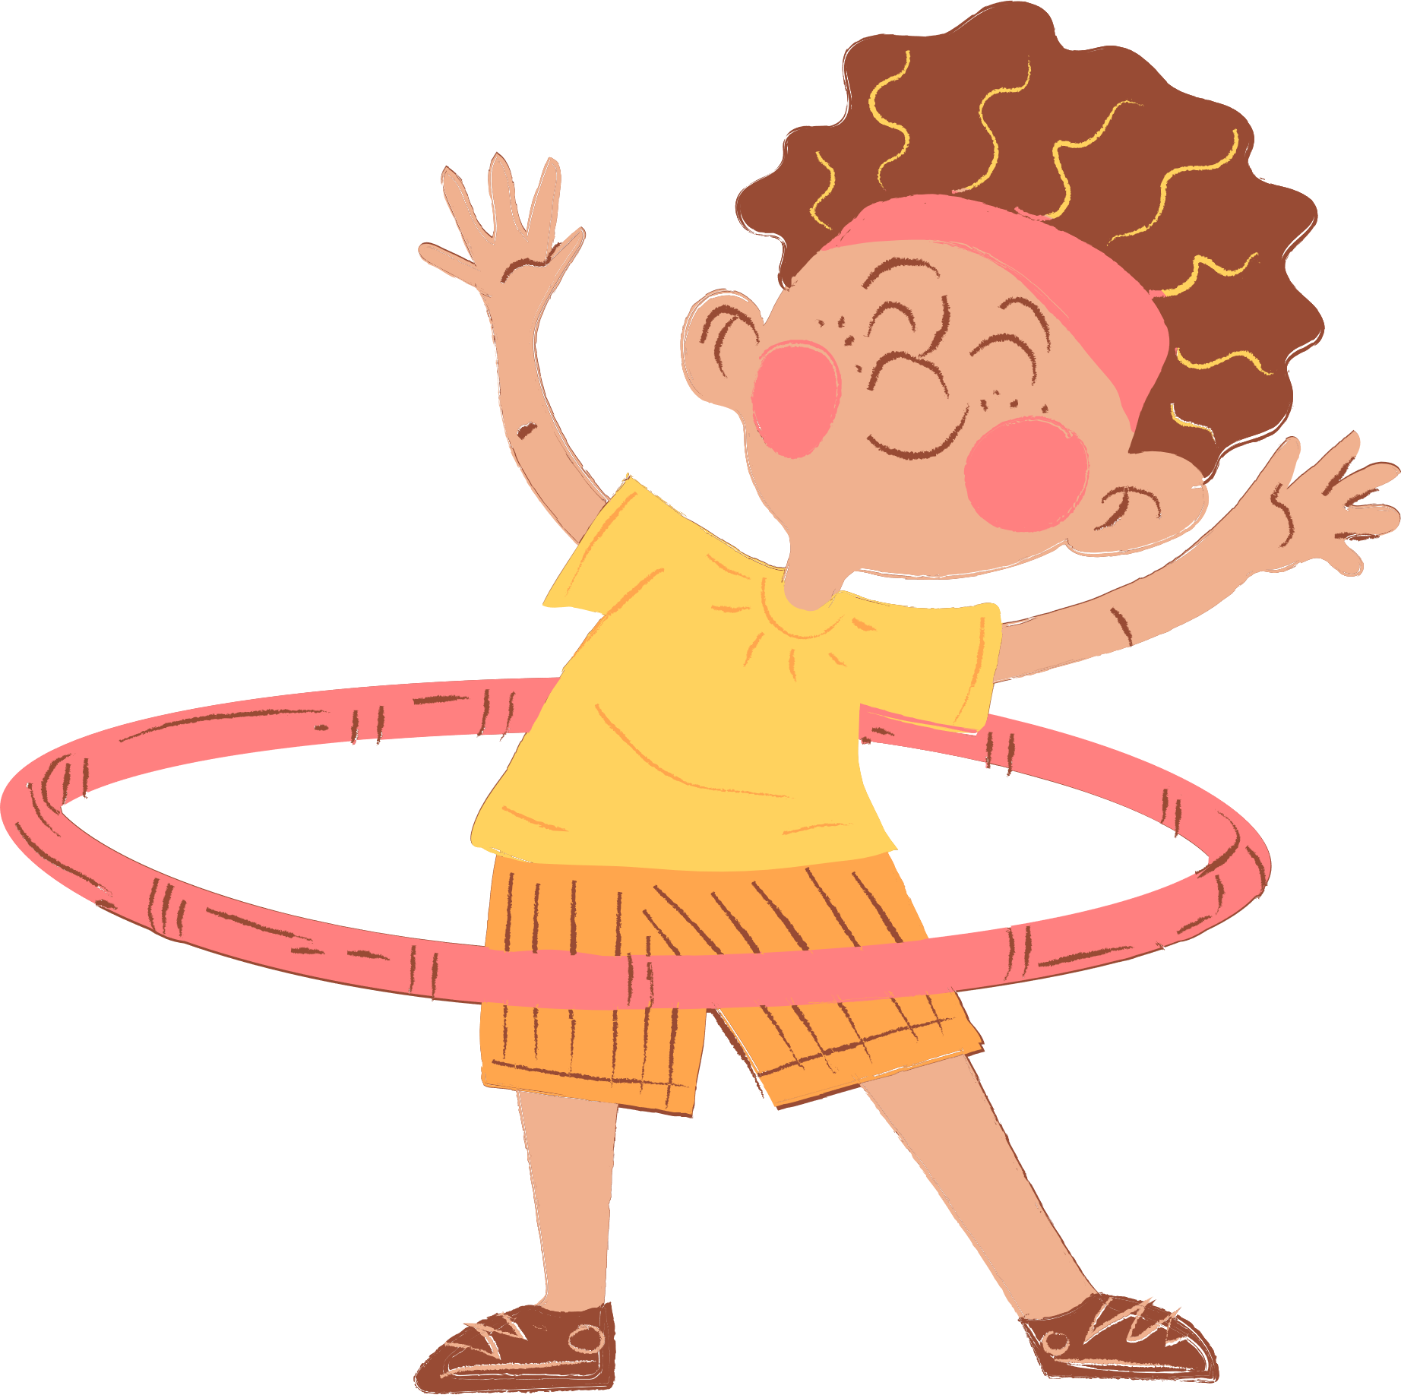
4
Our free-time activities
Lesson 1 - Period 1

Slide 3





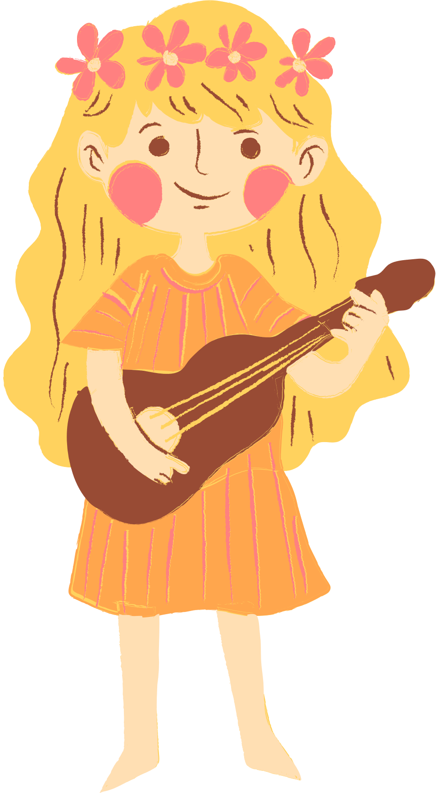
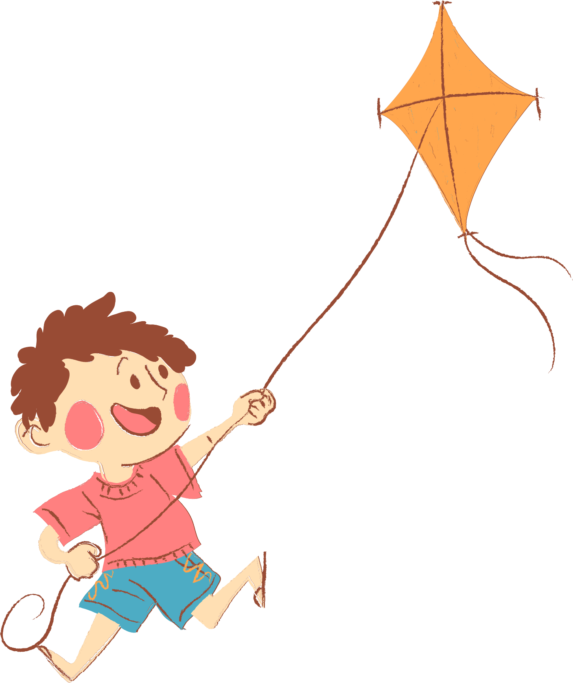
01. Warm-up:
Sing a song.

Slide 4


Notes:
Link video hoạt hình: https://hoclieu.vn/hop-phan-bo-tro/video-hoat-hinh/203

Slide 5
02. Look, listen and repeat.

Slide 6
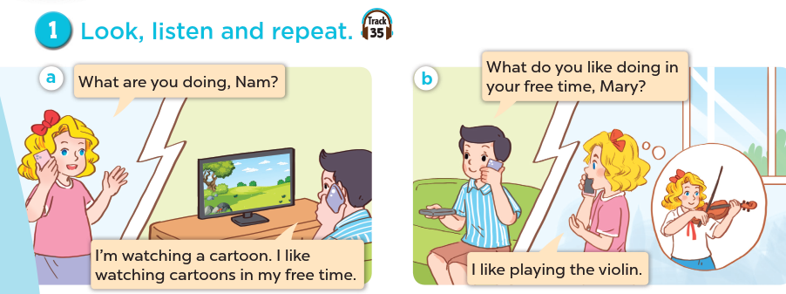
What are the people doing?
What are they talking about?
Listen and repeat.

Slide 7
03. Listen, point and say.

Slide 8
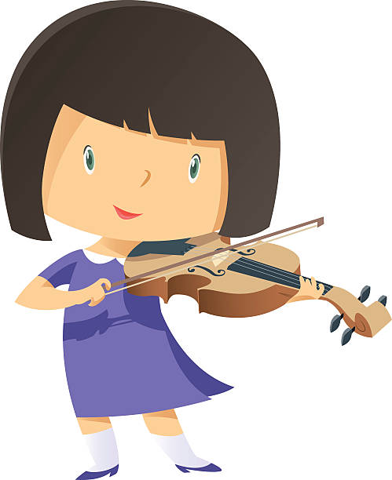
play the violin

Slide 9

surf the Internet

Slide 10
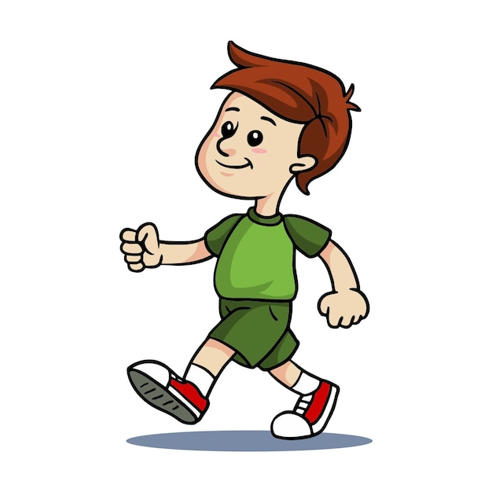
go for a walk

Slide 11
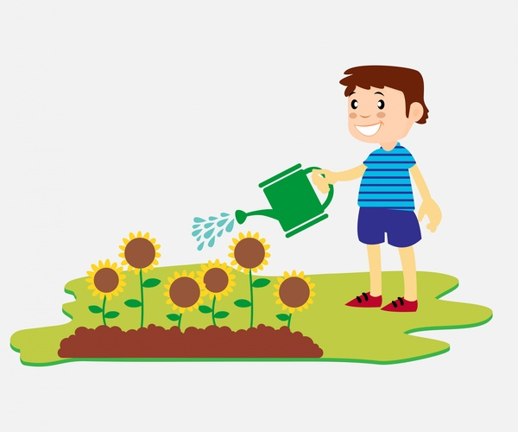
water the flowers

Slide 12
Look and guess.

Slide 13
surf the Internet

Slide 14
play the violin

Slide 15
water the flowers

Slide 16
go for a walk

Slide 17
Remember:

Slide 18
V-ing
play
surf
go
water
playing
surfing
going
watering

Slide 19
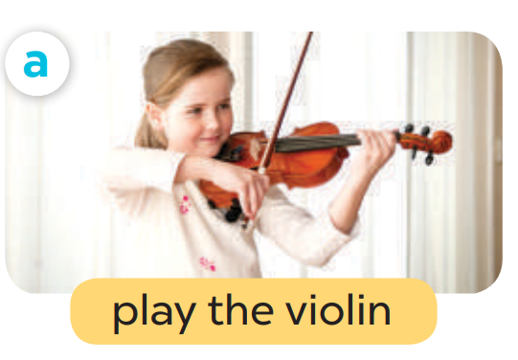
What do you like doing in your free time?
I like playing the violin.

Slide 20

What do you like doing in your free time?
I like surfing the Internet.

Slide 21
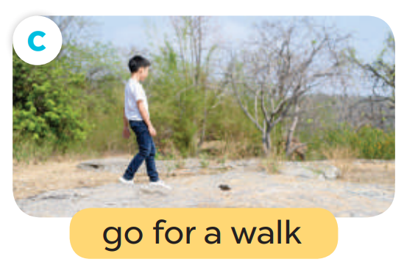
What do you like doing in your free time?
I like going the for a walk.

Slide 22

What do you like doing in your free time?
I like watering the flowers.

Slide 23
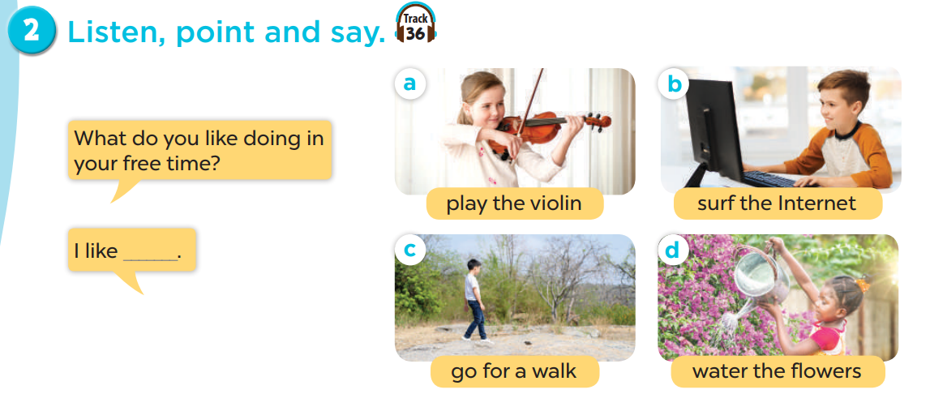
Listen, point and say.
Act it out.

Slide 24
05. Let’s talk.

Slide 25
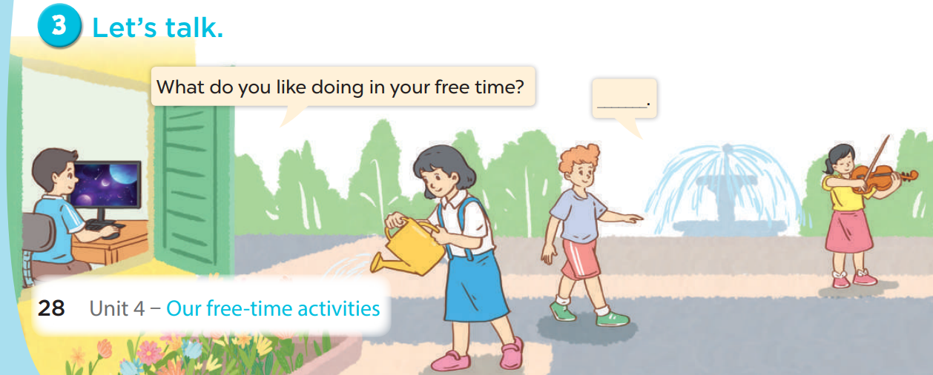
Work in pairs. Ask and answer.
What do you like doing in your free time?
I like _____.

