Slide 1




UBND QUẬN DƯƠNG KINH
TRƯỜNG TIỂU HỌC ANH DŨNG
ENGLISH - GRADE 5
UNIT 4: OUR FREE – TIME ACTIVITIES
LESSON 1 (4, 5, 6)

Slide 2








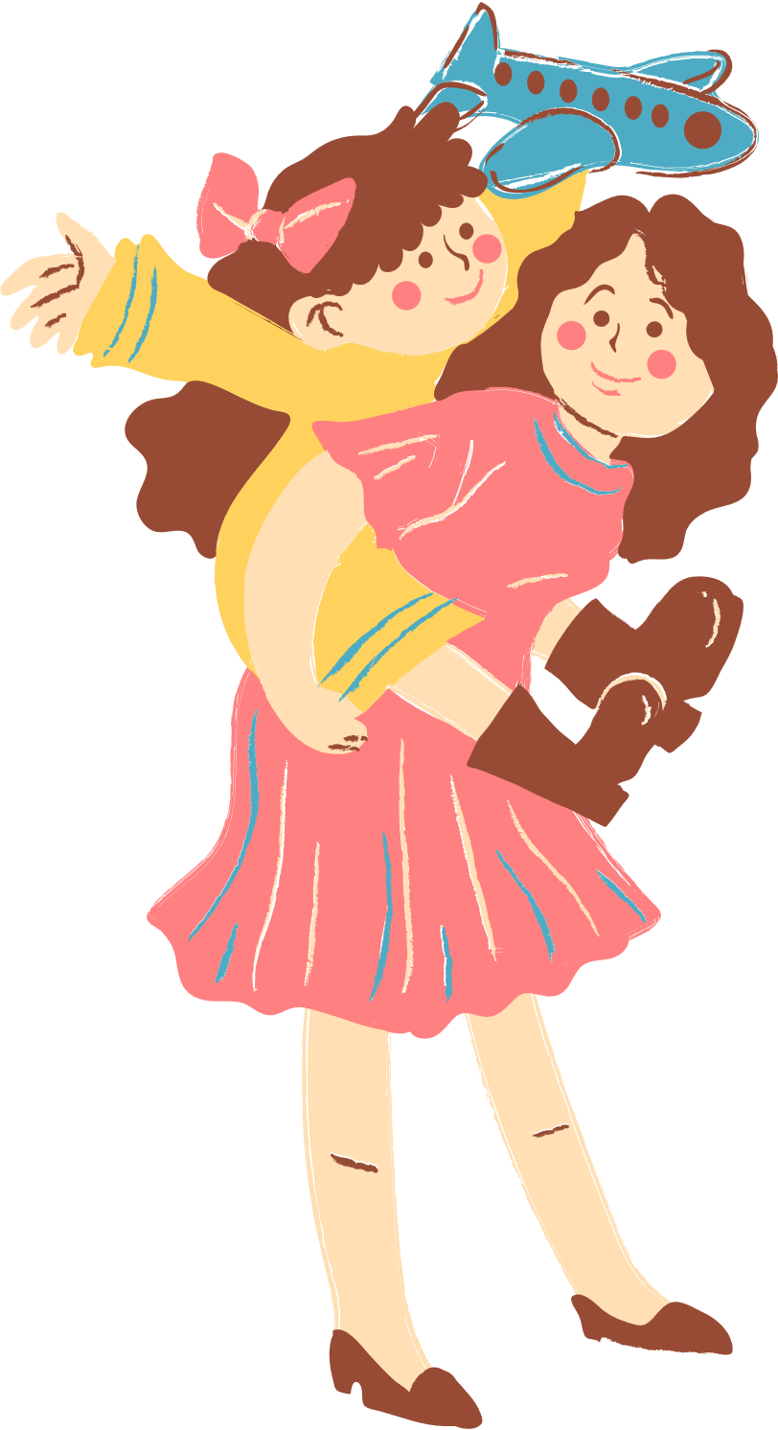
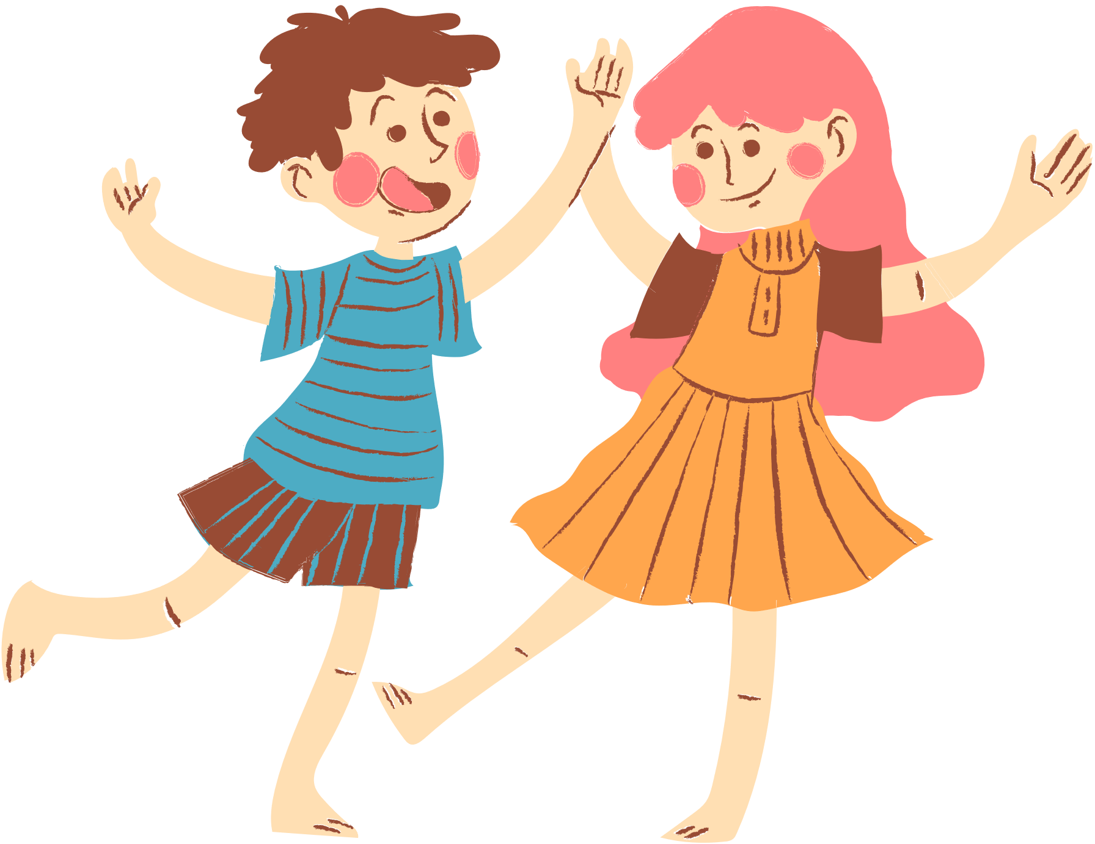
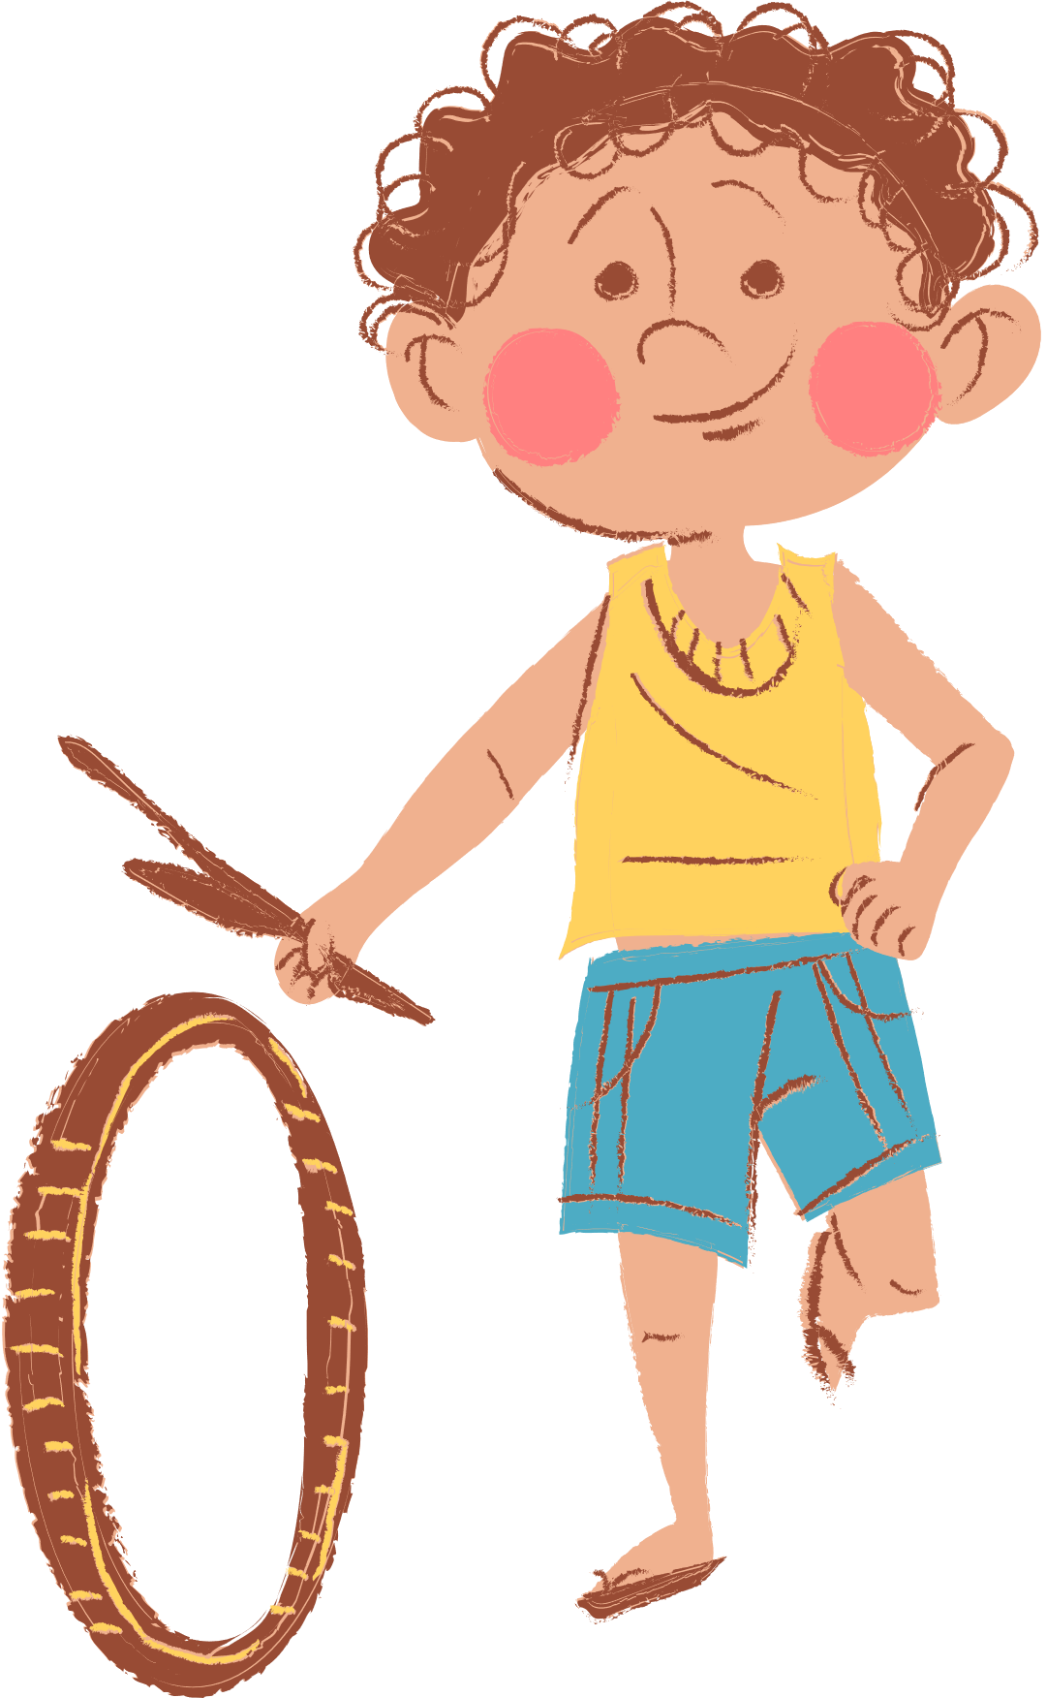
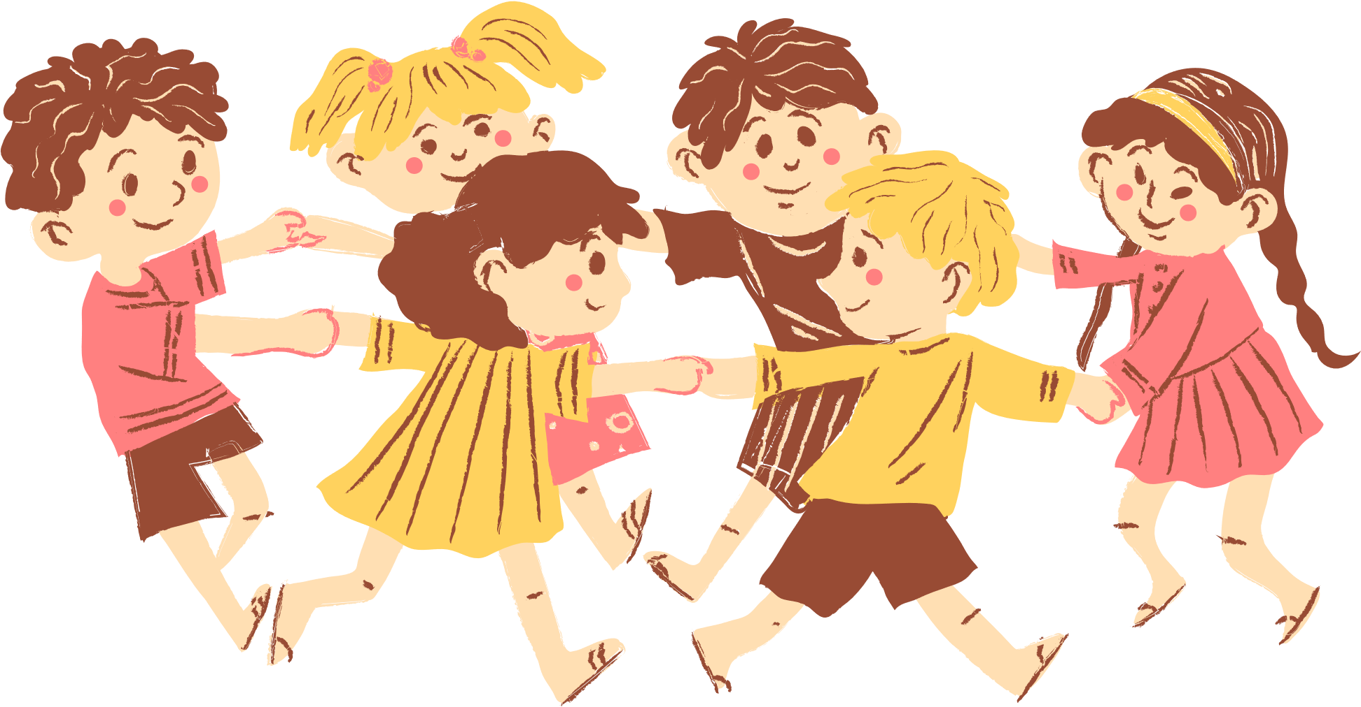
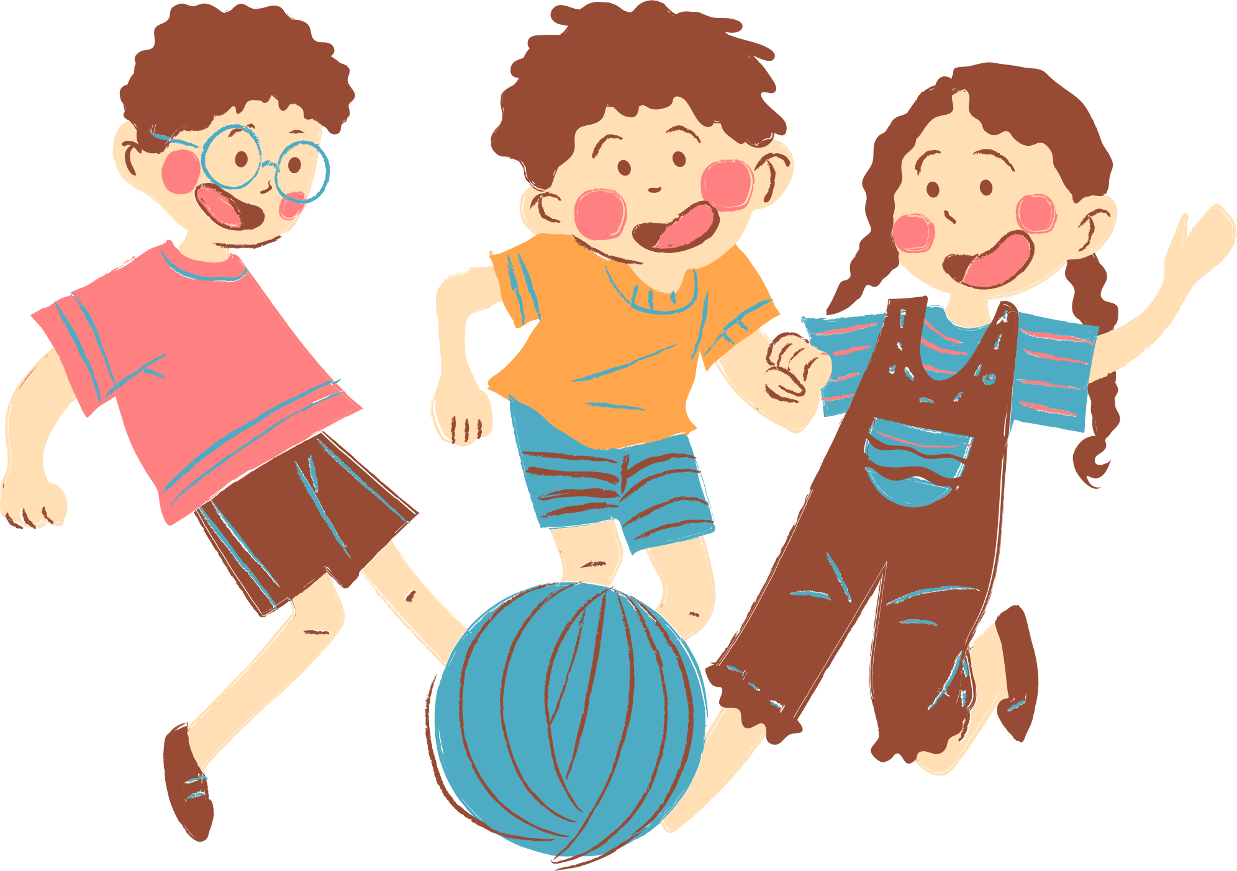
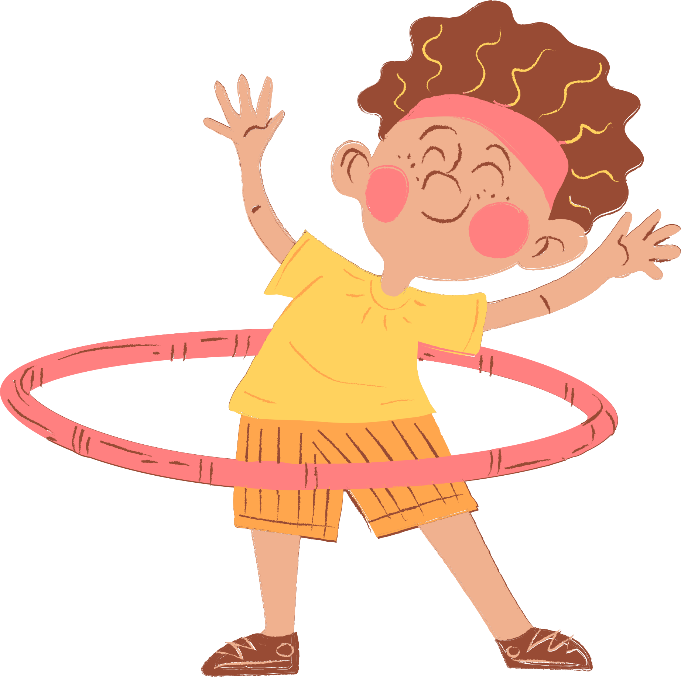
4
Our free-time activities

Slide 3





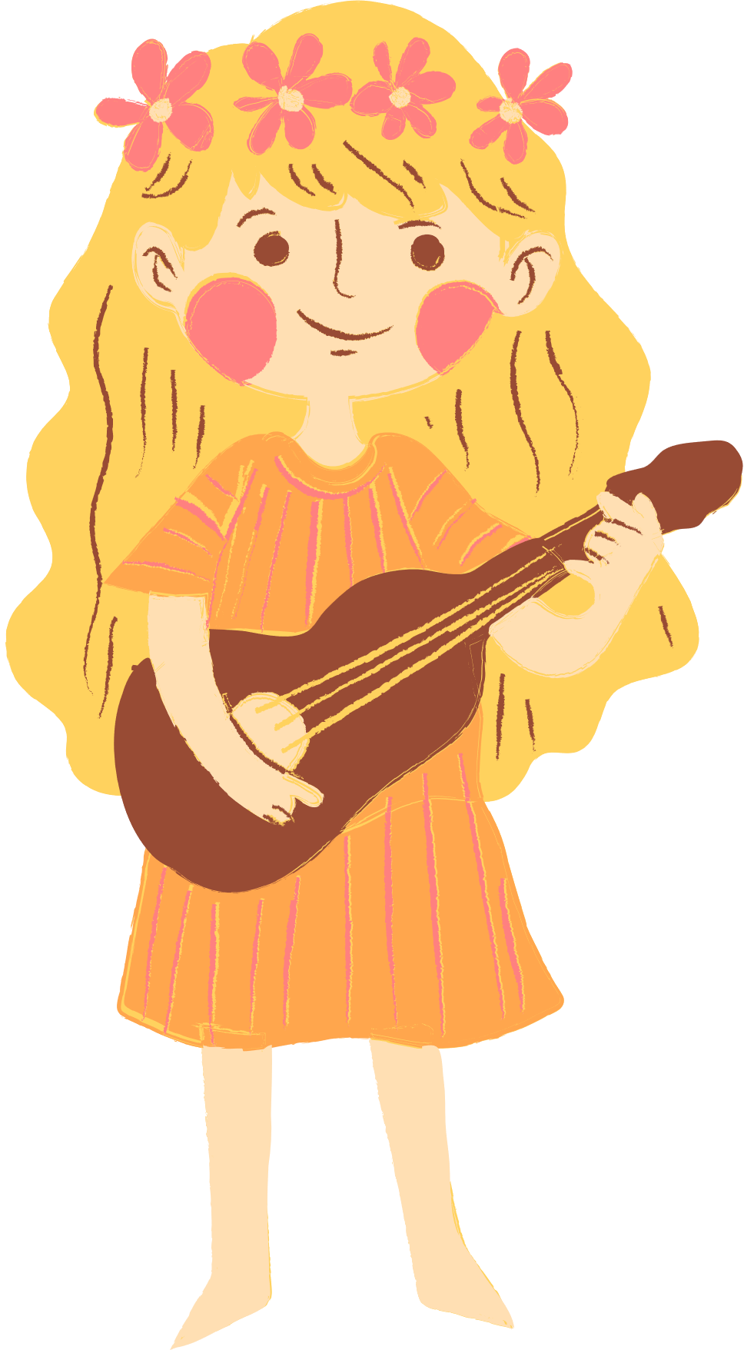
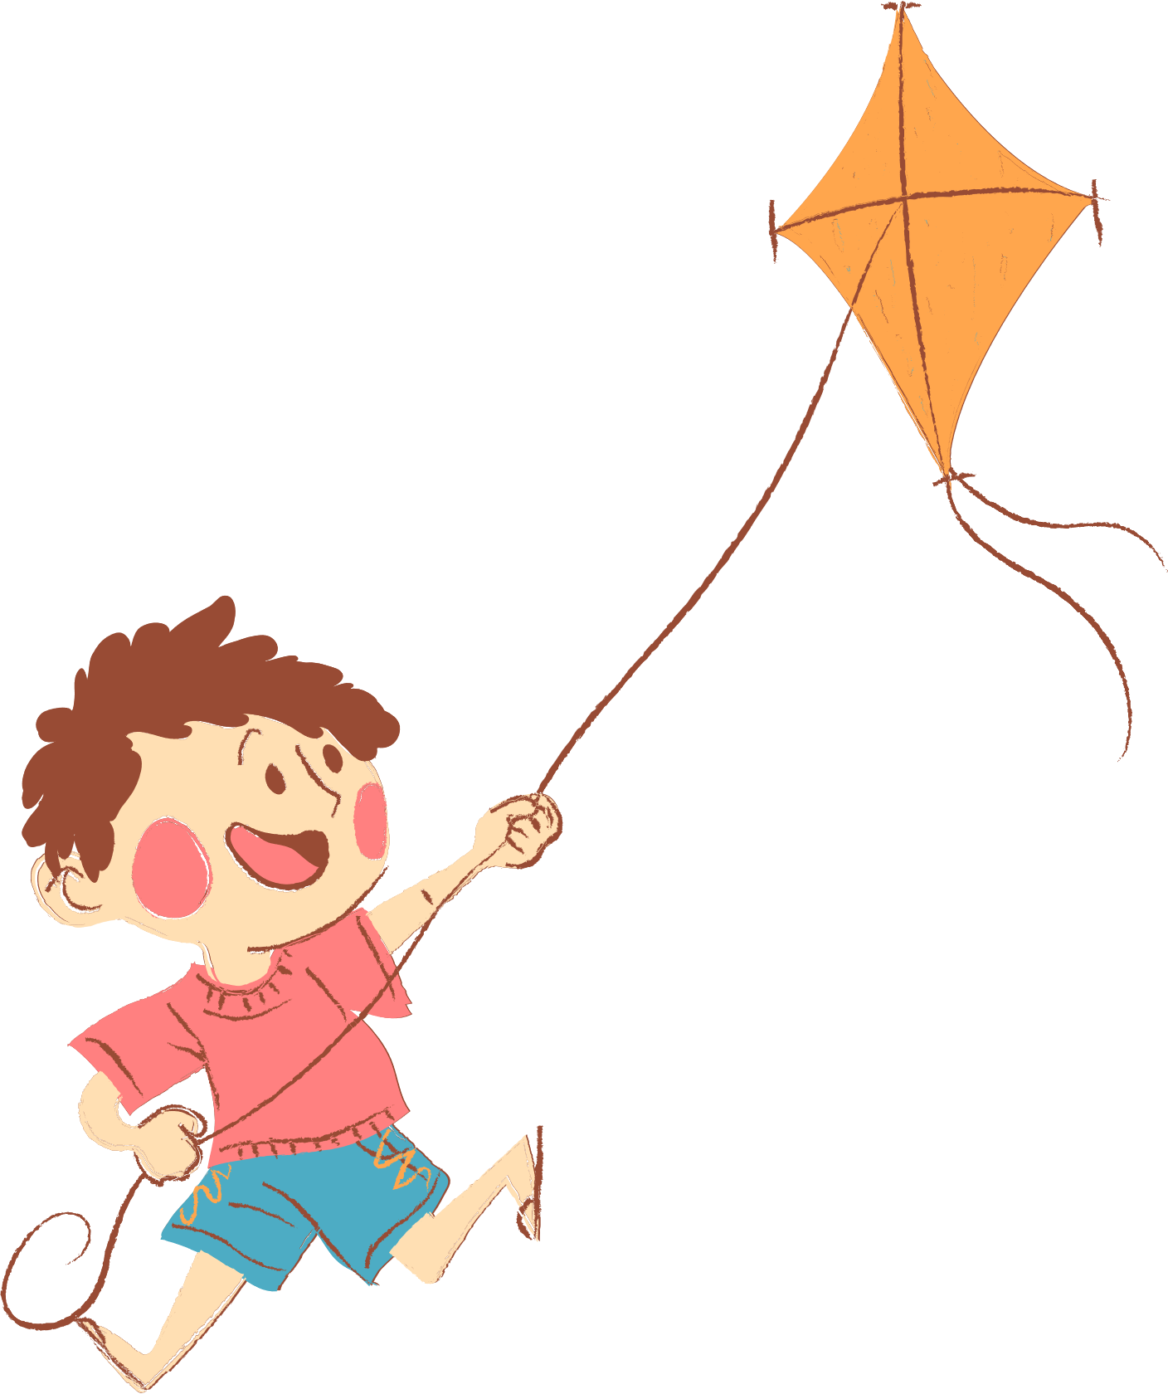
01. Review

Slide 4

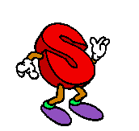
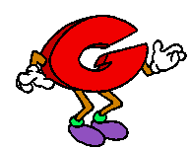
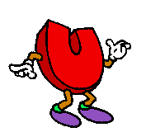
Can you

Slide 5
Look and guess what word is it.
1-open picture: 3 points
2-open pictures: 2 points
Picture left: 1 point

Slide 6

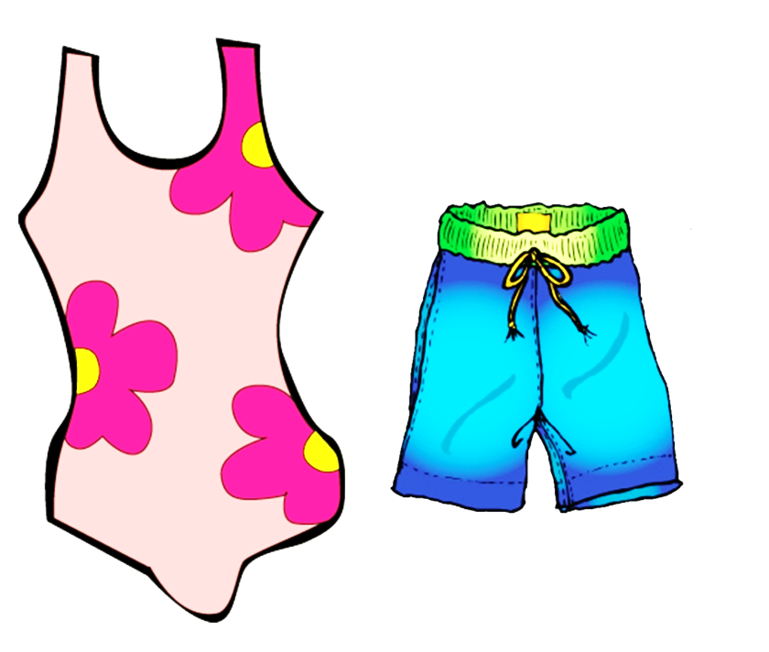
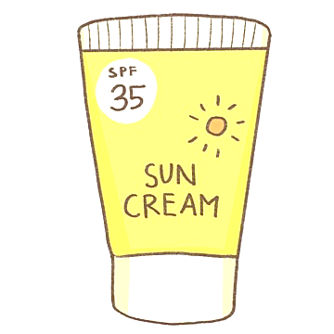

swim

Slide 7


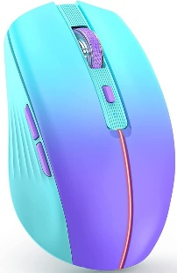
surf the Internet

Slide 8
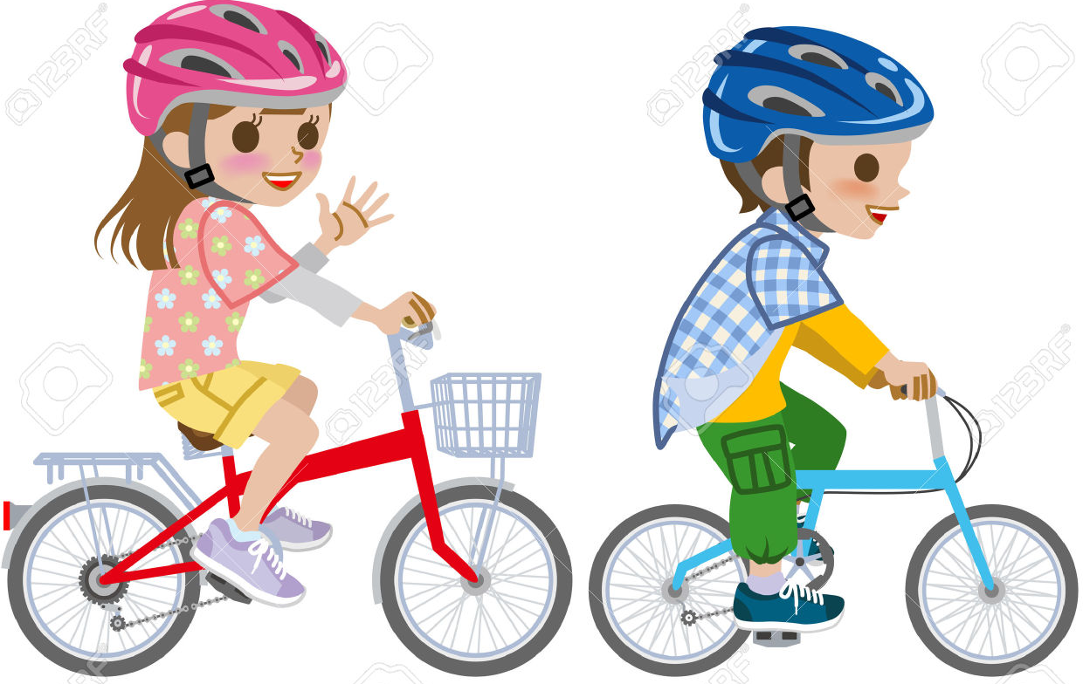
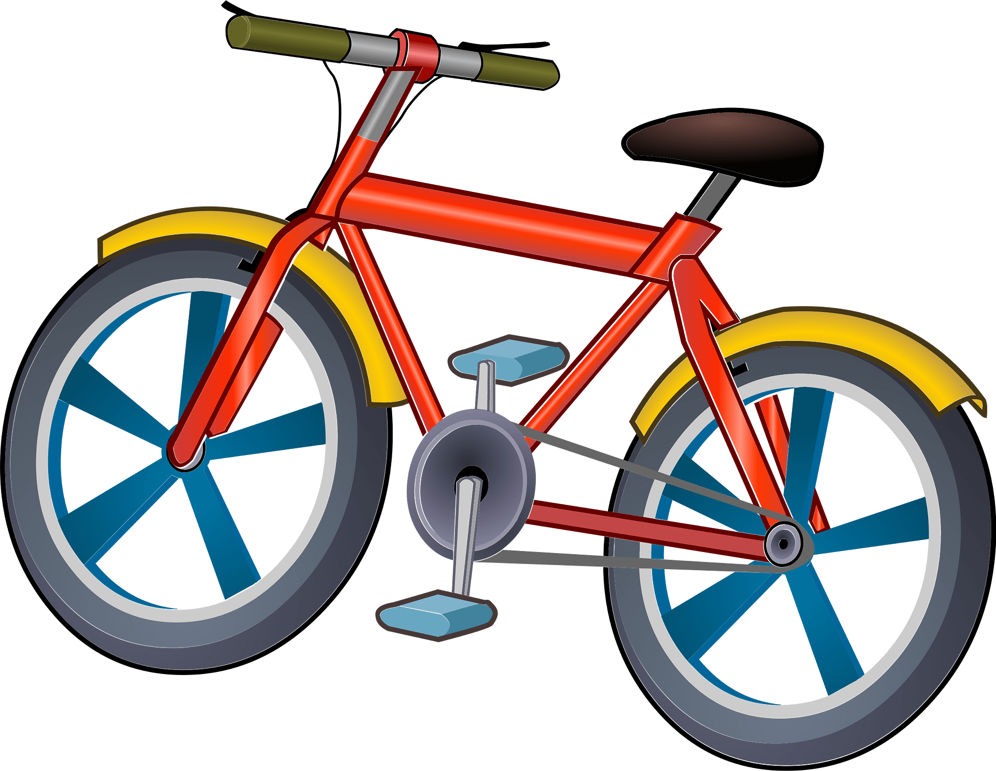
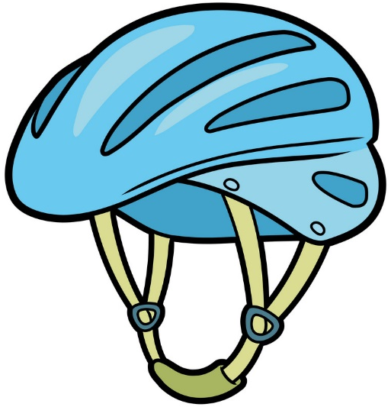
ride a bike

Slide 9
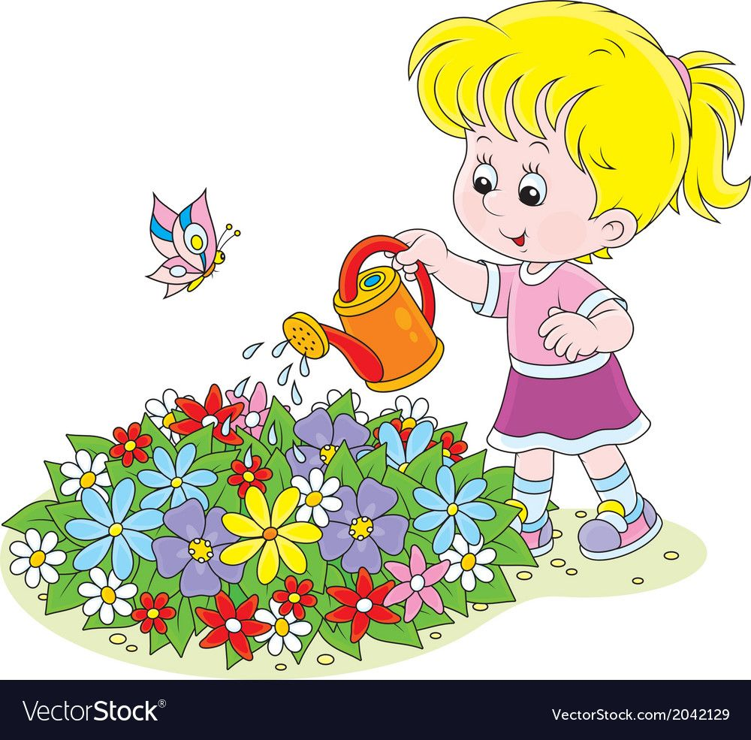


water the flowers

Slide 10
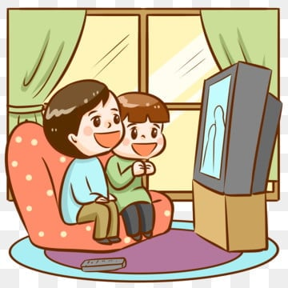


watch TV

Slide 11
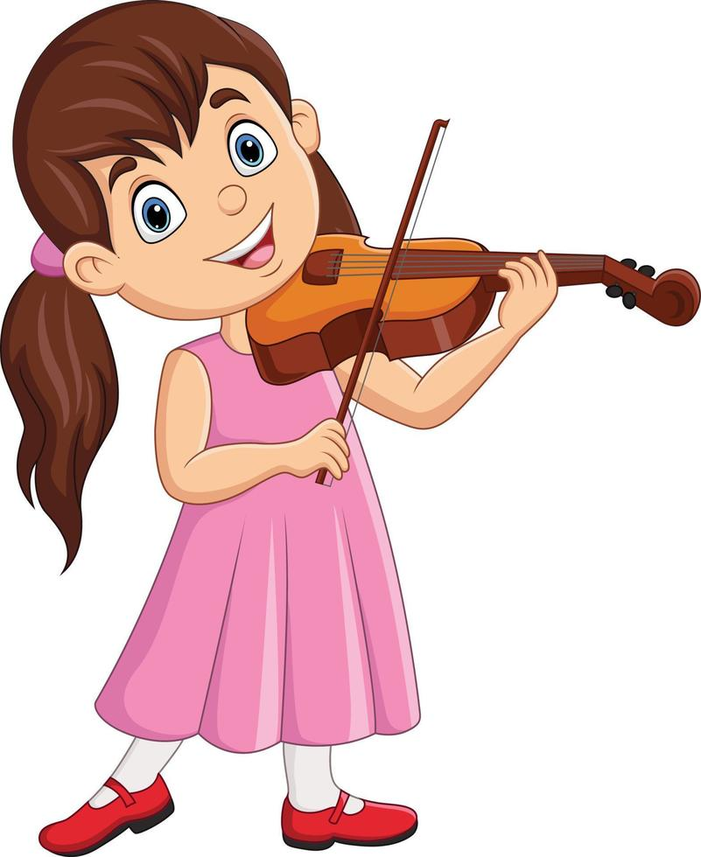

play the violin

Slide 12
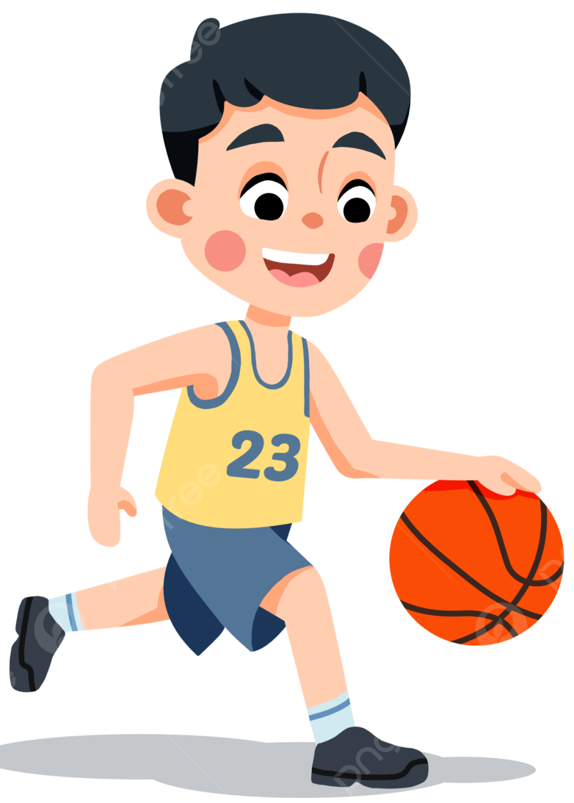
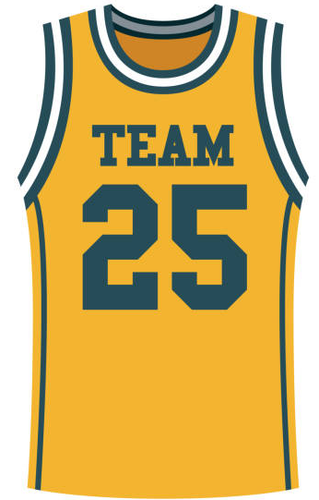

play basketball

Slide 13
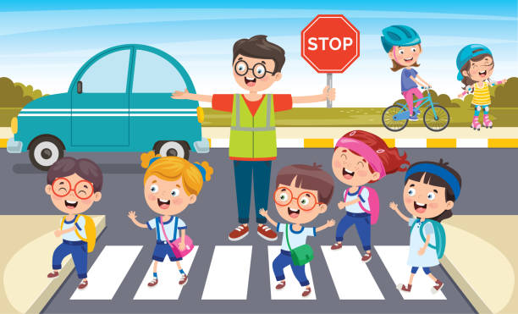

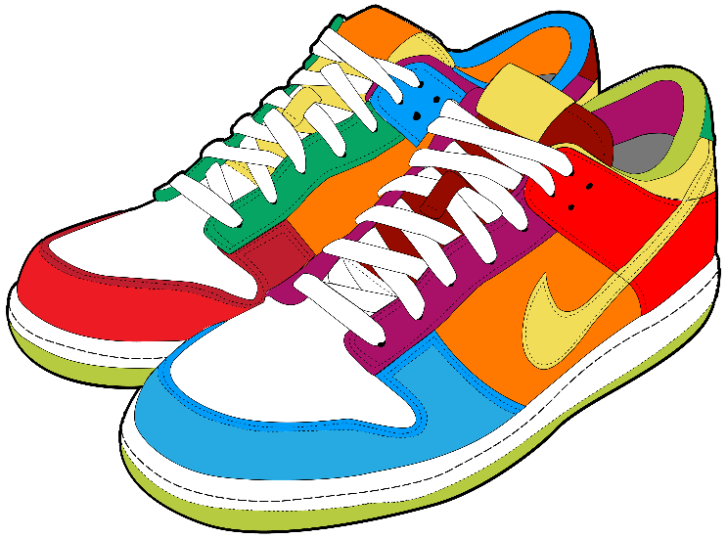
go for a walk

Slide 14
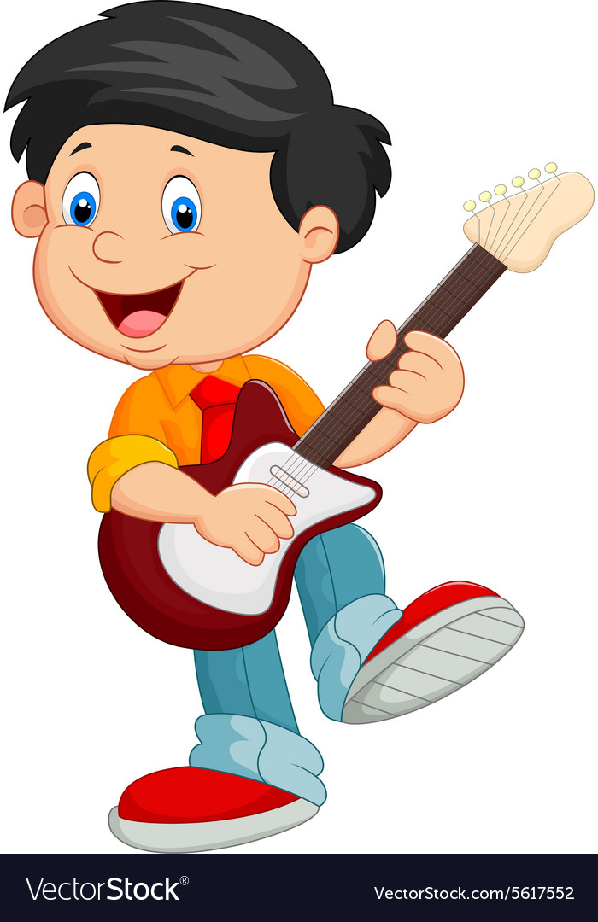
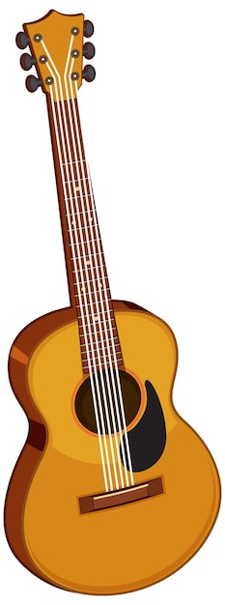

play the guitar

Slide 15
Let’s meet
my friends.
What do / don’t they like doing?

Slide 16
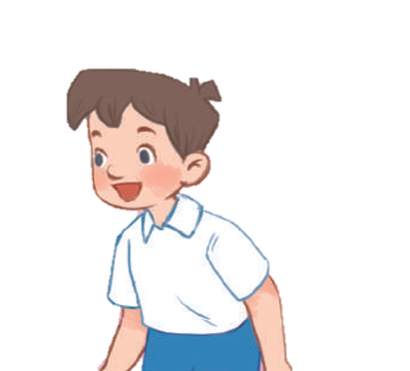


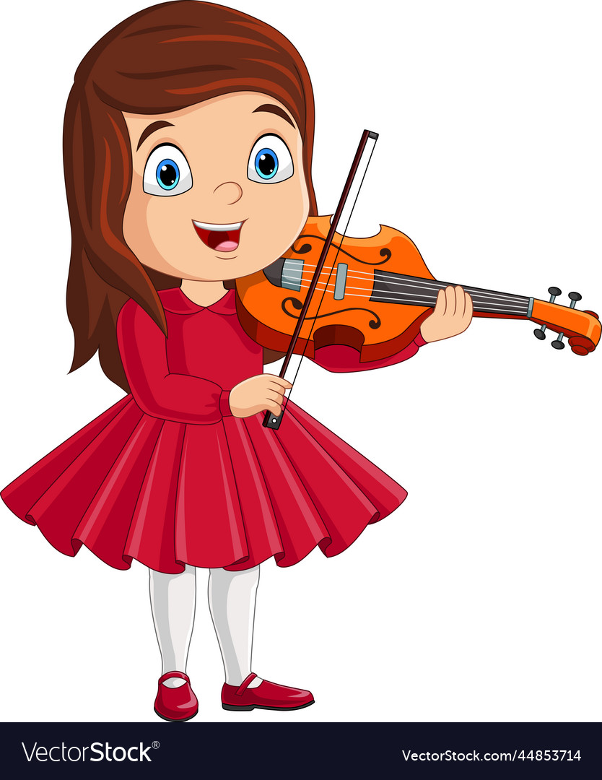
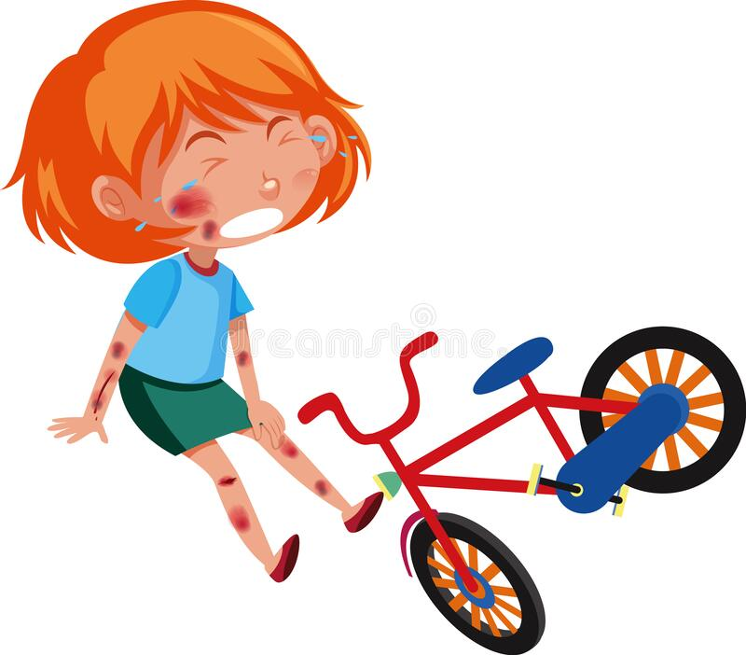


Do you like ………………. in your free time?
No, I don’t.
Yes, I do.
No, I don’t.

Slide 17


What do you like doing
in your free time?
I like ……………….

Slide 18
02. Listen and number.

Slide 19
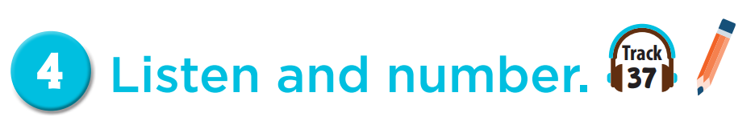


4
3
2
1

Slide 20
03. Read and complete.

Slide 21
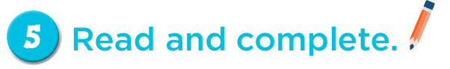
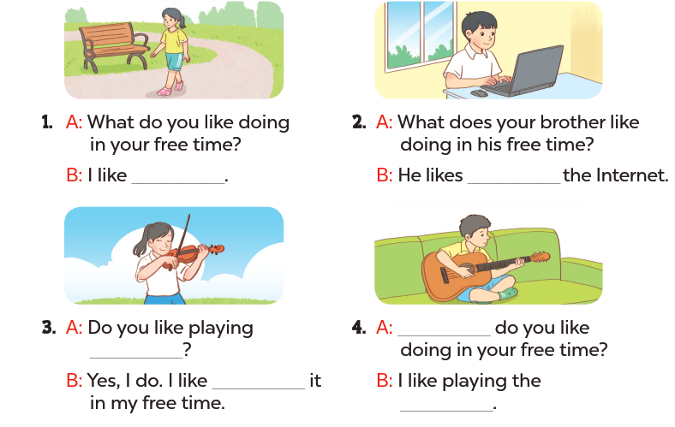
going for a walk
surfing
What
the violin
playing
guitar

Slide 22
04. Let’s play.

Slide 23
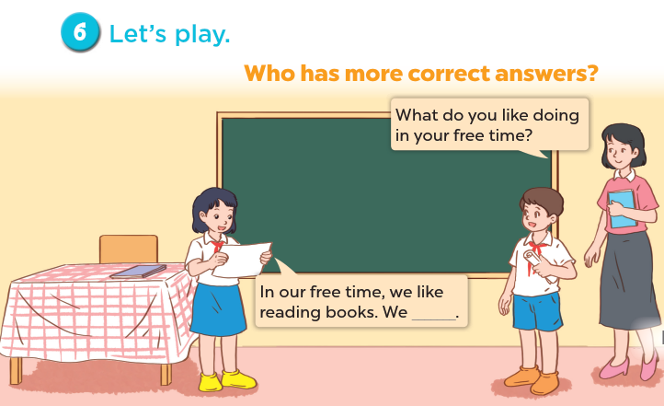

Slide 24
Share with friends.

