Slide 1




UBND QUẬN DƯƠNG KINH
TRƯỜNG TIỂU HỌC ANH DŨNG
ENGLISH - GRADE 5
UNIT 4: OUR FREE – TIME ACTIVITIES
LESSON 2 (4, 5, 6)

Slide 2








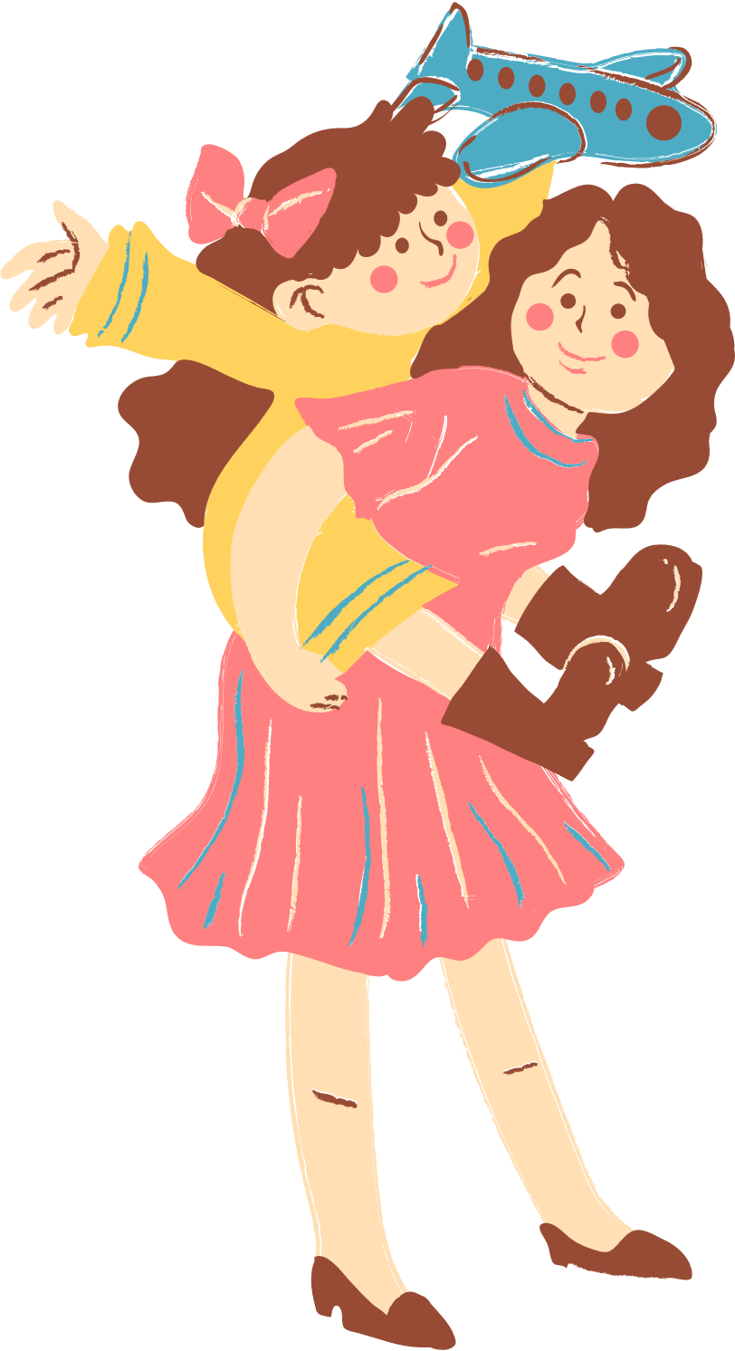
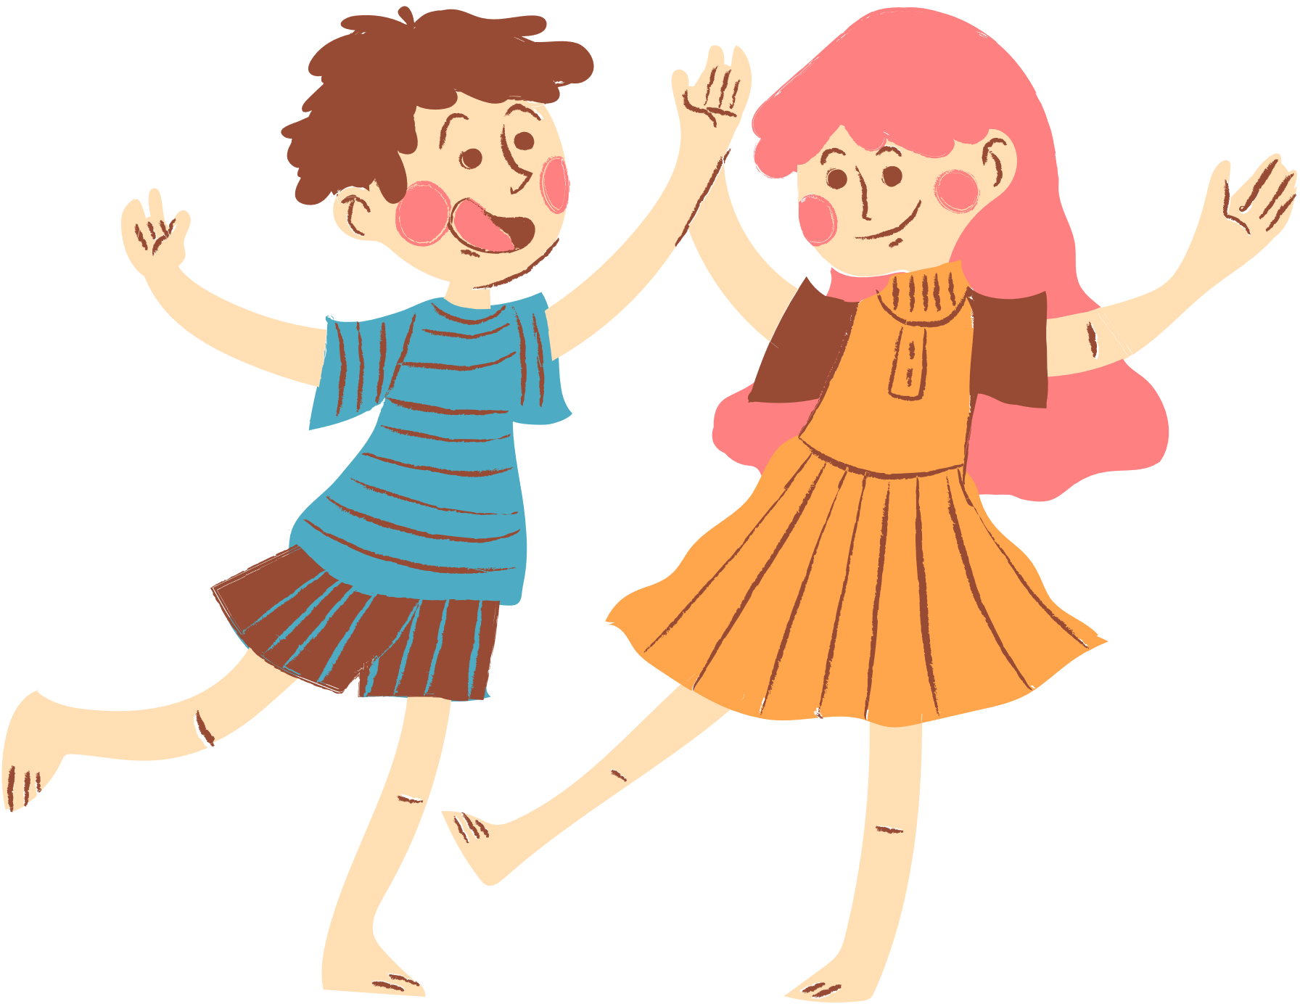
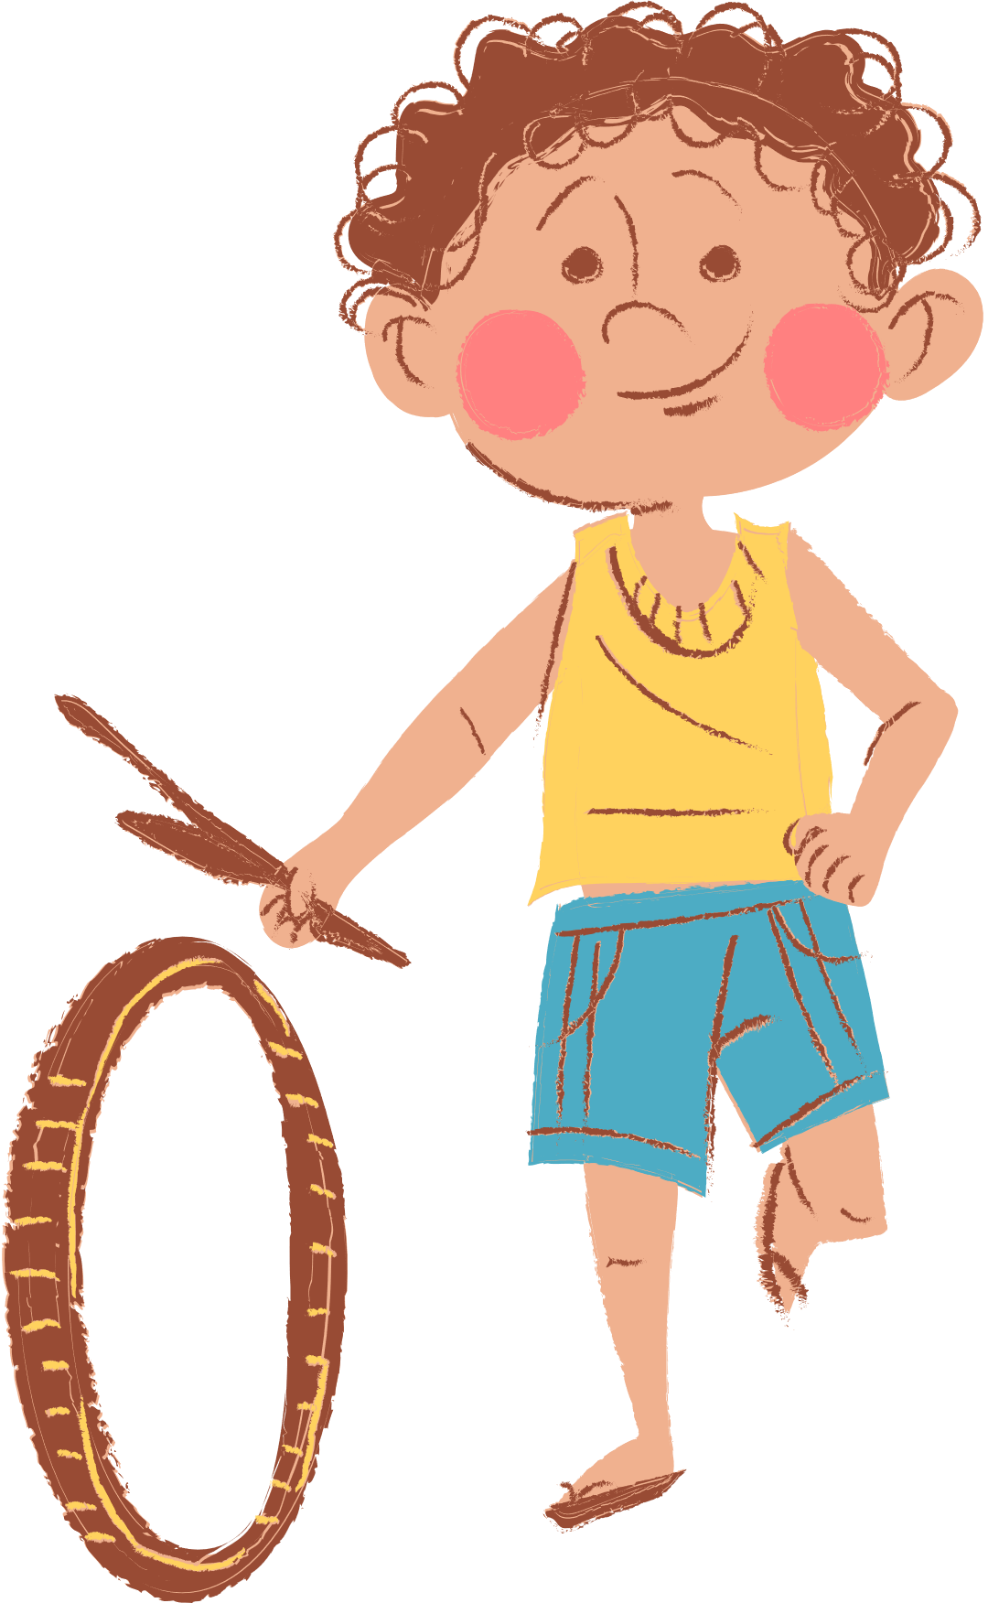
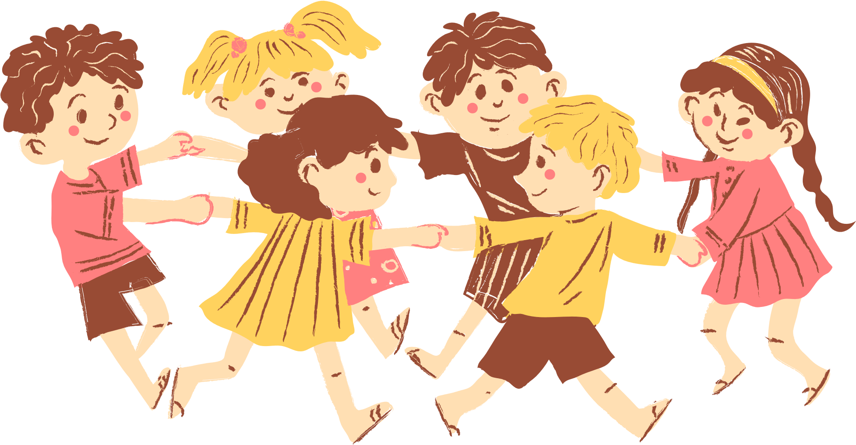
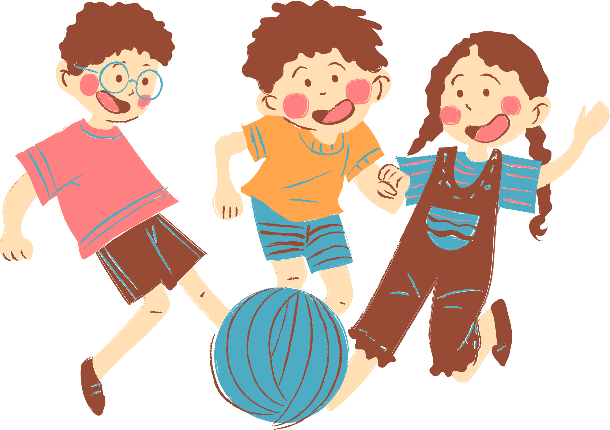
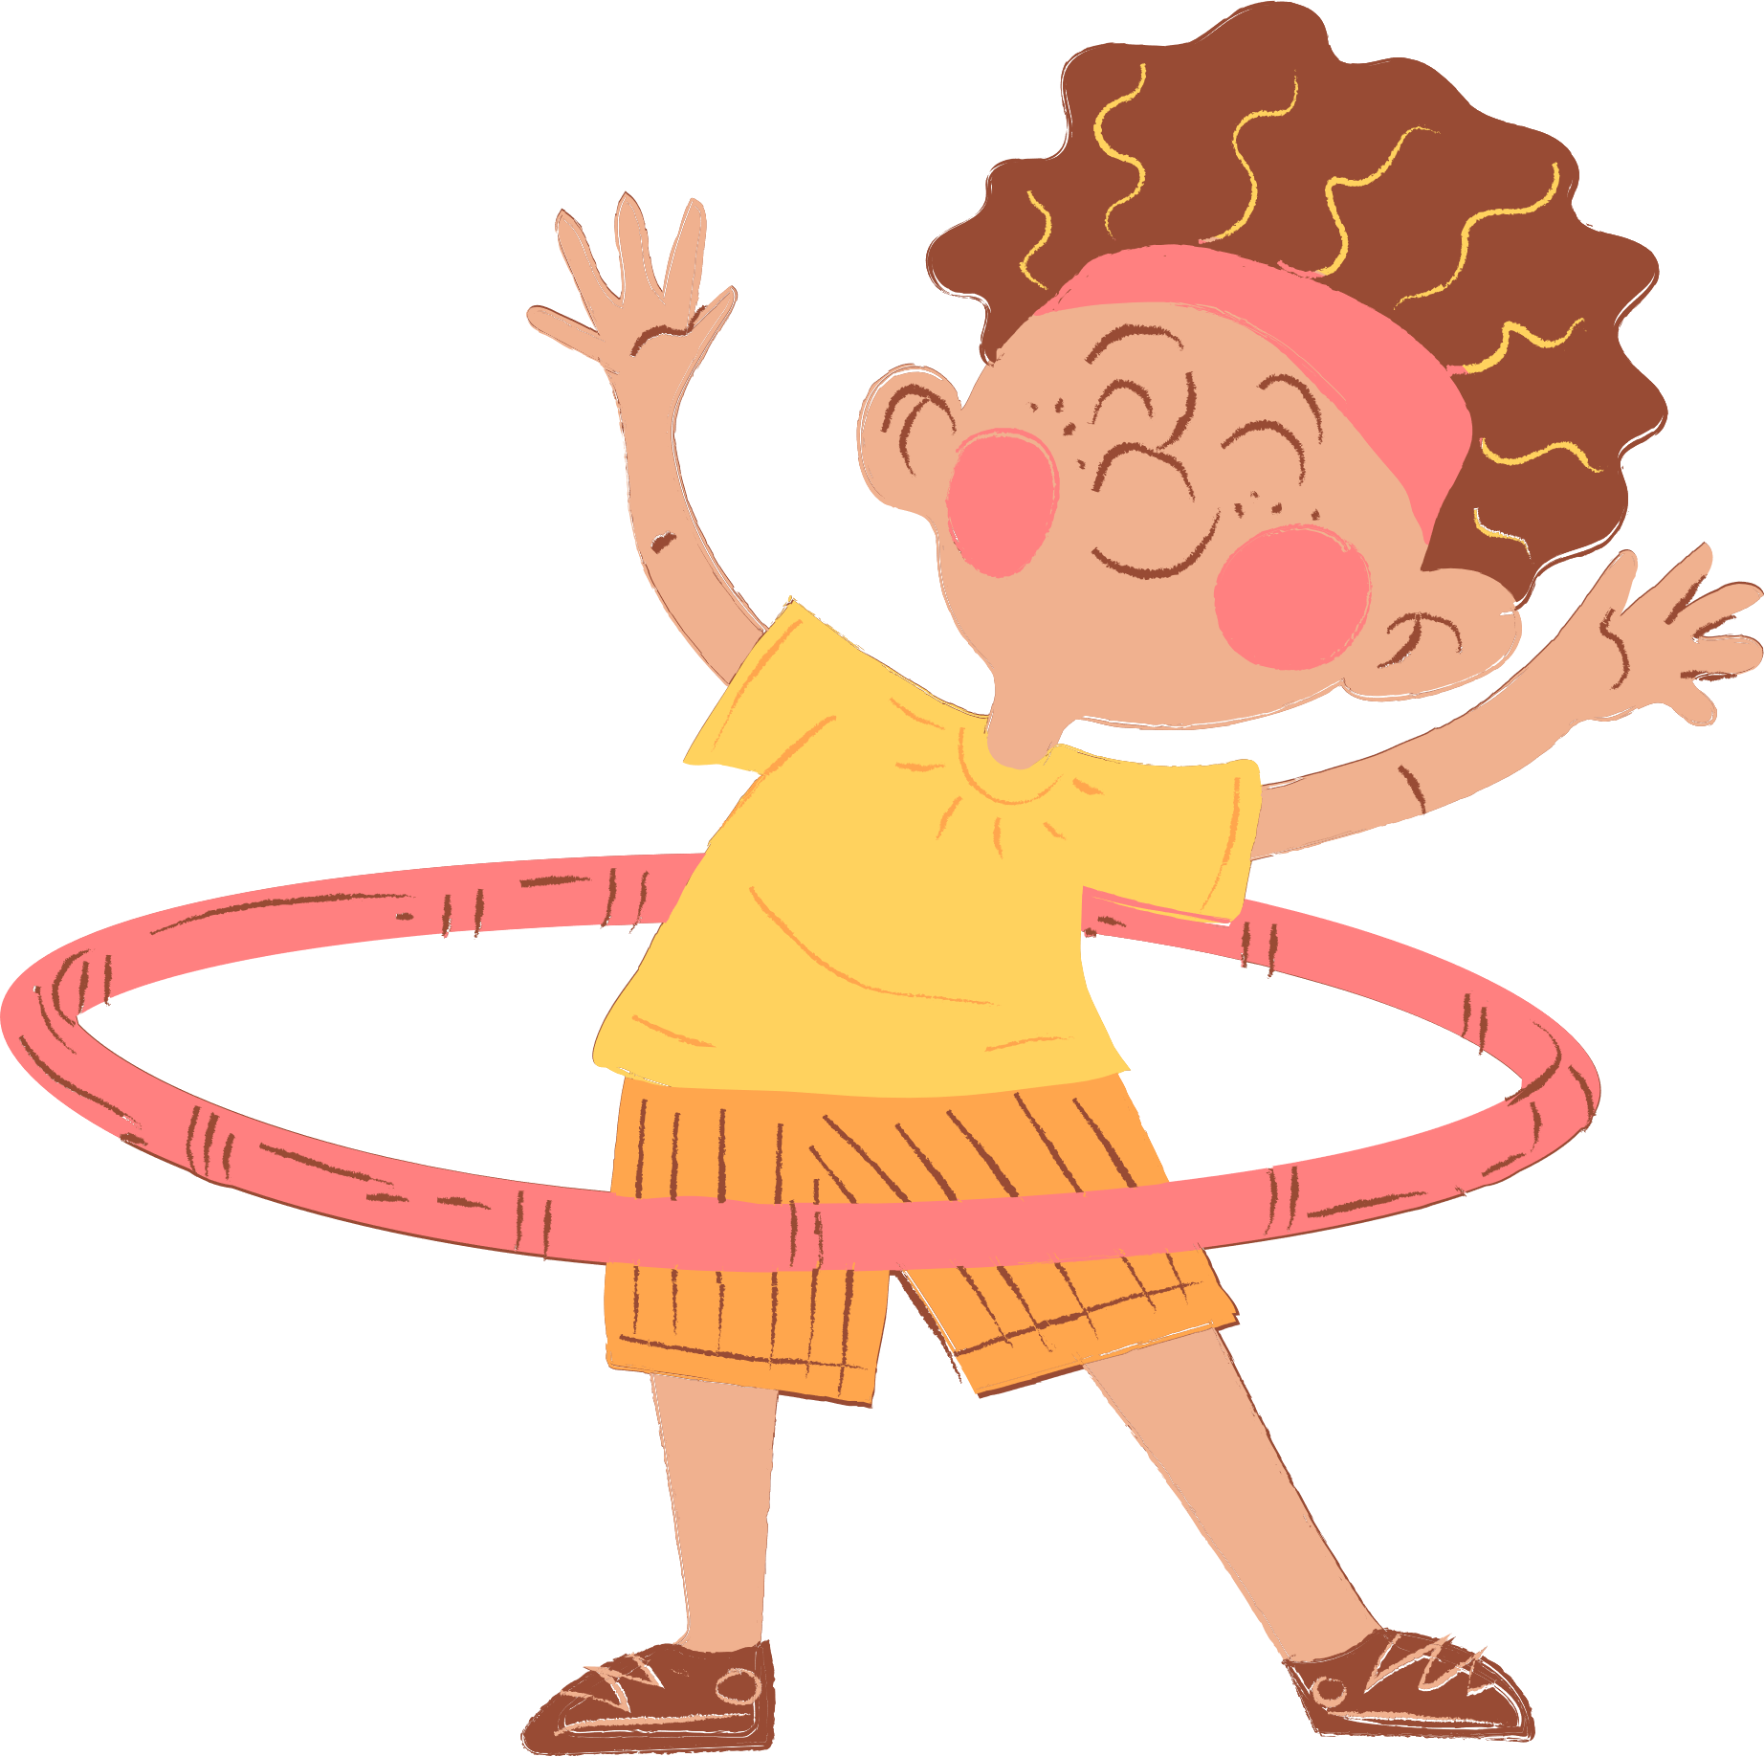
4
Our free-time activities

Slide 3





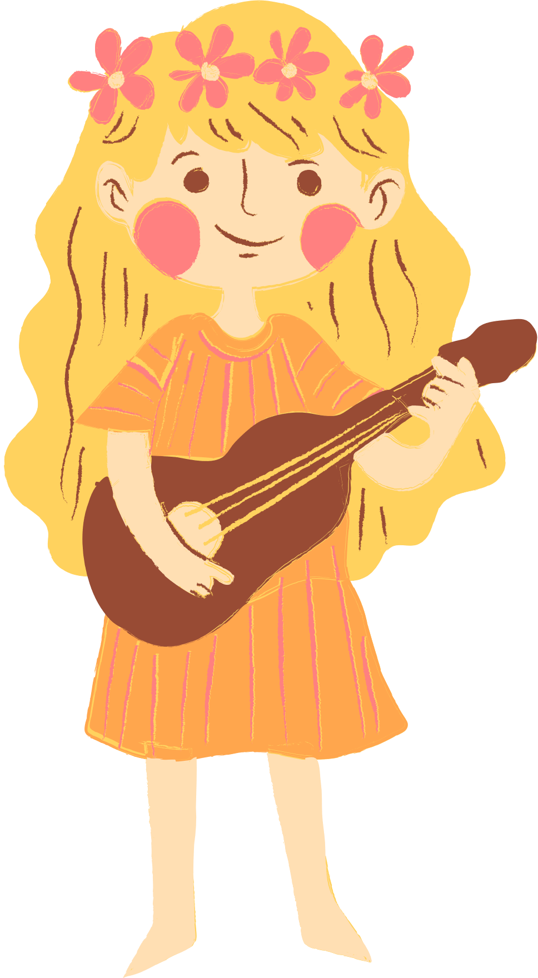
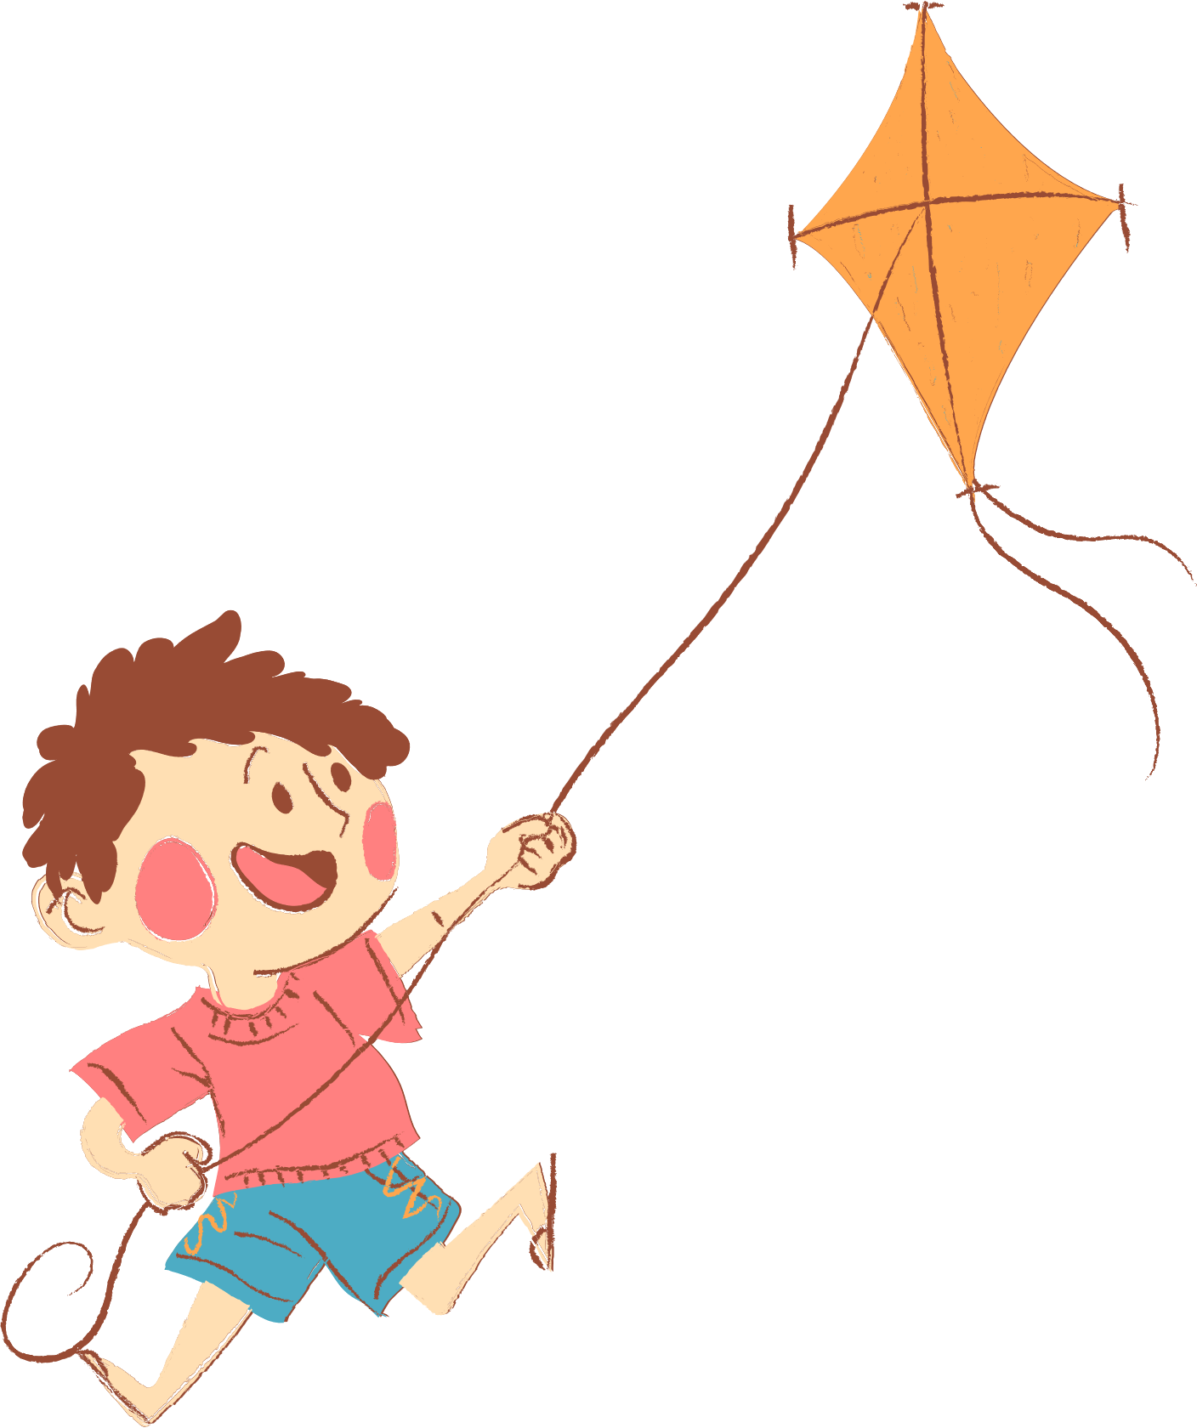

01. Warm-up and Review
Choose a number and say the activity.

Slide 4

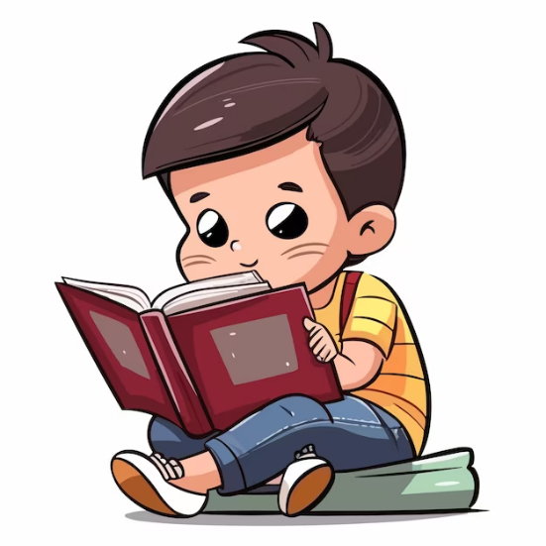
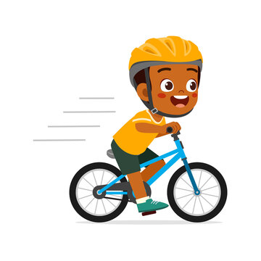
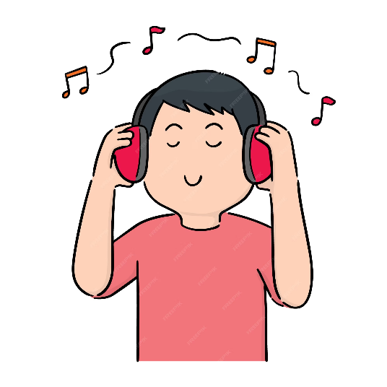


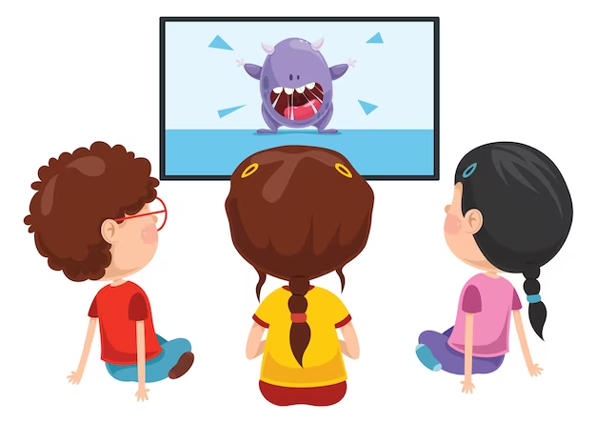


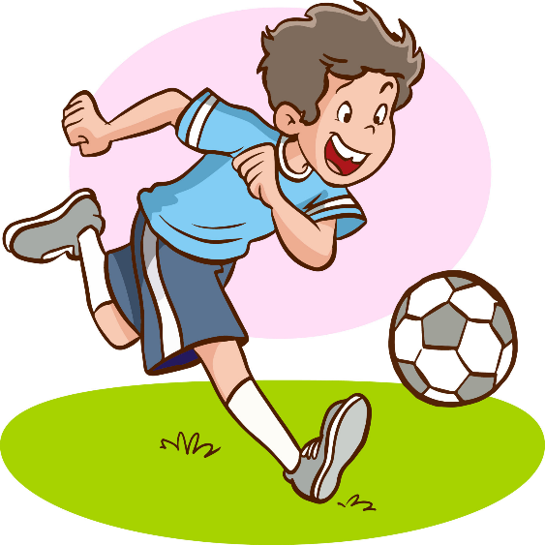
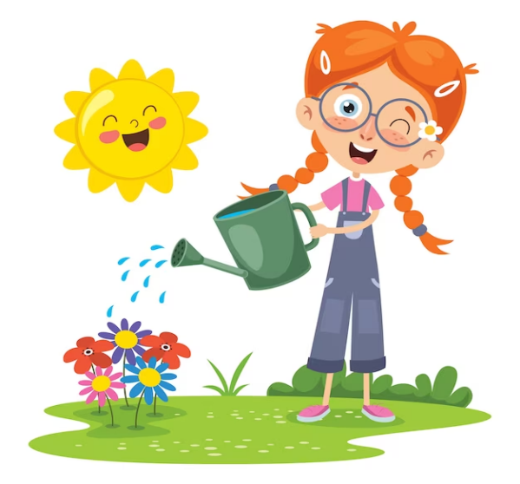
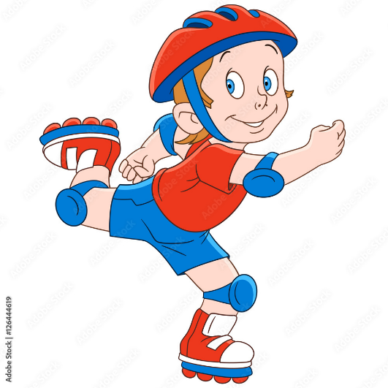
1
2
3
= +1 point
4
5
6
= lose 2 points
= rock, paper, scissors
(winner takes 2)
7
8
9
Notes:
- Divide the class into 3 teams.
- Pupils from each team choose a number (or throw sticky ball on the grid to choose the number), then have 2 pupils from each team ask and answer with the picture in that number.
- Pupils or teacher clicks on the month to reveal the icons indicating the points for that team.
- After 9 numbers, the team with the most points is the winner.

Slide 5


Adverbs of frequency
always
✓✓✓✓
usually
✓✓✓
often
✓✓
sometimes
✓
never
✗

Slide 6



What do you do at the weekend?
Mon. | Tue. | Wed. | Thu. | Fri. | Sat. | Sun.
always
I always read stories.

Slide 7
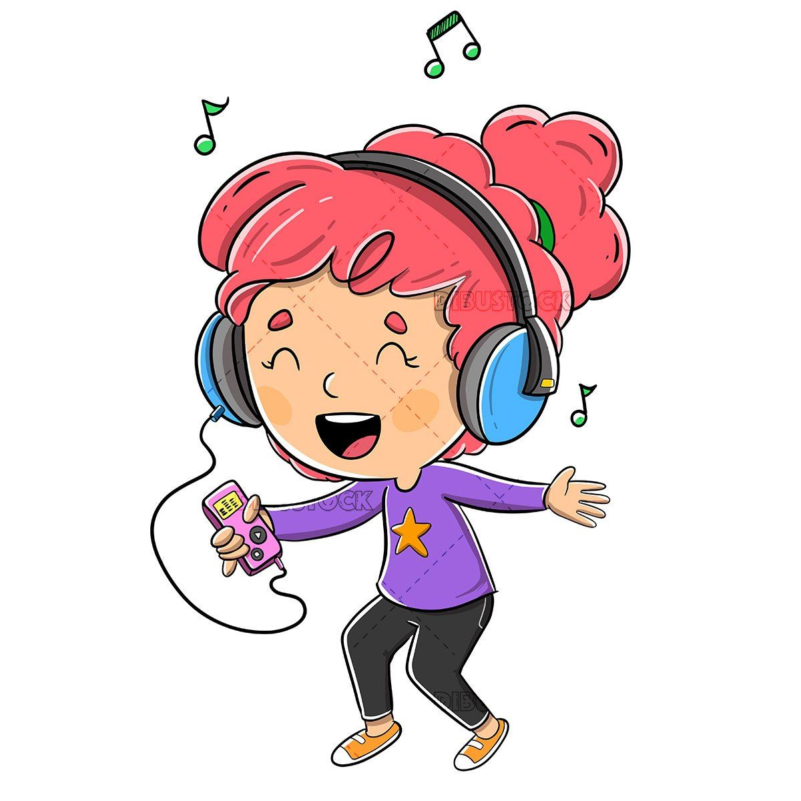
What do you do at the weekend?
Mon. | Tue. | Wed. | Thu. | Fri. | Sat. | Sun.
usually
I usually listen to music.

Slide 8
What do you do at the weekend?
Mon. | Tue. | Wed. | Thu. | Fri. | Sat. | Sun.
never
I never ride my bike.

Slide 9
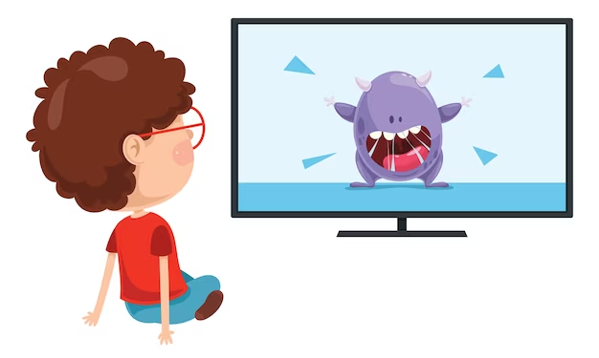
What do you do at the weekend?
Mon. | Tue. | Wed. | Thu. | Fri. | Sat. | Sun.
often
I often watch cartoons.

Slide 10
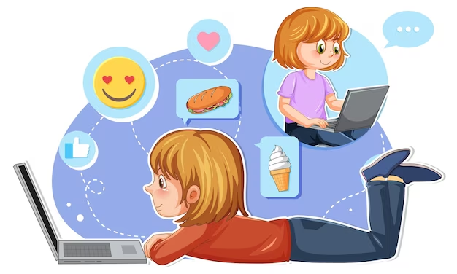
What do you do at the weekend?
Mon. | Tue. | Wed. | Thu. | Fri. | Sat. | Sun.
sometimes
I sometimes surf the Internet.

Slide 11
02.
Listen and tick.

Slide 12
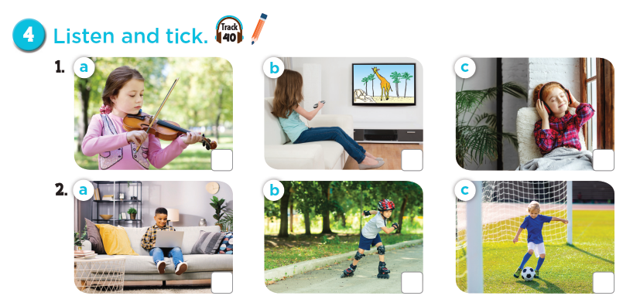

Notes:
Press the spacebar or down arrow to reveal the answer.
Press the X to go back to the letter slide (wrong answer), press the question box to go the reward slide (correct answer).

Slide 13

Let's check!
Notes:
Press the spacebar or down arrow to reveal the answer.
Press the X to go back to the letter slide (wrong answer), press the question box to go the reward slide (correct answer).

Slide 14
03.
Read and complete.

Slide 15
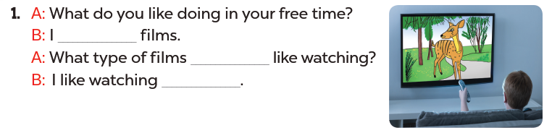
Read. What's the missing word?
like watching
do you
cartoons

Slide 16
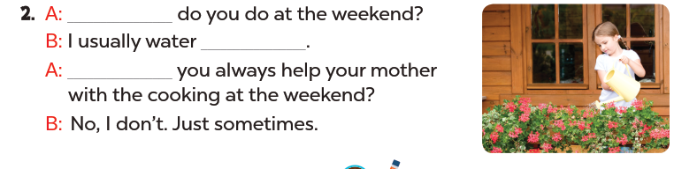
Read. What's the missing word?
What
the flowers
Do

Slide 17
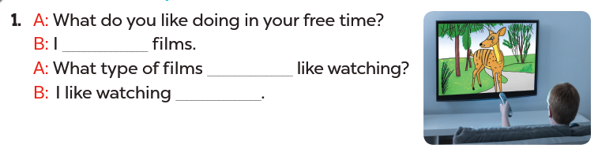
Read aloud.
like watching
do you
cartoons

Slide 18
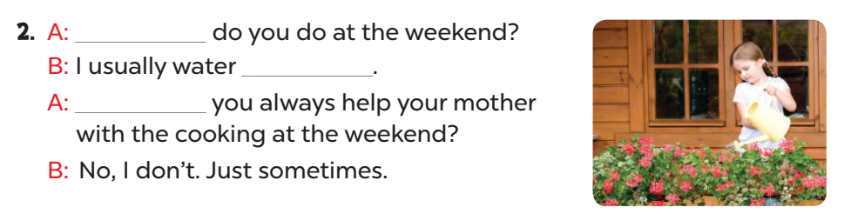
Act it out.
What
the flowers
Do

Slide 19
04.
Let's sing.

Slide 20
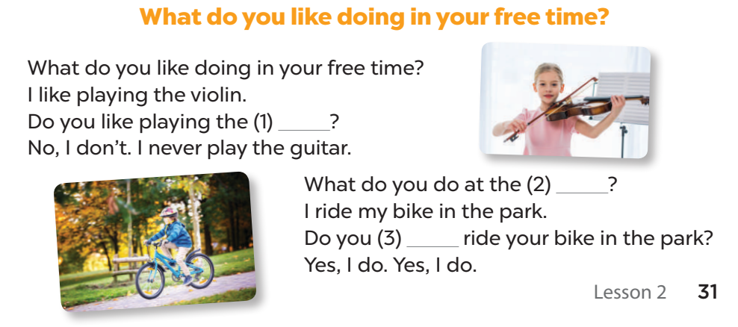
Listen and complete.
guitar
weekend
always

Slide 21
Let's sing.
guitar
weekend
always
Notes:
Link video hoạt hình: https://hoclieu.vn/hop-phan-bo-tro/video-hoat-hinh/203

