Slide 1




UBND QUẬN DƯƠNG KINH
TRƯỜNG TIỂU HỌC ANH DŨNG
ENGLISH - GRADE 5
UNIT 4: OUR FREE – TIME ACTIVITIES
LESSON 3 (1, 2, 3)

Slide 2









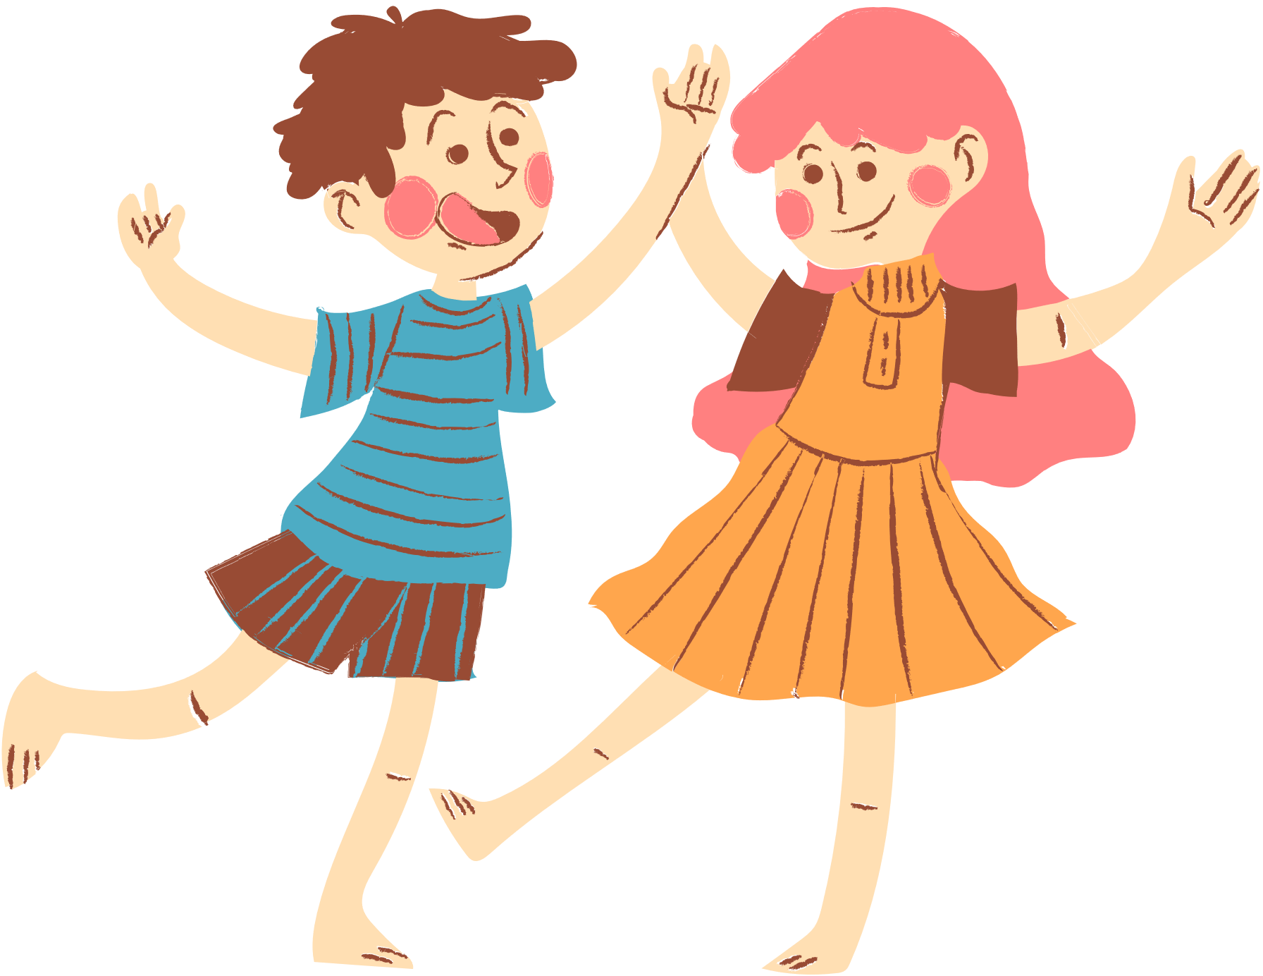
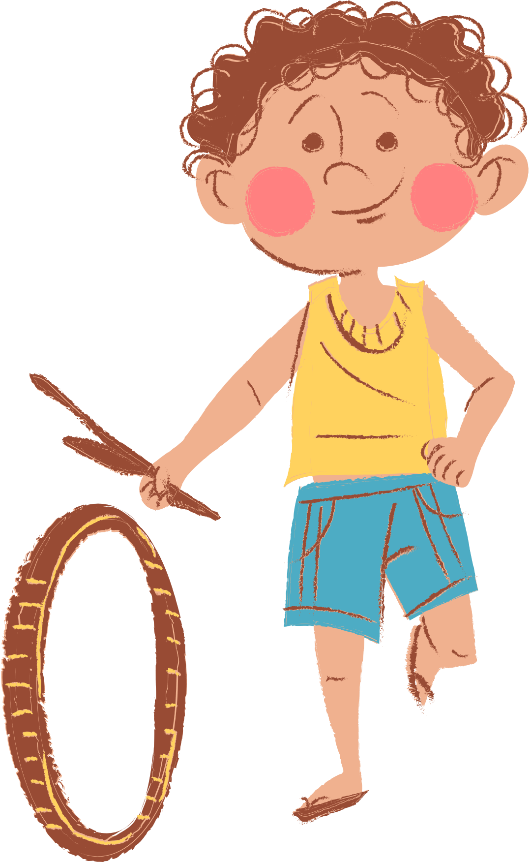
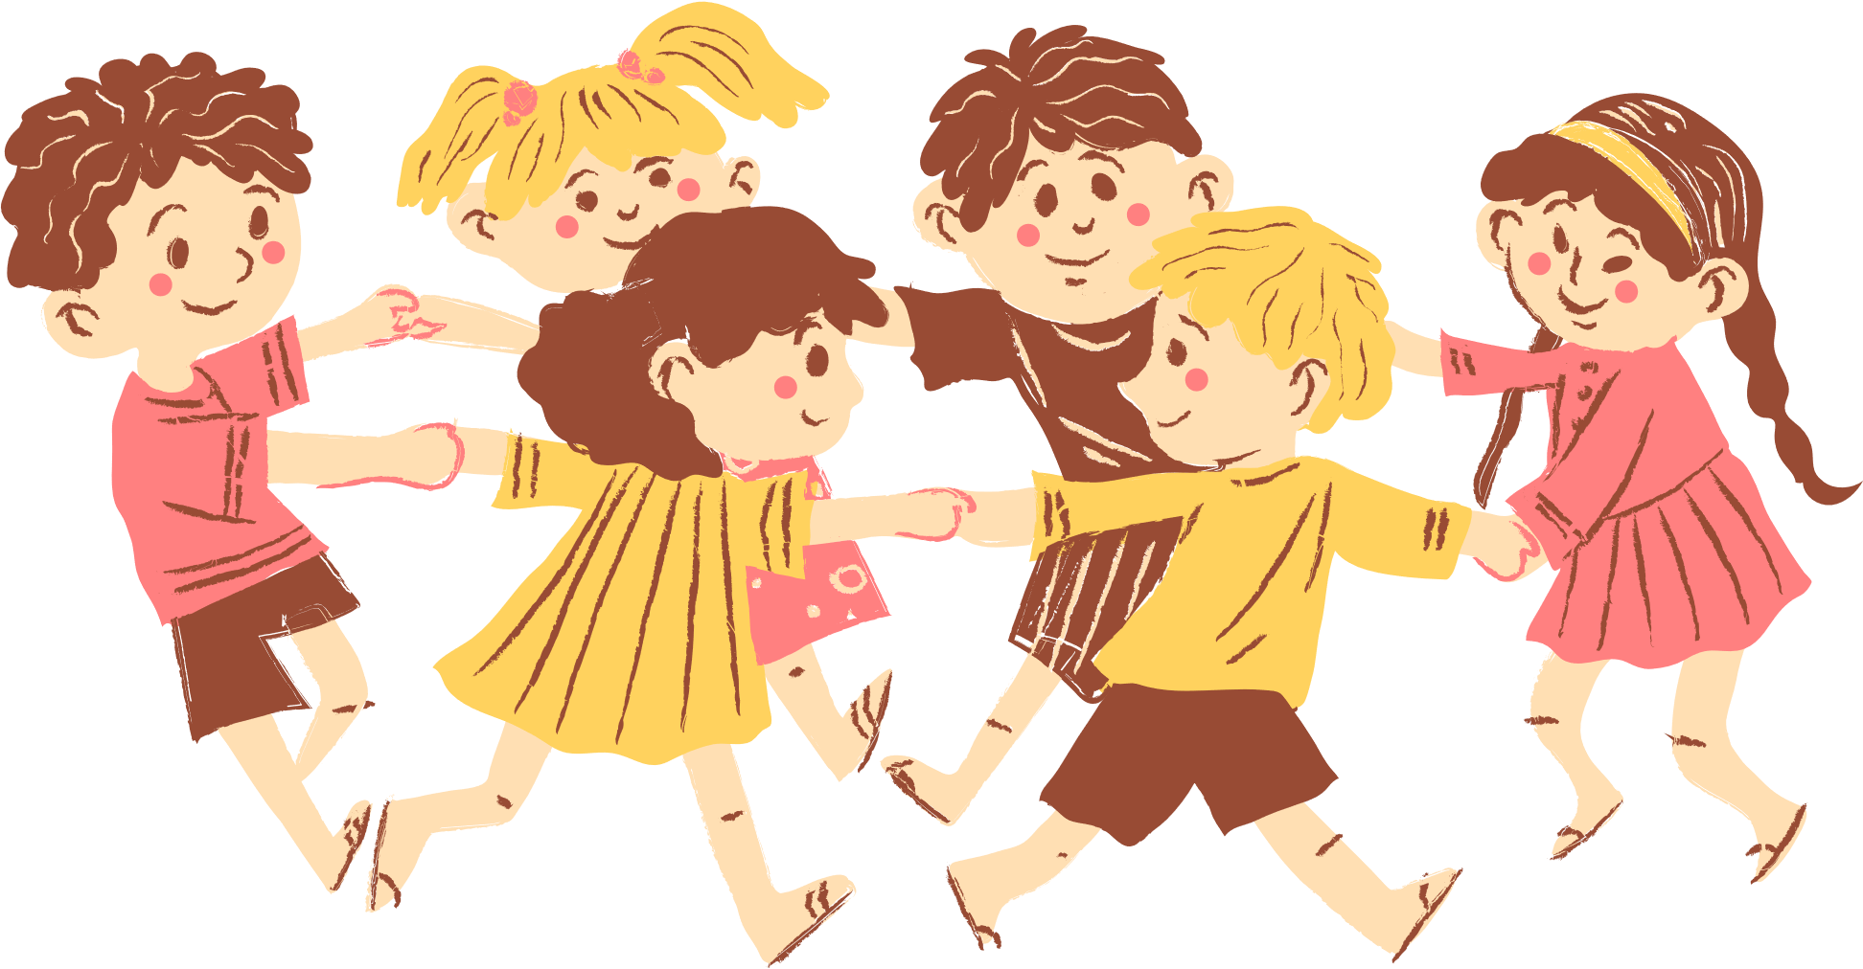
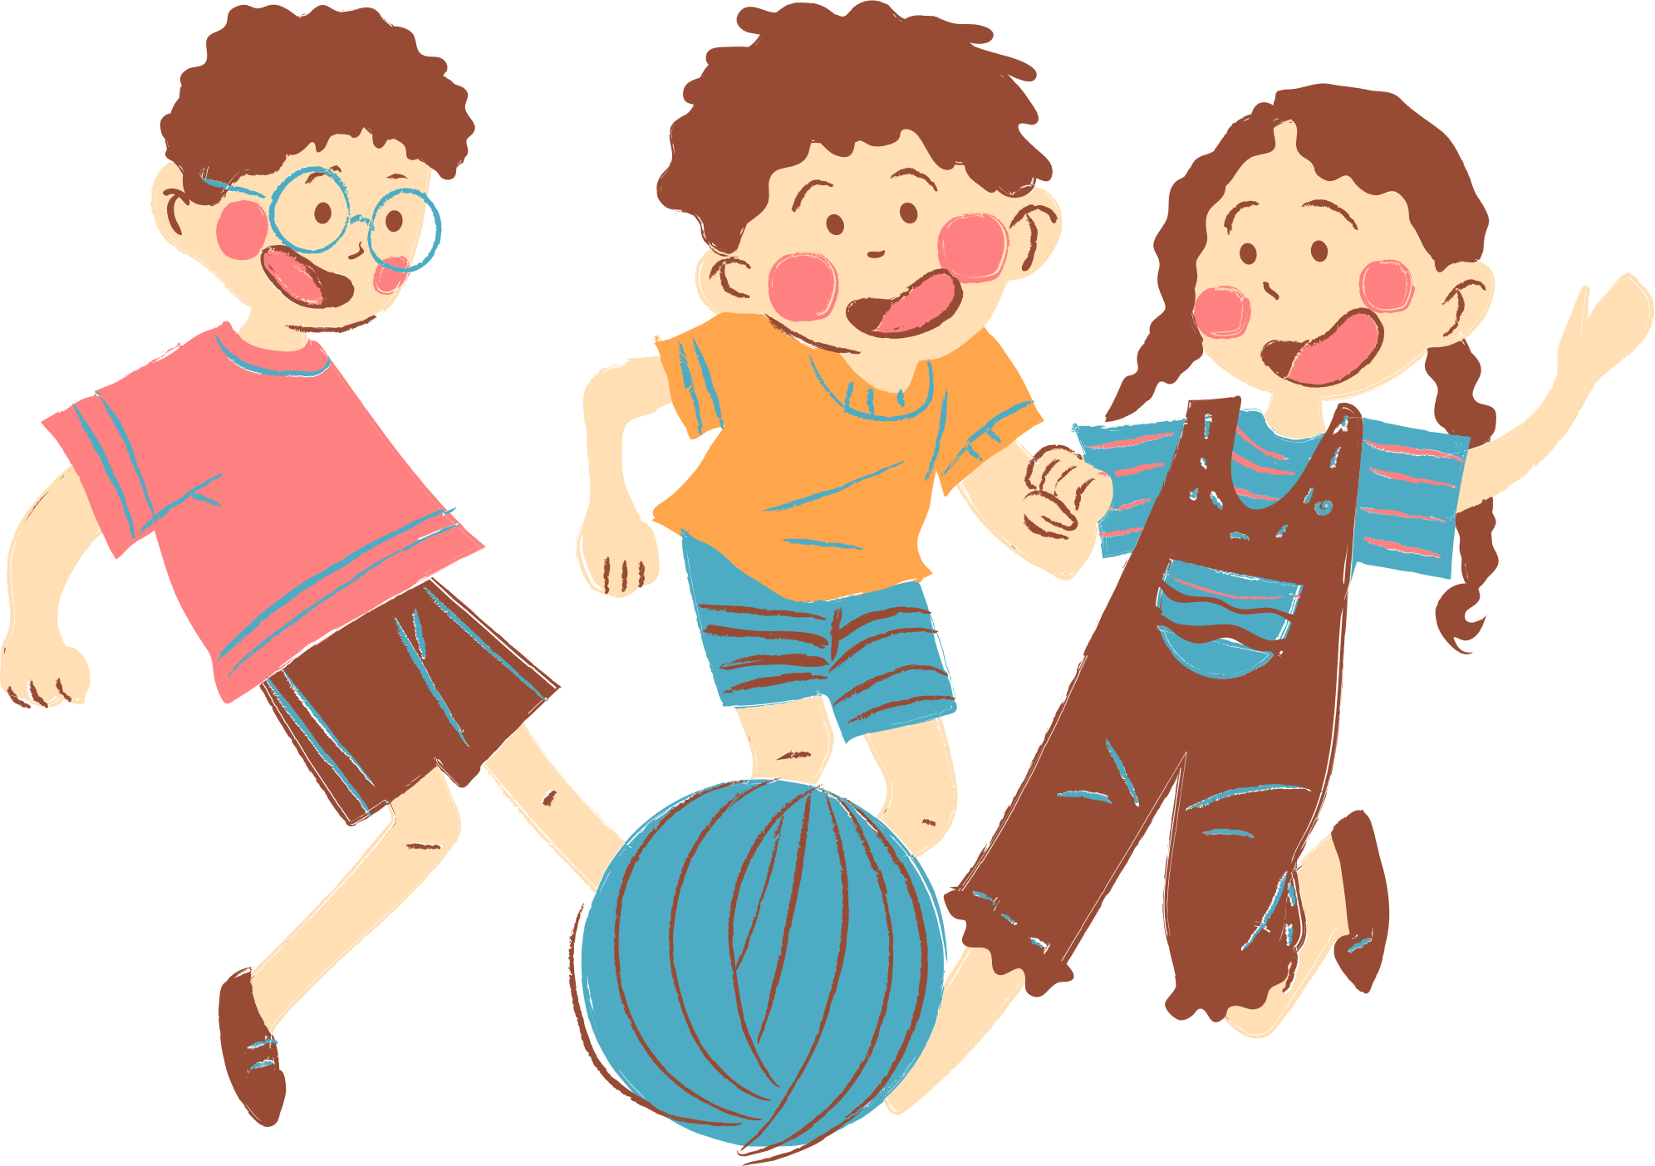
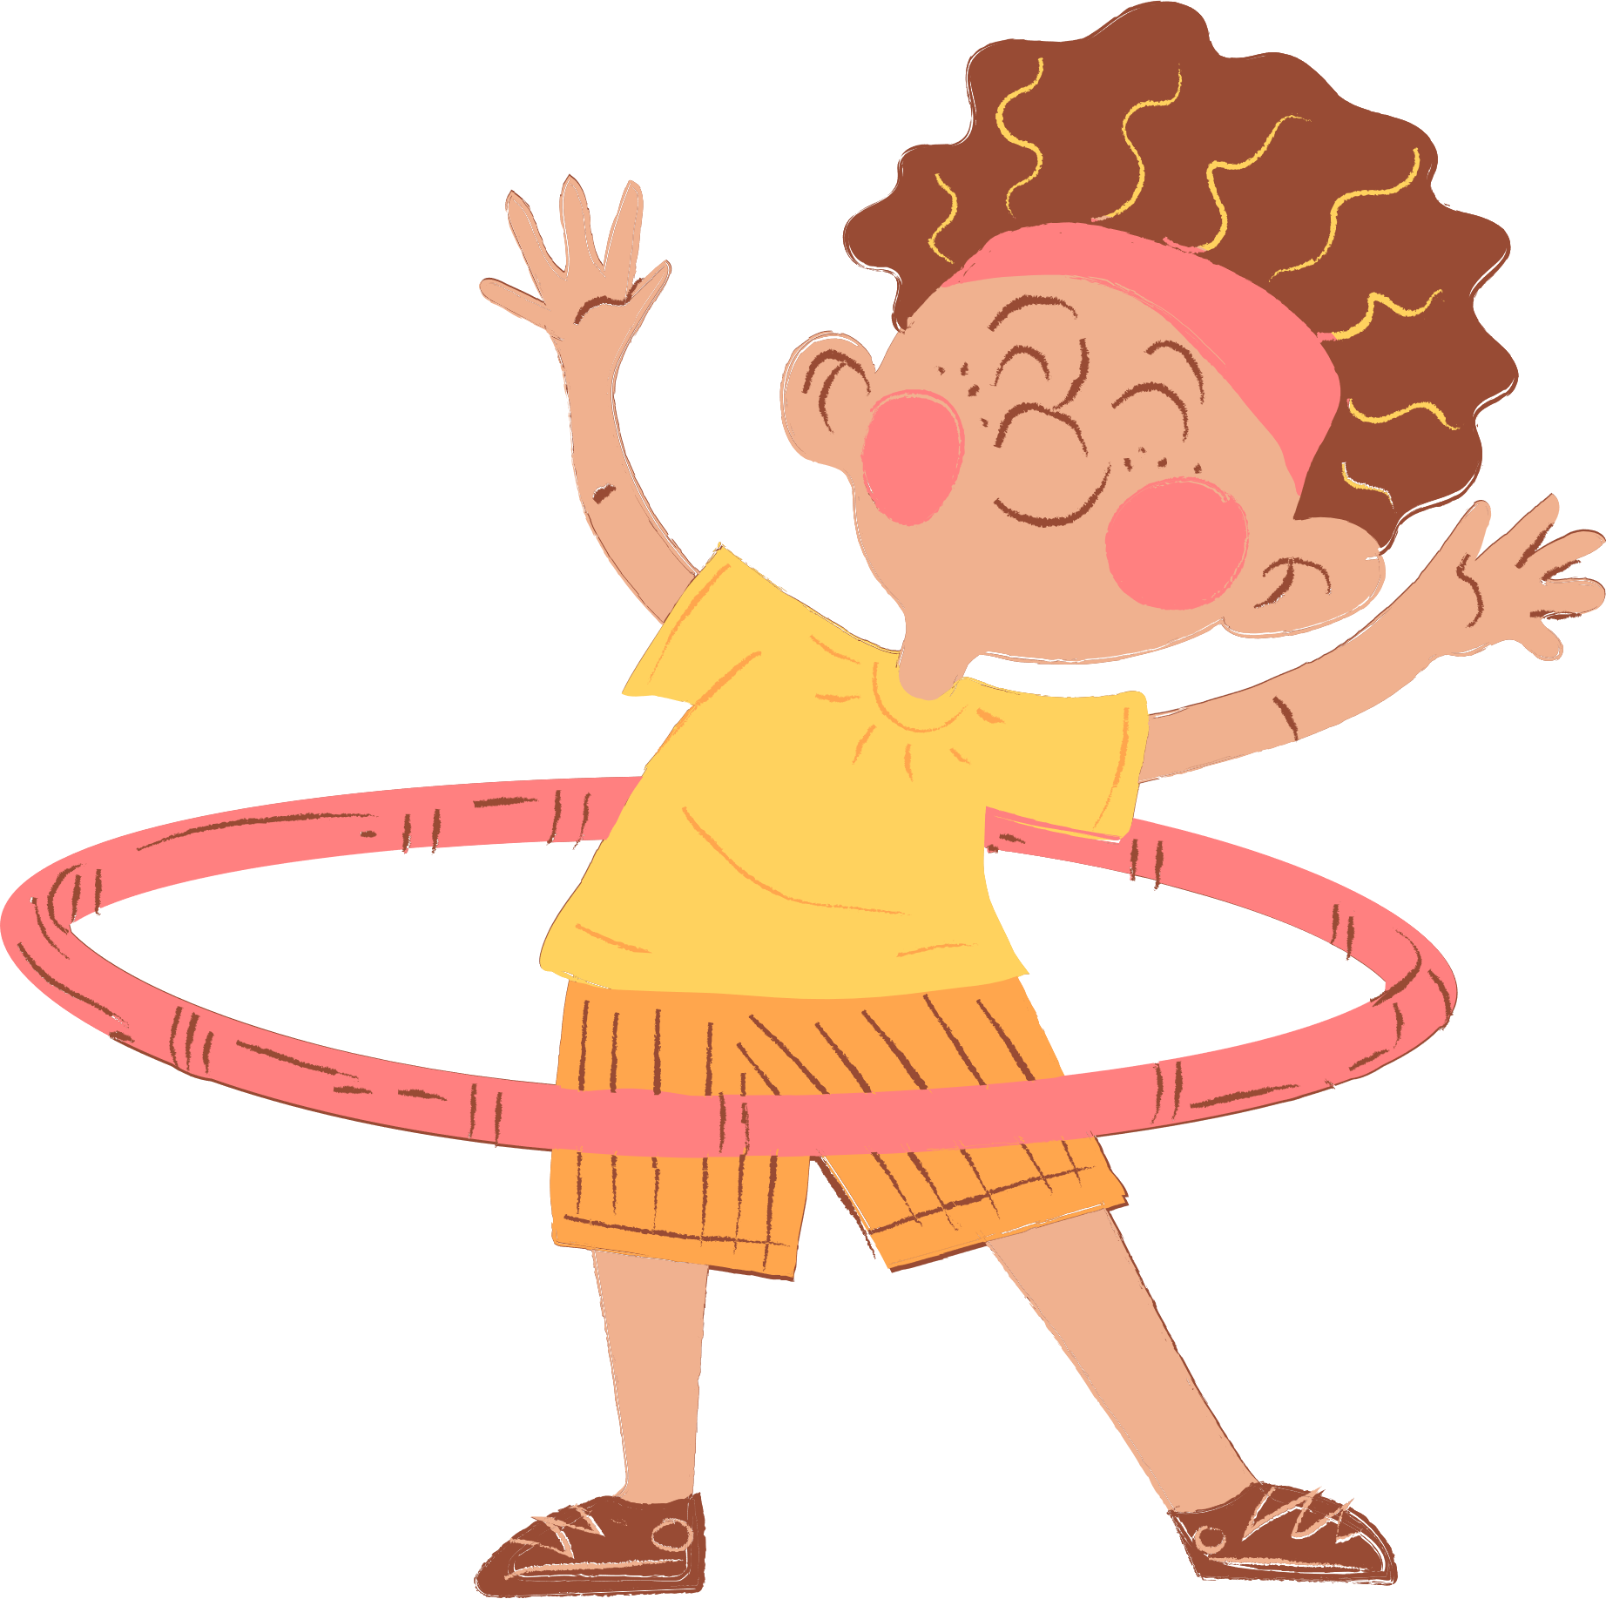
4
Our free-time activities

Slide 3






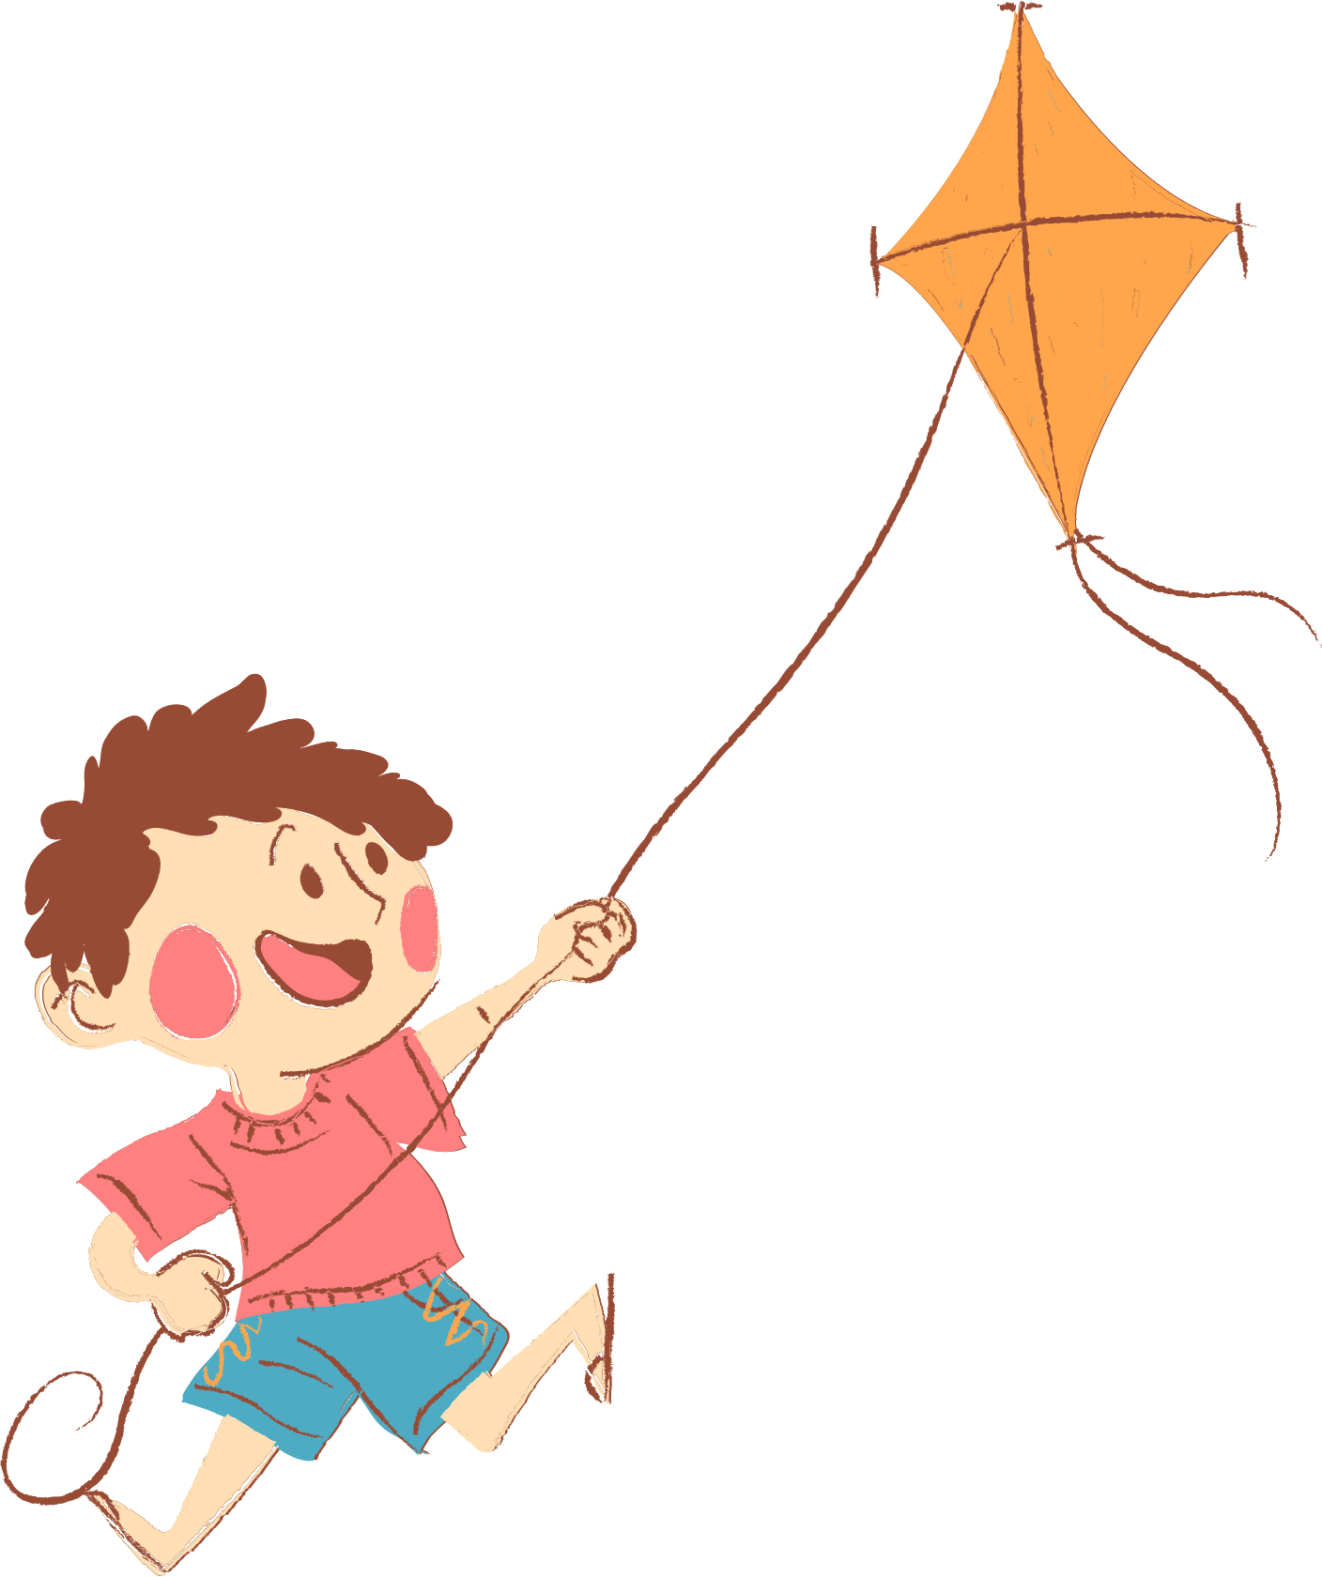
01. Warm-up and Review
Look and choose.

Slide 4



1
0
Start!
4
3
0
2
8
7
10
5
1
9
6
A. ride a bike
B. surf the Internet
C. play the violin
Notes:
- Student must answer in 10 seconds to get points.

Slide 5
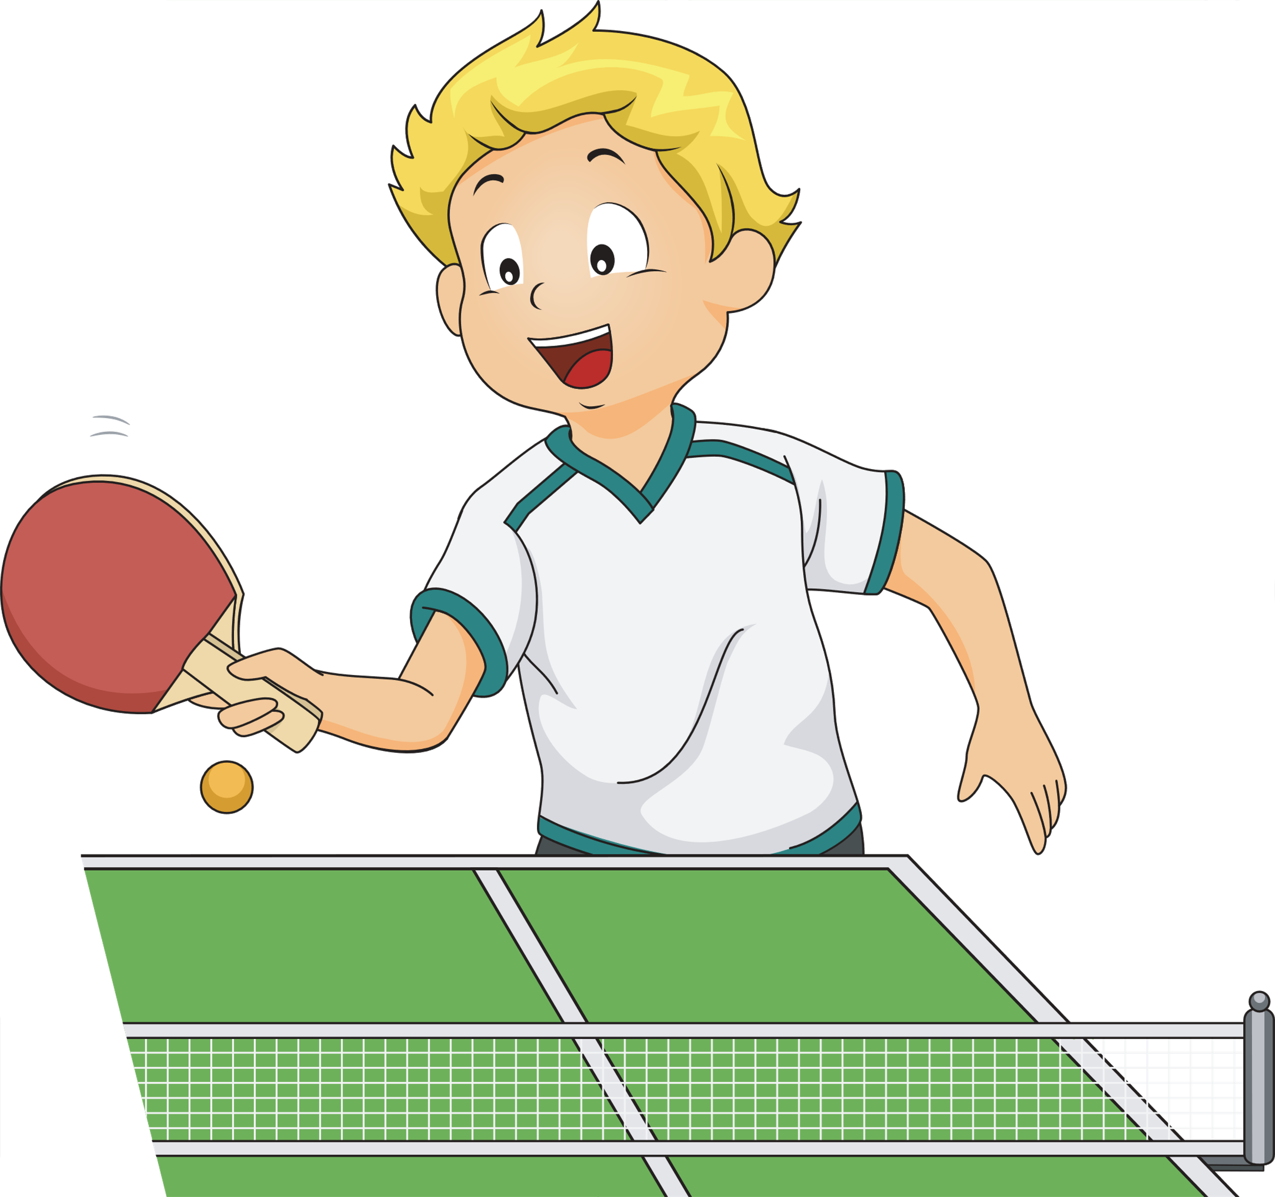
2
0
Start!
4
3
0
2
8
7
10
5
1
9
6
A. play table tennis
B. play tennis
C. play volleball
Notes:
- Student must answer in 10 seconds to get points.

Slide 6
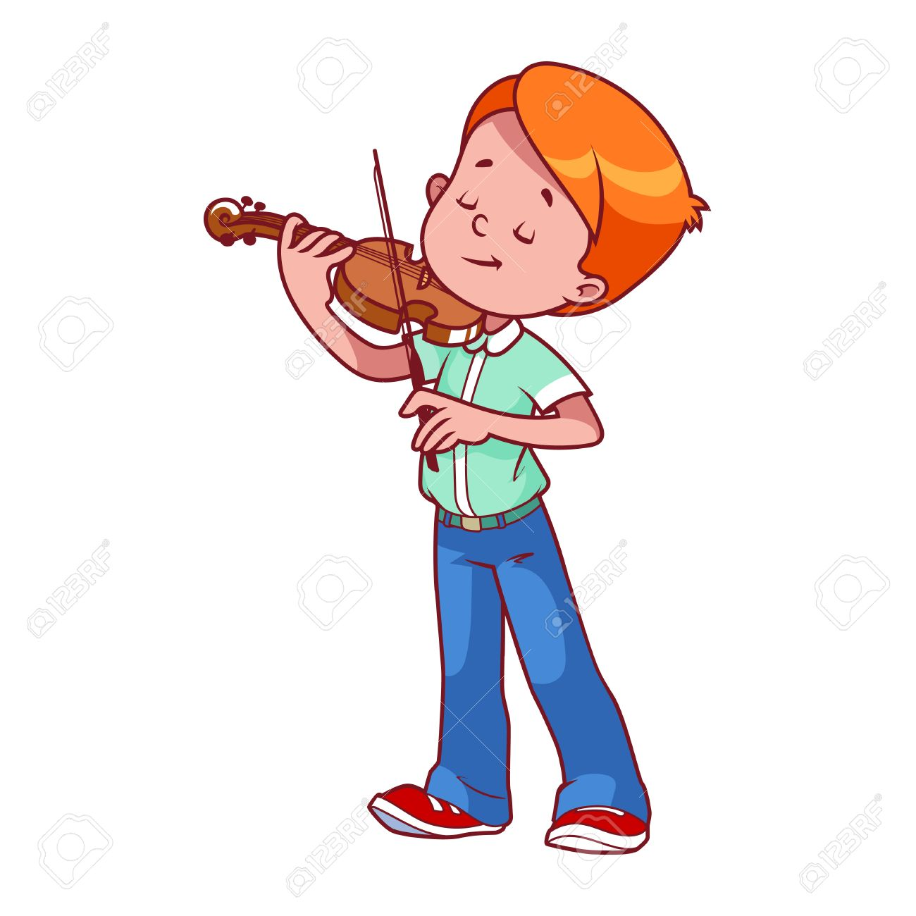
3
0
Start!
4
3
0
2
8
7
10
5
1
9
6
A. play the guitar
B. play the piano
C. play the violin
Notes:
- Student must answer in 10 seconds to get points.

Slide 7

4
0
Start!
4
3
0
2
8
7
10
5
1
9
6
A. go for a walk
B. read stories
C. listen to music
Notes:
- Student must answer in 10 seconds to get points.

Slide 8

5
0
Start!
4
3
0
2
8
7
10
5
1
9
6
A. water the flowers
B. surf the Internet
C. go for a walk
Notes:
- Student must answer in 10 seconds to get points.

Slide 9

6
0
Start!
4
3
0
2
8
7
10
5
1
9
6
A. play the guitar
B. play the violin
C. play the piano
Notes:
- Student must answer in 10 seconds to get points.

Slide 10



02. Listen and repeat.

Slide 11
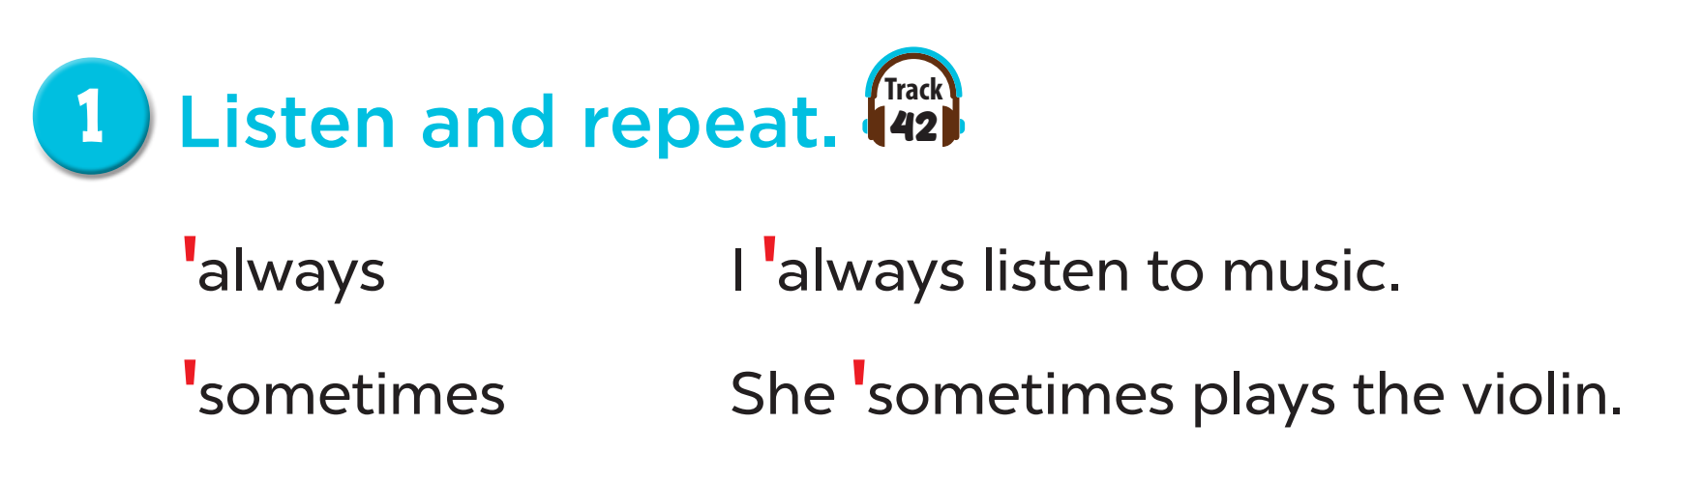


Slide 12
03. Circle, listen and check.

Slide 13
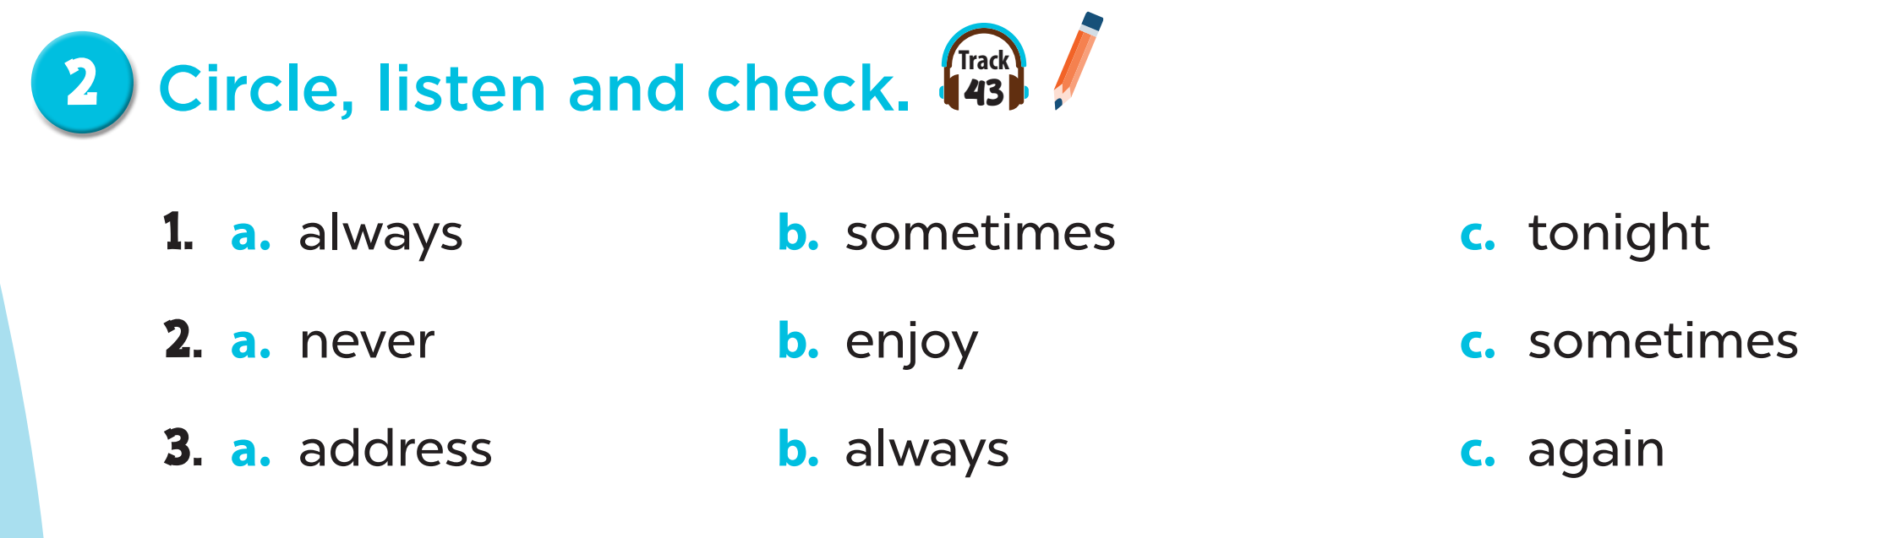
‘
‘
‘
‘
‘
‘
‘
‘
‘

Slide 14
04. Let’s chant.

Slide 15
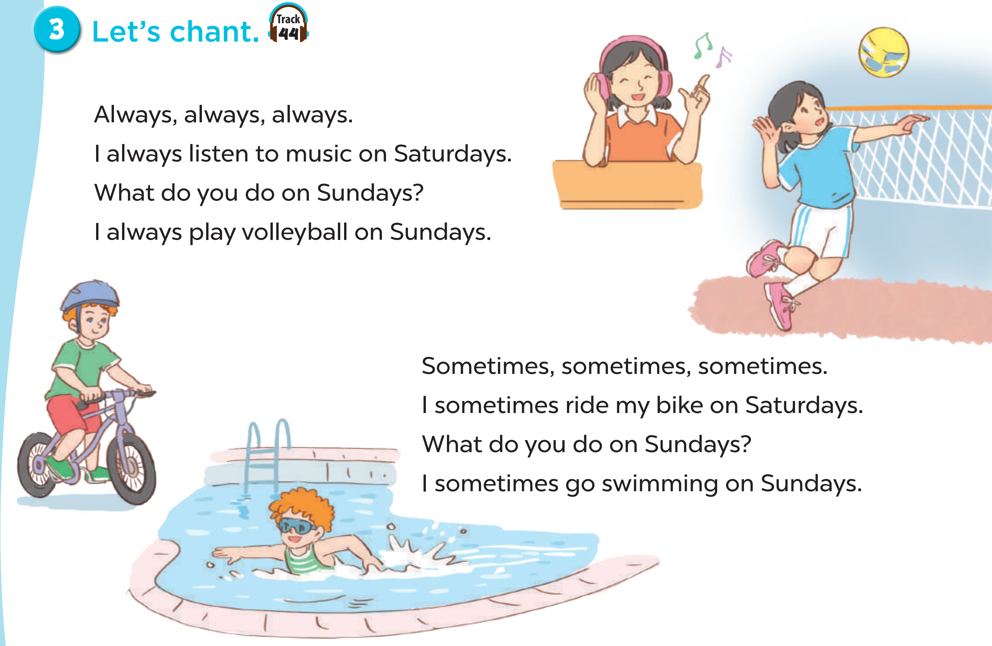
Notes:
Link video hoạt hình: Video hoạt hình - Tiếng Anh 5 | Học Liệu (hoclieu.vn)

