Slide 1




UBND QUẬN DƯƠNG KINH
TRƯỜNG TIỂU HỌC ANH DŨNG
ENGLISH - GRADE 5
UNIT 4: OUR FREE – TIME ACTIVITIES
LESSON 3 (4, 5, 6)

Slide 2








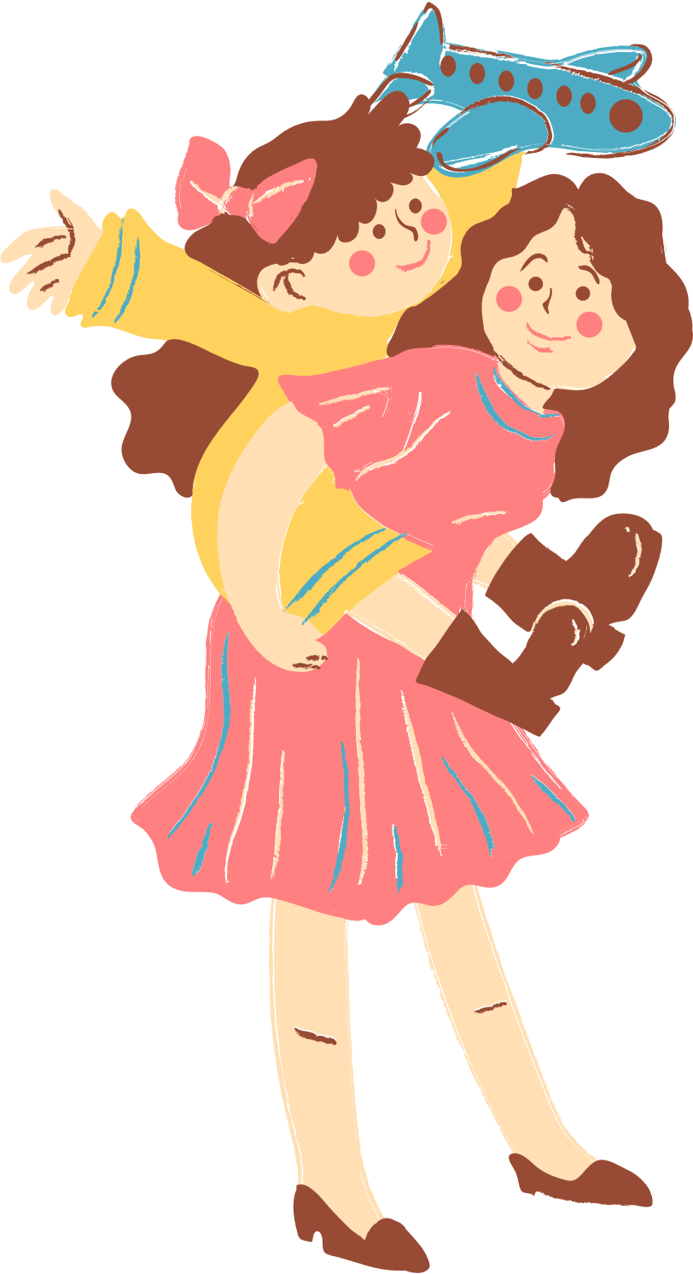
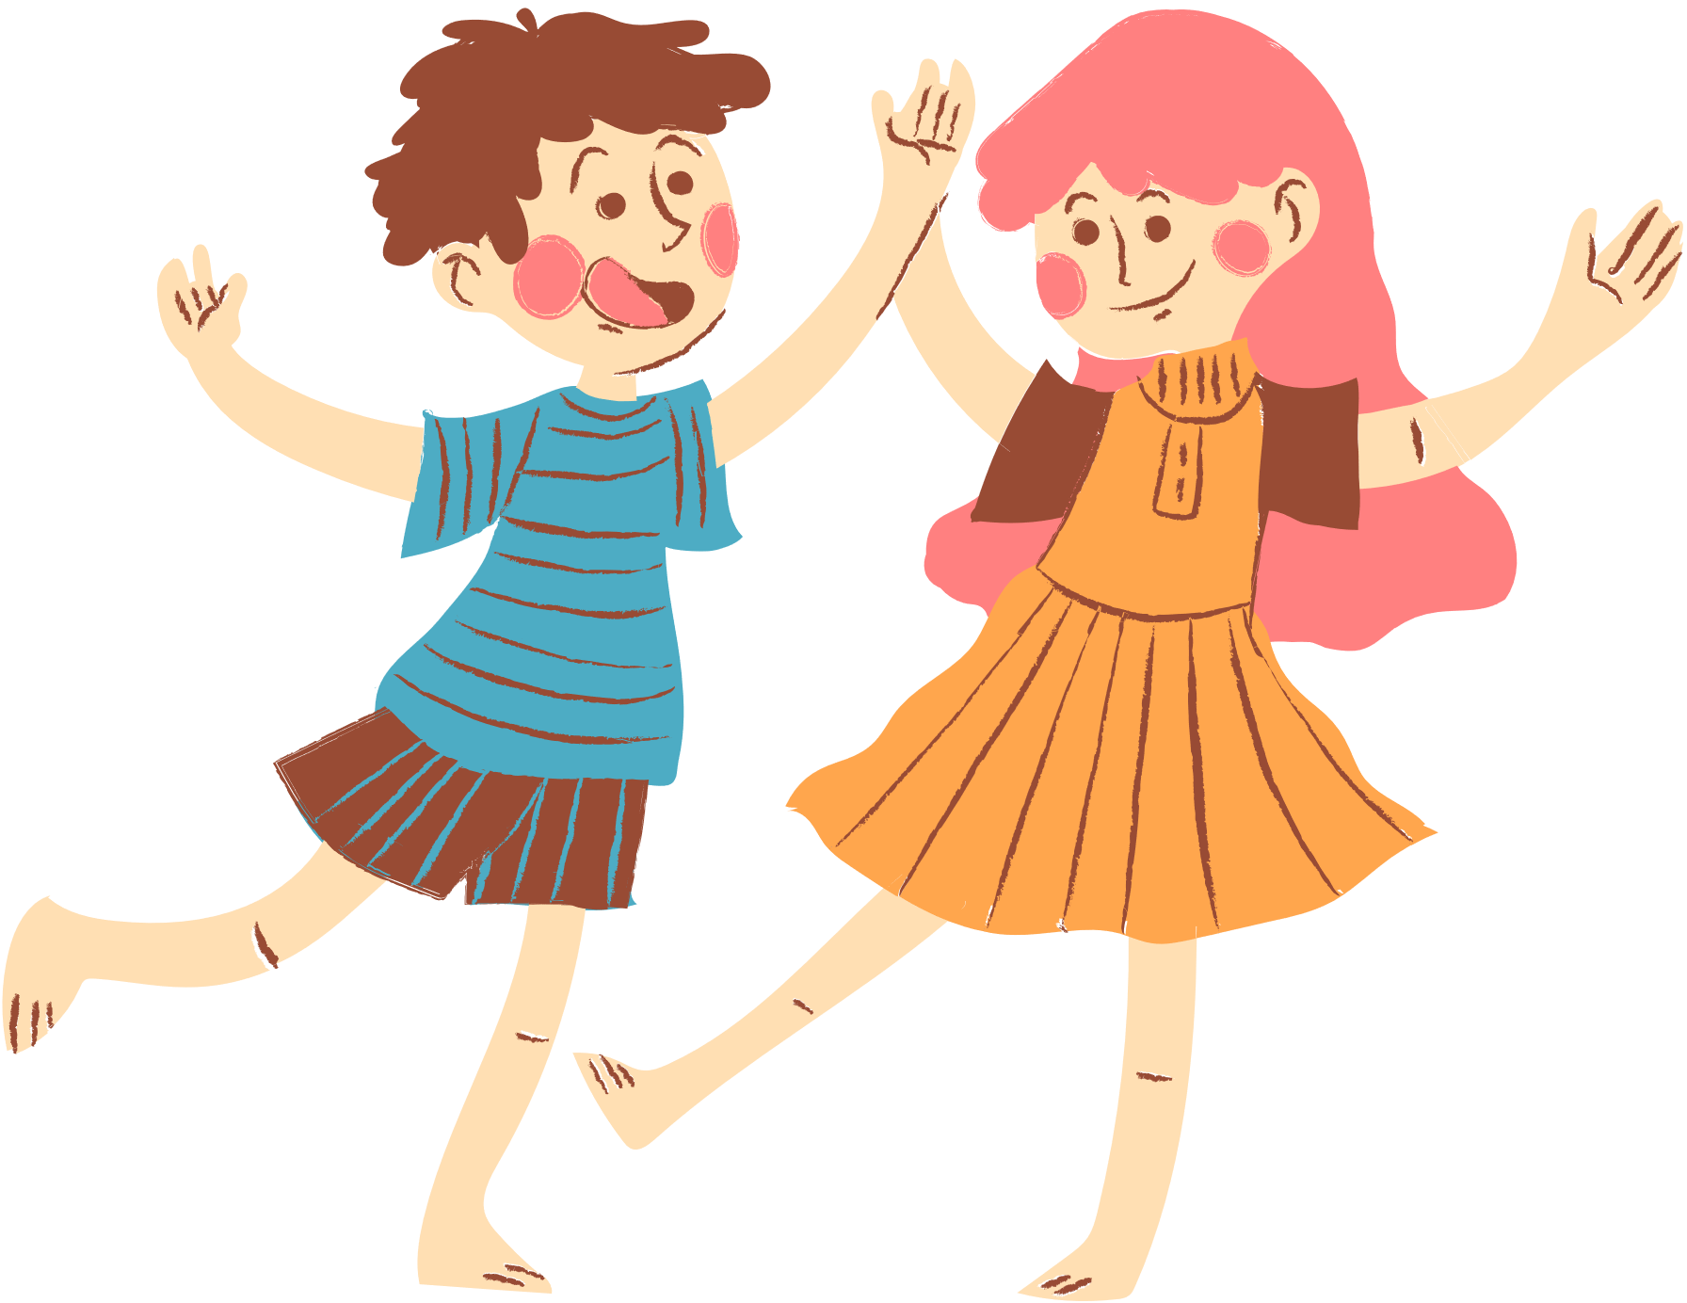
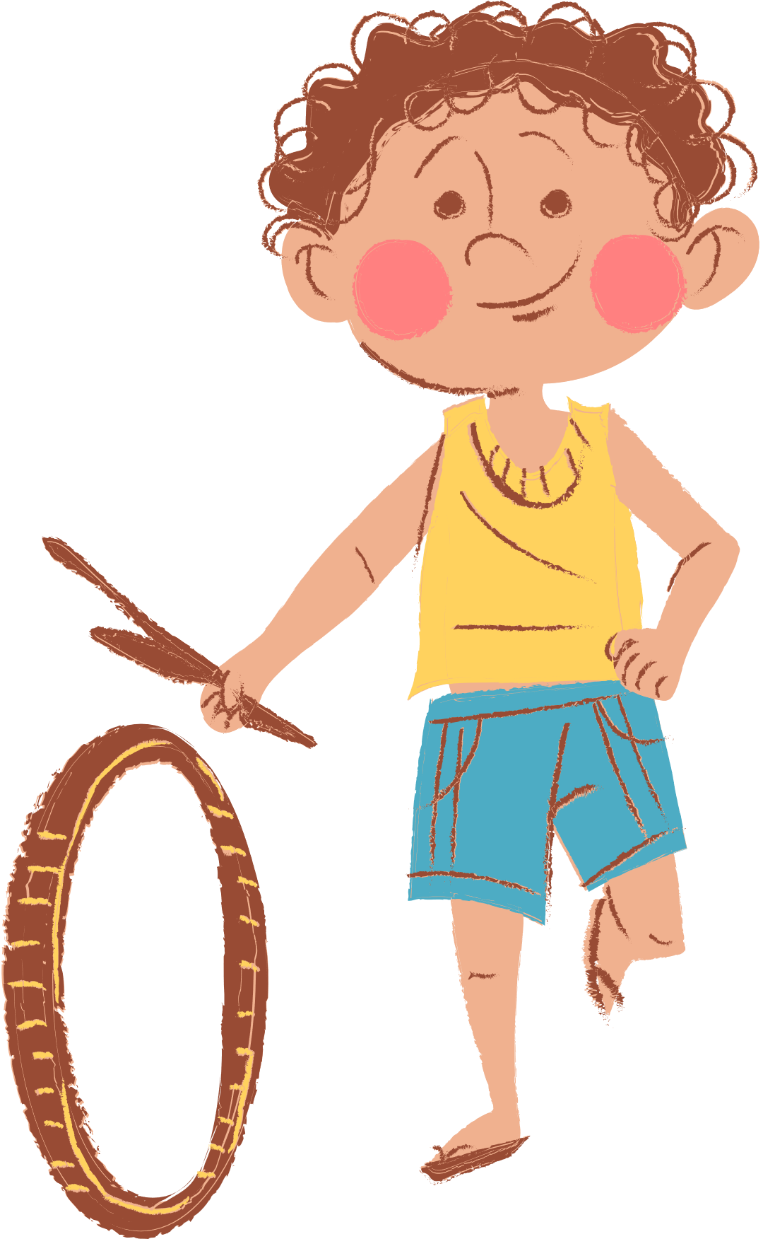
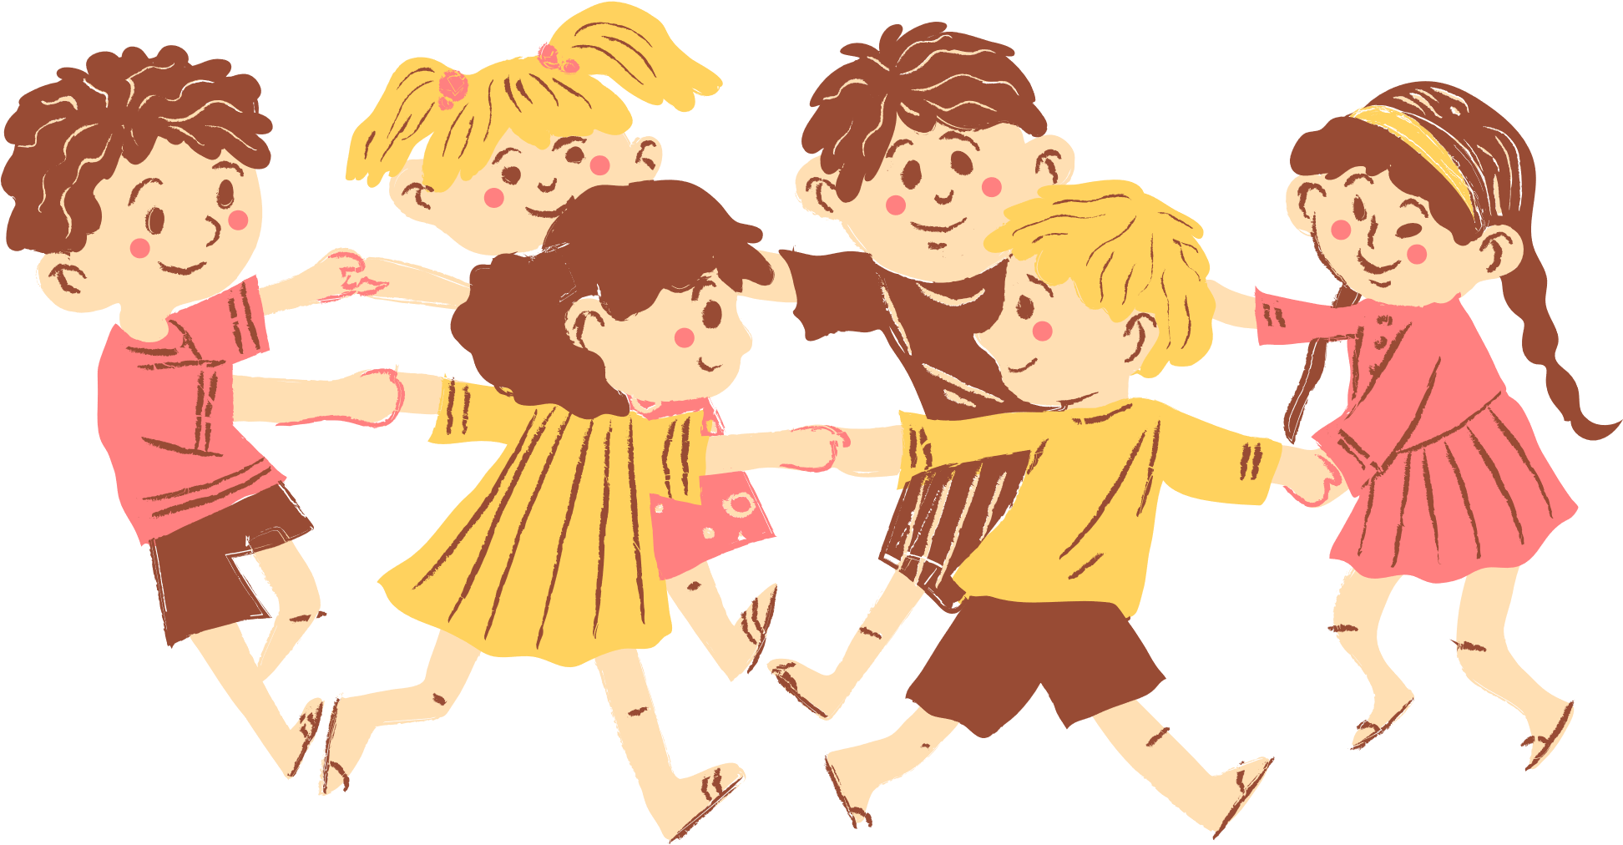
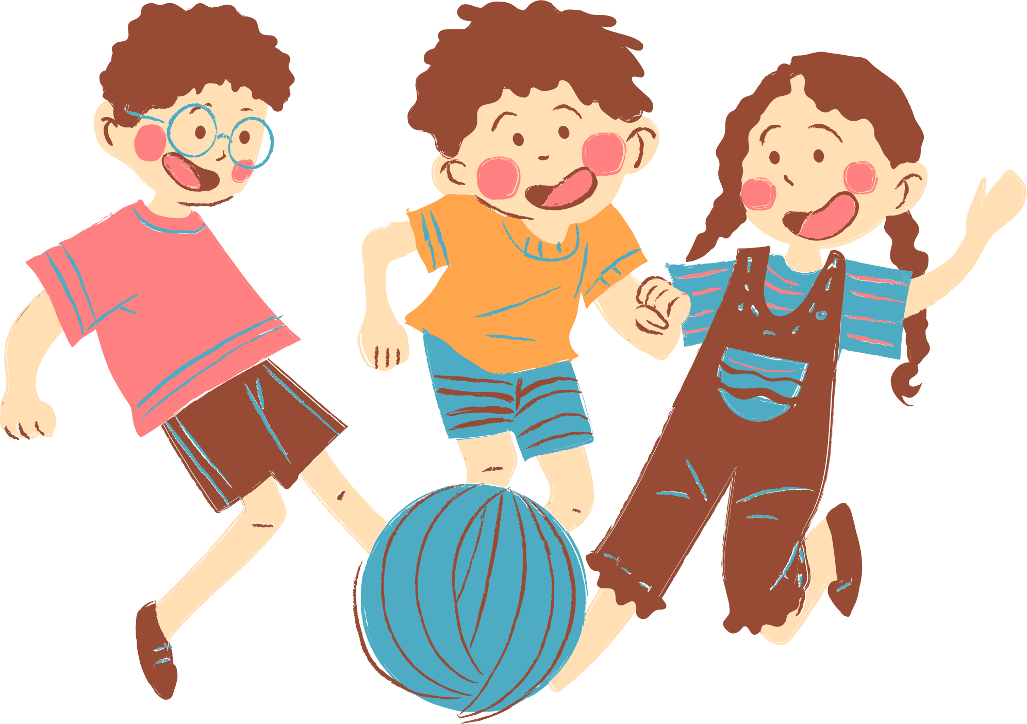
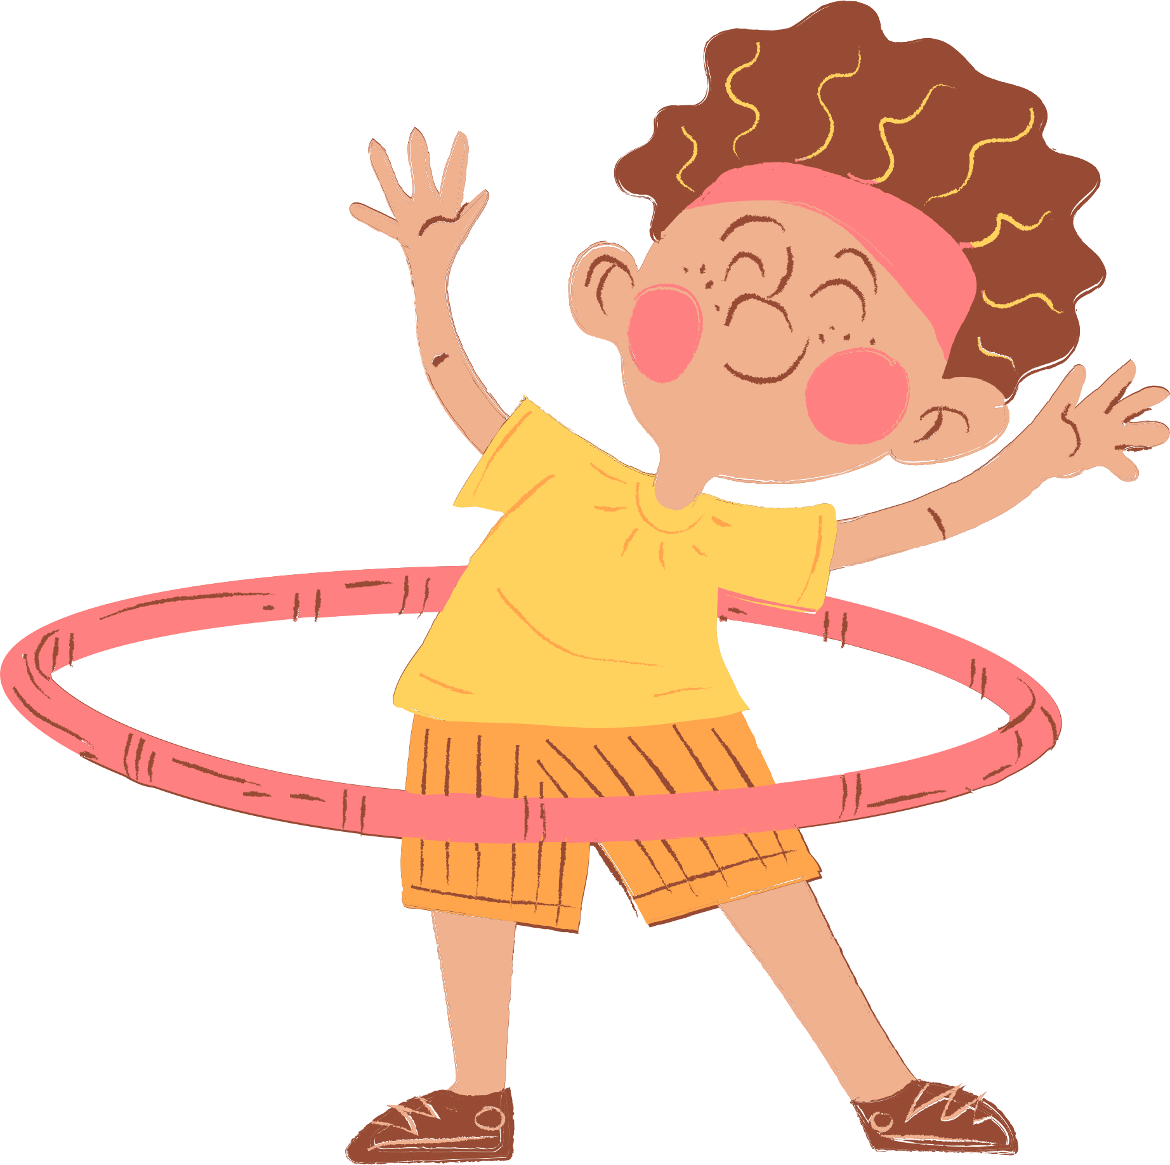
4
Our free-time activities

Slide 3






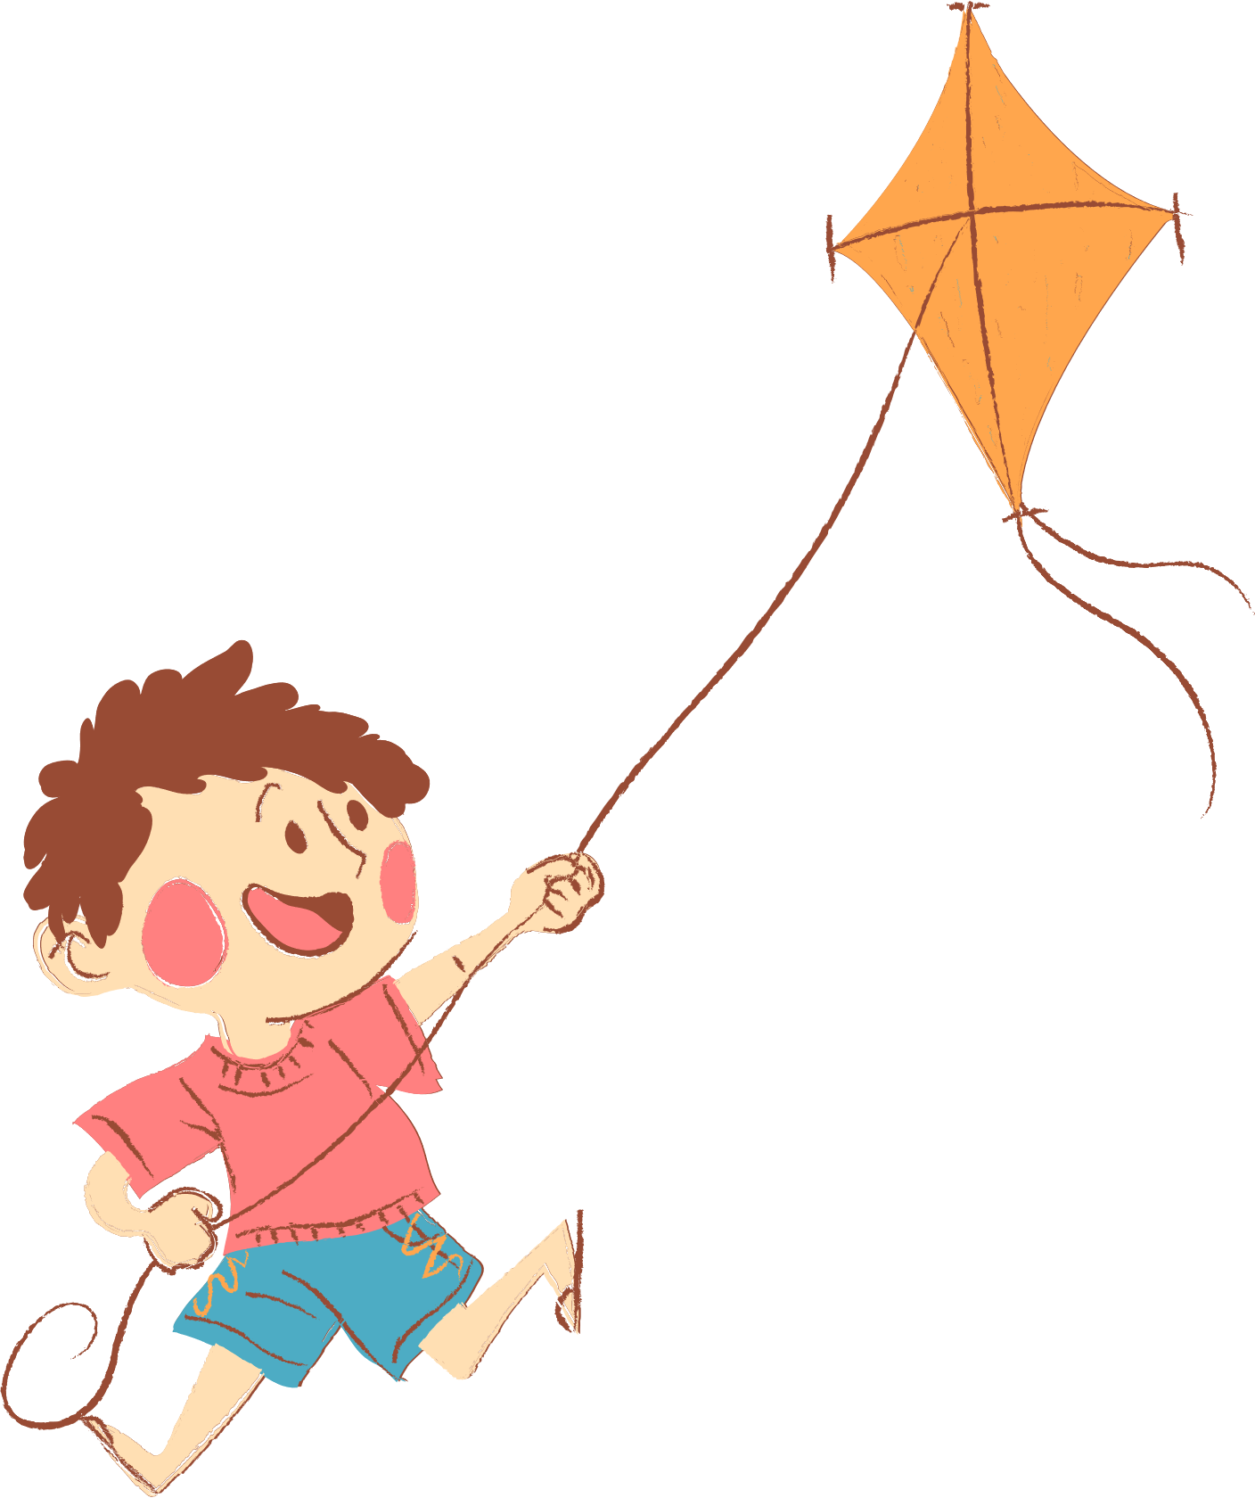
01. Warm-up and Review

Slide 4

mystery box

Slide 5

The mystery box may be good or bad!
+100 pts
-100 pts

Slide 6
Choose to keep the box or give it to another team!

Slide 7













Next
->

Slide 8
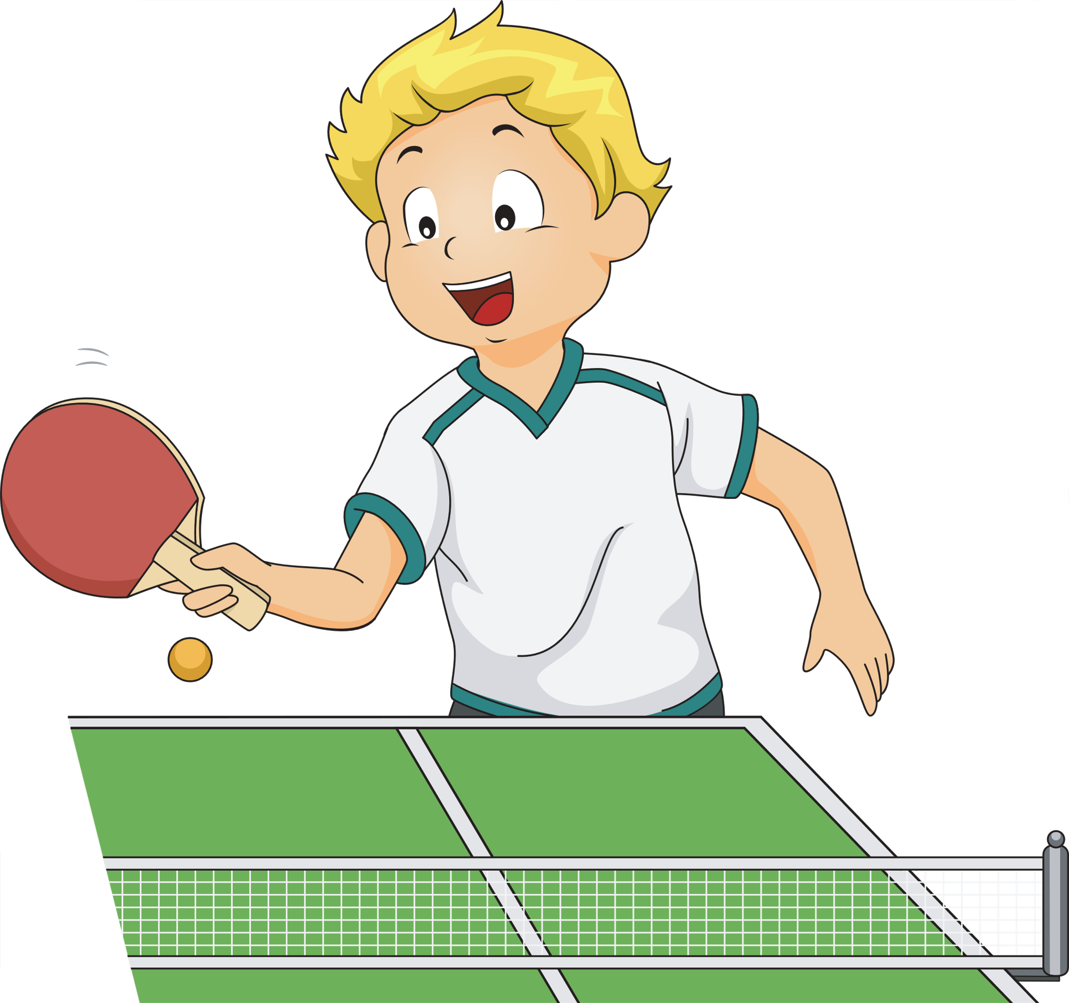

What do you do after school?
sometimes
I sometimes play table tennis.
Notes:
Press the spacebar or down arrow to reveal the answer.
Press the X to go back to the letter slide (wrong answer), press the question box to go the reward slide (correct answer).

Slide 9
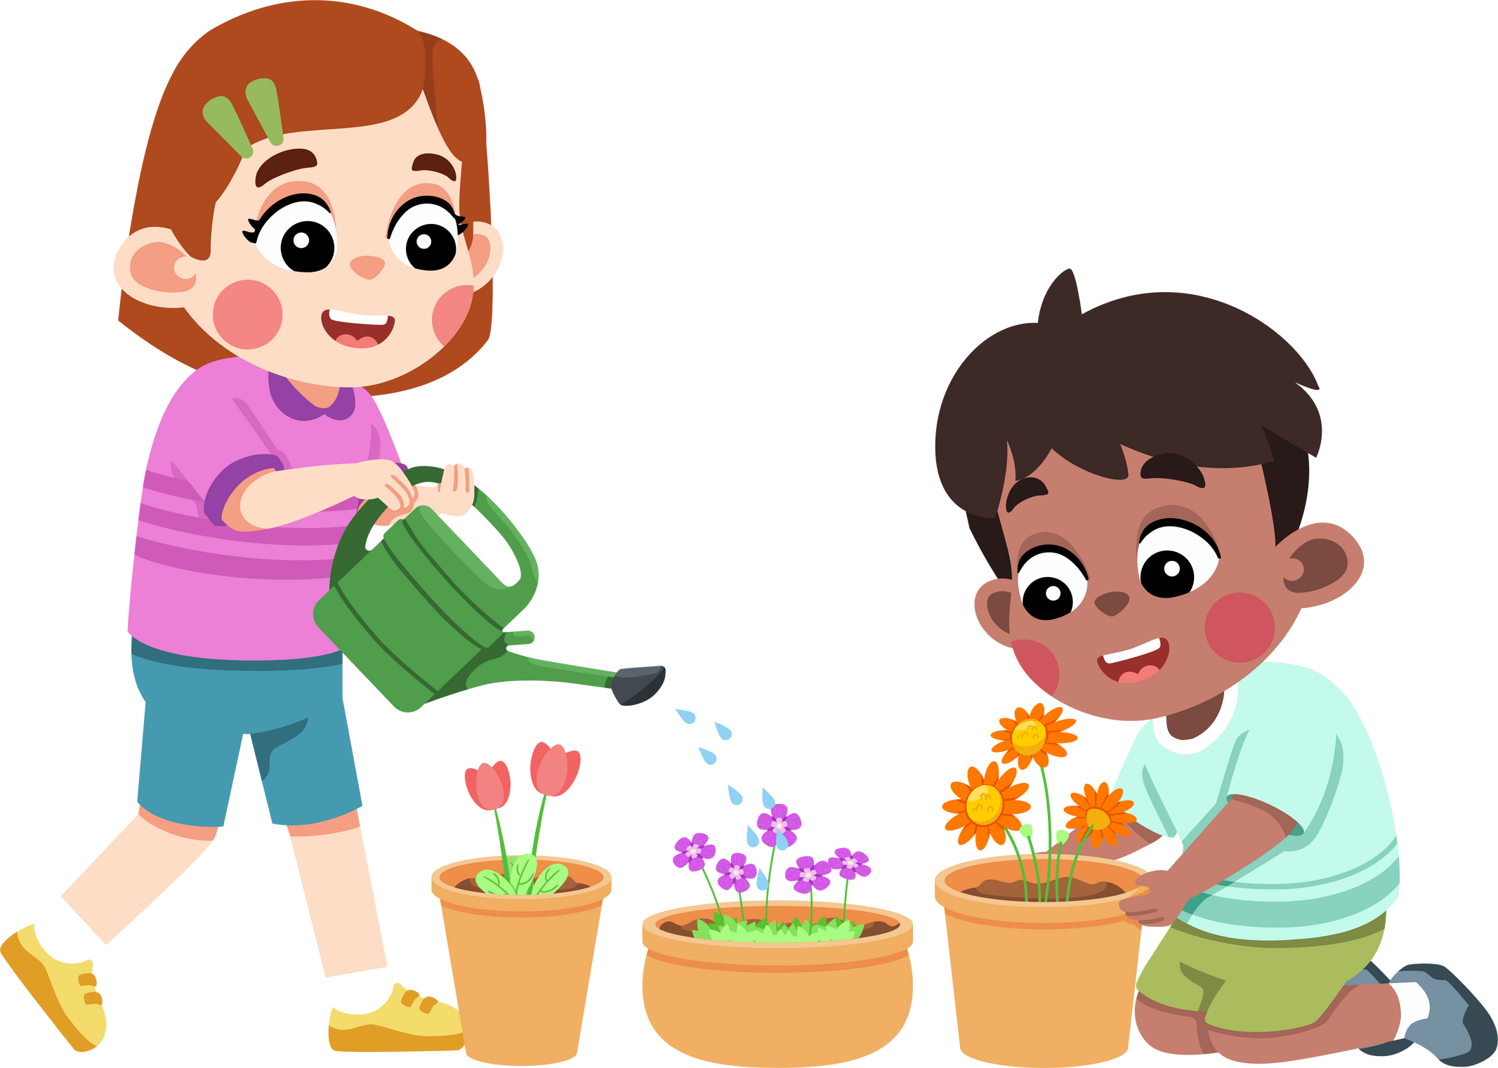
What do you like doing in your free time?
I/ We like watering the flowers.
Notes:
Press the spacebar or down arrow to reveal the answer.
Press the X to go back to the letter slide (wrong answer), press the question box to go the reward slide (correct answer).

Slide 10
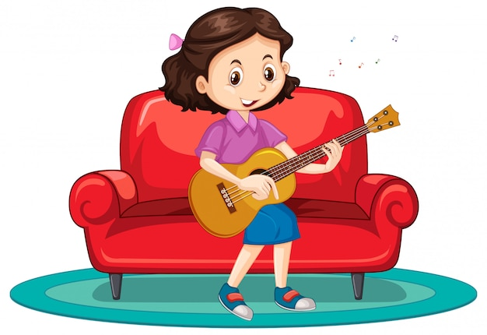
What do you like doing in your free time?
I like playing the guitar.
Notes:
Press the spacebar or down arrow to reveal the answer.
Press the X to go back to the letter slide (wrong answer), press the question box to go the reward slide (correct answer).

Slide 11

What do you like doing before going to bed?
I like reading stories (with my mum).
Notes:
Press the spacebar or down arrow to reveal the answer.
Press the X to go back to the letter slide (wrong answer), press the question box to go the reward slide (correct answer).

Slide 12

What do you do at the weekend?
always
I always go swimming.
Notes:
Press the spacebar or down arrow to reveal the answer.
Press the X to go back to the letter slide (wrong answer), press the question box to go the reward slide (correct answer).

Slide 13

What do you like doing in your free time?
I like surfing the Internet.
Notes:
Press the spacebar or down arrow to reveal the answer.
Press the X to go back to the letter slide (wrong answer), press the question box to go the reward slide (correct answer).

Slide 14

What do you do at the weekend?
always
I always ride my bike.
Notes:
Press the spacebar or down arrow to reveal the answer.
Press the X to go back to the letter slide (wrong answer), press the question box to go the reward slide (correct answer).

Slide 15

What do you like doing in your free time?
I like listening to music.
Notes:
Press the spacebar or down arrow to reveal the answer.
Press the X to go back to the letter slide (wrong answer), press the question box to go the reward slide (correct answer).

Slide 16
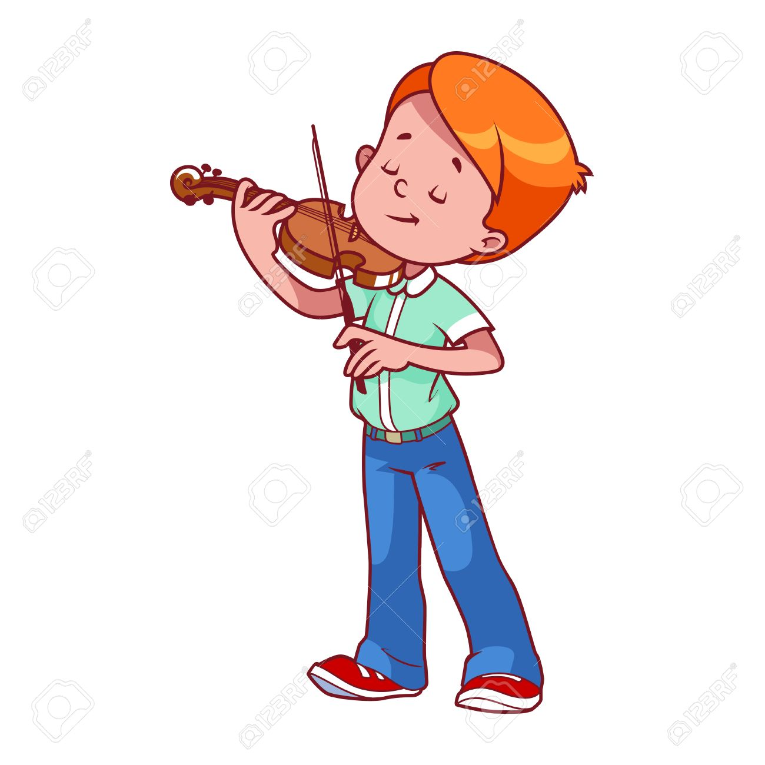
Do you like playing the violin in your free time?
Yes, I do.
Notes:
Press the spacebar or down arrow to reveal the answer.
Press the X to go back to the letter slide (wrong answer), press the question box to go the reward slide (correct answer).

Slide 17
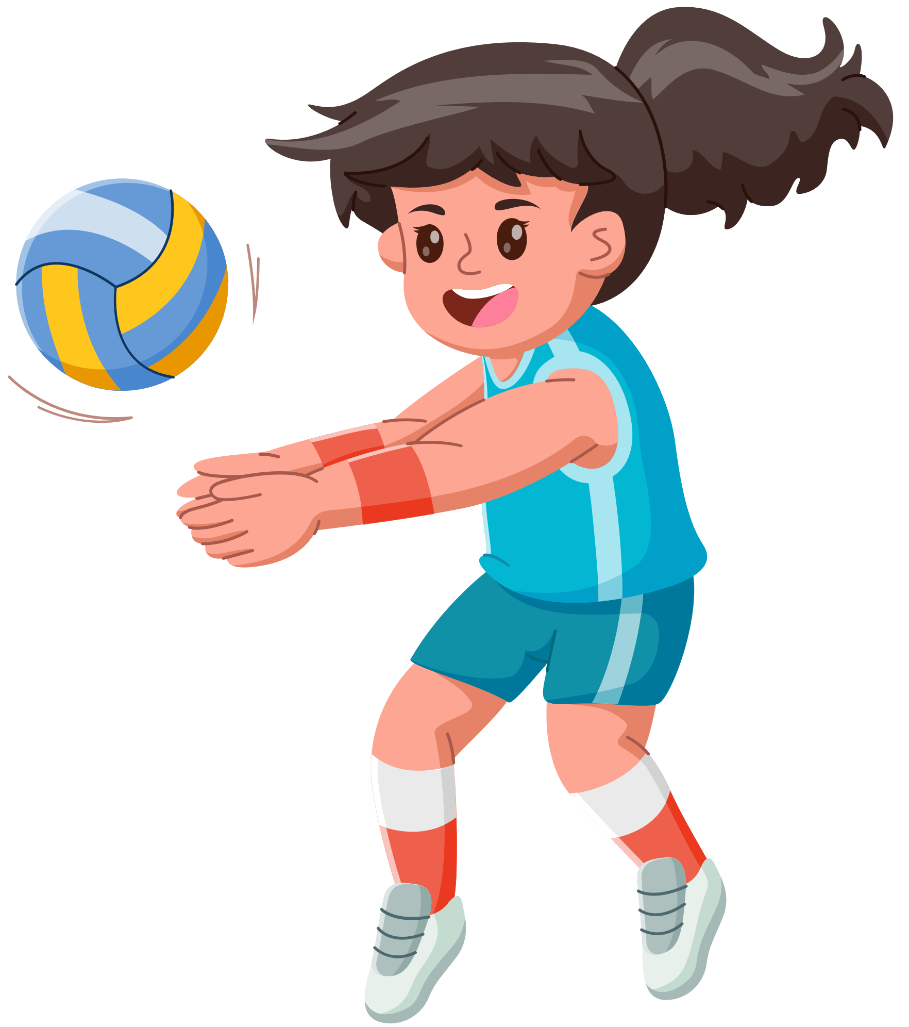
Do you play basketball at the weekend?
No, I don’t. I never play basketball at the weekend.
Notes:
Press the spacebar or down arrow to reveal the answer.
Press the X to go back to the letter slide (wrong answer), press the question box to go the reward slide (correct answer).

Slide 18
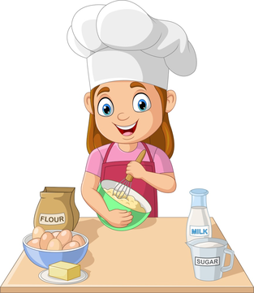
What do you do on Sundays?
often
I often cook (on Sundays).
Notes:
Press the spacebar or down arrow to reveal the answer.
Press the X to go back to the letter slide (wrong answer), press the question box to go the reward slide (correct answer).

Slide 19

What do you like doing in your free time?
I like walking.
Notes:
Press the spacebar or down arrow to reveal the answer.
Press the X to go back to the letter slide (wrong answer), press the question box to go the reward slide (correct answer).

Slide 20



+100 pts
Keep or give the mystery box?
Notes:
Ask the student(s) if they want to keep the box or give it to another student/team.
Click the question block to reveal the reward/punishment.
Press the Mario icon in the corner to go back to the letter slide.

Slide 21
+200 pts
Keep or give the mystery box?
Notes:
Ask the student(s) if they want to keep the box or give it to another student/team.
Click the question block to reveal the reward/punishment.
Press the Mario icon in the corner to go back to the letter slide.

Slide 22
+300 pts
Keep or give the mystery box?
Notes:
Ask the student(s) if they want to keep the box or give it to another student/team.
Click the question block to reveal the reward/punishment.
Press the Mario icon in the corner to go back to the letter slide.

Slide 23
+400 pts
Keep or give the mystery box?
Notes:
Ask the student(s) if they want to keep the box or give it to another student/team.
Click the question block to reveal the reward/punishment.
Press the Mario icon in the corner to go back to the letter slide.

Slide 24
+500 pts
Keep or give the mystery box?
Notes:
Ask the student(s) if they want to keep the box or give it to another student/team.
Click the question block to reveal the reward/punishment.
Press the Mario icon in the corner to go back to the letter slide.

Slide 25

-100 pts
Keep or give the mystery box?
Notes:
Ask the student(s) if they want to keep the box or give it to another student/team.
Click the question block to reveal the reward/punishment.
Press the Mario icon in the corner to go back to the letter slide.

Slide 26
-100 pts
Keep or give the mystery box?
Notes:
Ask the student(s) if they want to keep the box or give it to another student/team.
Click the question block to reveal the reward/punishment.
Press the Mario icon in the corner to go back to the letter slide.

Slide 27
-200 pts
Keep or give the mystery box?
Notes:
Ask the student(s) if they want to keep the box or give it to another student/team.
Click the question block to reveal the reward/punishment.
Press the Mario icon in the corner to go back to the letter slide.

Slide 28


Change pts!
Keep or give the mystery box?
Notes:
Ask the student(s) if they want to keep the box or give it to another student/team.
Click the question block to reveal the reward/punishment.
Press the Mario icon in the corner to go back to the letter slide.

Slide 29


Steal 200 pts!
Keep or give the mystery box?
Notes:
Ask the student(s) if they want to keep the box or give it to another student/team.
Click the question block to reveal the reward/punishment.
Press the Mario icon in the corner to go back to the letter slide.

Slide 30


Lose all pts!
Keep or give the mystery box?
Notes:
Ask the student(s) if they want to keep the box or give it to another student/team.
Click the question block to reveal the reward/punishment.
Press the Mario icon in the corner to go back to the letter slide.

Slide 31

+1000 pts!
Keep or give the mystery box?
Notes:
Ask the student(s) if they want to keep the box or give it to another student/team.
Click the question block to reveal the reward/punishment.
Press the Mario icon in the corner to go back to the letter slide.

Slide 32
02. Read and answer

Slide 33
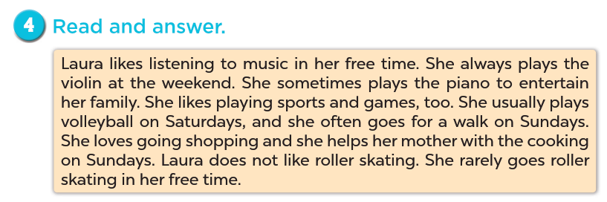

Slide 34
- She always plays the violin (at the weekend).

Slide 35
- She usually plays volleyball (on Saturdays).

Slide 36
V
- She often goes for a walk on Sundays.

Slide 37
- She helps her mother with the cooking.

Slide 38
03. Let’s write.

Slide 39
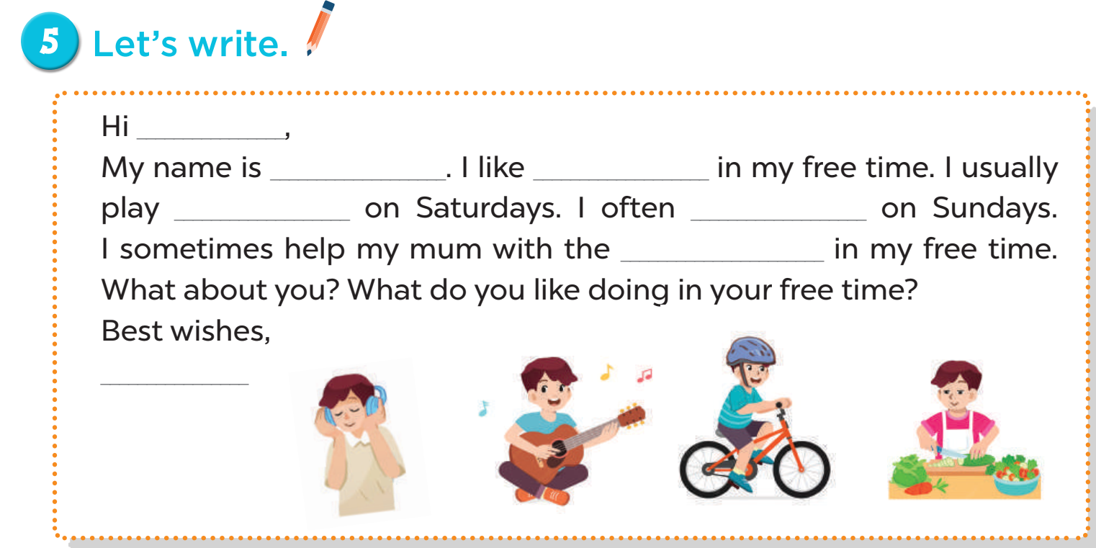
Now you write!

Slide 40
04. Project

Slide 41
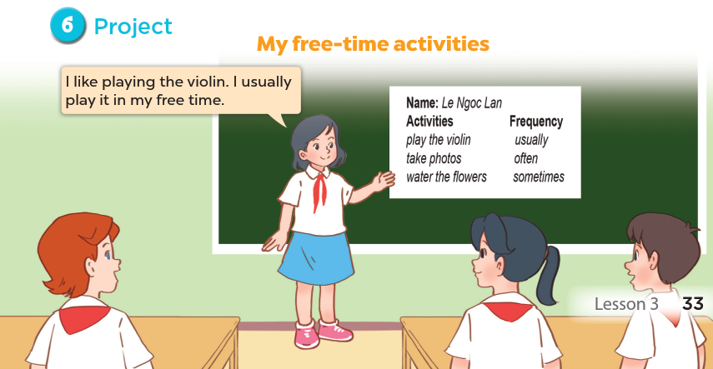

Slide 42
05. Fun corner and Wrap-up

