Slide 1




UBND QUẬN DƯƠNG KINH
TRƯỜNG TIỂU HỌC ANH DŨNG
ENGLISH - GRADE 5
UNIT 5: MY FUTURE JOB
LESSON 2 (1, 2, 3)

Slide 2






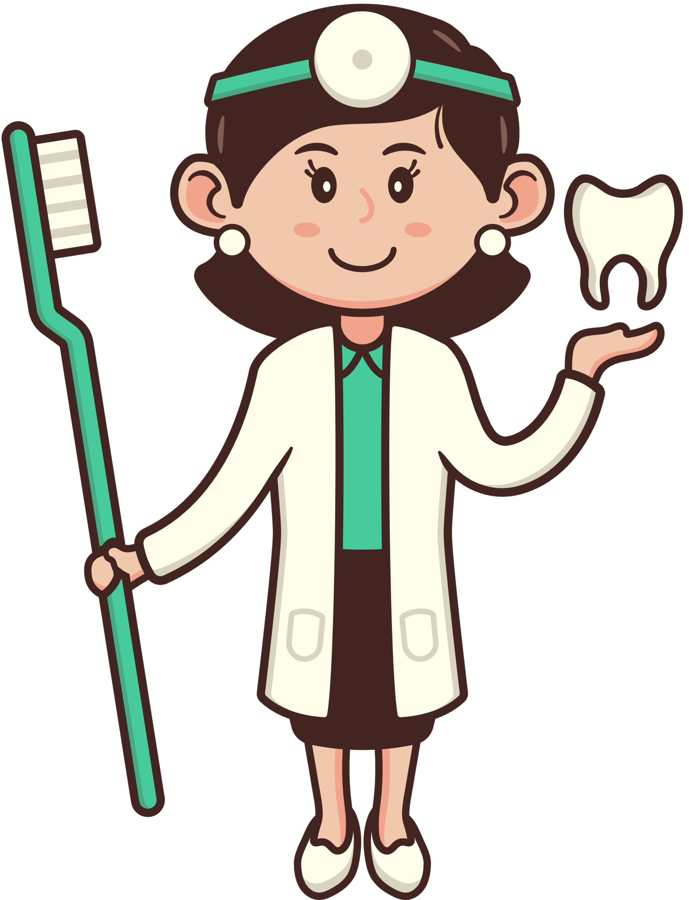


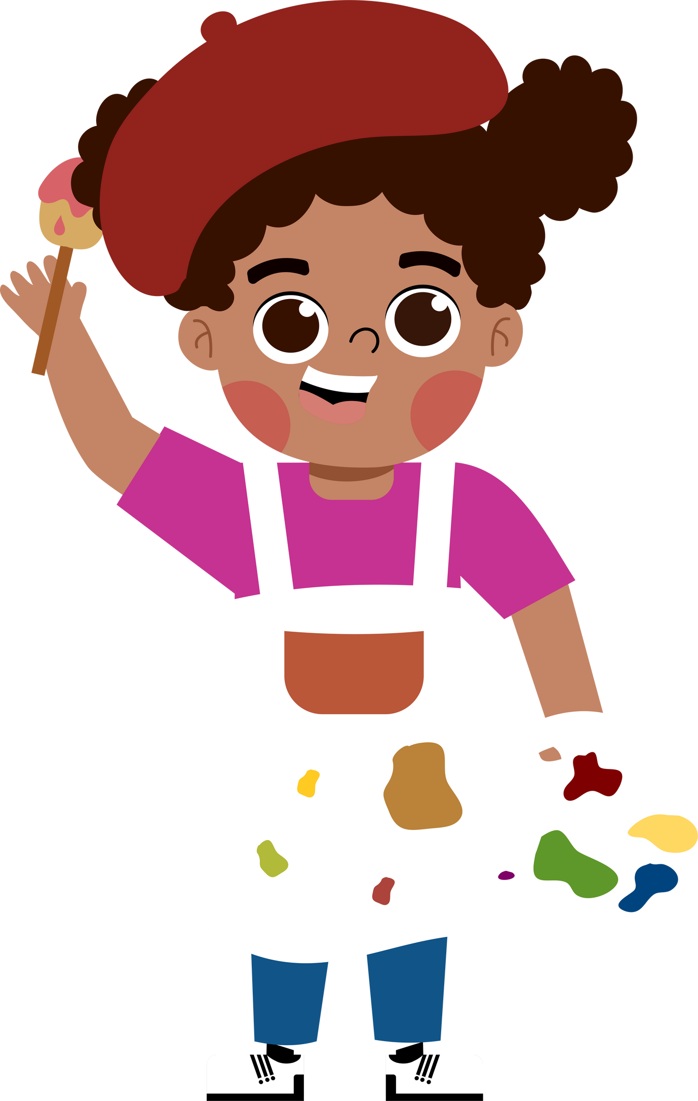
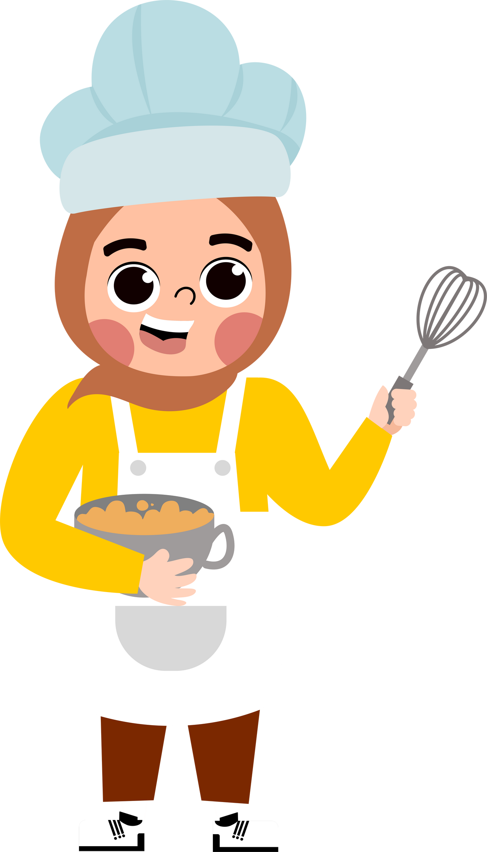
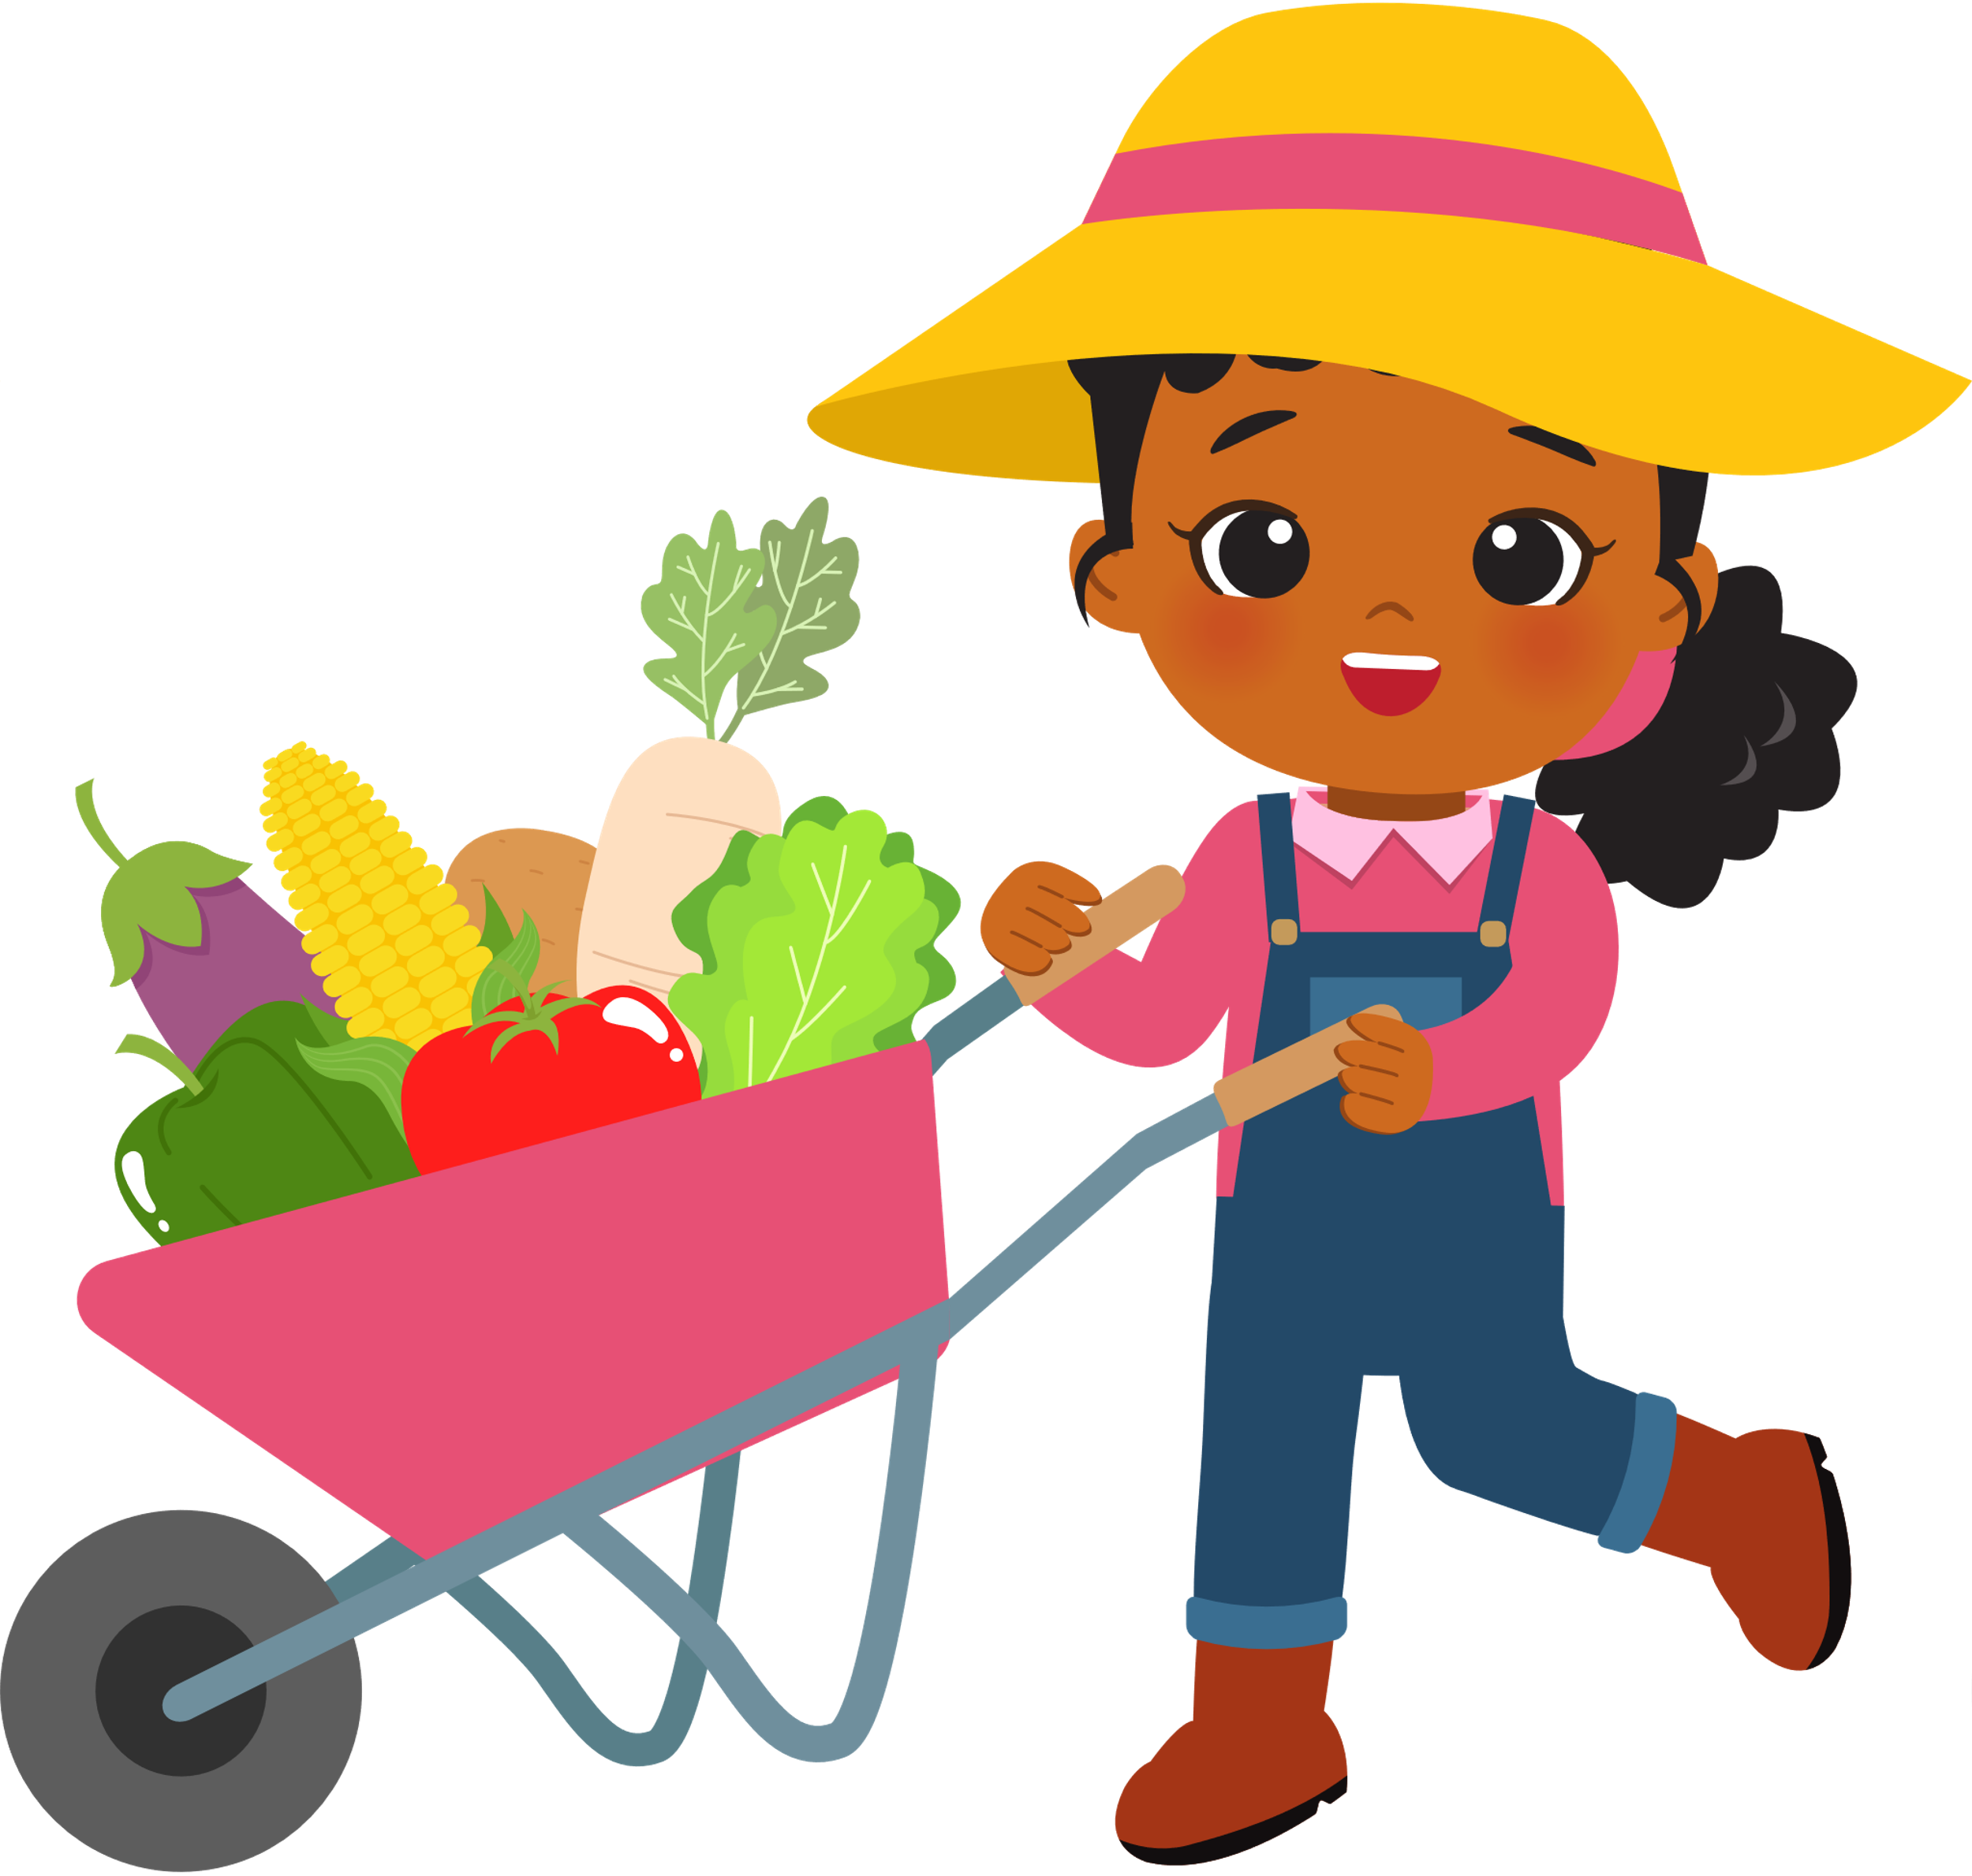

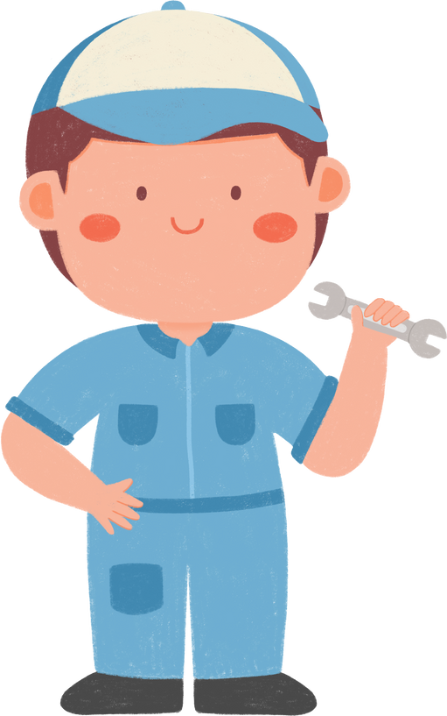
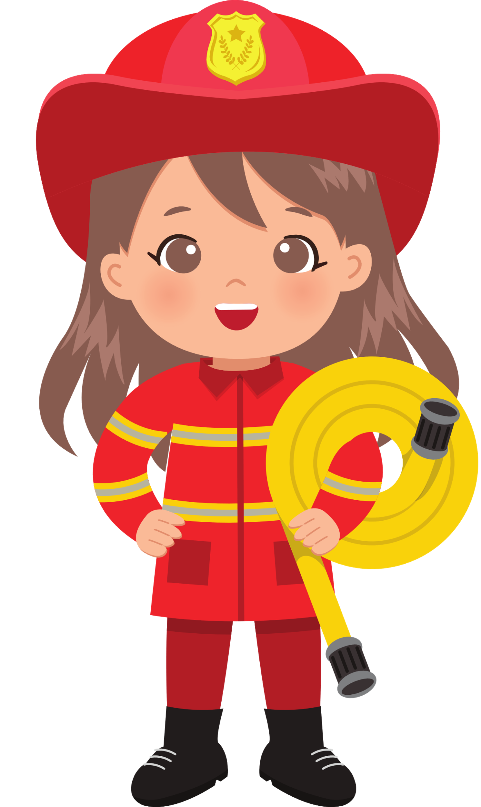
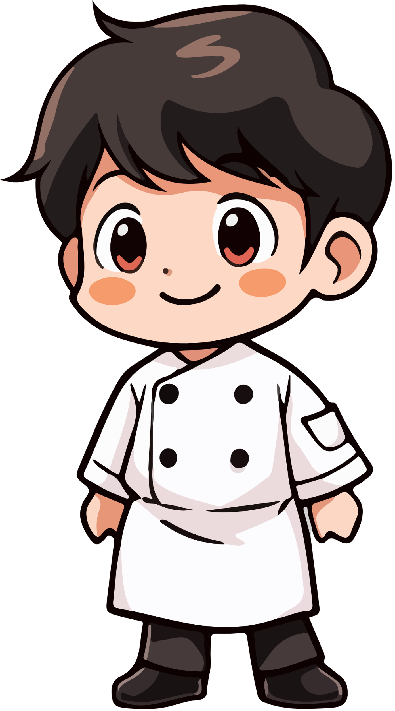


5
My future job
  Lesson 2 - Period 3
  Lesson 2 - Period 3

Slide 3




01.
Warm-up
and Review

Slide 4




Guessing game

Slide 5
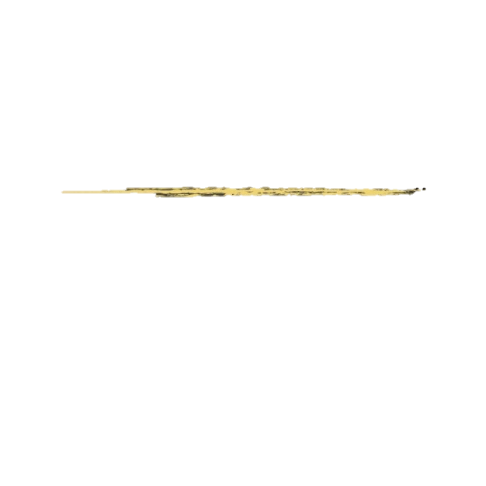

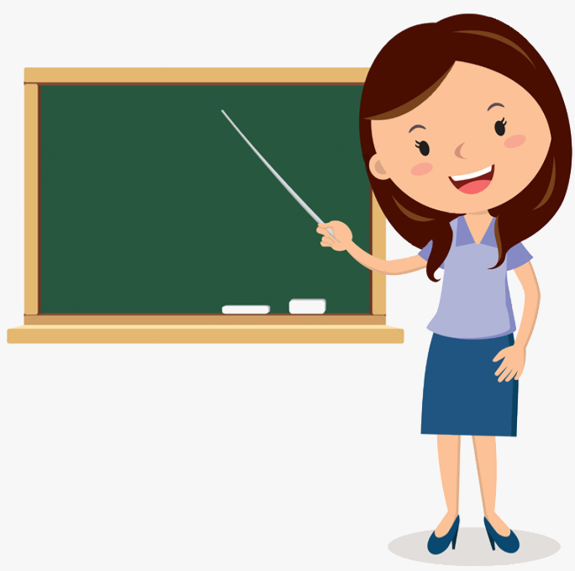

She loves children.
She works at school.
_ _ a c _ e_
t
e
h
r

Slide 6

He sometimes works in the office
and sometimes in the street.
c
a
_ o l _ _ e m _ n
p
i

Slide 7
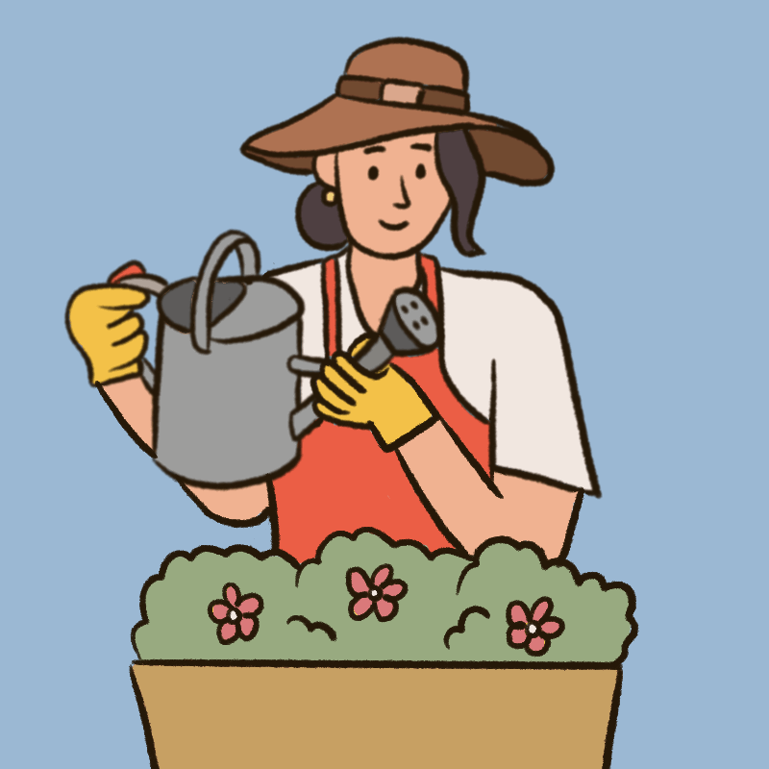
She loves plants and flowers.
a
e
r
g _ r d_ n e _

Slide 8
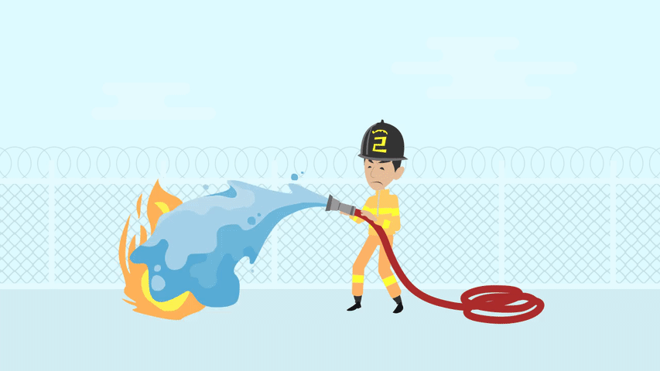
He is very brave. He can stop fire.
_ i r _ f i _ h t _ _
e
g
e
r
f

Slide 9
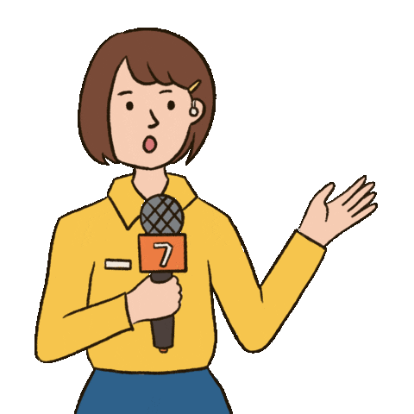
You can see her on TV or on the radio. She reports the news.
e
_ e p _ _ t _ r
r
o
r

Slide 10
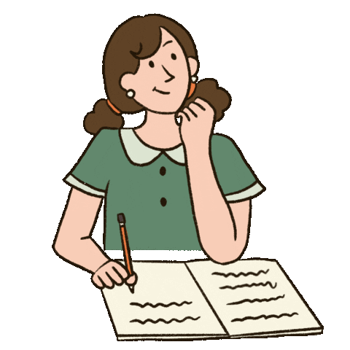
She loves reading stories and
writing new stories.
w
_ r _ _ e r
i
t

Slide 11

He helps sick people.
He works in the hospital.
d
c
_ o _ t o _
r

Slide 12
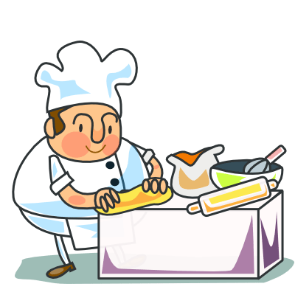
He works in the restaurant.
He loves cooking.
c
o
k
_ _ o _

Slide 13
02.
Look, listen and repeat.

Slide 14




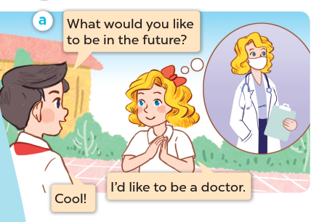


Listen and repeat.

Slide 15
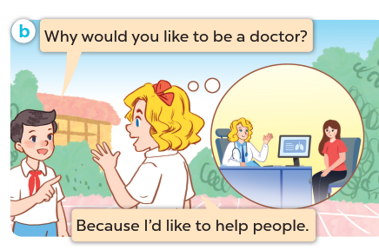
Listen and repeat.

Slide 16
03.
Listen, point and say.

Slide 17
New words

Slide 18


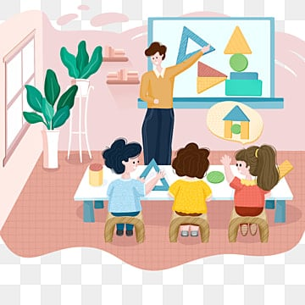

teach children

Slide 19

report the news

Slide 20
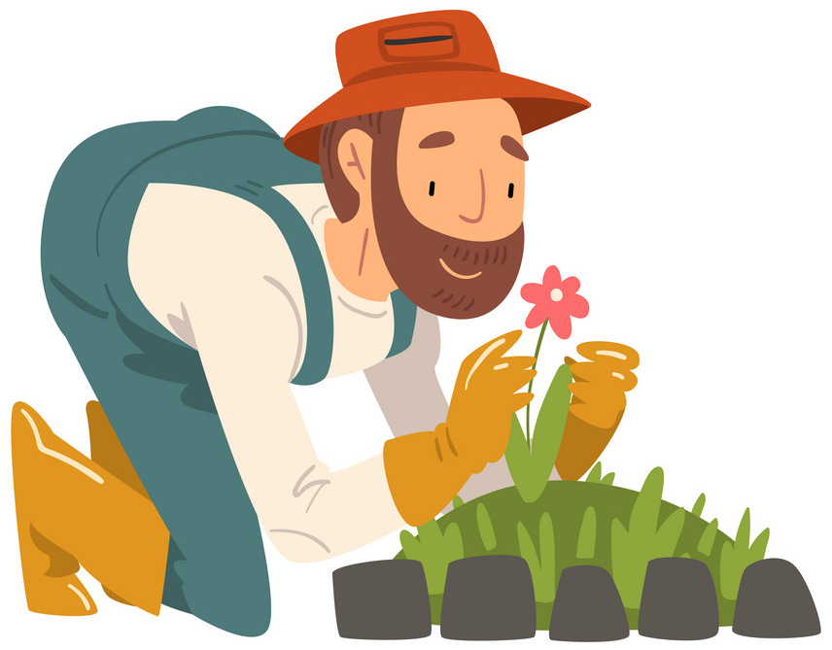
grow flowers

Slide 21

write stories

Slide 22
report the news
teach children
grow flowers
write stories

Slide 23
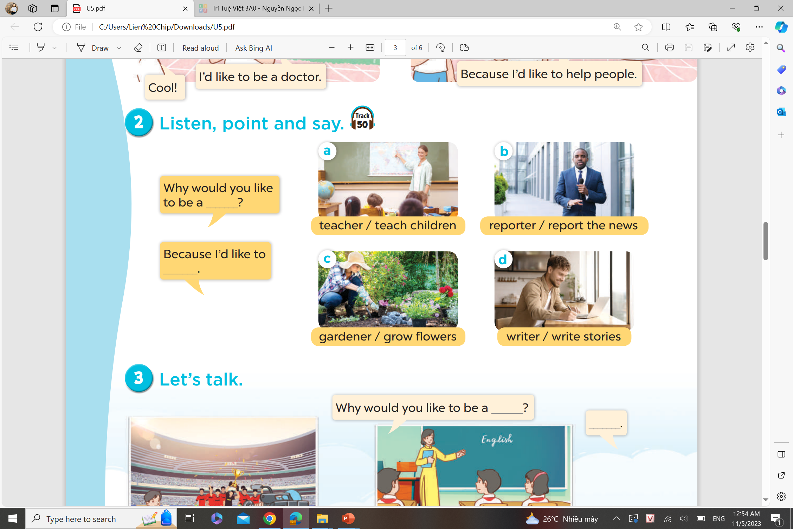
Listen and answer.

Slide 24
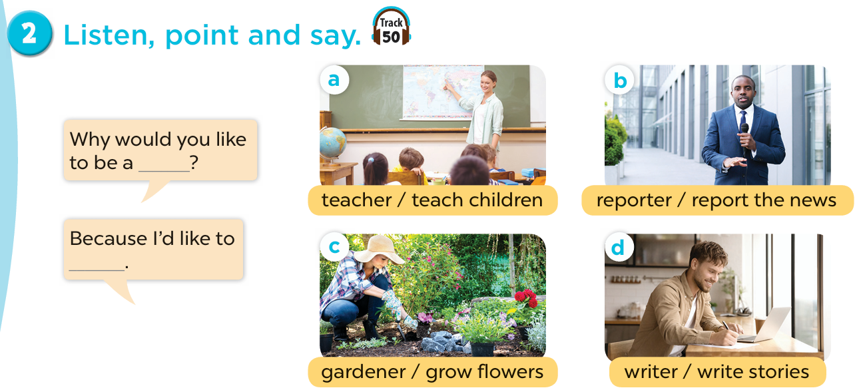

Slide 25




04.
Let’s talk.

Slide 26
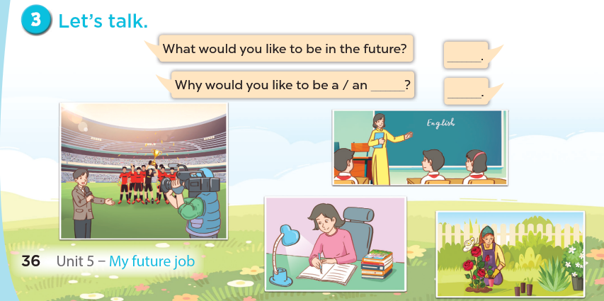

Slide 27
05.
Fun corner and Wrap-up

Slide 28
Look and say.

Slide 29


What
.................. would you like to be
in the future?
A. Why
B. What
C. Because

Slide 30
A: Why would you like to be a gardener?
B: ...................... I like to grow flowers.
Because
A. What
B. When
C. Because

Slide 31
Why would you like to
be a ......................?
reporter
A. reporter
B. gardener
C. doctor

Slide 32
Why would you like to be a teacher?
- Because I ................... to teach children.
like
A. to like
B. likes
C. like

Slide 33
writer
Why would you like to be a ......................?
- Because I like to write new stories.
A. writer
B. cook
C. farmer

Slide 34
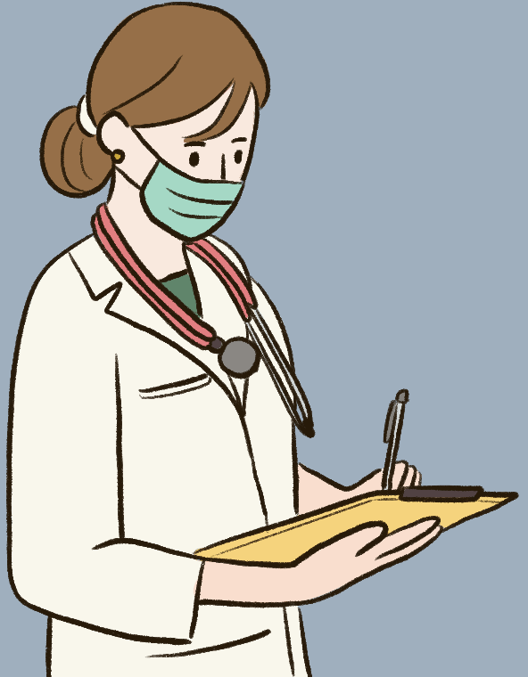
Why would you like to be a doctor?
- Because I like to ...............................
help sick people
A. teach children
B. help sick people
C. play football

Slide 35
A: Why would you like to be a ...................?
B: Because I like to cook.
cook
A. farmer
B. cook
C. dancer

Slide 36
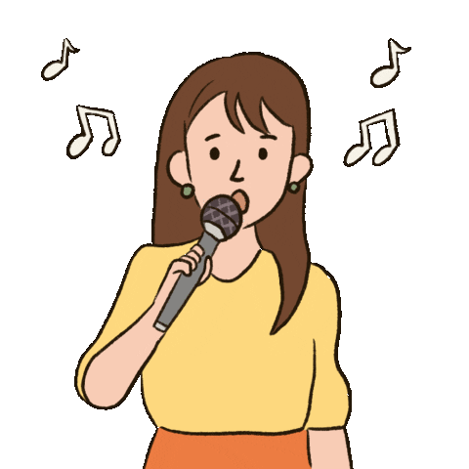
Why would you like to be a singer?
- Because I like to ....................
sing
A. help people
B. write stories
C. sing

