Slide 1




UBND QUẬN DƯƠNG KINH
TRƯỜNG TIỂU HỌC ANH DŨNG
ENGLISH - GRADE 5
UNIT 5: MY FUTURE JOB
LESSON 3 (4, 5, 6)

Slide 2









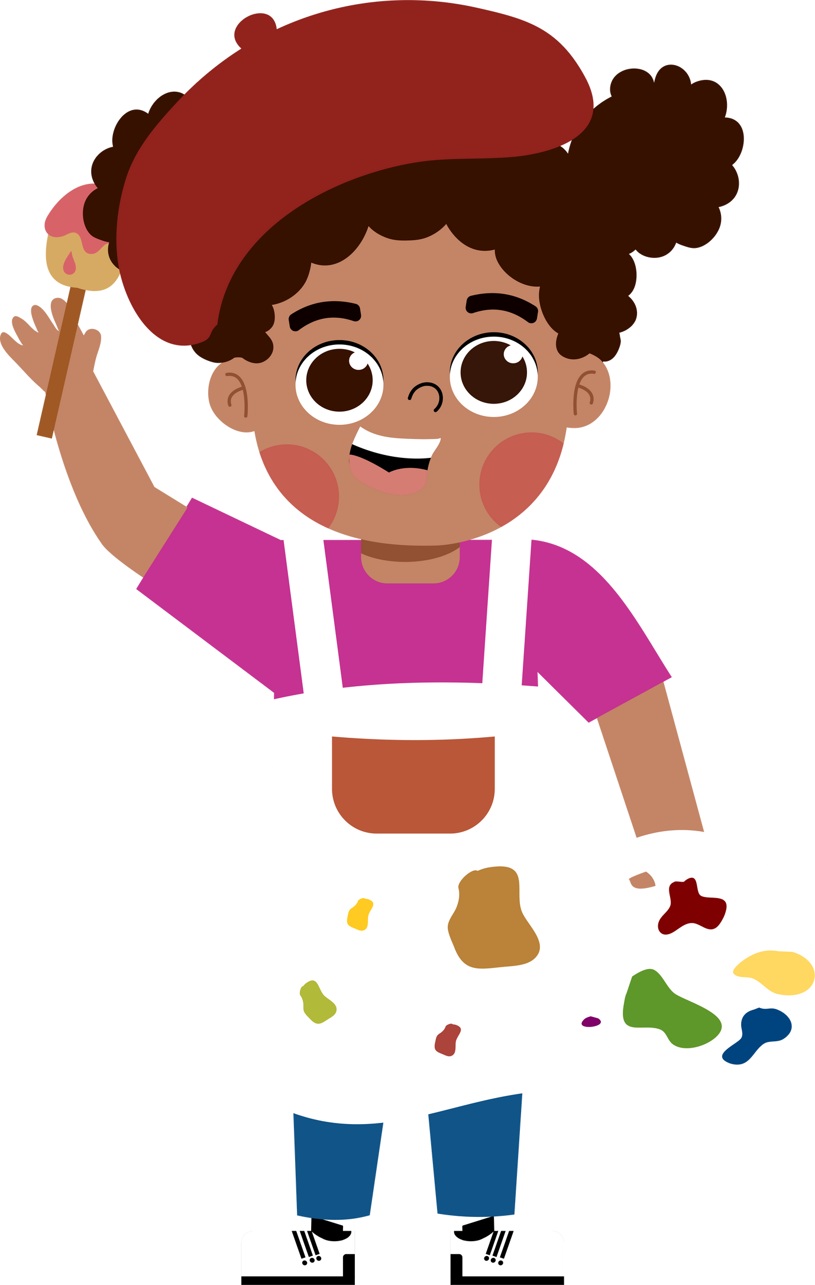
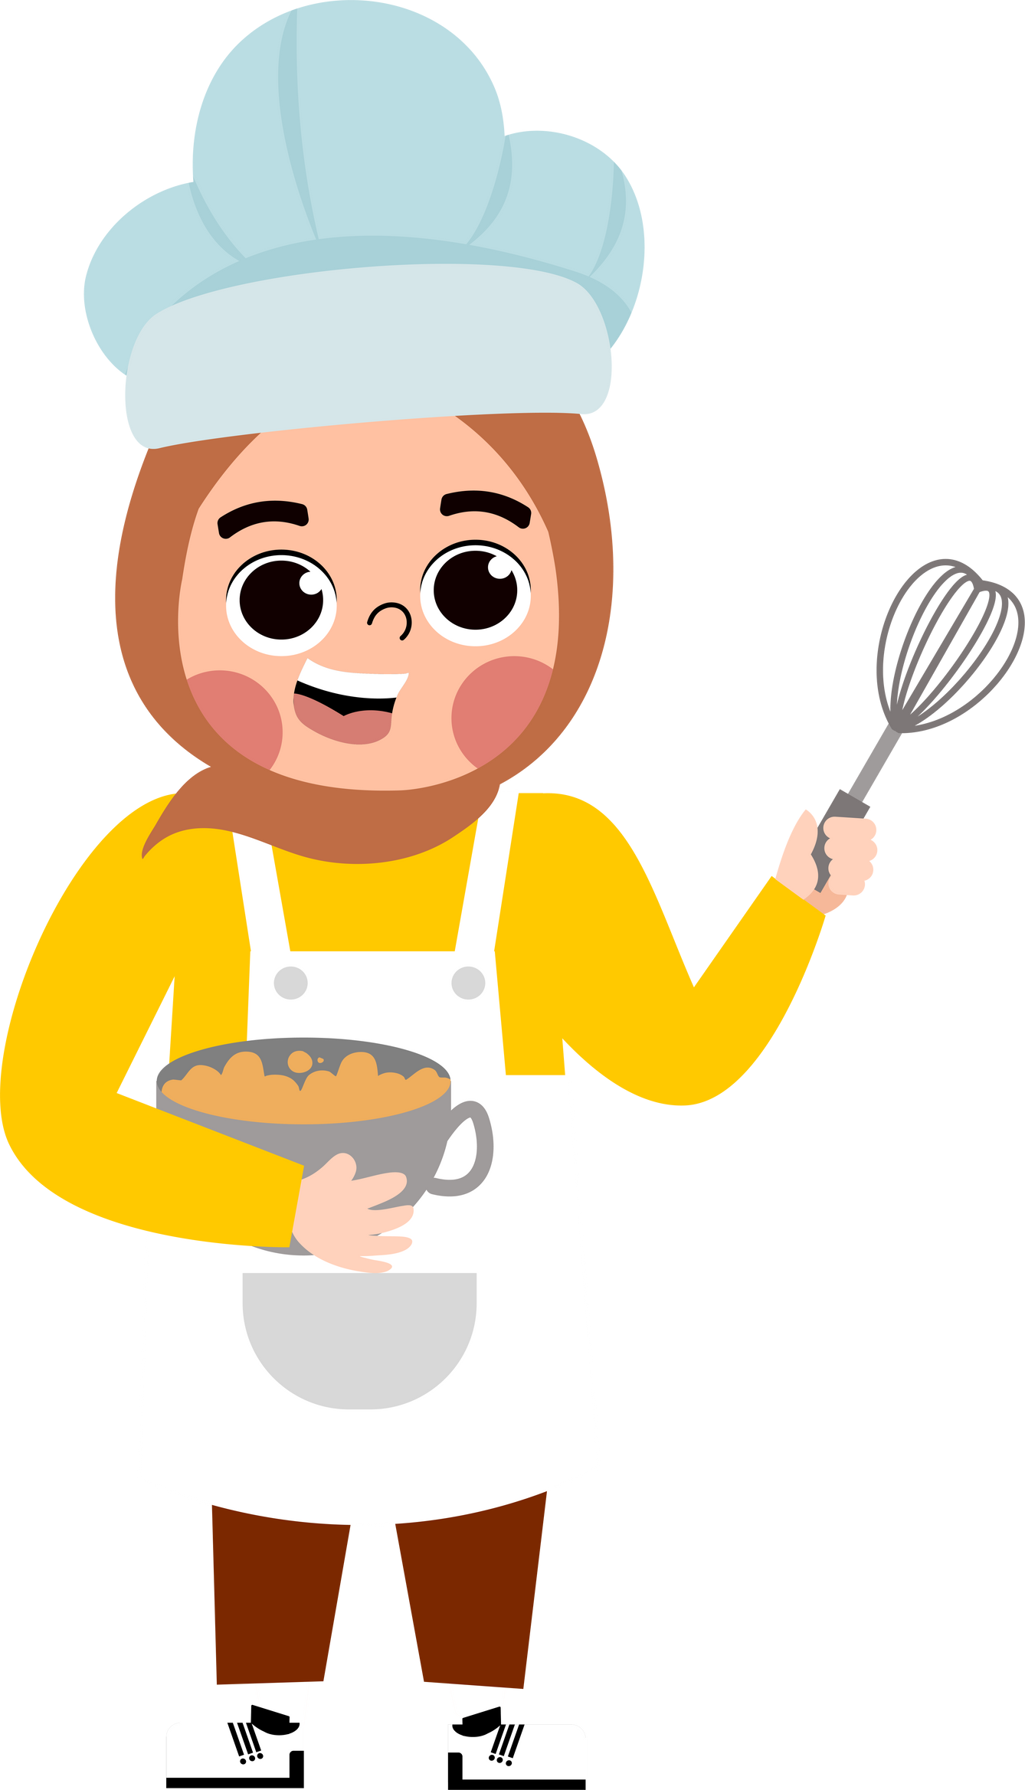







5
My future job
  Lesson 3 – Period 6

Slide 3




01.
Warm-up
and Review

Slide 4
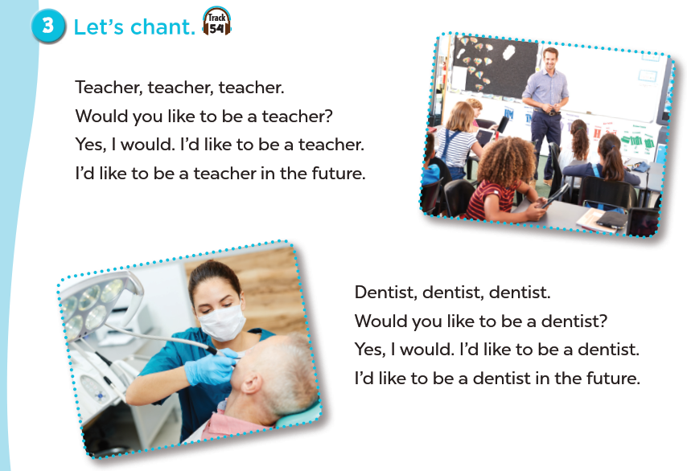


Slide 5
02.
Read and circle.

Slide 6



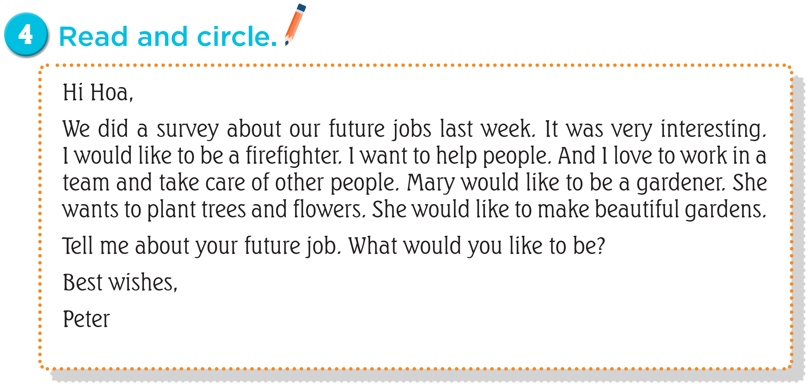


Read the email.

Slide 7
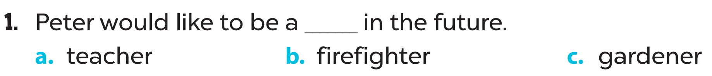

Slide 9
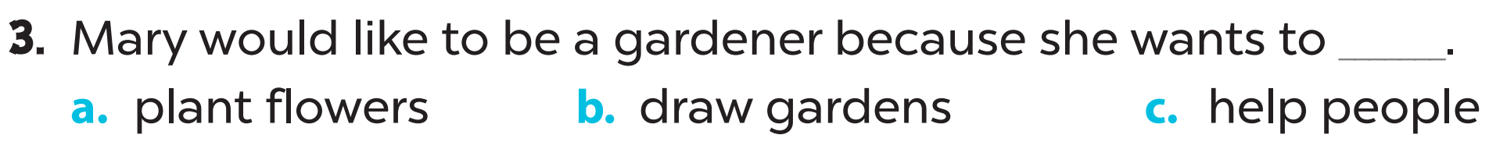

Slide 10
03.
Let’s write.

Slide 11


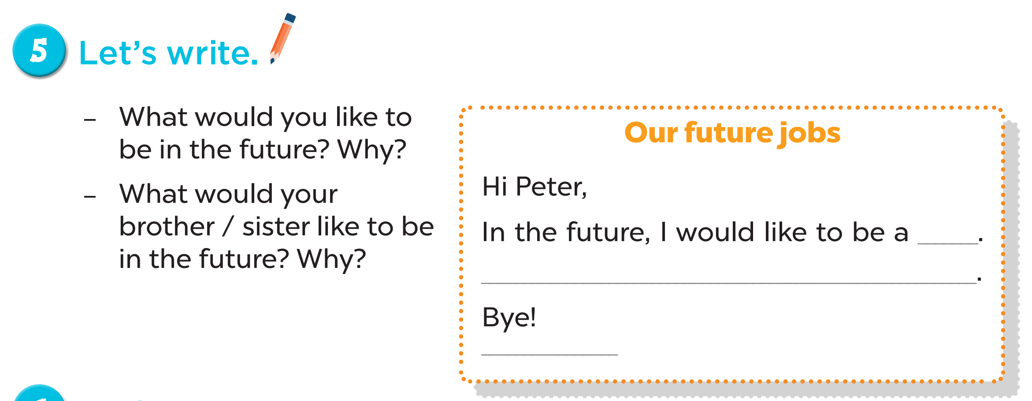


Slide 12
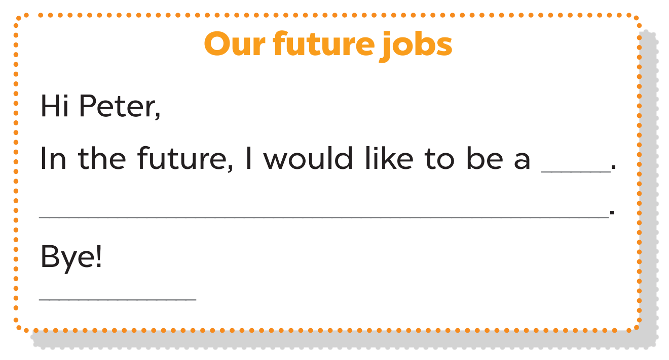

Slide 13
04.
Project

Slide 14
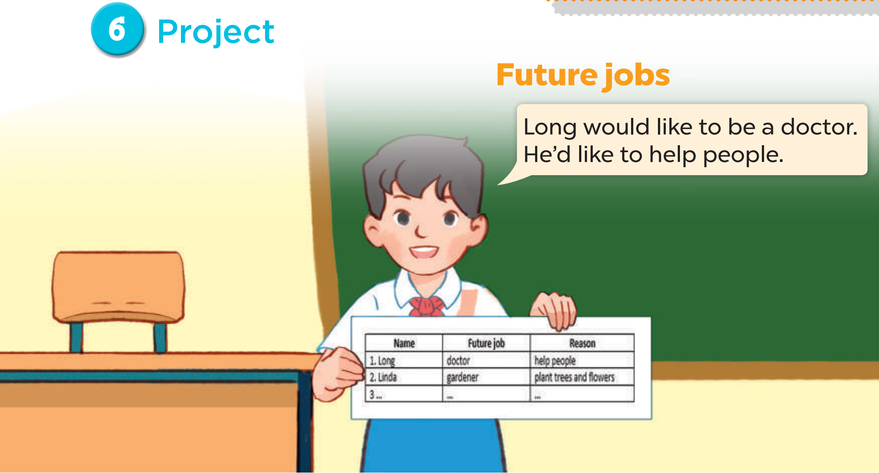

Slide 15
05.
Fun corner and Wrap-up
Lucky number

Slide 16












Notes:
Choose a number
Read the question and say the answer
Get points in each question

Slide 17

What would you like to be
in the future?
I’d like to be a dentist.
Notes:
If the answer is correct, click “check” icon to get points.
If not, click “cross” icon (x) to move back to slide 16

Slide 18

+ 4 POINTS
Notes:
Click the arrow to move back to slide 16

Slide 19
What would you like to be
in the future?
I’d like to be a firefighter.
Notes:
If the answer is correct, click “check” icon to get points.
If not, click “cross” icon (x) to move back to slide 16

Slide 20
- 2 POINTS
Notes:
Click the arrow to move back to slide 16

Slide 21

What would you like to be
in the future?
I’d like to be a doctor.
Notes:
If the answer is correct, click “check” icon to get points.
If not, click “cross” icon (x) to move back to slide 16

Slide 22
+ 3 POINTS
Notes:
Click the arrow to move back to slide 16

Slide 23
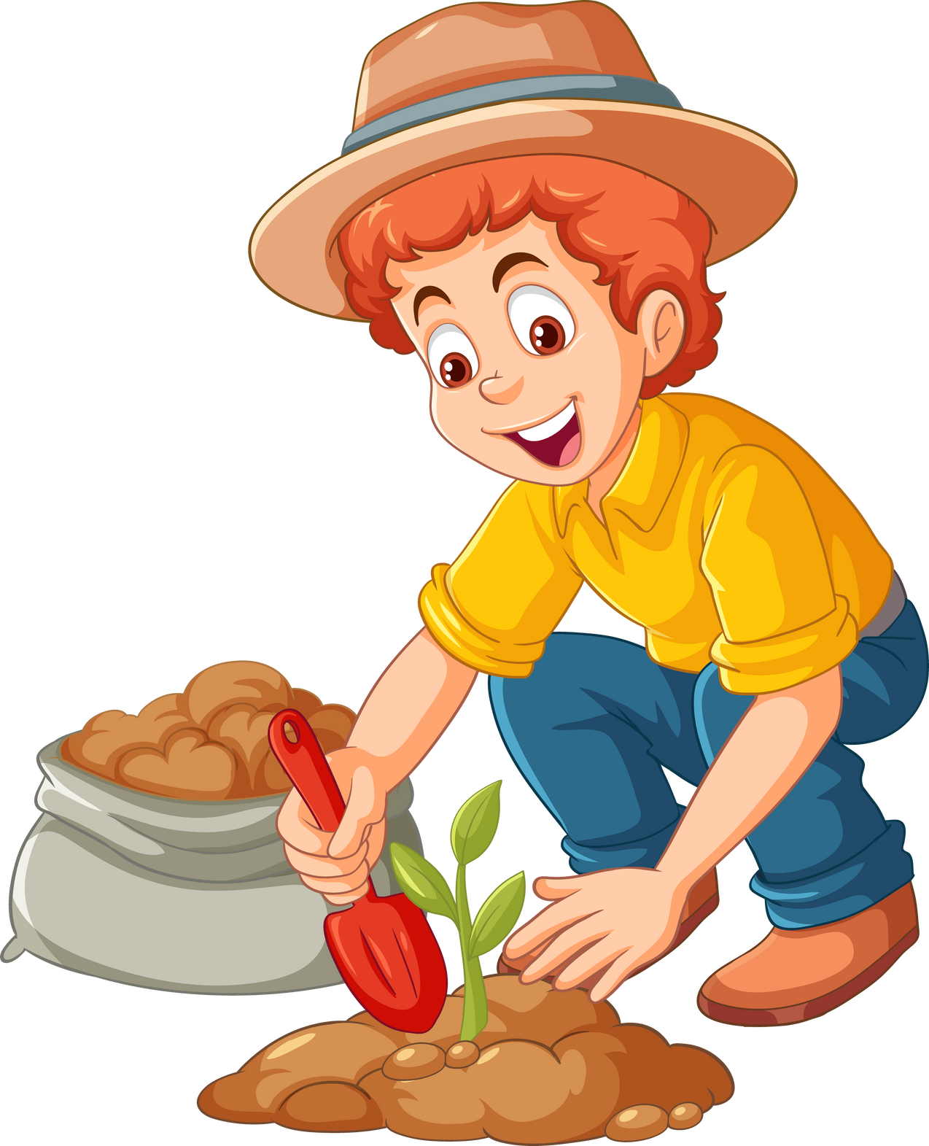
Why would you like to be
a gardener?
Because I’d like to grow flowers.
Notes:
If the answer is correct, click “check” icon to get points.
If not, click “cross” icon (x) to move back to slide 16

Slide 24

Winner +5 points
Notes:
- Play rock, paper, scissors to get points, winner will get 5 points
- Click the arrow to move back to slide 16

Slide 25

Why would you like to be a writer?
Because I’d like to write stories.
Notes:
If the answer is correct, click “check” icon to get points.
If not, click “cross” icon (x) to move back to slide 16

Slide 26
- 3 POINTS
Notes:
Click the arrow to move back to slide 16

Slide 27

Why would you like to be
a reporter?
Because I’d like to report the news.
Notes:
If the answer is correct, click “check” icon to get points.
If not, click “cross” icon (x) to move back to slide 16

Slide 28
+ 10 POINTS
Notes:
Click the arrow to move back to slide 16

Slide 29
Why would you like to be a teacher?
Because I’d like to teach children.
Notes:
If the answer is correct, click “check” icon to get points.
If not, click “cross” icon (x) to move back to slide 16

Slide 30
STEAL
5 POINTS
Notes:
Click the arrow to move back to slide 16

Slide 31
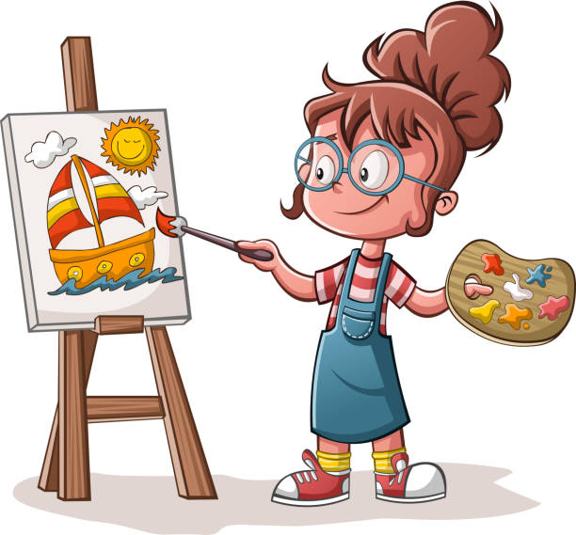

Would you like to be an artist?
Yes, I would.
Notes:
If the answer is correct, click “check” icon to get points.
If not, click “cross” icon (x) to move back to slide 16

Slide 32
DOUBLE POINTS
Notes:
Click the arrow to move back to slide 16

Slide 33


Would you like to be a firefighter?
No, I wouldn’t.
Notes:
If the answer is correct, click “check” icon to get points.
If not, click “cross” icon (x) to move back to slide 16

Slide 34
+ 1 POINT
Notes:
Click the arrow to move back to slide 16

Slide 35

Would you like to be a cook?
No, I wouldn’t.
Notes:
If the answer is correct, click “check” icon to get points.
If not, click “cross” icon (x) to move back to slide 16

Slide 36
- 5 POINTS
Notes:
Click the arrow to move back to slide 16

