Slide 1




UBND QUẬN DƯƠNG KINH
TRƯỜNG TIỂU HỌC ANH DŨNG
ENGLISH - GRADE 5
REVIEW 1 – PERIOD 1

Slide 2





REVIEW 1
Period 1

Slide 3





01
Warm-up and Review

Slide 4












Let's Play
The Memory Game

Slide 5

Round 1
Let's Go!

Slide 6



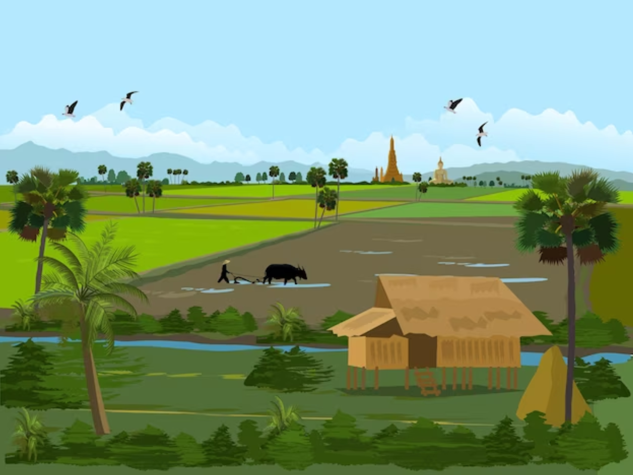
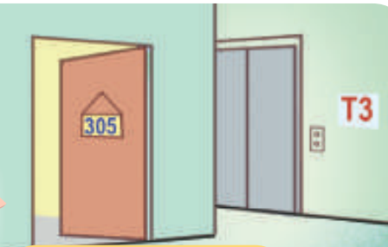
A
B
C
D
E
F
G
H
house
flat
countryside
city

Slide 7

Round 1 Score Board
Use this to keep track of the points! Copy and paste the token for every point a player receives.
Player 1
Player 2
Player 3
Notes:
Copy and paste the token for every point a player receives.

Slide 8
Round 2
You got this!

Slide 9






A
B
C
D
E
surf
the
Internet
water
the
flowers
play
the violin
I
F
G
H
J
Malaysia
Australia

Slide 10
Round 2 Score Board
Use this to keep track of the points! Copy and paste the token for every point a player receives.
Player 1
Player 2
Player 3

Slide 11

Thank you for playing!
See you next time!

Slide 12


02
Activity 1
Listen and circle a, b or c.

Slide 13



Look and read.
a. I have a dolphin.
b. It’s a dolphin.
c. I can see a dolphin.
Notes:
Step 1: Draw pupils’ attention to the first set of suggested answers. Have them read the answer options. Check comprehension.

Slide 14


Look and read.
a. Yes, I can.
b. Yes, I do.
c. Yes, I am.
Notes:
Step 1: Draw pupils’ attention to the first set of suggested answers. Have them read the answer options. Check comprehension.

Slide 15

Look and read.
a. I’d like to write stories for children.
b. I’m a writer.
c. I’d like to be a writer.
Notes:
Step 1: Draw pupils’ attention to the first set of suggested answers. Have them read the answer options. Check comprehension.

Slide 16

Look and read.
a. He’s in the computer room.
b. He likes playing football.
c. He’s active.
Notes:
Step 1: Draw pupils’ attention to the first set of suggested answers. Have them read the answer options. Check comprehension.

Slide 17

Look and read.
a. I like watering flowers.
b. I’m watering flowers.
c. I like flowers.
Notes:
Step 1: Draw pupils’ attention to the first set of suggested answers. Have them read the answer options. Check comprehension.

Slide 18


Listen and circle a, b or c.
a. I have a dolphin.
b. It’s a dolphin.
c. I can see a dolphin.
Notes:
Step 2: Play the recording for Question 1. Play the recording again for pupils to do the task. Play the recording a third time for pupils to check their answers.

Slide 19

Listen and circle a, b or c.
a. I’d like to write stories
for children.
b. I’m a write.
c. I’d like to be a writer.
a. I have a dolphin.
b. It’s a dolphin.
c. I can see a dolphin.
a. Yes, I can.
b. Yes, I do.
c. Yes, I am.
a. He’s in the computer room.
b. He likes playing football.
c. He’s active.
a. I like watering flowers.
b. I’m watering flowers.
c. I like flowers.
Notes:
Step 3: Repeat Steps 1 and 2 for the rest of the questions.

Slide 20

YOUR ANSWERS
b
______
______
______
______
______
Notes:
Step 4: Get pupils to swap books with a partner, then check answers as a class. Write the correct answers on the board.
Step 5: Play the recording for pupils to double-check their answers.

Slide 21
Let’s check!
a. Yes, I can.
b. Yes, I do.
c. Yes, I am.
Notes:
* Key: 1. b, 2. b, 3. c, 4. c, 5. a

Slide 22
Let’s check!
a. I’d like to write stories for children.
b. I’m a writer.
c. I’d like to be a writer.
Notes:
* Key: 1. b, 2. b, 3. c, 4. c, 5. a

Slide 23
Let’s check!
a. He’s in the computer room.
b. He likes playing football.
c. He’s active.
Notes:
* Key: 1. b, 2. b, 3. c, 4. c, 5. a

Slide 24
Let’s check!
a. I like watering flowers.
b. I’m watering flowers.
c. I like flowers.
Notes:
* Key: 1. b, 2. b, 3. c, 4. c, 5. a

Slide 25
03
Activity 2
Ask and answer.

Slide 26

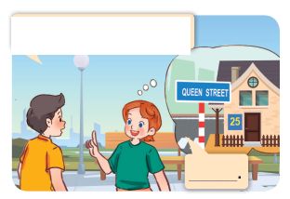


Look and say.
What’s your address?
Lucy
Nick
It’s 25 Queen Street.
Notes:
Step 1: Draw pupils’ attention to the first picture. Get them to look at the bubble to identify the activity shown in it. Check pupils’ comprehension.
Step 2: Draw pupils’ attention to Question 1. Have pupils look at the bubble over Lucy’s head to answer the question.

Slide 27

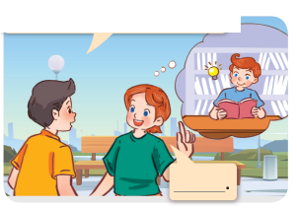
Look and say.
What’s your brother like?
He’s clever.
Notes:
Step 3: Repeat Step 1 and 2 with the rest of the questions.

Slide 28

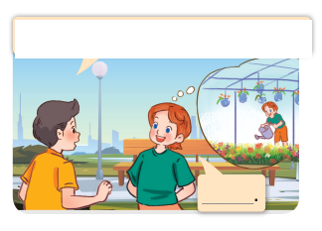
Look and say.
What do you do at the weekend?
I water flowers.
Notes:
Step 3: Repeat Step 1 and 2 with the rest of the questions.

Slide 29

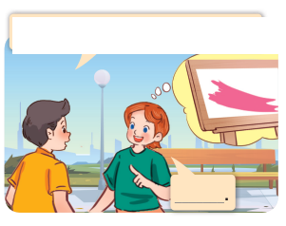
Look and say.
What’s your favourite color?
It’s pink.
Notes:
Step 3: Repeat Step 1 and 2 with the rest of the questions.

Slide 30

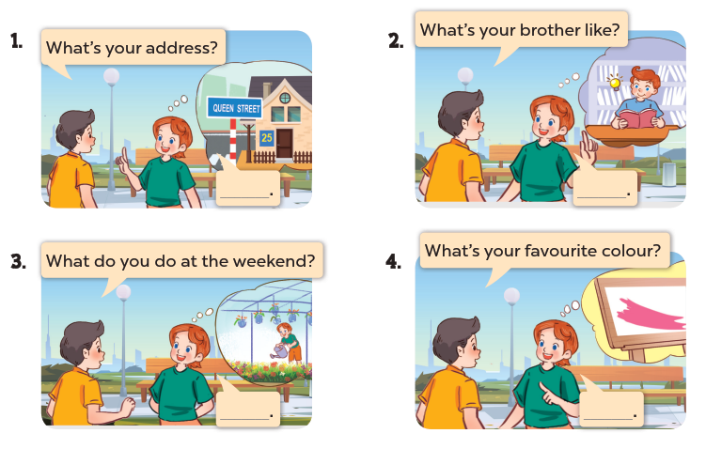
Ask and answer.
Notes:
Step 4: Have pupils work in pairs to role-play the four exchanges. Go around the classroom to monitor the activity.

Slide 31
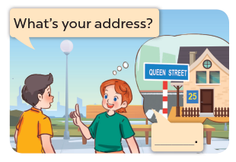
Game: PASS THE BALLS!
Notes:
Extension: Invite pairs of pupils to stand up and take it in turns to role-play the target exchanges.
Game: Pass the balls!
Pupils pass the two balls; one is red and the other is blue. Listen to music and they pass the balls. When the music stops, the pupils with the red ball will make a question and the one with the blue ball will give the answer.

Slide 32
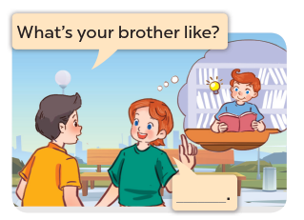
Notes:
Extension: Invite pairs of pupils to stand up and take it in turns to role-play the target exchanges.
Game: Pass the balls!
Pupils pass the two balls; one is red and the other is blue. Listen to music and they pass the balls. When the music stops, the pupils with the red ball will make a question and the one with the blue ball will give the answer.

Slide 33
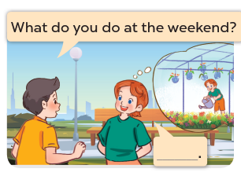
Notes:
Extension: Invite pairs of pupils to stand up and take it in turns to role-play the target exchanges.
Game: Pass the balls!
Pupils pass the two balls; one is red and the other is blue. Listen to music and they pass the balls. When the music stops, the pupils with the red ball will make a question and the one with the blue ball will give the answer.

Slide 34
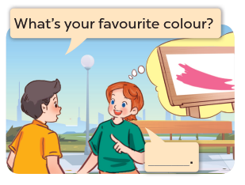
Notes:
Extension: Invite pairs of pupils to stand up and take it in turns to role-play the target exchanges.
Game: Pass the balls!
Pupils pass the two balls; one is red and the other is blue. Listen to music and they pass the balls. When the music stops, the pupils with the red ball will make a question and the one with the blue ball will give the answer.

Slide 35
04
Fun corner and Wrap-up

Slide 36





Let's Play
TIC TAC TOE

Slide 37











Team 1
blue
pink
clever
31
Nguyen
Hue
street
17
Hoa Binh
street
go for
a walk
Team 2
surf the Internet
active
orange
Notes:
GV kết hợp cách cho điểm ở bảng đen.

Slide 38



Score Board
Team 1
Team 2
Notes:
Copy and paste the token for every point a team receives.

Slide 39

THANK YOU
for
PLAYING!

