Slide 1




UBND QUẬN DƯƠNG KINH
TRƯỜNG TIỂU HỌC ANH DŨNG
ENGLISH - GRADE 5
UNIT 16: SEASONS AND THE WEATHER
- LESSON 2 (4, 5, 6)

Slide 2
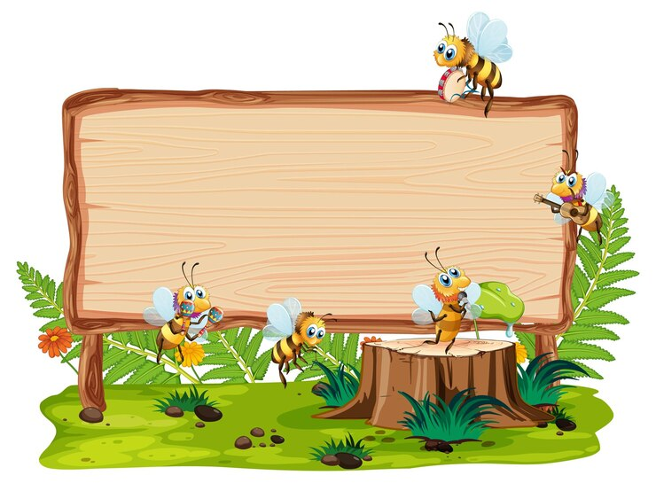

01
Warm-up and Review

Slide 3

What do you usually wear in ______?
I wear _____.

Slide 4
02
Listen and circle.

Slide 5

Listen and circle.
1. A. What season is it in Sydney? – It’s ________.
a. autumn b. summer
B. What does he usually wear? – He wears _______.
a. shorts and a T-shirt b. jeans and a T-shirt
2. A. What season is it in Ha Noi? – It’s ______.
a. winter b. summer
B. What does she usually wear? – She wears _____.
a. a skirt and a jumper b. jeans and a jumper

Slide 6
Listen and check.
1. A: What season is it in Sydney? – It’s ________.
a. autumn b. summer
B: What does he usually wear? – He wears _____.
a. shorts and a T-shirt b. jeans and a T-shirt

Slide 7
Listen and check
2. A: What season is it in Ha Noi? – It’s ________.
a. winter b. summer
B: What does she usually wear? – She wears ___.
a. a skirt and a jumper b. jeans and a jumper

Slide 8
03
Read and complete.

Slide 9
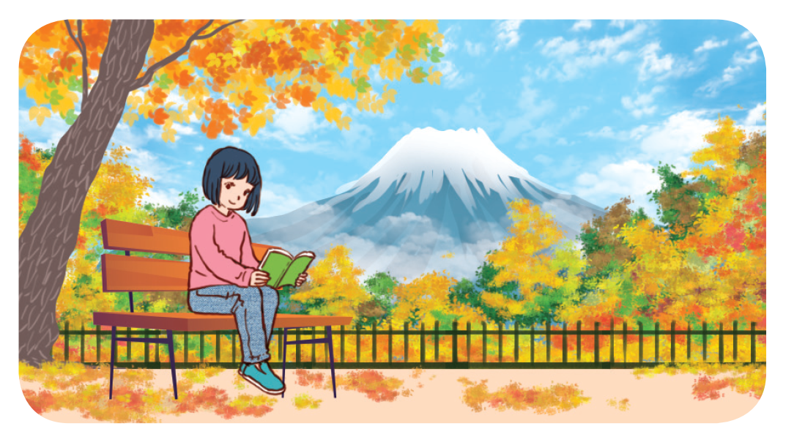
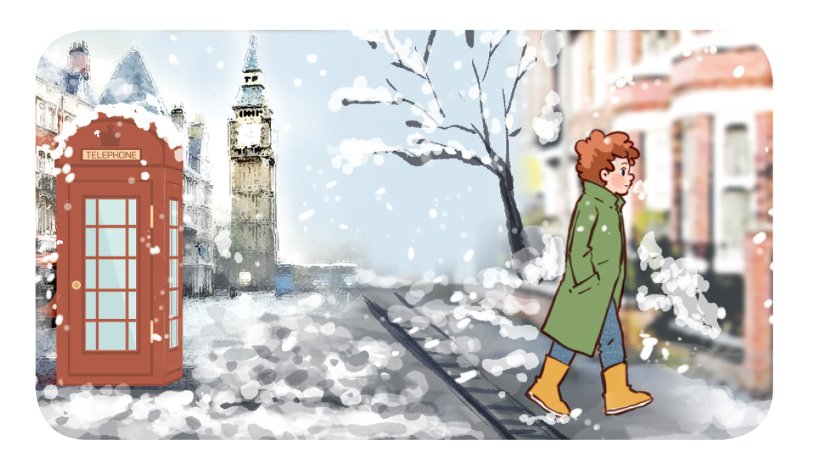
Read and complete.

Slide 10
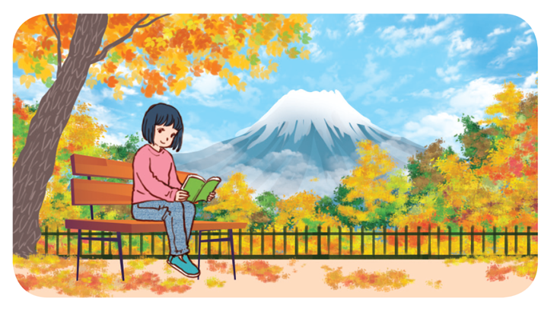
Read and complete.
1. A: How’s ___________ in Japan, Akiko?
B: It’s cool and windy. It’s autumn.
A: What do you usually wear at this time of year?
B: I wear ___________ and a __________.

Slide 11
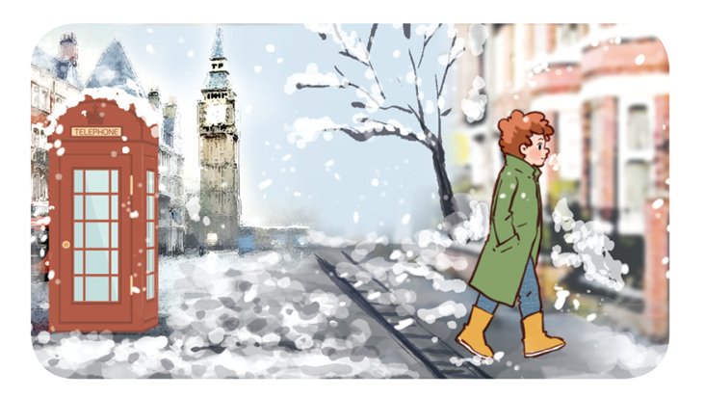
Read and complete.
2. A: What season is it in London now, Tom?
B: It’s ___________. It’s very cold and snowy.
A: What ________________ in winter?
B: I wear ___________ and a coat.

Slide 12
Let’s check.
the weather
1.A: How’s ___________ in Japan, Akiko?
B: It’s cool and windy. It’s autumn.
A: What do you usually wear at this time of year?
B: I wear _____ and a ______.
2.A: What season is it in London now, Tom?
B: It’s ______. It’s very cold and snowy.
A: What _________________ in winter?
B: I wear ______ and a coat.
winter
do you usually wear
jeans
jeans
jumper

