Slide 1




UBND QUẬN DƯƠNG KINH
TRƯỜNG TIỂU HỌC ANH DŨNG
ENGLISH - GRADE 5
EXTENTION ACTIVITIES

Slide 2





01
Warm-up and Review

Slide 3












HELLO EVERYONE
Let's play a game!
GUESSING GAME

Slide 4



The person putting out fires is called a ...
Question 1

Slide 5



THE ANSWER IS...
FIREFIGHTER

Slide 6

The person writing stories is called a ...
Question 2

Slide 7
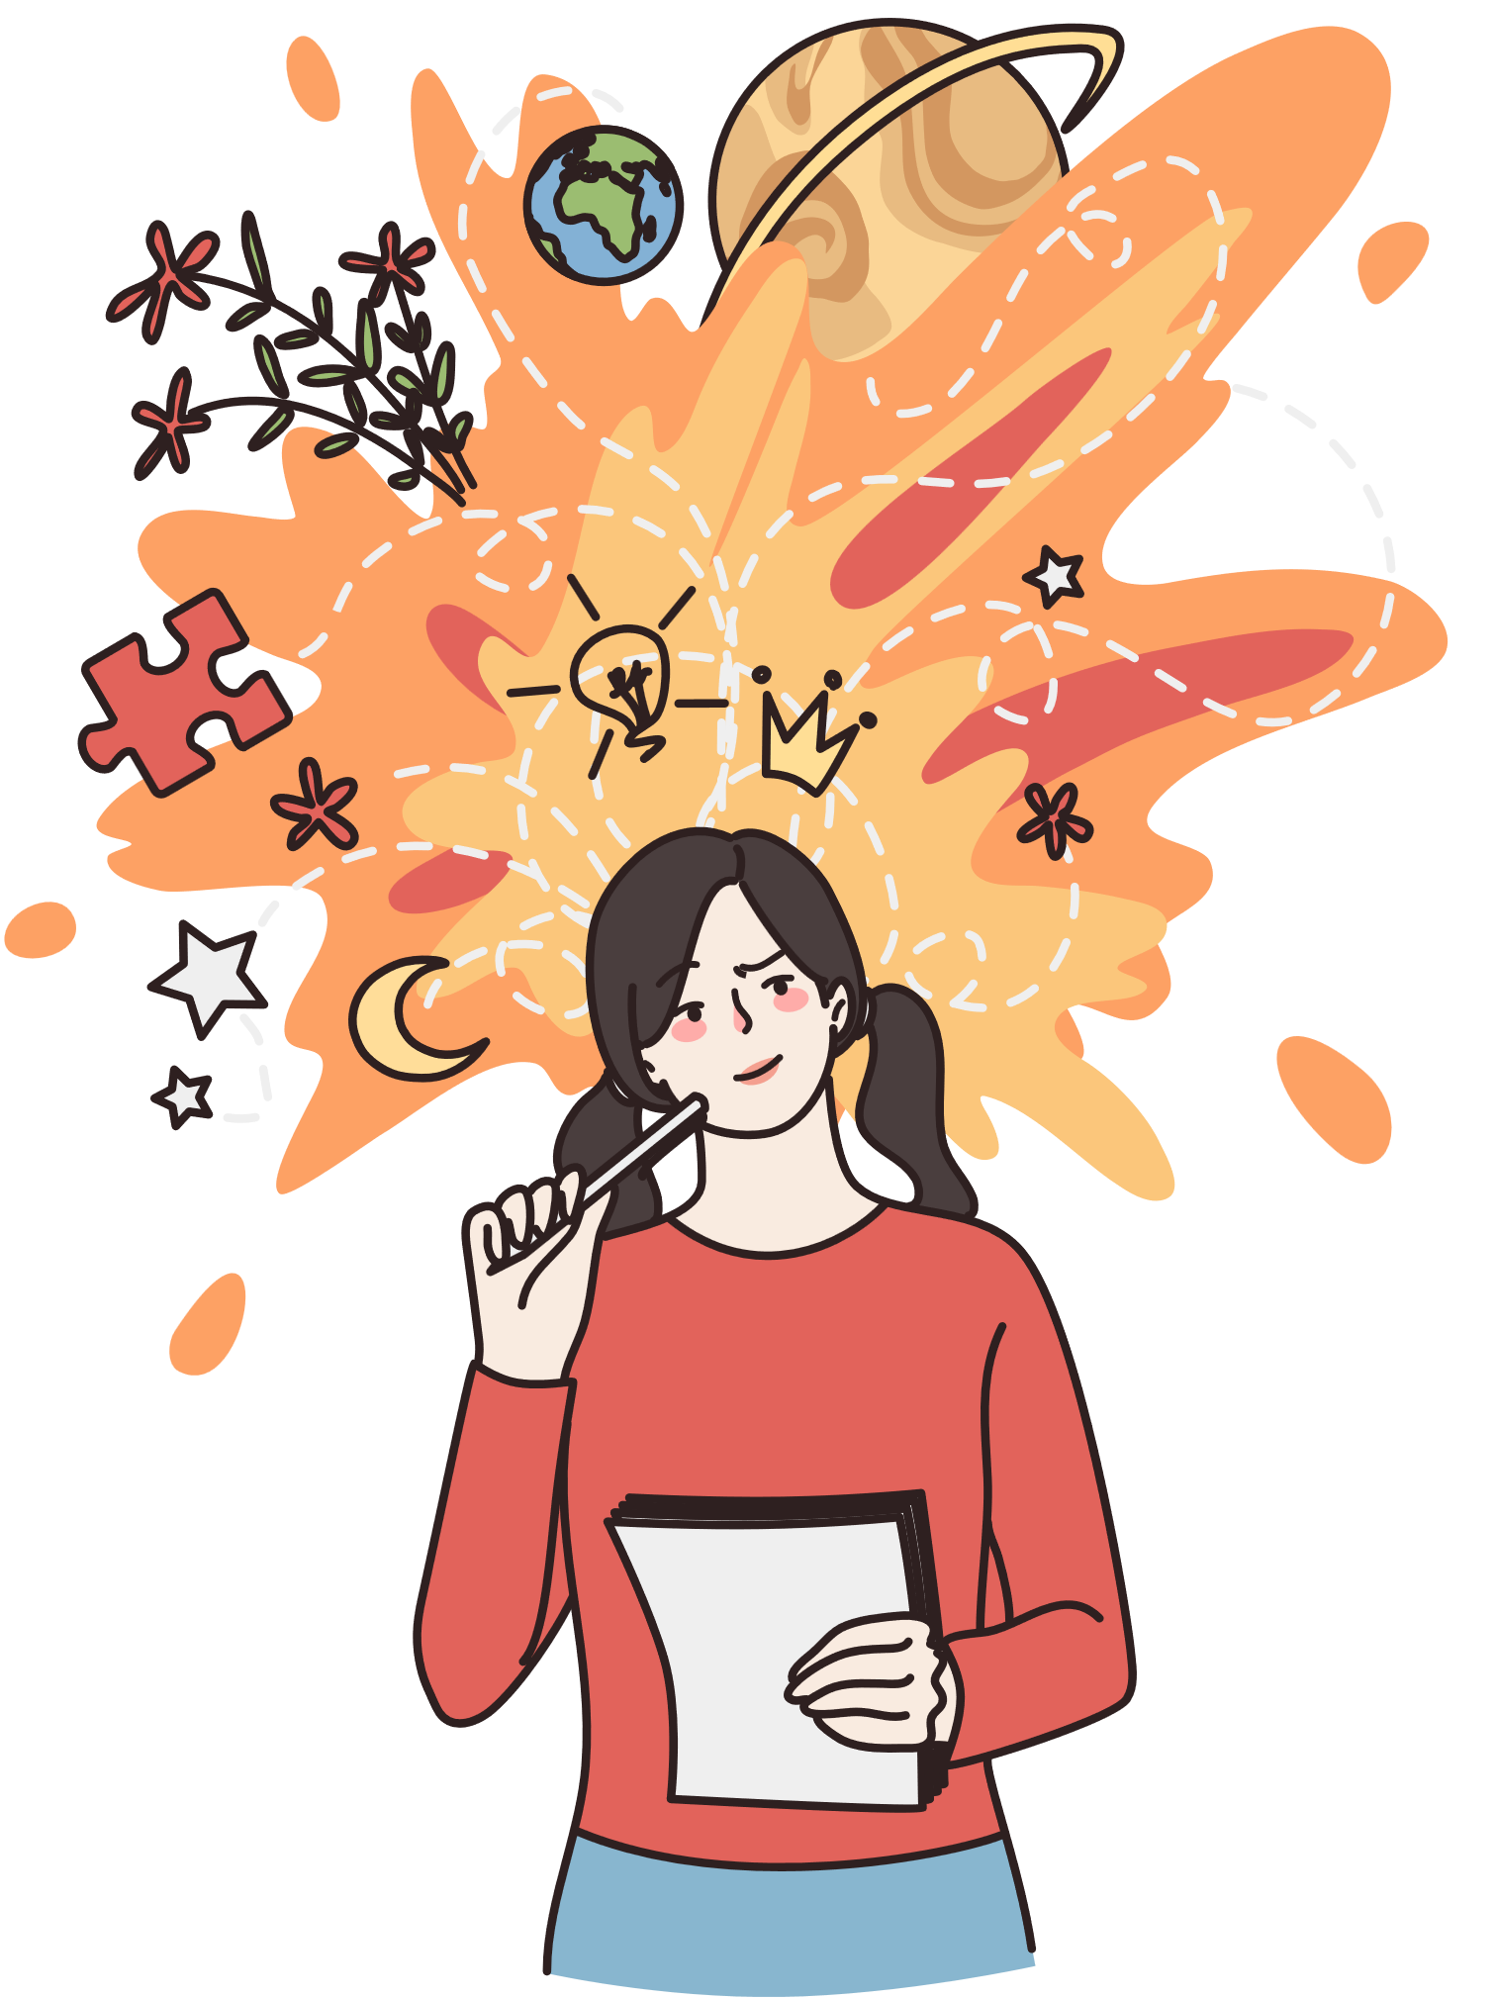
THE ANSWER IS...
WRITER

Slide 8



QUESTION 3
Guess the word
D
C
T
R

Slide 9
THE ANSWER IS...
D
O
C
T
O
R

Slide 10

QUESTION 4
Guess the word
G
R
D
R

Slide 11
THE ANSWER IS...
G
A
R
D
E
N
E
R

Slide 12




QUESTION 5
Where is it?

Slide 13
THE ANSWER IS...
THEATRE

Slide 14

QUESTION 6
Where is it?

Slide 15
THE ANSWER IS...
SCHOOL

Slide 16
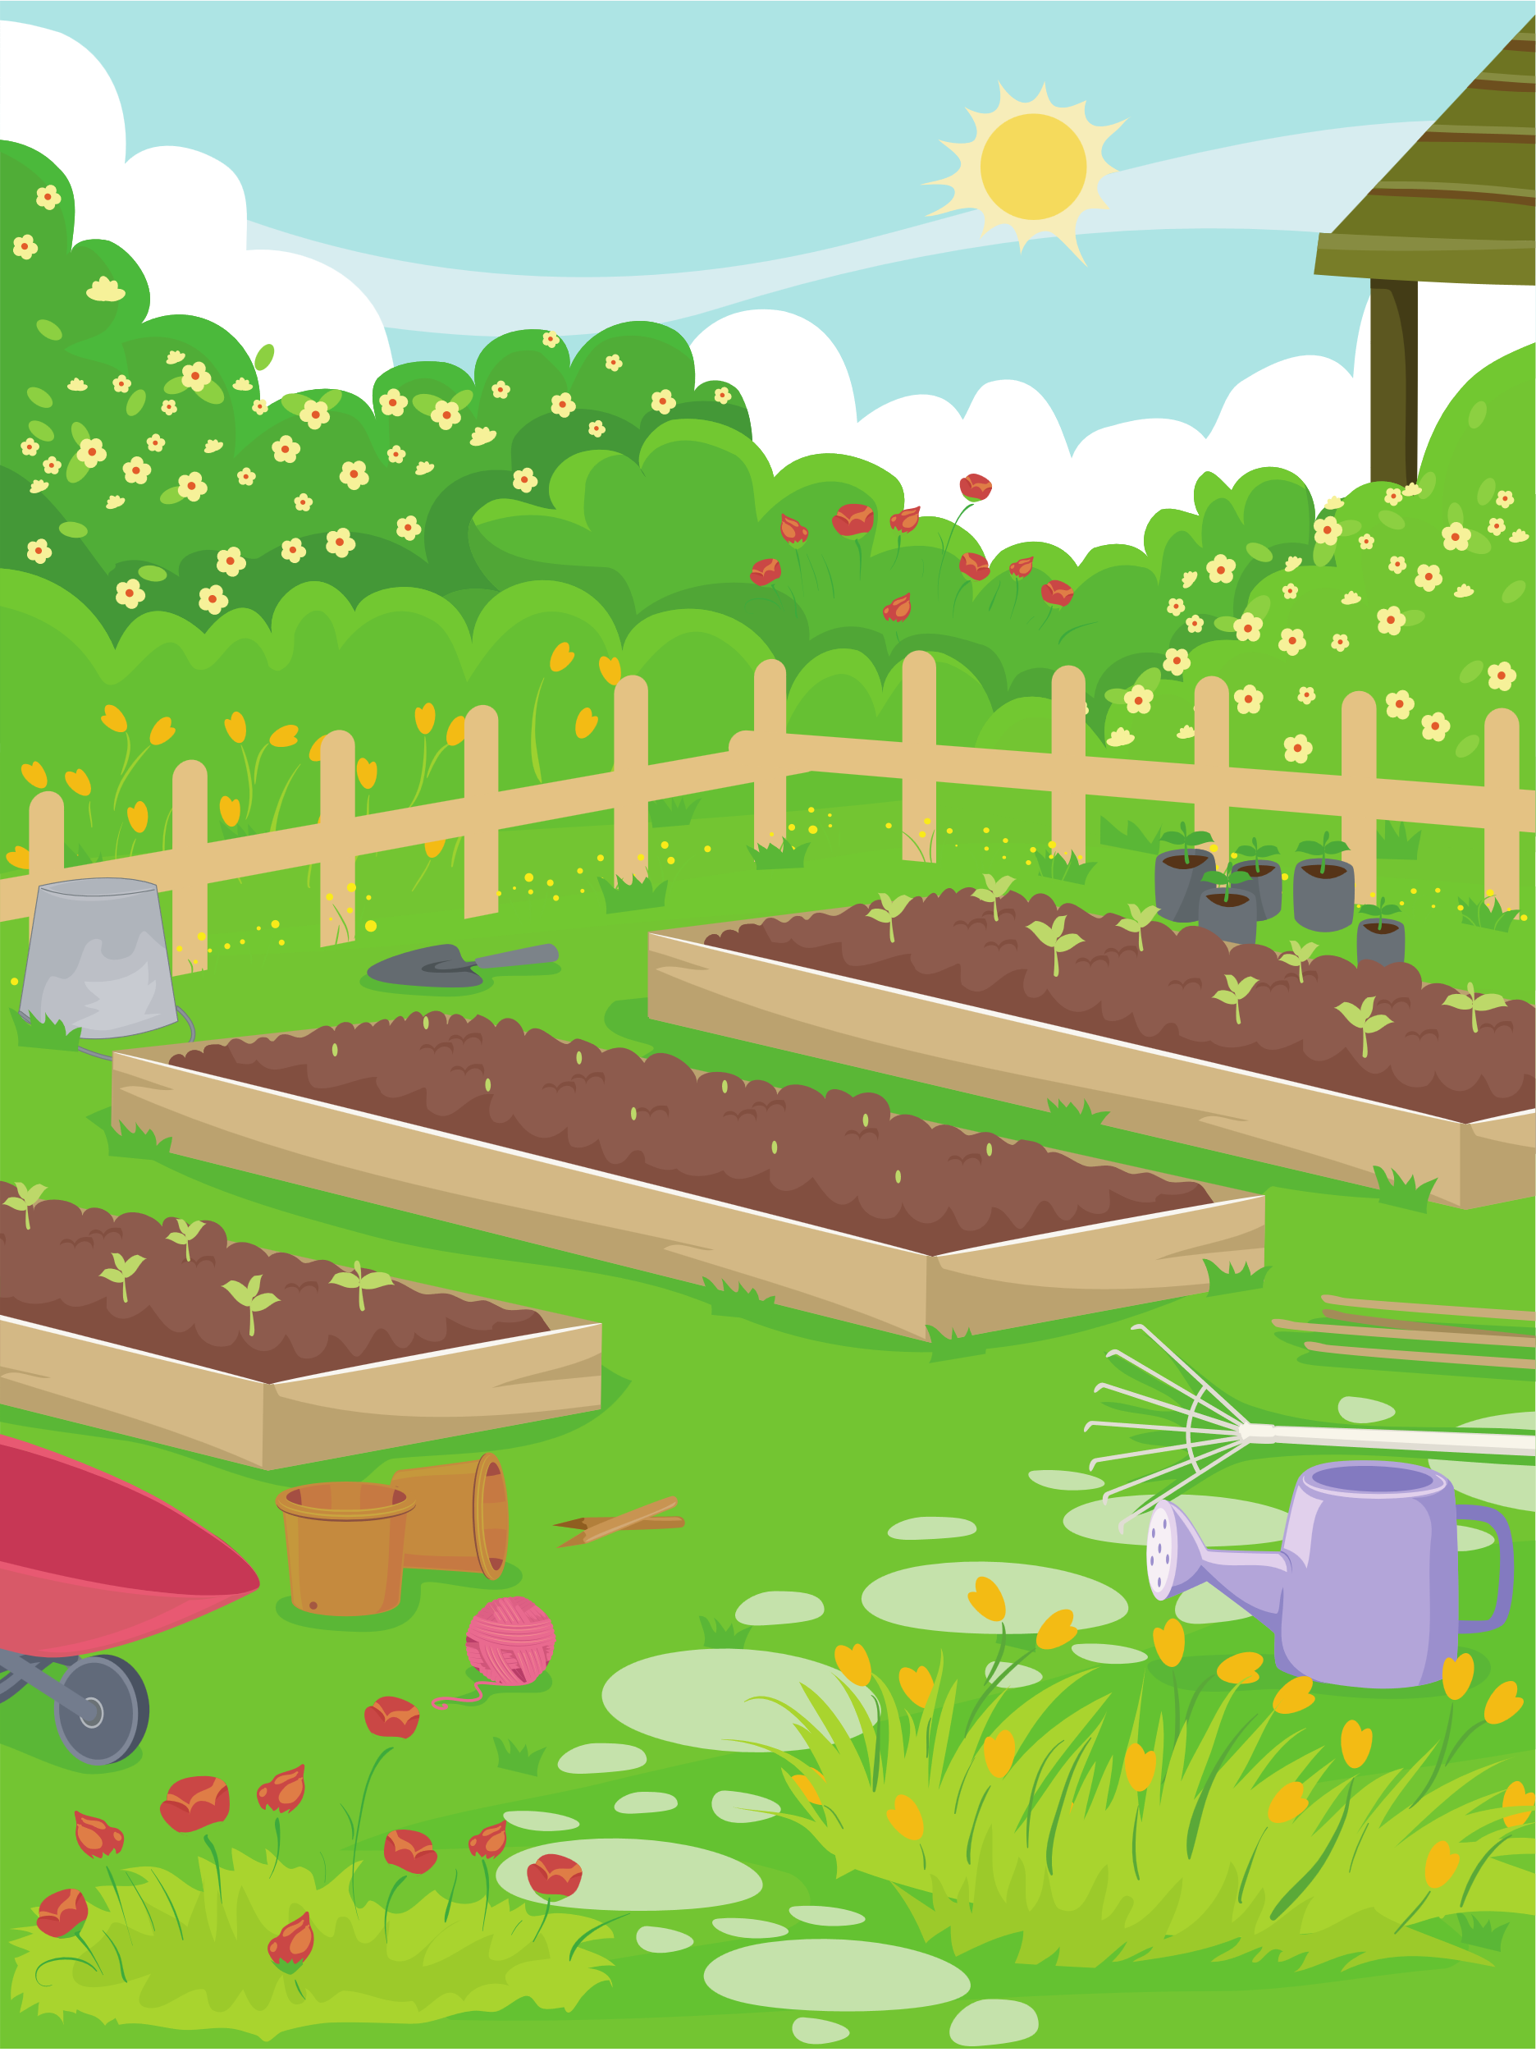
QUESTION 7
Where is it?

Slide 17
THE ANSWER IS...
GARDEN

Slide 18





THANK YOU FOR YOUR PLAYING!

Slide 19


02
Activity 1
Choose and write the correct words on the lines.

Slide 20


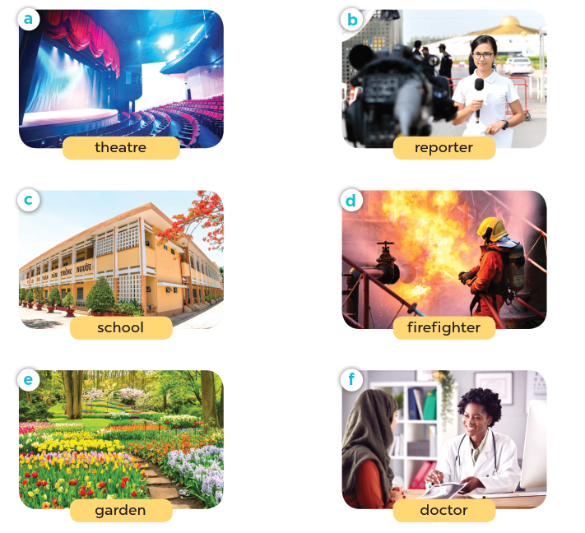


Choose and write the correct words on the lines.
1. I teach English. I have lots of pupils. Where do I work?
__________
school
2. I help sick people. I work in a hospital. What am I?
__________
doctor
3. I act and tell stories to lots of people. Where do I work?
__________
theatre
4. I report news stories. I work in an office, but I travel a lot.
What am I?
__________
reporter
5. I put out. I work in a fire station. What is my job?
__________
firefighter
6. I plant beautiful flowers and trees. Where do I work?
__________
garden

Slide 21
03
Activity 2
Complete the table about jobs.

Slide 22



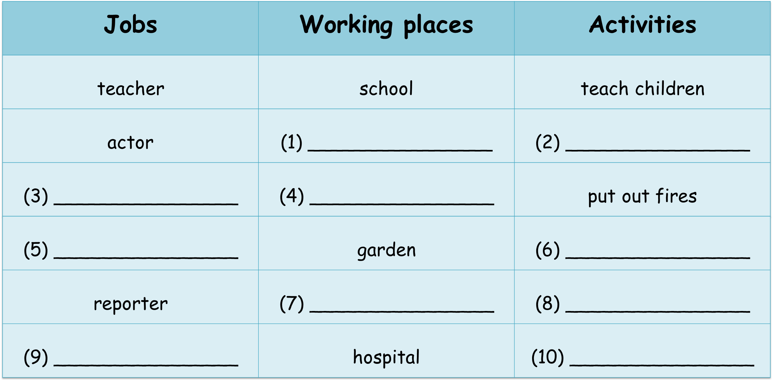
Complete the table about jobs
theatre
act and tell stories
firefighter
fire station
gardener
water the plants
office
report the news
doctor
help sick people

Slide 23
04
Activity 3
Work in groups. Talk about what you want to be in the future. Say why.

Slide 24


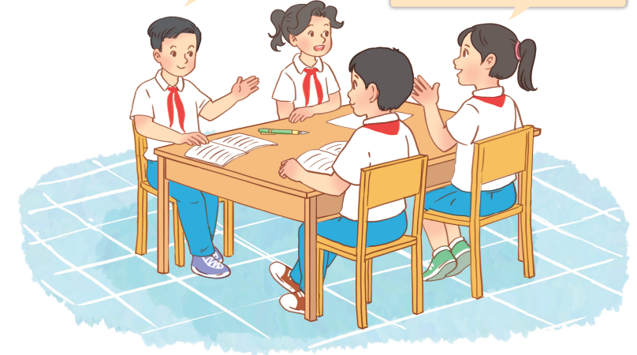
Work in groups. Talk about what you want to be in the future. Say why.
I want to be a teacher because _____.
I want to be _____ because _____.

Slide 25

Example
I’d like to teach children
I want to be a teacher because _____________________.
I want to be _____ because _____.

Slide 26
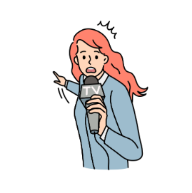
Example
a reporter
I’d like to report the news
I want to be ________ because _____________________.

Slide 27
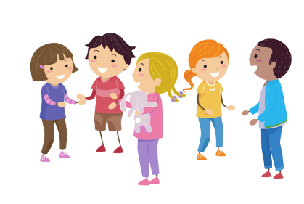
Work in groups.

Slide 28

05
Fun corner and Wrap-up.

Slide 29









Lucky numbers
Play

Slide 30











NEXT
Notes:
- Click the number to go to the Question slide.
- Click the BACK to return the game..

Slide 31




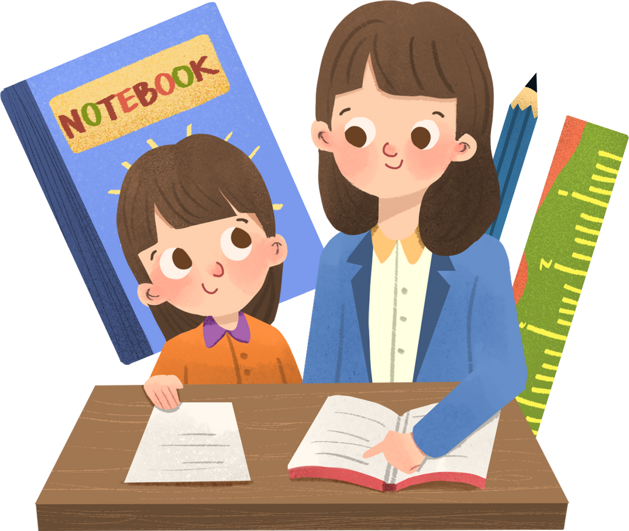


1
What would you like to be in the future?
a teacher
I’d like to be __________.

Slide 32




2
What would you like to be in the future?
a reporter
I’d like to be ____________.

Slide 33


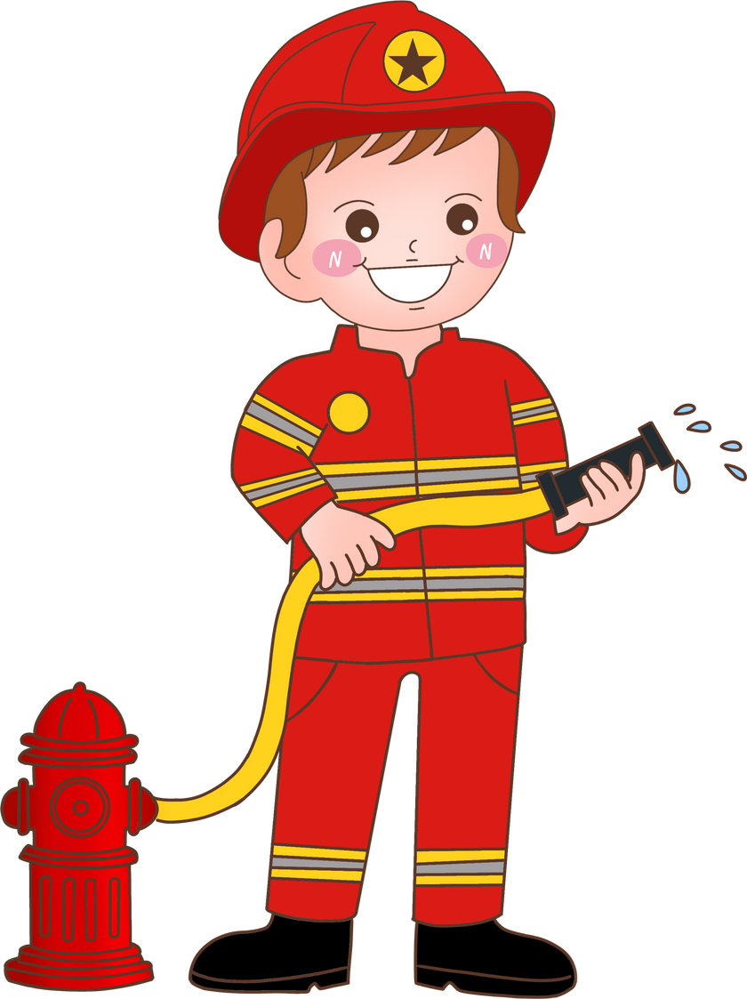

3
Why would you like to be a firefighter?
put out fires
Because I’d like to _______________.

Slide 34




4
Why would you like to be a teacher?
teach children
Because I’d like to be ________________.

Slide 35


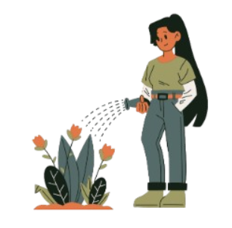

5
a gardener
I want to be ____________ because I’d like to ____________________.
water the flowers

Slide 36




6
a writer
I want to be ____________ because I’d like to ____________________.
tell stories

Slide 37

Notes:
- Click the number to go to the Question slide.
- Click the colored box to disappear the choice.

