Slide 1




UBND QUẬN DƯƠNG KINH
TRƯỜNG TIỂU HỌC ANH DŨNG
ENGLISH - GRADE 5
UNIT 6: OUR SCHOOL ROOMS
LESSON 3 (1, 2, 3)

Slide 2


01
Warm-up & Review

Slide 3
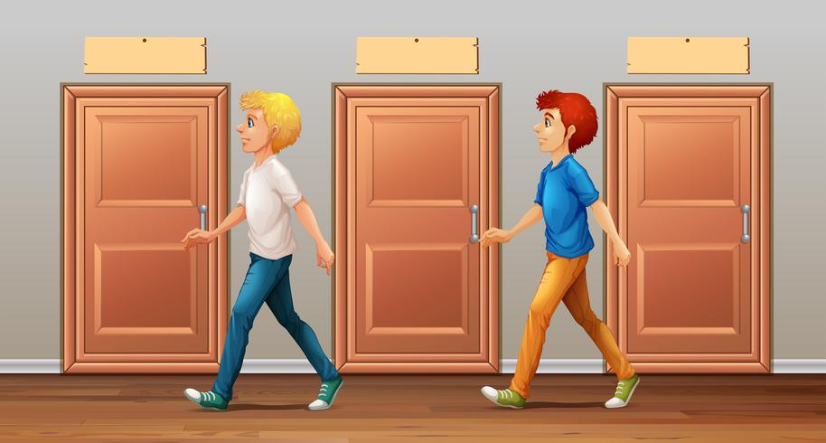
go along the corridor

Slide 4

go upstairs

Slide 5
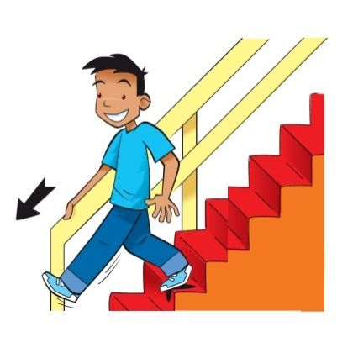
go downstairs

Slide 6

turn left

Slide 7

turn right

Slide 8
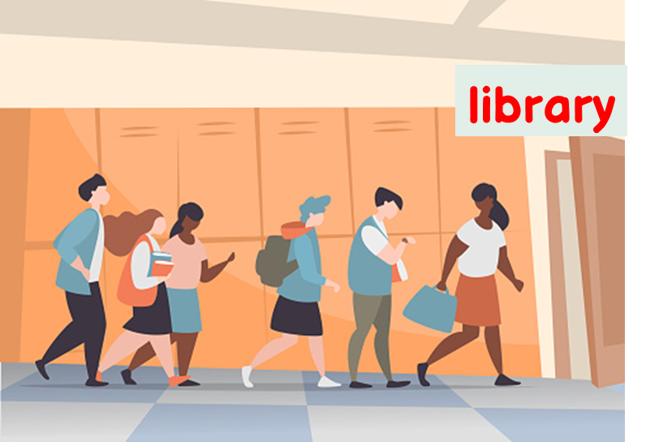
go past the library

Slide 9
Syllable
and stress
Notes:
Click the options A/B/C to check the answer.

Slide 10
Listen, and clap. How many syllables?
upstairs
along
library
corridor
downstairs
second
sunny
computer
ahead
2 syllables | More than 2 syllables

Slide 11
We say the red part more loudly.
The stress is on the second syllable.
down’stairs
up’stairs
downstairs
upstairs
a’long
a’head
along
ahead
inside
in’side
in’door
indoor

Slide 12
02
Listen and repeat.

Slide 13

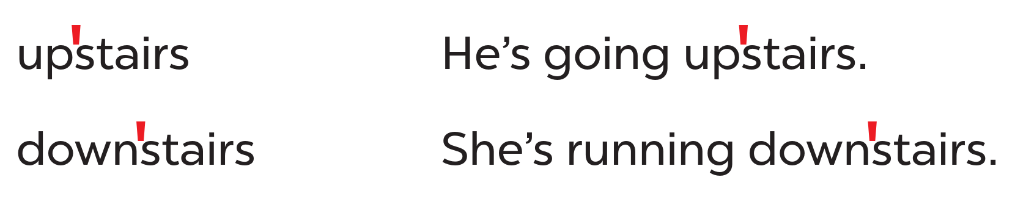
Look at the words and the sentences.
Work in pairs and say.
Listen and repeat.
stress mark

Slide 14
03
Circle, listen and check.

Slide 15
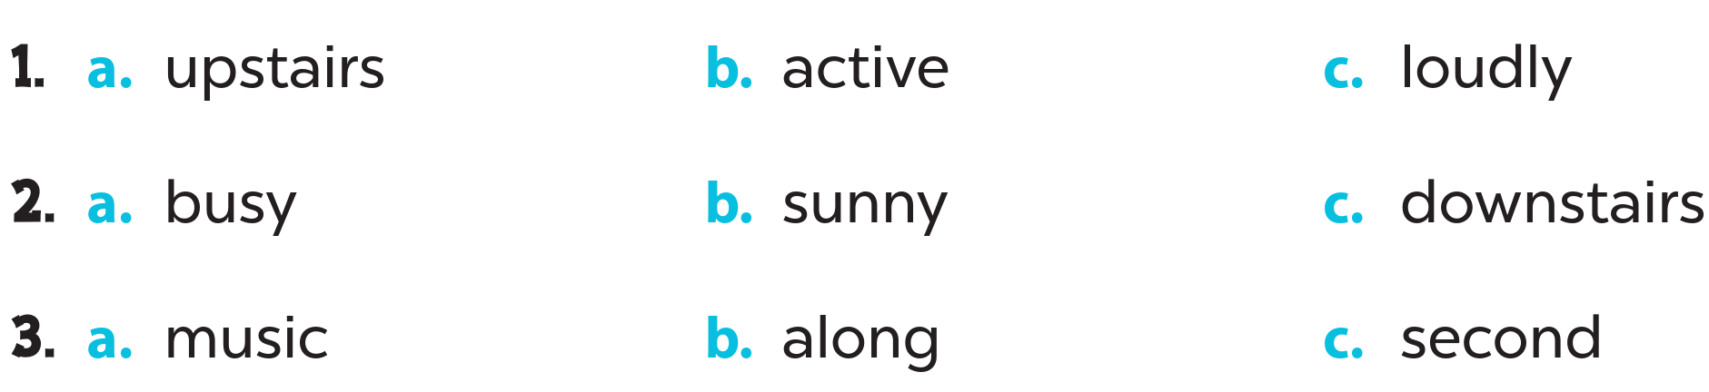
Look and circle.
Listen and check.

Slide 16
04
Let’s chant.

Slide 17
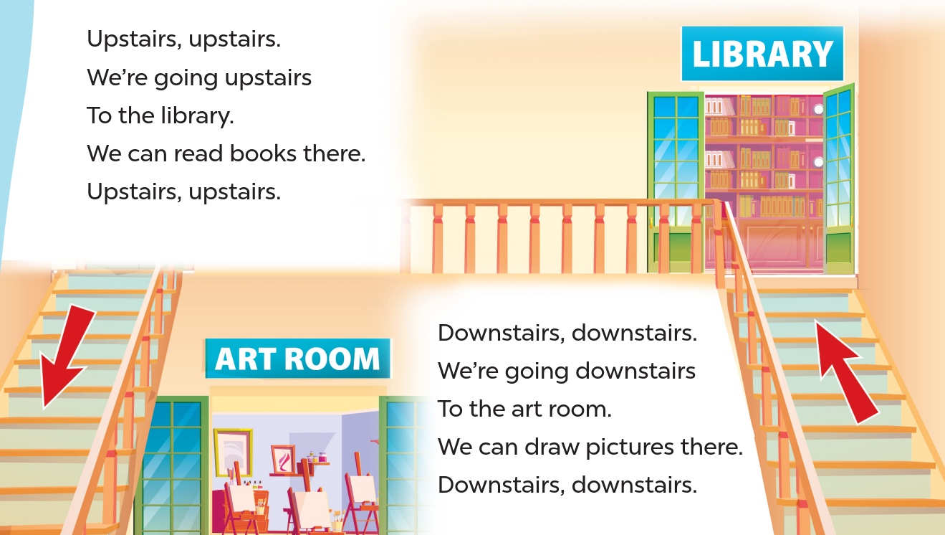
Listen and repeat.
Clap and chant.
Look and read.

Slide 18
05
Fun corner & Wrap-up

Slide 19

Odd one out
Notes:
Click the options A/B/C to check the answer.

Slide 20


A. along
B. second
C. downstairs

Slide 21
A. music
B. second
C. along

Slide 22
A. active
B. downstairs
C. upstairs

Slide 23
A. writer
B. sunny
C. along

Slide 24
A. along
B. busy
C. ahead

Slide 25
A. artist
B. second
C. downstairs

