Slide 1




UBND QUẬN DƯƠNG KINH
TRƯỜNG TIỂU HỌC ANH DŨNG
ENGLISH - GRADE 5
UNIT 8: IN OUR CLASSROOM
LESSON 3 (1, 2, 3)

Slide 2




01
Warm-up & Review

Slide 3


Game:
RING THE BELL!

Slide 4






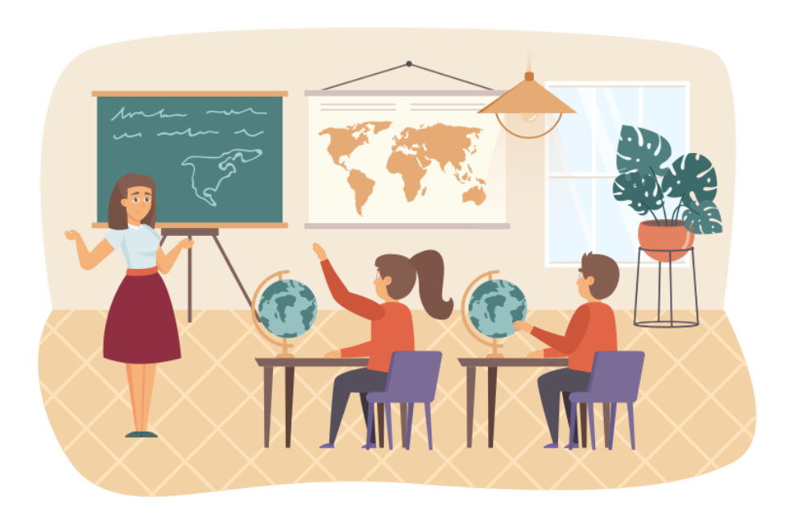


Choose a, b or c. Then say.
6
1
2
3
4
5
7
8
9
10
START
The map is _______ the board.
a. on
b. beside
c. under

Slide 5

6
1
2
3
4
5
7
8
9
10
START
Whose _______ this? - It’s Nam’s.
a. glue stick
b. set square
c. pencil

Slide 6

6
1
2
3
4
5
7
8
9
10
START
Whose _______ this? - It’s Bill’s.
a. book
b. crayon
c. map

Slide 7
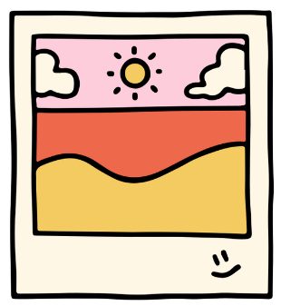
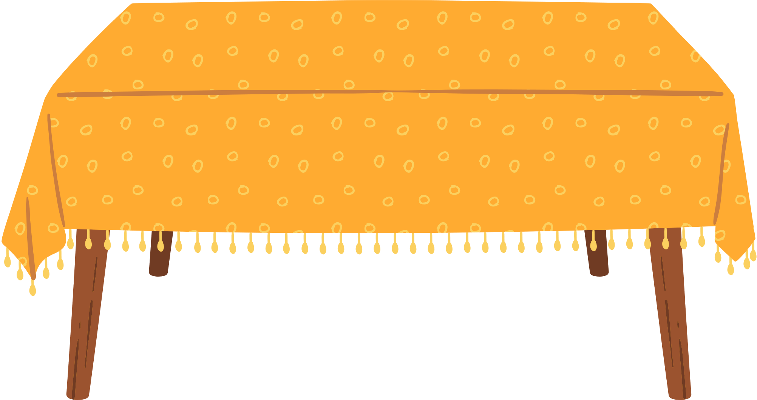
6
1
2
3
4
5
7
8
9
10
START
The photo is _______ the table.
a. in front of
b. over
c. above

Slide 8





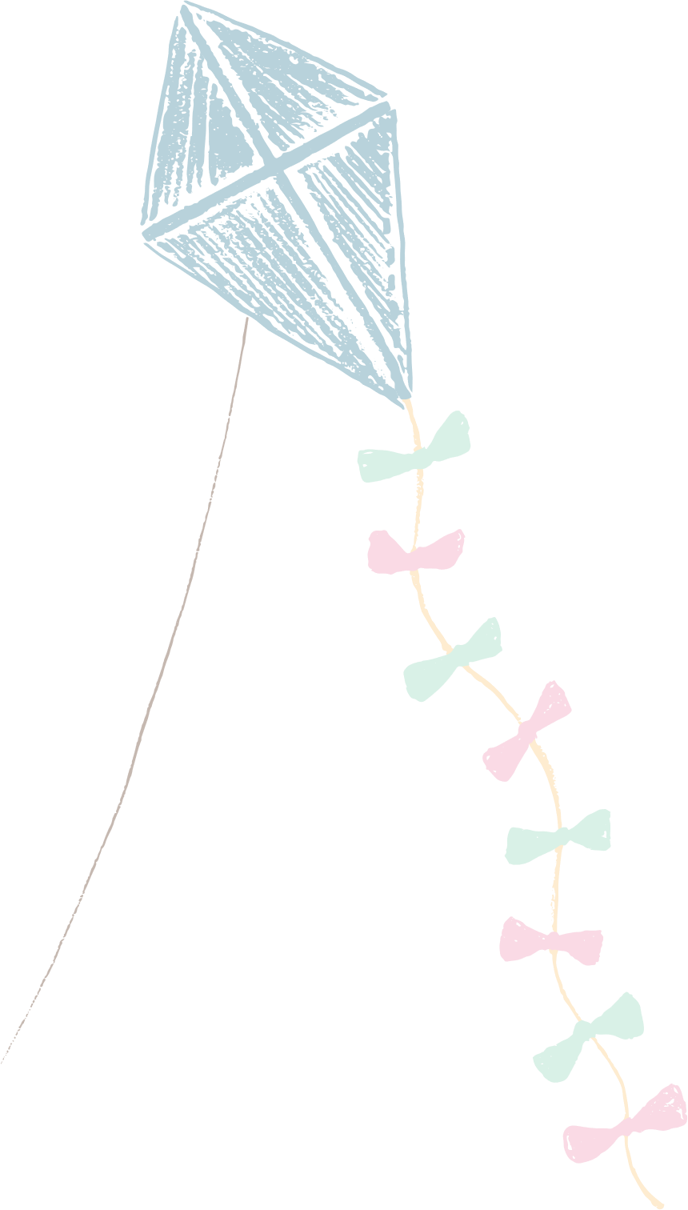






Slide 9
02
Listen and repeat.

Slide 10






Listen and point.
'
above
'
The picture is above the window.

Slide 11
Listen and repeat.
'
above
'
The picture is above the window.

Slide 12
Listen and point.
'
beside
'
The map is beside the board.

Slide 13
Listen and point.
'
beside
'
The map is beside the board.

Slide 14
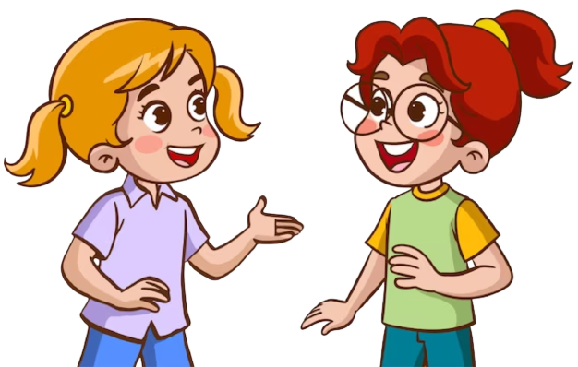
Practice ! ! !
above The picture is above the window.
beside The map is beside the board.
‘
‘
‘
‘

Slide 16
03
Circle, listen and check.

Slide 17







Circle, listen and check!
a. above
b. under
c. beside
a. above
b. under
c. beside
a. behind
b. over
c. above

Slide 18






SWAP your BOOKS!

Slide 19
Let’s check!
'
'
'
a. above
b. under
c. beside

Slide 20
Circle, listen and check!
'
'
'
a. over
b. above
c. under

Slide 21
Circle, listen and check!
'
'
'
a. behind
b. over
c. above

Slide 22
Circle, listen and check!
a. above
b. under
c. beside
a. above
b. under
c. beside
a. behind
b. over
c. above

Slide 24
04
Let’s chant.

Slide 25




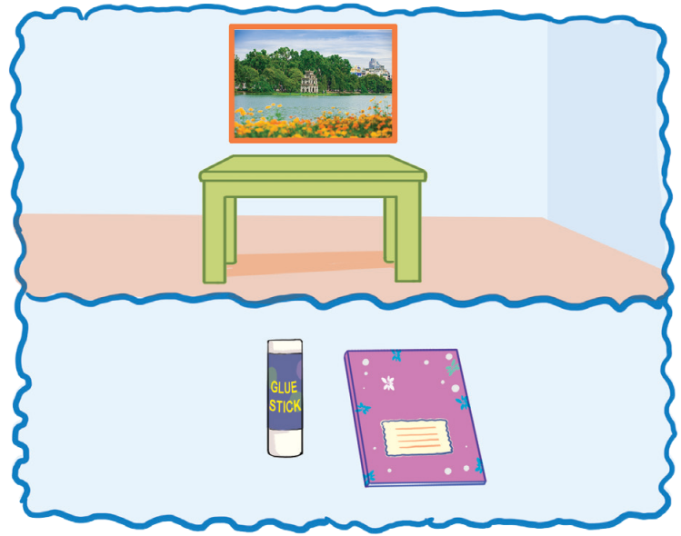
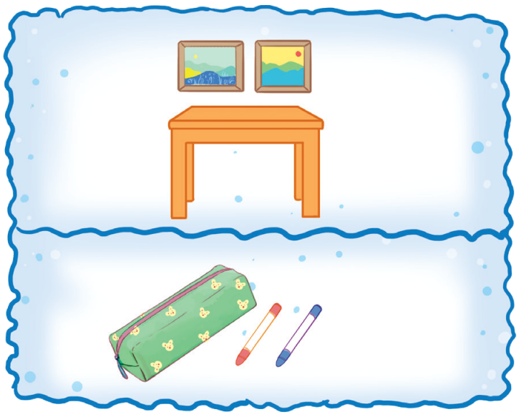

Look and point.
Where is the photo?
It’s above the table. Where is the glue stick?
It’s beside the notebook.
Where are the pictures? They’re above the table. Where are the crayons? They’re beside the pencil case.

Slide 26

Listen and point.
Where is the photo?
It’s above the table. Where is the glue stick?
It’s beside the notebook.

Slide 27
Listen and point.
Where are the pictures? They’re above the table. Where are the crayons? They’re beside the pencil case.

Slide 28

Listen and repeat.
Where is the photo?
It’s above the table.
Where is the glue stick?
It’s beside the notebook.

Slide 29

Listen and repeat.
Where are the pictures?
They’re above the table.
Where are the crayons.
They’re beside the pencil case.

Slide 30
Sing and clap.
Where is the photo?
It’s above the table. Where is the glue stick?
It’s beside the notebook.
Where are the pictures? They’re above the table. Where are the crayons? They’re beside the pencil case.

Slide 32
05
Fun corner & Wrap-up

Slide 33



Let's play!
Pictionary Game

Slide 34


Group 1
Group 2
1
2
3
4
5
6
7
8
9
10
Notes:
Click numbers to move to the Question slides.

Slide 35


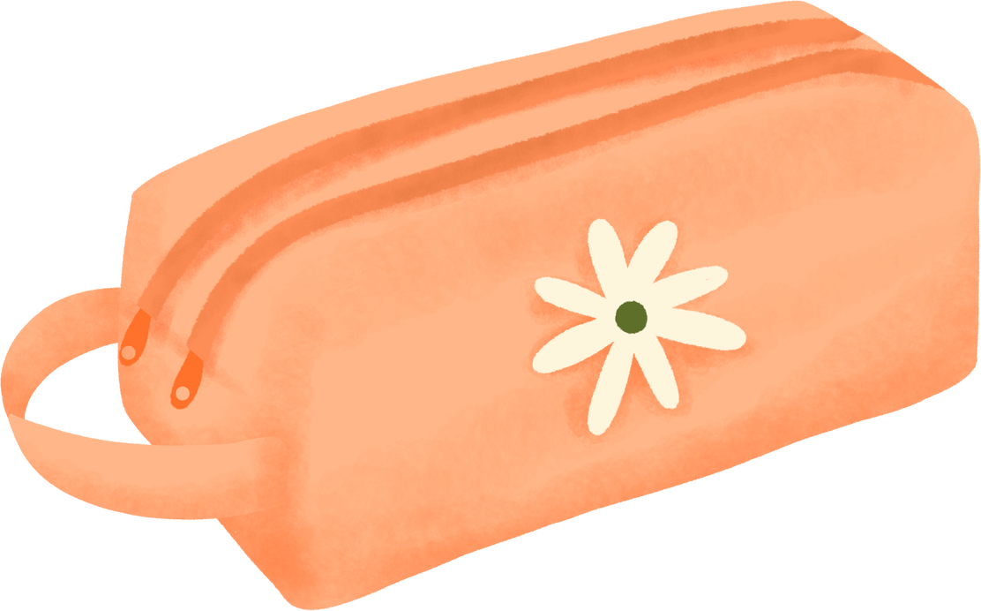



The crayon is beside
the pencil case.

Slide 36
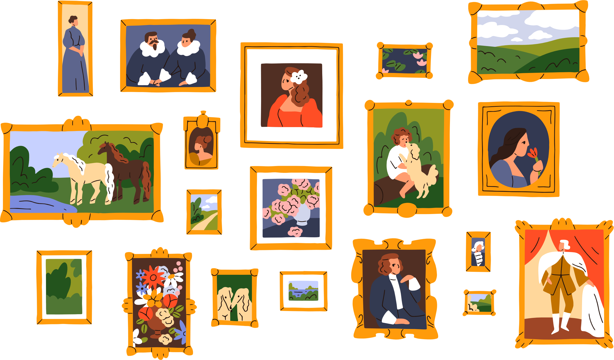
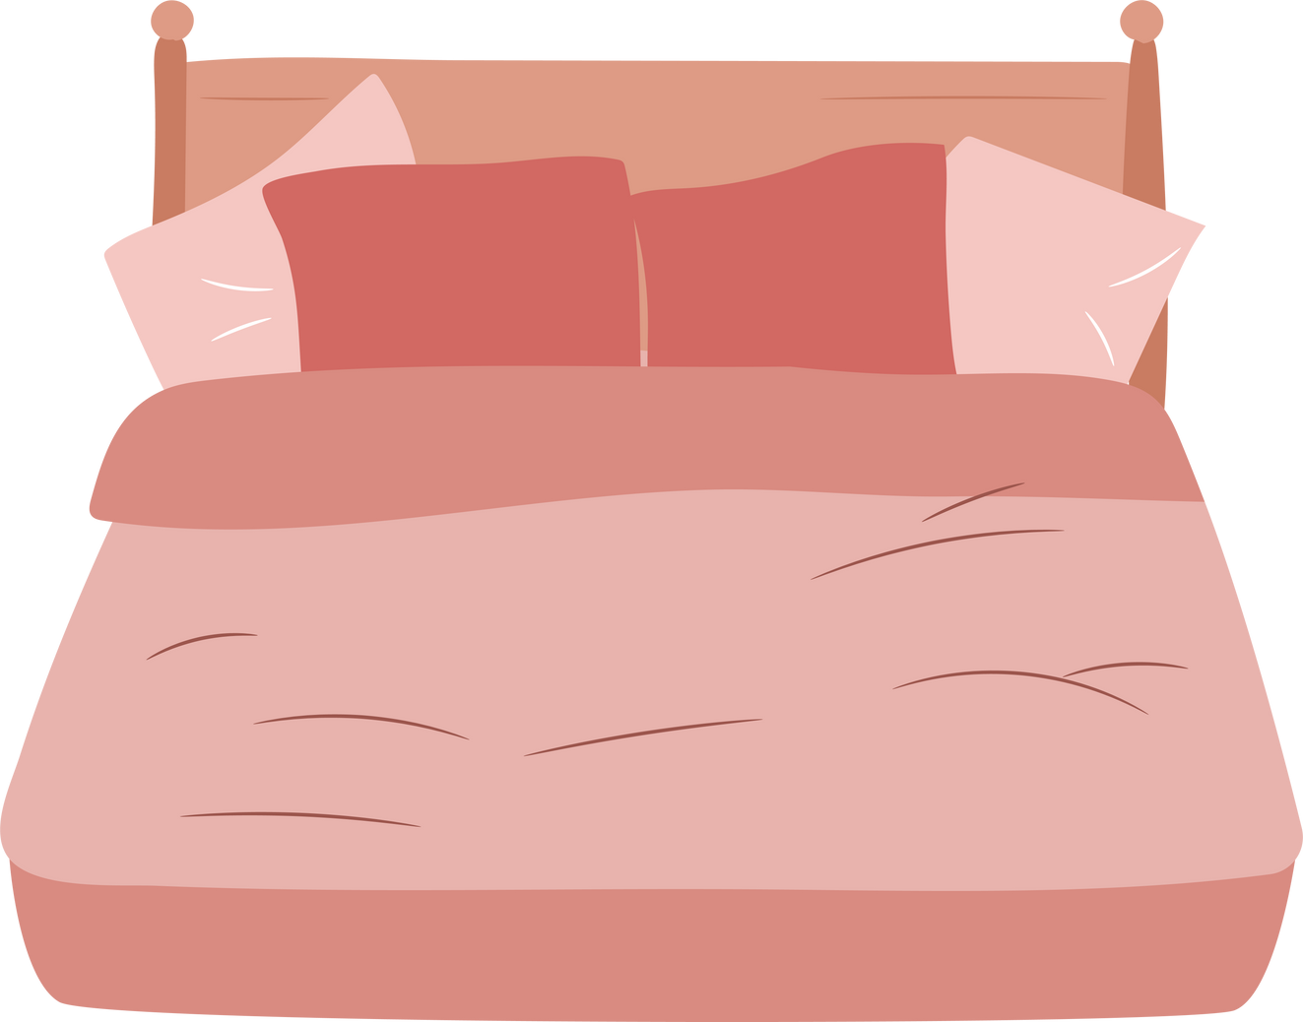
The photos are above the pencil case.

Slide 37
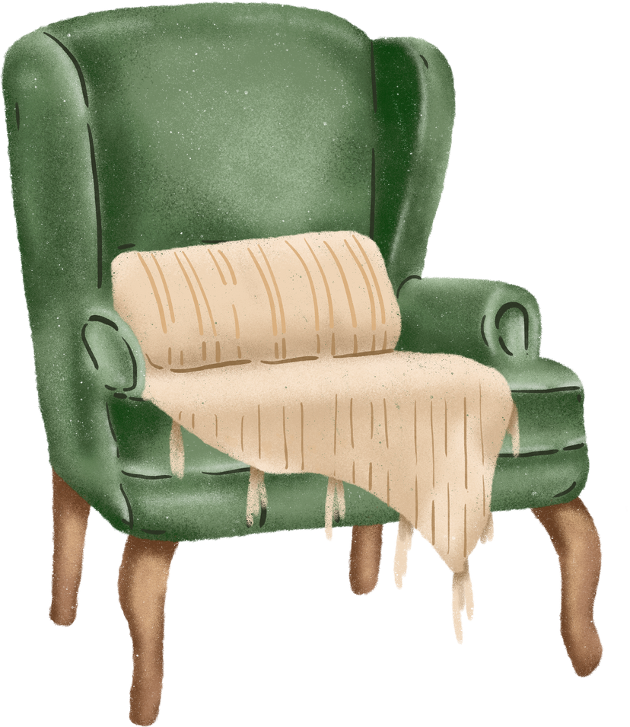

The cat is beside the chair.

Slide 38


The lamp is beside the sofa.

Slide 39
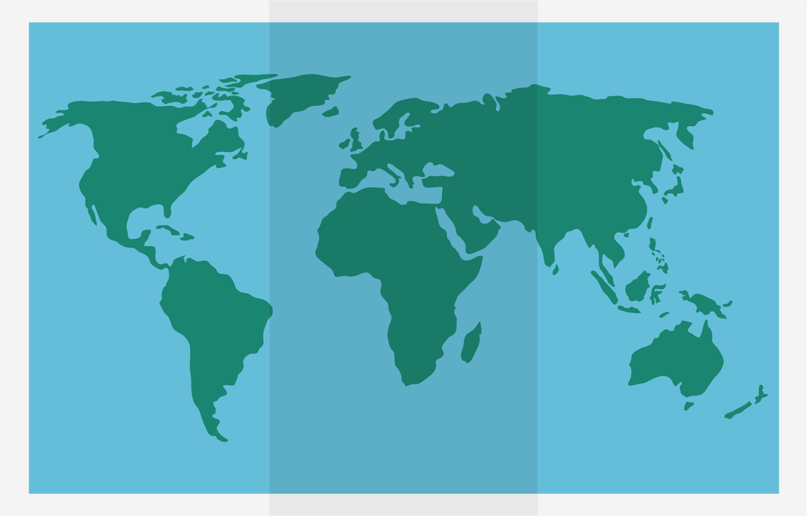

The map is above the bookcase.

Slide 40


The bike is under the tree.

Slide 41

The flowers are on the table.

Slide 42

The cat is under the box.

Slide 43

The books are in the school bag.

Slide 44
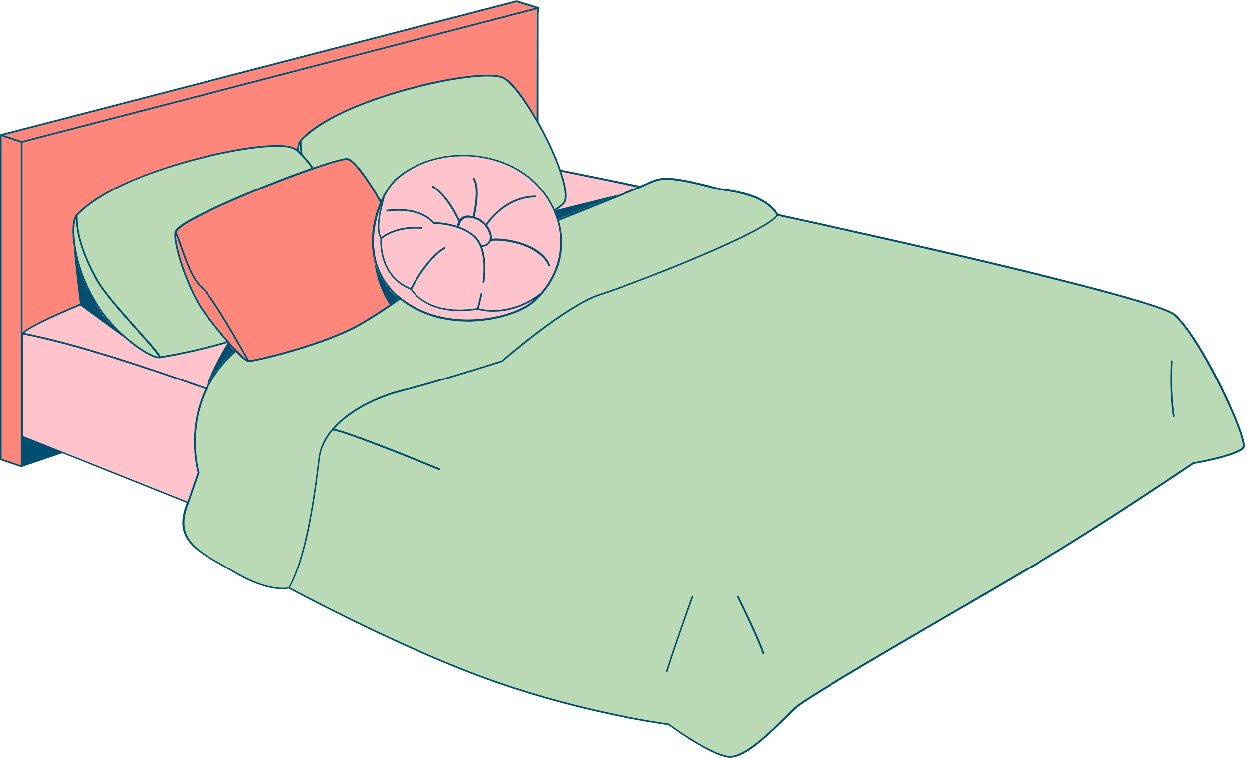

The bags are on the bed.

Slide 45

See you next time!

