Slide 1




UBND QUẬN DƯƠNG KINH
TRƯỜNG TIỂU HỌC ANH DŨNG
ENGLISH - GRADE 5
UNIT 12: OUR TET HOLIDAY
LESSON 2 (1, 2, 3)

Slide 2
1
Warm-up
What are the missing letters?

Slide 3
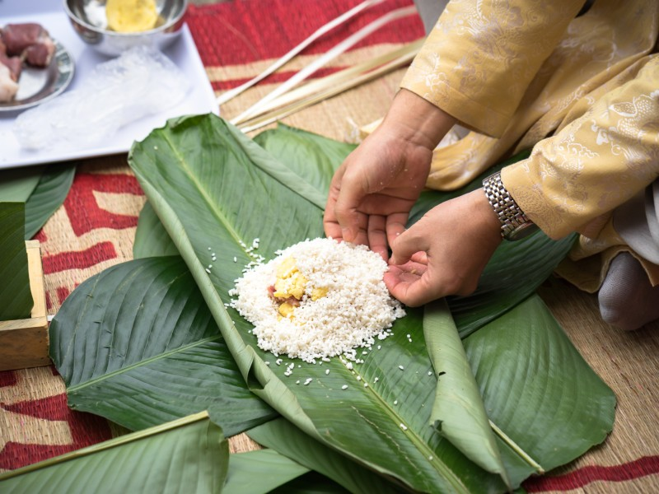
k
_ake chung ca_e
m

Slide 4
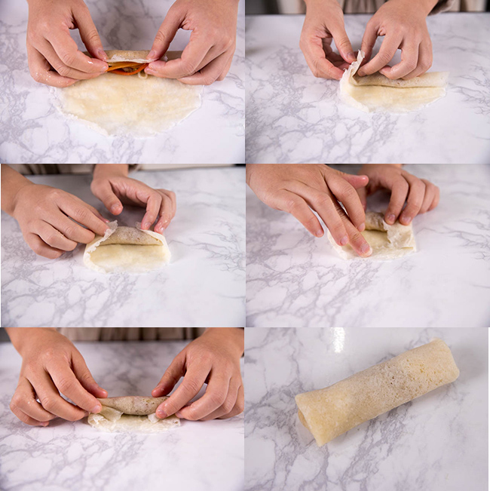
a
p
l
m_ke s_ring ro_ls

Slide 5
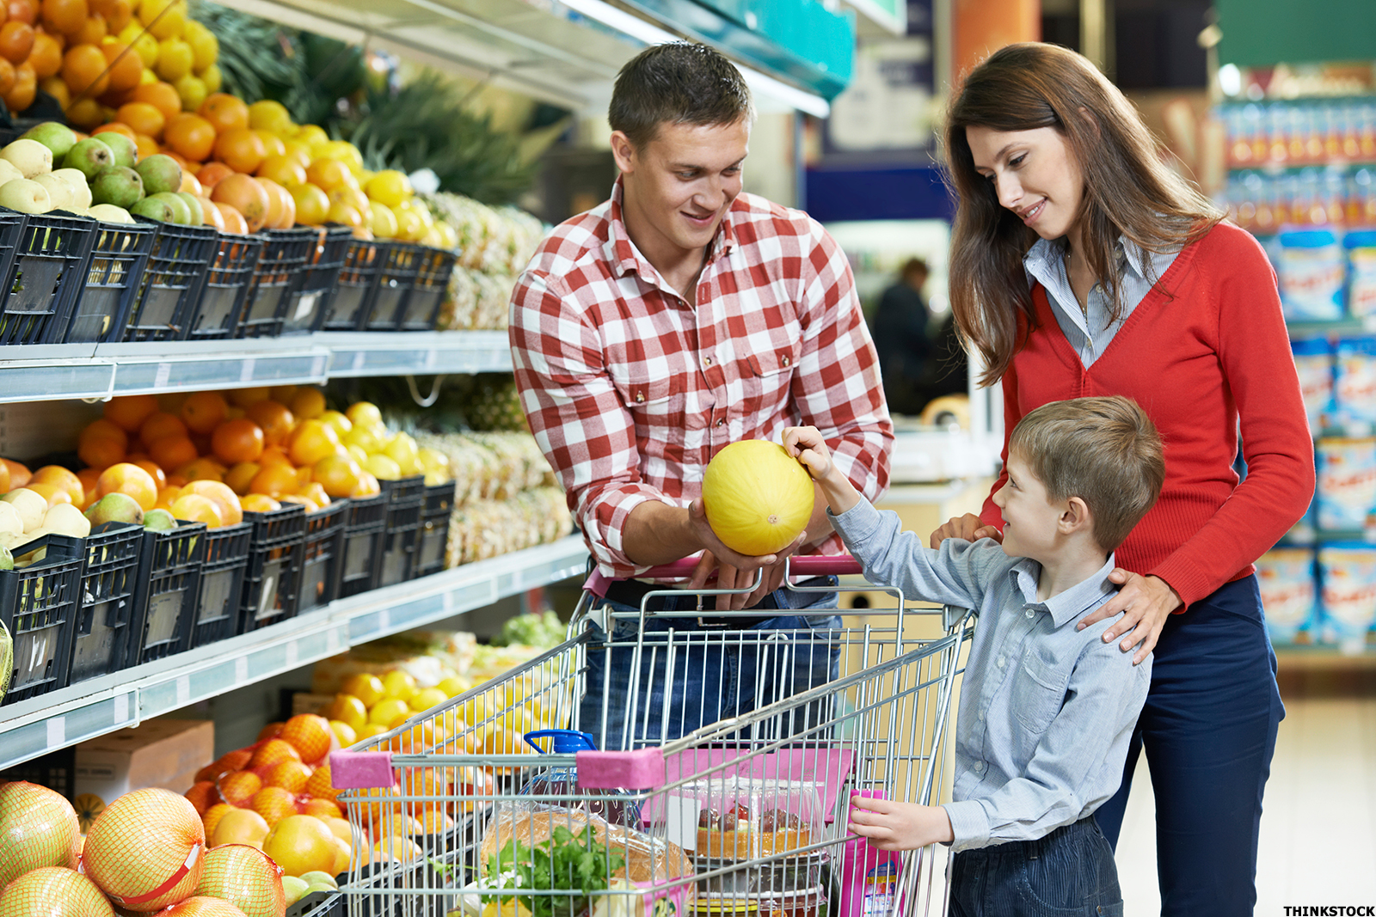
d_ the s_op_ing
o
h
p

Slide 6
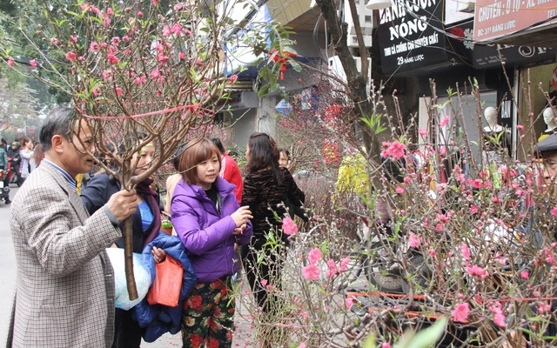
r
bu_ a b_anch of
pe_ch blo_soms
y
a
s

Slide 7
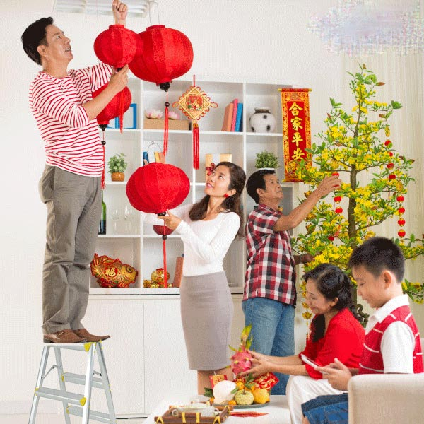
s
d_co_ate the hou_e
e
r

Slide 8
Awesome words

Slide 9
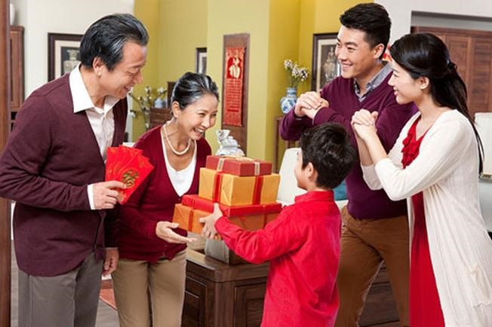
our grandparents’ house

Slide 10
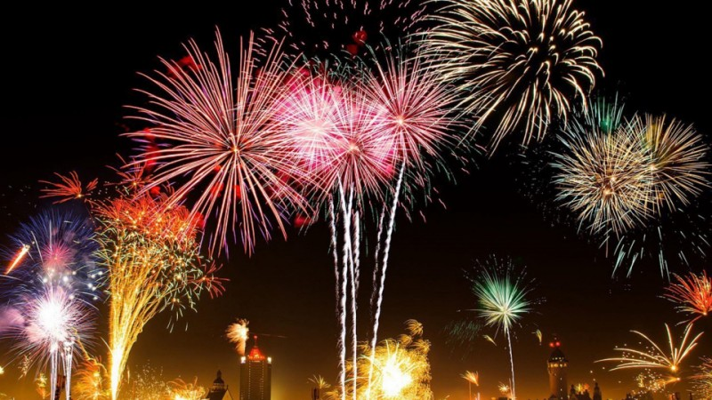
a fireworks show

Slide 11
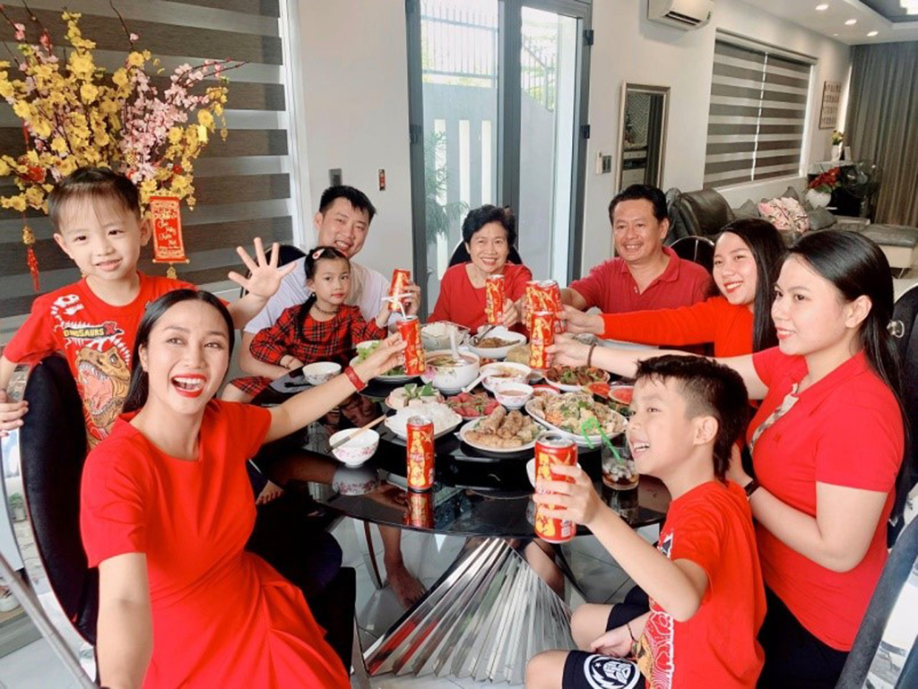
a New Year party

Slide 12
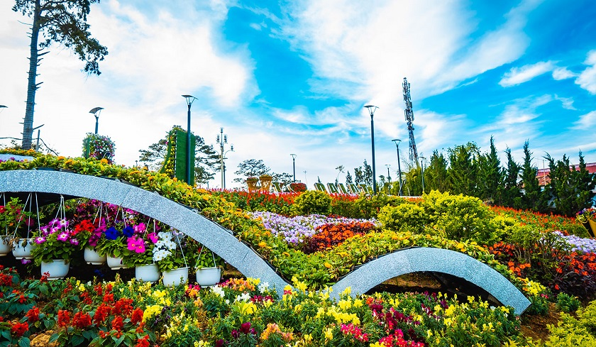
a flower festival

Slide 13
2
Look, listen and repeat.
Activity 1

Slide 14
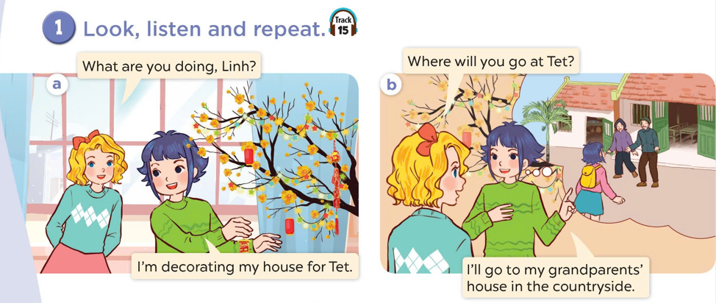
Look at the pictures.
Where are they?
What are they doing?

Slide 15

Look, listen and repeat.

Slide 16
3
Listen, point and say.
Activity 2

Slide 17

Where will you go at Tet?
I will go to my grandparents’ house.

Slide 18

Where will you go at Tet?
I will go to a fireworks show.

Slide 19
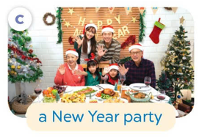
Where will you go at Tet?
Where will you go at Tet?
I will go to a New Year party.

Slide 20

Where will you go at Tet?
I will go to a flower festival.

Slide 21
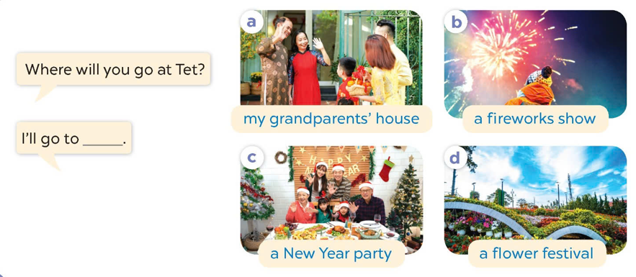
Listen and repeat.
Look and repeat the phrases.
Work in pairs. Ask and answer.

Slide 22
4
Let’s talk.
Activity 3

Slide 23
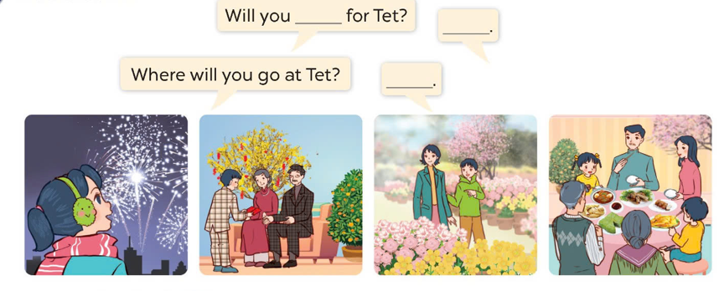
Look and say.
a fireworks show
my grandparents’ house
a flower festival
a New Year party

Slide 24
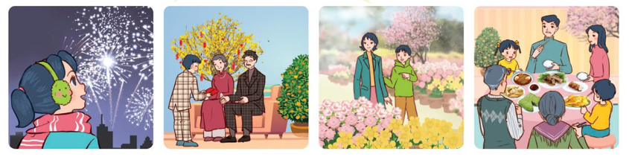
Work in pairs. Ask and answer.
Where will you go at Tet?
I’ll go to ________.
a fireworks show
my grandparents’ house
a flower festival
a New Year party

Slide 25
5
Game time Lucky number

Slide 26
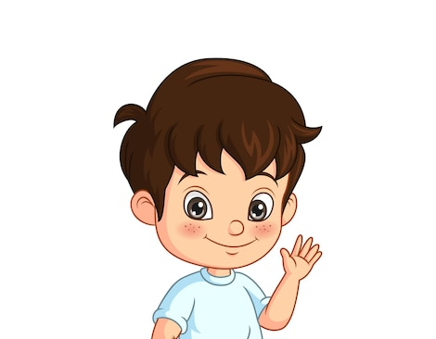







2

Slide 27


I will go to ……………………… .
my grandparents’ house.

Slide 28
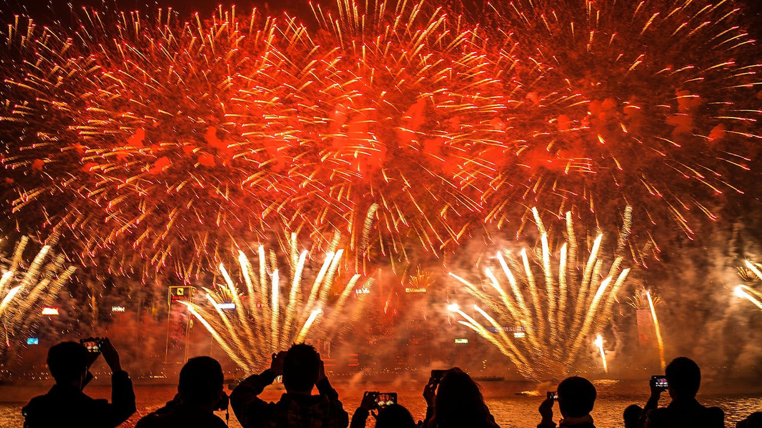
I will go to ……………………… .
a firework show.

Slide 29
a New Year party.
I will go to ……………………… .

Slide 30
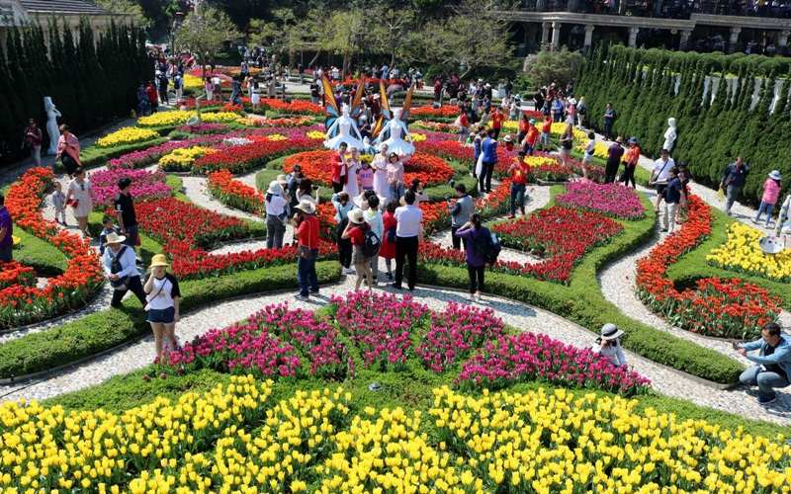
a flower festival.
I will go to ……………………… .

Slide 31

at/ Where/ will/ go/ Tet?/ you/
.…..?
Where will you go at Tet?

Slide 32
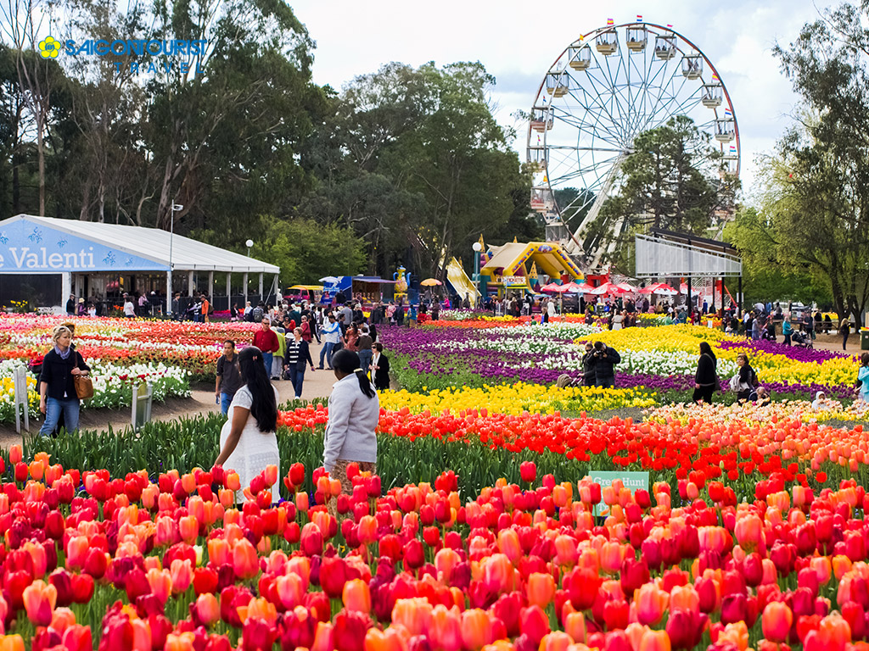
will/ I/ to / festival./ a / go/ flower/
I will go to a flower festival.

