Slide 1




UBND QUẬN DƯƠNG KINH
TRƯỜNG TIỂU HỌC ANH DŨNG
ENGLISH - GRADE 5
UNIT 13: OUR SPECIAL DAY
LESSON 1 (1, 2, 3)

Slide 2
01
Warm-up
Let's chant.

Slide 3
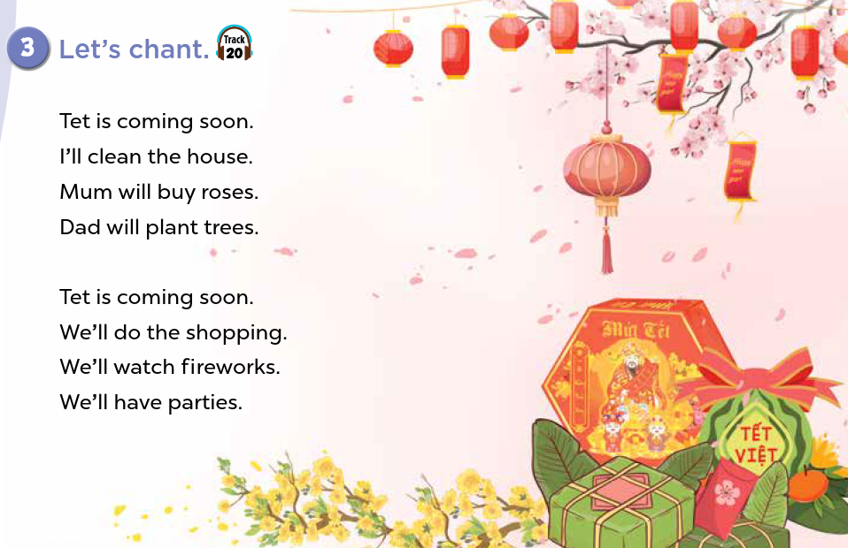


Slide 4
02
Activity 1
Look, listen and repeat.

Slide 5
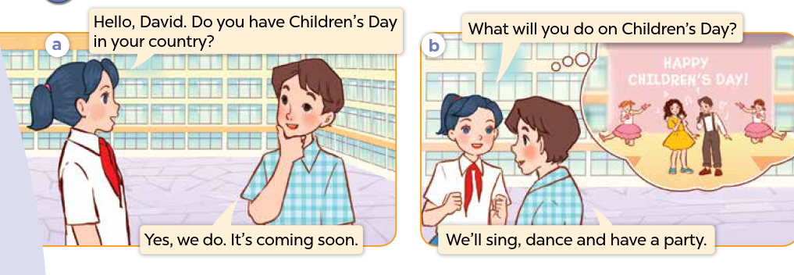
Who can you see? Where are they?
What are they talking about?

Slide 6
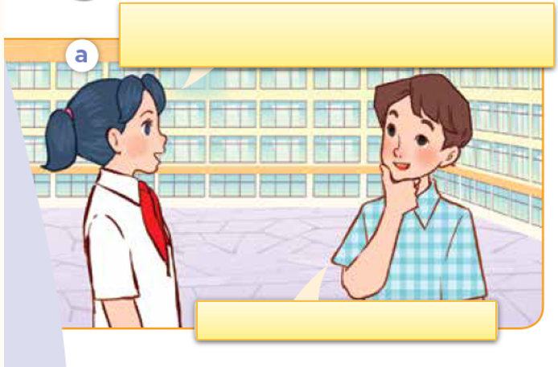
Look, listen and repeat.

Slide 7
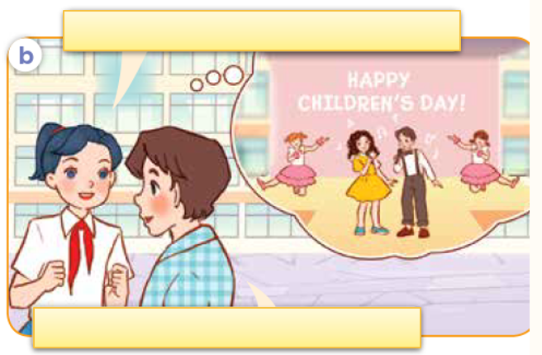
Look, listen and repeat.

Slide 8
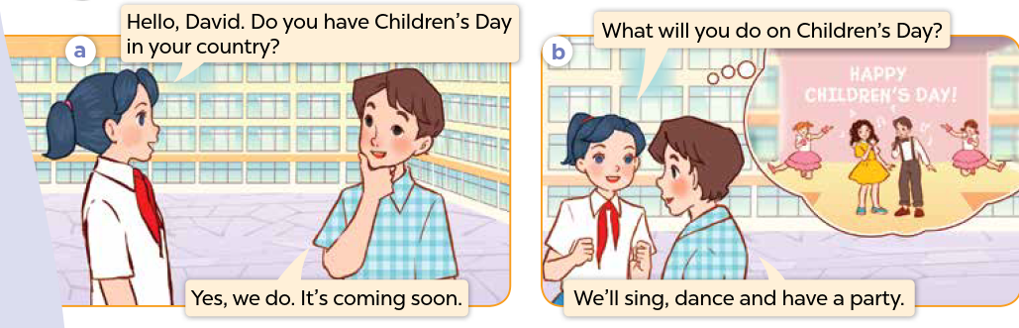
Look, listen, and repeat.

Slide 9
03
Activity 2
Listen, point and say.

Slide 10
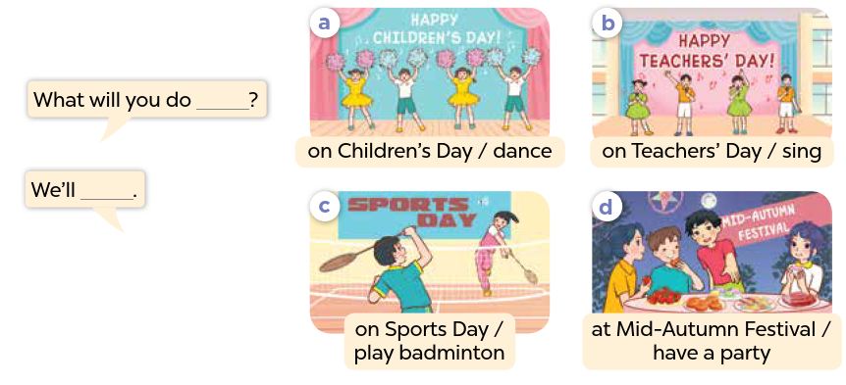

Slide 11
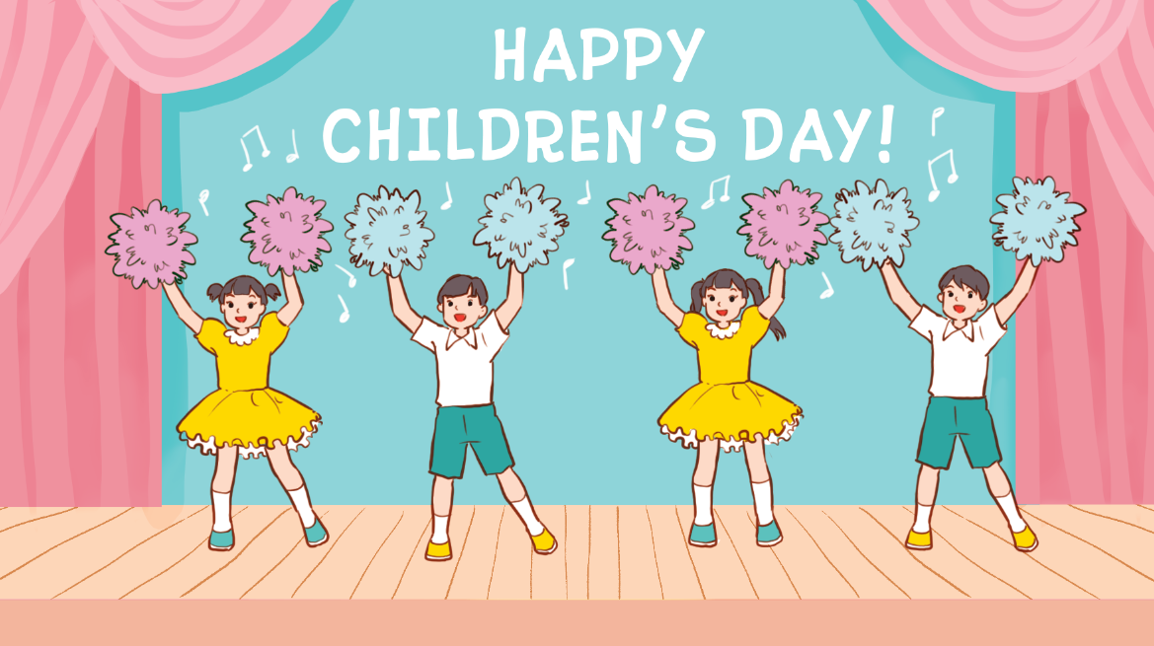
Listen, point and say.
a. On Children’s Day / dance

Slide 12
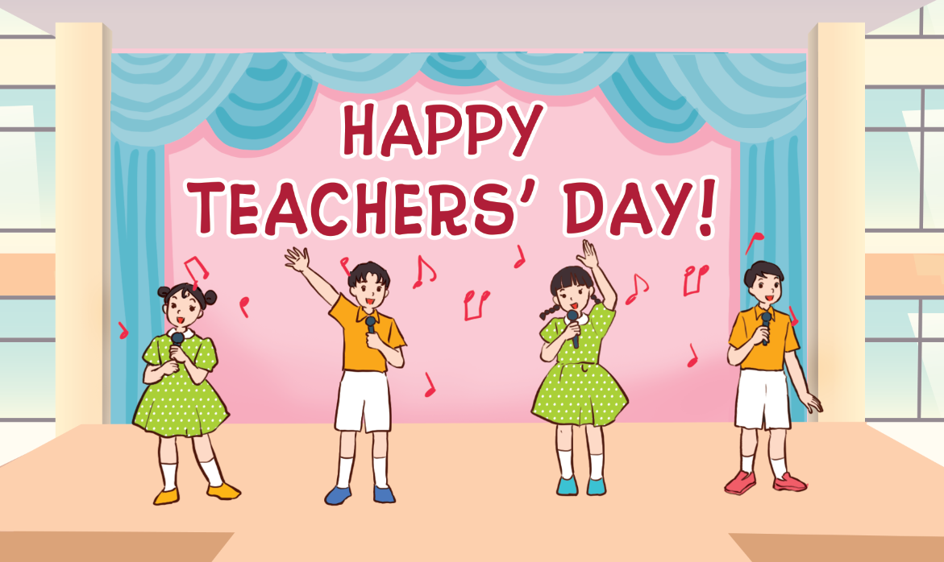
Listen, point and say.
b. on Teacher’s Day / sing

Slide 13
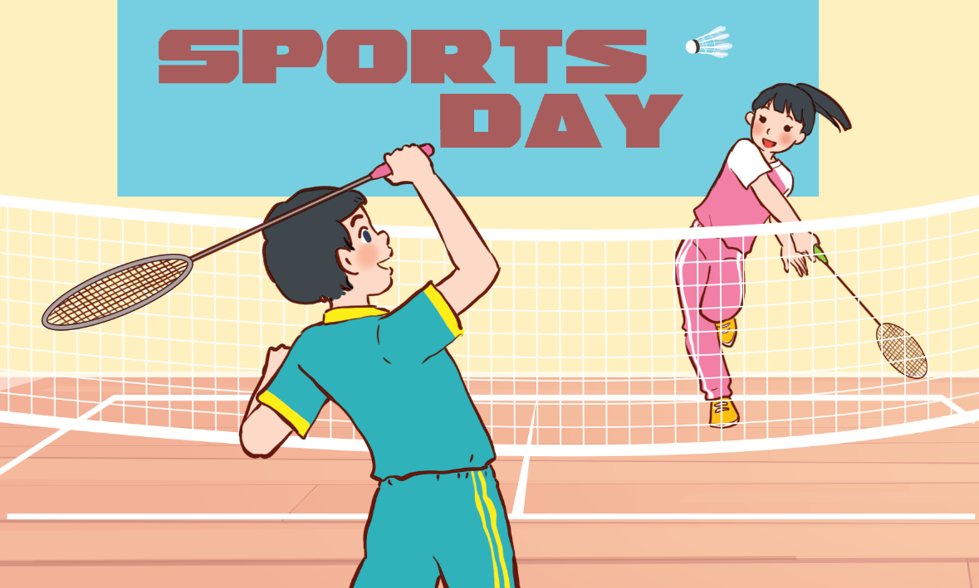
Listen, point and say.
c. on Sports Day / play badminton

Slide 14
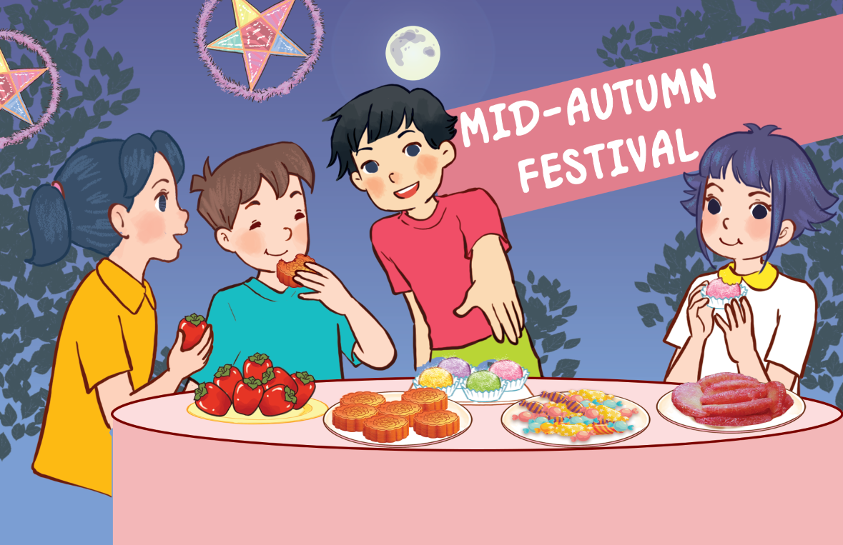
Listen, point and say.
d. at Mid-Autumn Festival / have a party

Slide 15
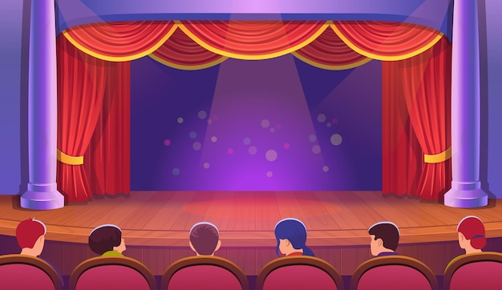
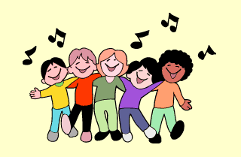
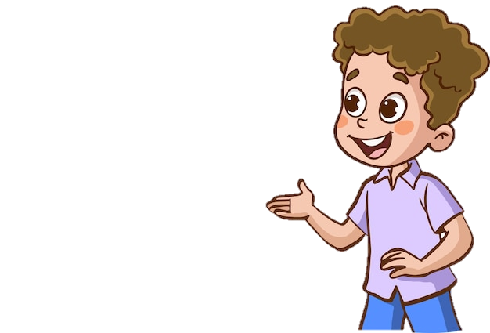
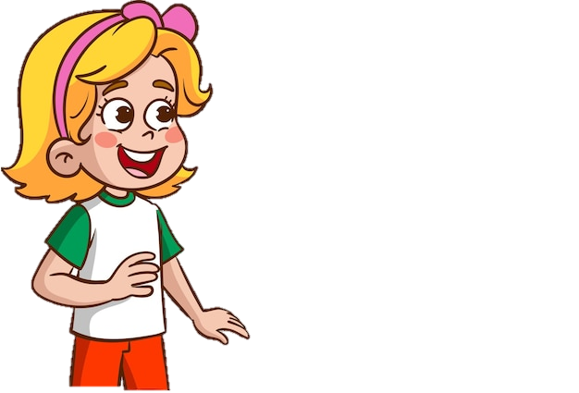
What will you do on Children's Day?
We'll sing.
HAPPY
CHILDREN'S DAY!

Slide 16
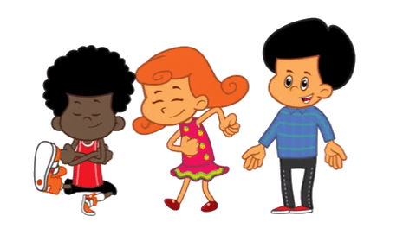
What will you do on Teachers' Day?
We'll dance.
HAPPY
TEACHERS' DAY!

Slide 17
What will you do ________?
We'll ____.

Slide 18
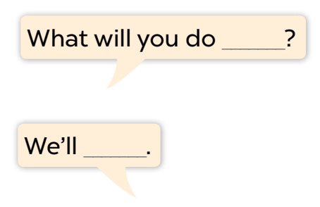
Listen, point and say.
a. On Children’s Day / dance

Slide 19
Listen, point and say.
b. on Teacher’s Day / sing

Slide 20
Listen, point and say.
c. on Sports Day / play badminton

Slide 21
Listen, point and say.
d. at Mid-Autumn Festival / have a party

Slide 22
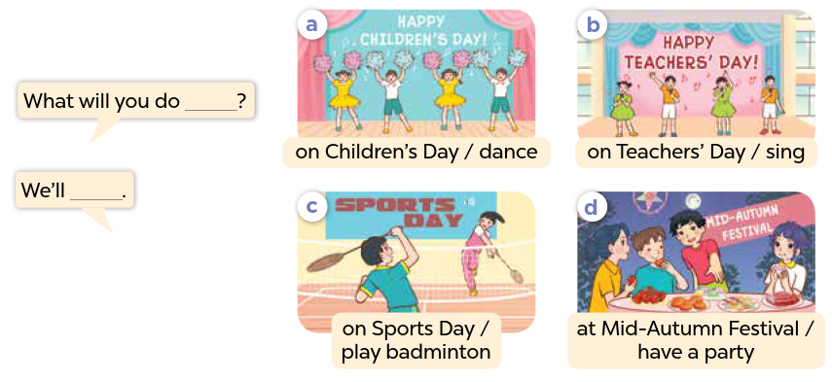
Work in pairs. Ask and answer.

Slide 23
Activity 3
04
Let's talk.

Slide 24
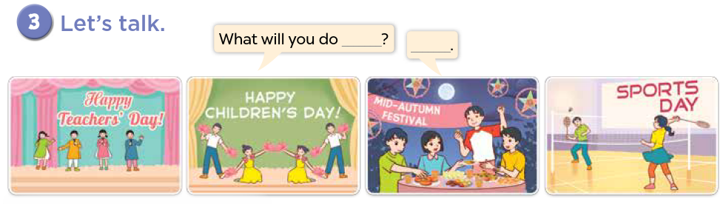

Slide 25
Fun Corner
05
SPIN THE WHEEL

Slide 26
Spin the wheel
3 JUMPING JACKS
1 STAR
5 STARS
3 STARS
SPIN AROUND
SAY AN ENGLISH WORD
Click here to spin
5 HIGH KNEES
NO STAR
-2 STARS
-5 STARS
3 SQUATS
10 STARS

Slide 27
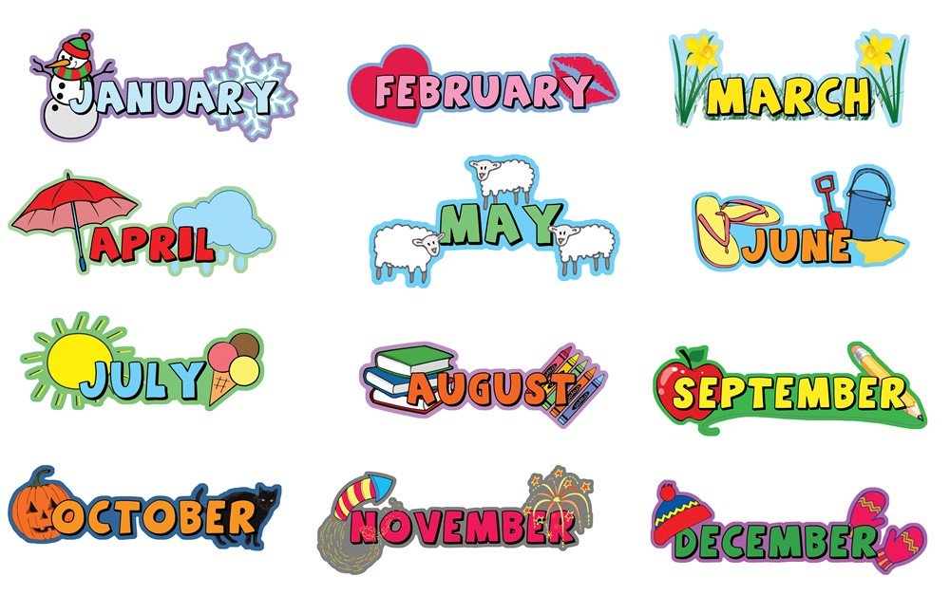
What's your favourite month?

Slide 28

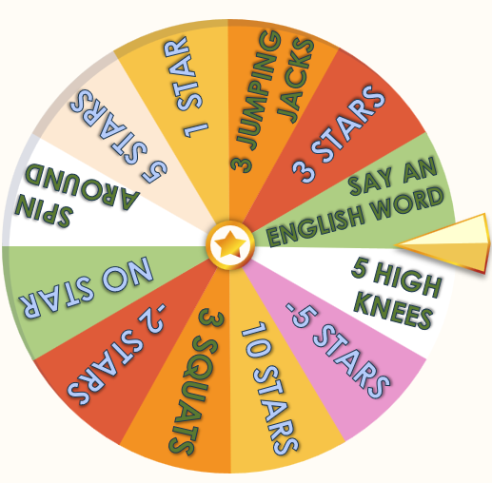
What day is June 1st?
It's Children's Day.

Slide 29

What day is November 20th?
It's Vietnamese Teachers' Day.

Slide 30
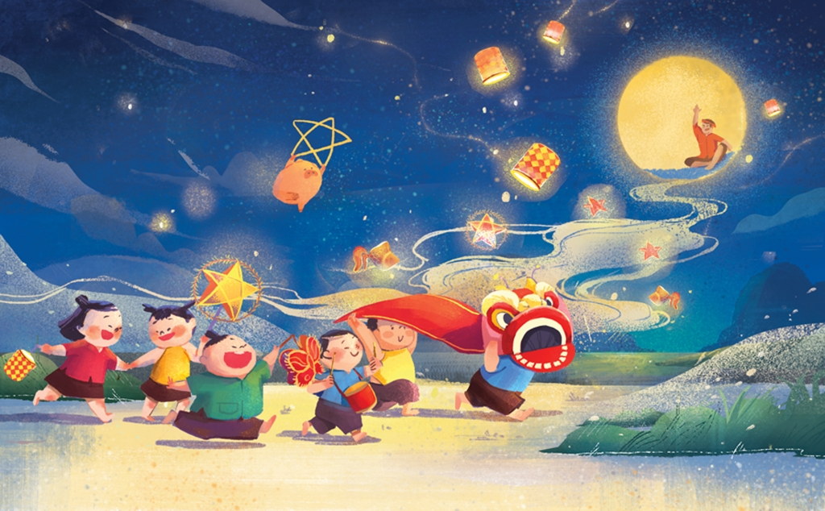
What festival is it?
It's Mid-Autumn Festival.

Slide 31
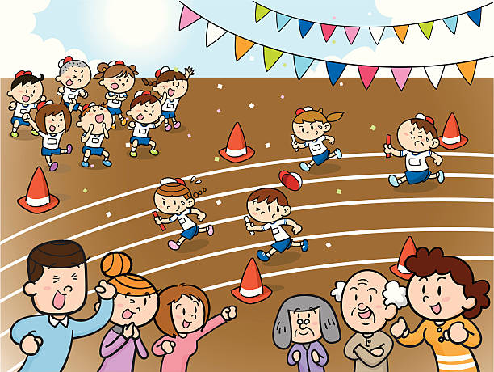
What day is it?
It's Sports Day.

Slide 32
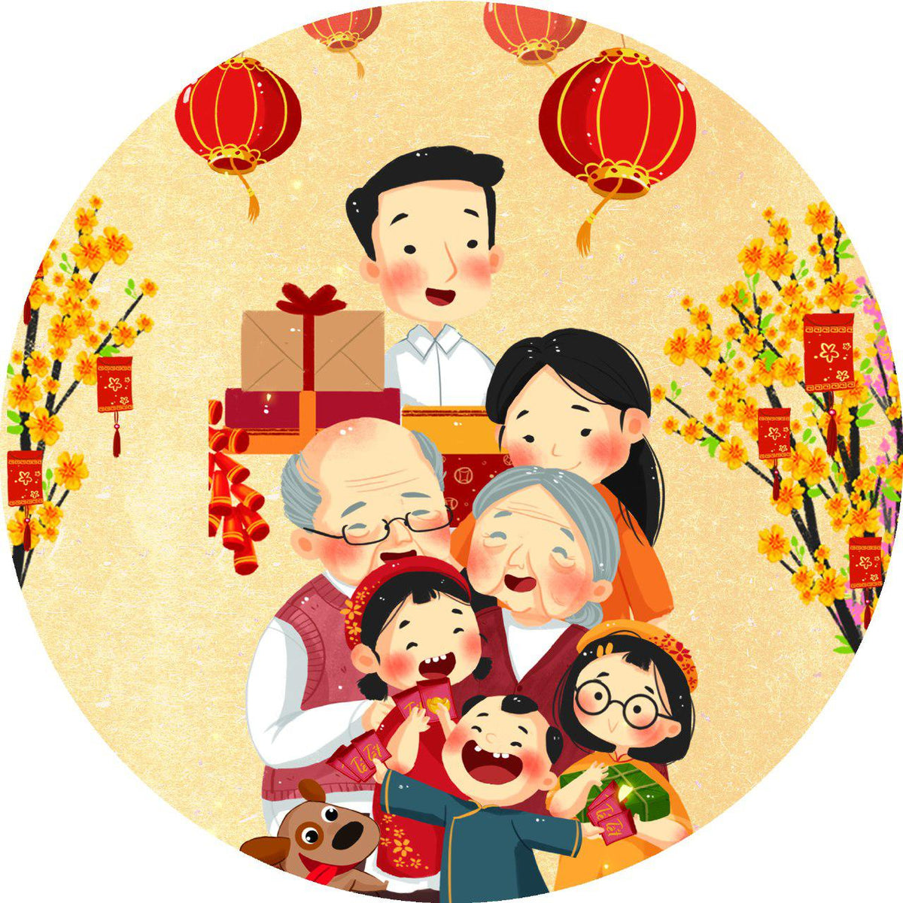
What festival is it?
It’s Tet Festival.
(Lunar New Year)

Slide 33
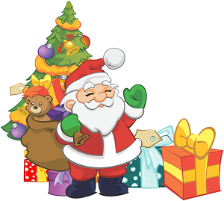
What day is it?
It's Christmas Day.

Slide 34
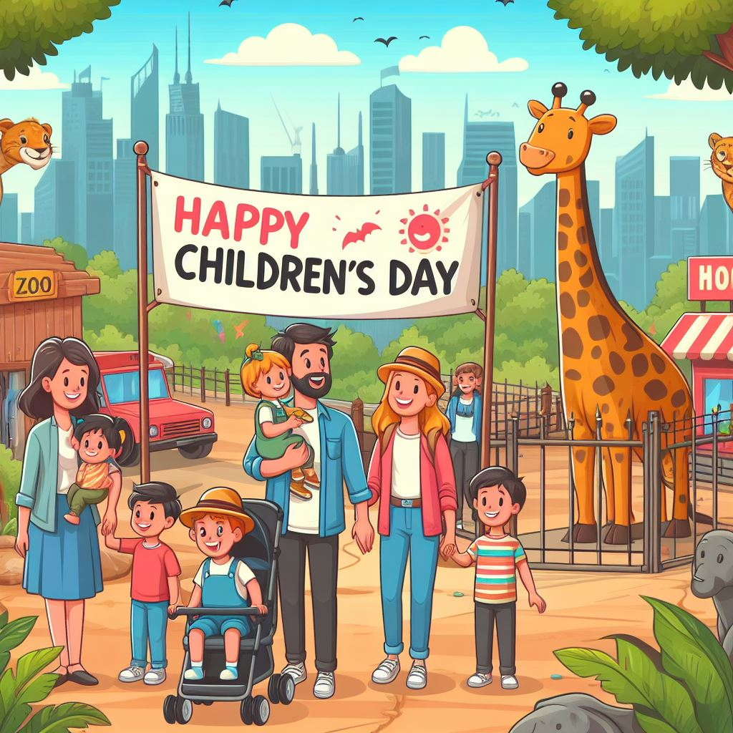
Ask and answer.
What will you do ___________?
on Children's Day
We'll ________.
go to the zoo

Slide 35

Ask and answer.
What will you do ___________?
'
on Teachers' Day
We'll _____.
sing

Slide 36
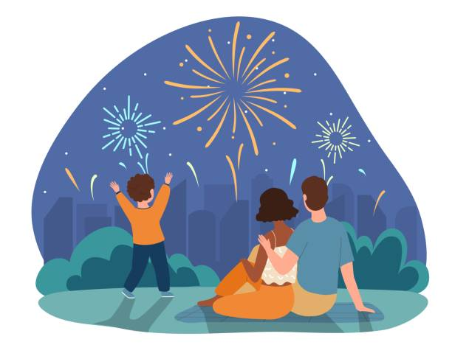
Ask and answer.
What will you do ___________?
at Tet Festival
___ watch _____.
We'll
fireworks

Slide 37
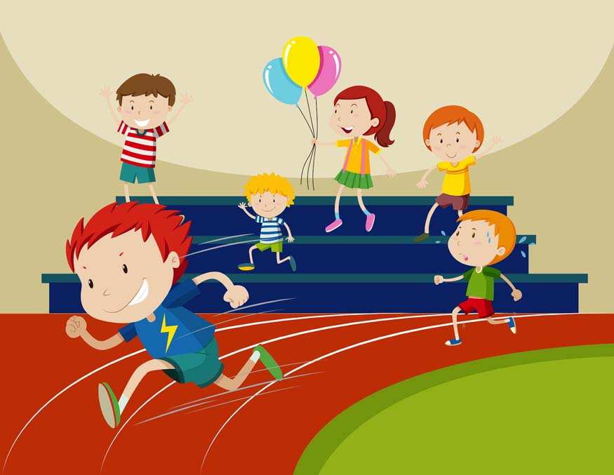
Ask and answer.
What will you do ___________?
on Sports Day
We'll _____.
run

Slide 38
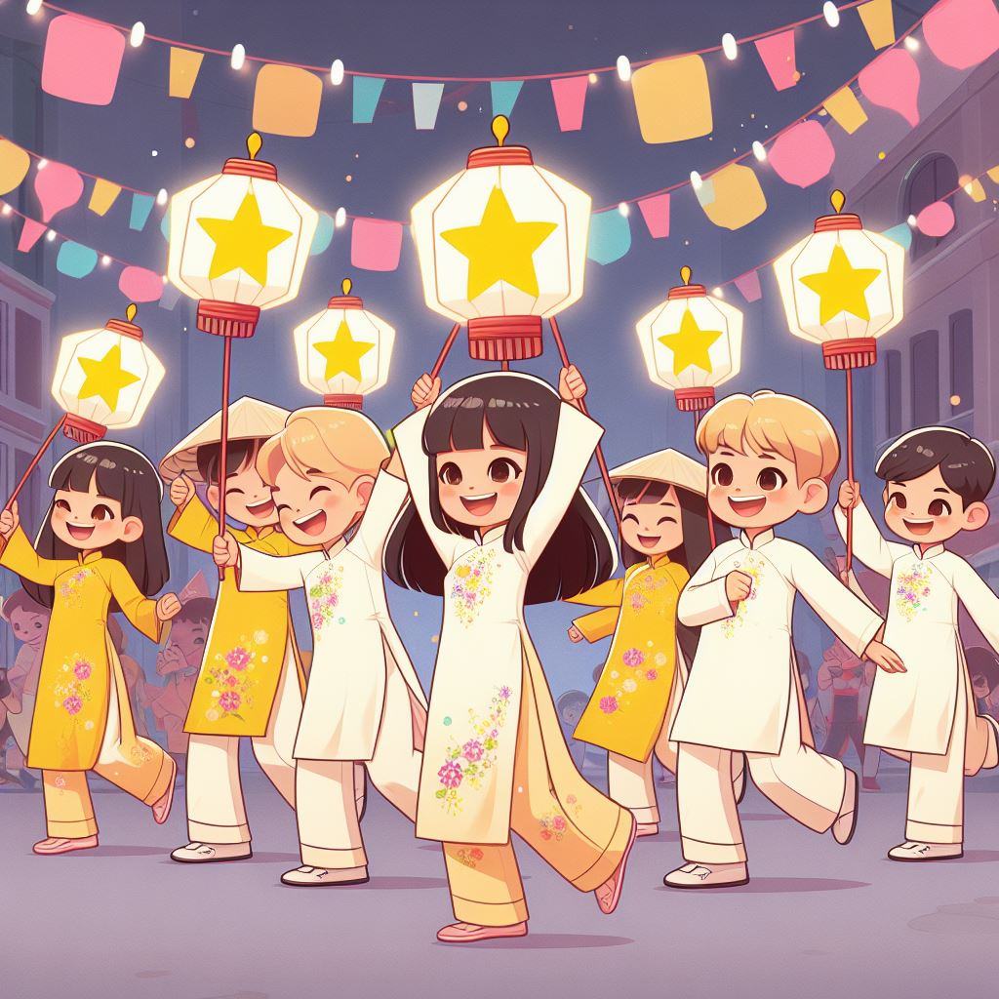
Ask and answer.
_________at Mid-Autumn Festival?
What will you do
______ dance and have fun.
We'll

Slide 39
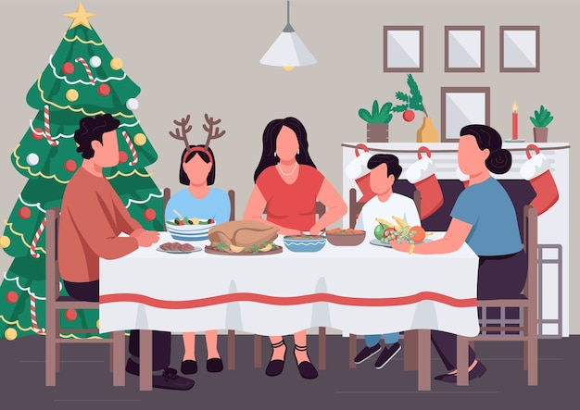
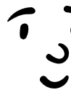




Ask and answer.
_________ on Christmas Day?
What will you do
___________.
We'll have a party

