Slide 1




UBND QUẬN DƯƠNG KINH
TRƯỜNG TIỂU HỌC ANH DŨNG
ENGLISH - GRADE 5
UNIT 14: STAYING HEALTHY
LESSON 2 (1, 2, 3)

Slide 2




01
Warm-up and Review.

Slide 3




LOOK
and
CHOOSE

Slide 4




1
✓
A
eat healthy food
B
drink fresh juice
C
eat seafood

Slide 5
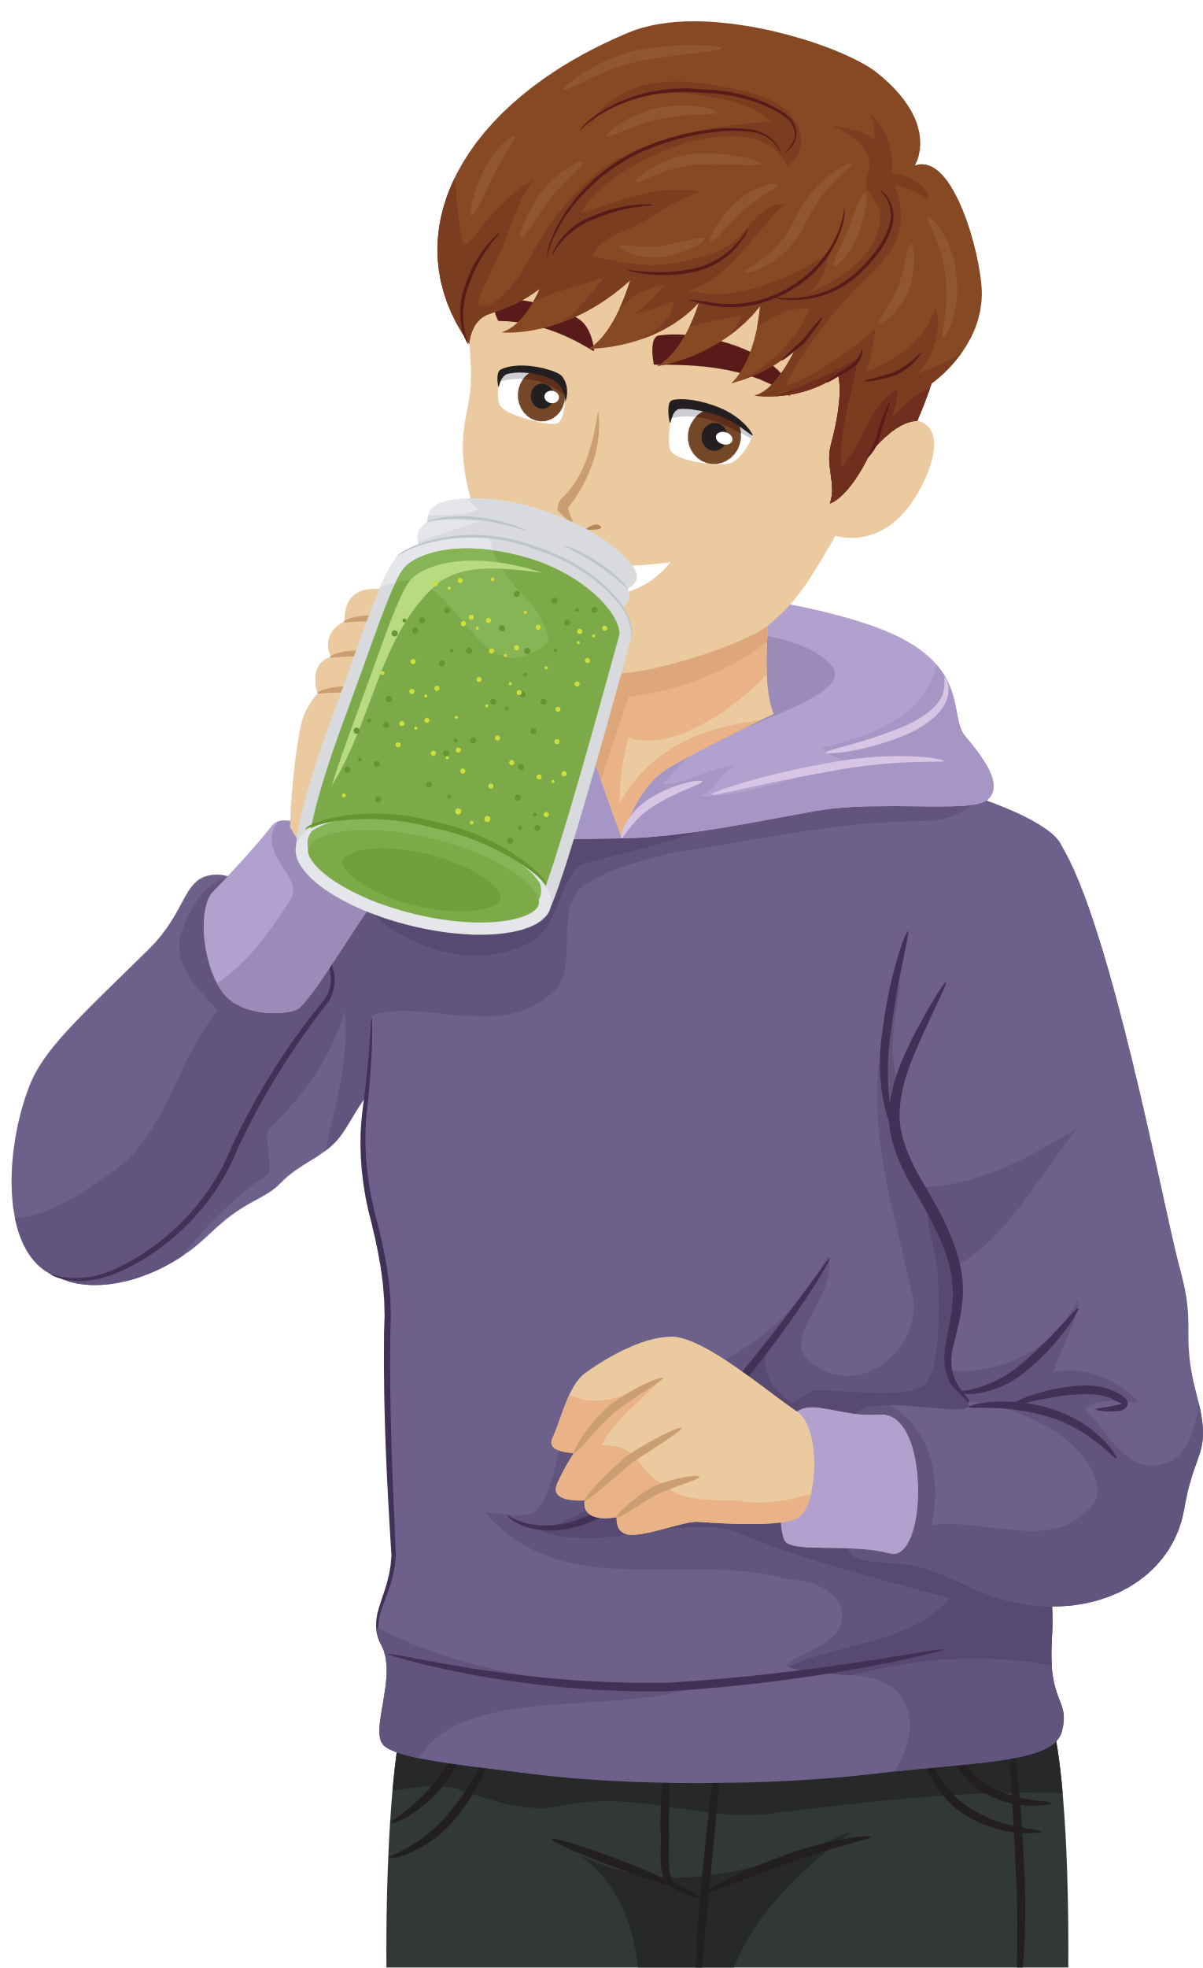
1
A
eat seafood
B
eat salad
✓
C
drink fresh juice

Slide 6

1
A
play
✓
B
swim
C
eat

Slide 7
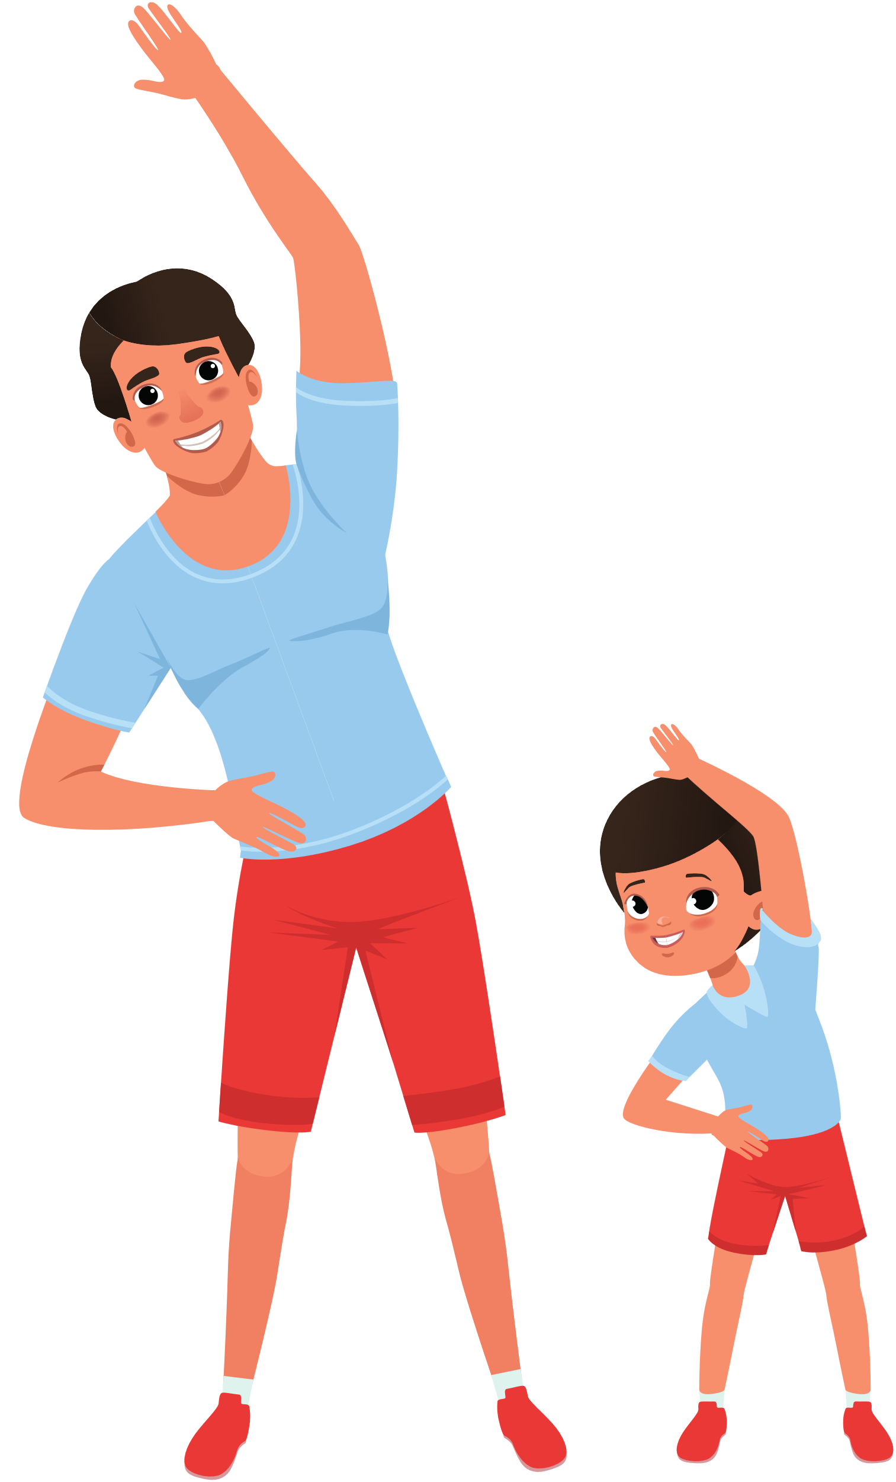
1
A
do homework
✓
B
do morning exercise
C
do housework

Slide 8
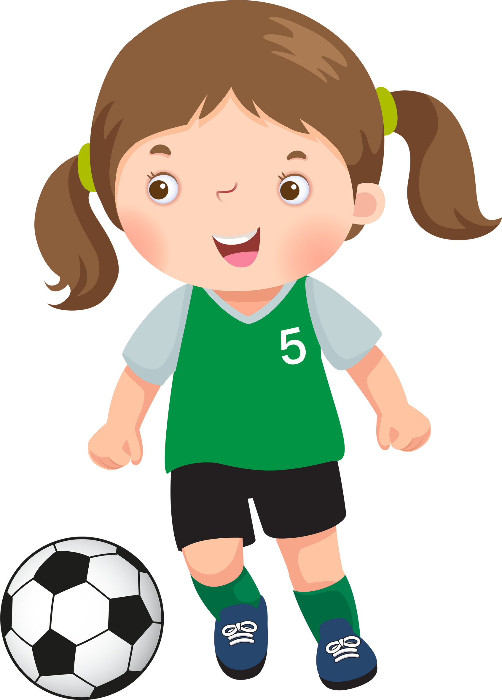
1
✓
A
play football
B
play badminton
C
play basketball

Slide 9

1
A
play table tennis
B
play chess
✓
C
play basketball

Slide 10
THANK YOU
FOR
PLAYING!

Slide 11
02
Activity 1
Look, listen and repeat.

Slide 12



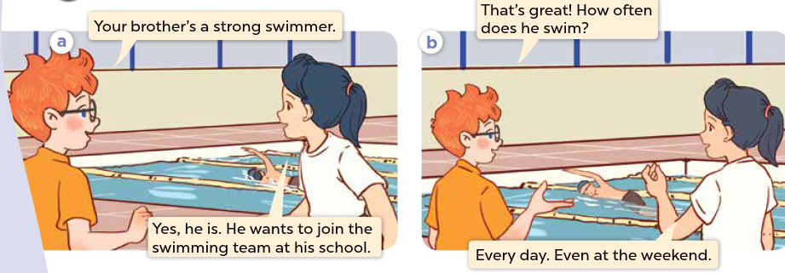


Look and say.
Notes:
Step 1: Ask pupils to look at Pictures a and b, identify the characters and predict who they are talking about.
Step 2: Play the recording for them to listen and check the prediction.

Slide 13
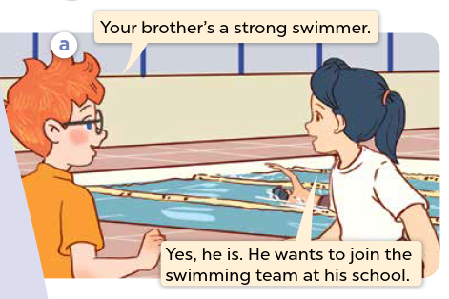

Look, listen and repeat.
Notes:
Step 3: Play the recording again, encourage pupils to point at the characters while listening.

Slide 14
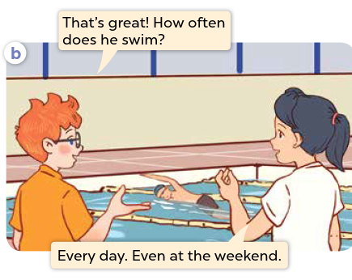
Look, listen and repeat.
Notes:
Step 3: Play the recording again, encourage pupils to point at the characters while listening.

Slide 15

Look, listen and repeat.
Notes:
Step 4: Play the recording again, sentence by sentence, for pupils to listen, point to the sentences and repeat. Correct their pronunciation where necessary.
Step 5: Draw pupils’ attention to the question How often does he swim? and the answer Every day. Explain that they are used to talk about the frequency of an activity.

Slide 16
03
Activity 2
Listen, point and say.

Slide 17


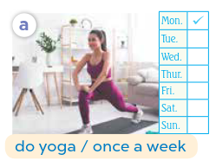
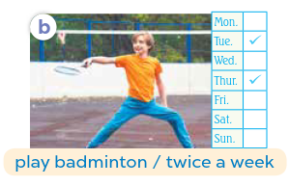
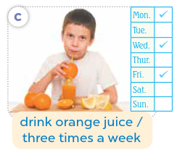
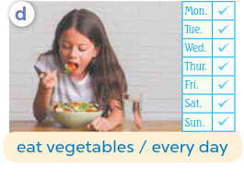


Listen, point and say.
Notes:
Step 1: Ask pupils to look at Pictures a, b, c, and d and describe what they can see in each picture.
Step 2: Play the recording for pupils to listen to and repeat the phrases in chorus and individually until they feel confident. Use the flashcards for do yoga / once a week, play badminton / twice a week, drink orange juice / three times a week, eat vegetables / every day to practise the phrases.

Slide 18
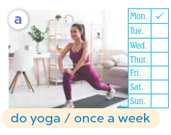
Listen, point and say.
Notes:
Step 3: Draw pupils’ attention to the speech bubbles and elicit the missing words in the question and answer by pointing at Picture a. Ask pupils to look at the picture and choose the correct word he or she in the speech bubbles. Play the recording for pupils to listen to and repeat the sentences in both bubbles a few times. Repeat the same procedure with Pictures b, c, and d.

Slide 19
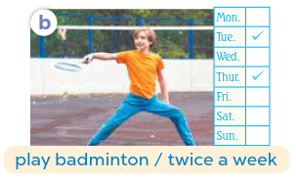
Listen, point and say.
Notes:
Step 3: Draw pupils’ attention to the speech bubbles and elicit the missing words in the question and answer by pointing at Picture a. Ask pupils to look at the picture and choose the correct word he or she in the speech bubbles. Play the recording for pupils to listen to and repeat the sentences in both bubbles a few times. Repeat the same procedure with Pictures b, c, and d.

Slide 20

Listen, point and say.
Notes:
Step 3: Draw pupils’ attention to the speech bubbles and elicit the missing words in the question and answer by pointing at Picture a. Ask pupils to look at the picture and choose the correct word he or she in the speech bubbles. Play the recording for pupils to listen to and repeat the sentences in both bubbles a few times. Repeat the same procedure with Pictures b, c, and d.

Slide 21
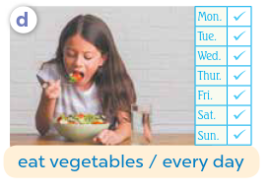
Listen, point and say.
Notes:
Step 3: Draw pupils’ attention to the speech bubbles and elicit the missing words in the question and answer by pointing at Picture a. Ask pupils to look at the picture and choose the correct word he or she in the speech bubbles. Play the recording for pupils to listen to and repeat the sentences in both bubbles a few times. Repeat the same procedure with Pictures b, c, and d.

Slide 22



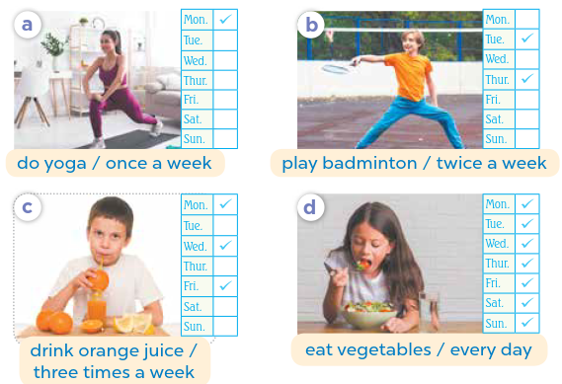



Work in pairs.
How often does he / she ______?
__________.
Notes:
Step 4: Let pupils point at the pictures and say the sentences in pairs. Go around the classroom to offer help where necessary.

Slide 23


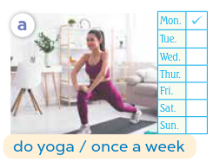


Listen, point and say.
How often does she do yoga?
Once a week.
Notes:
Step 5: Invite a few pairs to act out the exchanges in front of the class.

Slide 24
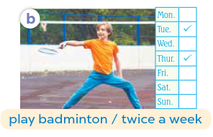
Listen, point and say.
How often does he play badminton?
Twice a week.
Notes:
Step 5: Invite a few pairs to act out the exchanges in front of the class.

Slide 25
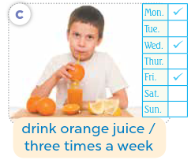
Listen, point and say.
How often does he drink orange juice?
Three times a week.
Notes:
Step 5: Invite a few pairs to act out the exchanges in front of the class.

Slide 26
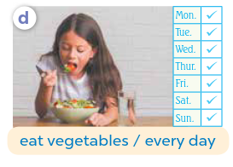
Listen, point and say.
How often does she eat vegetables?
Every day.
Notes:
Step 5: Invite a few pairs to act out the exchanges in front of the class.

Slide 27
04
Activity 3
Let’s talk.

Slide 28


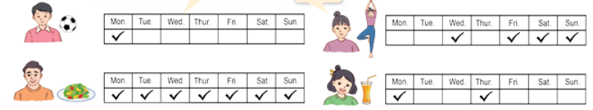


Let’s talk.
How often does your ______?
_____.
Notes:
Step 1: Ask pupils to look at the picture and elicit the lifestyle of each character in the picture. Remind pupils that How often does your ____? and – ___. are used to ask and answer questions about their family member’s habits.

Slide 29
Work in pairs.
How often does your ______?
_____.
Notes:
Step 2: Give pupils time to work in pairs and take turns pointing at the pictures and asking and answering questions about their family member’s habits.

Slide 30

Let’s talk.
How often does your brother play football?
Once a week.
Notes:
Step 3: Invite a few pairs to come to the front of the classroom and act out the exchanges.

Slide 31

Let’s talk.
How often does your mother do yoga?
Four times a week.
Notes:
Step 3: Invite a few pairs to come to the front of the classroom and act out the exchanges.

Slide 32

Let’s talk.
How often does your father eat vegetables?
Every day.
Notes:
Step 3: Invite a few pairs to come to the front of the classroom and act out the exchanges.

Slide 33

Let’s talk.
How often does your sister drink orange juice?
Twice a week.
Notes:
Step 3: Invite a few pairs to come to the front of the classroom and act out the exchanges.

Slide 34
05
Fun corner and wrap-up.

Slide 35





GAME
TICTACTOE

Slide 36

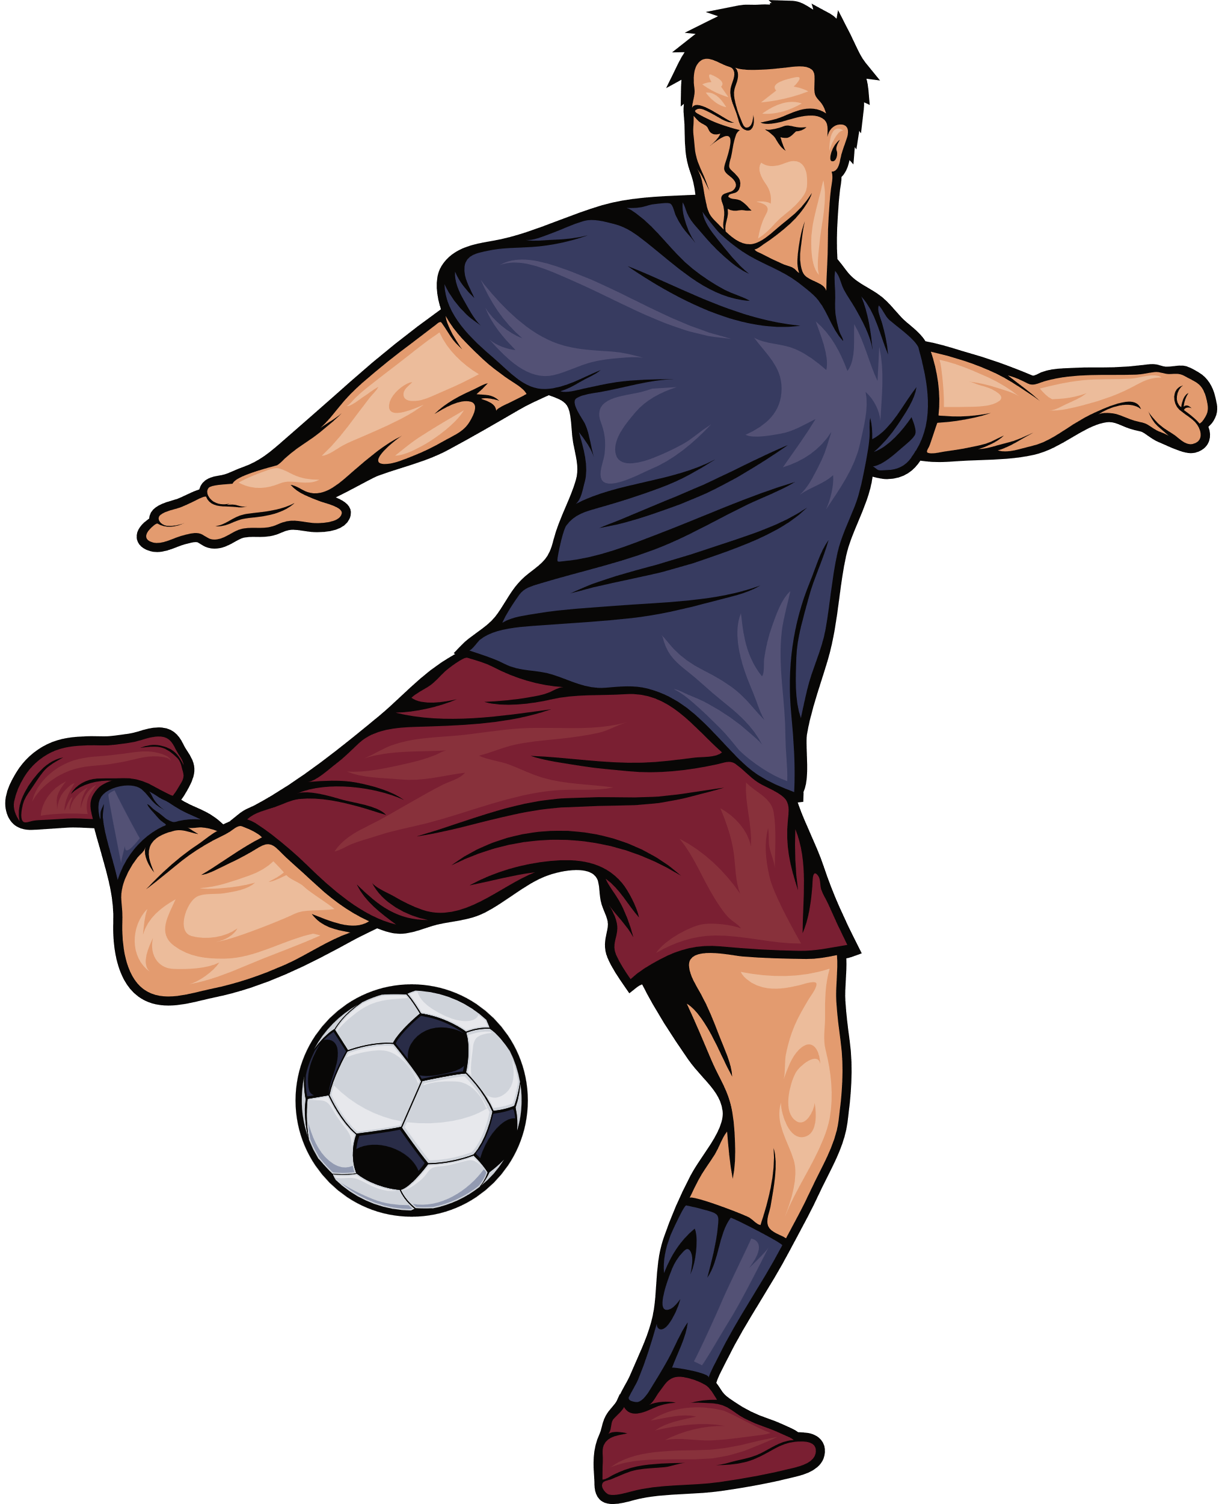

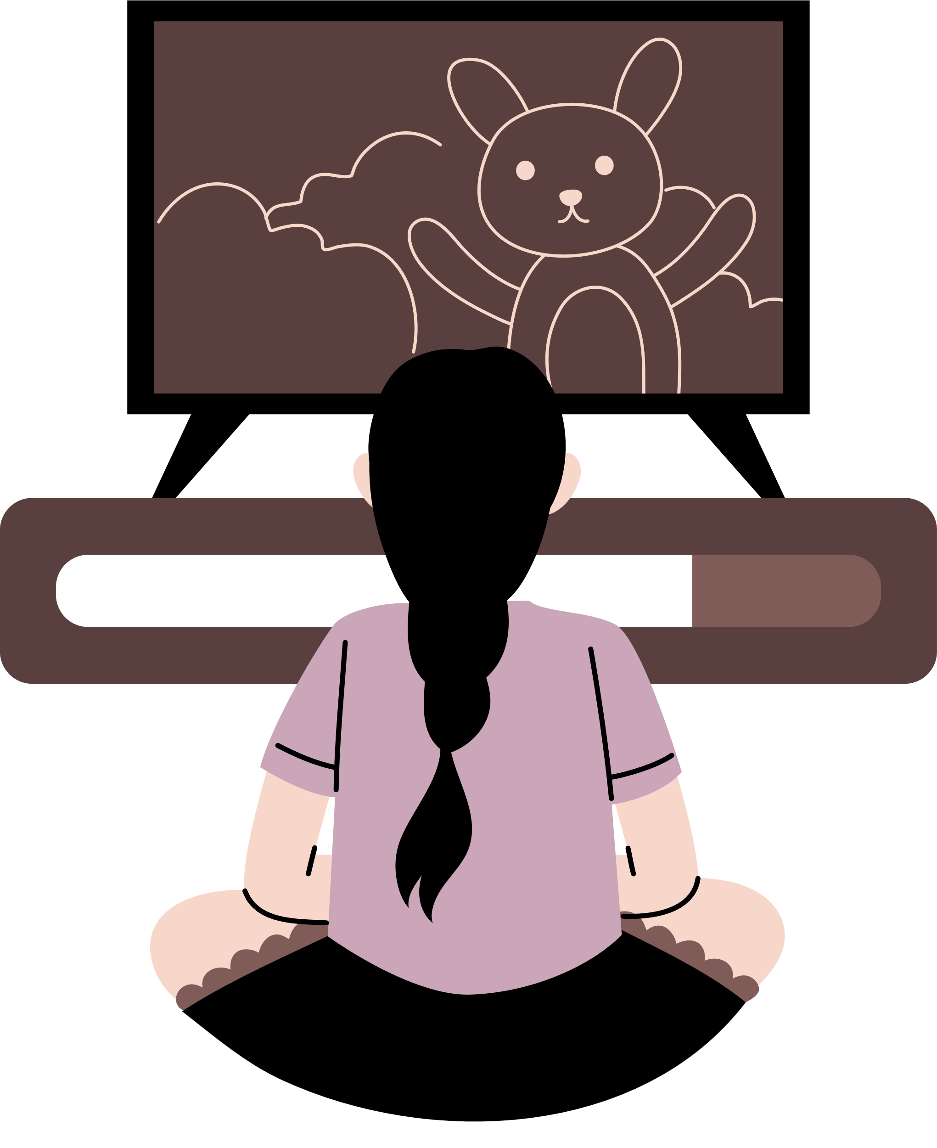





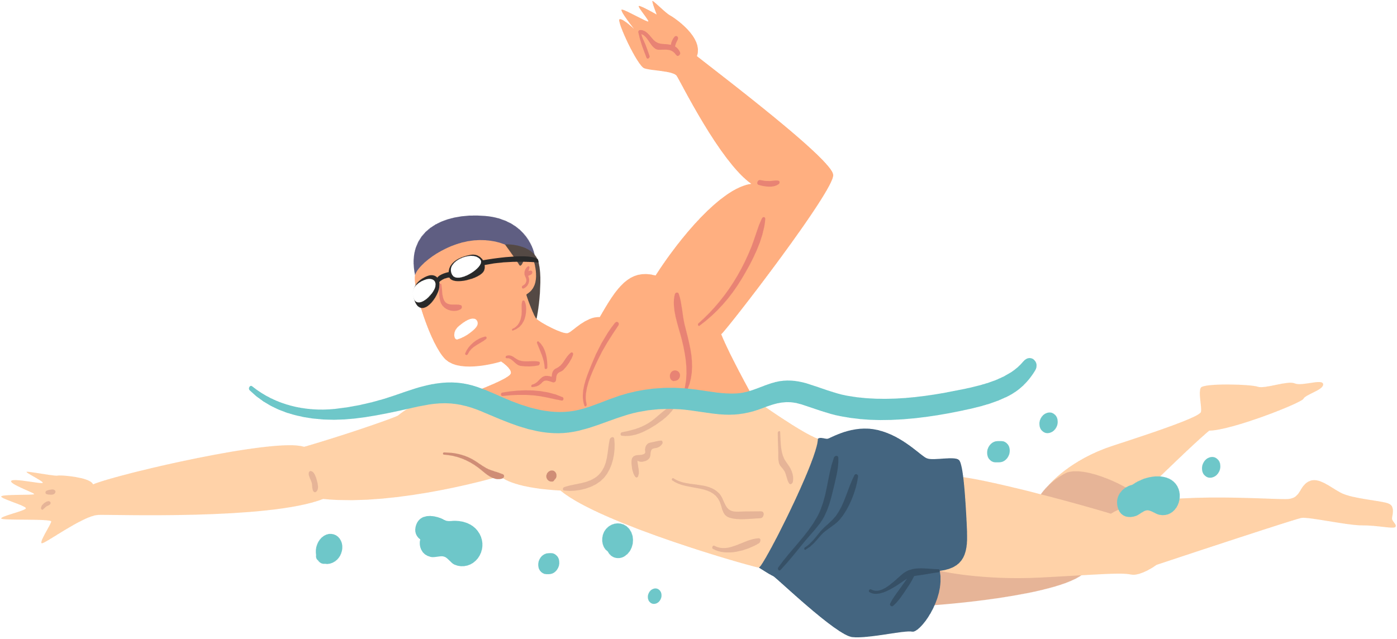
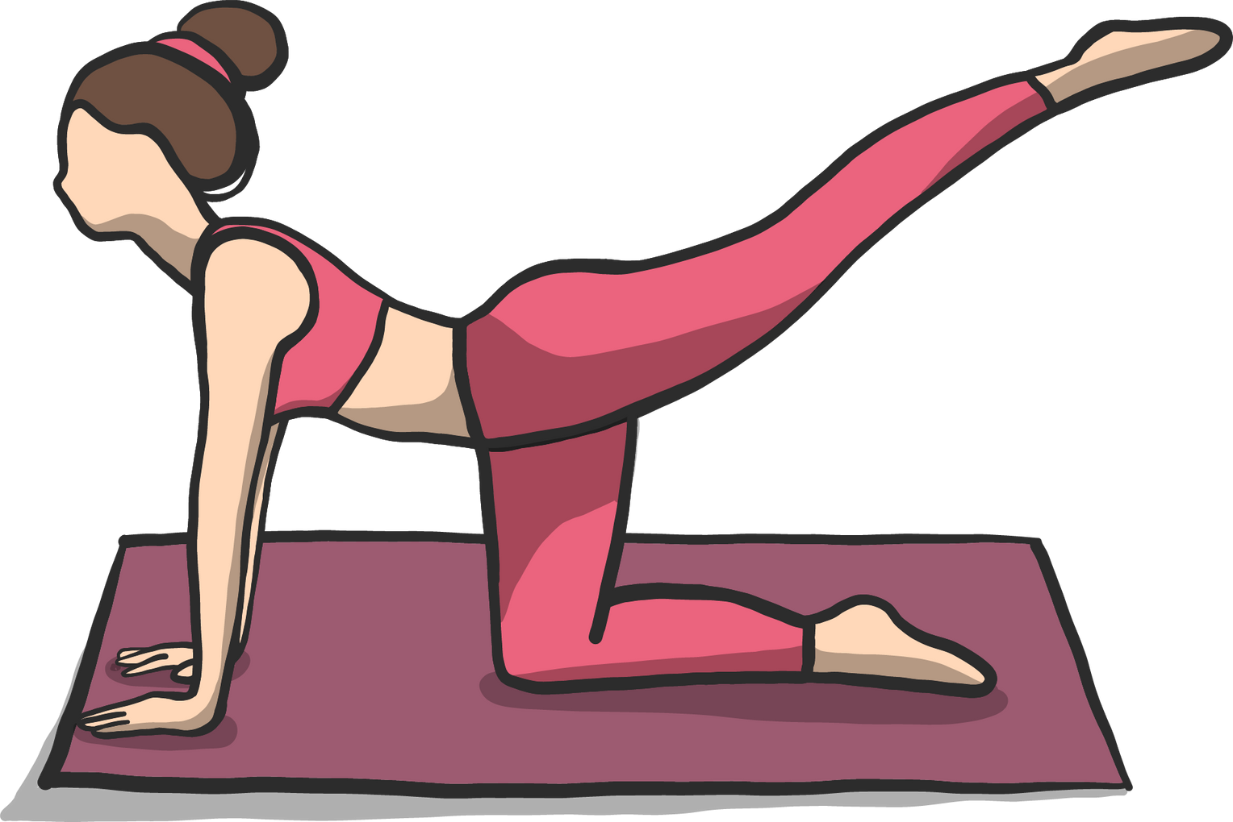
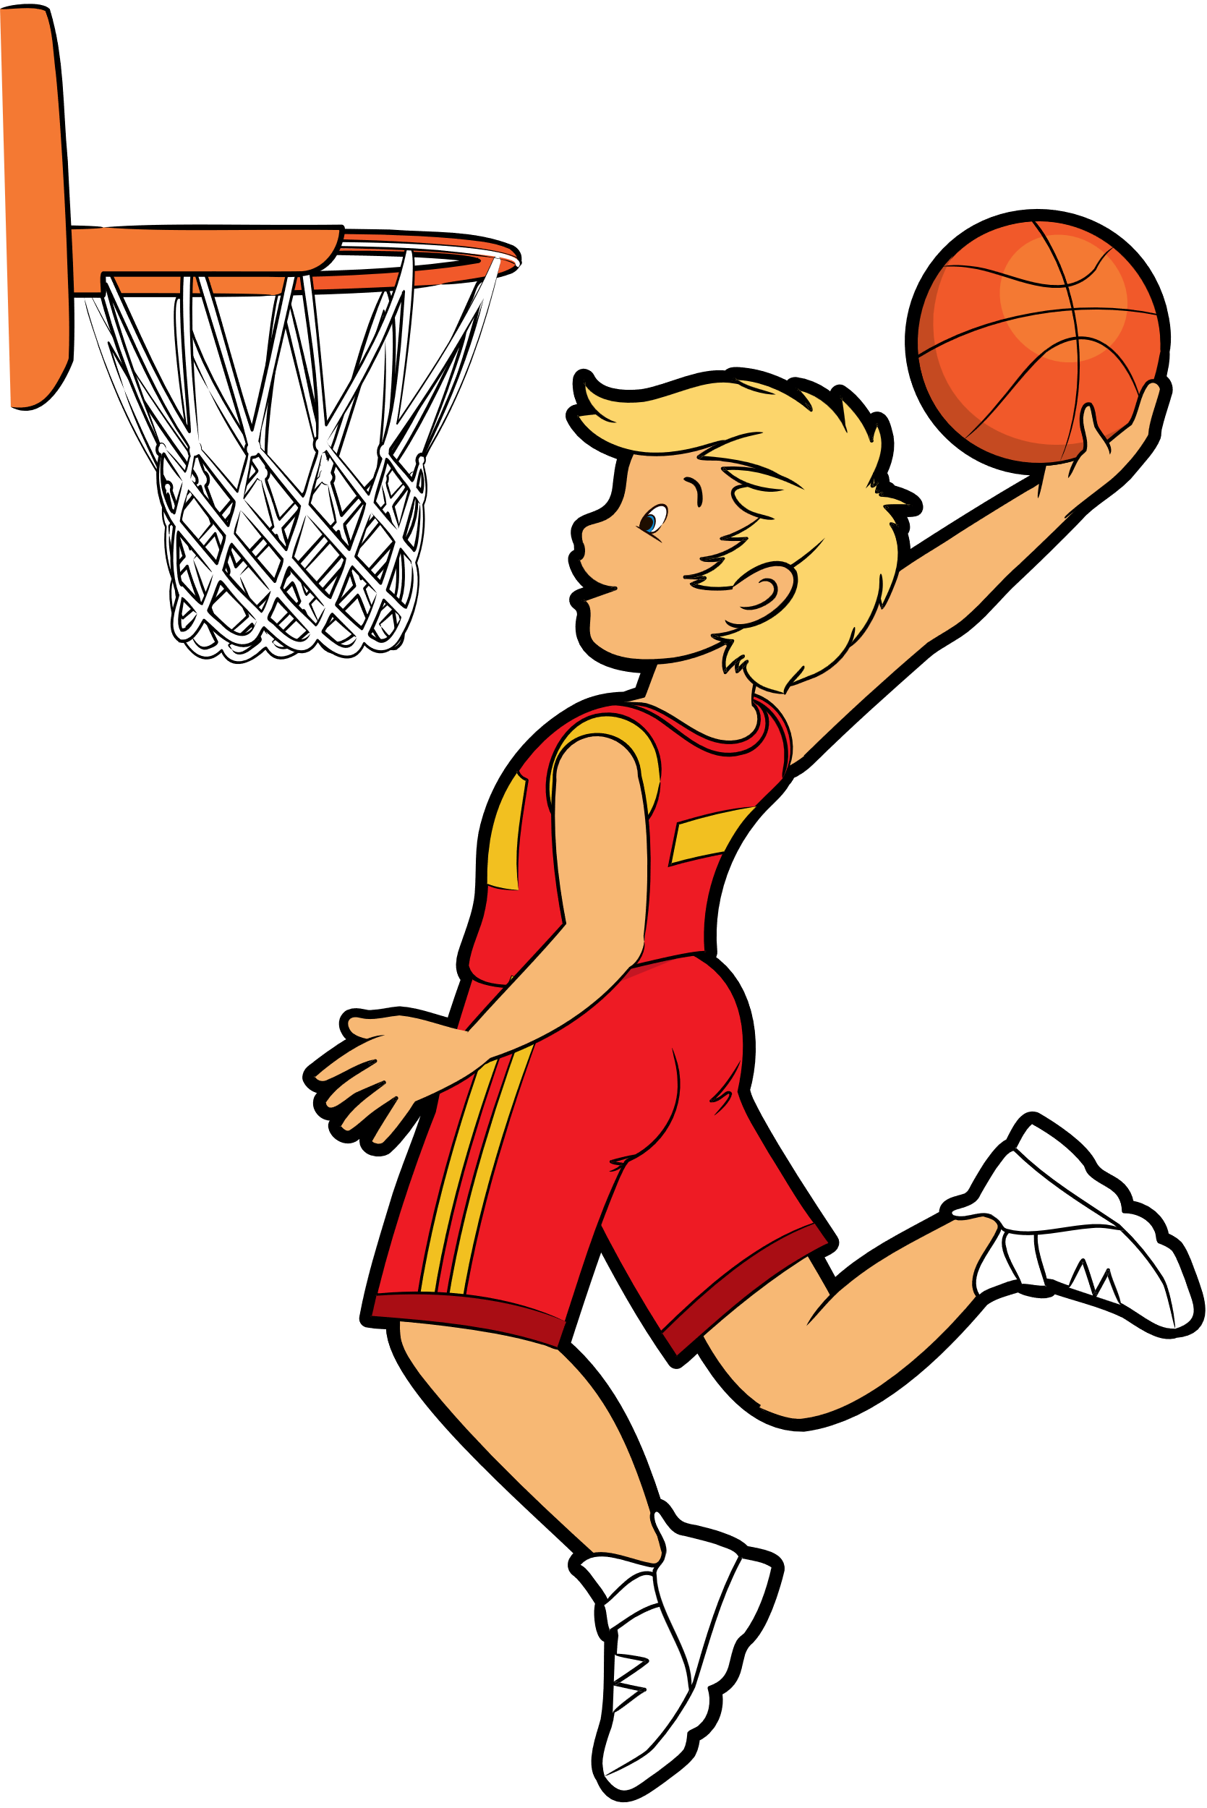
TICTACTOE
TEAM 1
TEAM 2

Slide 37
THANK YOU FOR PLAYING!

