Slide 1




UBND QUẬN DƯƠNG KINH
TRƯỜNG TIỂU HỌC ANH DŨNG
ENGLISH - GRADE 5
UNIT 1: ALL ABOUT ME
- LESSON 3 (4, 5, 6)

Slide 2


01
Warm-up and review

Slide 3
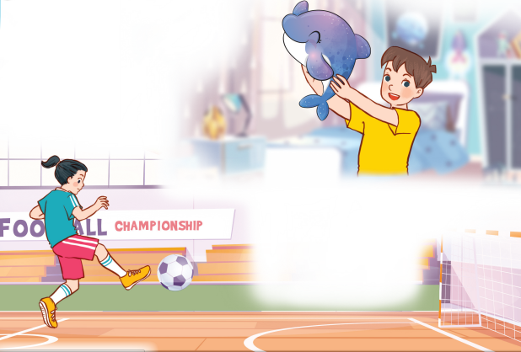
Let’s chant.
What’s your favourite animal?
Do you like pandas?
No, I don’t.
I don’t like pandas.
I like dolphins.
What’s your favourite sport?
Do you like tennis?
No, I don’t.
I don’t like tennis.
I like football.

Slide 4


Let’s chant.
What’s your favourite animal?
Do you like pandas?
No, I don’t.
I don’t like pandas.
I like dolphins.
What’s your favourite sport?
Do you like tennis?
No, I don’t.
I don’t like tennis.
I like football.

Slide 5
02
Read and circle.

Slide 6
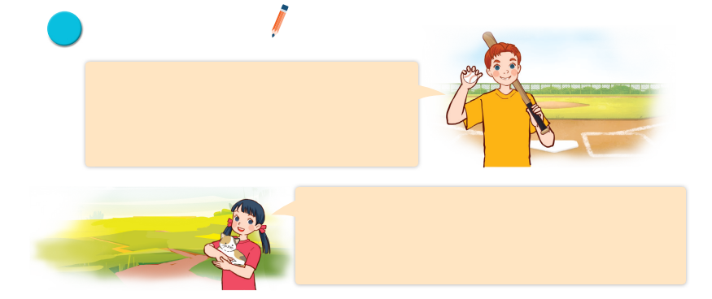
Read and circle.
Hi, all. Let me tell you a little bit about myself. My name’s Tom. I’m in Grade 5. I live in a big city. My favourite subject is maths. My favourite food is fish and chips. I’m a big fan of baseball.
It’s really fun.
Hello, everyone. Let me introduce myself. My full name’s Le Mai Lan. You can call me Lan. I’m in Class 5C. I live in the countryside. I love pets. I have two kittens and a rabbit. My favourite colour is pink. My favourite food is chicken pho. Yum!

Slide 7
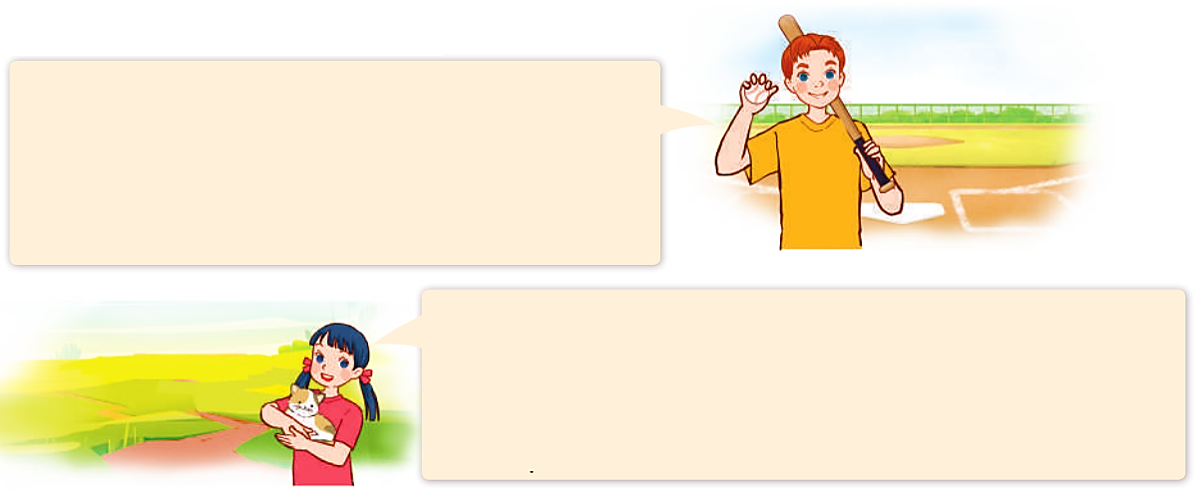
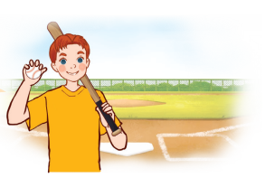

Read and circle.
Hi, all. Let me tell you a little bit about myself. My name’s Tom. I’m in Grade 5. I live in a big city. My favourite subject is maths. My favourite food is fish and chips. I’m a big fan of baseball.
It’s really fun.
Hello, everyone. Let me introduce myself. My full name’s Le Mai Lan. You can call me Lan. I’m in Class 5C. I live in the countryside. I love pets. I have two kittens and a rabbit. My favourite colour is pink. My favourite food is chicken pho. Yum!
1. Tom lives in _______.
a. a big village b. a big city c. a big town

Slide 8
Read and circle.
Hi, all. Let me tell you a little bit about myself. My name’s Tom. I’m in Grade 5. I live in a big city. My favourite subject is maths. My favourite food is fish and chips. I’m a big fan of baseball.
It’s really fun.
Hello, everyone. Let me introduce myself. My full name’s Le Mai Lan. You can call me Lan. I’m in Class 5C. I live in the countryside. I love pets. I have two kittens and a rabbit. My favourite colour is pink. My favourite food is chicken pho. Yum!
2. He likes _______.
a. fish and rice b. chicken and chips c. fish and chip

Slide 9
Read and circle.
Hi, all. Let me tell you a little bit about myself. My name’s Tom. I’m in Grade 5. I live in a big city. My favourite subject is maths. My favourite food is fish and chips. I’m a big fan of baseball.
It’s really fun.
Hello, everyone. Let me introduce myself. My full name’s Le Mai Lan. You can call me Lan. I’m in Class 5C. I live in the countryside. I love pets. I have two kittens and a rabbit. My favourite colour is pink. My favourite food is chicken pho. Yum!
3. Lan is in _______.
a. Class 4C b. Class 5C c. Class 3C

Slide 10
Read and circle.
Hi, all. Let me tell you a little bit about myself. My name’s Tom. I’m in Grade 5. I live in a big city. My favourite subject is maths. My favourite food is fish and chips. I’m a big fan of baseball.
It’s really fun.
Hello, everyone. Let me introduce myself. My full name’s Le Mai Lan. You can call me Lan. I’m in Class 5C. I live in the countryside. I love pets. I have two kittens and a rabbit. My favourite colour is pink. My favourite food is chicken pho. Yum!
4. Her favourite colour is _______.
a. pink b. green c. blue

Slide 11
Read and circle.
Hi, all. Let me tell you a little bit about myself. My name’s Tom. I’m in Grade 5. I live in a big city. My favourite subject is maths. My favourite food is fish and chips. I’m a big fan of baseball.
It’s really fun.
Hello, everyone. Let me introduce myself. My full name’s Le Mai Lan. You can call me Lan. I’m in Class 5C. I live in the countryside. I love pets. I have two kittens and a rabbit. My favourite colour is pink. My favourite food is chicken pho. Yum!
4. Her favourite colour is _______.
a. pink b. green c. blue

Slide 12
Read and circle.
Hi, all. Let me tell you a little bit about myself. My name’s Tom. I’m in Grade 5. I live in a big city. My favourite subject is maths. My favourite food is fish and chips. I’m a big fan of baseball.
It’s really fun.
Hello, everyone. Let me introduce myself. My full name’s Le Mai Lan. You can call me Lan. I’m in Class 5C. I live in the countryside. I love pets. I have two kittens and a rabbit. My favourite colour is pink. My favourite food is chicken pho. Yum!
1. Tom lives in _______.
a. a big village b. a big city c. a big town
2. He likes _______.
a. fish and rice b. chicken and chips c. fish and chips
3. Lan is in _______.
a. Class 4C b. Class 5C c. Class 3C
4. Her favourite colour is _______.
a. pink b. green c. blue

Slide 13
03
Let’s write.

Slide 14

Let’s write.
My name is _________. I live in the __________________. I am in Class _______. My favourite sport is ____________. My favourite food is ___________________. My favourite colour is ___________________. My favourite animal is ___________________.
What about you? What are your favourite things?

Slide 15
Let’s write.
Nam
My name is _____.

Slide 16
04
Project

Slide 17

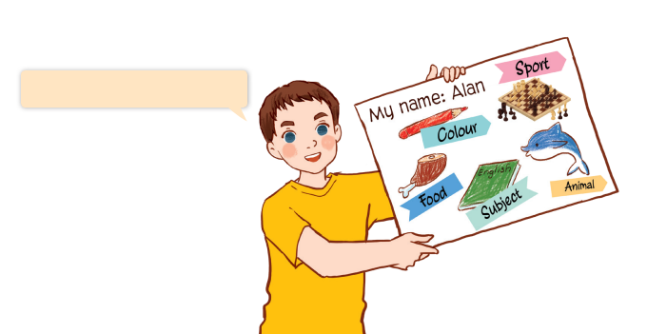
Project
My favourite things
My favourite colour is red.

Slide 18
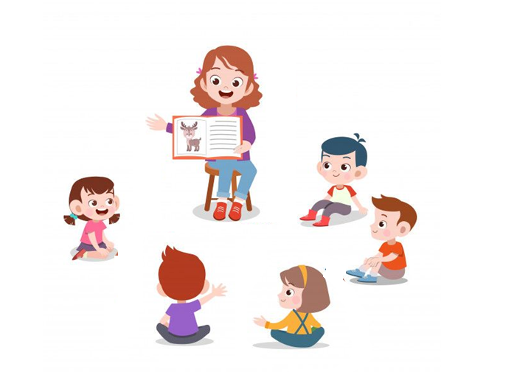
My favourite food is chicken.
My favourite sport is chess.

