Slide 1




UBND QUẬN DƯƠNG KINH
TRƯỜNG TIỂU HỌC ANH DŨNG
ENGLISH - GRADE 5
UNIT 2: OUR HOME
LESSON 2 (1, 2, 3)

Slide 2

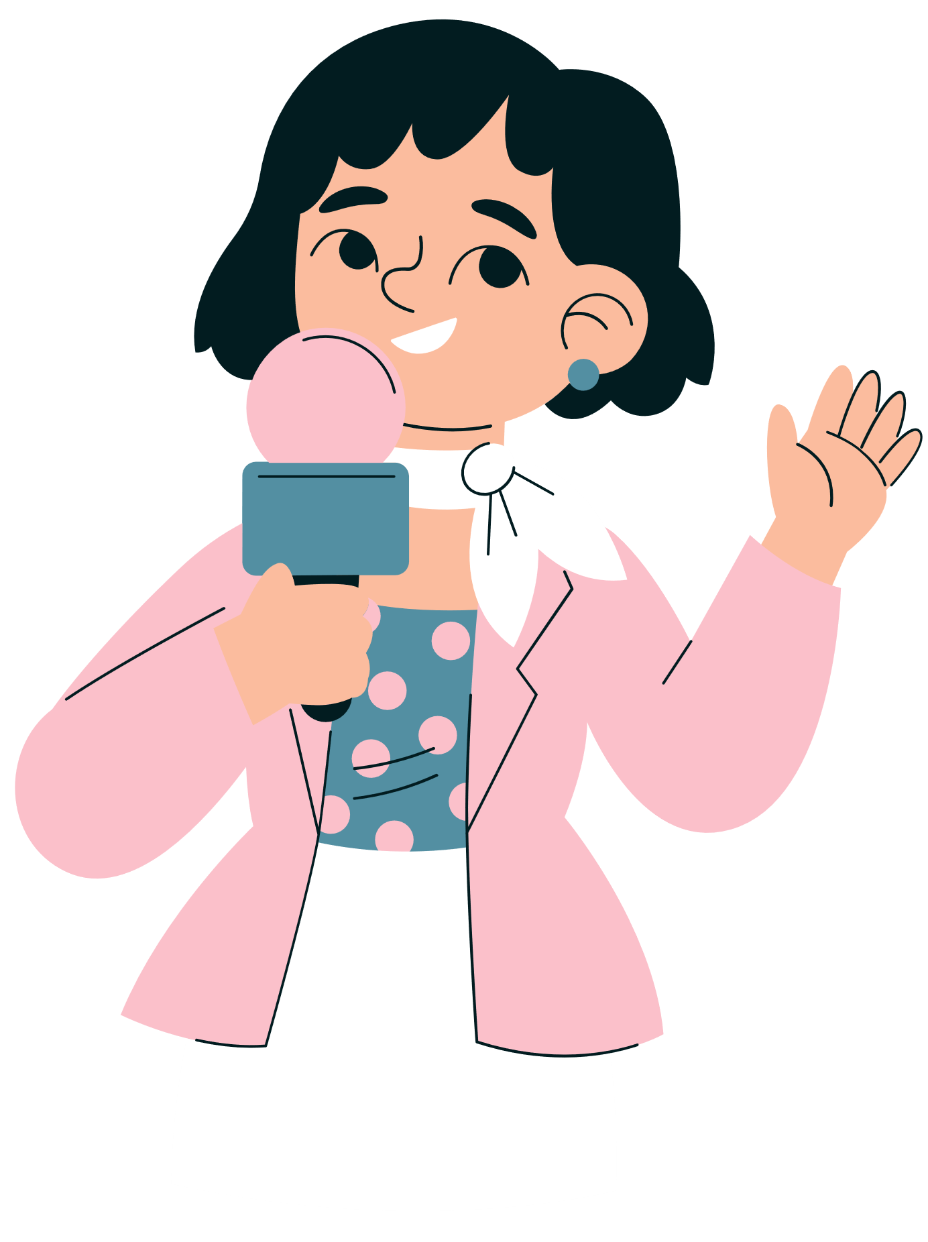

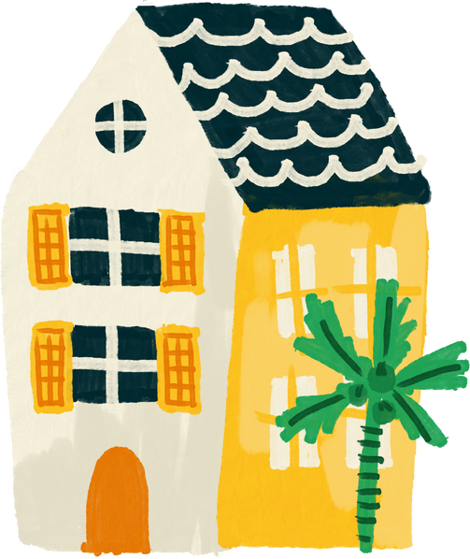
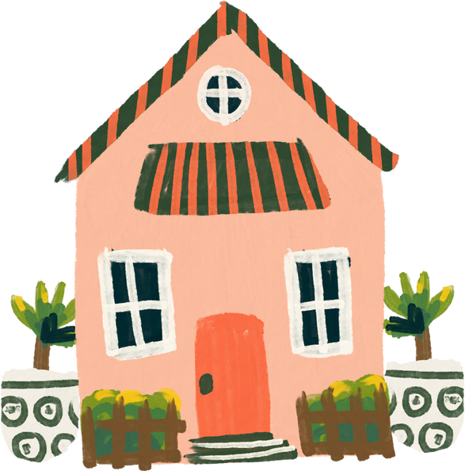
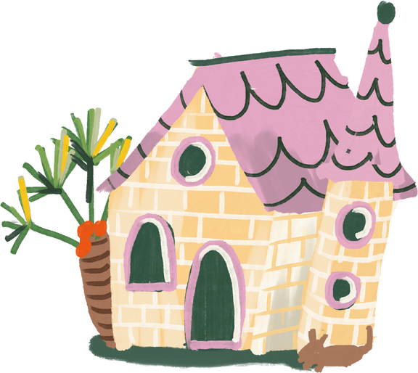
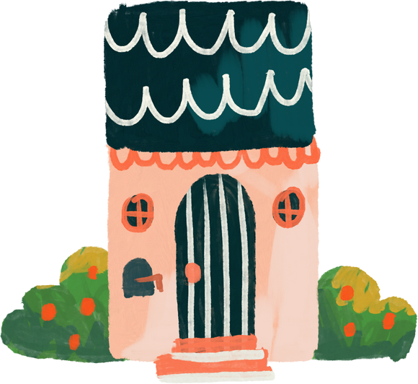
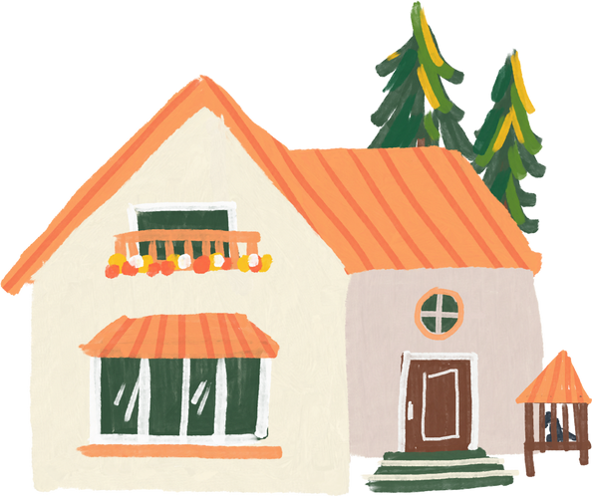
01
Warm-up and review
SLAP THE BOARD
SLAP THE BOARD
Notes:
- T numbers SS in each team
- T call out a number, ss with that number stand up and say the answee
- SS who have the fastest and correct answer will get 2 points, the slower correct answer will get 1 point

Slide 3

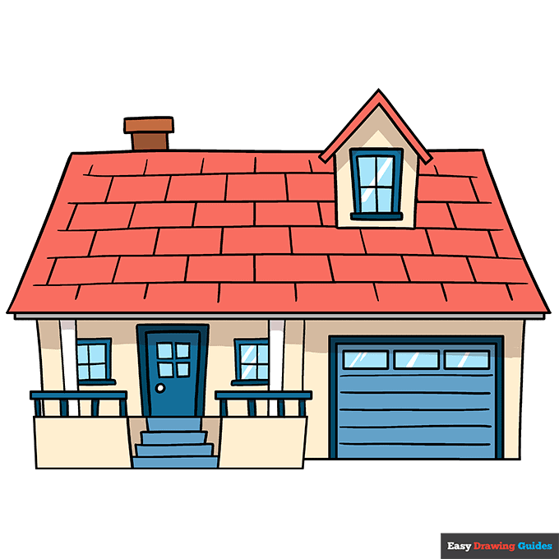
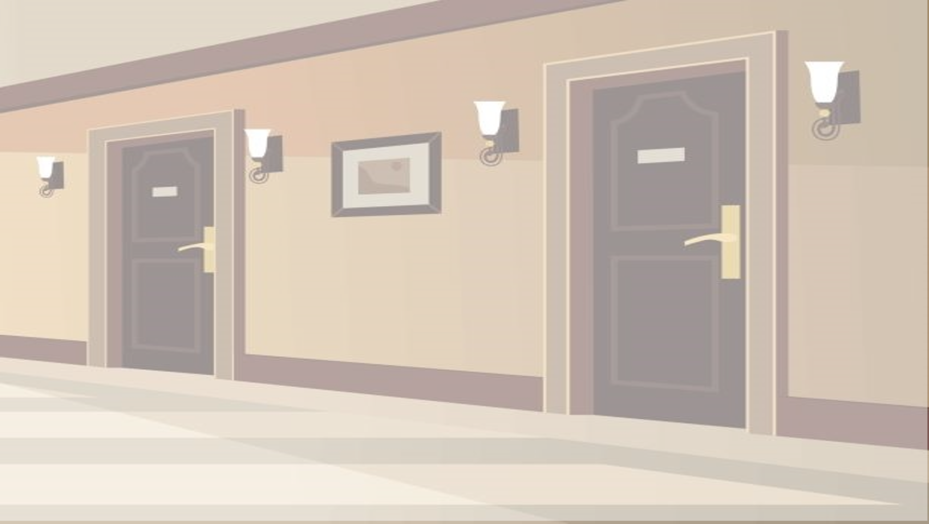
I live in a tower.
z
A
B
C

Slide 4
I live in a flat.
z
A
B
C

Slide 5

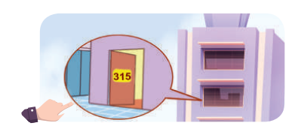



I live in that house.
A
B
C

Slide 6
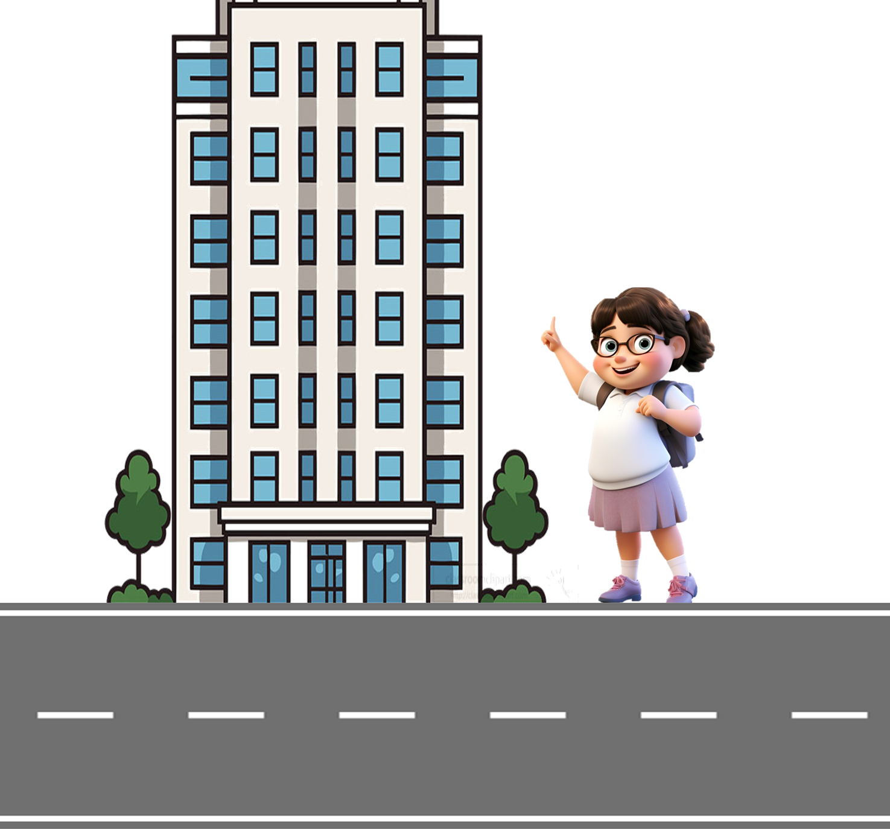
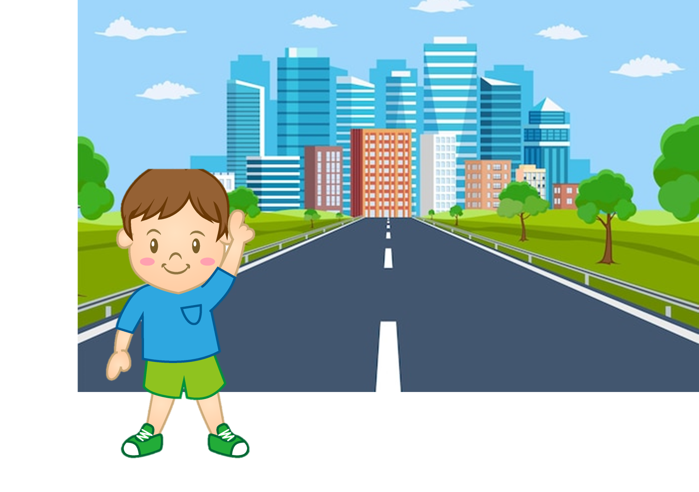
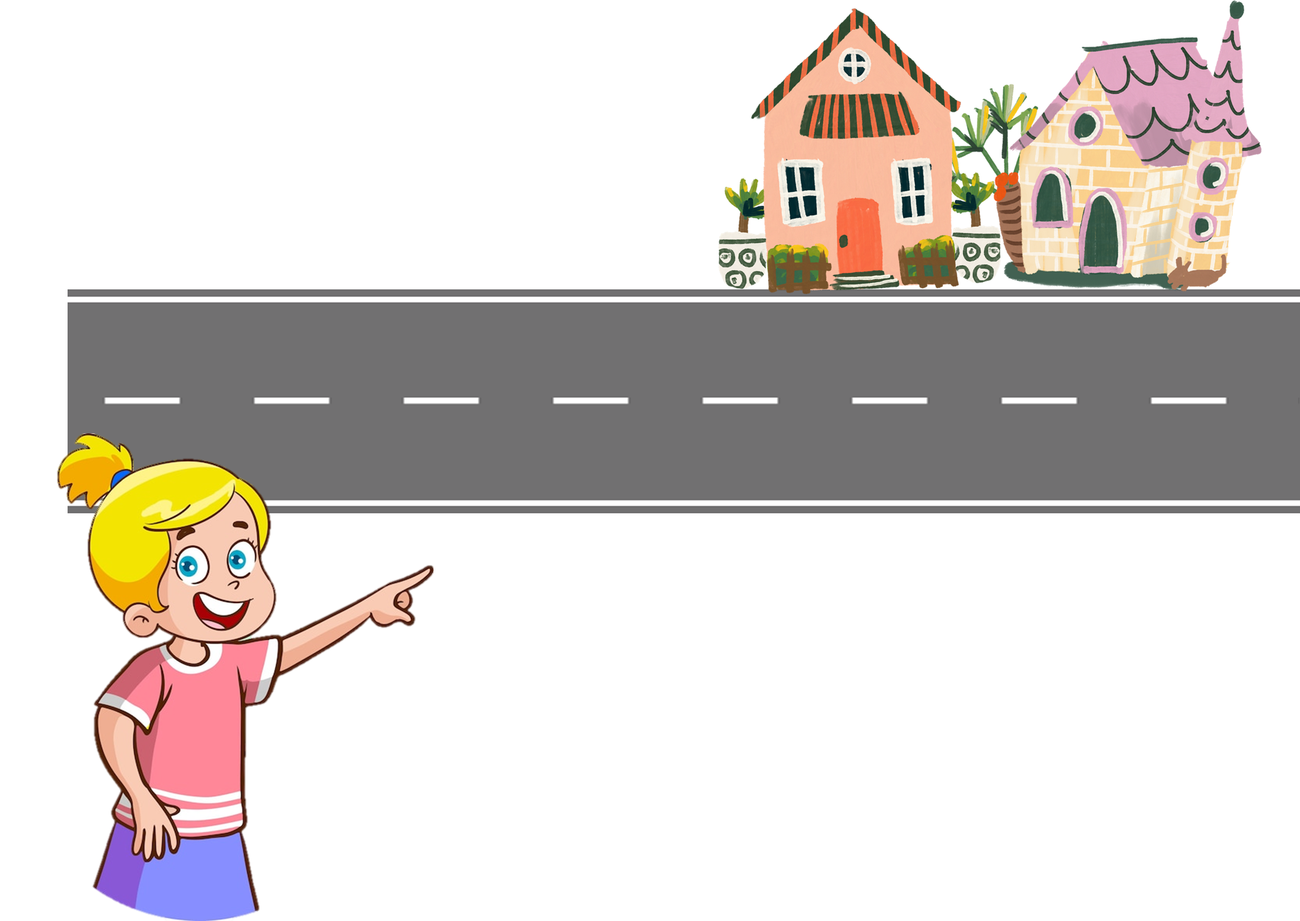
I live in that tower.
z
A
B
C

Slide 7
Review
Numbers 1 - 100

Slide 8



How to say a number?
= 60 and 5
sixty-five

Slide 9

How to say a number >100
= one-one-six

Slide 10
Let's say the numbers!
74
55
37
91
42
245
126
168
29
383

Slide 11
02
Look, listen and repeat.
Notes:
- T numbers SS in each team
- T call out a number, ss with that number stand up and say the answee
- SS who have the fastest and correct answer will get 2 points, the slower correct answer will get 1 point

Slide 12
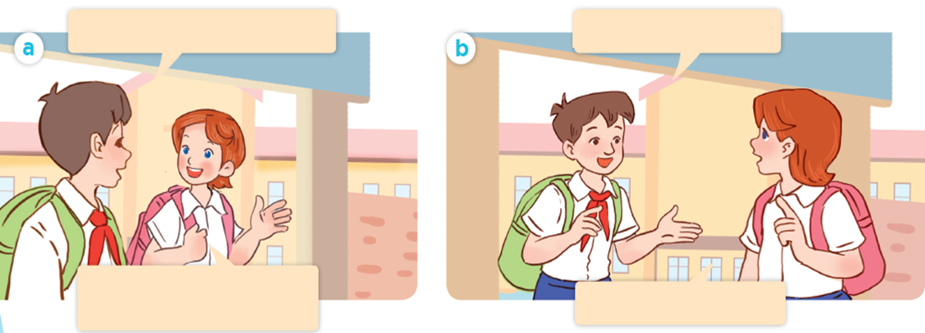
Where are they going?
Look! Where are they?

Slide 13


Look, listen and repeat.
Do you live near the school?
Yes, I do. I live about one
kilometre from here.

Slide 14
Look, listen and repeat
What's your address?
It's 45 Ba Trieu Street.

Slide 15
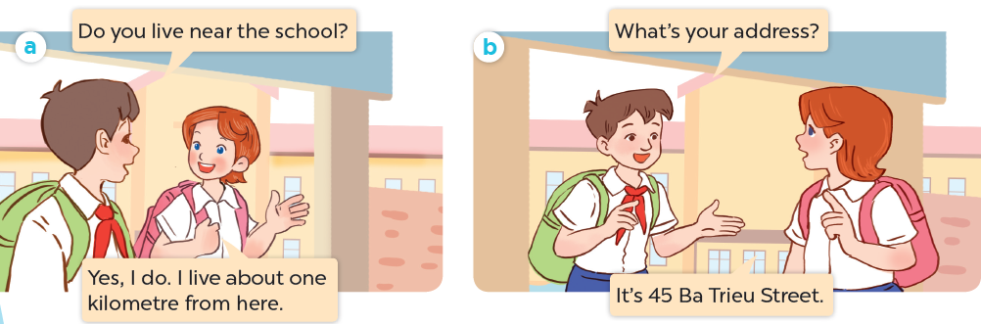
Look, listen and repeat

Slide 16
What's your address?
It's 45 Ba Trieu Street.

Slide 17
03
Listen, point and say.
Notes:
- T numbers SS in each team
- T call out a number, ss with that number stand up and say the answee
- SS who have the fastest and correct answer will get 2 points, the slower correct answer will get 1 point

Slide 18
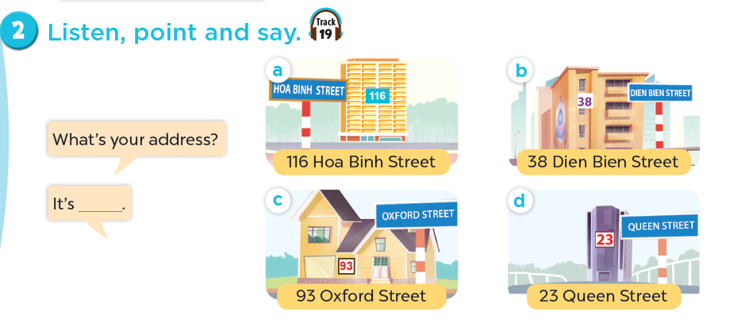
Listen, point and say.

Slide 19
Listen, point and say.
116 Hoa Binh Street

Slide 20
Listen, point and say.
38 Dien Bien Street

Slide 21
Listen, point and say.
93 0xford Street

Slide 22
Listen, point and say.
23 Queen Street

Slide 23


What's your address?
Ba Trieu
45
It's 45 Ba Trieu street.

Slide 24

What's your address?
Queen
134
It's 134 Queen street.

Slide 25
What's your address?
It's _______ street.

Slide 26

Listen, point and say.
What's your address?
It's 116 Hoa Binh Street.
116 Hoa Binh Street

Slide 27
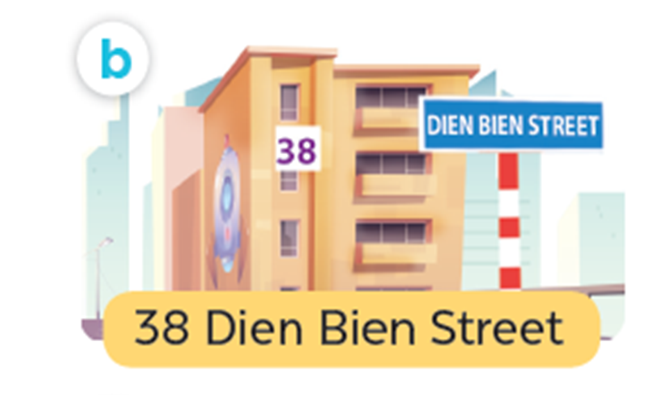
Listen, point and say.
What's your address?
It's 38 Dien Bien Street.
38 Dien Bien Street

Slide 28
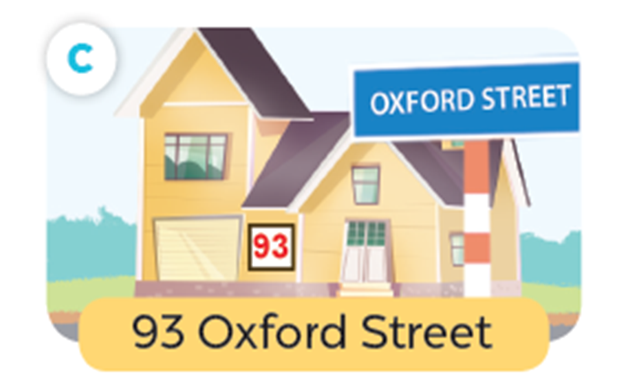
Listen, point and say.
What's your address?
It's 93 Oxford Street.
93 0xford Street

Slide 29
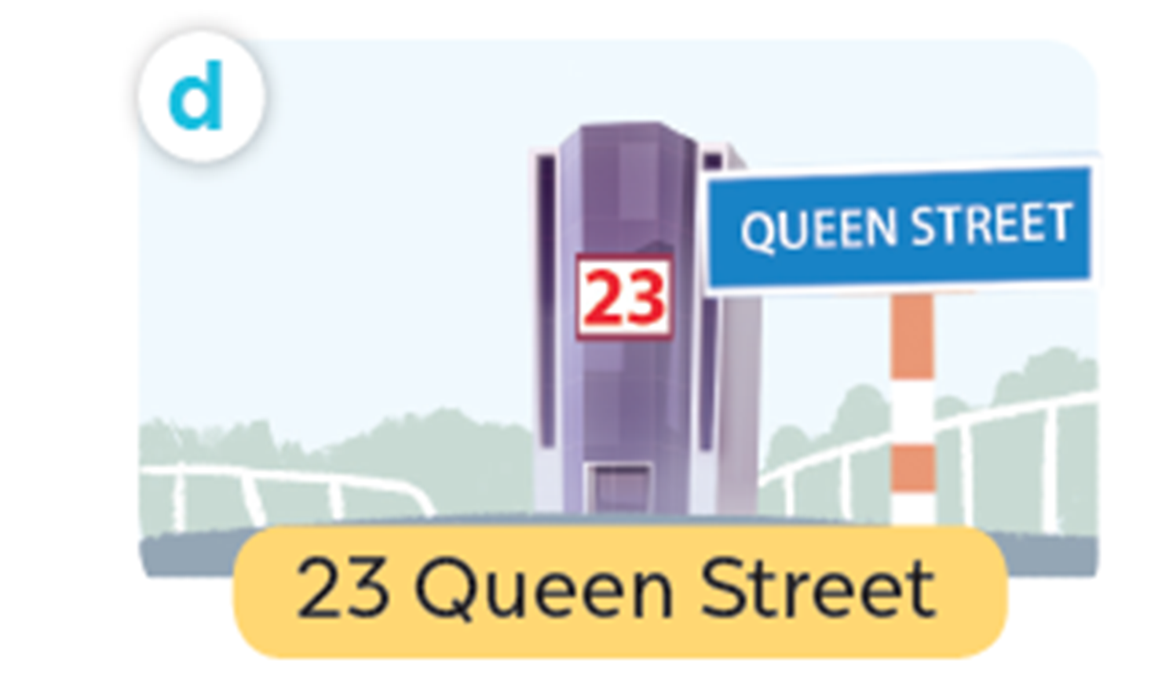
Listen, point and say.
What's your address?
It's 23 Queen Street.
23 Queen Street

Slide 30
Work in pairs. Practise.
What’s your address ?
116 Hoa Binh Street
38 Dien Bien Street
It’s ______ .
93 Oxford Street
23 Queen Street

Slide 31
04
Let's talk.
Notes:
- T numbers SS in each team
- T call out a number, ss with that number stand up and say the answee
- SS who have the fastest and correct answer will get 2 points, the slower correct answer will get 1 point

Slide 32
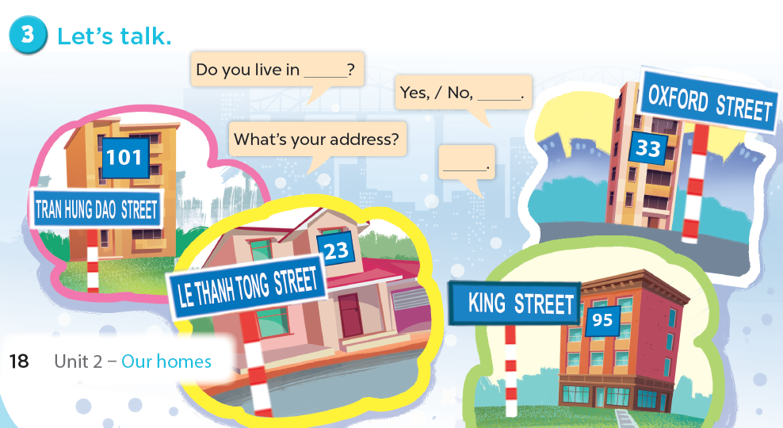
Let's talk.

Slide 33
05
Fun corner and wrap-up
Notes:
- T numbers SS in each team
- T call out a number, ss with that number stand up and say the answee
- SS who have the fastest and correct answer will get 2 points, the slower correct answer will get 1 point

Slide 34



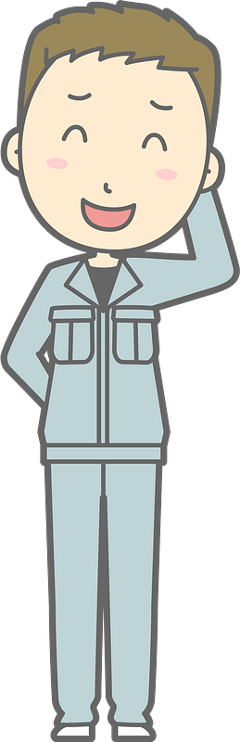

Bad
Luck
Billy
Notes:
This template is for educational, non-commercial purposes only. For more free game templates like this one, visit https://www.taysteachingtoolkit.com

Slide 35




This is Billy.
He has bad luck.

Slide 36

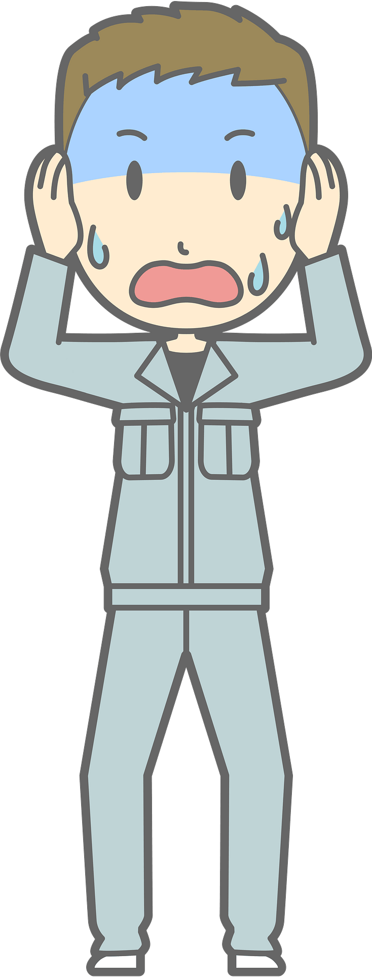
Dark clouds like to follow him…

Slide 37


…and strike him with lightning!
Notes:
Skeleton image designed by creazilla.com

Slide 38
Don’t worry,
Billy is okay…

Slide 39
…but, don’t have
bad luck like Billy.

Slide 40
How to play:
Everyone stands up.
One person reads the question on the screen.
Then, the next person goes.
If Billy is struck by lightning when you’re reading, you’re out (sit down).
The last person standing is the winner!
Notes:
TEACHER NOTES:
When I say ”Then, the next person goes.” I mean the next person reads the same word/sentence on the screen. The order of students reading is up to you and what makes the most sense for your class.
Feel free to adjust the instructions as needed for your class.
Skeleton image designed by creazilla.com

Slide 41
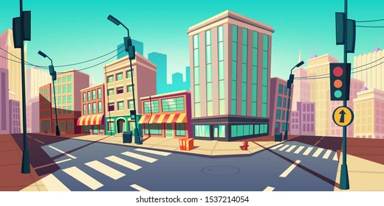

What's your address?
Ready?
67
Notes:
TEACHER NOTES:
Replace the text in the box with your key vocabulary/sentences.
OR if you want to make it into a speaking activity, delete the text and put an image in the box.
When playing the game, click/press the spacebar to send in the dark clouds.
Students start reading the text in the box after the dark cloud music stops.
Lightning will strike automatically after the dark clouds appear, no need to click again. The time when it strikes is different on each slide (view the animation pane to view or change the timing).
After the lightning strikes Billy and the student reading sits down, click/press the spacebar to go to the next slide.
Currently, there are 30 game slides in total (meant for 31 students). However, feel free to add or delete slides as needed for the number of students in your class.
If you want to adjust the time of when the lightning strikes, go to the “Animations” tab and open the ”Animation Pane.” Then, click on the “Lightning Strike” animation and adjust the delay time in the timing window.
If using the game more than once with the same class and are worried students will remember the lightning strike timing on each slide, no need to adjust the times of each lightning strike animation, just reorder the slides to save time and make the game feel fresh.
Skeleton image designed by creazilla.com

Slide 42


What's your address?
Ready?
108
Oxford
Notes:
TEACHER NOTES:
Replace the text in the box with your key vocabulary/sentences.
OR if you want to make it into a speaking activity, delete the text and put an image in the box.
When playing the game, click/press the spacebar to send in the dark clouds.
Students start reading the text in the box after the dark cloud music stops.
Lightning will strike automatically after the dark clouds appear, no need to click again. The time when it strikes is different on each slide (view the animation pane to view or change the timing).
After the lightning strikes Billy and the student reading sits down, click/press the spacebar to go to the next slide.
Currently, there are 30 game slides in total (meant for 31 students). However, feel free to add or delete slides as needed for the number of students in your class.
If you want to adjust the time of when the lightning strikes, go to the “Animations” tab and open the ”Animation Pane.” Then, click on the “Lightning Strike” animation and adjust the delay time in the timing window.
If using the game more than once with the same class and are worried students will remember the lightning strike timing on each slide, no need to adjust the times of each lightning strike animation, just reorder the slides to save time and make the game feel fresh.
Skeleton image designed by creazilla.com

Slide 43
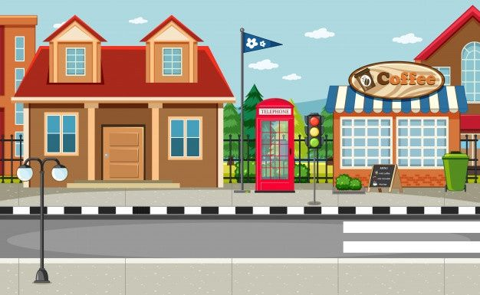
What's your address?
Ready?
76
Hung Vuong
Notes:
TEACHER NOTES:
Replace the text in the box with your key vocabulary/sentences.
OR if you want to make it into a speaking activity, delete the text and put an image in the box.
When playing the game, click/press the spacebar to send in the dark clouds.
Students start reading the text in the box after the dark cloud music stops.
Lightning will strike automatically after the dark clouds appear, no need to click again. The time when it strikes is different on each slide (view the animation pane to view or change the timing).
After the lightning strikes Billy and the student reading sits down, click/press the spacebar to go to the next slide.
Currently, there are 30 game slides in total (meant for 31 students). However, feel free to add or delete slides as needed for the number of students in your class.
If you want to adjust the time of when the lightning strikes, go to the “Animations” tab and open the ”Animation Pane.” Then, click on the “Lightning Strike” animation and adjust the delay time in the timing window.
If using the game more than once with the same class and are worried students will remember the lightning strike timing on each slide, no need to adjust the times of each lightning strike animation, just reorder the slides to save time and make the game feel fresh.
Skeleton image designed by creazilla.com

Slide 44
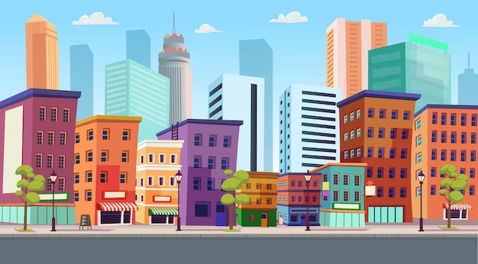
What's your address?
Ready?
25
Power
Notes:
TEACHER NOTES:
Replace the text in the box with your key vocabulary/sentences.
OR if you want to make it into a speaking activity, delete the text and put an image in the box.
When playing the game, click/press the spacebar to send in the dark clouds.
Students start reading the text in the box after the dark cloud music stops.
Lightning will strike automatically after the dark clouds appear, no need to click again. The time when it strikes is different on each slide (view the animation pane to view or change the timing).
After the lightning strikes Billy and the student reading sits down, click/press the spacebar to go to the next slide.
Currently, there are 30 game slides in total (meant for 31 students). However, feel free to add or delete slides as needed for the number of students in your class.
If you want to adjust the time of when the lightning strikes, go to the “Animations” tab and open the ”Animation Pane.” Then, click on the “Lightning Strike” animation and adjust the delay time in the timing window.
If using the game more than once with the same class and are worried students will remember the lightning strike timing on each slide, no need to adjust the times of each lightning strike animation, just reorder the slides to save time and make the game feel fresh.
Skeleton image designed by creazilla.com

Slide 45

_____________?
It's 33 Oxford street.
Ready?
Notes:
TEACHER NOTES:
Replace the text in the box with your key vocabulary/sentences.
OR if you want to make it into a speaking activity, delete the text and put an image in the box.
When playing the game, click/press the spacebar to send in the dark clouds.
Students start reading the text in the box after the dark cloud music stops.
Lightning will strike automatically after the dark clouds appear, no need to click again. The time when it strikes is different on each slide (view the animation pane to view or change the timing).
After the lightning strikes Billy and the student reading sits down, click/press the spacebar to go to the next slide.
Currently, there are 30 game slides in total (meant for 31 students). However, feel free to add or delete slides as needed for the number of students in your class.
If you want to adjust the time of when the lightning strikes, go to the “Animations” tab and open the ”Animation Pane.” Then, click on the “Lightning Strike” animation and adjust the delay time in the timing window.
If using the game more than once with the same class and are worried students will remember the lightning strike timing on each slide, no need to adjust the times of each lightning strike animation, just reorder the slides to save time and make the game feel fresh.
Skeleton image designed by creazilla.com

Slide 46
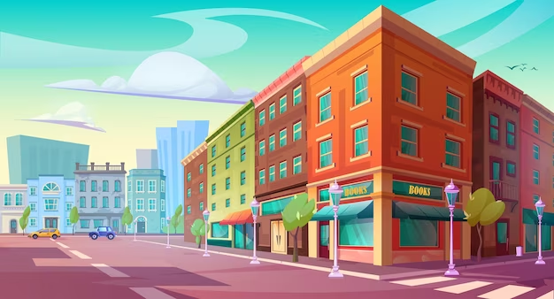
What's your address?
Ready?
246
Cau Giay
Notes:
TEACHER NOTES:
Replace the text in the box with your key vocabulary/sentences.
OR if you want to make it into a speaking activity, delete the text and put an image in the box.
When playing the game, click/press the spacebar to send in the dark clouds.
Students start reading the text in the box after the dark cloud music stops.
Lightning will strike automatically after the dark clouds appear, no need to click again. The time when it strikes is different on each slide (view the animation pane to view or change the timing).
After the lightning strikes Billy and the student reading sits down, click/press the spacebar to go to the next slide.
Currently, there are 30 game slides in total (meant for 31 students). However, feel free to add or delete slides as needed for the number of students in your class.
If you want to adjust the time of when the lightning strikes, go to the “Animations” tab and open the ”Animation Pane.” Then, click on the “Lightning Strike” animation and adjust the delay time in the timing window.
If using the game more than once with the same class and are worried students will remember the lightning strike timing on each slide, no need to adjust the times of each lightning strike animation, just reorder the slides to save time and make the game feel fresh.
Skeleton image designed by creazilla.com

