Slide 1




UBND QUẬN DƯƠNG KINH
TRƯỜNG TIỂU HỌC ANH DŨNG
ENGLISH - GRADE 5
UNIT 3: MY FOREIGN FRIENDS
LESSON 3 (1, 2, 3)

Slide 2


01
Warm-up and Review

Slide 3


Describing people's
APPEARANCE
and
PERSONALITY

Slide 4

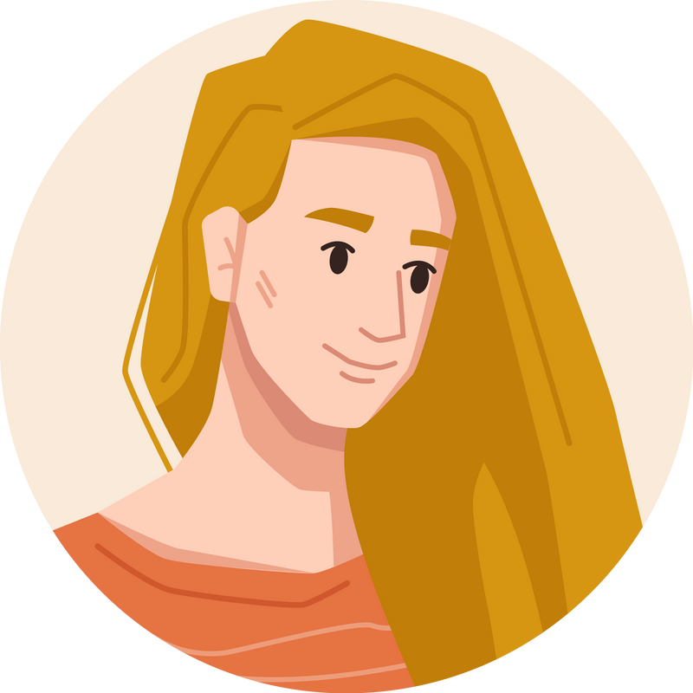
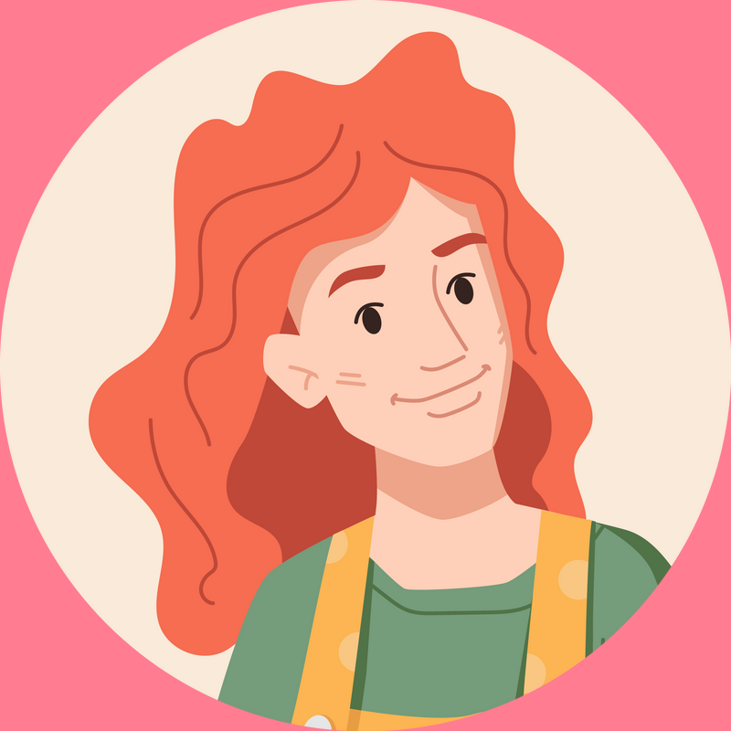

She has long and red hair.

Slide 5

She has long and red hair.

Slide 6

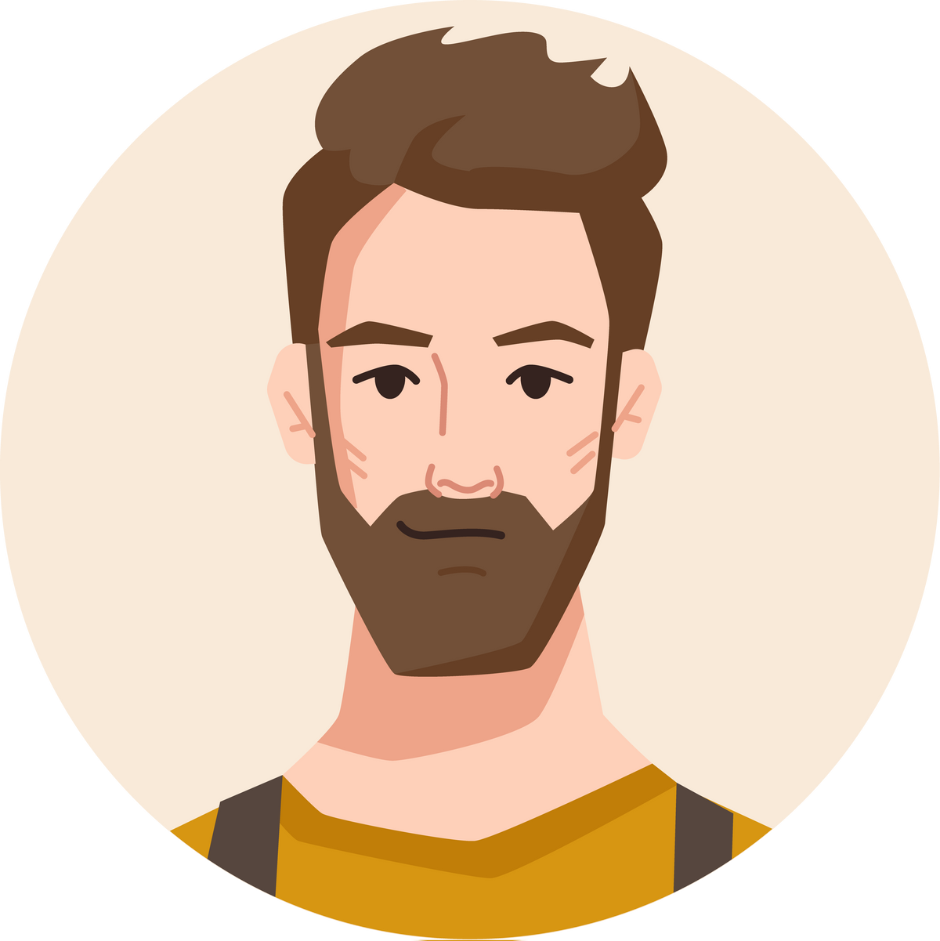
He has long and brown hair.
He is big and fat.
He has short and brown hair.

Slide 7
He has long and brown hair.
He is big and fat.
He has short and brown hair.

Slide 8
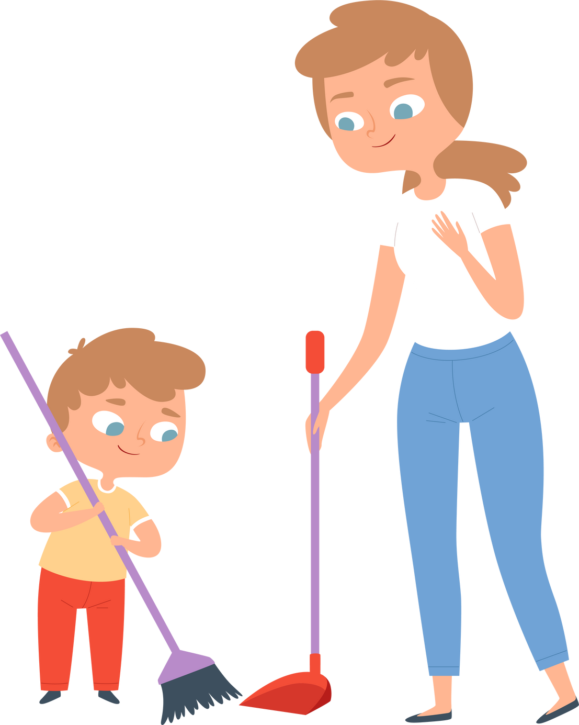
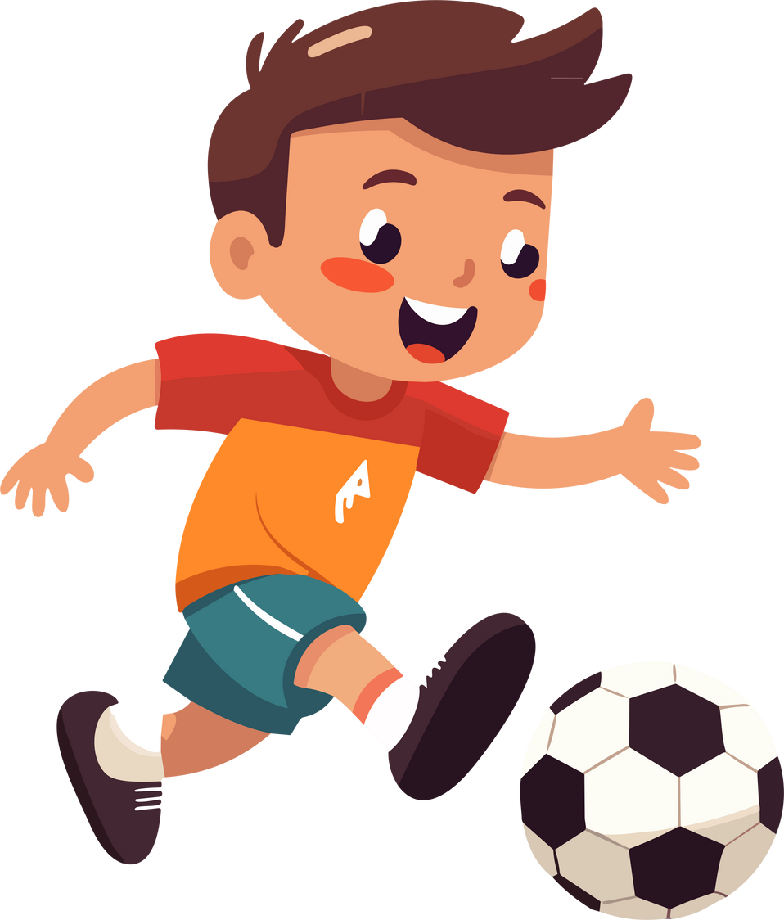
He is very active.

Slide 9
He is very active.

Slide 10

My sister has eyes.

Slide 11
big
My sister has eyes.

Slide 12


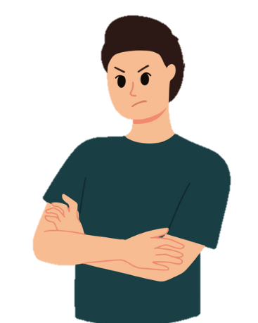
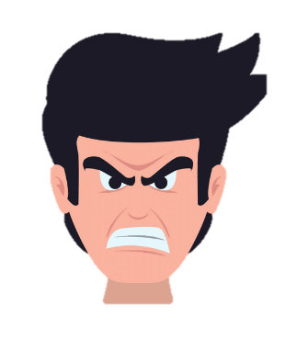
My brother is friendly.

Slide 13
My brother is friendly.

Slide 14


My little brother is helpful.
My little brother is clever.
My little brother is active.

Slide 15
My little brother is helpful.
My little brother is clever.
My little brother is active.

Slide 16
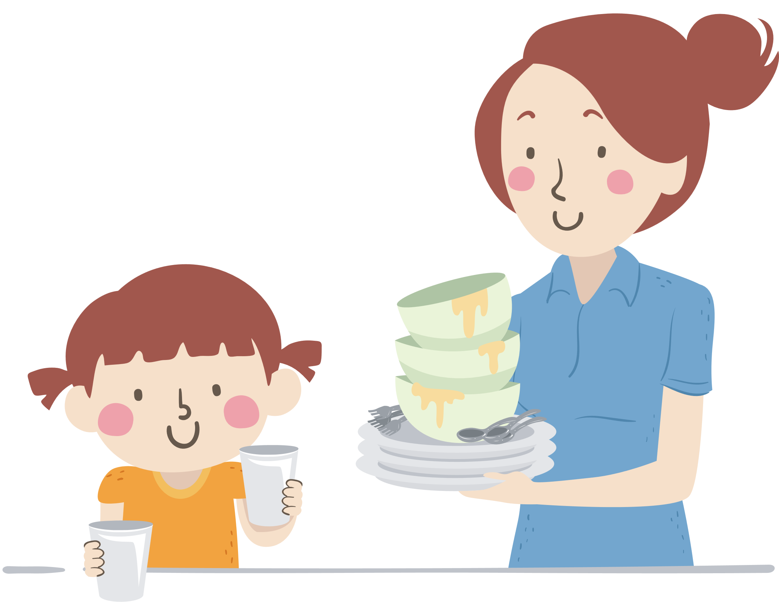
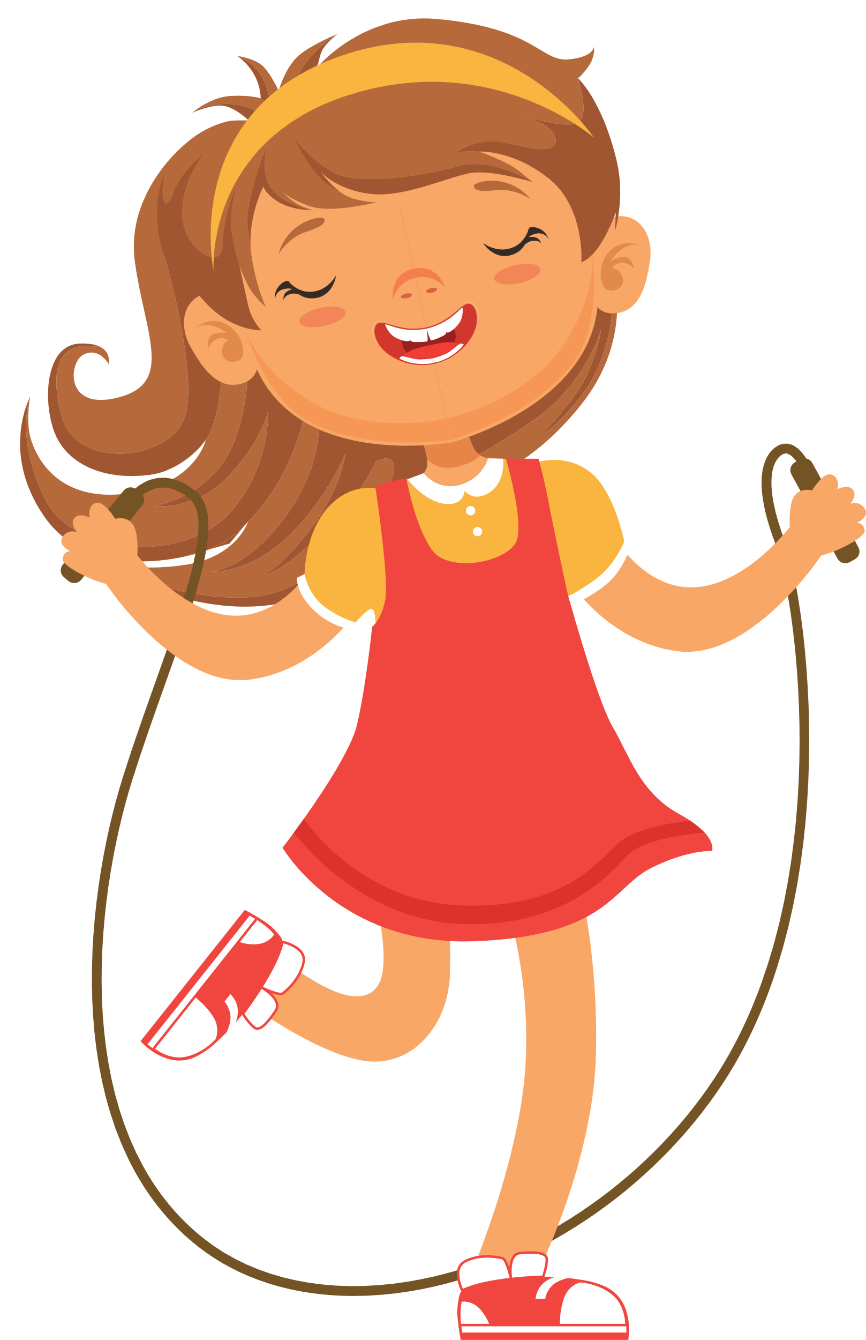
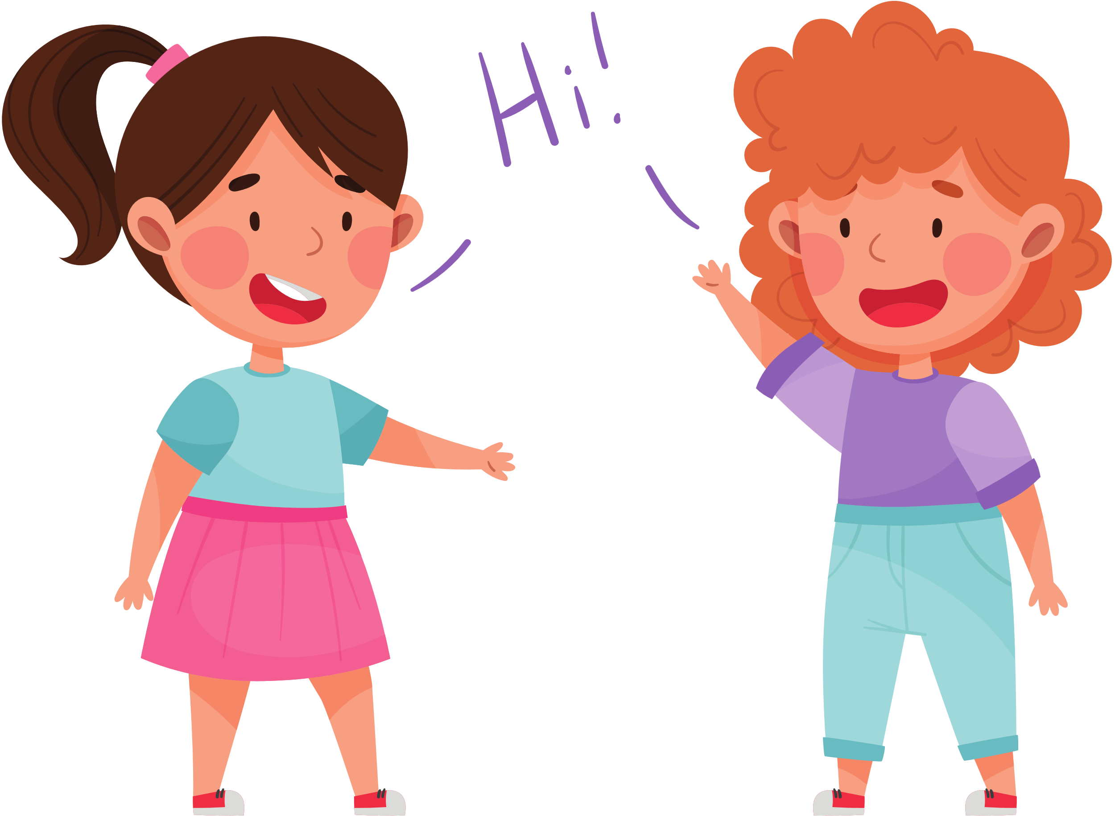
My younger sister is helpful.

Slide 17
My younger sister is helpful.

Slide 18





Slide 19
02
Listen and repeat.

Slide 20
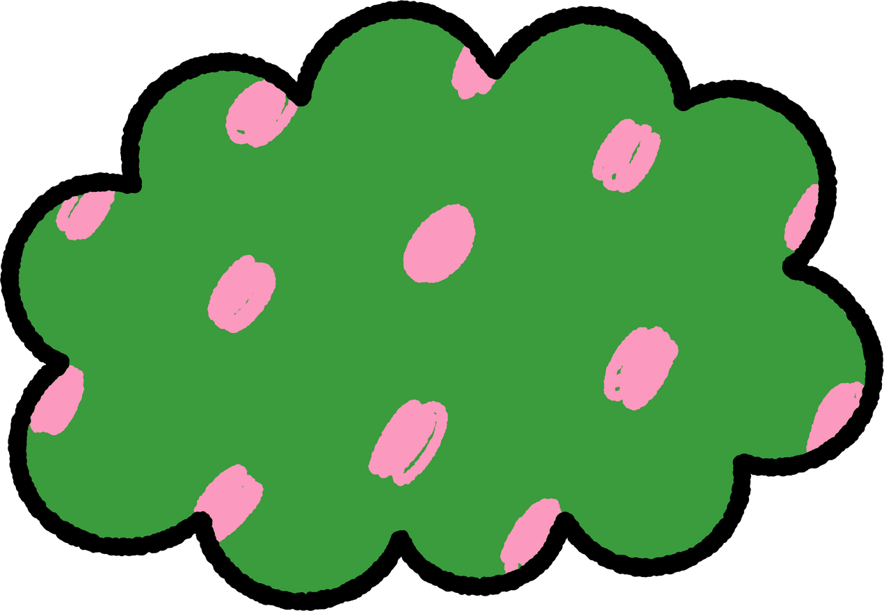





LISTEN, POINT AND REPEAT.
‘active
He’s ‘active.

Slide 21
LISTEN, POINT AND REPEAT.
‘friendly
She’s ‘friendly.

Slide 22



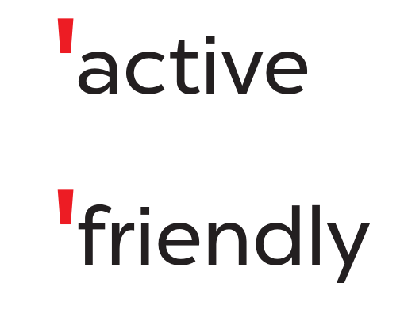
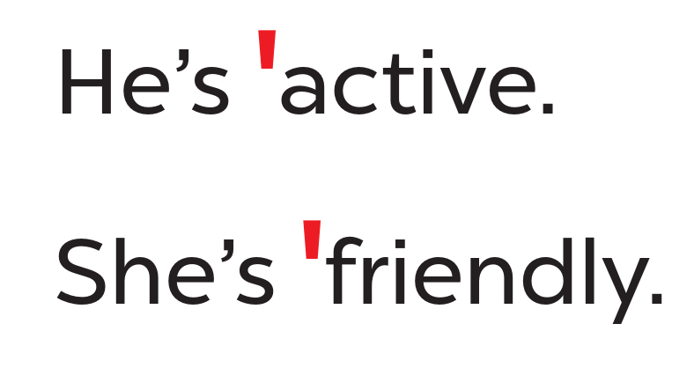


WORK IN PAIRS.

Slide 23
03
Circle, listen and check.

Slide 24




READ AND CIRCLE.
a. friendly
b. fifteen
c. active
a. sixteen
b. eighteen
c. clever
a. helpful
b. about
c. nineteen

Slide 25

SWAP YOUR BOOKS.

Slide 26
LISTEN AND CHECK.
a. friendly
b. fifteen
c. active
a. sixteen
b. eighteen
c. clever
a. helpful
b. about
c. nineteen

Slide 27



LOOK AND SAY ALOUD.
friendly
helpful
active
clever
She’s active.
He’s friendly.
He’s clever.
She’s helpful.

Slide 29
04
Let’s chant.

Slide 30
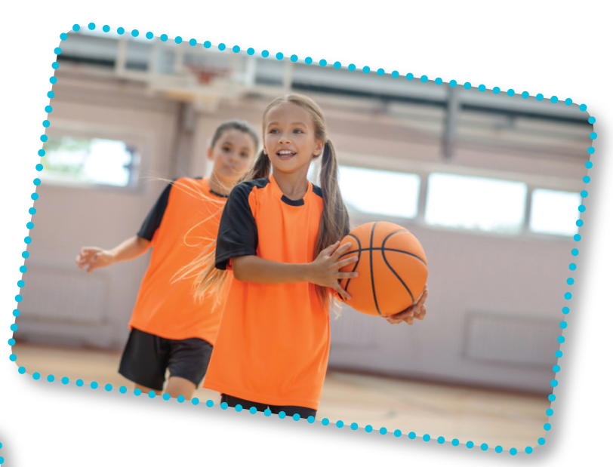
LOOK AND SAY.
play basketball
active

Slide 31
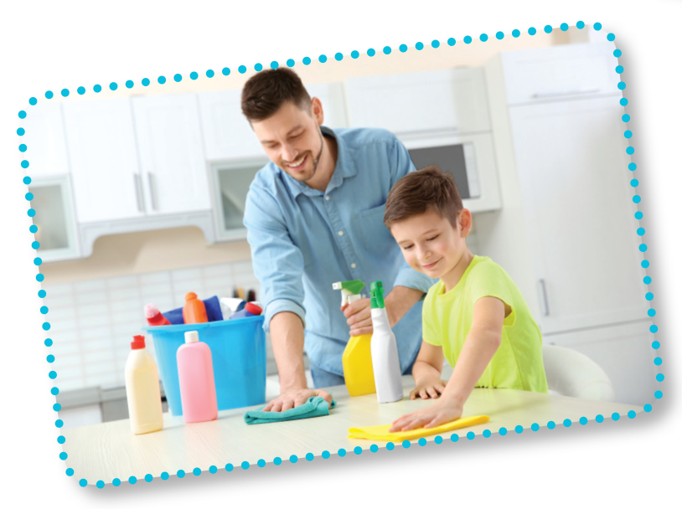
LOOK AND SAY.
clean the table
helpful

Slide 32
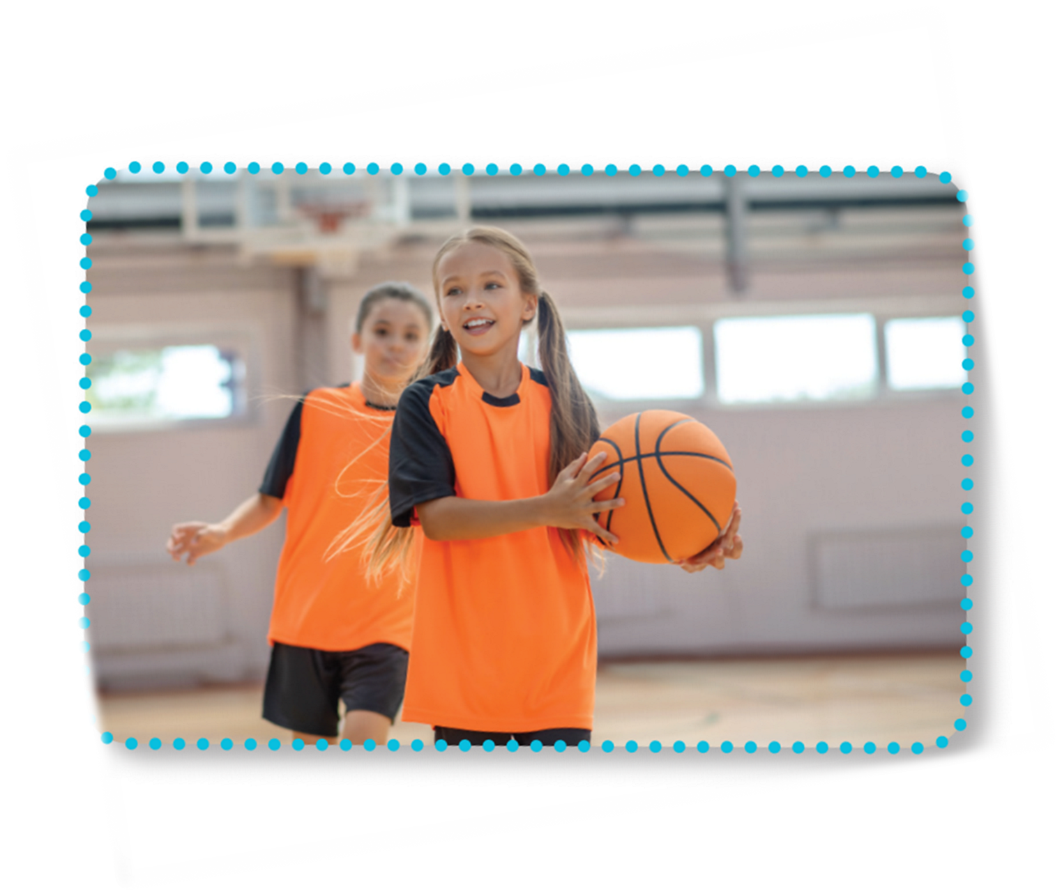

LOOK AND READ.
Is she active?
Yes, she is.
Is she friendly?
Yes, she is.
She’s active and friendly.

Slide 33
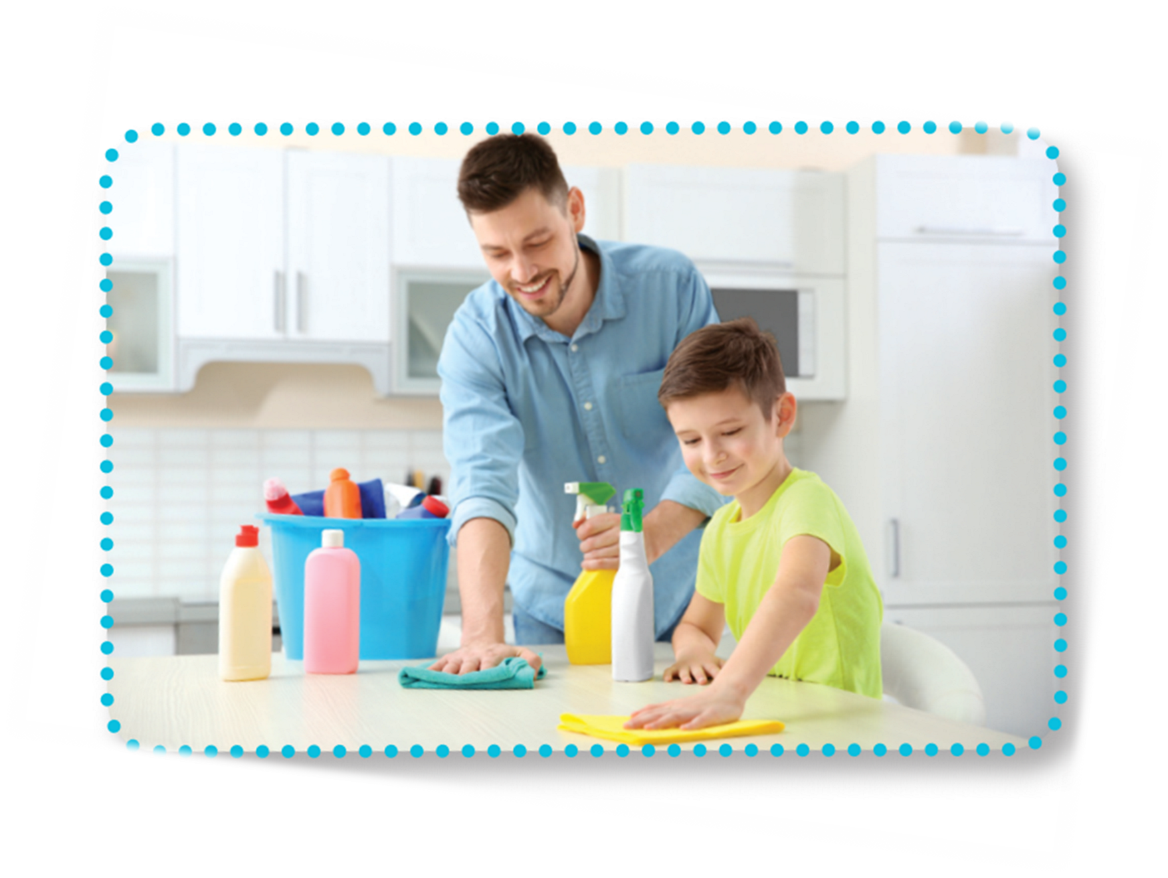
LOOK AND READ.
Is he helpful?
Yes, he is.
Is he clever?
Yes, he is.
He’s helpful and clever.

Slide 34

LISTEN AND POINT.
Is she active?
Yes, she is.
Is she friendly?
Yes, she is.
She’s active and friendly.

Slide 35

LISTEN AND POINT.
Is he helpful?
Yes, he is.
Is he clever?
Yes, he is.
He’s helpful and clever.

Slide 36
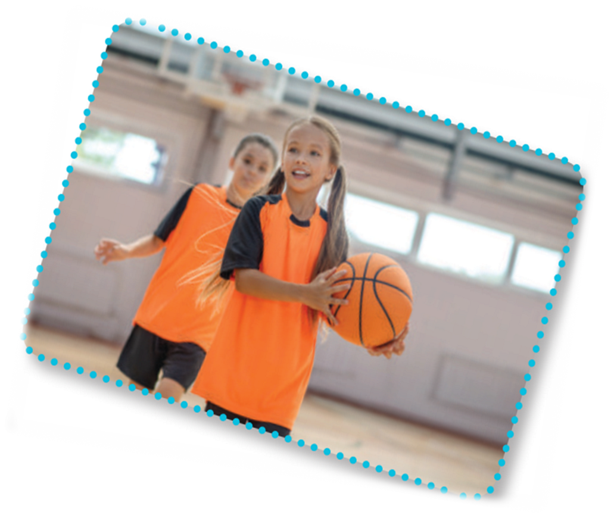
LISTEN AND REPEAT.
Is she active?
Yes, she is.
Is she friendly?
Yes, she is.
She’s active and friendly.

Slide 37

LISTEN AND REPEAT.
Is he helpful?
Yes, he is.
Is he clever?
Yes, he is.
He’s helpful and clever.

Slide 38

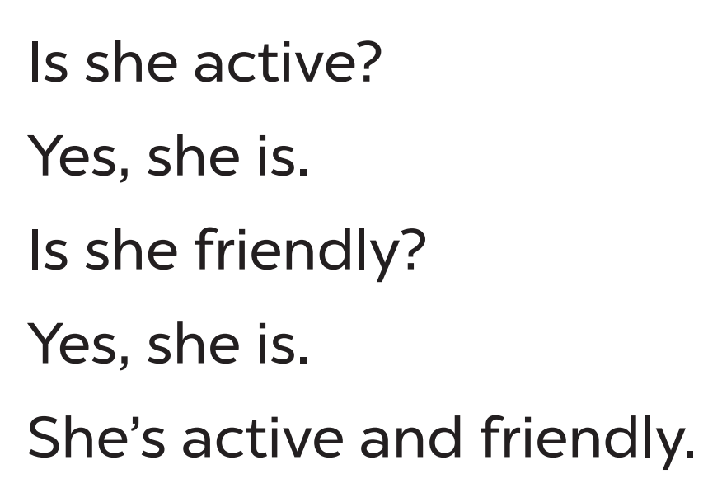
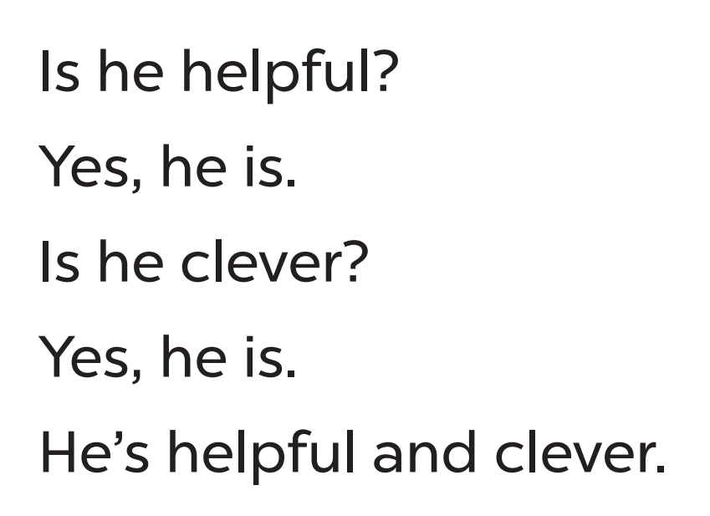
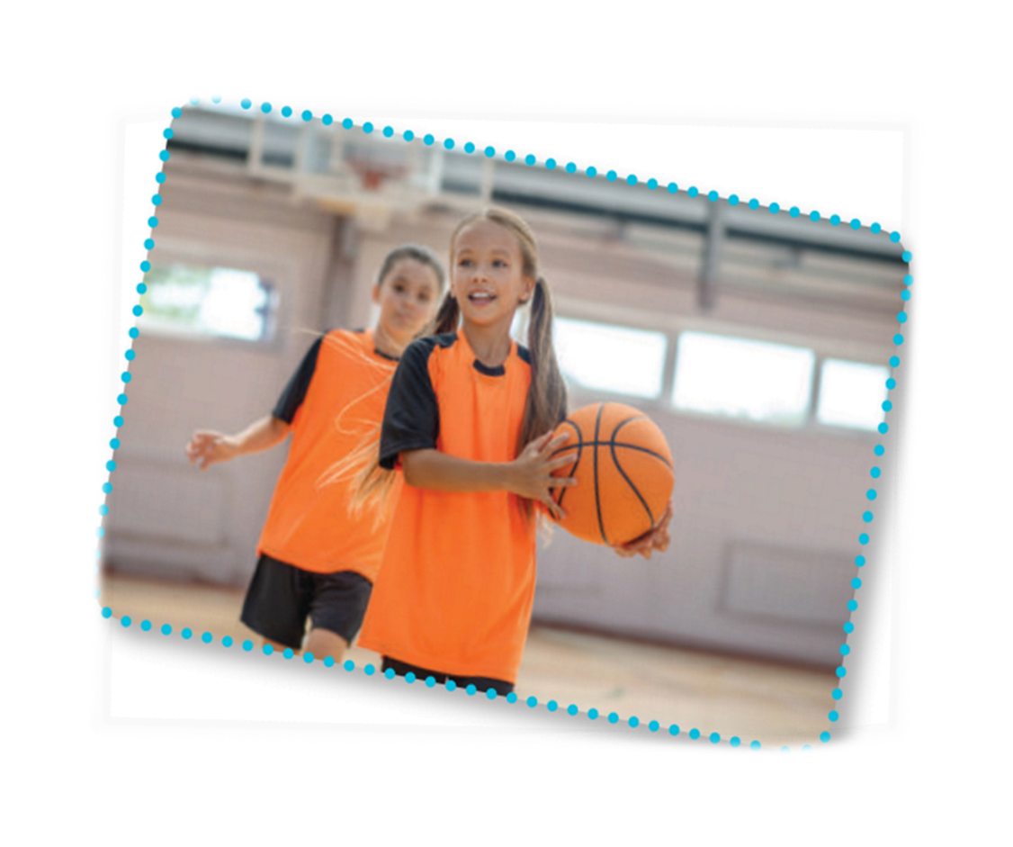

CHANT AND CLAP

Slide 39




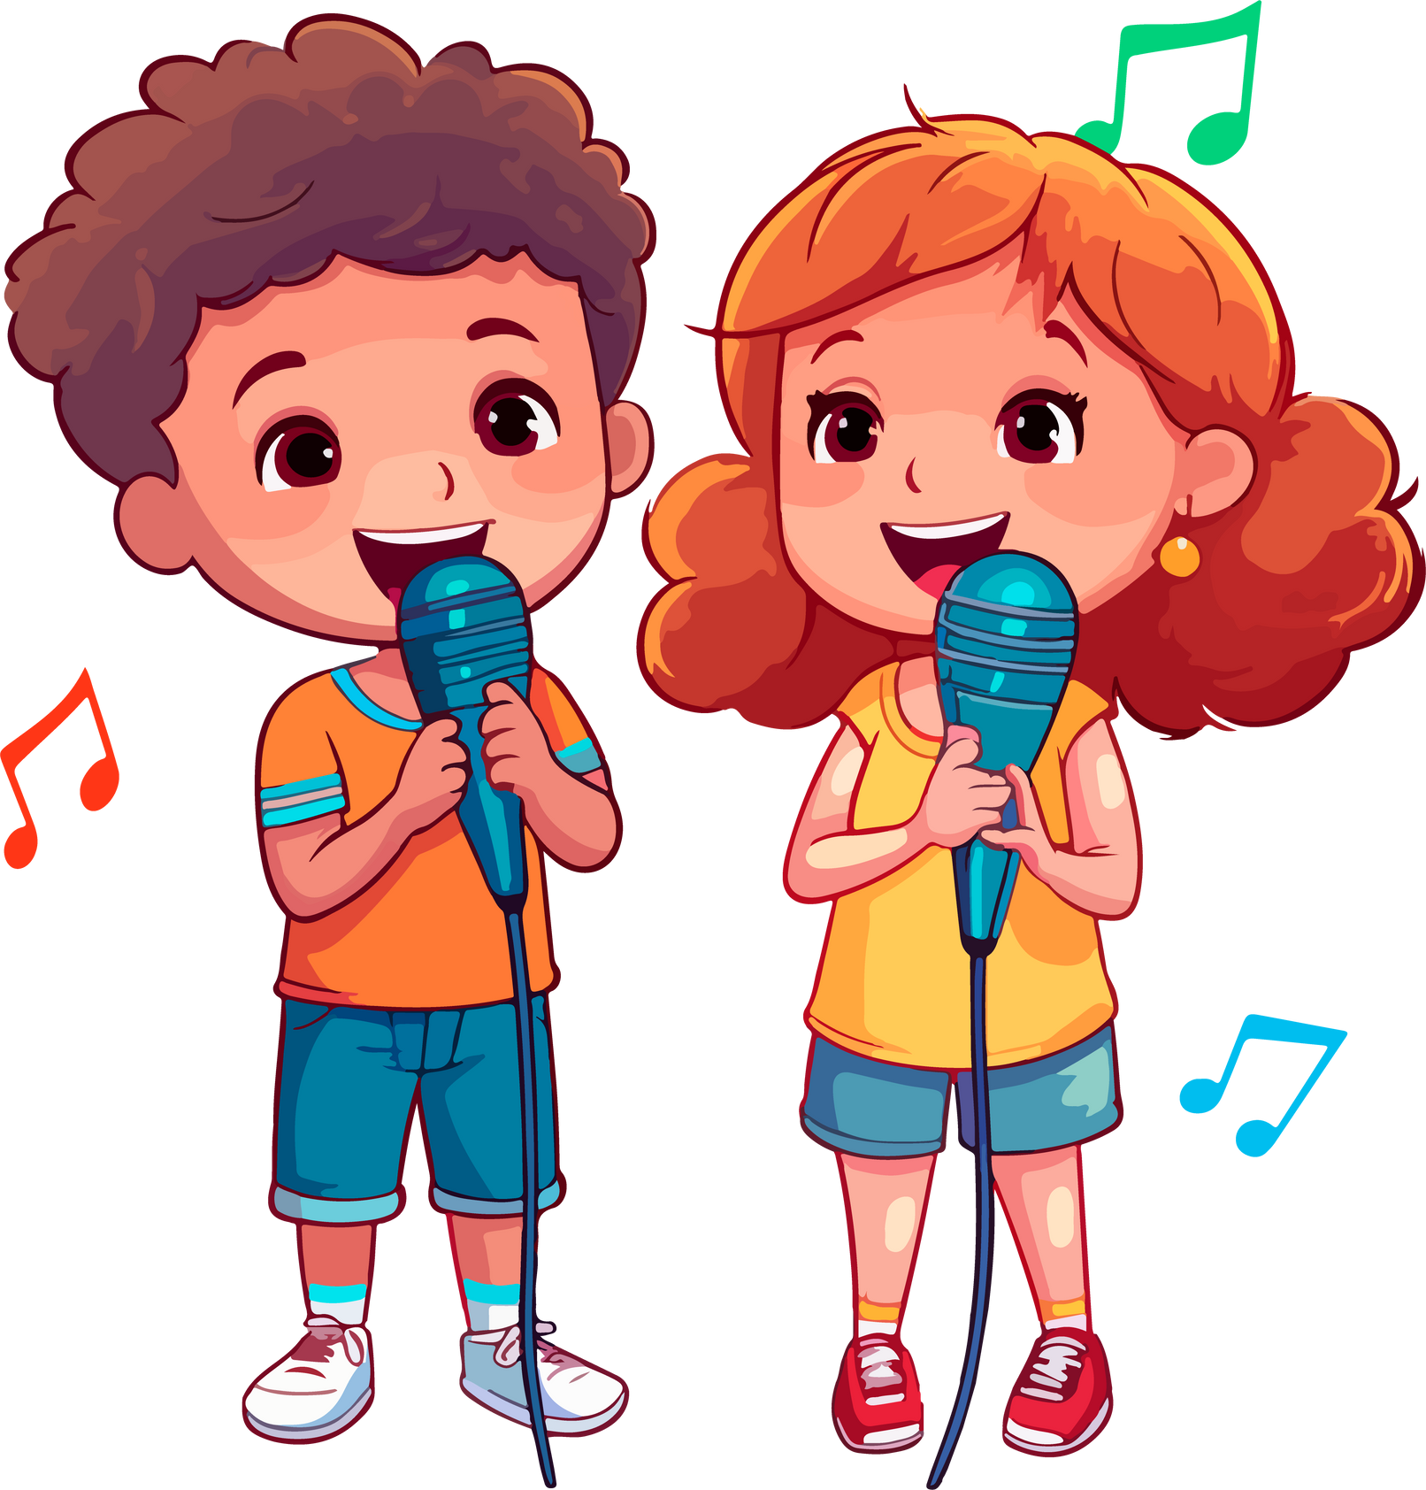


LET’S CHANT IN THE FRONT.
Notes:
Link video hoạt hình: https://hoclieu.vn/hop-phan-bo-tro/video-hoat-hinh/203?gidzl=92okFGyK4JiWCwOu3mqMD24oe3WI2HLjEJAgQKPOJcu-OVXg4b1FQ6fX-3XEMKSwOc7oEpCT2OOq2nKGE0

Slide 40
PRACTISE THE NEW CHANT.
happy
busy
quiet
tidy
gentle
Is she active?
Is he helpful?
Yes, she is.
Yes, he is.
Is she friendly?
Is he clever?
Yes, she is.
Yes, he is.
She’s active and friendly.
He’s helpful and clever.
Notes:
Extension (For consolidation): Replace two adjectives in the chant with other adjectives which have the stress on the first syllable for example, happy, busy, quiet, tidy, gentle. Have pupils practice the new chant.

Slide 42
05
Fun corner
and Wrap-up

Slide 43






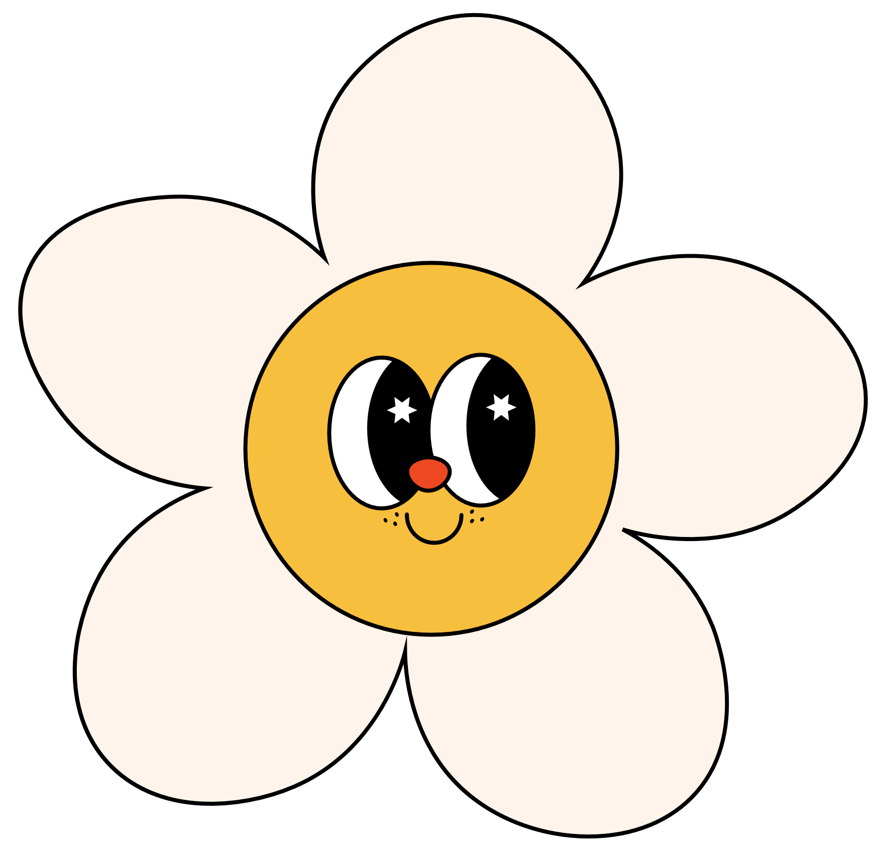

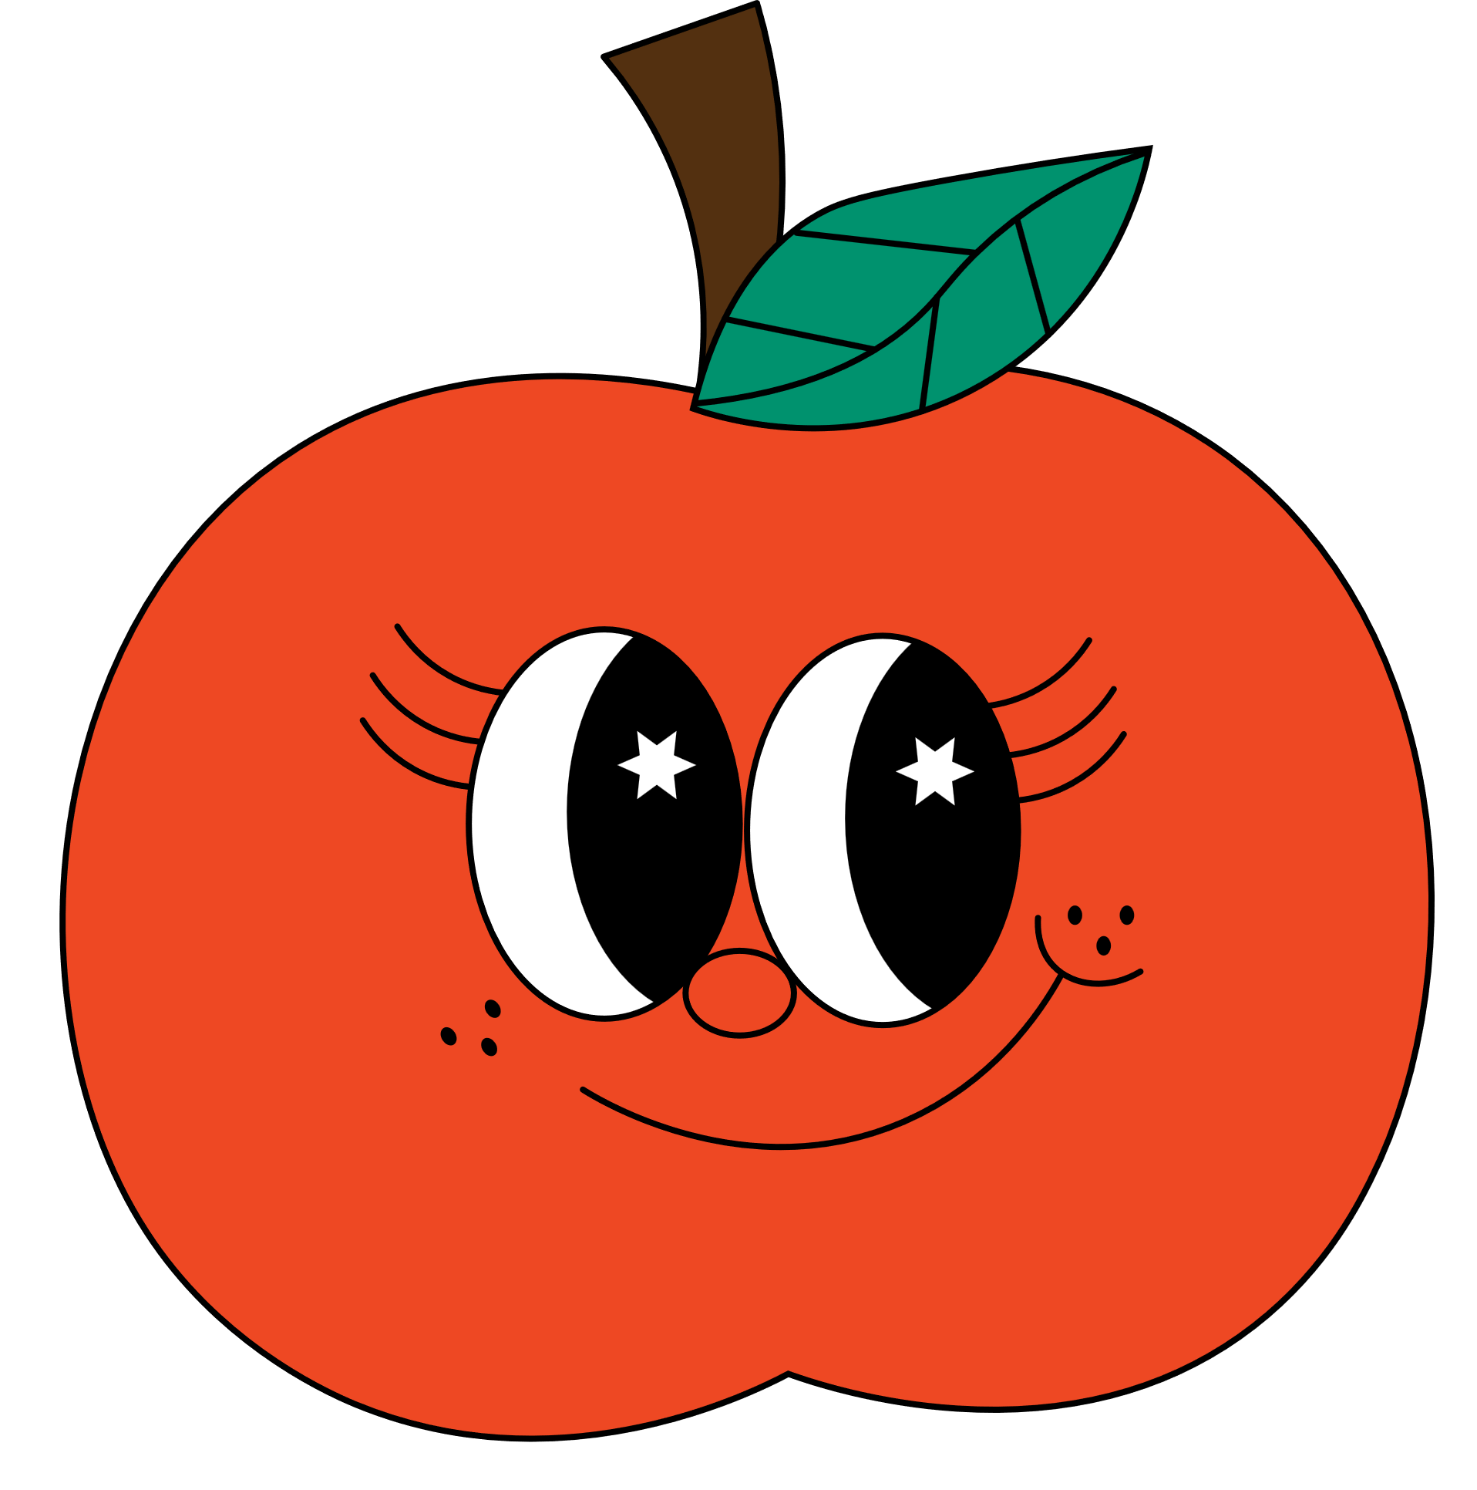


Let’s talk about your beloved ones!
Have fun!

Slide 44








What is like?
Let’s talk about the friend sitting at your left.

Slide 45






What is like?
Let’s talk about the friend sitting at your right.

Slide 46



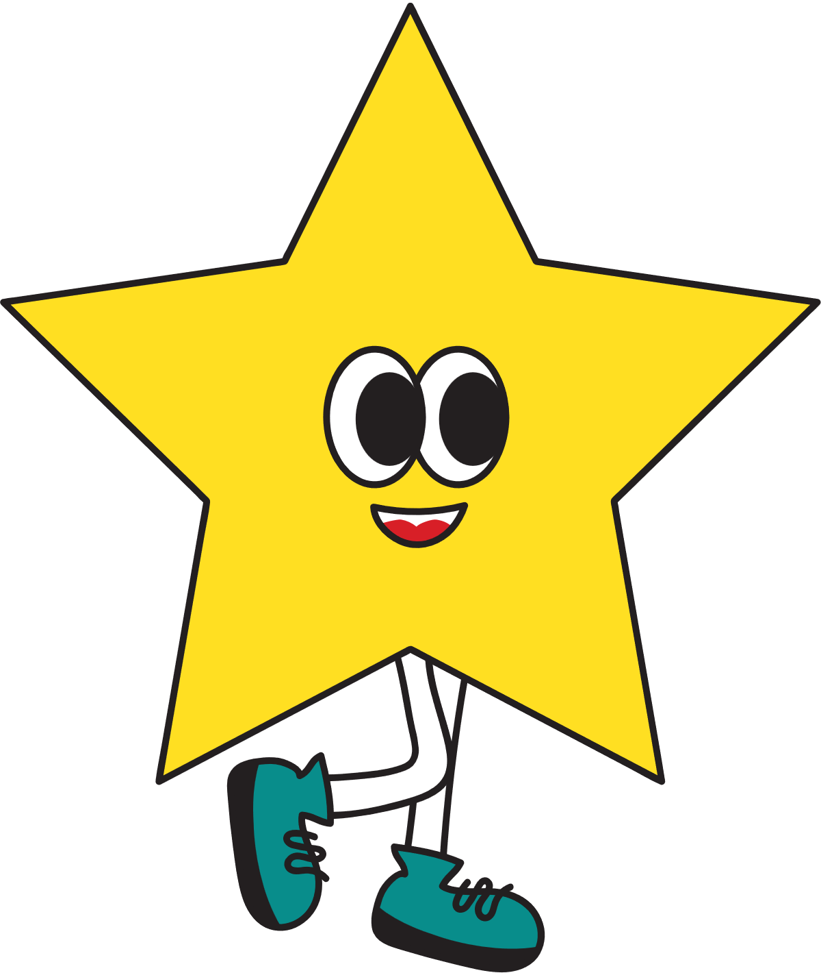


What is like?
Let’s talk about the friend behind you.

Slide 47


What is like?
Let’s talk about the friend in front of you.

Slide 48

What is like?
Let’s talk about your favourite teacher.

Slide 49
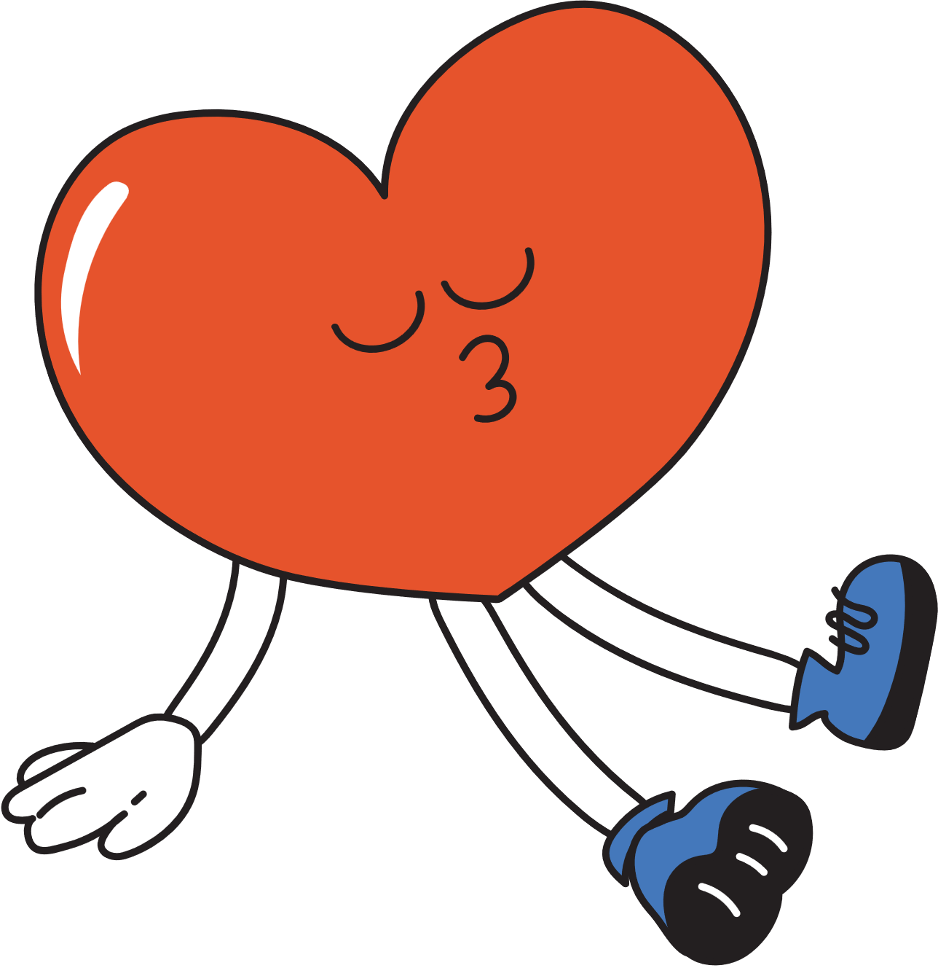

Good job!

