Slide 1




UBND QUẬN DƯƠNG KINH
TRƯỜNG TIỂU HỌC ANH DŨNG
ENGLISH - GRADE 5
UNIT 4: OUR FREE – TIME ACTIVITIES
LESSON 2 (1, 2, 3)

Slide 2









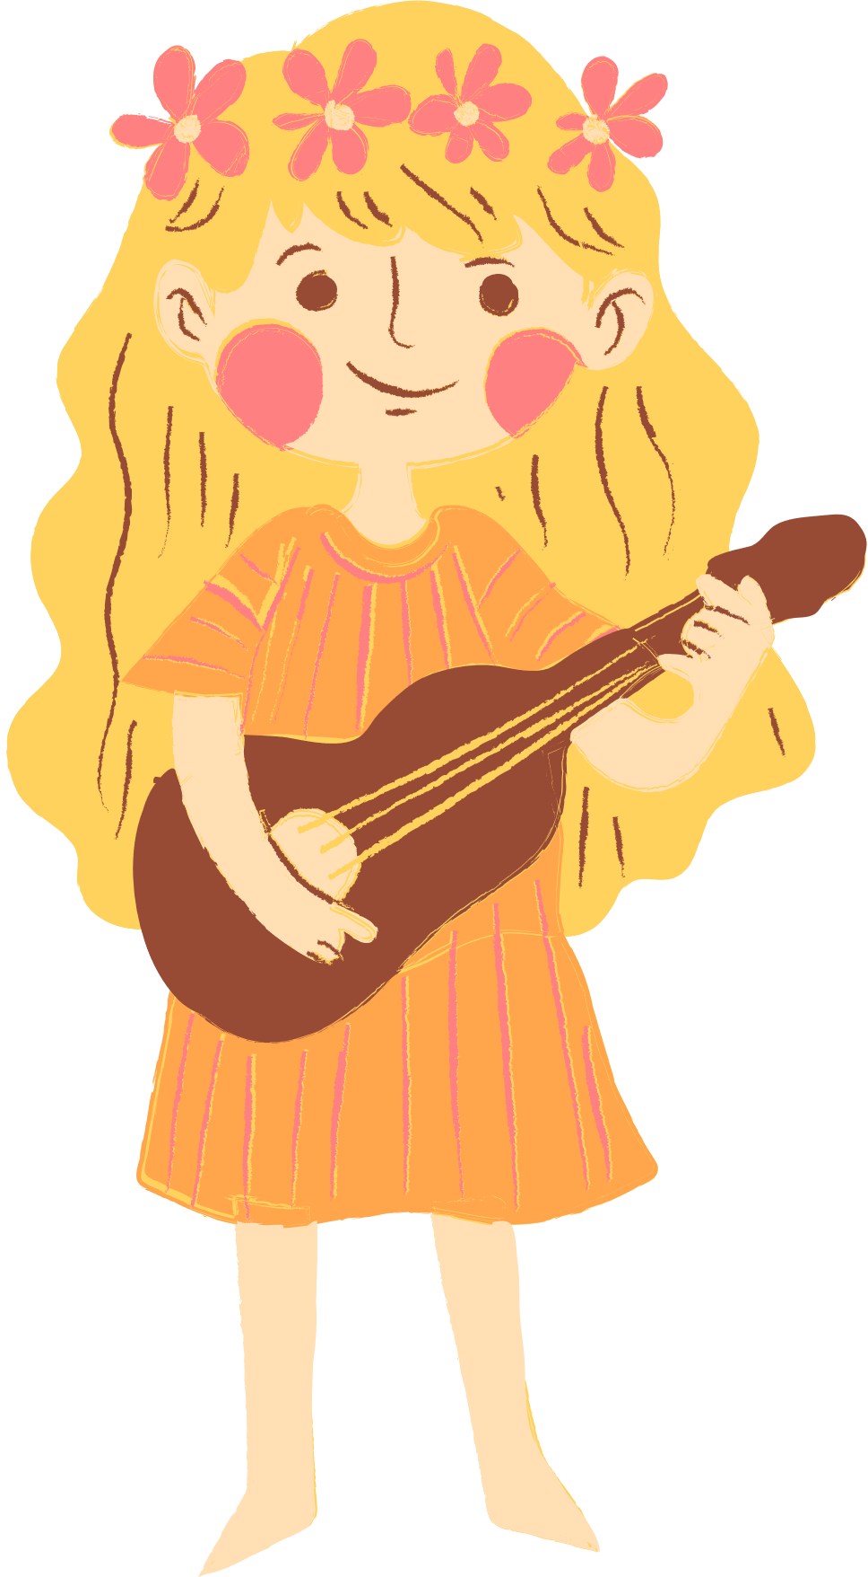
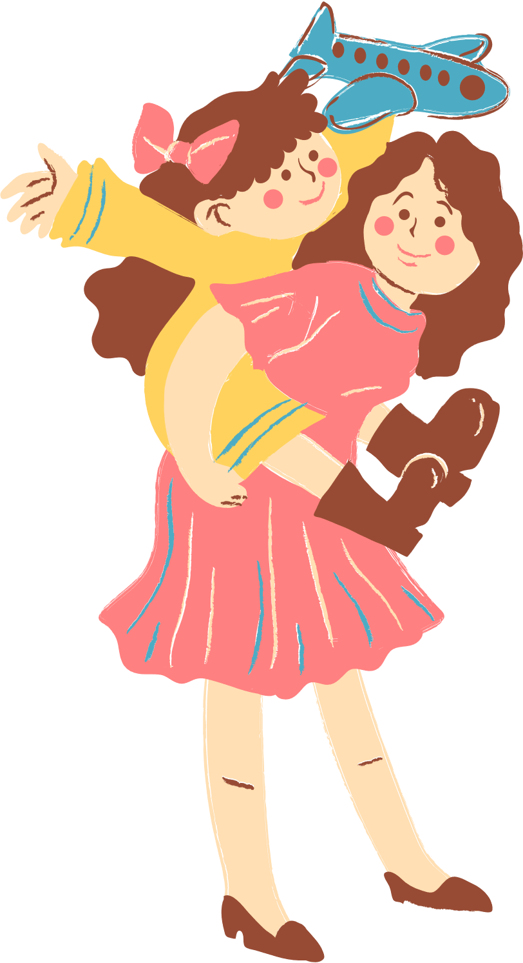
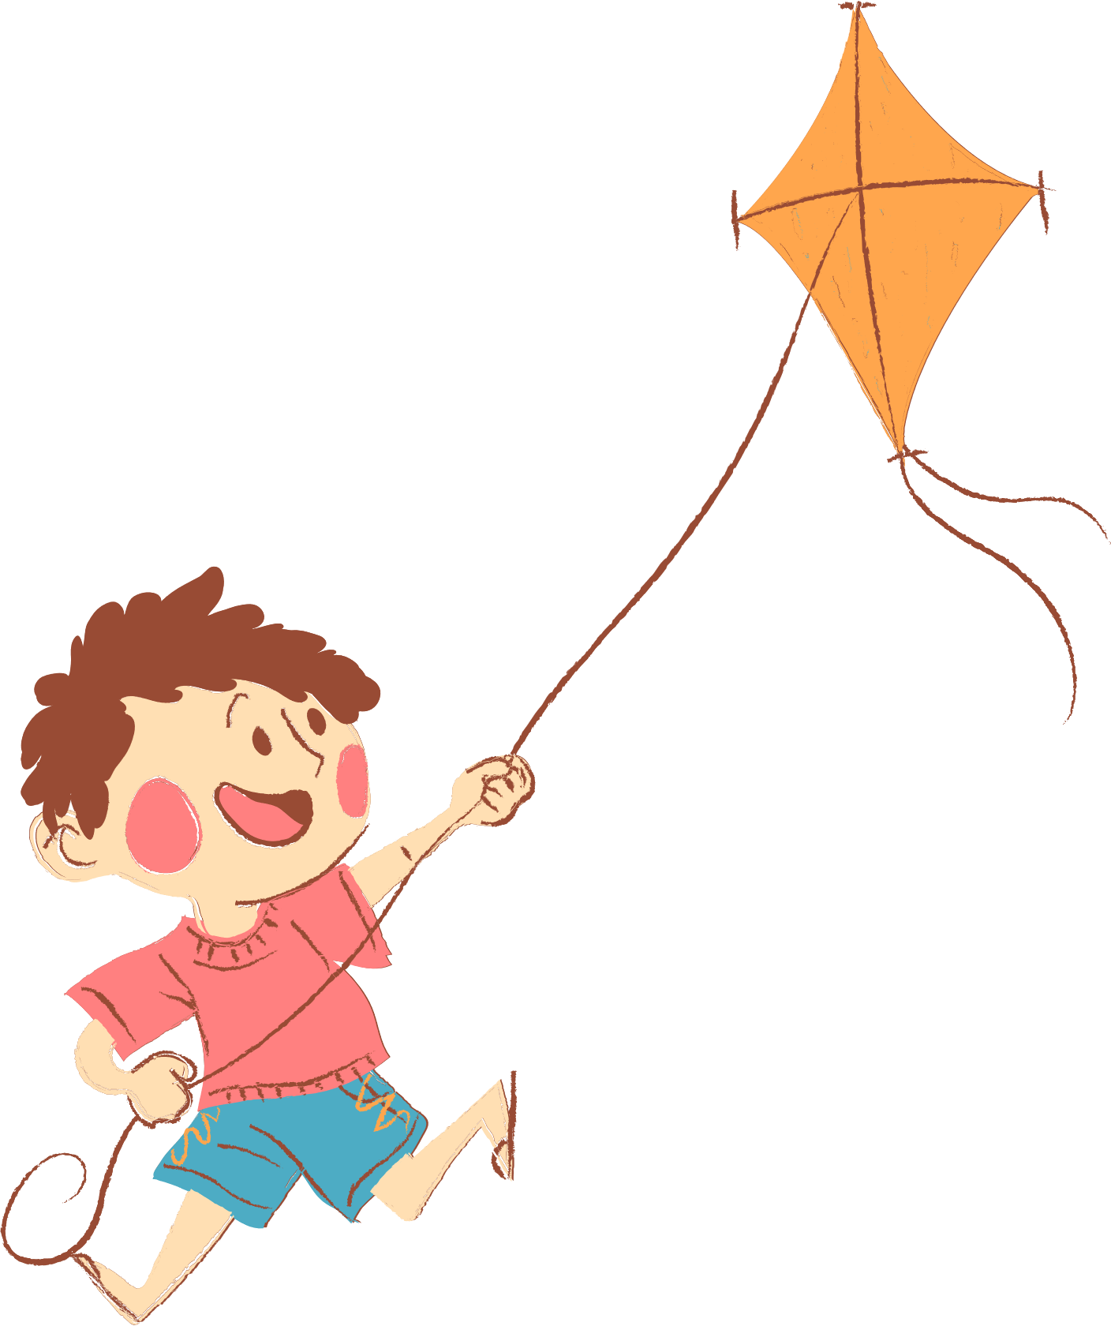
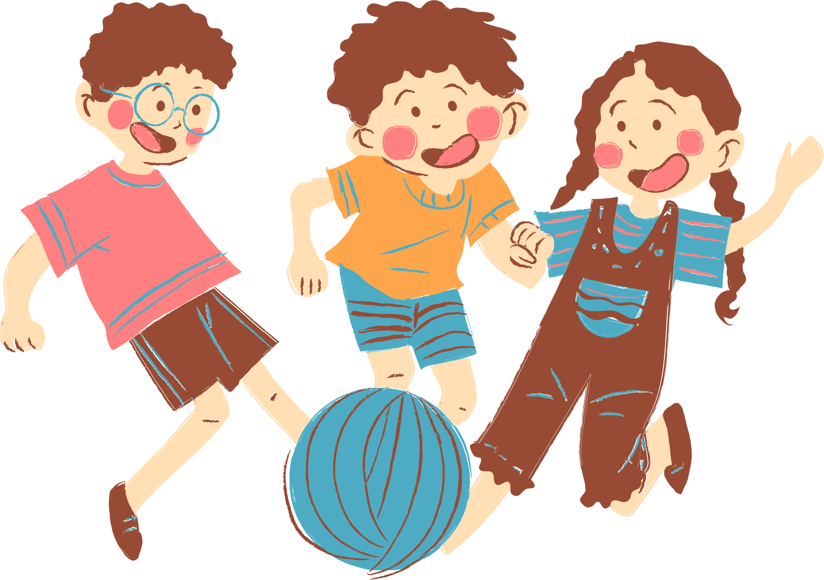
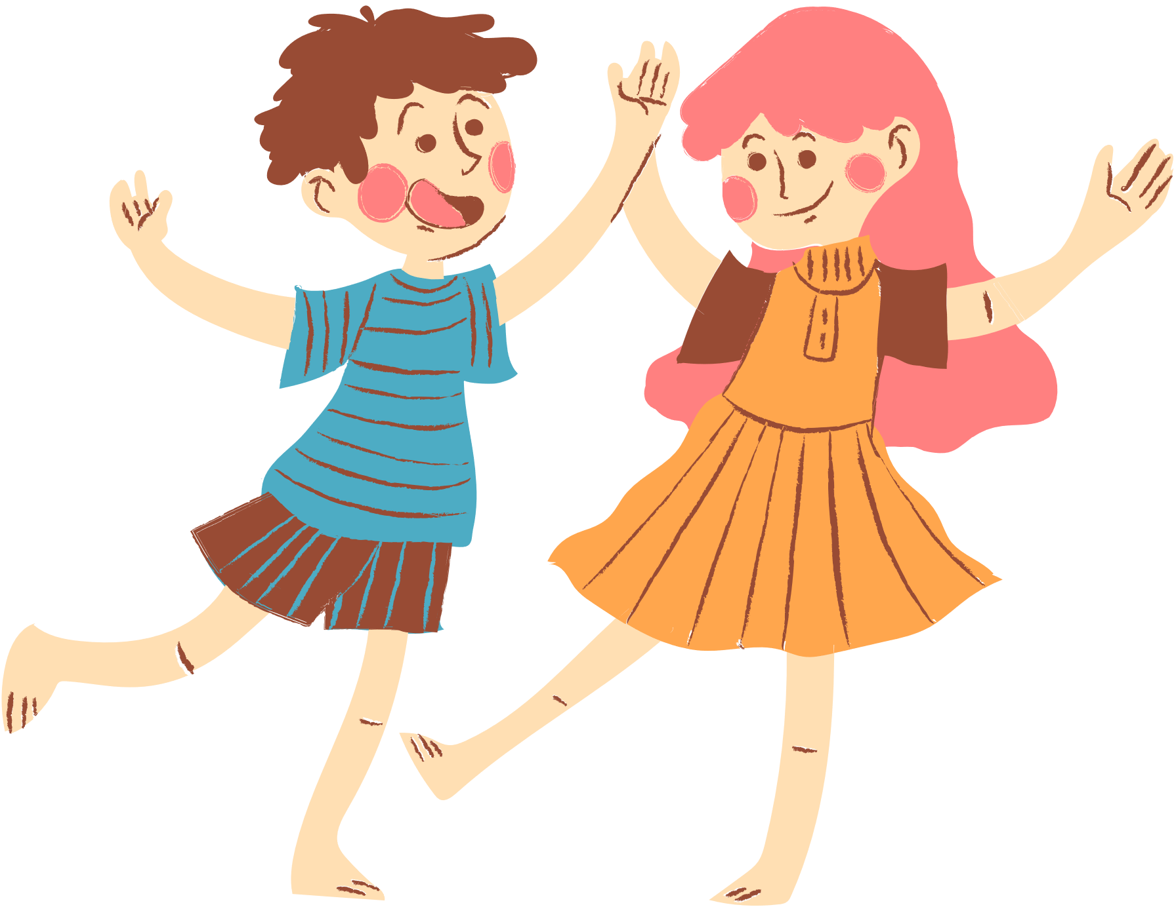
01. Warm-up and Review

Slide 3





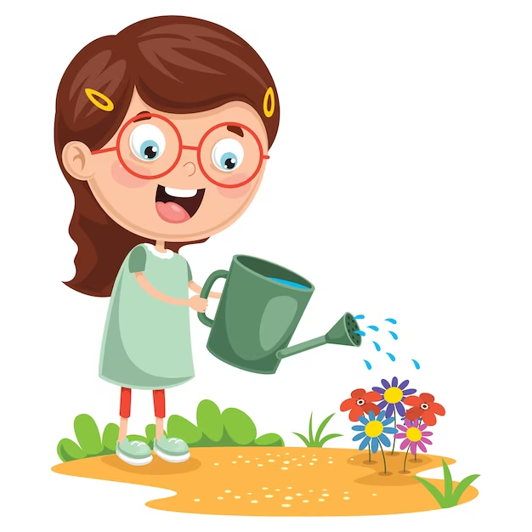
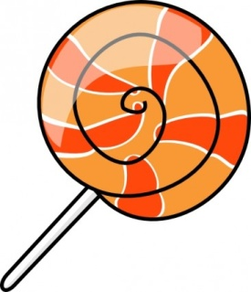
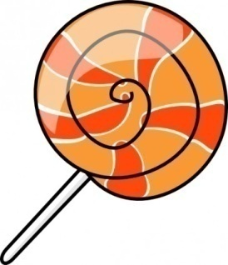



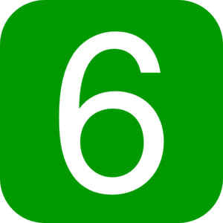
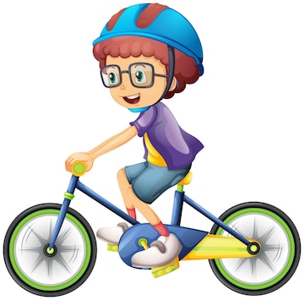
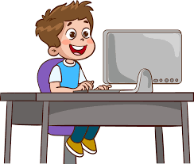
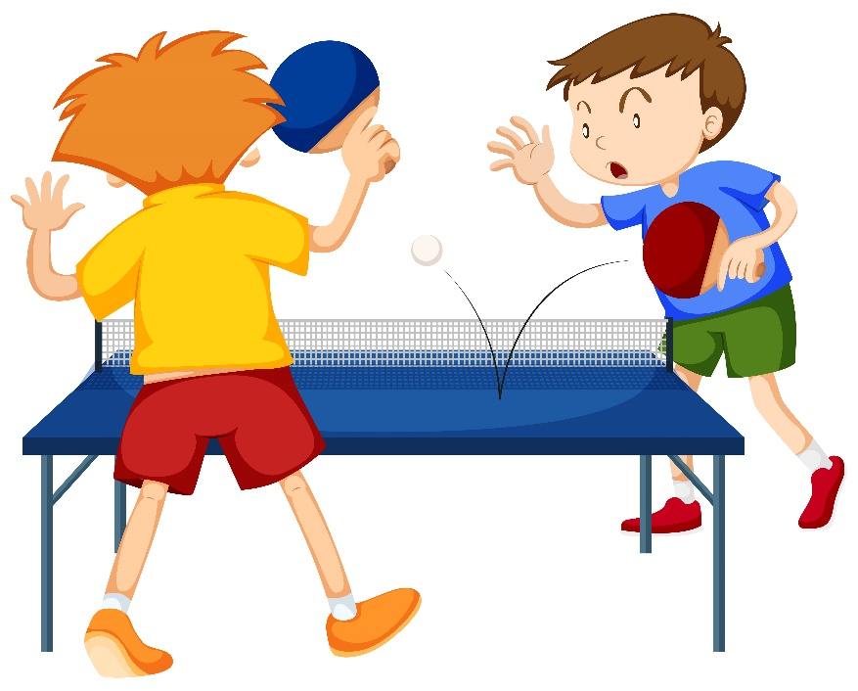
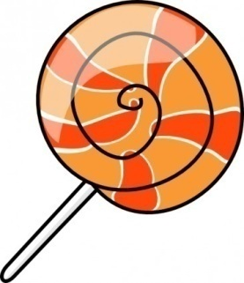

Slide 4
02. Look, listen and repeat.

Slide 5


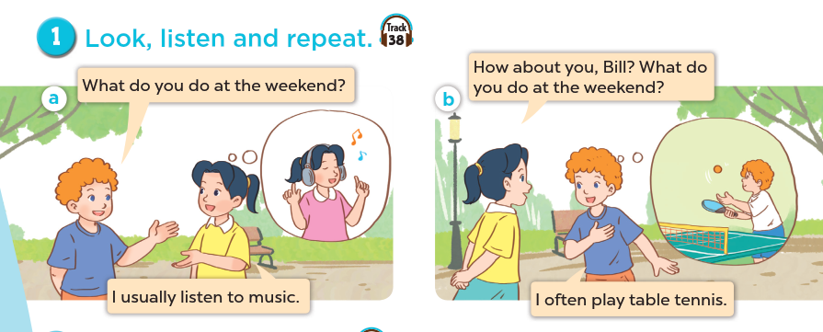
Who are they?
What are they doing?
Where are they?

Slide 6
03. Listen, point and say.

Slide 7
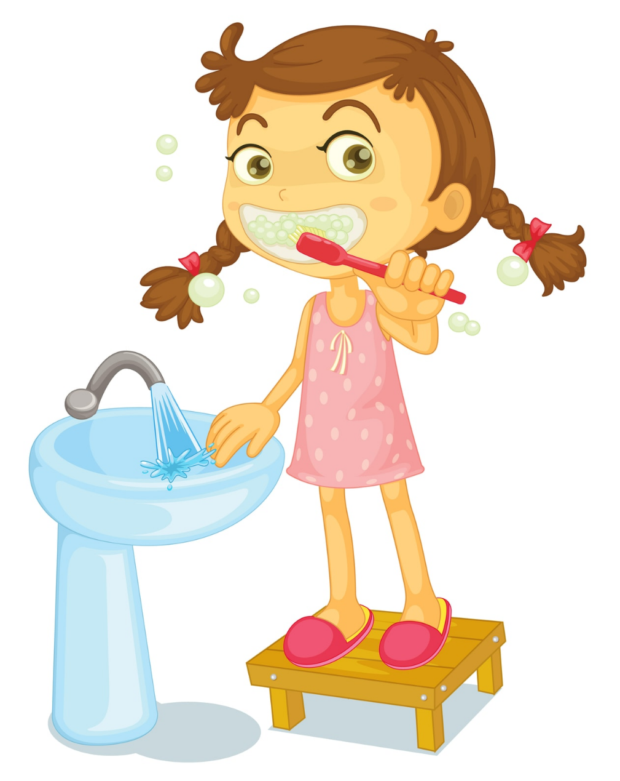

Sun
Mon
Tue
Wed
Thu
Fri
Sat
We always brush my teeth in the morning.

Slide 8

Sun
Mon
Tue
Wed
Thu
Fri
Sat
She usually go to school by bus.

Slide 9
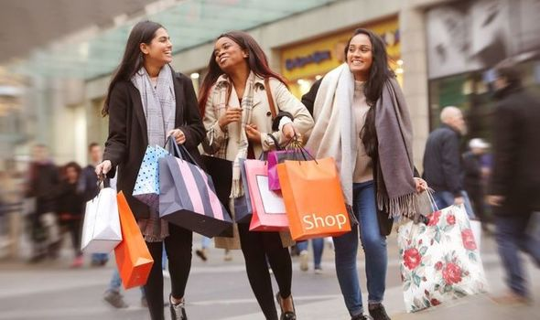
Mon | Tue | Wed | Thu | Fri | Sat | Sun
 | 1 | 2 | 3 | 4 | 5 | 6
7 | 8 | 9 | 10 | 11 | 12 | 13
14 | 15 | 16 | 17 | 18 | 19 | 20
21 | 22 | 23 | 24 | 25 | 26 | 27
28 | 29 | 30 | 31
We often go shopping on Sundays.

Slide 10
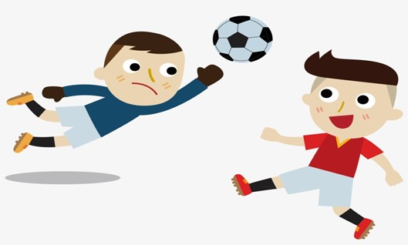
Sun
Mon
Tue
Wed
Thu
Fri
Sat
He sometimes plays football in his free time.

Slide 11

Remember:
always
usually
often
sometimes
0 %
100 %
90 %
70 %
50 %

Slide 12
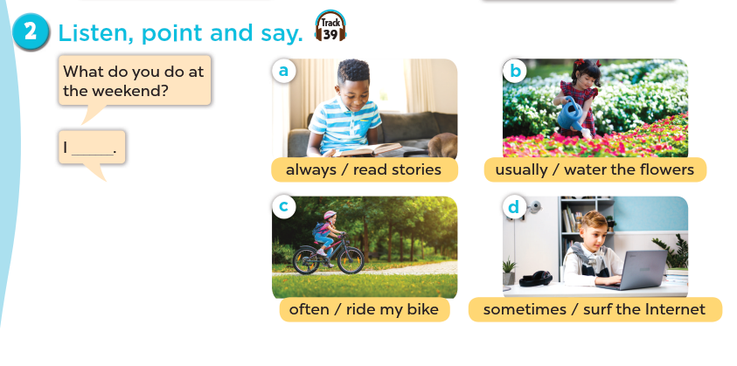

Slide 13
Extension

Slide 14
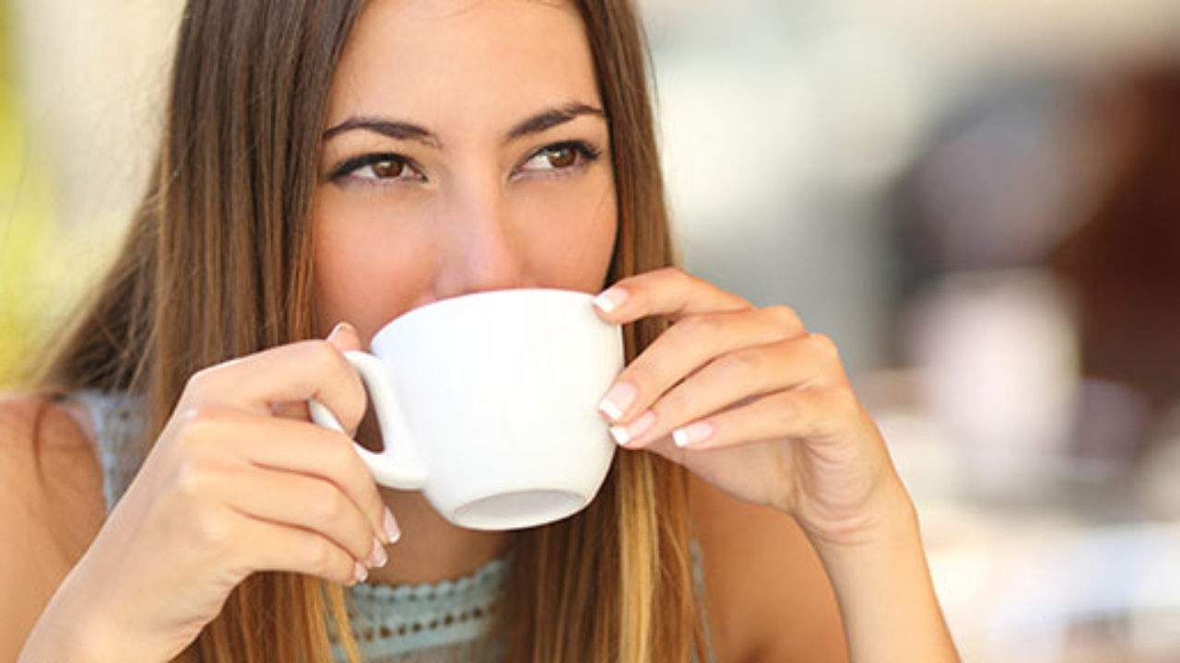
Mon | Tue | Wed | Thu | Fri | Sat | Sun
 | 1 | 2 | 3 | 4 | 5 | 6
7 | 8 | 9 | 10 | 11 | 12 | 13
14 | 15 | 16 | 17 | 18 | 19 | 20
21 | 22 | 23 | 24 | 25 | 26 | 27
28 | 29 | 30 | 31
My mother rarely drinks tea.

Slide 15
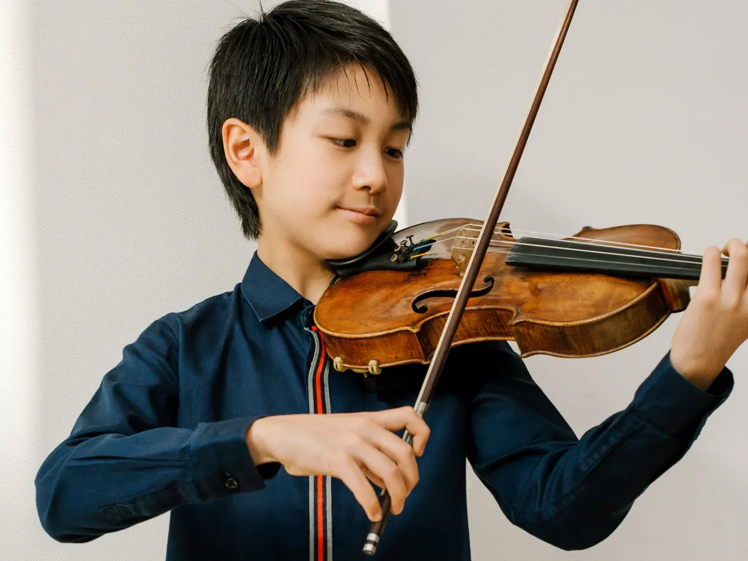
Mon | Tue | Wed | Thu | Fri | Sat | Sun
 | 1 | 2 | 3 | 4 | 5 | 6
7 | 8 | 9 | 10 | 11 | 12 | 13
14 | 15 | 16 | 17 | 18 | 19 | 20
21 | 22 | 23 | 24 | 25 | 26 | 27
28 | 29 | 30 | 31
My brother never plays the violin.

Slide 16
Remember:
always
usually
often
sometimes
rarely
never
100 %
90 %
70 %
50 %
5 %
0 %

Slide 17
04. Let’s talk

Slide 18
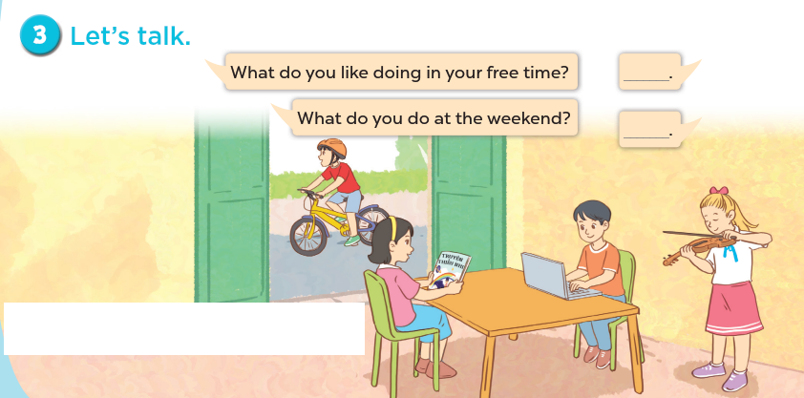

Slide 19
05. Fun corner and Wrap-up
Game: Who has more correct answers?

Slide 20
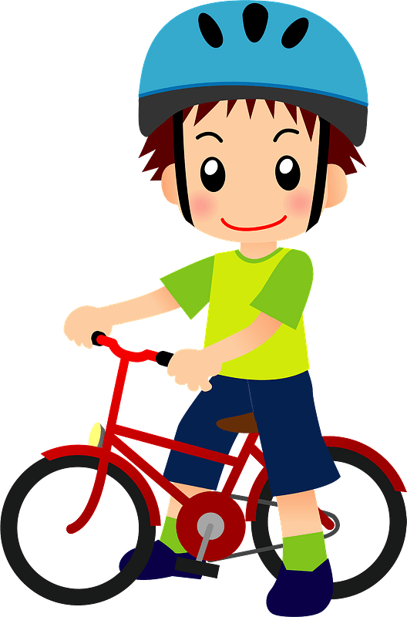
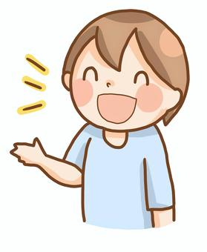

1. What do you do at the weekend?
100 %
I ……………… ride my bike.
A. always
B. never
C. usually

Slide 21


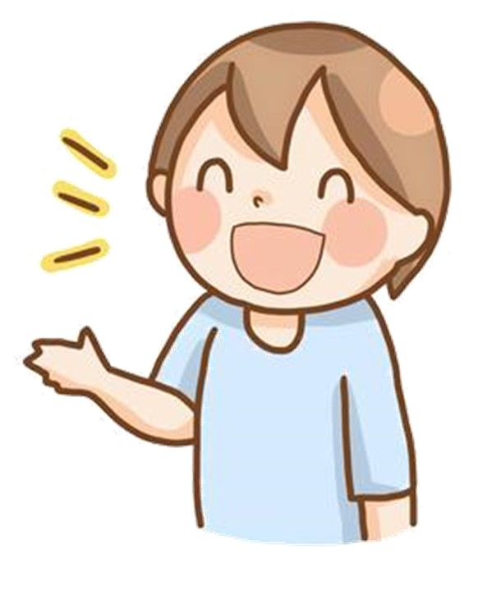
2. What do you do at the weekend?
50 %
I …………………… surf the Internet.
A. often
B. rarely
C. sometimes

Slide 22
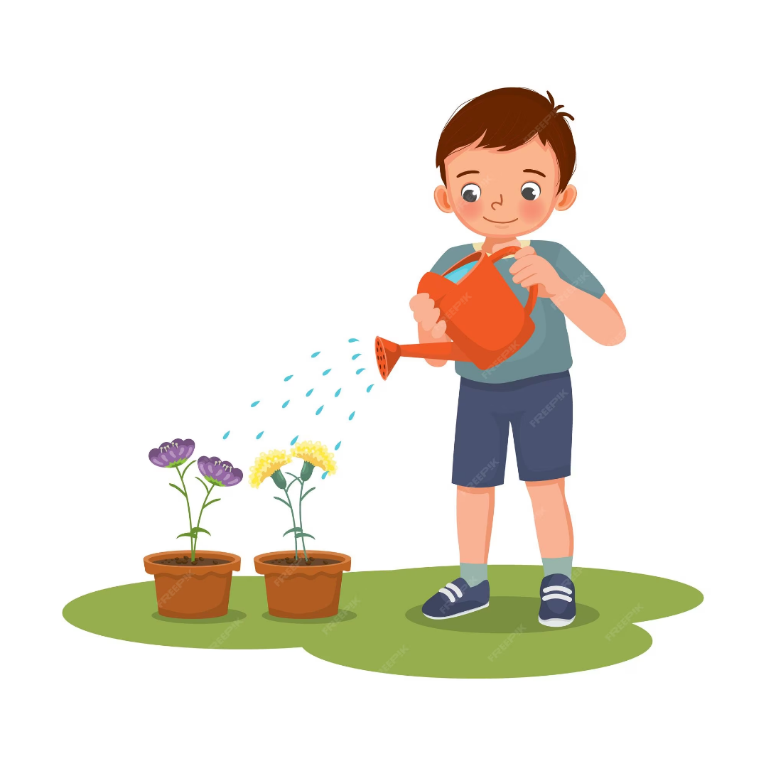
5 %
3. What do you do at the weekend?
I ……………. water the flowers.
A. always
B. rarely
C. often

Slide 23

4. What do you do at the weekend?
90 %
I …………………. read stories.
A. sometimes
B. never
C. usually

Slide 24
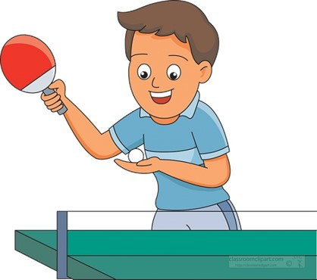
5. What do you do at the weekend?
0 %
I ……………… play table tennis.
A. never
B. often
C. usually

Slide 25
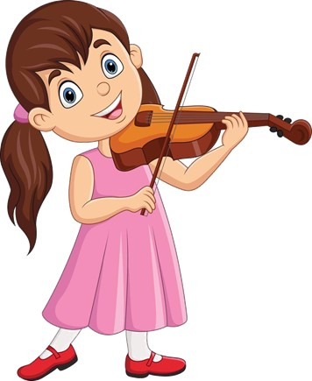
6. What do you do at the weekend?
70 %
I …………………… play the violin.
A. always
B. sometimes
C. often

Slide 26

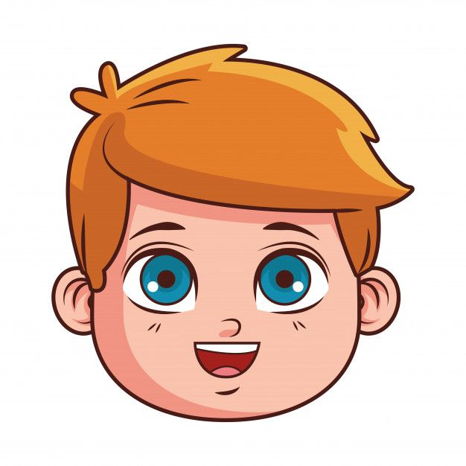
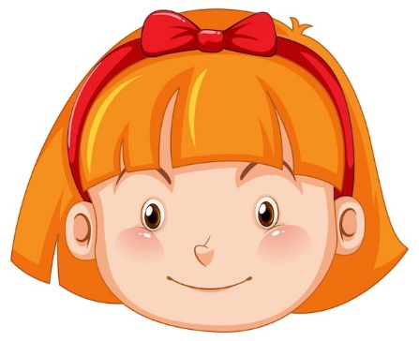
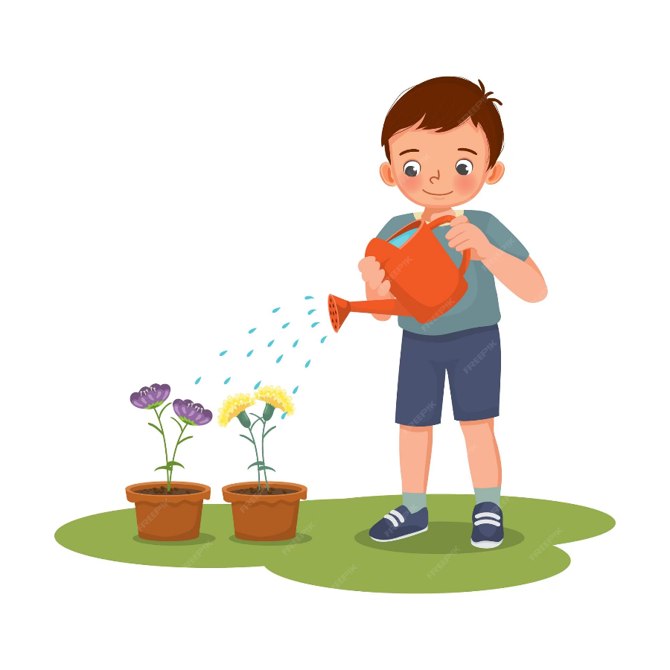


Pair work
What do you do at the weekend?
I …….. ……….

