Slide 2




UBND QUẬN DƯƠNG KINH
TRƯỜNG TIỂU HỌC ANH DŨNG
ENGLISH - GRADE 5
UNIT 5: MY FUTURE JOB
LESSON 1 (1, 2, 3)

Slide 3





01.
Warm-up
and Review

Slide 4
Quiz game

Slide 5







He cooks food in the restaurant. Who is he?
cook
pupil
pupil

Slide 6

She works at school. She teaches pupils. Who is she?
actor
teacher

Slide 7

He works in a police station. Who is he?
cook
policeman

Slide 8

She takes care of sick people.
Who is she?
doctor
farmer

Slide 9

She’s young, she studies at school. Who is she?
pupil
teacher

Slide 10

She works on a farm. Who is she?
policeman
farmer

Slide 11

He can sing very well. Who is he?
actor
singer

Slide 12
02.
Look, listen and repeat.

Slide 13


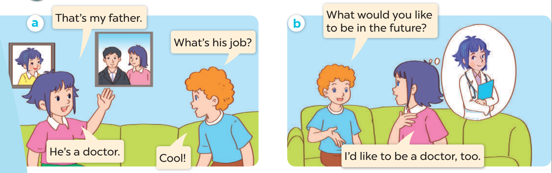

Listen and repeat.

Slide 14
03.
Listen, point and say.

Slide 15
New words
Look, listen and repeat.

Slide 16





firefighter

Slide 17

writer

Slide 18

gardener

Slide 19

reporter

Slide 20
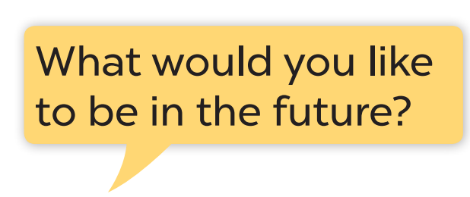
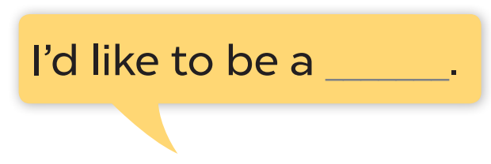
Listen and repeat.

Slide 22
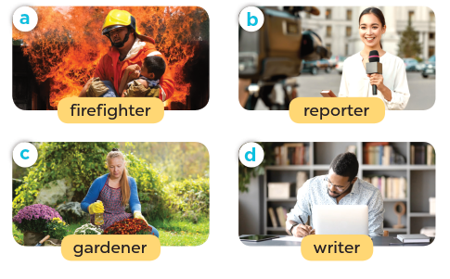
Listen, point and say.

Slide 23
03.
Let’s talk.

Slide 24
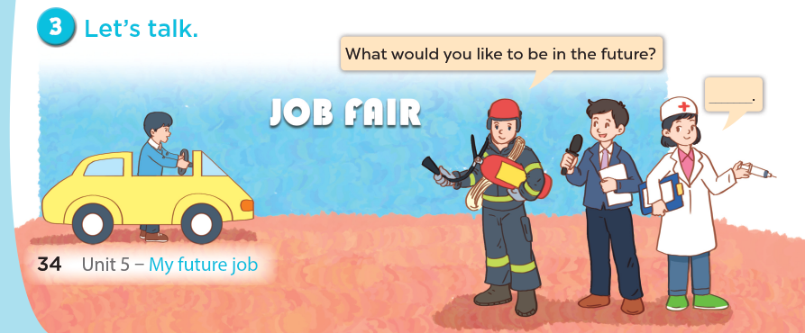

Slide 25
04.
Fun corner and Wrap-up

Slide 26
PASS THE BALL!

Slide 27
HOW TO PLAY
Pass the balls: When the music stops, whoever has a ball must stand up and either ask or answer the question on the screen.
Notes:
GV có thể thay tranh khác hoặc bỏ tranh để hs nói về mình.

Slide 28
PASS THE BALL!
STOP!

Slide 29

QUESTION:
ANSWER: here
gardener.

Slide 30
PASS THE BALL!
STOP!

Slide 31

QUESTION: Question here
ANSWER: here
firefighter.

Slide 32
PASS THE BALL!
STOP!

Slide 33

QUESTION: Question here
ANSWER: here
writer

Slide 34
PASS THE BALL!
STOP!

Slide 35

QUESTION: Question here
ANSWER: here
reporter.

Slide 36
PASS THE BALL!
STOP!

Slide 37

QUESTION: Question here
ANSWER: here
writer

Slide 38
PASS THE BALL!
STOP!

Slide 39
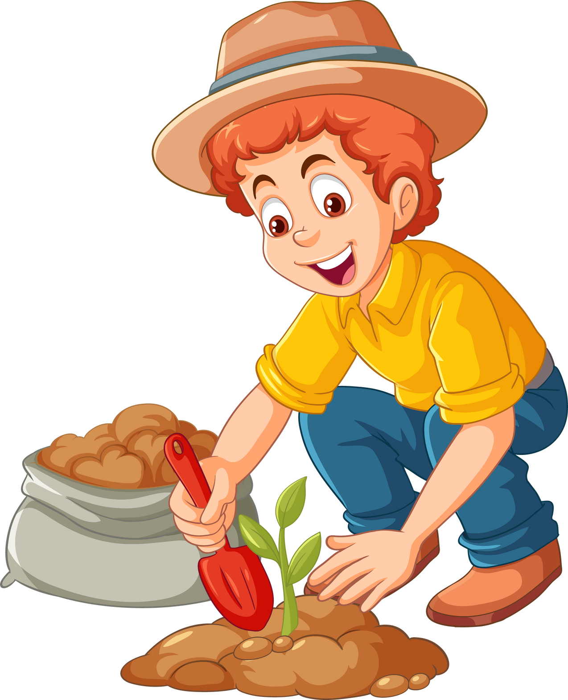
QUESTION: Question here
ANSWER: here
gardener.

Slide 40
PASS THE BALL!
STOP!

Slide 41

QUESTION: Question here
ANSWER: here
reporter.

Slide 42
PASS THE BALL!
STOP!

Slide 43

QUESTION: Question here
ANSWER: here
reporter.

Slide 44
PASS THE BALL!
STOP!

Slide 45

QUESTION: Question here
ANSWER: here
writer

