Slide 1





















Notes:
Để nguyên trang bìa như này, chỉ thay đổi tên bài trong quá trình làm. Logo của sách Wonderful World

Slide 2




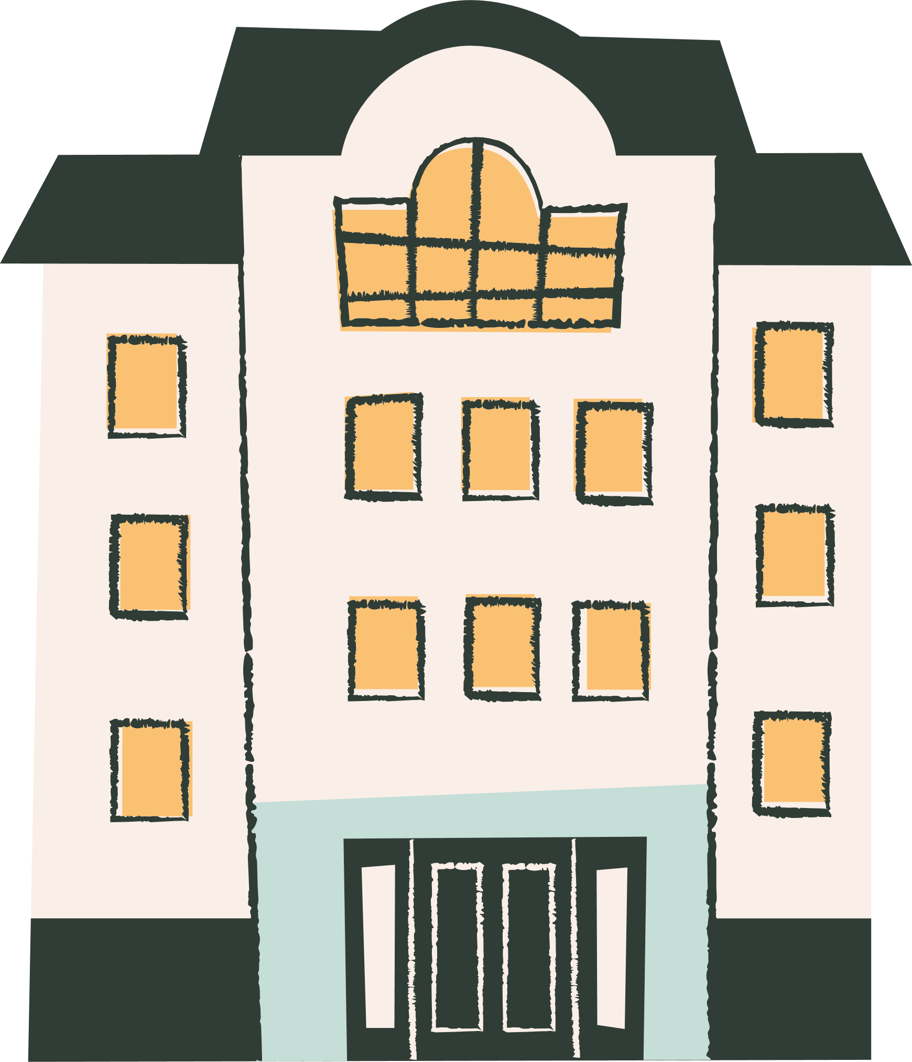



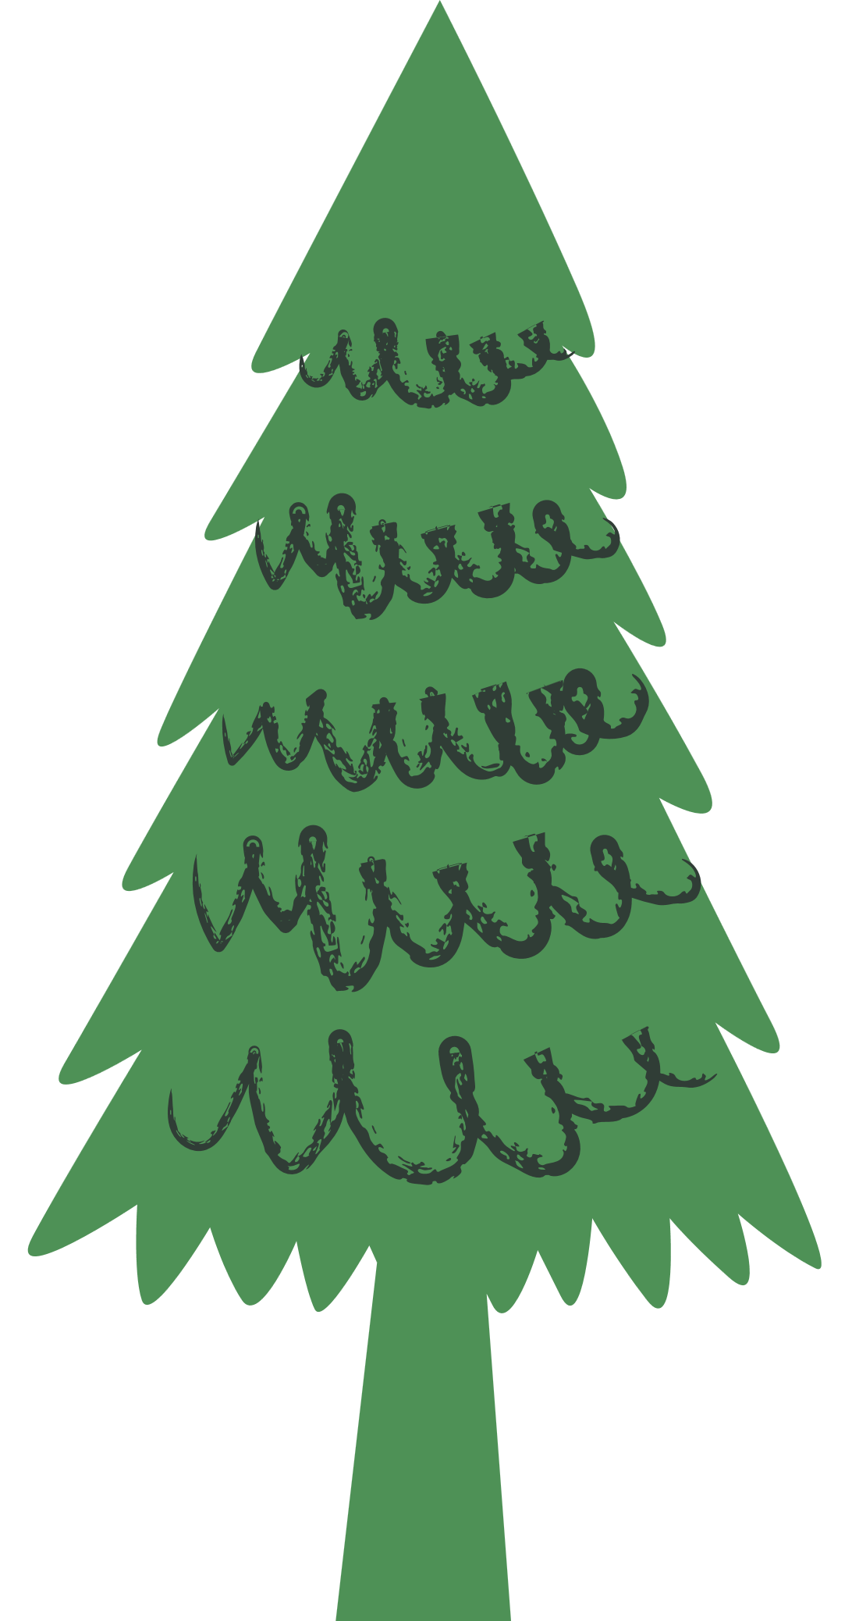

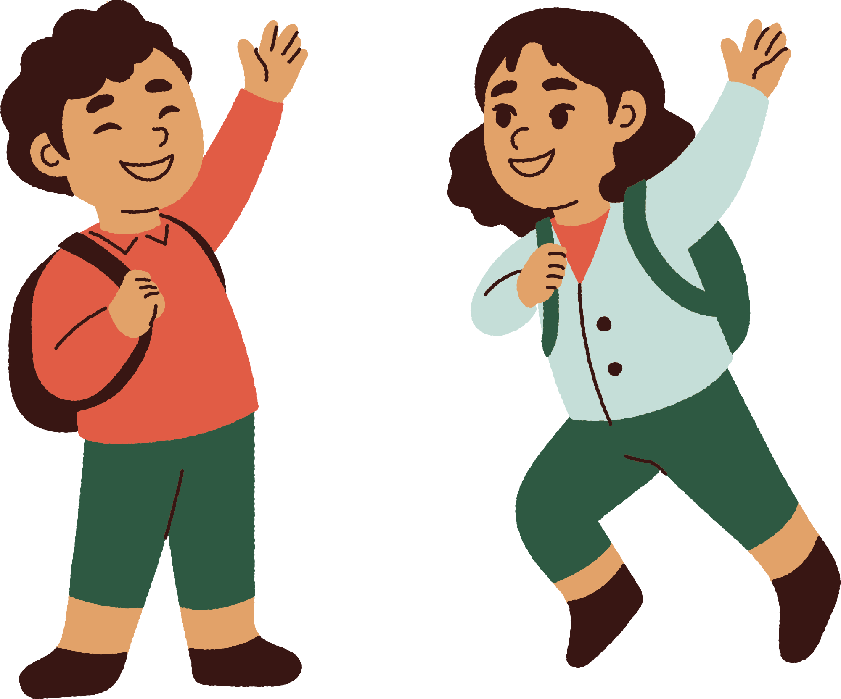



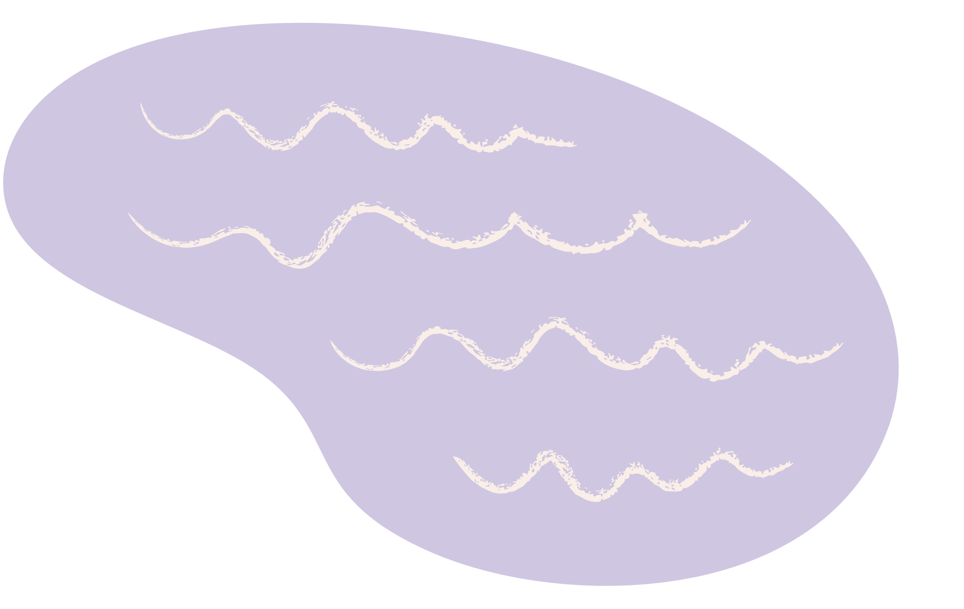
Unit 8
People and Places
LESSON 1 PART 1 2 3

Slide 3



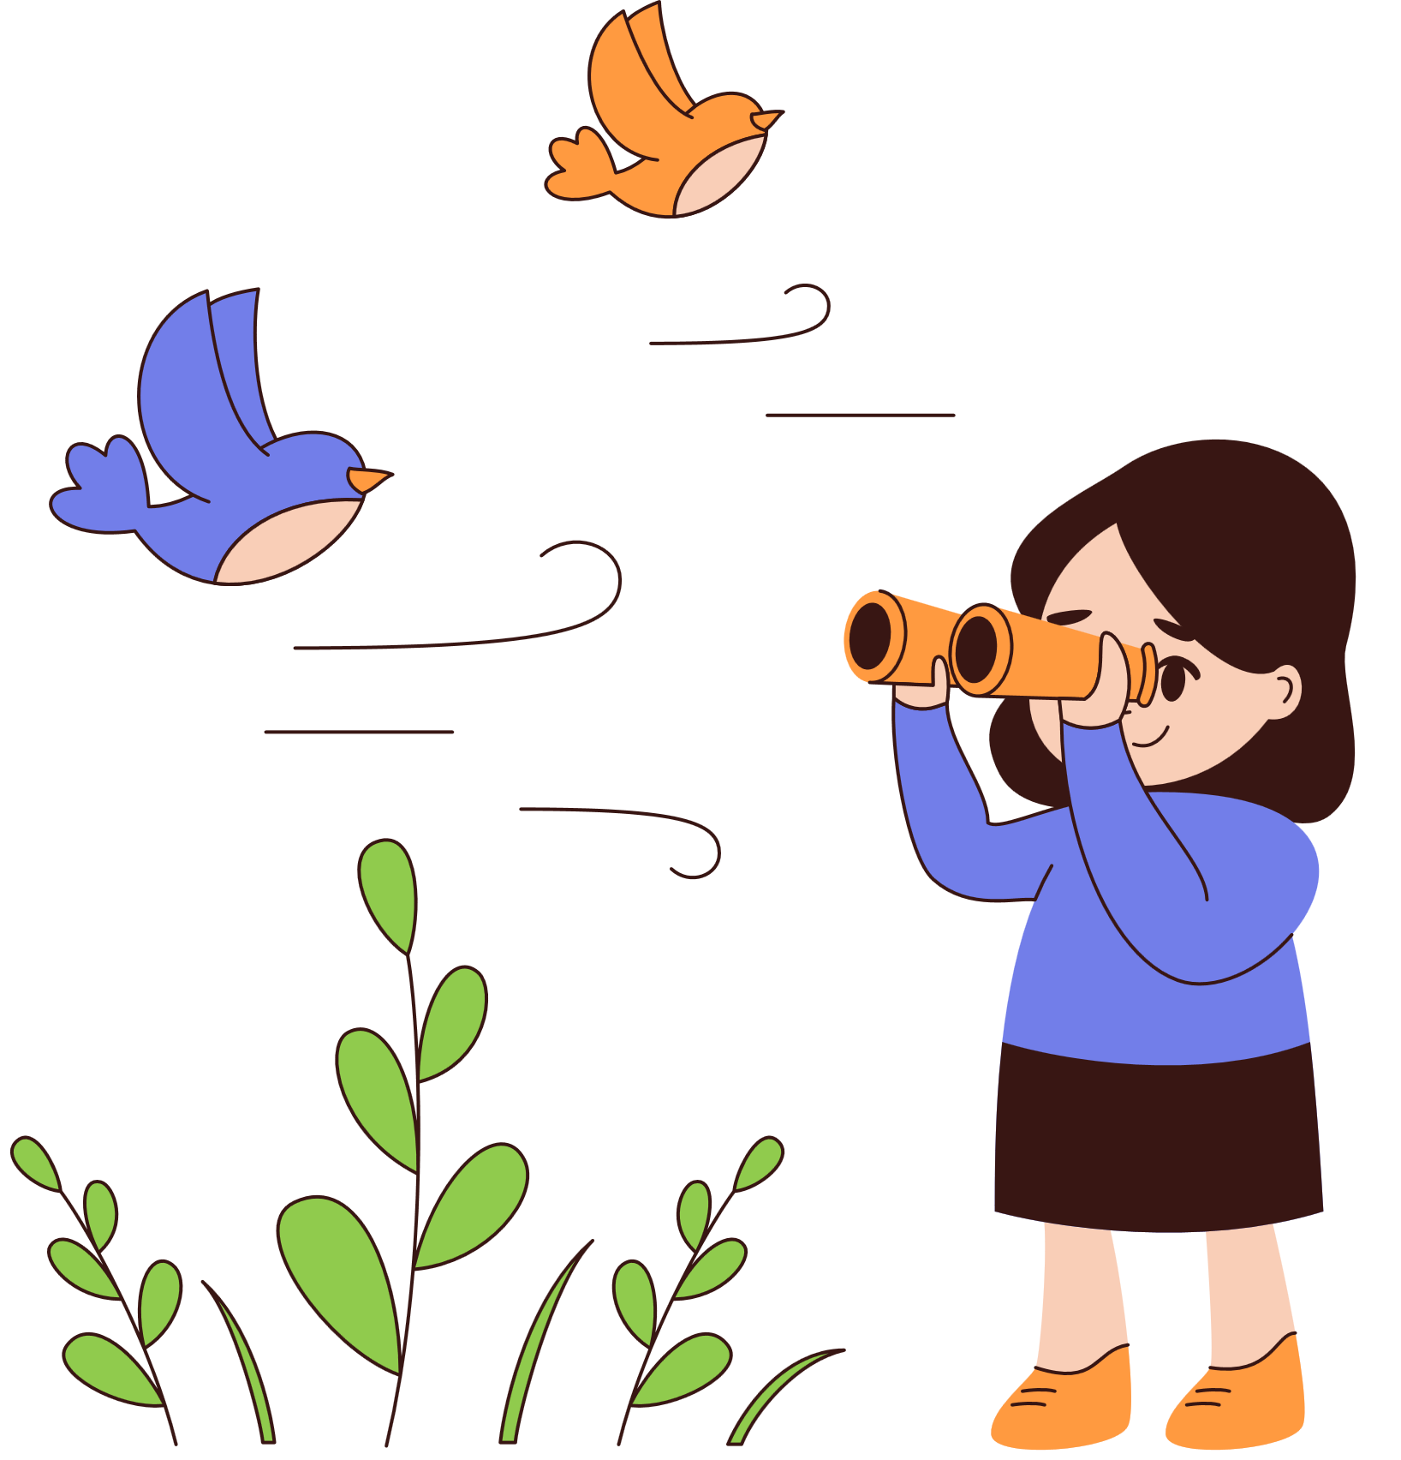

1
Warm-up

Slide 4
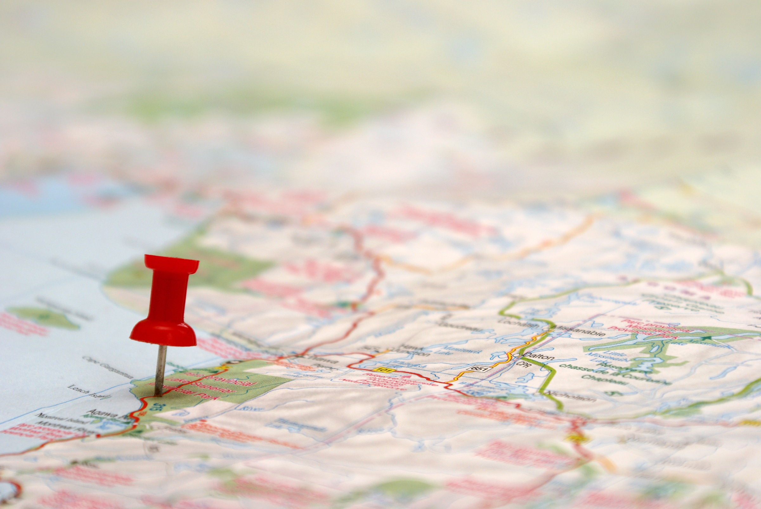

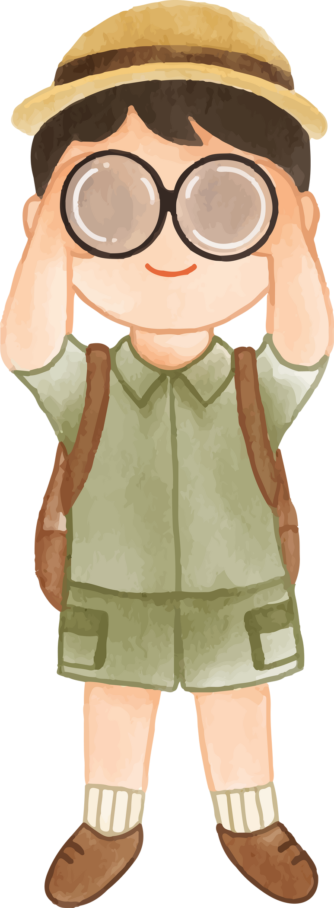

FAMOUS LANDMARKS

Slide 5


2
Presentation

Slide 6
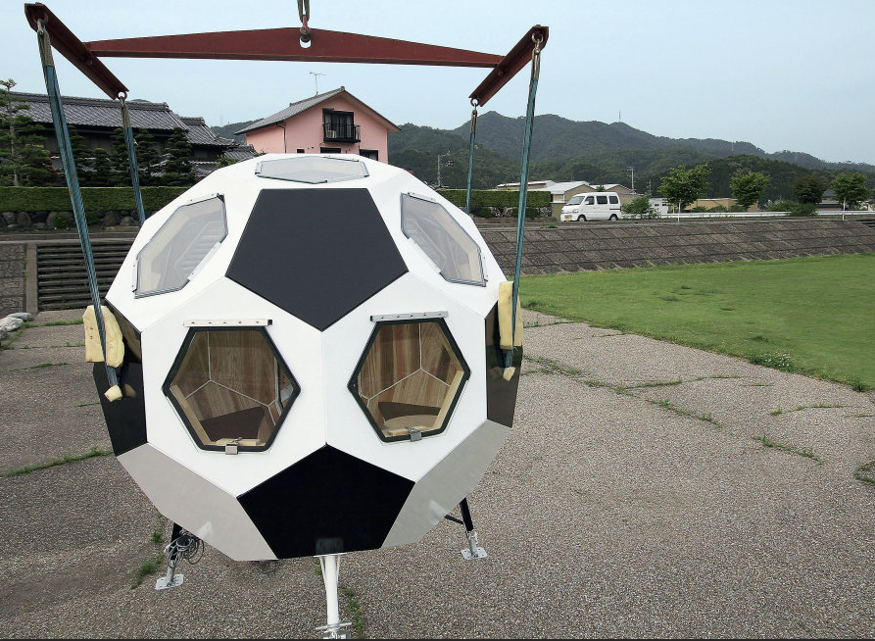

1 Listen and read. Would you like to live in a football-shaped house? Why or why not?
In Japan, some people live inside football-shaped houses. They’re very strong. They keep people safe in an earthquake or a flood. In these homes, the bedrooms are above the living room. You need to climb a ladder to get into bed. These houses haven’t got basements or balconies.
Each house has got 32 parts, just like a football. Some of them are windows, and some windows open to the sky. When you’re lying in bed at night, you’ve got great views of the stars.

Slide 7
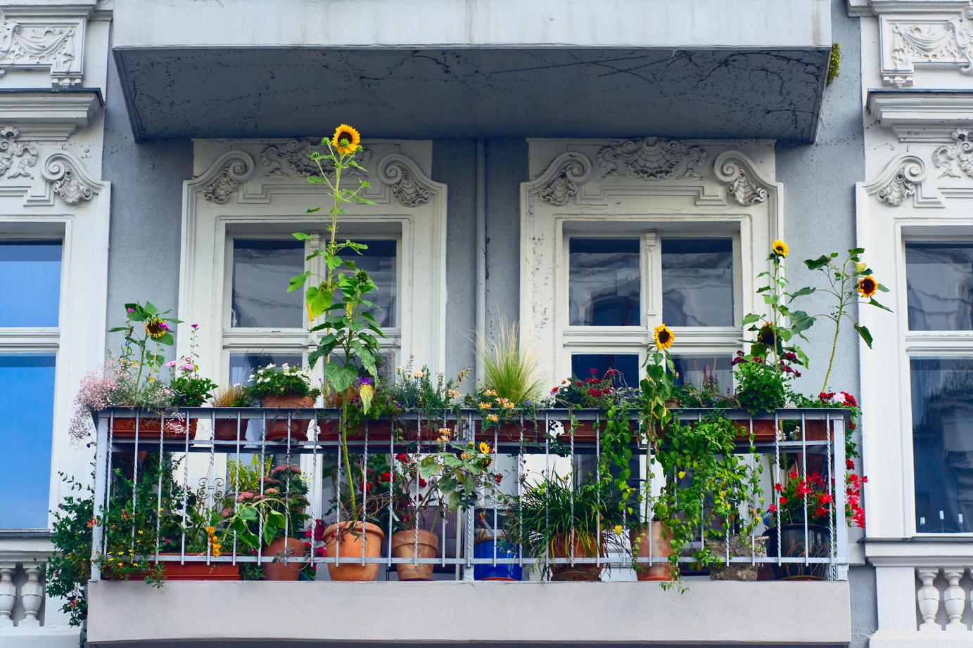


balcony
/ˈbæl.kə.ni

Slide 8
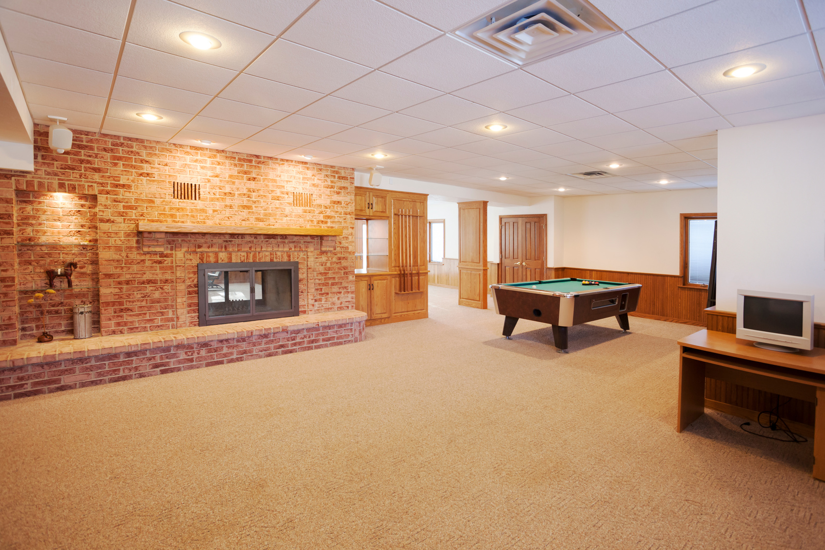
basement
/ˈbeɪs.mənt/

Slide 9
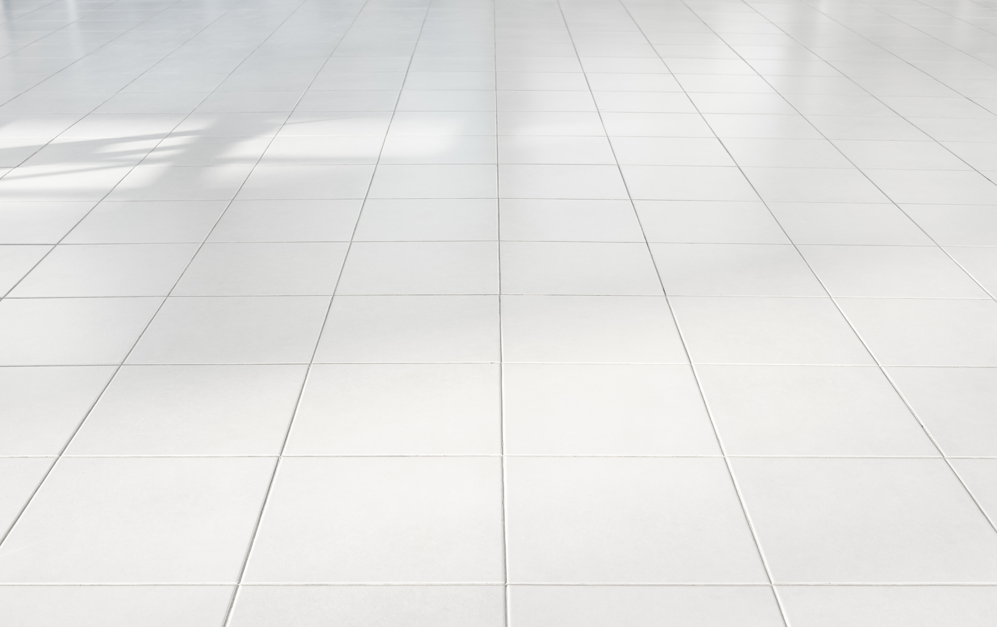
floor
/flɔːr/

Slide 10
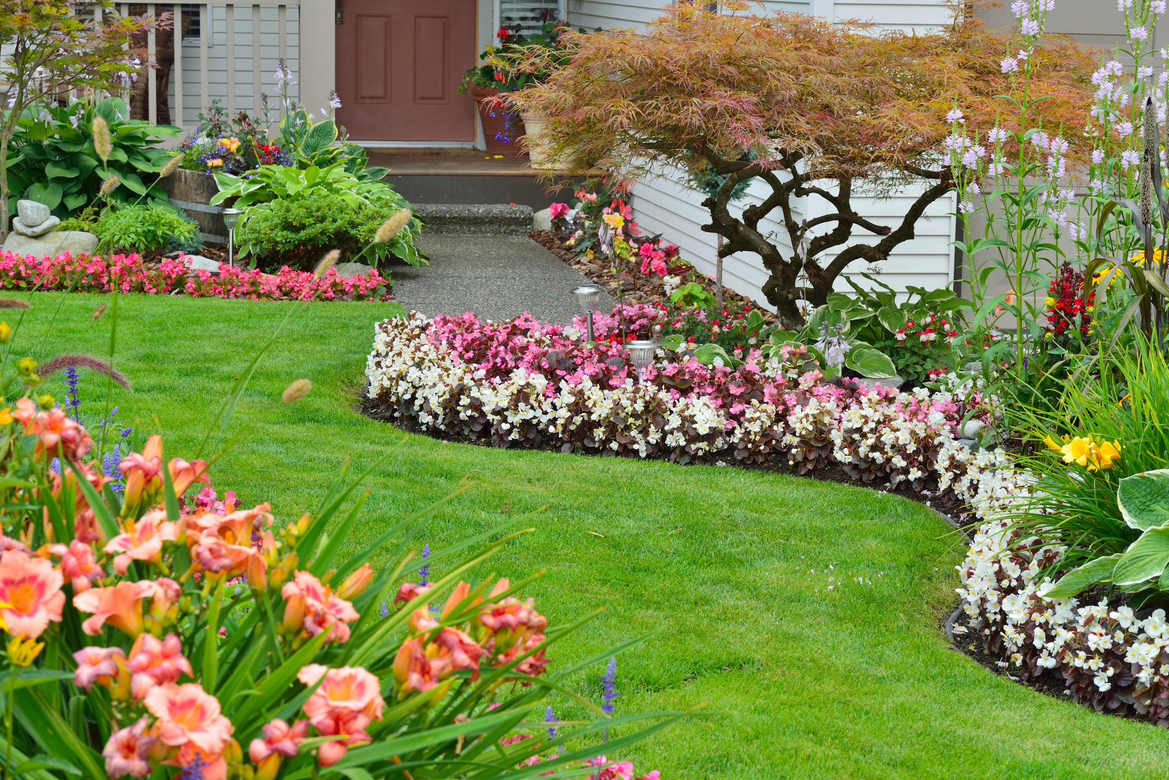
garden
/ˈɡɑː.dən/

Slide 11
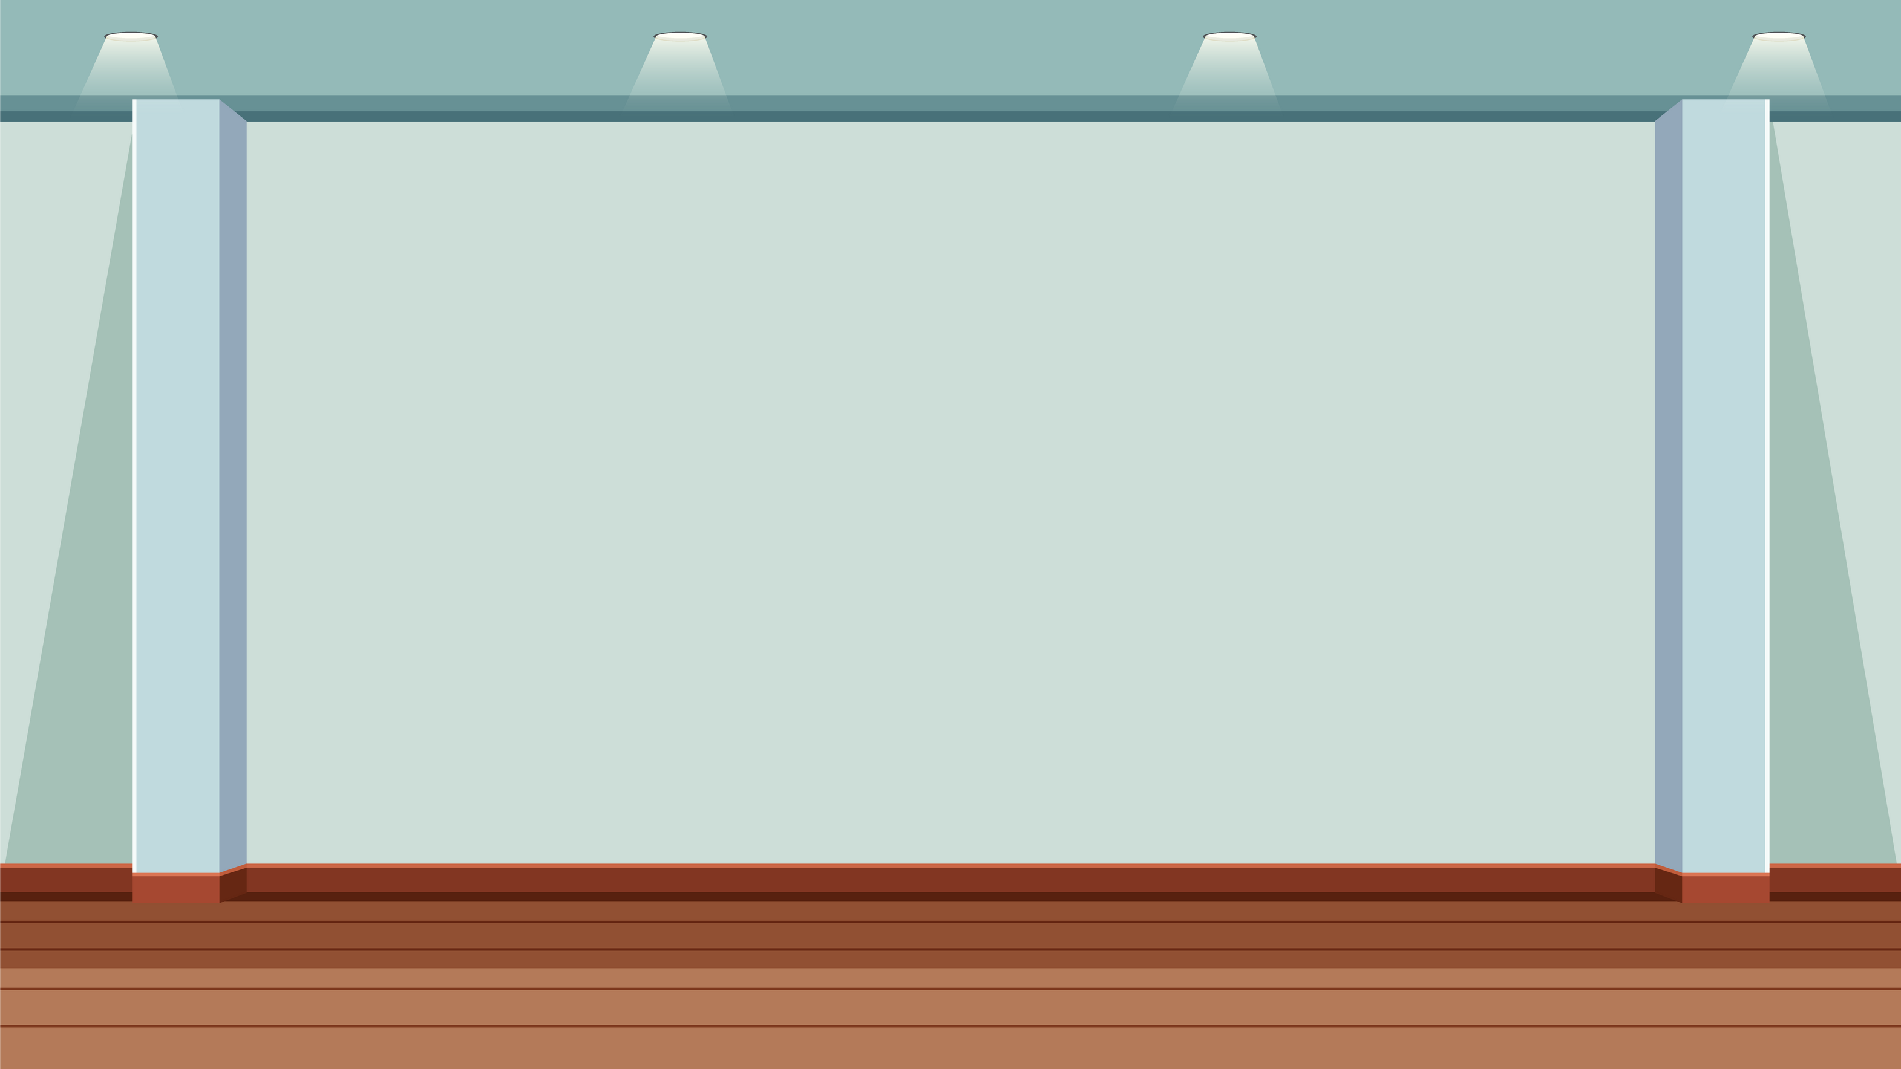
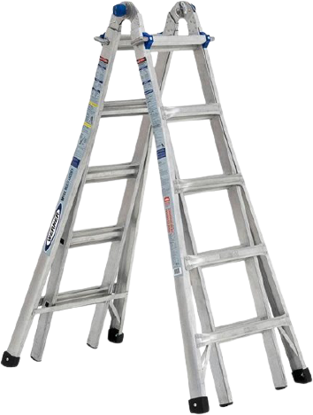
ladder
/ˈlæd.ər/

Slide 12
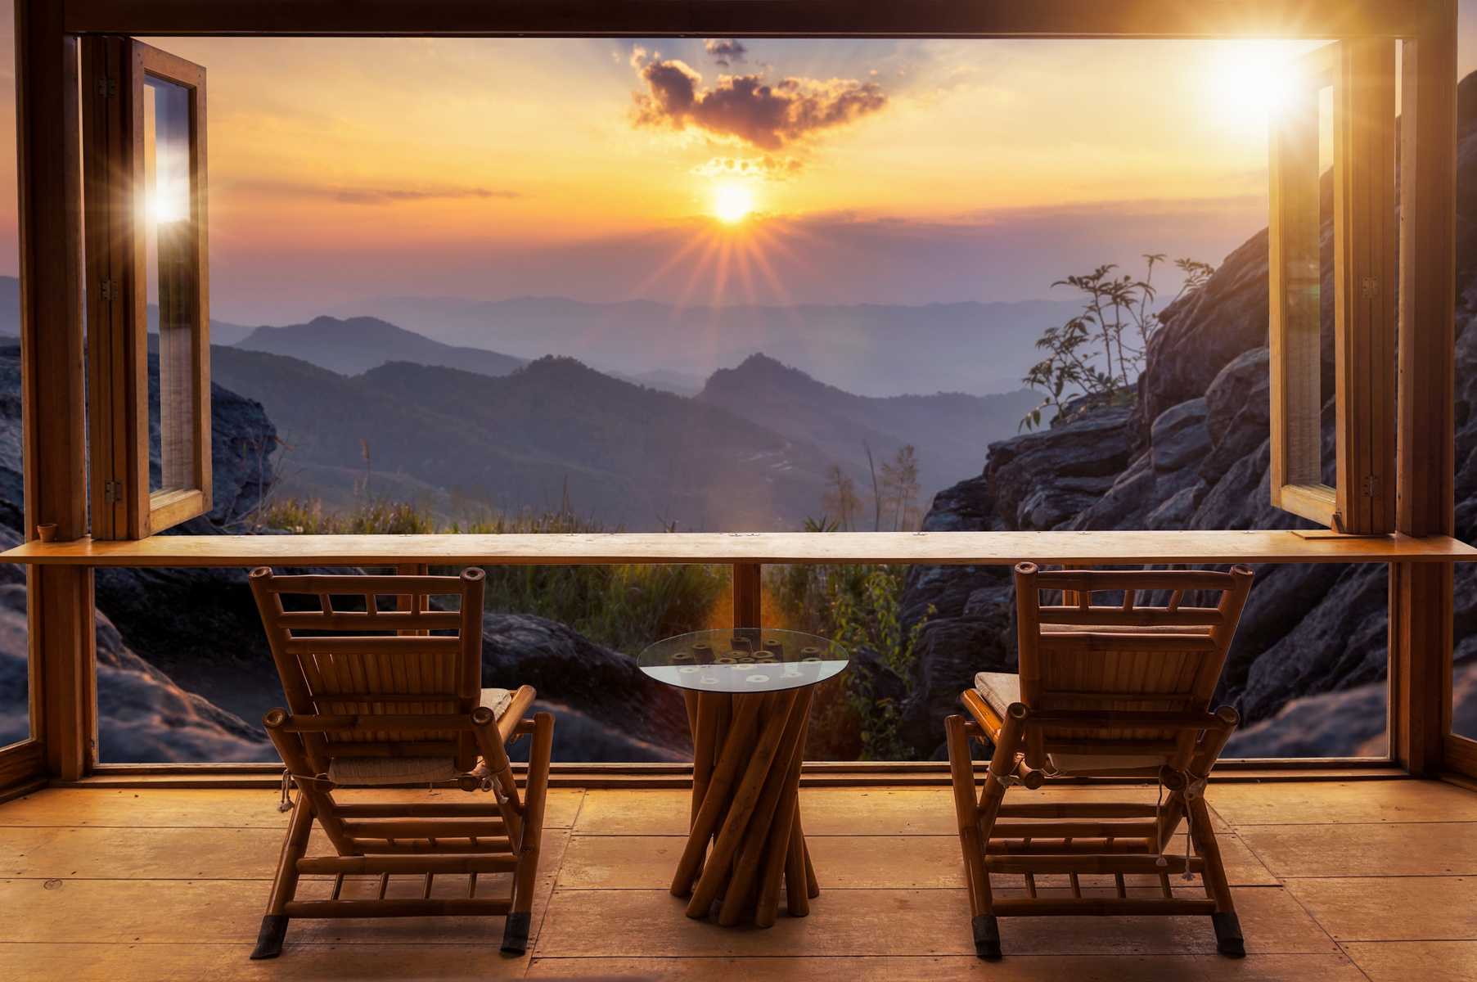
view
/vjuː/

Slide 13
3
Practice

Slide 14

Complete the sentences with these words
balcony basement garden
floor ladder
1 The __________ is high, so we’ve got a good view from it.
2 Mum keeps old things in the ____________ .
3 Our cat is in the tree. Please bring me a___________ , so I can get it down!
4 Our flat is on the fourth___________ of this building.
5 It’s a sunny day! Let’s have lunch in the___________.
balcony
basement
ladder
floor
garden

Slide 15
4
Production

Slide 16

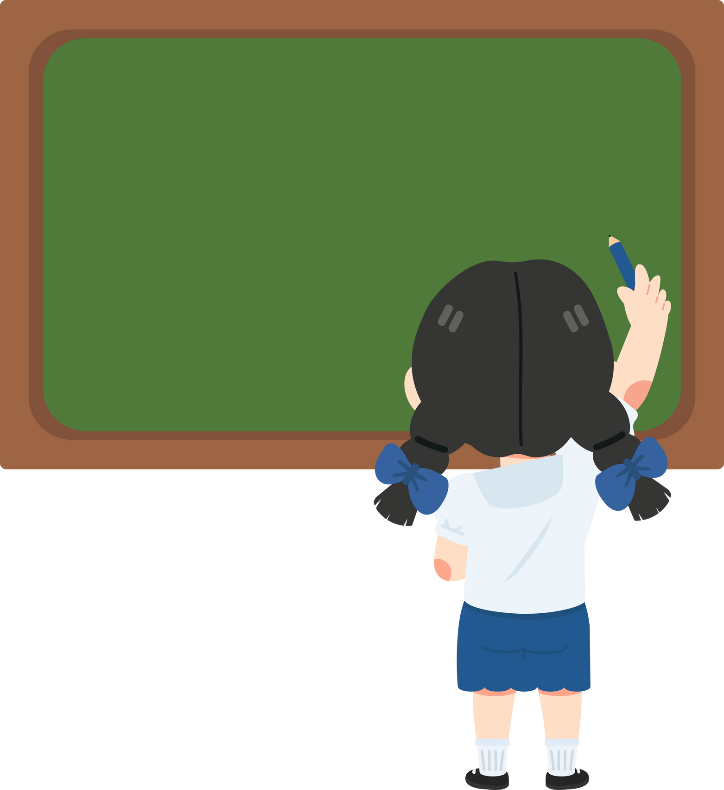

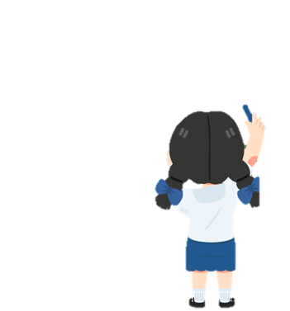





Let’s talk.
In pairs, draw your house
Choose some of them to draw:
balcony, garden, basement, floor, ladder

Slide 17







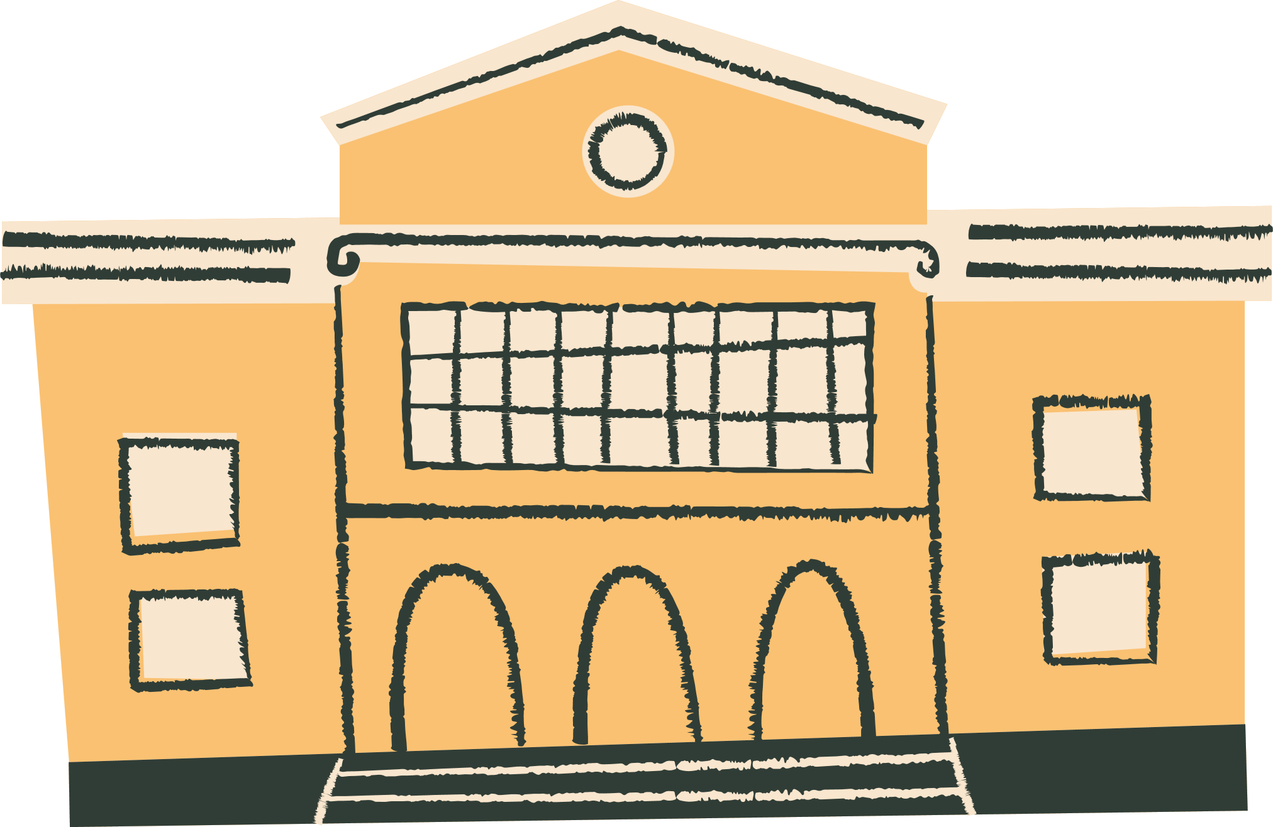




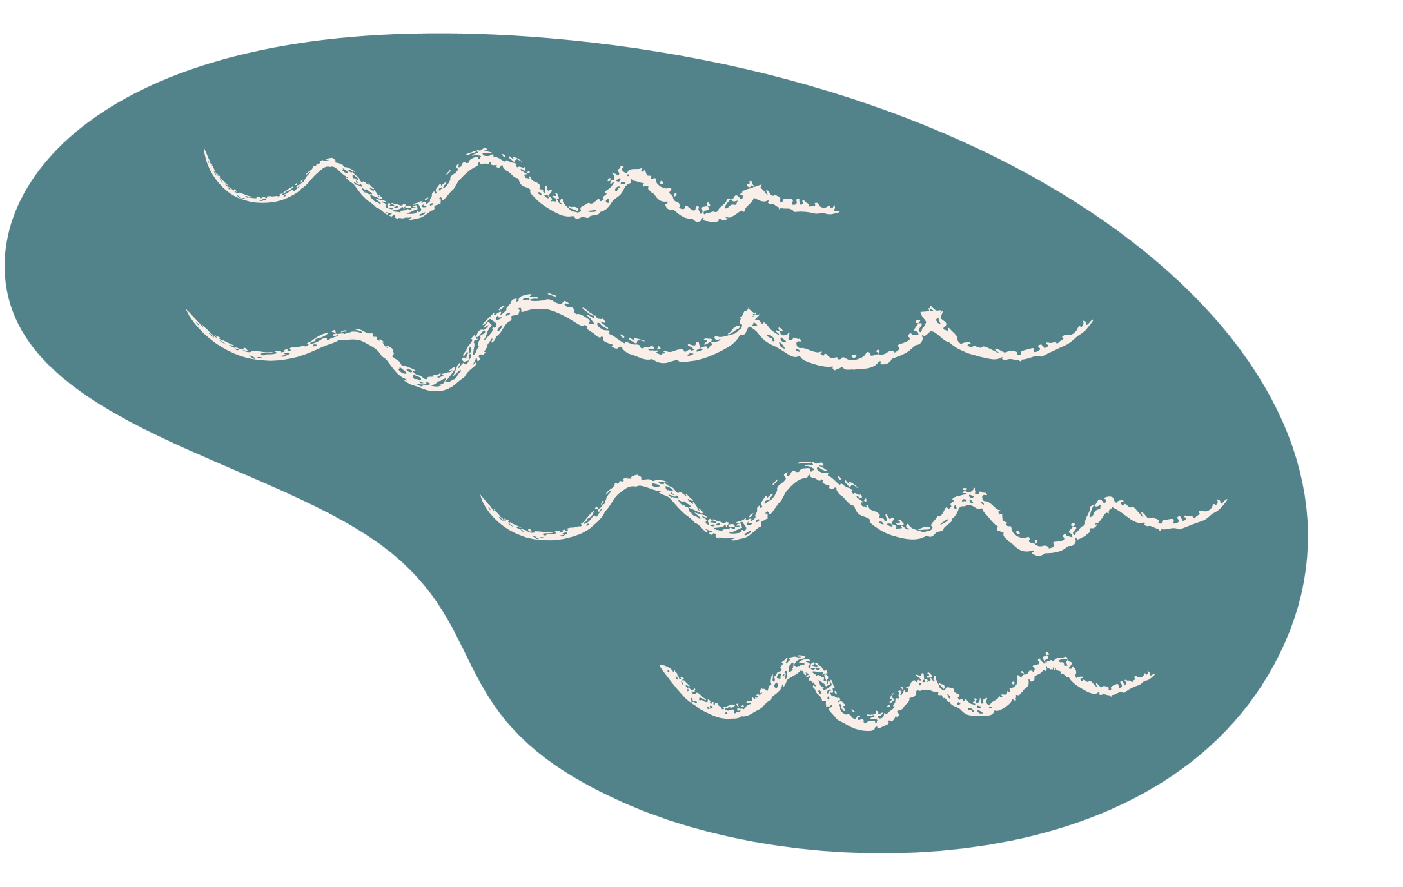
Thank You
for your attention

