Slide 1










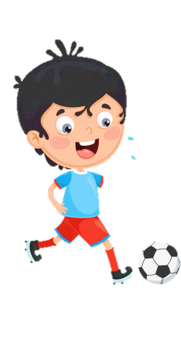
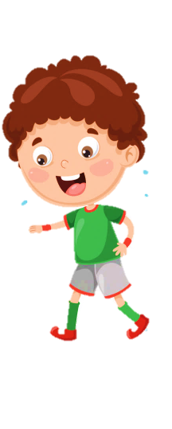

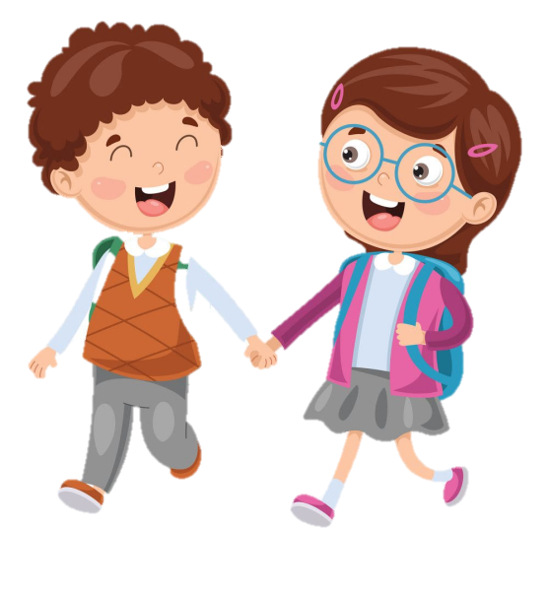



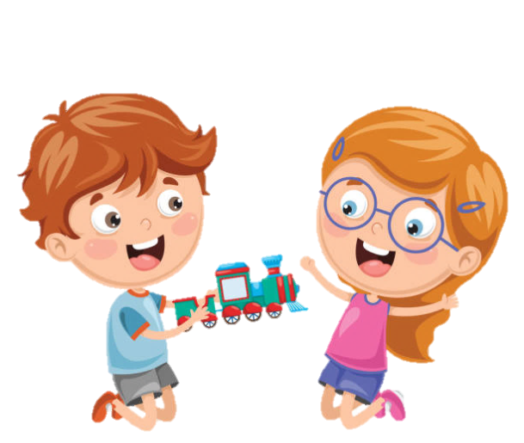




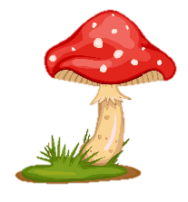
SCHOOL

Slide 2
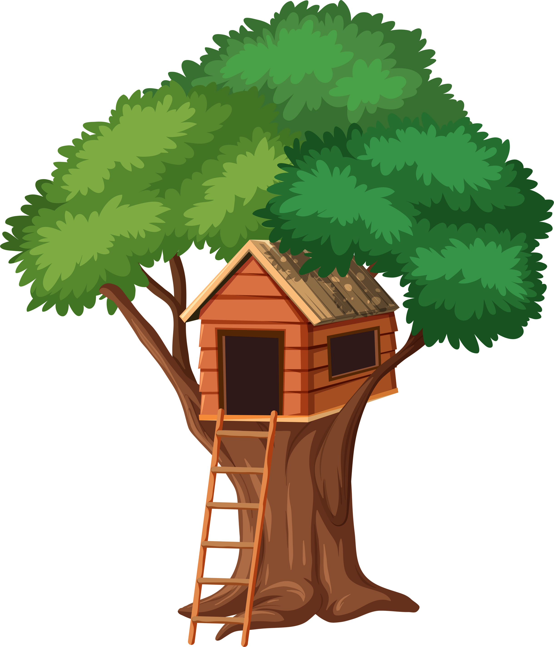
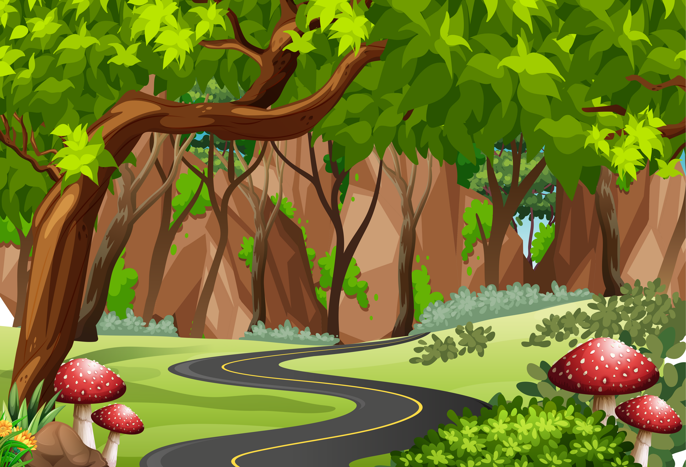

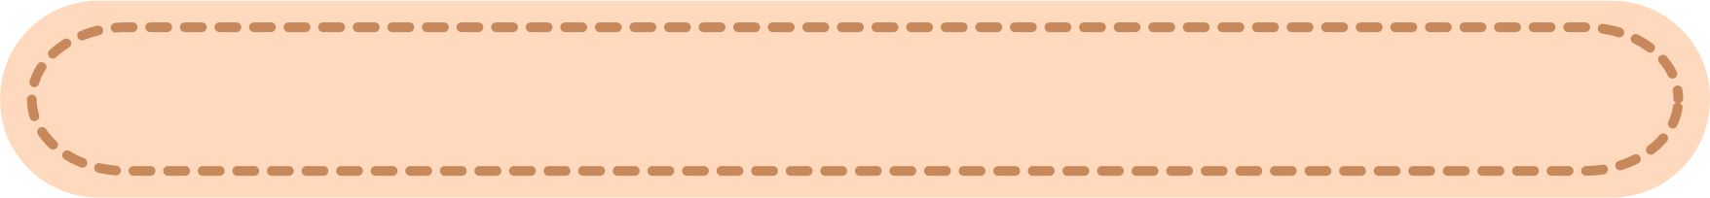
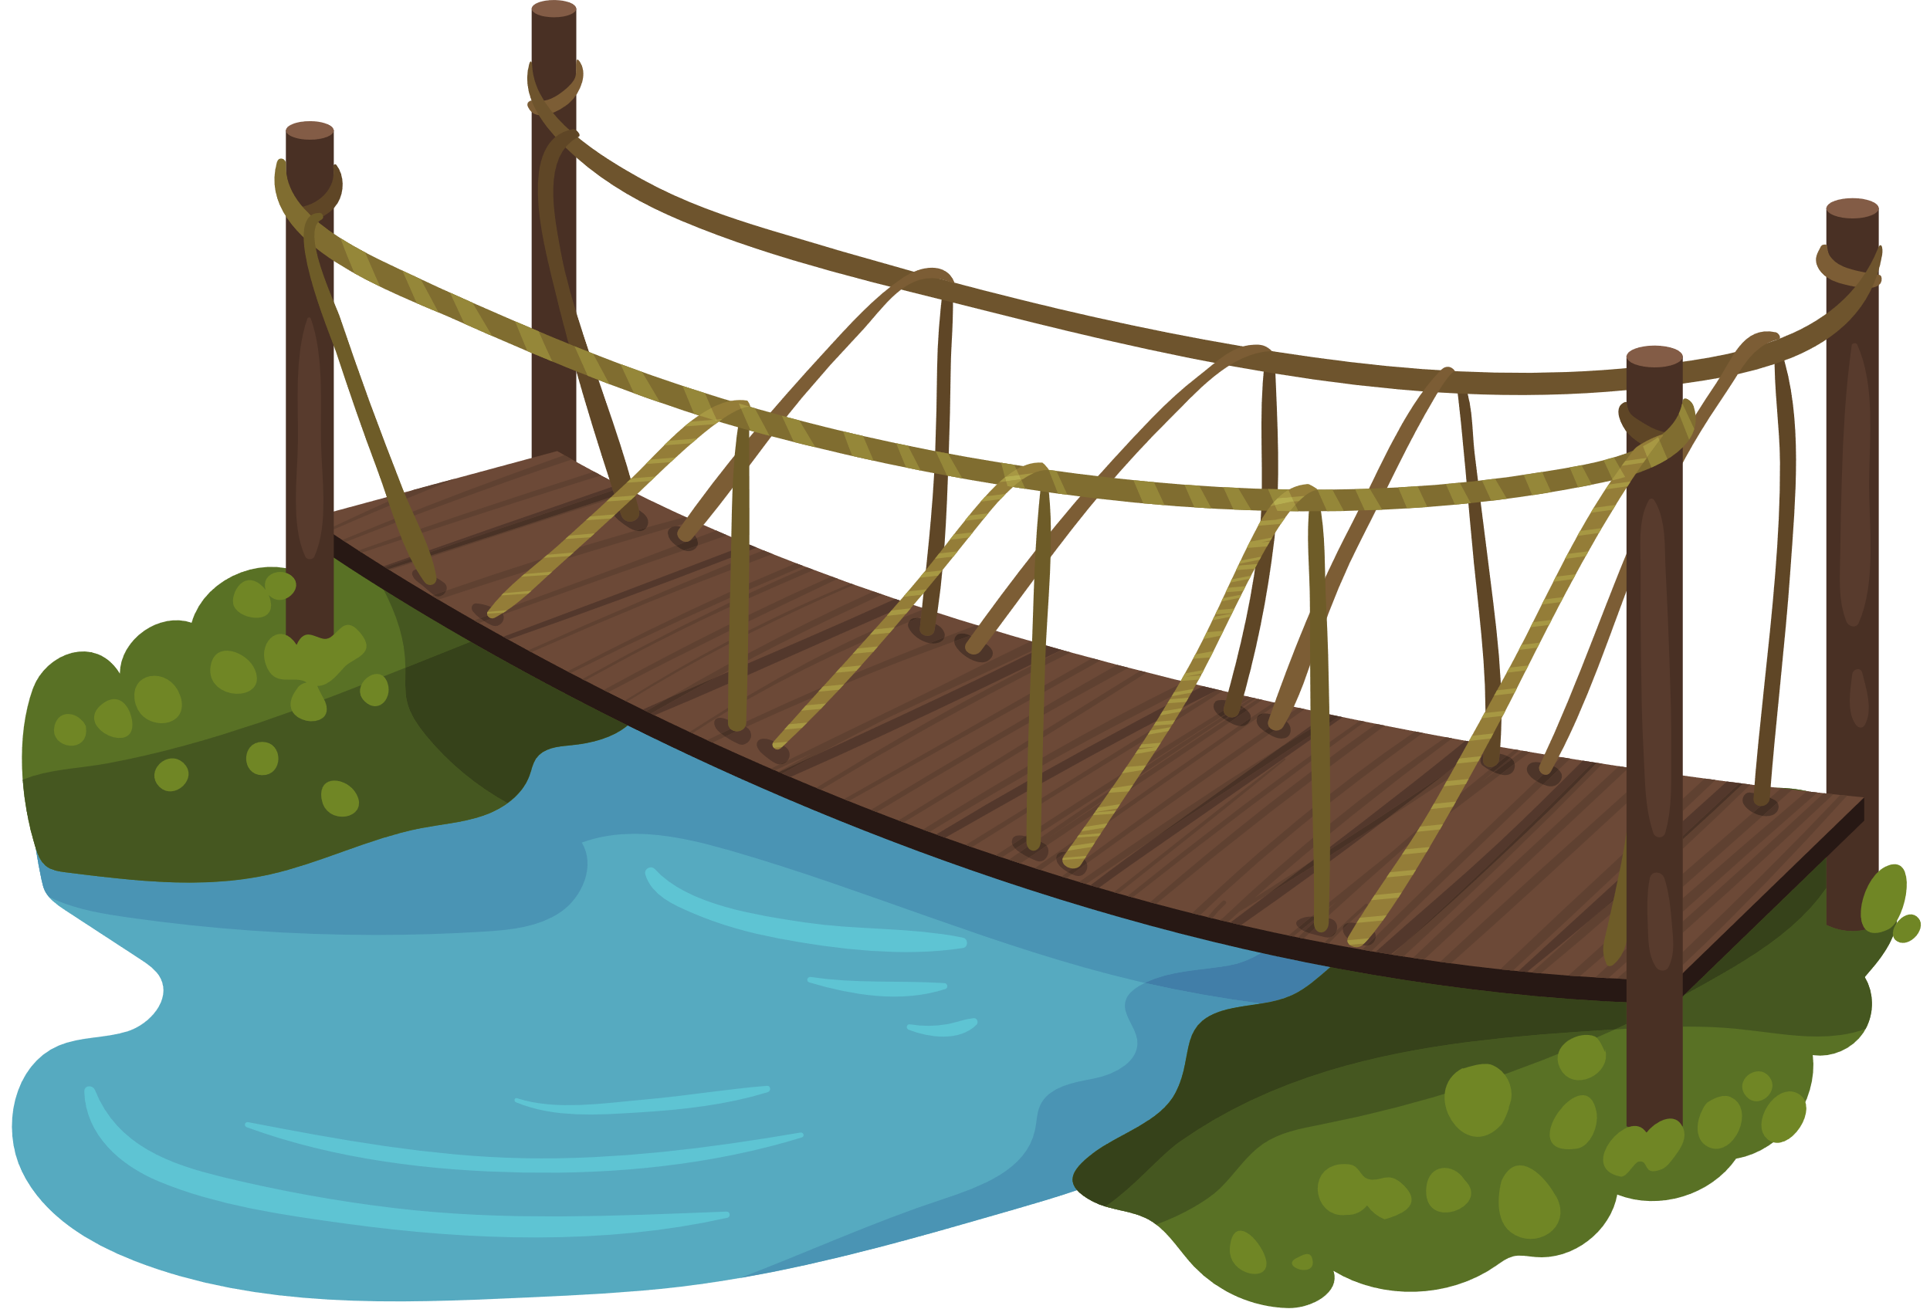
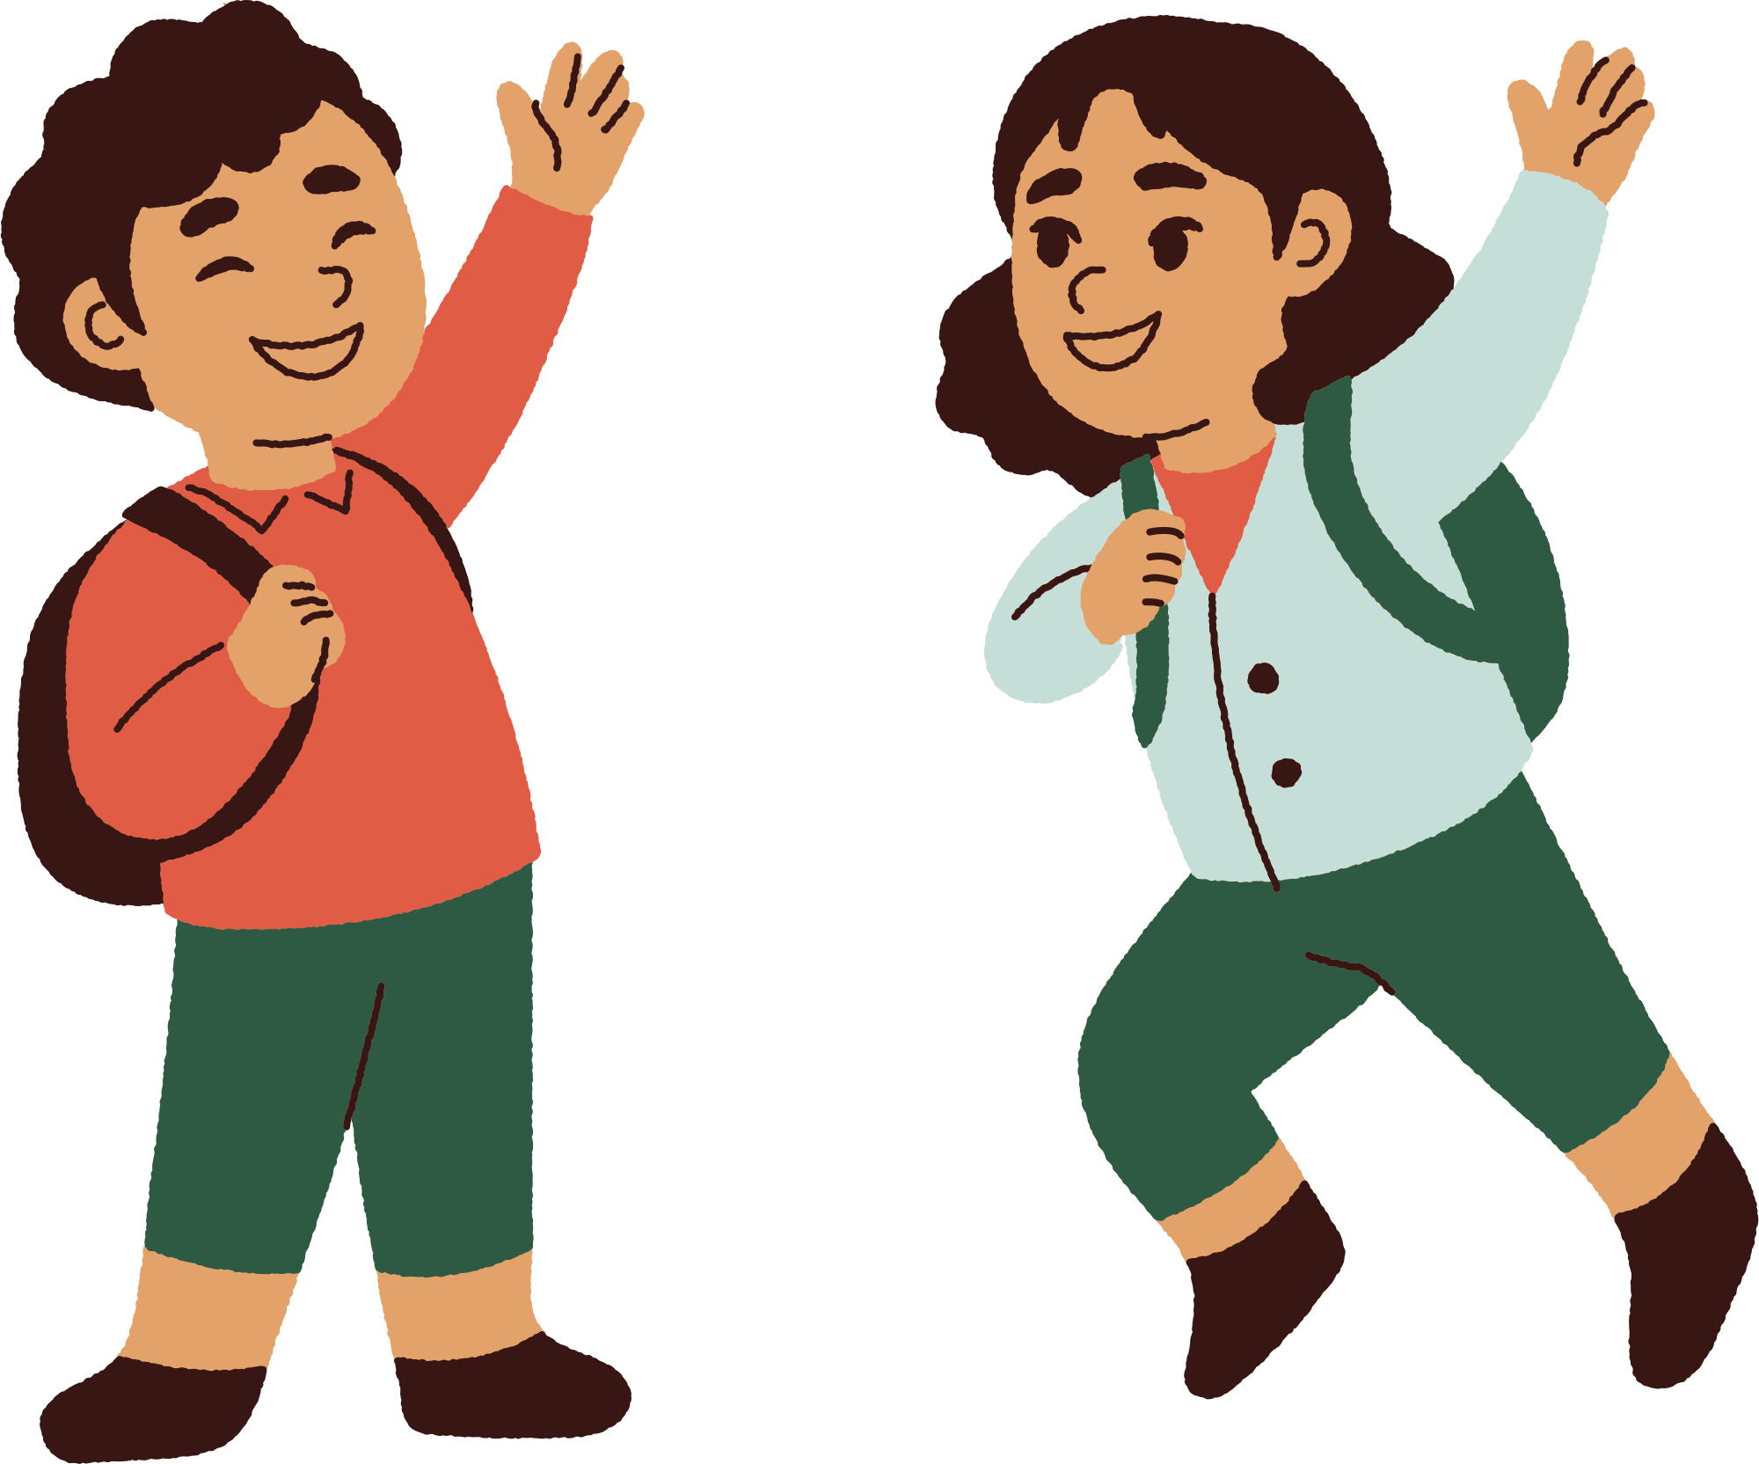

Unit 8
People and Places
LESSON 1 PART 4 5 6

Slide 3



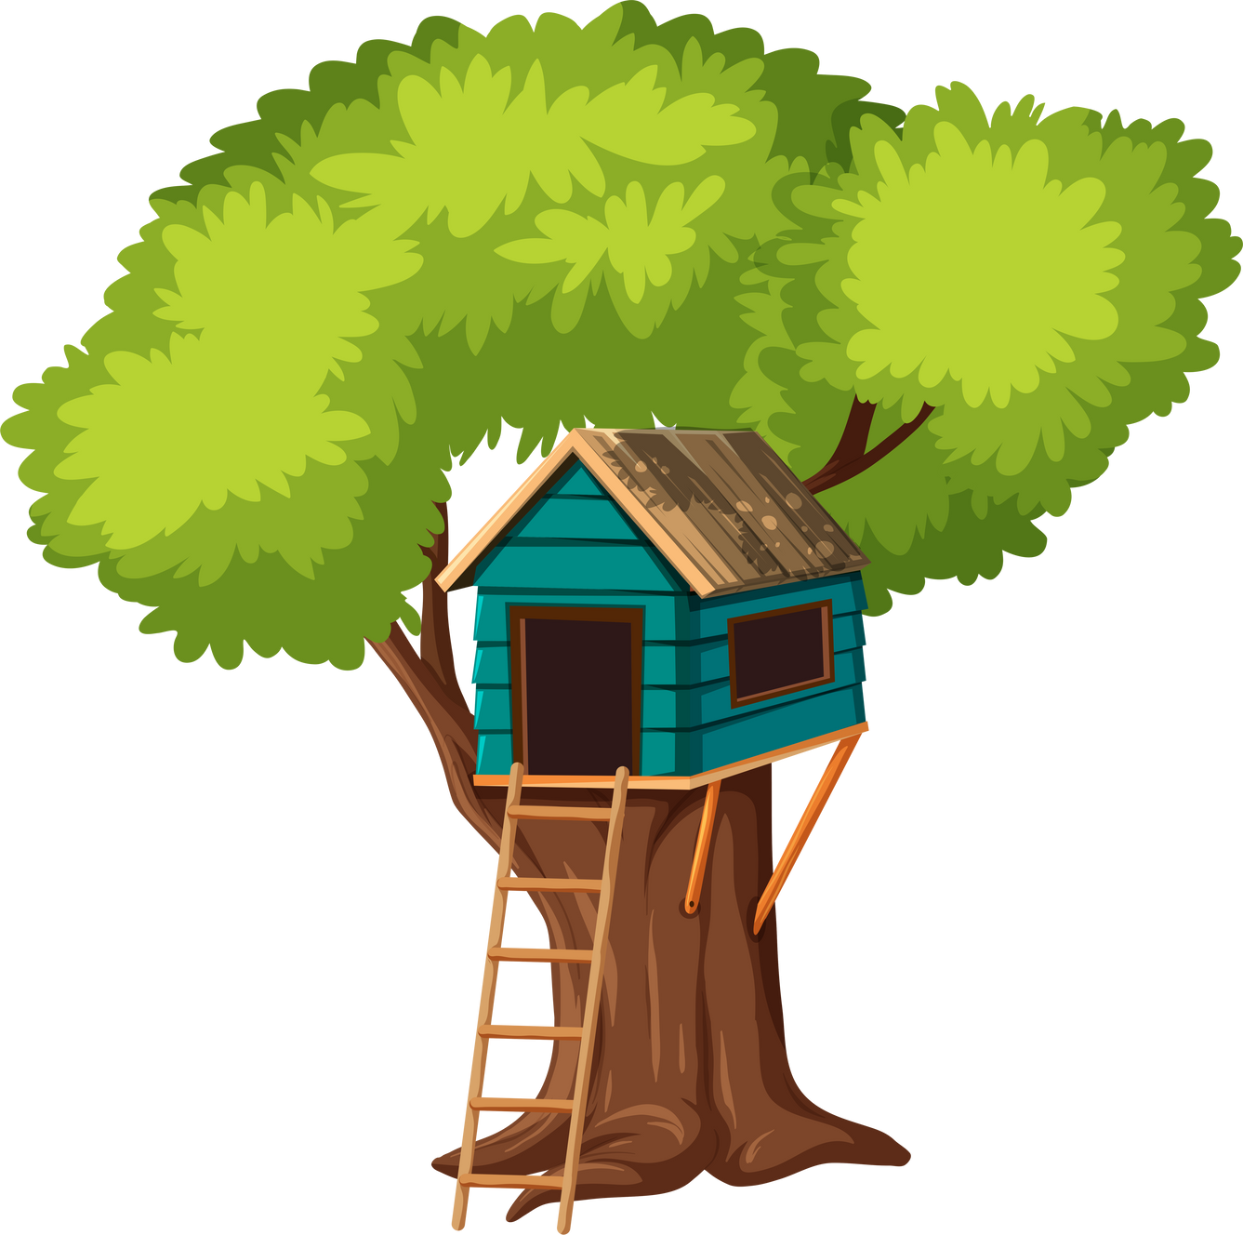


1
Warm-up

Slide 4

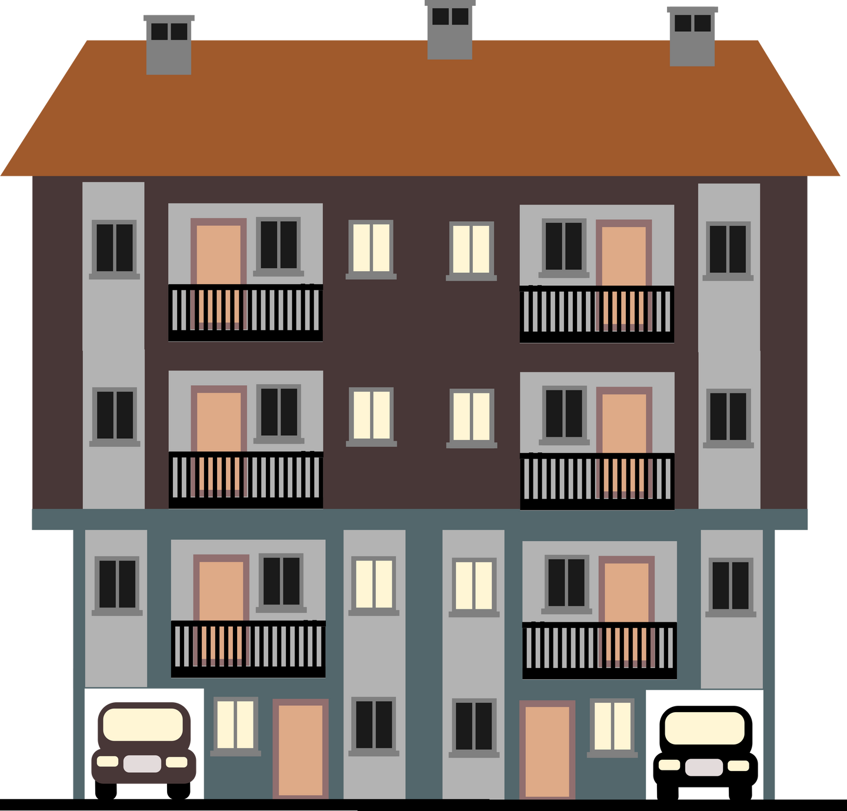

An apartment
is a home in a big building where lots of families live close together.
It typically consists of multiple rooms, including a living room, bedrooms, a kitchen, and a bathroom.

Slide 5

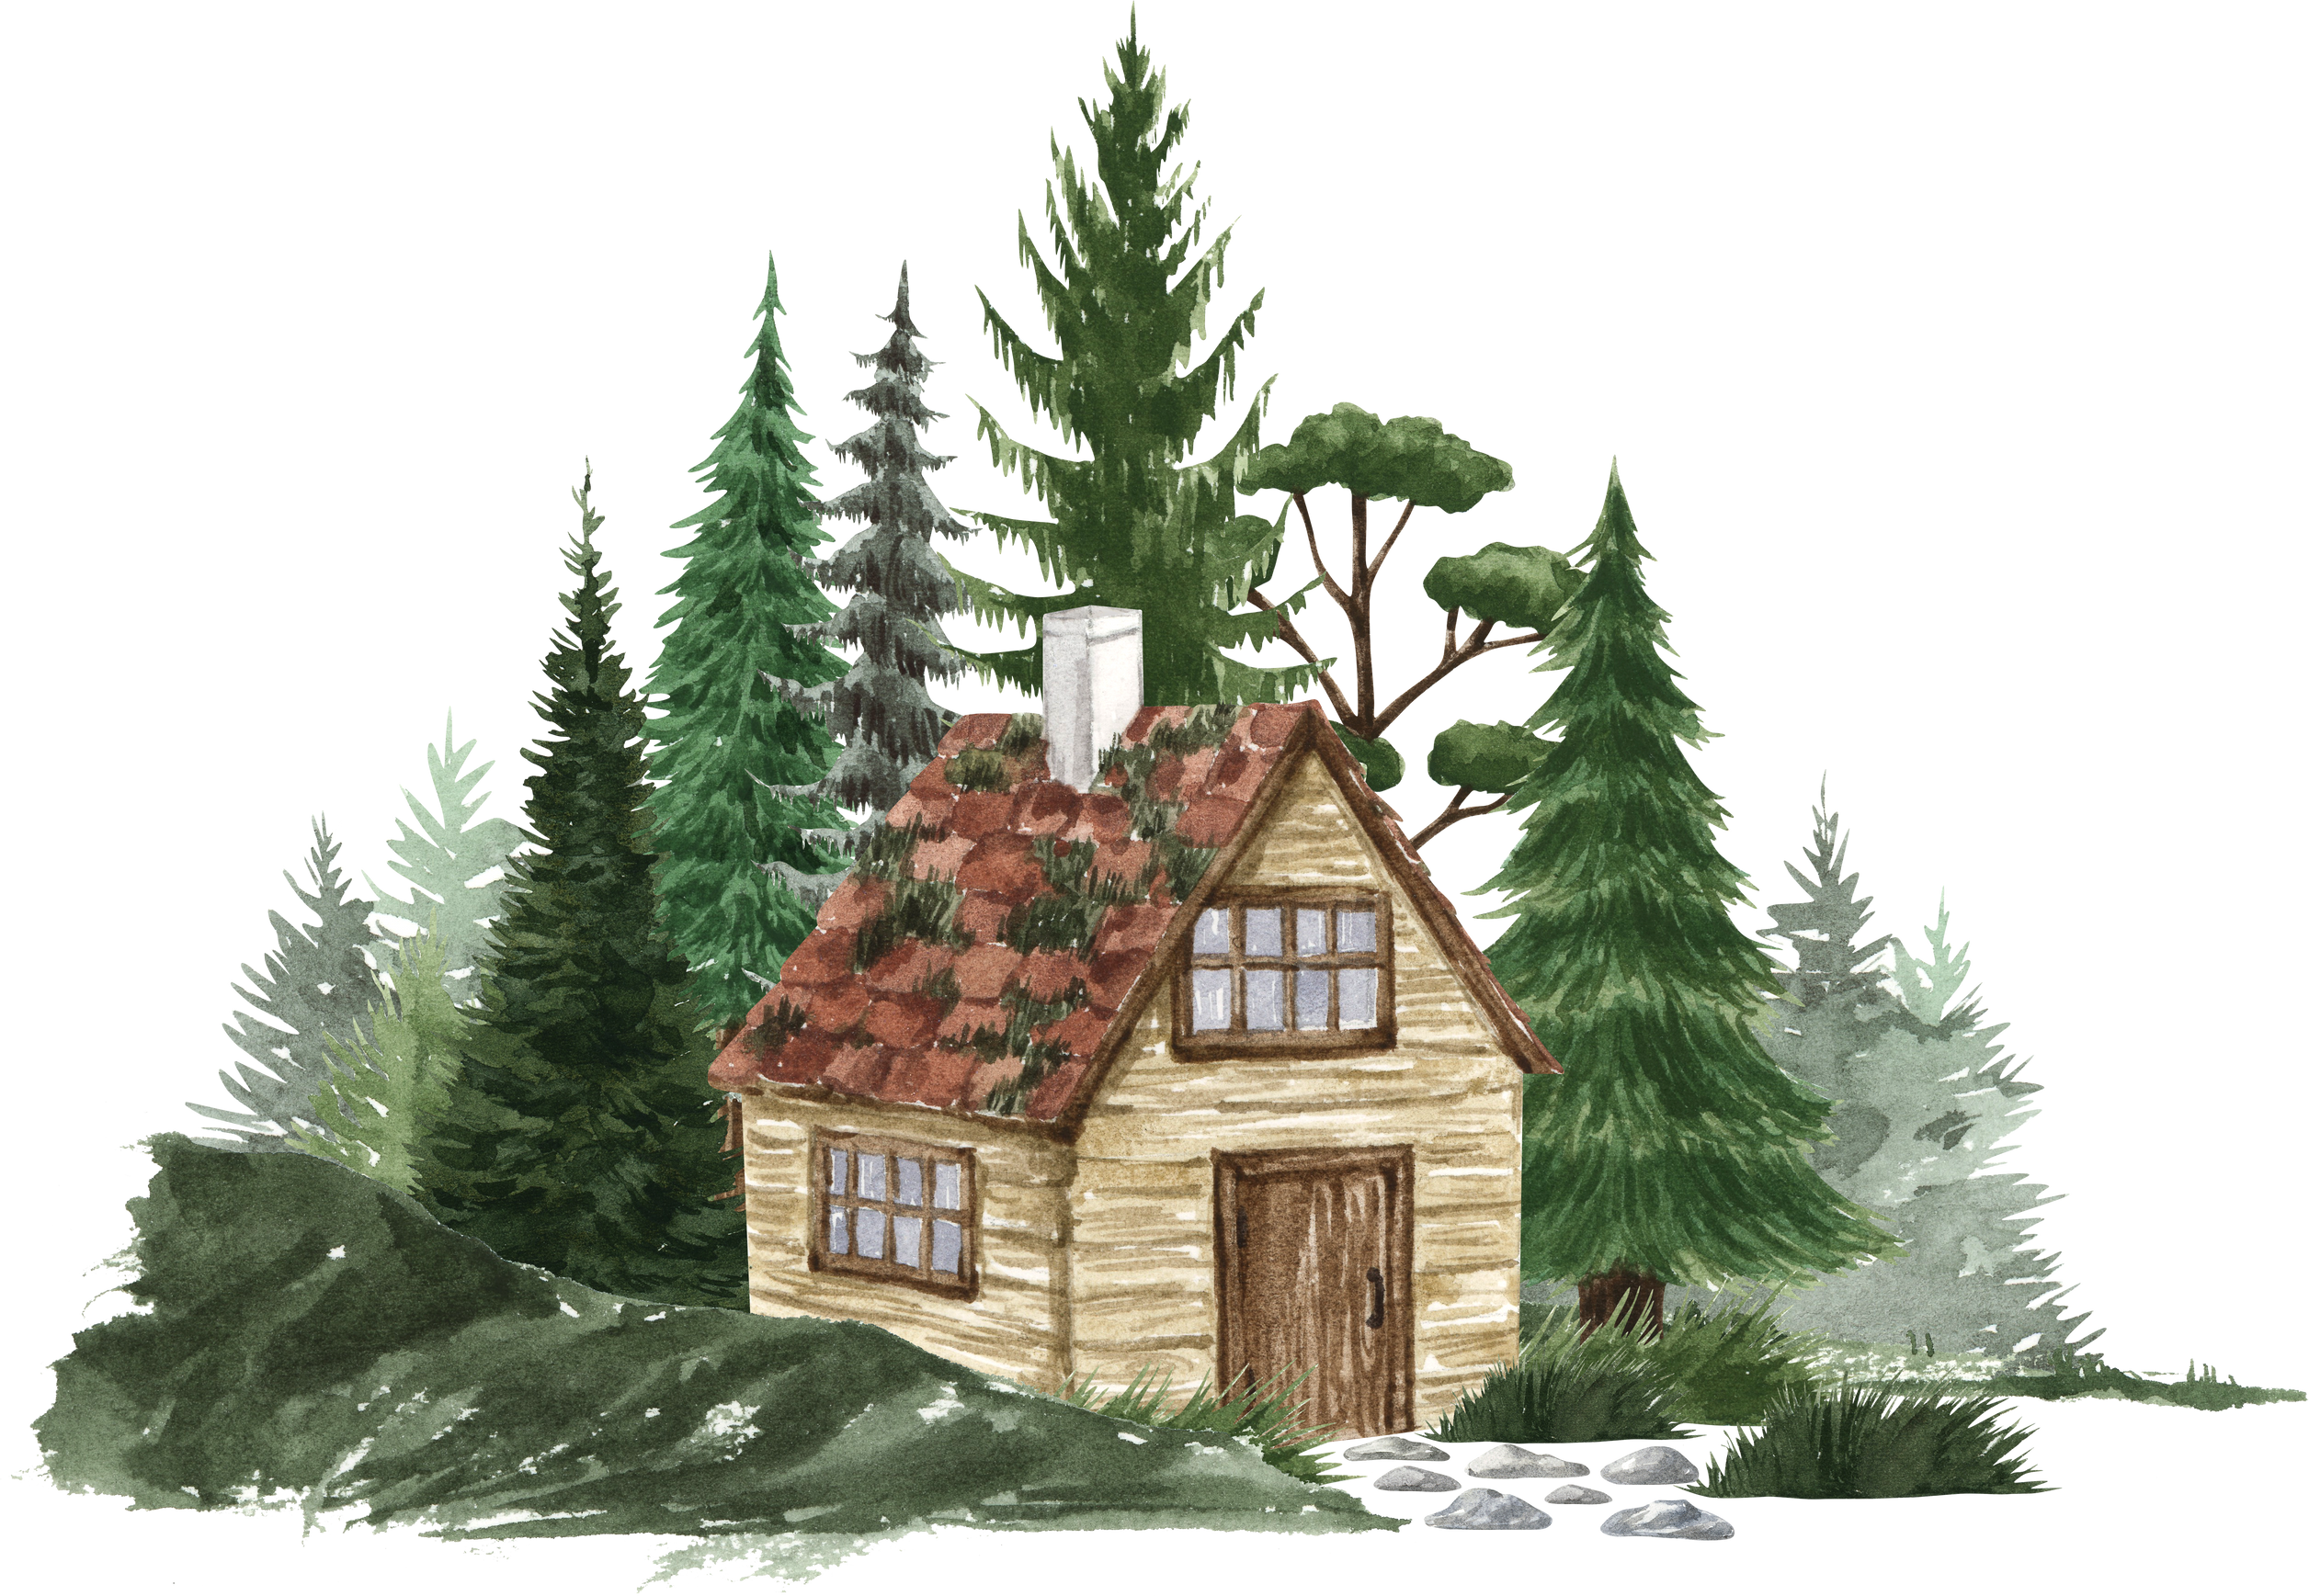

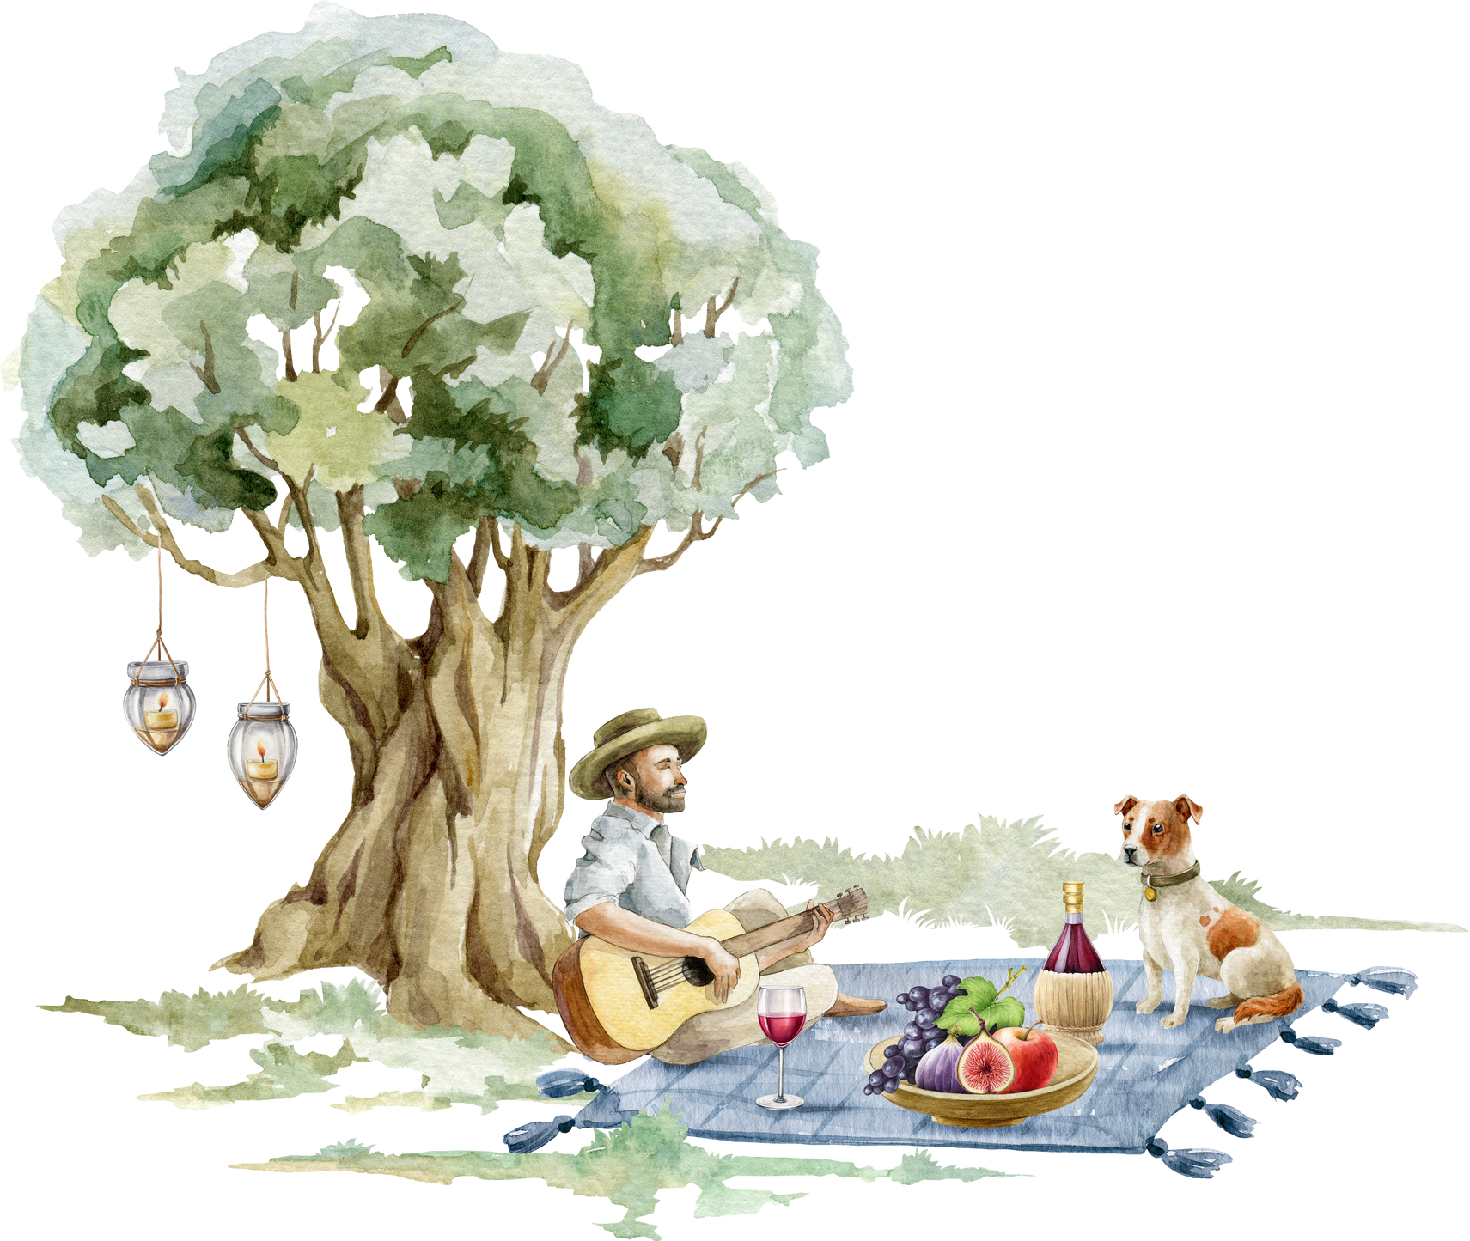
A cottage
is a small house with a pretty garden, usually in the countryside.
It's a cozy place where people go to relax and enjoy nature.

Slide 6
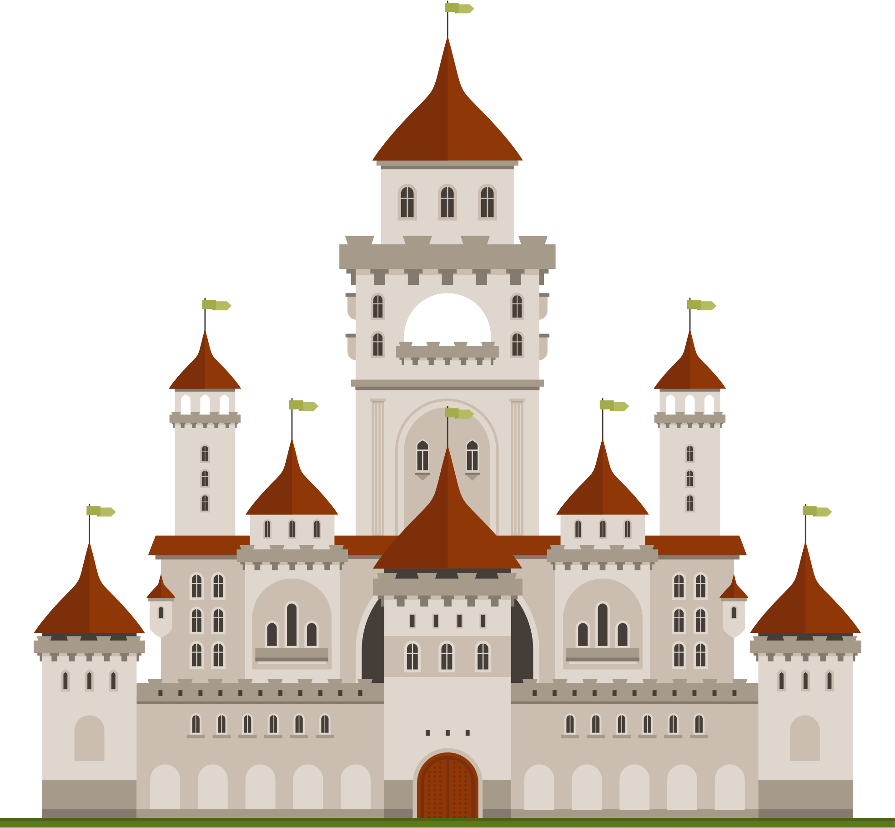
A castle
is a big, strong building with tall towers and walls made of stone.
Long ago, knights and kings lived in castles and used them to stay safe and protect their kingdoms.

Slide 7

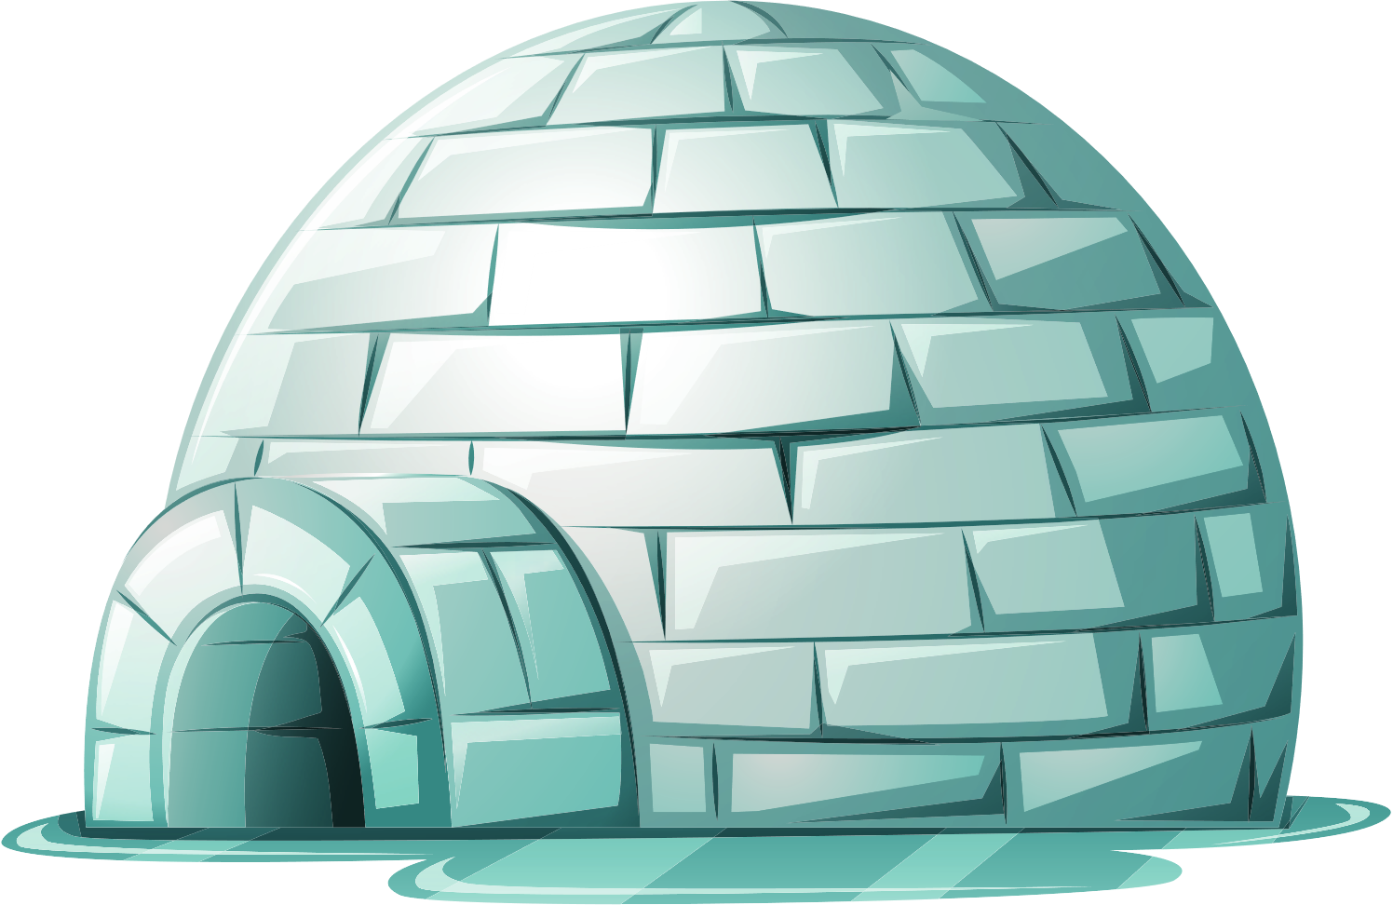
An igloo
is a house made of ice and snow, shaped like a dome.
People who live in cold places like the Arctic build igloos to stay warm and cozy.

Slide 8

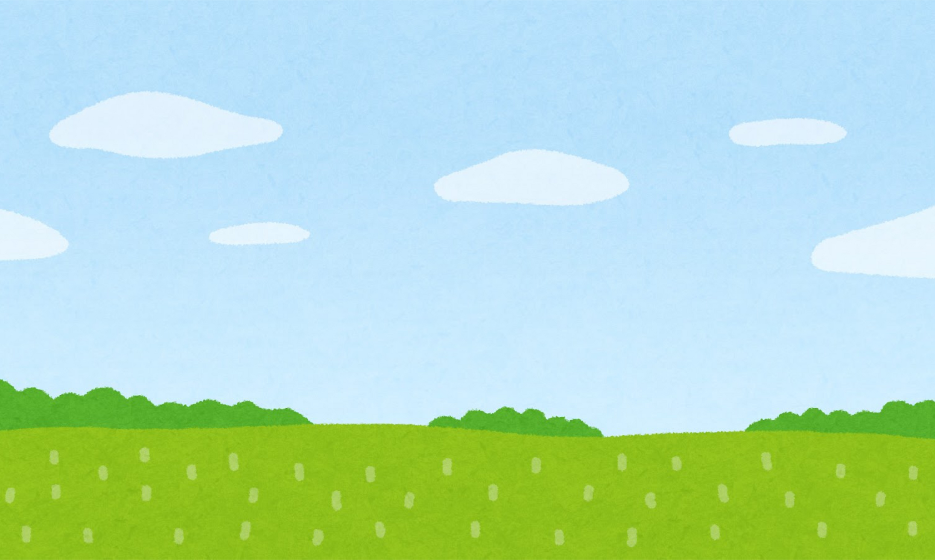
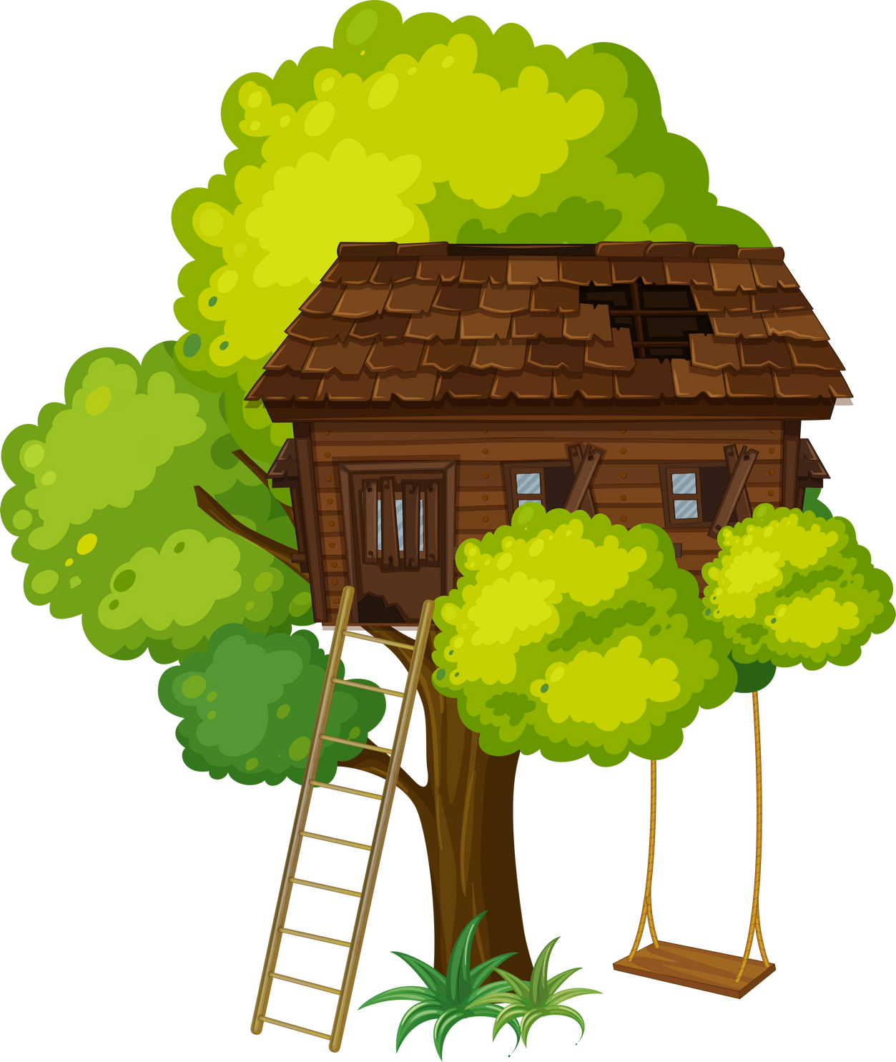
A tree house
is a house built up in a tree, like a cozy hideout in the branches.
It's a fun place where kids can play, read books, and imagine they're high up in the sky with the birds.

Slide 9

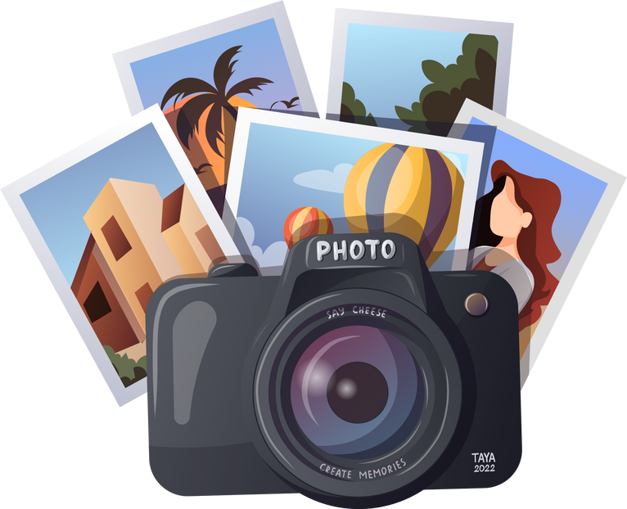
2
Presentation

Slide 10


Would you like to live in a treehouse, a castle, an apartment or a cottage ?

Slide 11

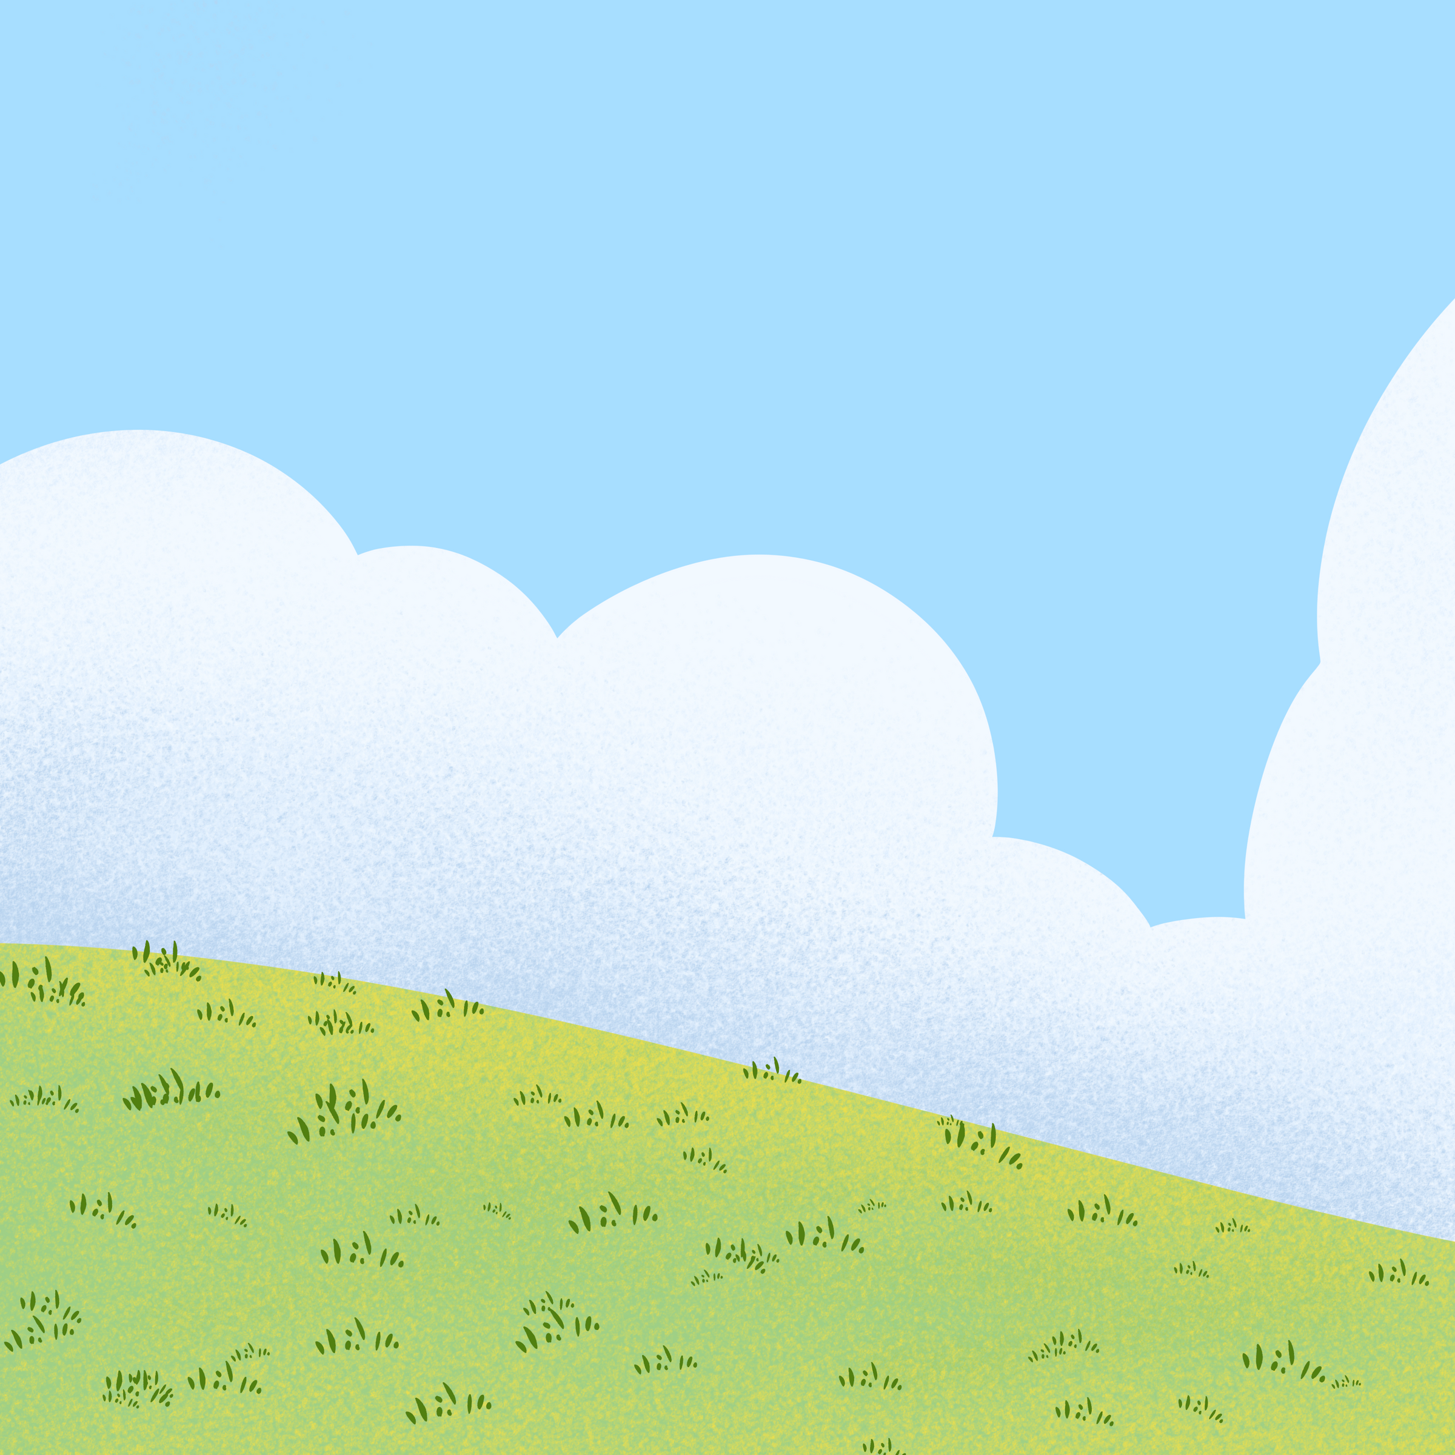
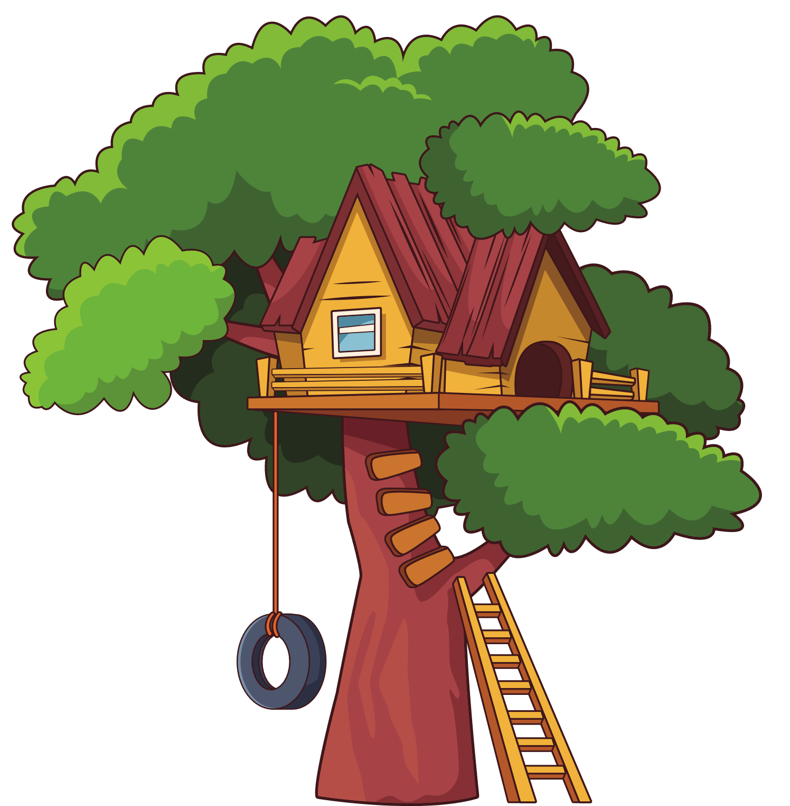


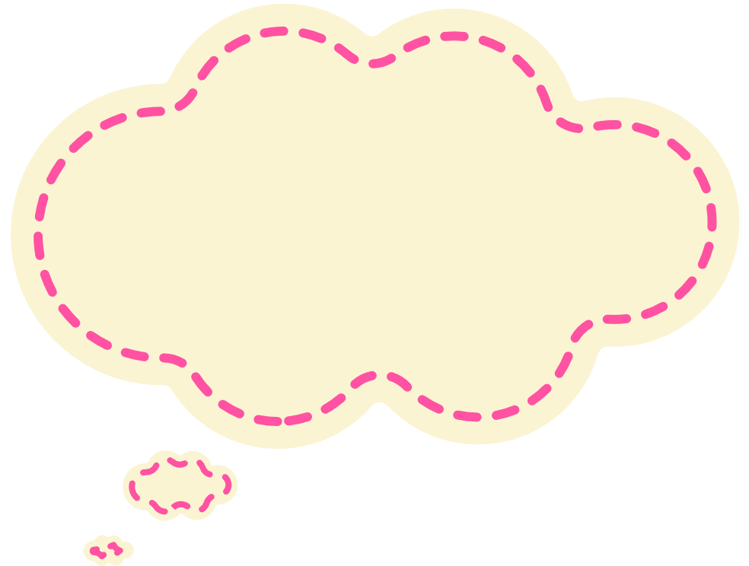
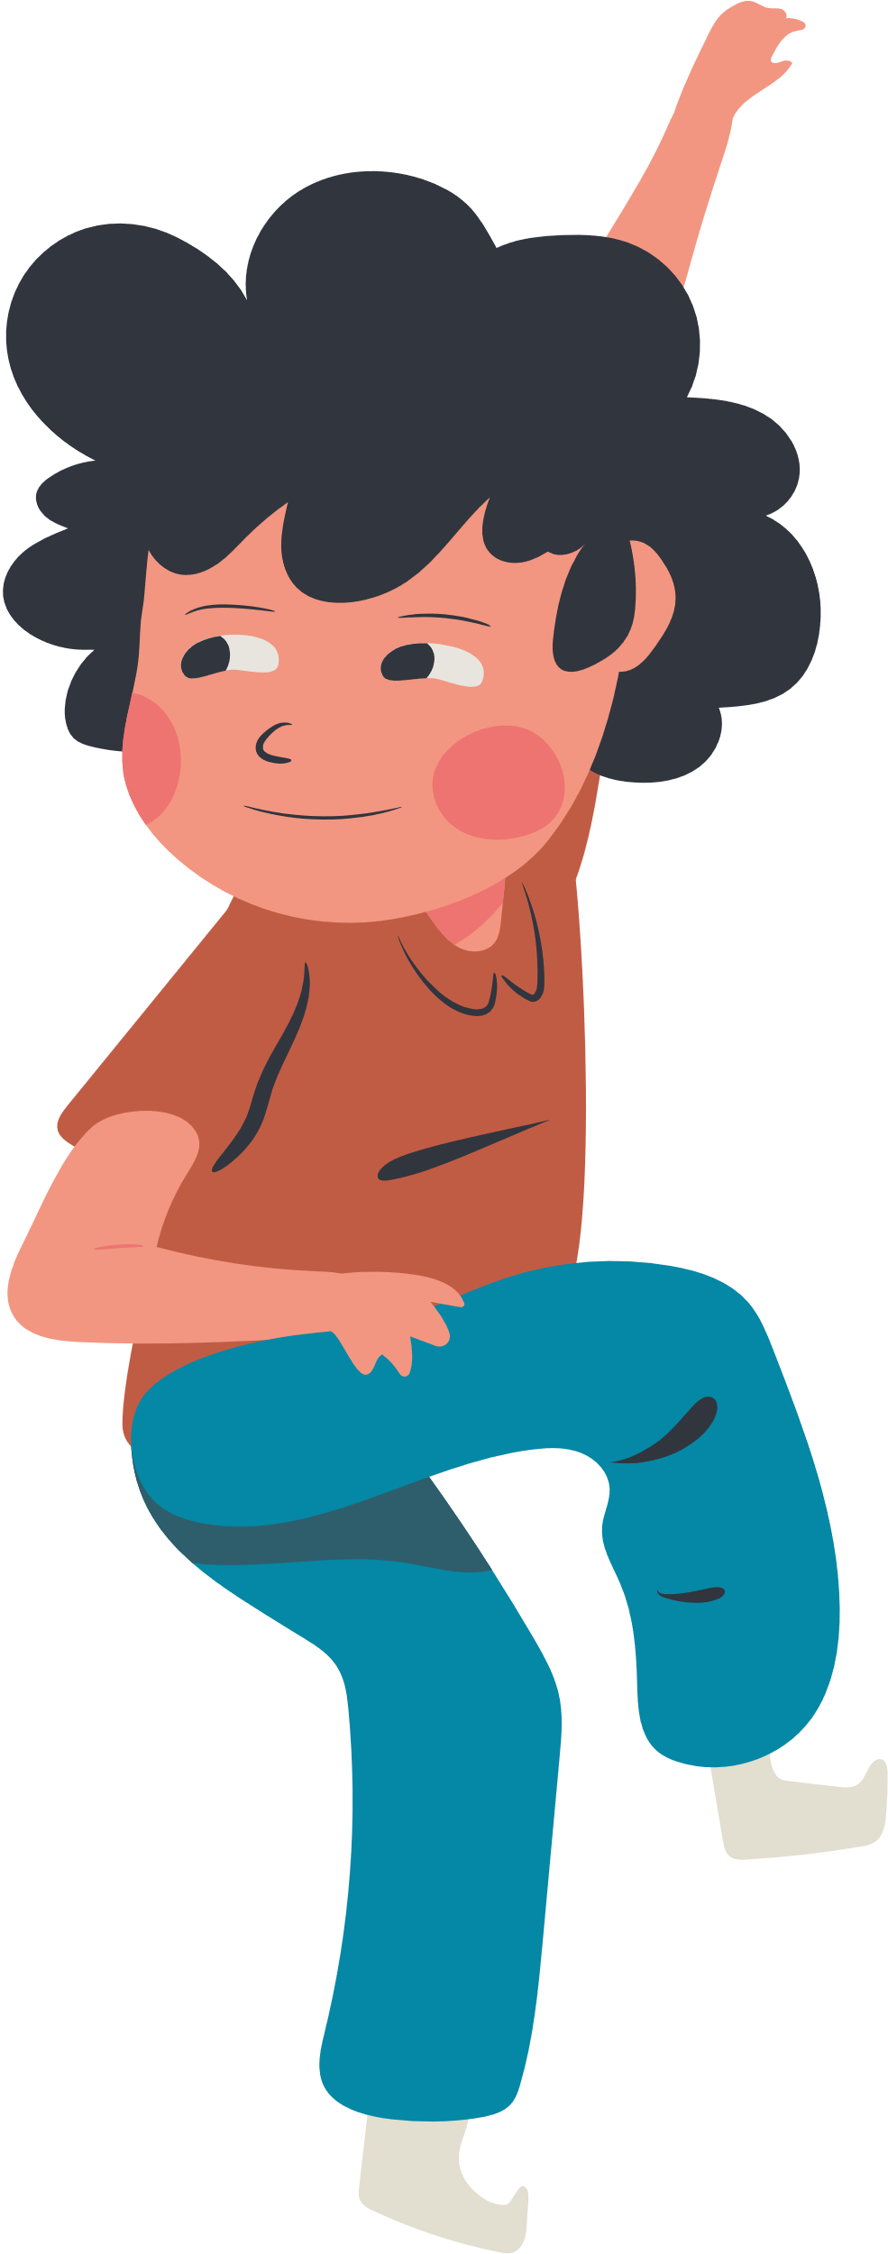
Would you like to live in a treehouse?
Yes, I would.

Slide 12

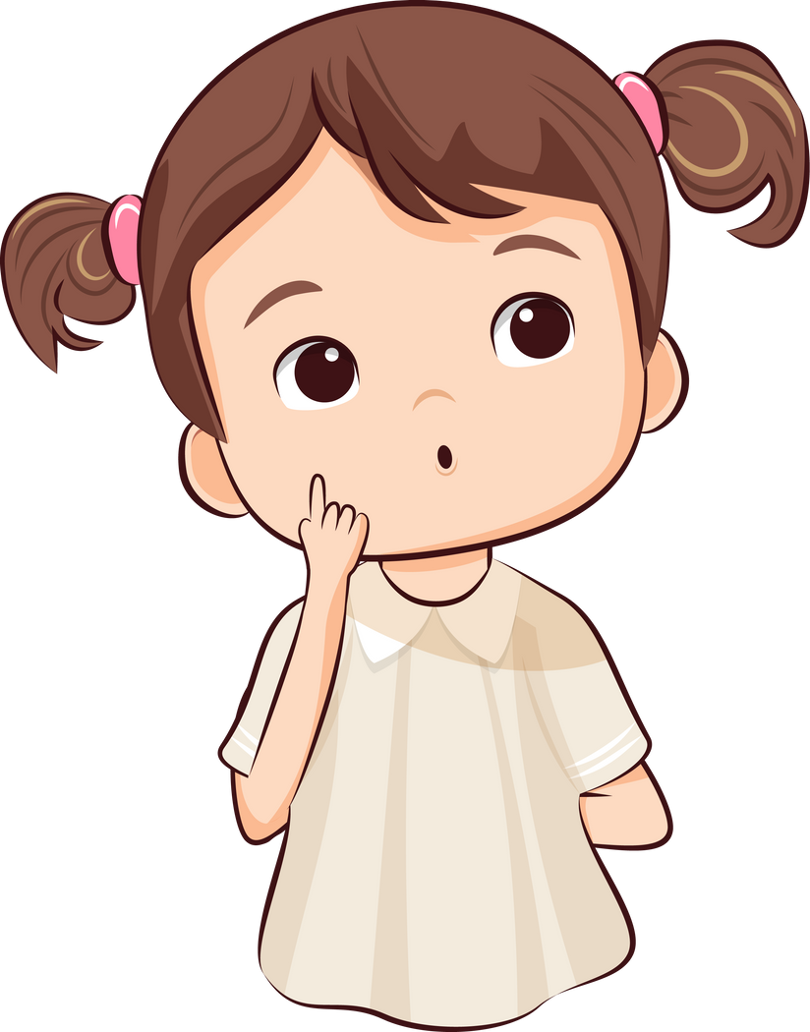

Structure
Would you like ...?
Would you like + N/ to V-inf ?
  Would you like to live in a treehouse?
  Yes, I would.
S + would like (to + V-inf) ?
  I’d like to go to the beach.

Slide 13

3
Practice

Slide 14





Racing monster truck

Slide 15


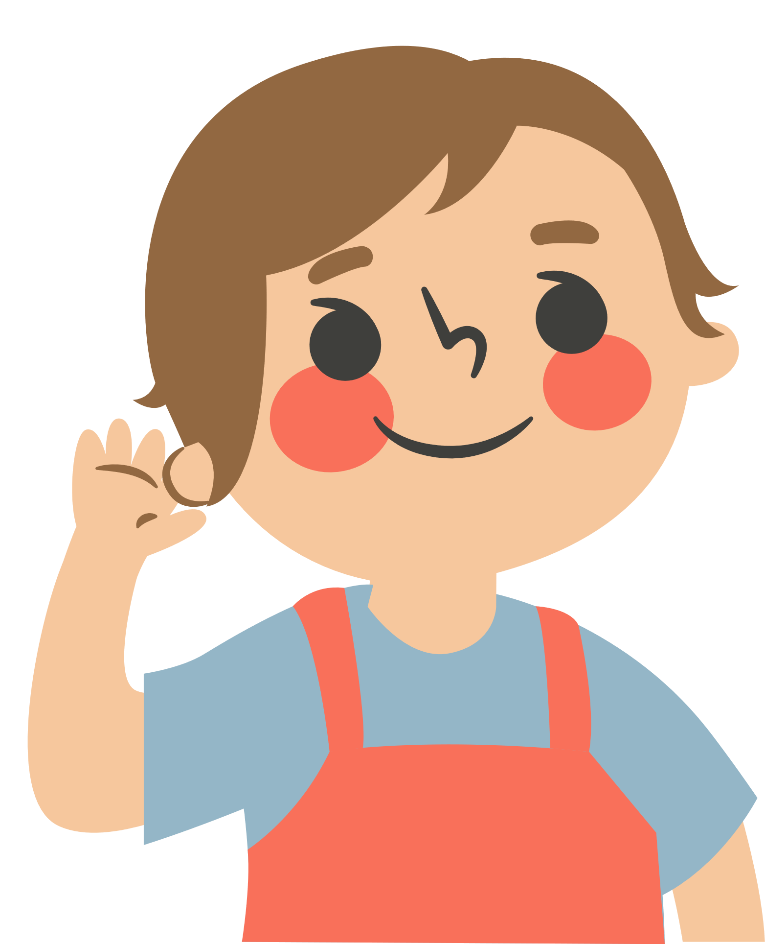
5. Listen and circle

Slide 16
4
Production

Slide 17

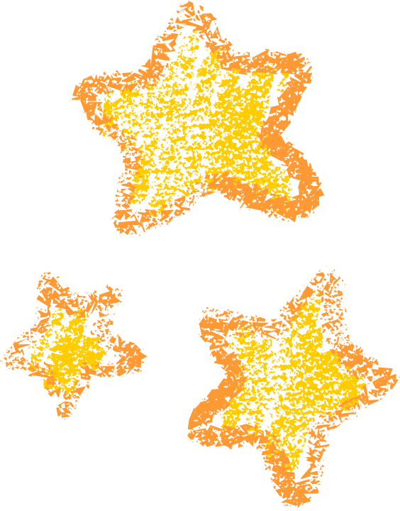


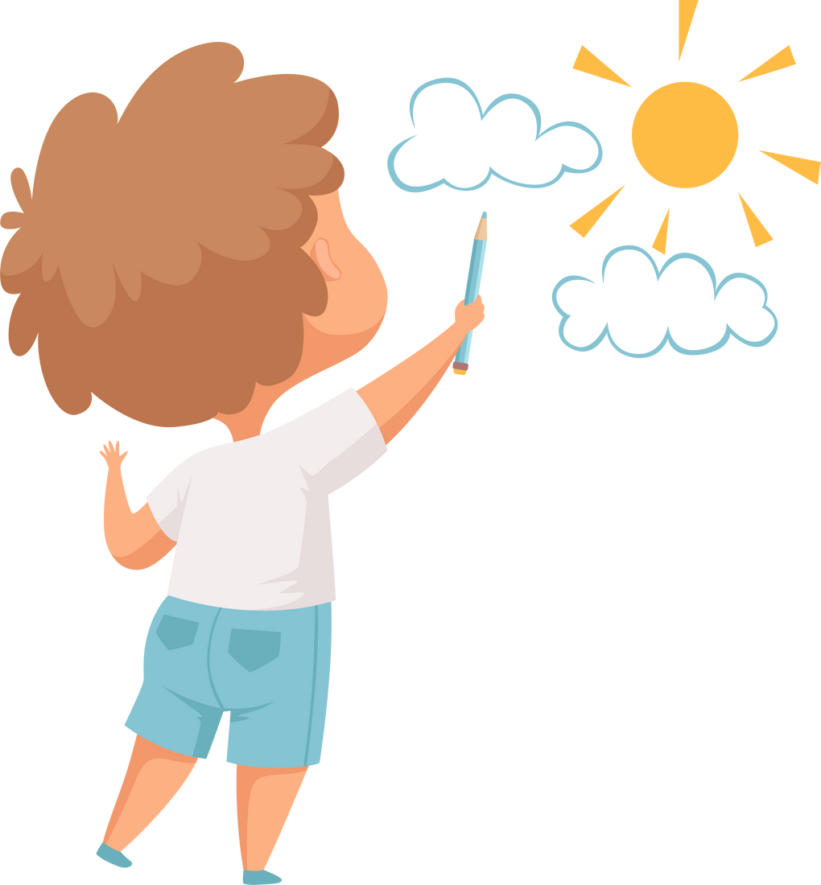




Project
HOUSE
Draw your dream house
Decorate it
Tell the class about your house
Which home would you like to live in, an apartment in the town or a cottage in the countryside?
I’d like to live in a cottage in the countryside.

Slide 18
5
Wrap-up &
Assessment

Slide 19








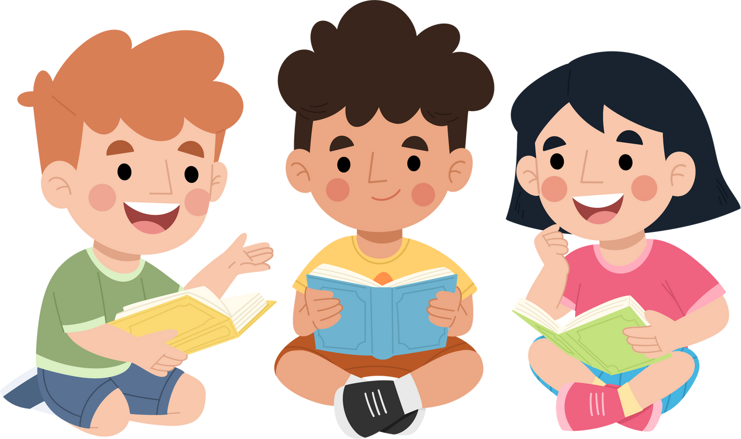
Thanh You
for your attention

