Slide 1




















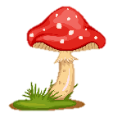
Notes:
Để nguyên trang bìa như này, chỉ thay đổi tên bài trong quá trình làm. Logo của sách Wonderful World

Slide 2
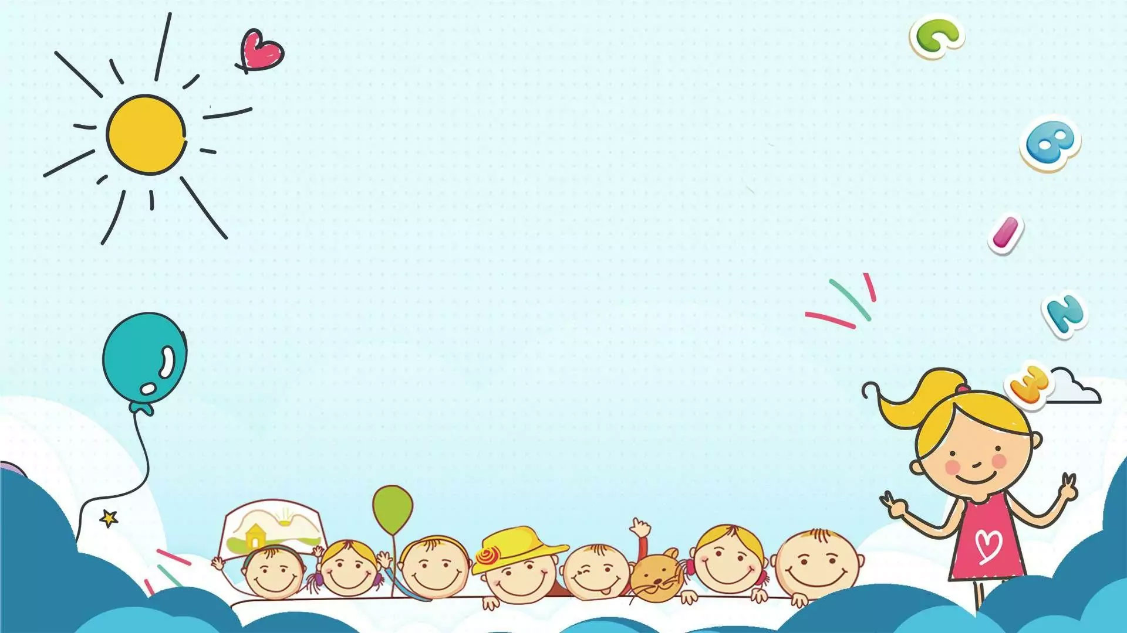



Unit: 4
FREE TIME
Lesson 1: Task 1, 2, 3

Slide 3





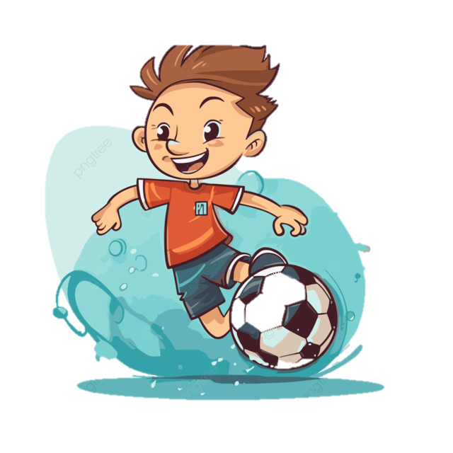
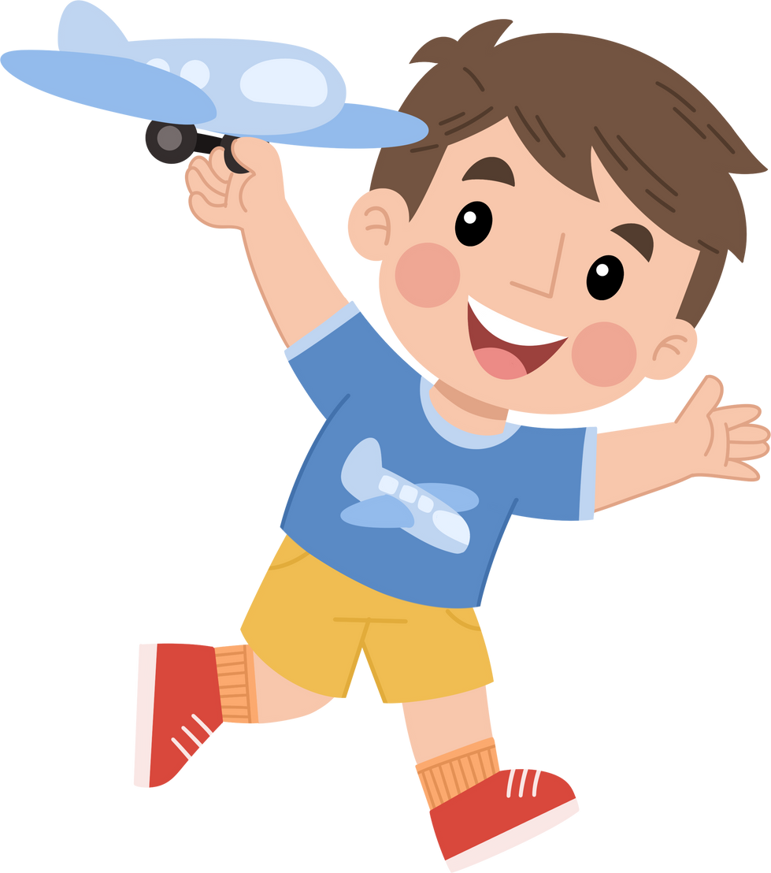



Table of contents
01
02
Warm-up
Presentation
04
05
Production
Wrap-up & Assessment
03
Practice

Slide 4
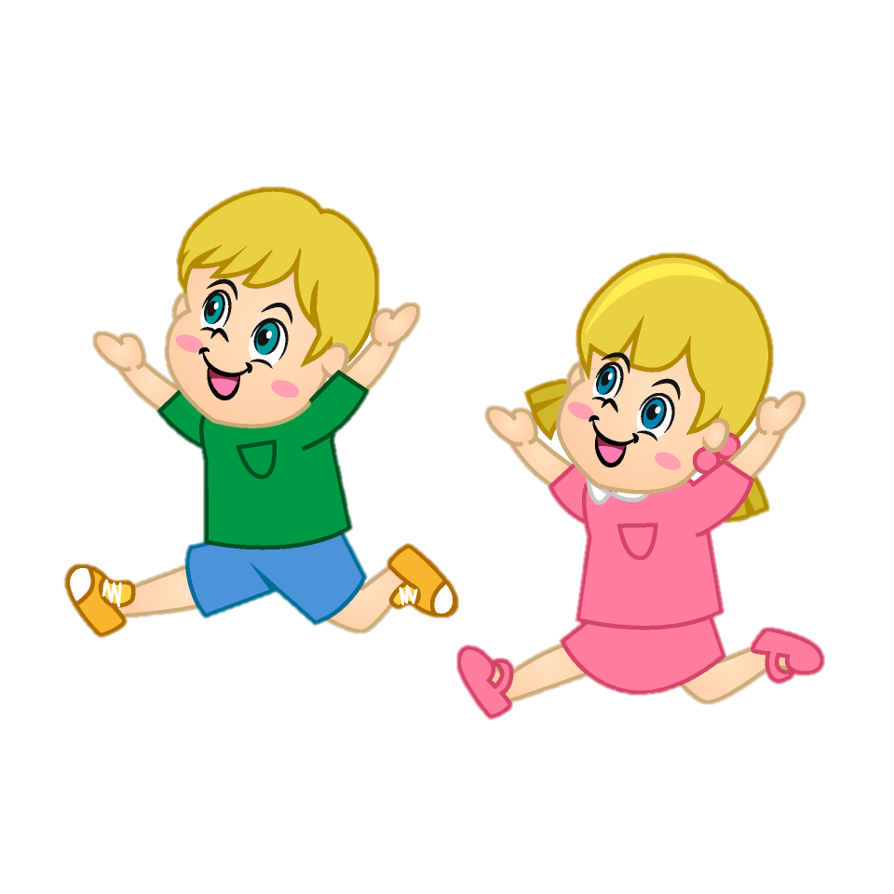
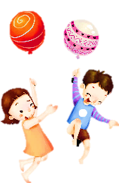

Warm-up
01
Let’s play game: Secret picture

Slide 5




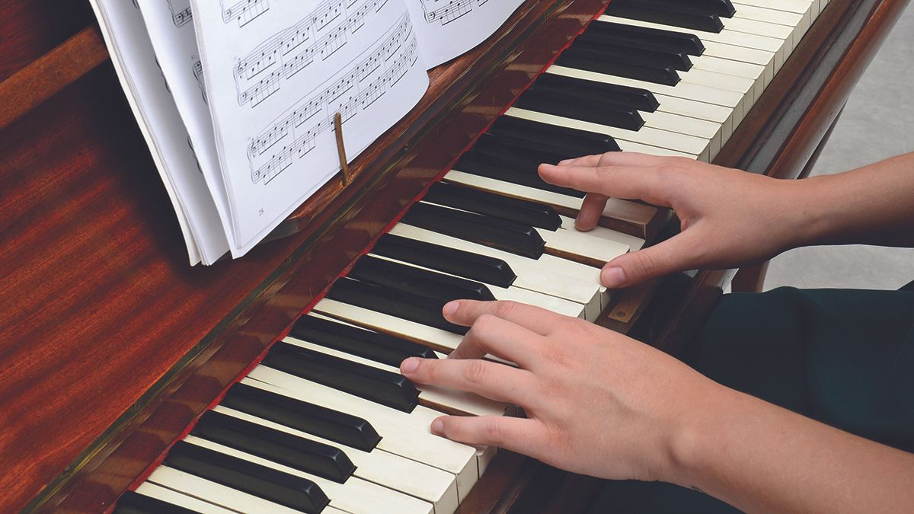


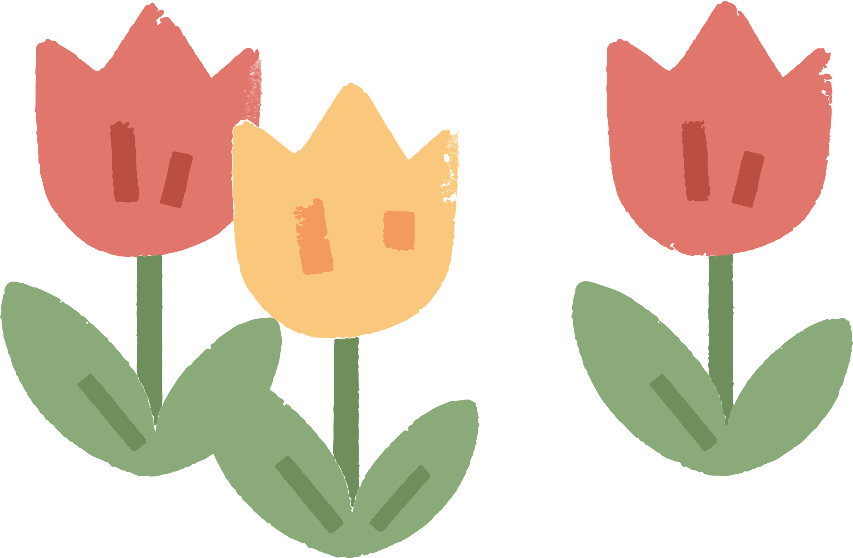
play the piano

Slide 6


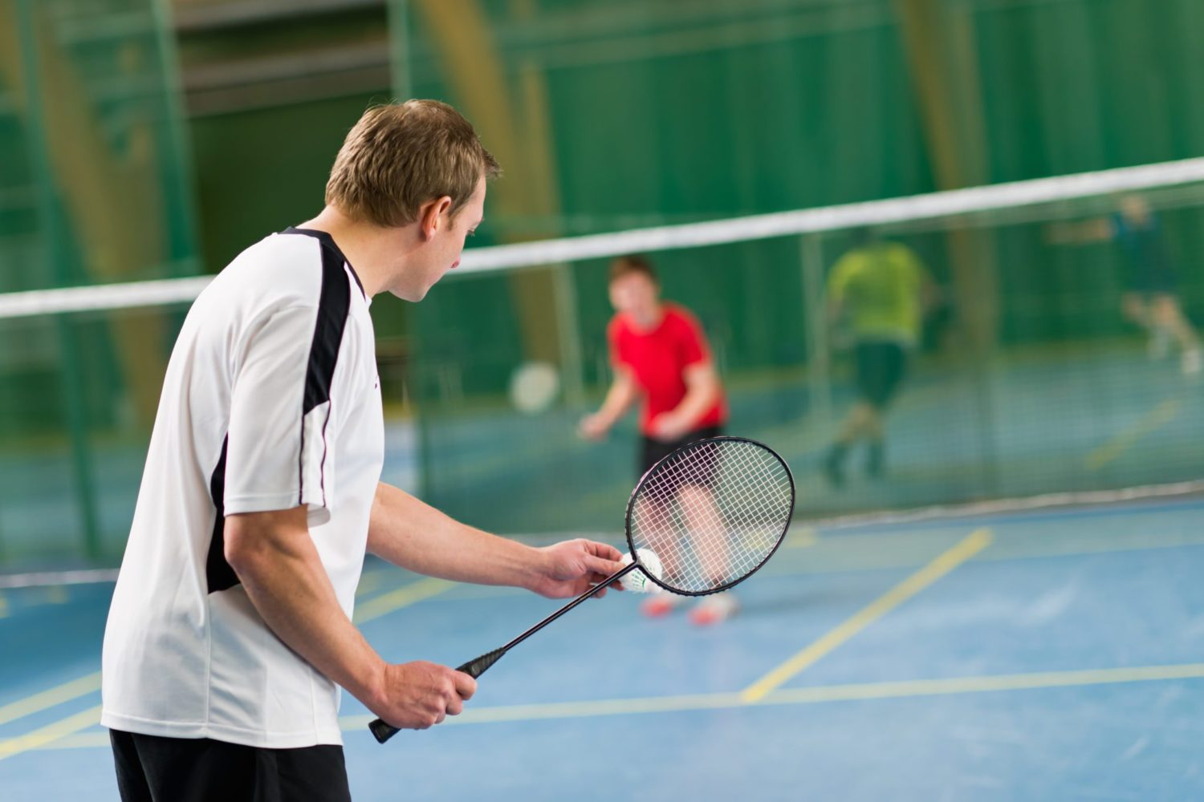
play badminton

Slide 7
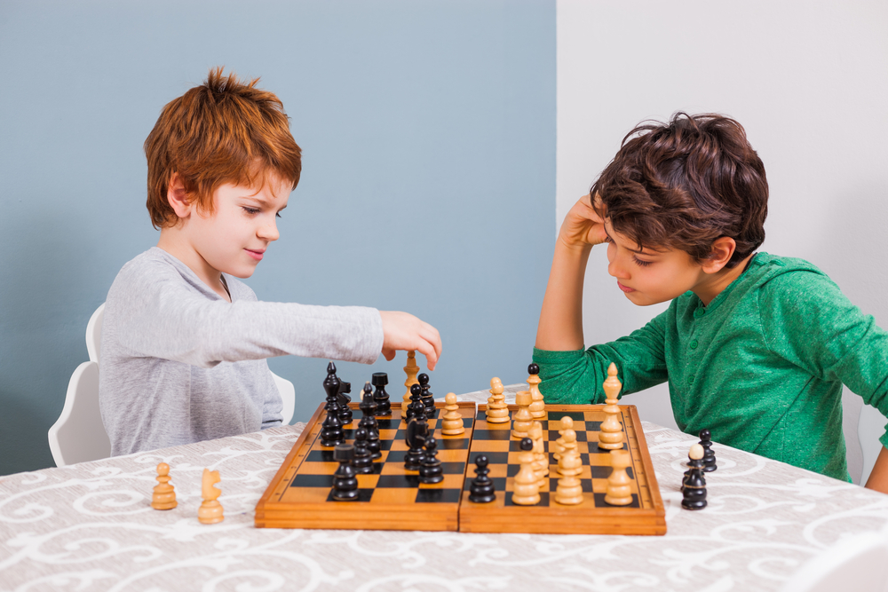

play chess

Slide 8
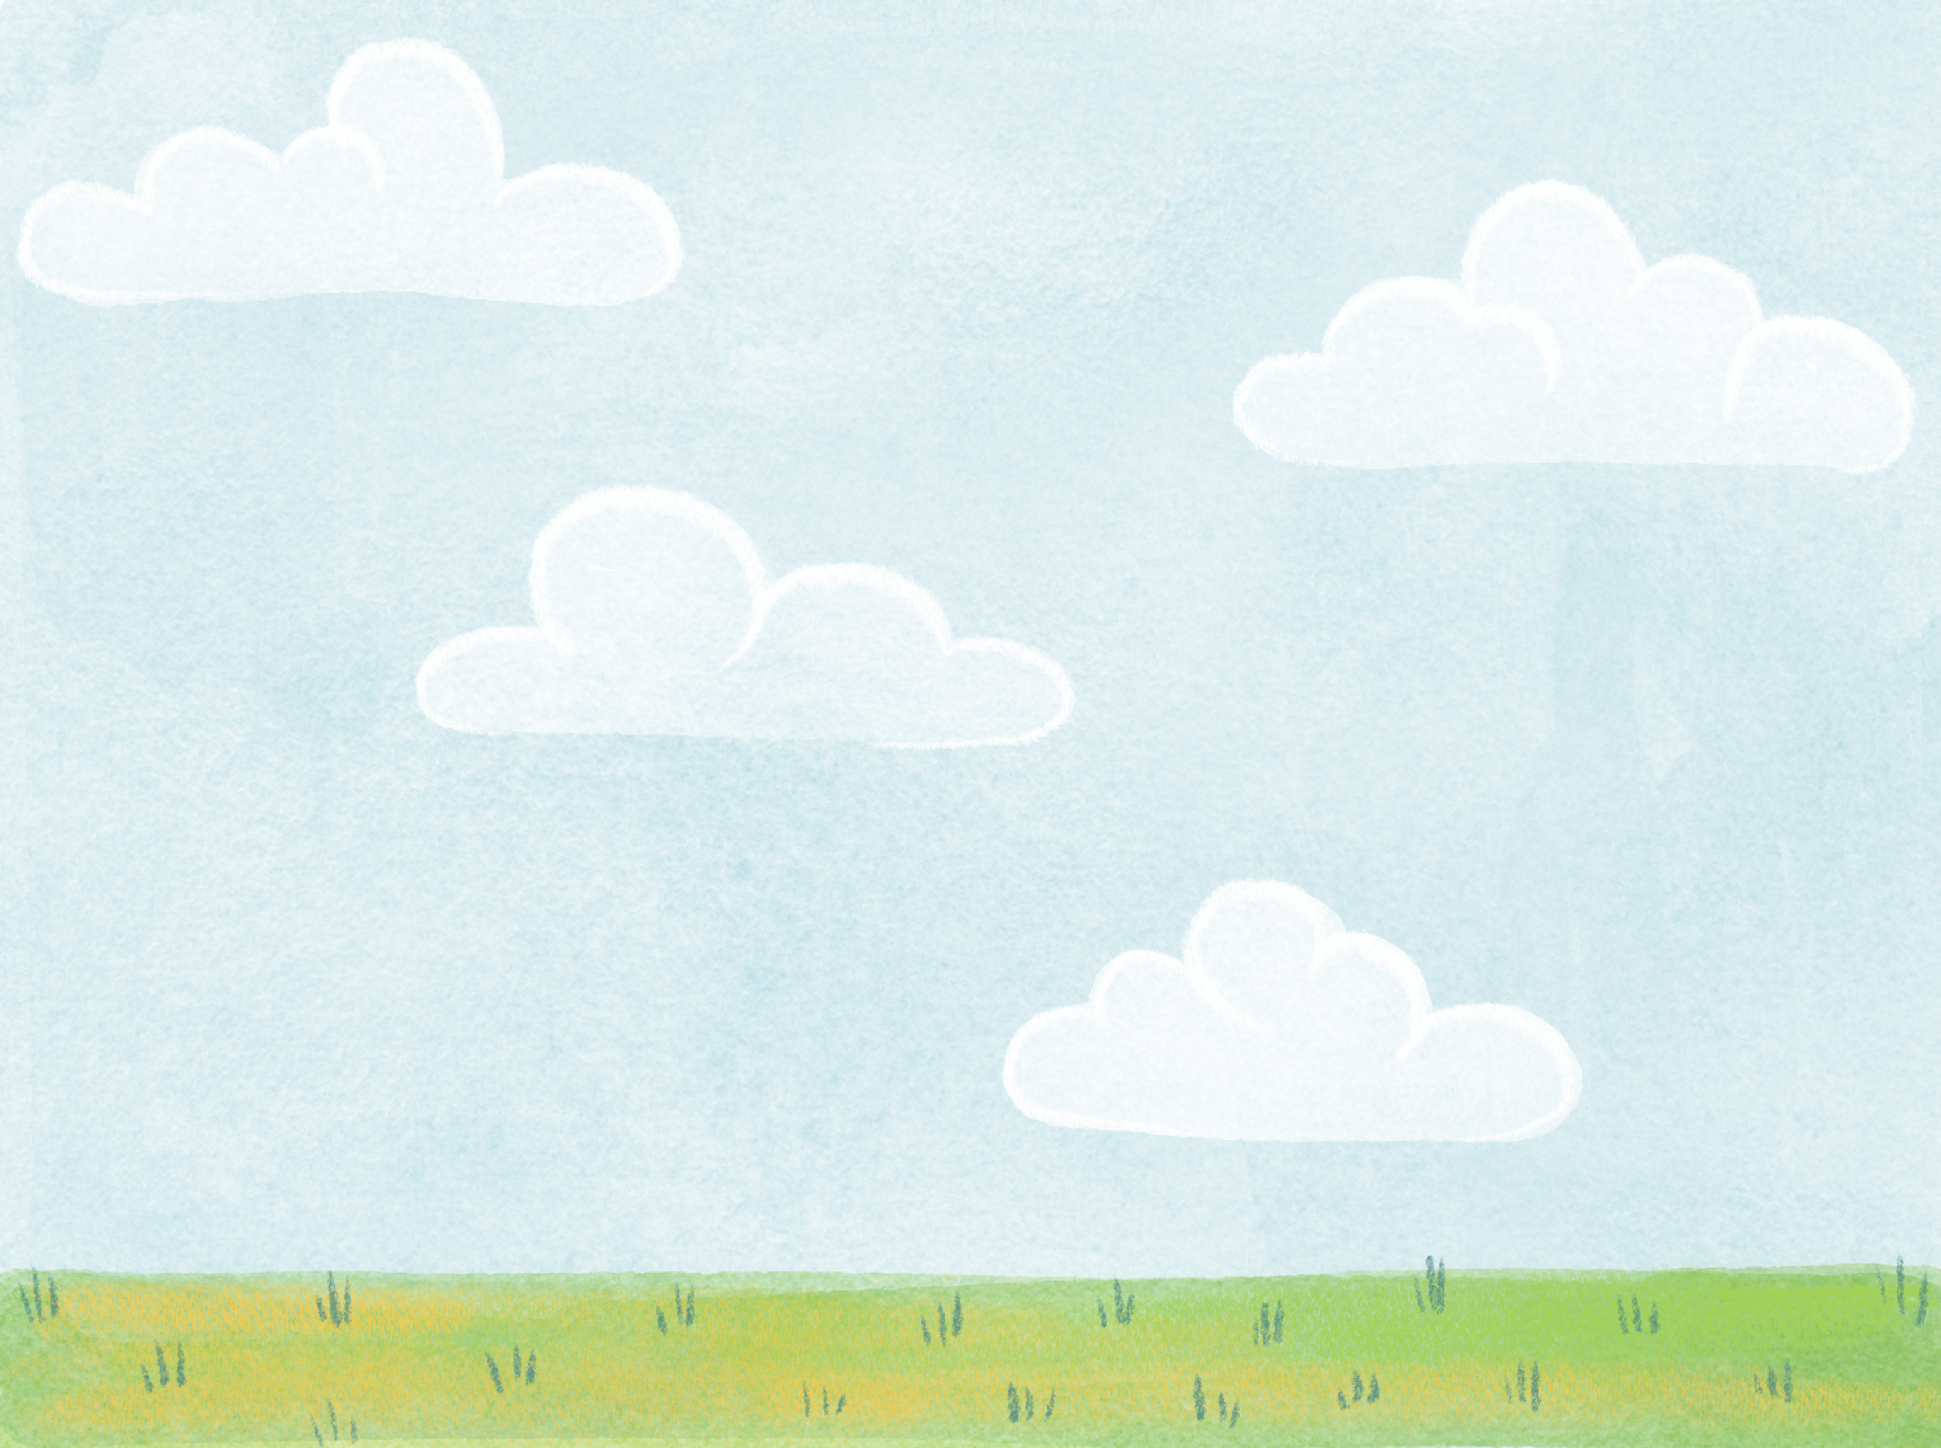

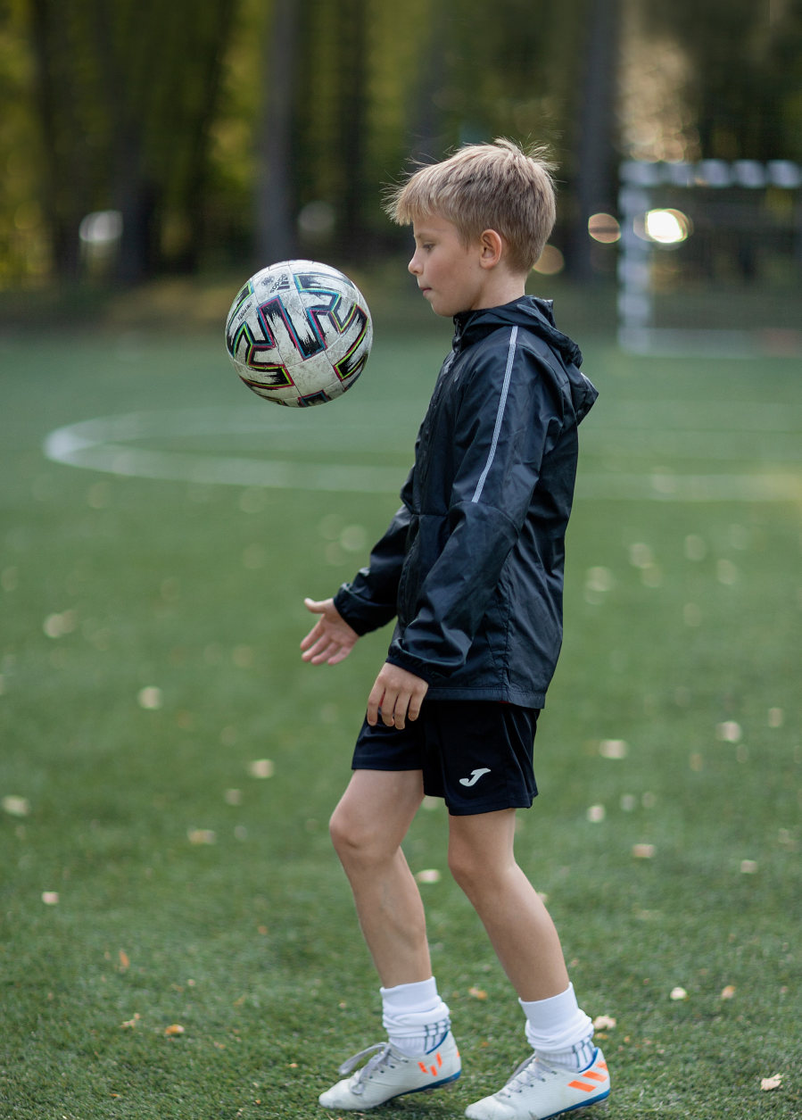
What is the boy doing ?
He is practising sport.

Slide 9
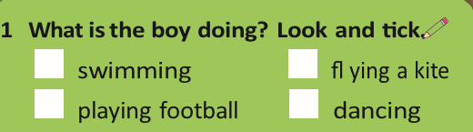
✓
2 What do you like doing in your free time ?

Slide 10
Presentation
02

Slide 11
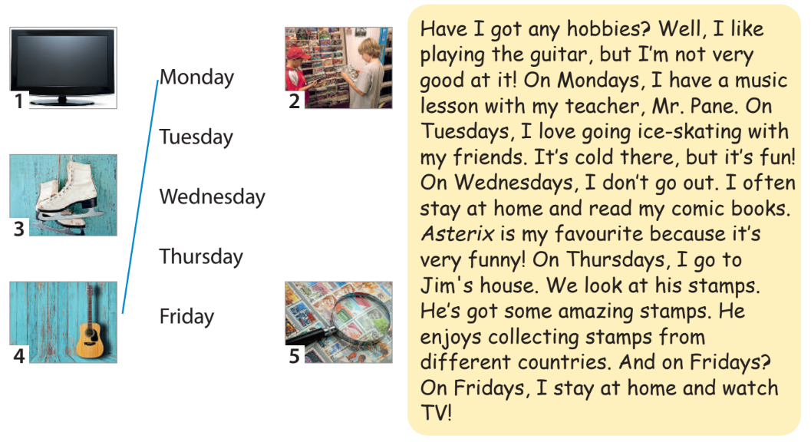
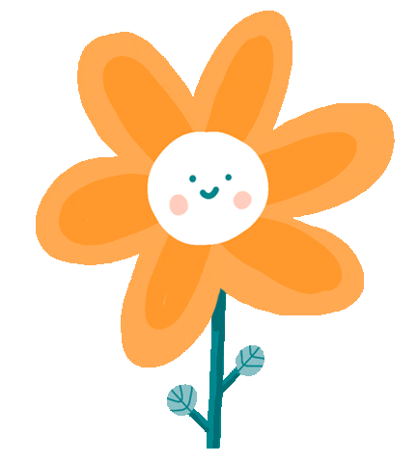
1 Listen and read about Adam’s hobbies. Match the pictures to the correct days. Track 4.1

Slide 12
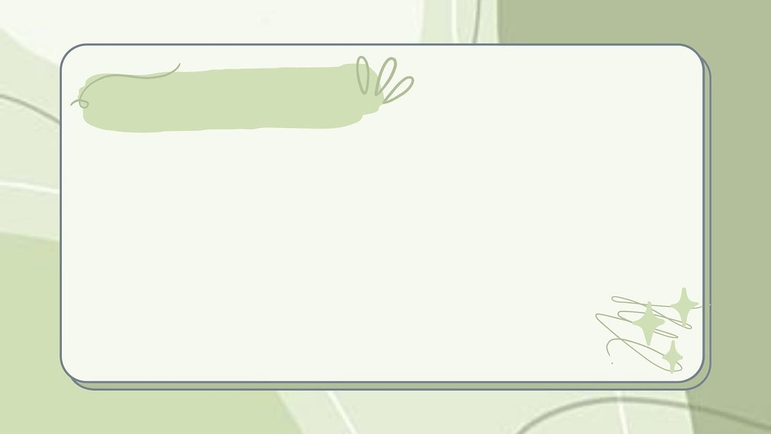
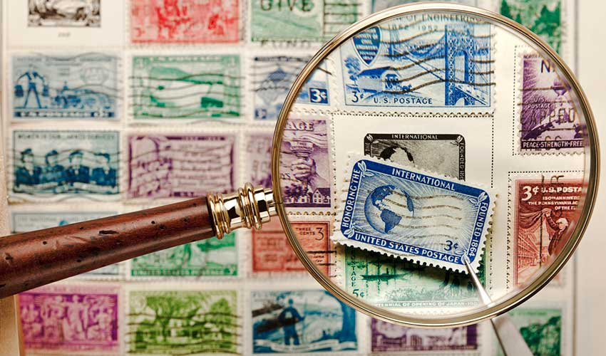
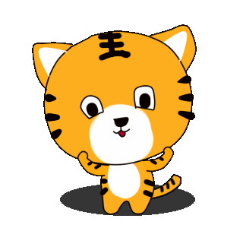
collect stamps
/kəˈlekt stæmps/

Slide 13
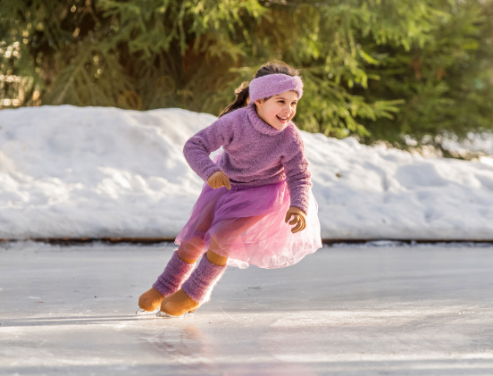
go ice-skating
/ɡəʊ ˈaɪs ˌskeɪ.tɪŋ/

Slide 14
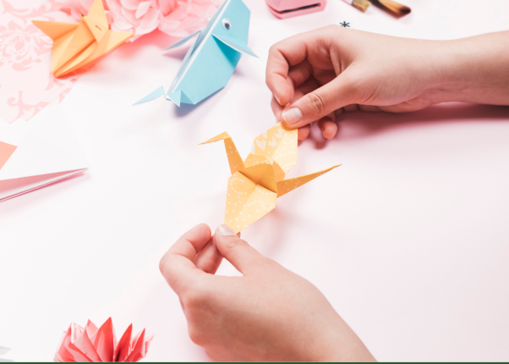
make a paper bird
/meɪk ə ˈpeɪ.pər bɜːd/

Slide 15
play the piano
/pleɪ ðə piˈæn.əʊ/

Slide 16
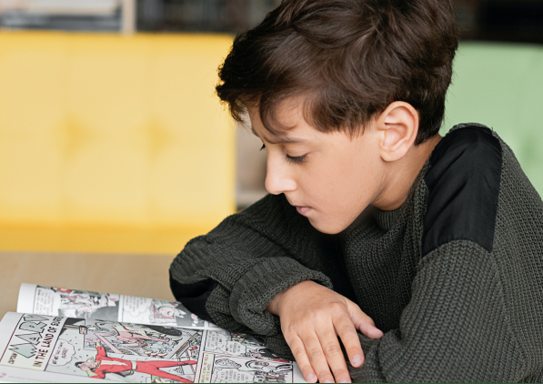
read comic books
/riːd ˈkɑm.ɪkˌbʊks/

Slide 17
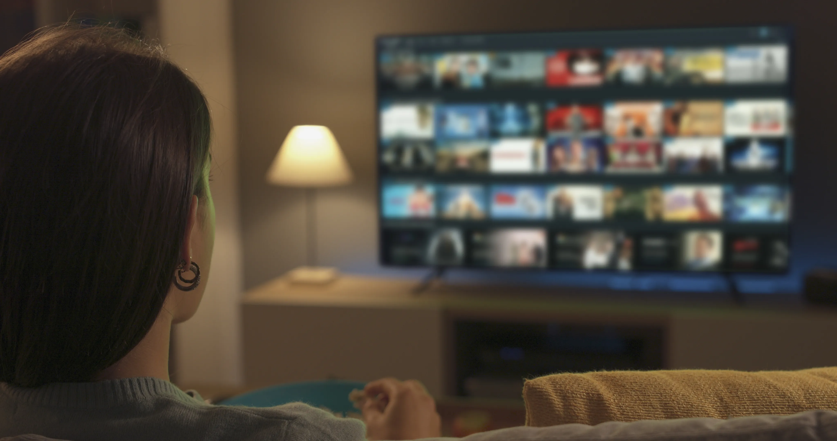
watch movies
/wɒtʃ ˈmu.viz/

Slide 18


2 Listen, point and repeat.
collect stamps
go ice-skating
make a paper bird
play the piano
read comic books
watch movies

Slide 19



Let’s play a game
Sharp eyes

Slide 20



Slide 21
play the piano

Slide 23
read comic books

Slide 25
make a paper bird

Slide 27
go ice-skating

Slide 28
Practice
03

Slide 29

Game
Protect the forest

Slide 30

3 Circle the word that does NOT belong
1 watch ____
a TV b a story c a film
2 go ____
a coins b swimming c ice-skating
3 read ____
a a story b the guitar c a comic book
4 collect ____
a coins b stamps c the piano
5 play ____
a the flute b a film c the drums

Slide 31
Production
04

Slide 32
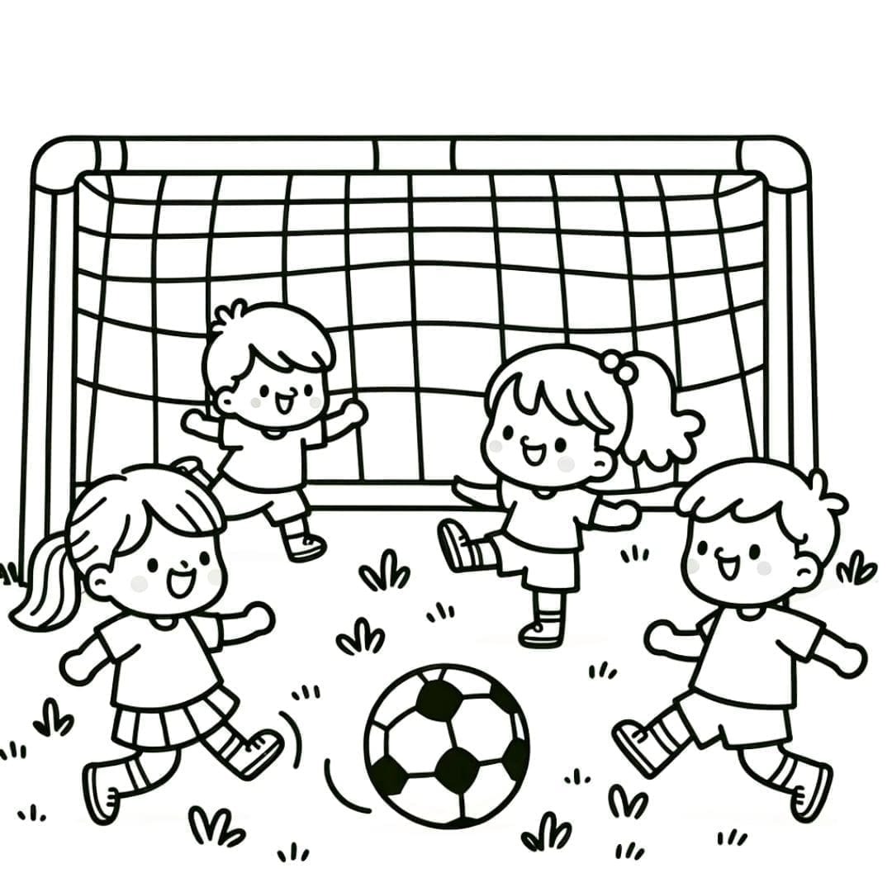
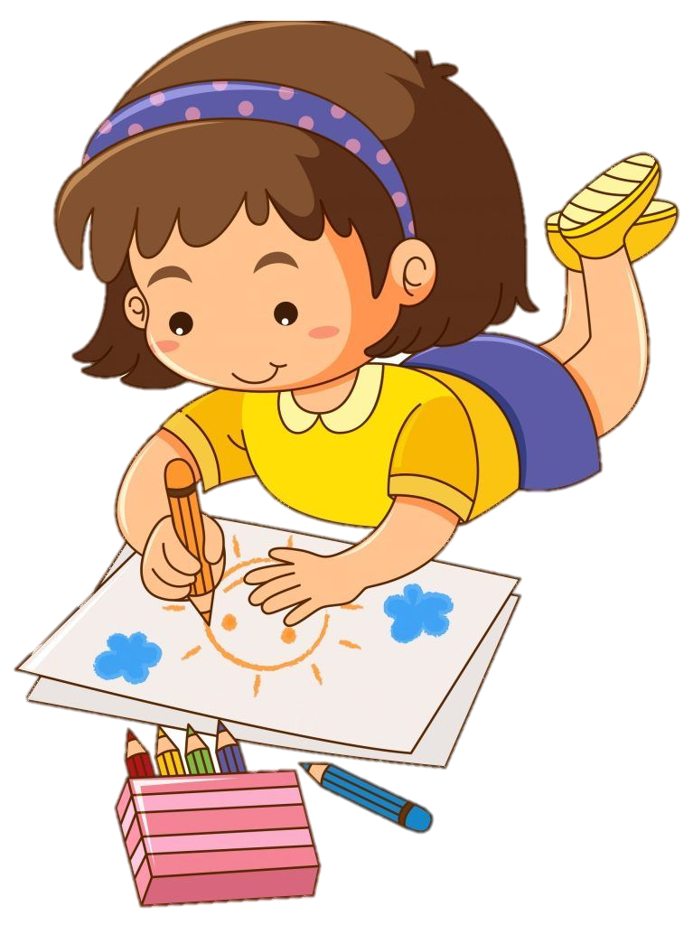
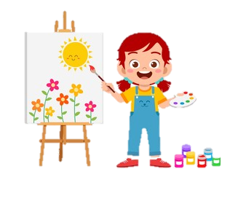
Draw a picture and talk about your free time.
Example:

Slide 33
Wrap-up & Assessment
05

Slide 34

Unit 4: Free time Lesson 1 – Part 1,2,3
What have we learnt today?
Vocabulary:
collect stamps, go ice-skating, make a paper bird, play the piano, read comic books, watch movies.

Slide 35
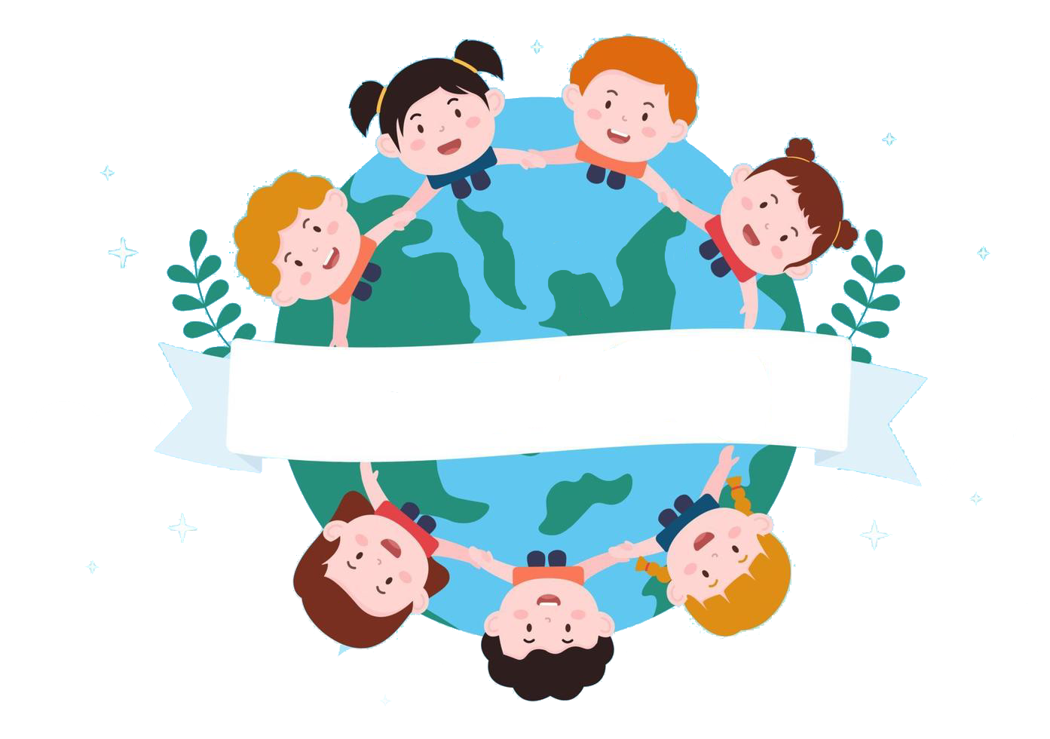
Thank you
& goodbye!

