Slide 1




















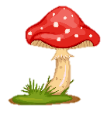
Notes:
Để nguyên trang bìa như này, chỉ thay đổi tên bài trong quá trình làm. Logo của sách Wonderful World

Slide 2
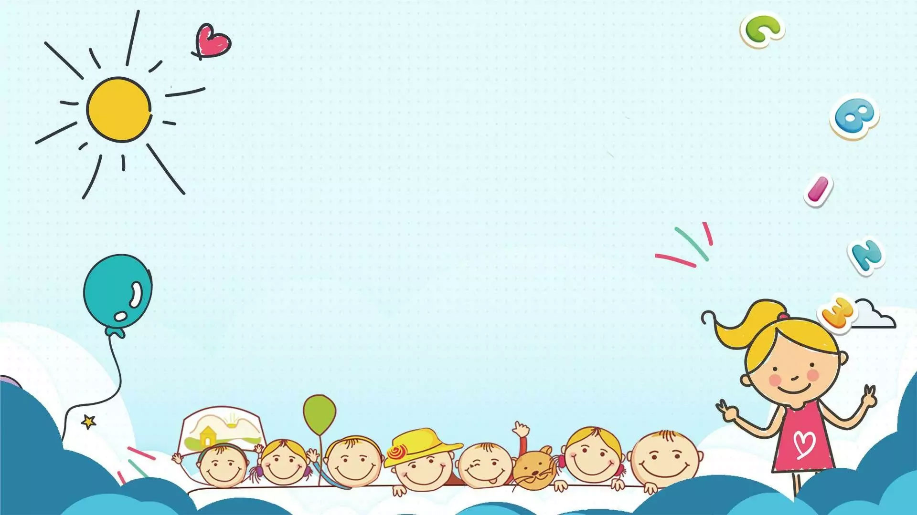



Unit: 4
FREE TIME
Lesson 1: Task 4, 5, 6

Slide 3
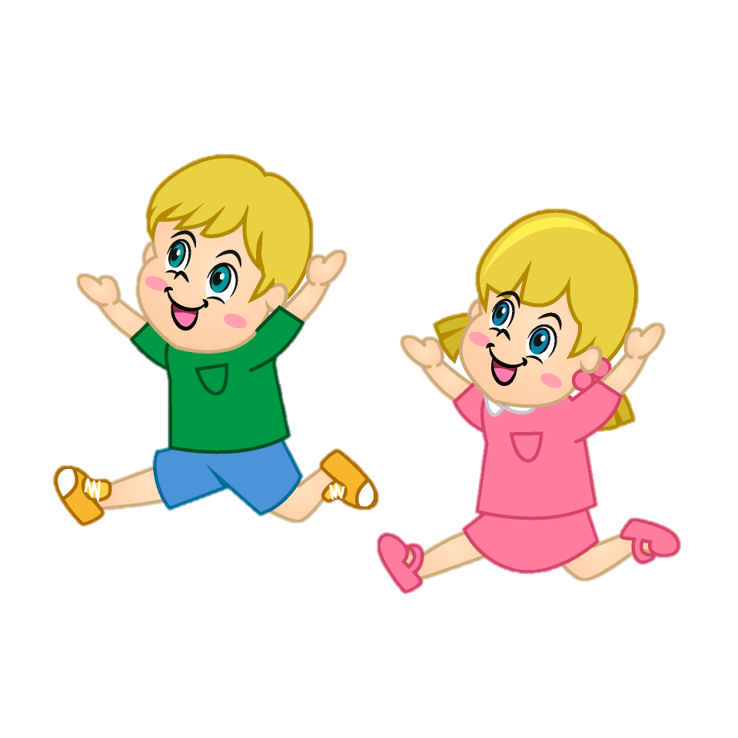
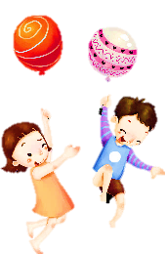



Warm-up
01

Slide 4
Presentation
02

Slide 5




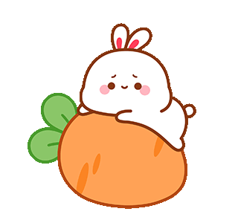
I like playing football.
I love playing outside.
I enjoy reading comic books.

Slide 6
like / love / enjoy + V-ing
I/You/We/They + like/love/enjoy + V-ing

Slide 7
- She playing the piano.
like /
likes
She/He/It + likes/loves/enjoys + V-ing

Slide 8
Good at
I am good at playing soccer.
S + is/am/are + good at + V-ing

Slide 9
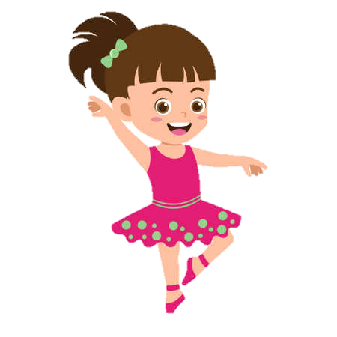

Is she good at dancing?
Yes, she is.

Slide 10

To be + S + good at + V-ing?
Yes, S + to be.
x No, S + to be + not.

Slide 11
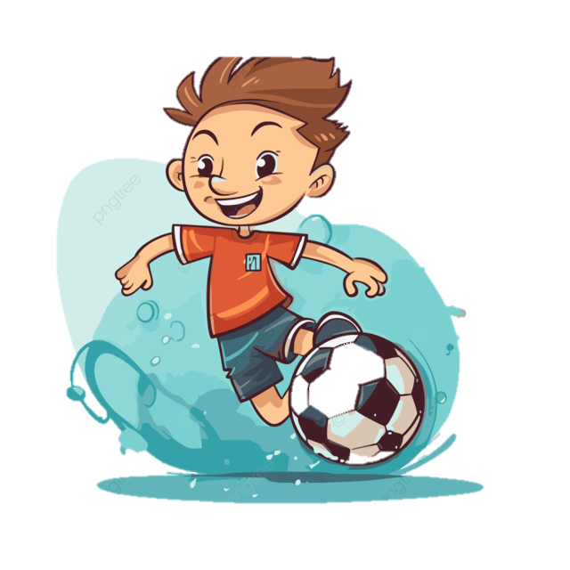
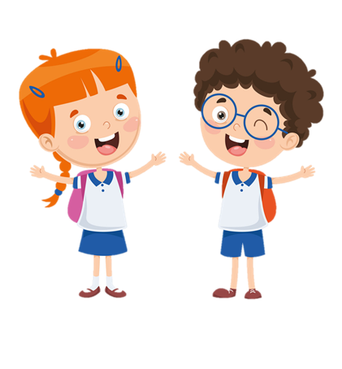
What do you like doing?
I like playing football.

Slide 12
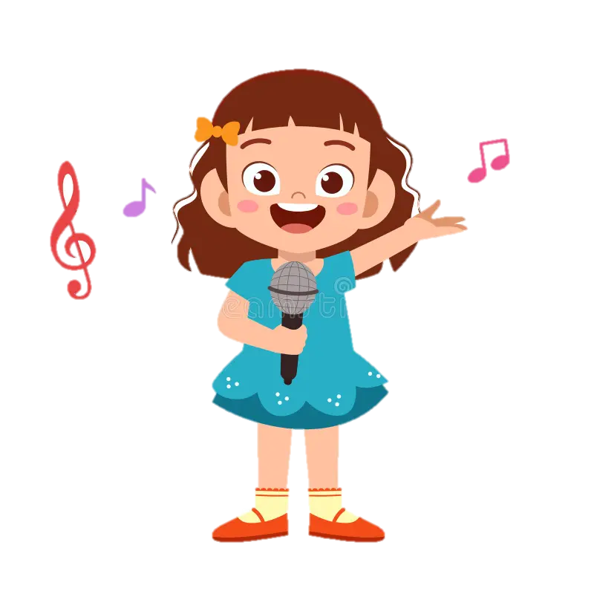
What is she good at?
She is good at singing.

Slide 13

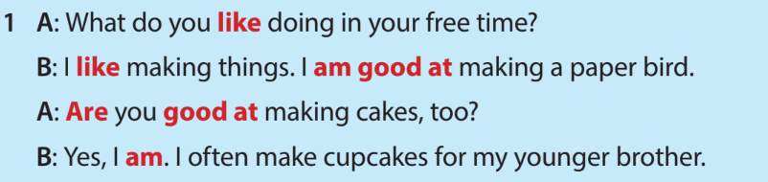
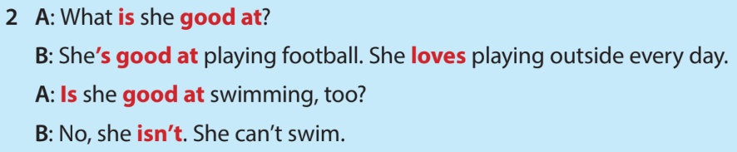


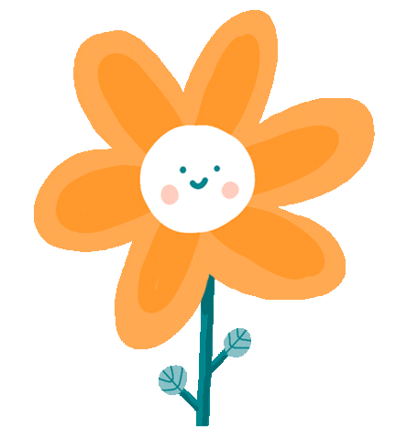
4 Listen and read.

Slide 14
Practice
03

Slide 15



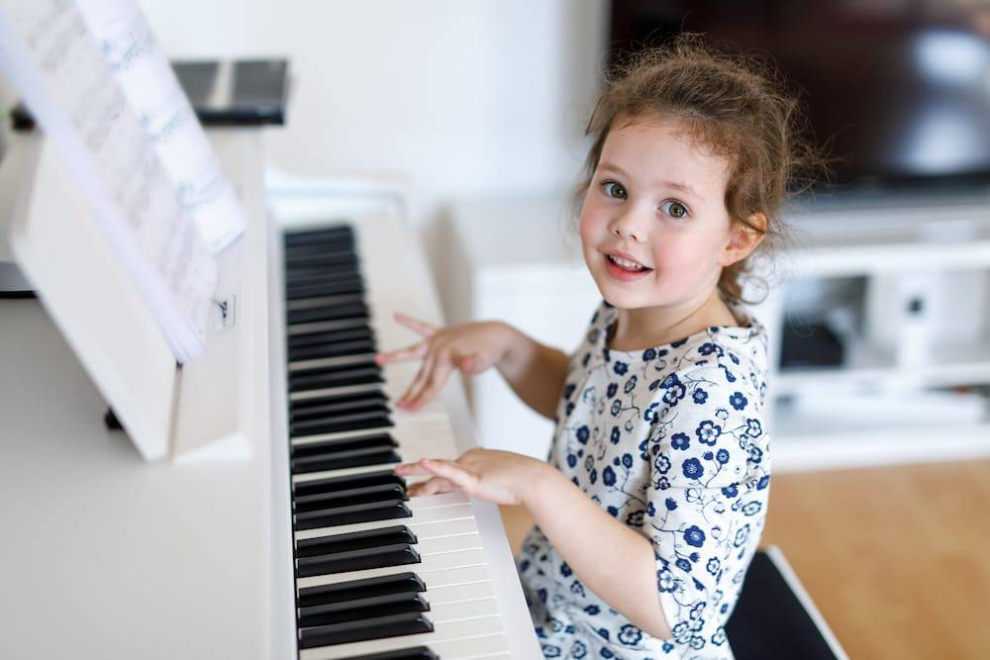
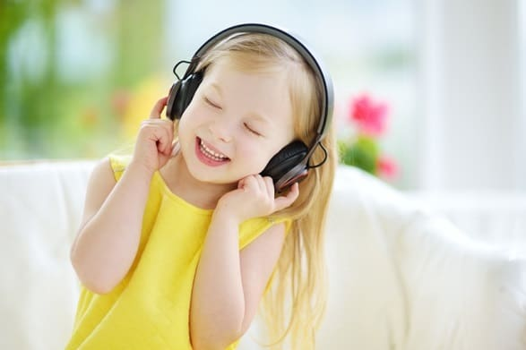
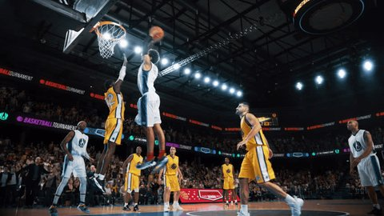
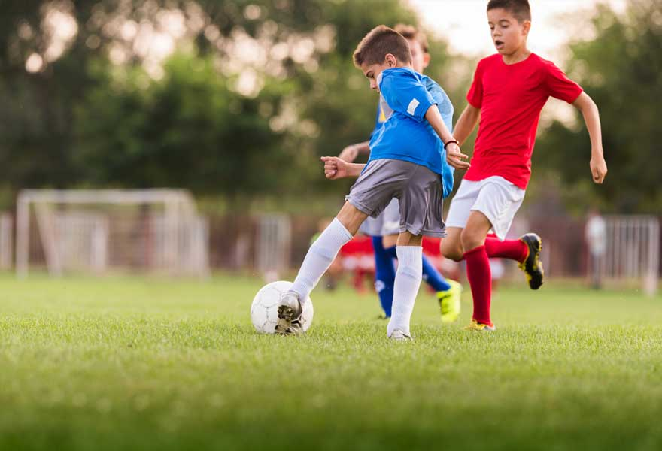


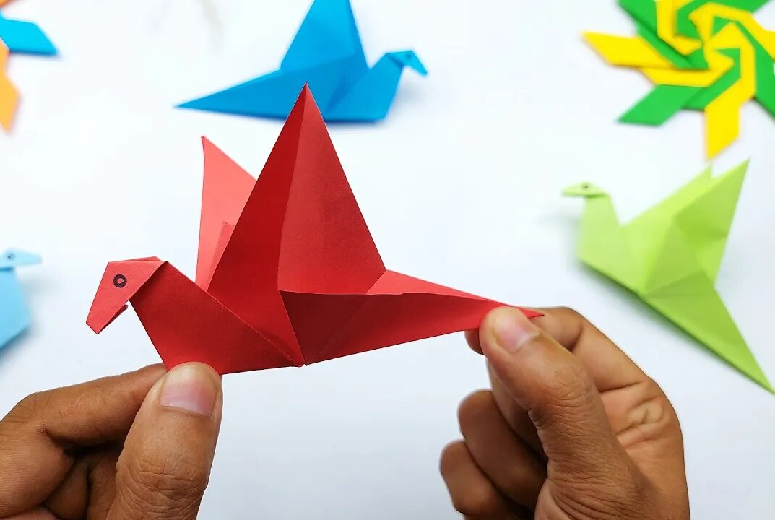
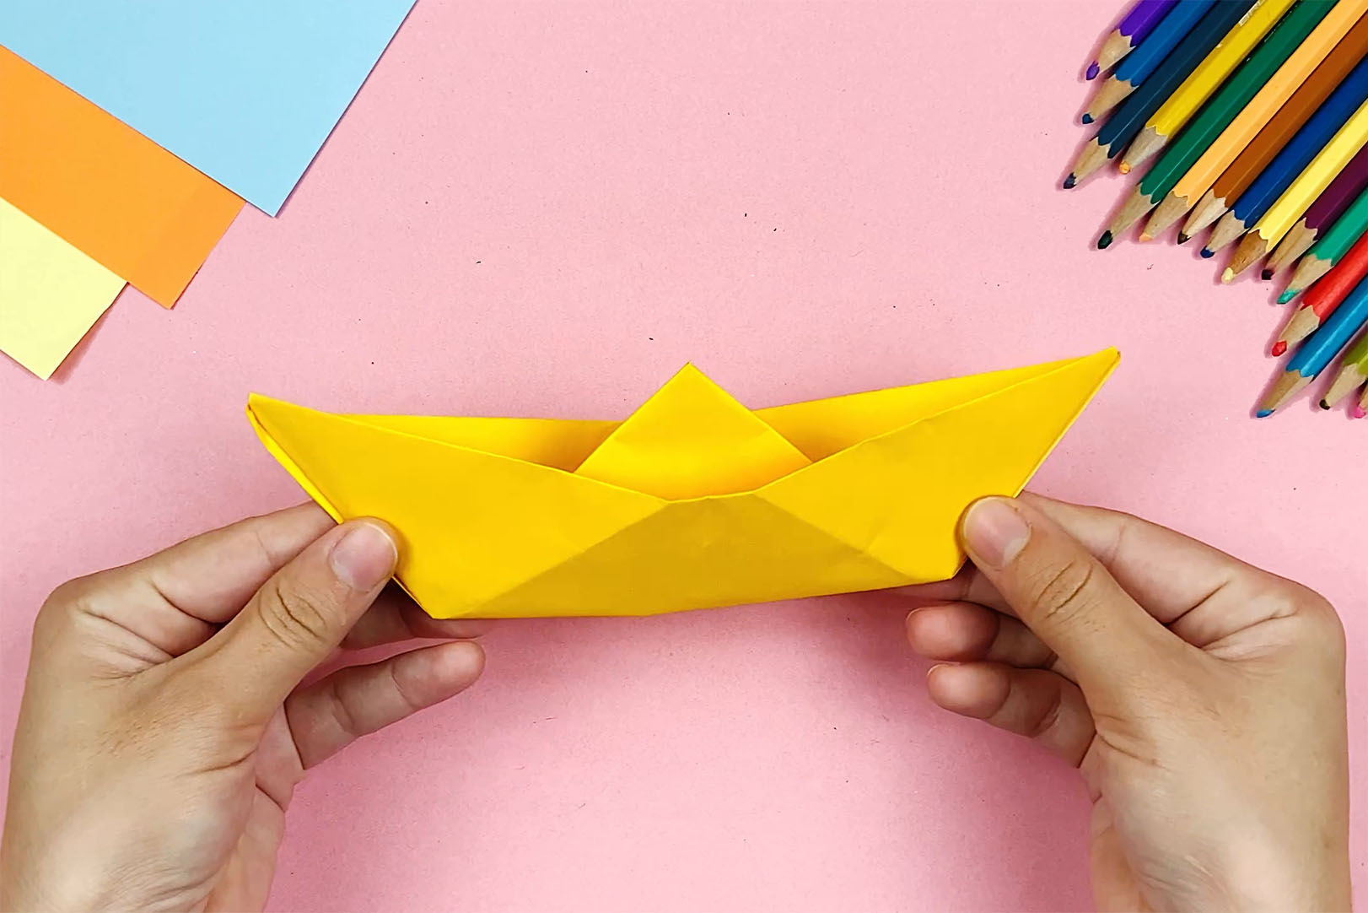
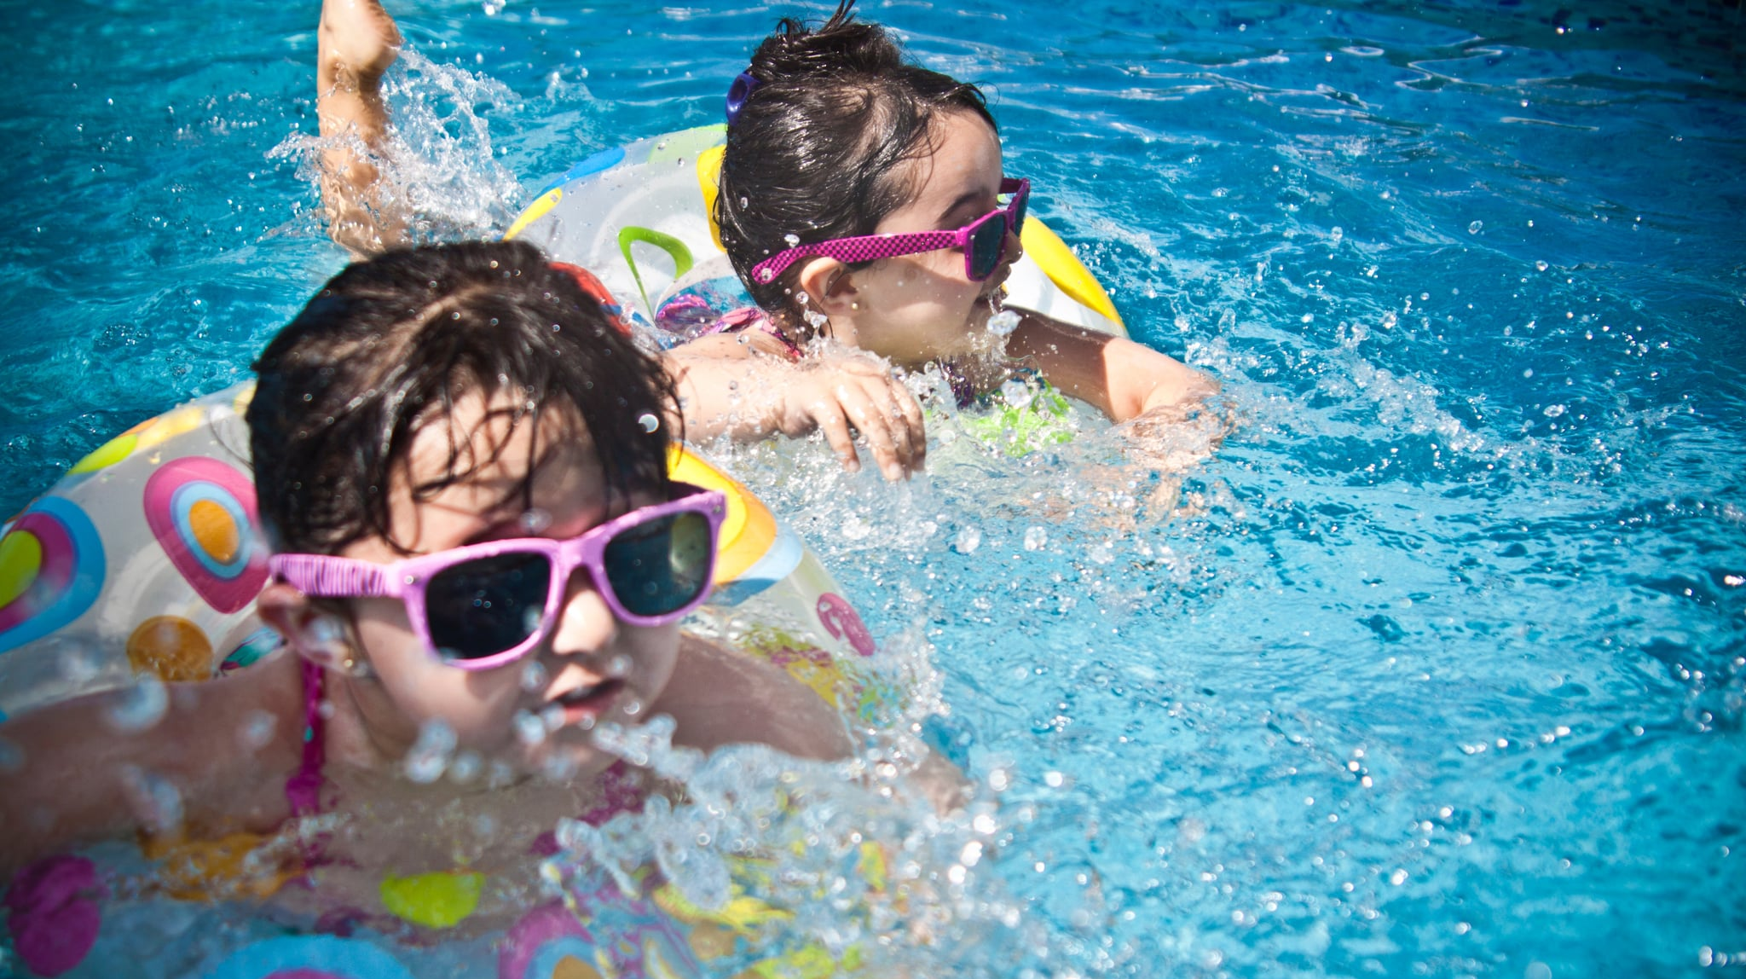
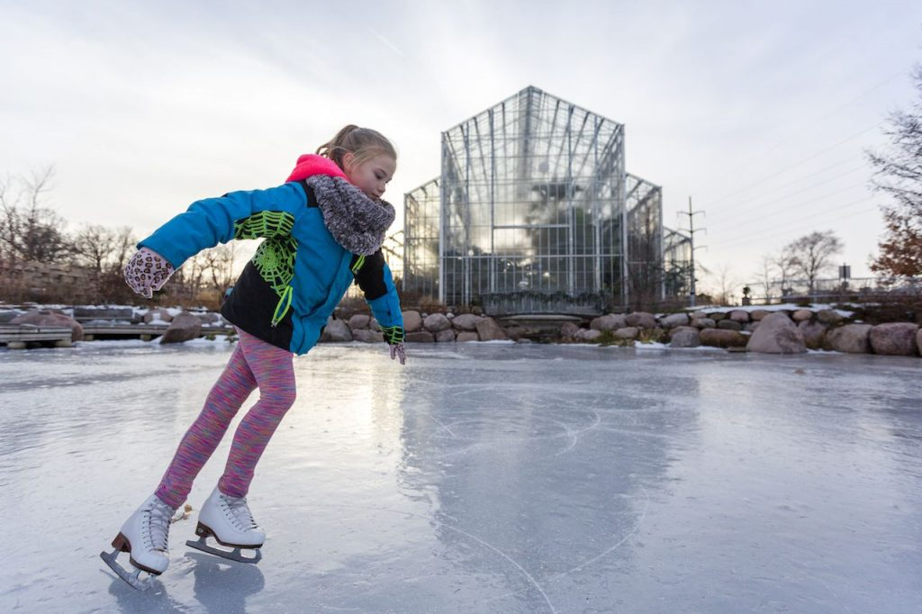
5 What are they good at?
Listen and tick ( ) or cross ( X ).
X
X
X
X

Slide 16
Production
04

Slide 17

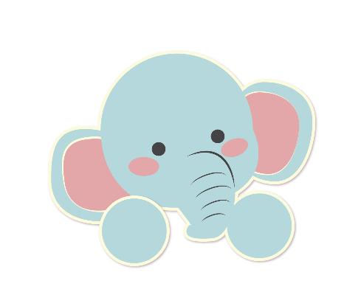
6 Let’s talk.
Love
love like enjoy be good at make
collect go play watch read

Slide 18
Wrap-up & Assessment
05

Slide 19
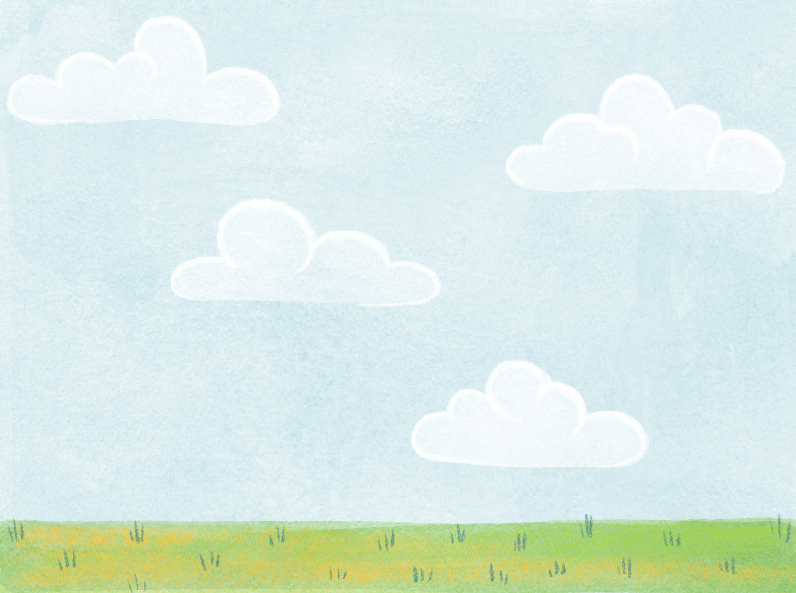


Unit 4: Free time Lesson 1 – Part 4,5,6
What have we learnt today?
Vocabulary:
Learn and use new grammar:
to be + good at/ love + V-ing .

Slide 20
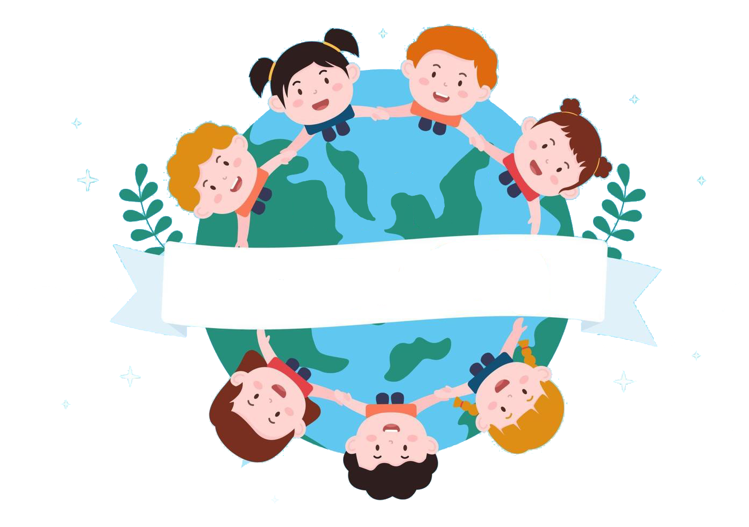
Thank you
& goodbye!

