Slide 1





















Notes:
Để nguyên trang bìa như này, chỉ thay đổi tên bài trong quá trình làm. Logo của sách Wonderful World

Slide 2
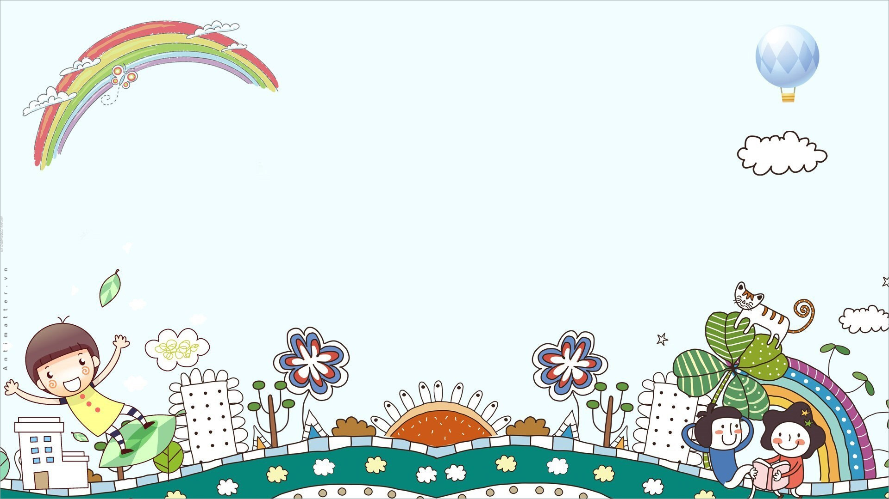




Unit: 4
FREE TIME
Lesson 2: Part 1, 2, 3

Slide 3





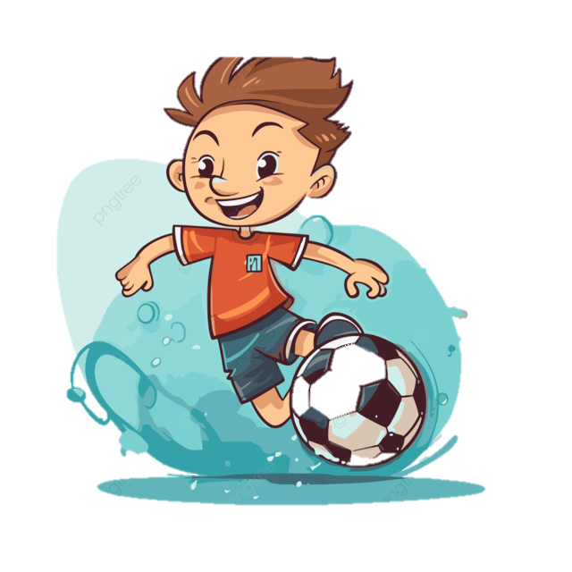
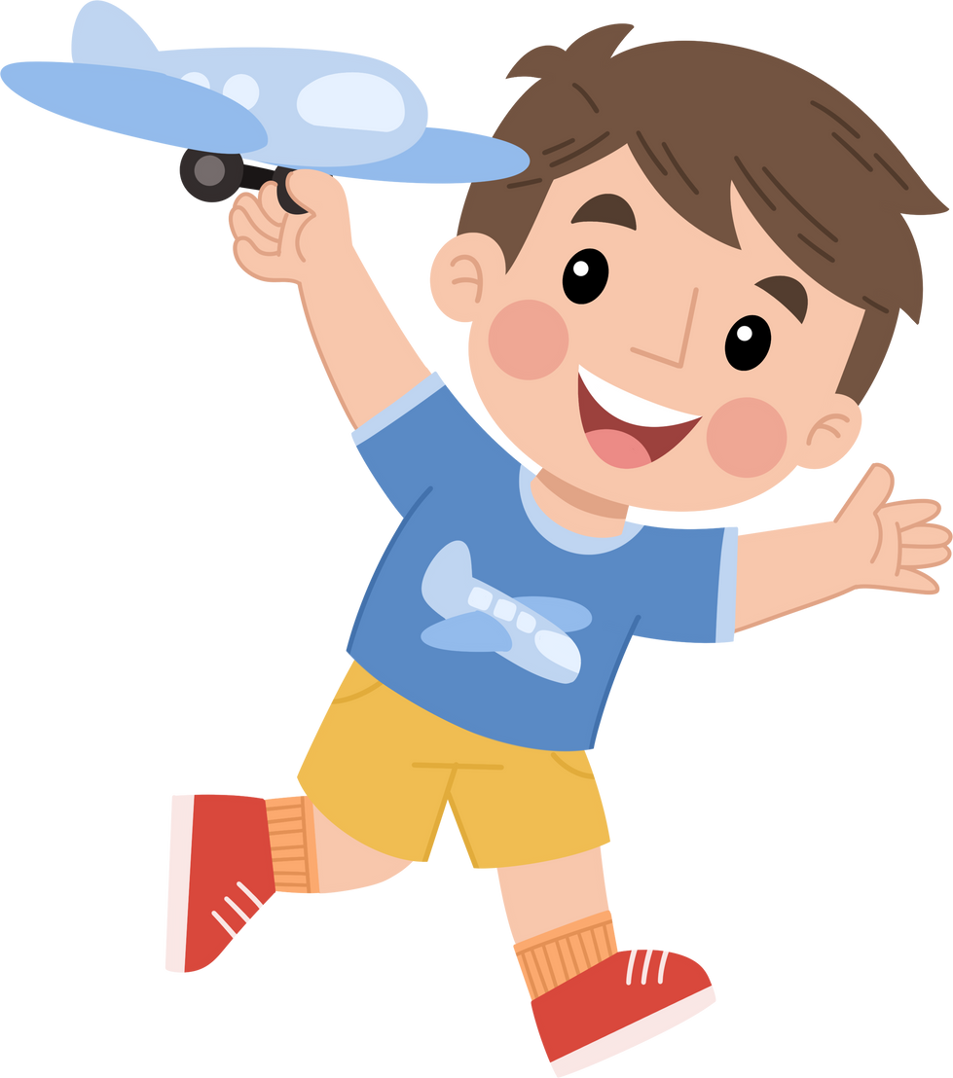



Table of contents
01
02
Warm-up
Presentation
04
05
Production
Wrap-up & Assessment
03
Practice

Slide 4
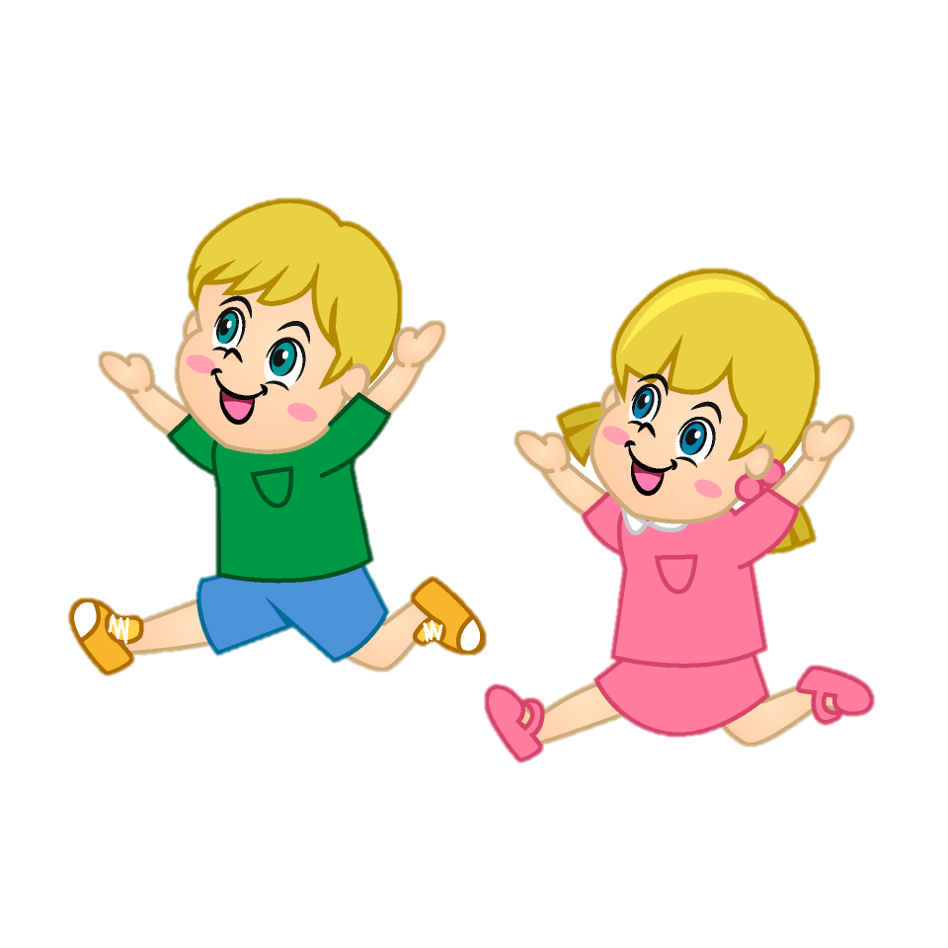
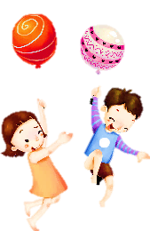

Warm-up
01

Slide 5


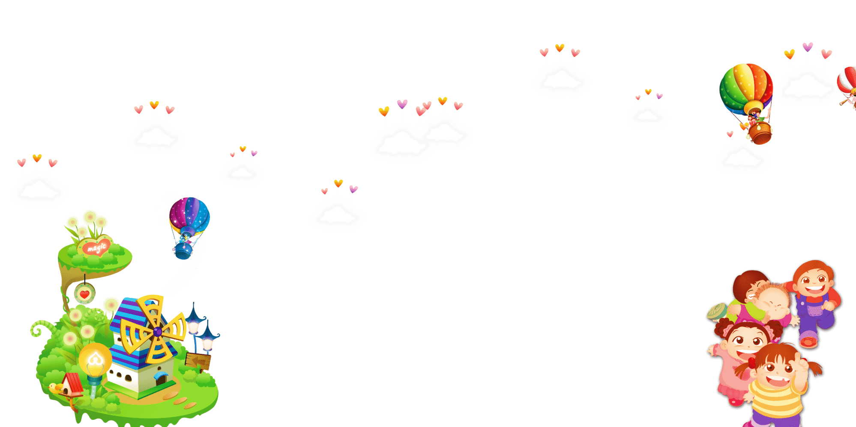


Guessing game
01
02
03
04
05
06

Slide 6


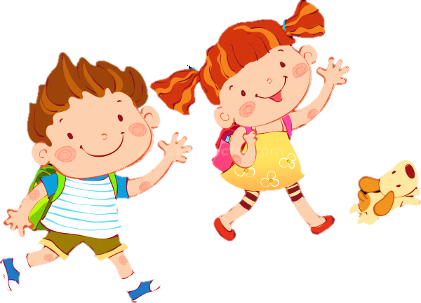

s t a m p s
10 stars
Notes:
Ngôi sao vàng góc phải bấm để quay về chọn số tiếp theo
- Ấn vào hộp quà để mở lấy sao.
Ấn vào trái tim góc dưới hộp quà là chuyển phần tiếp theo bài học

Slide 7


t h e p i a n o
10 stars

Slide 8
c o m i c b o o k s
7 stars

Slide 9
m o v i e s
8 stars

Slide 10
s w i m m i n g p o o l
5 stars

Slide 11
s p o r t s
8 stars

Slide 12
Presentation
02

Slide 13
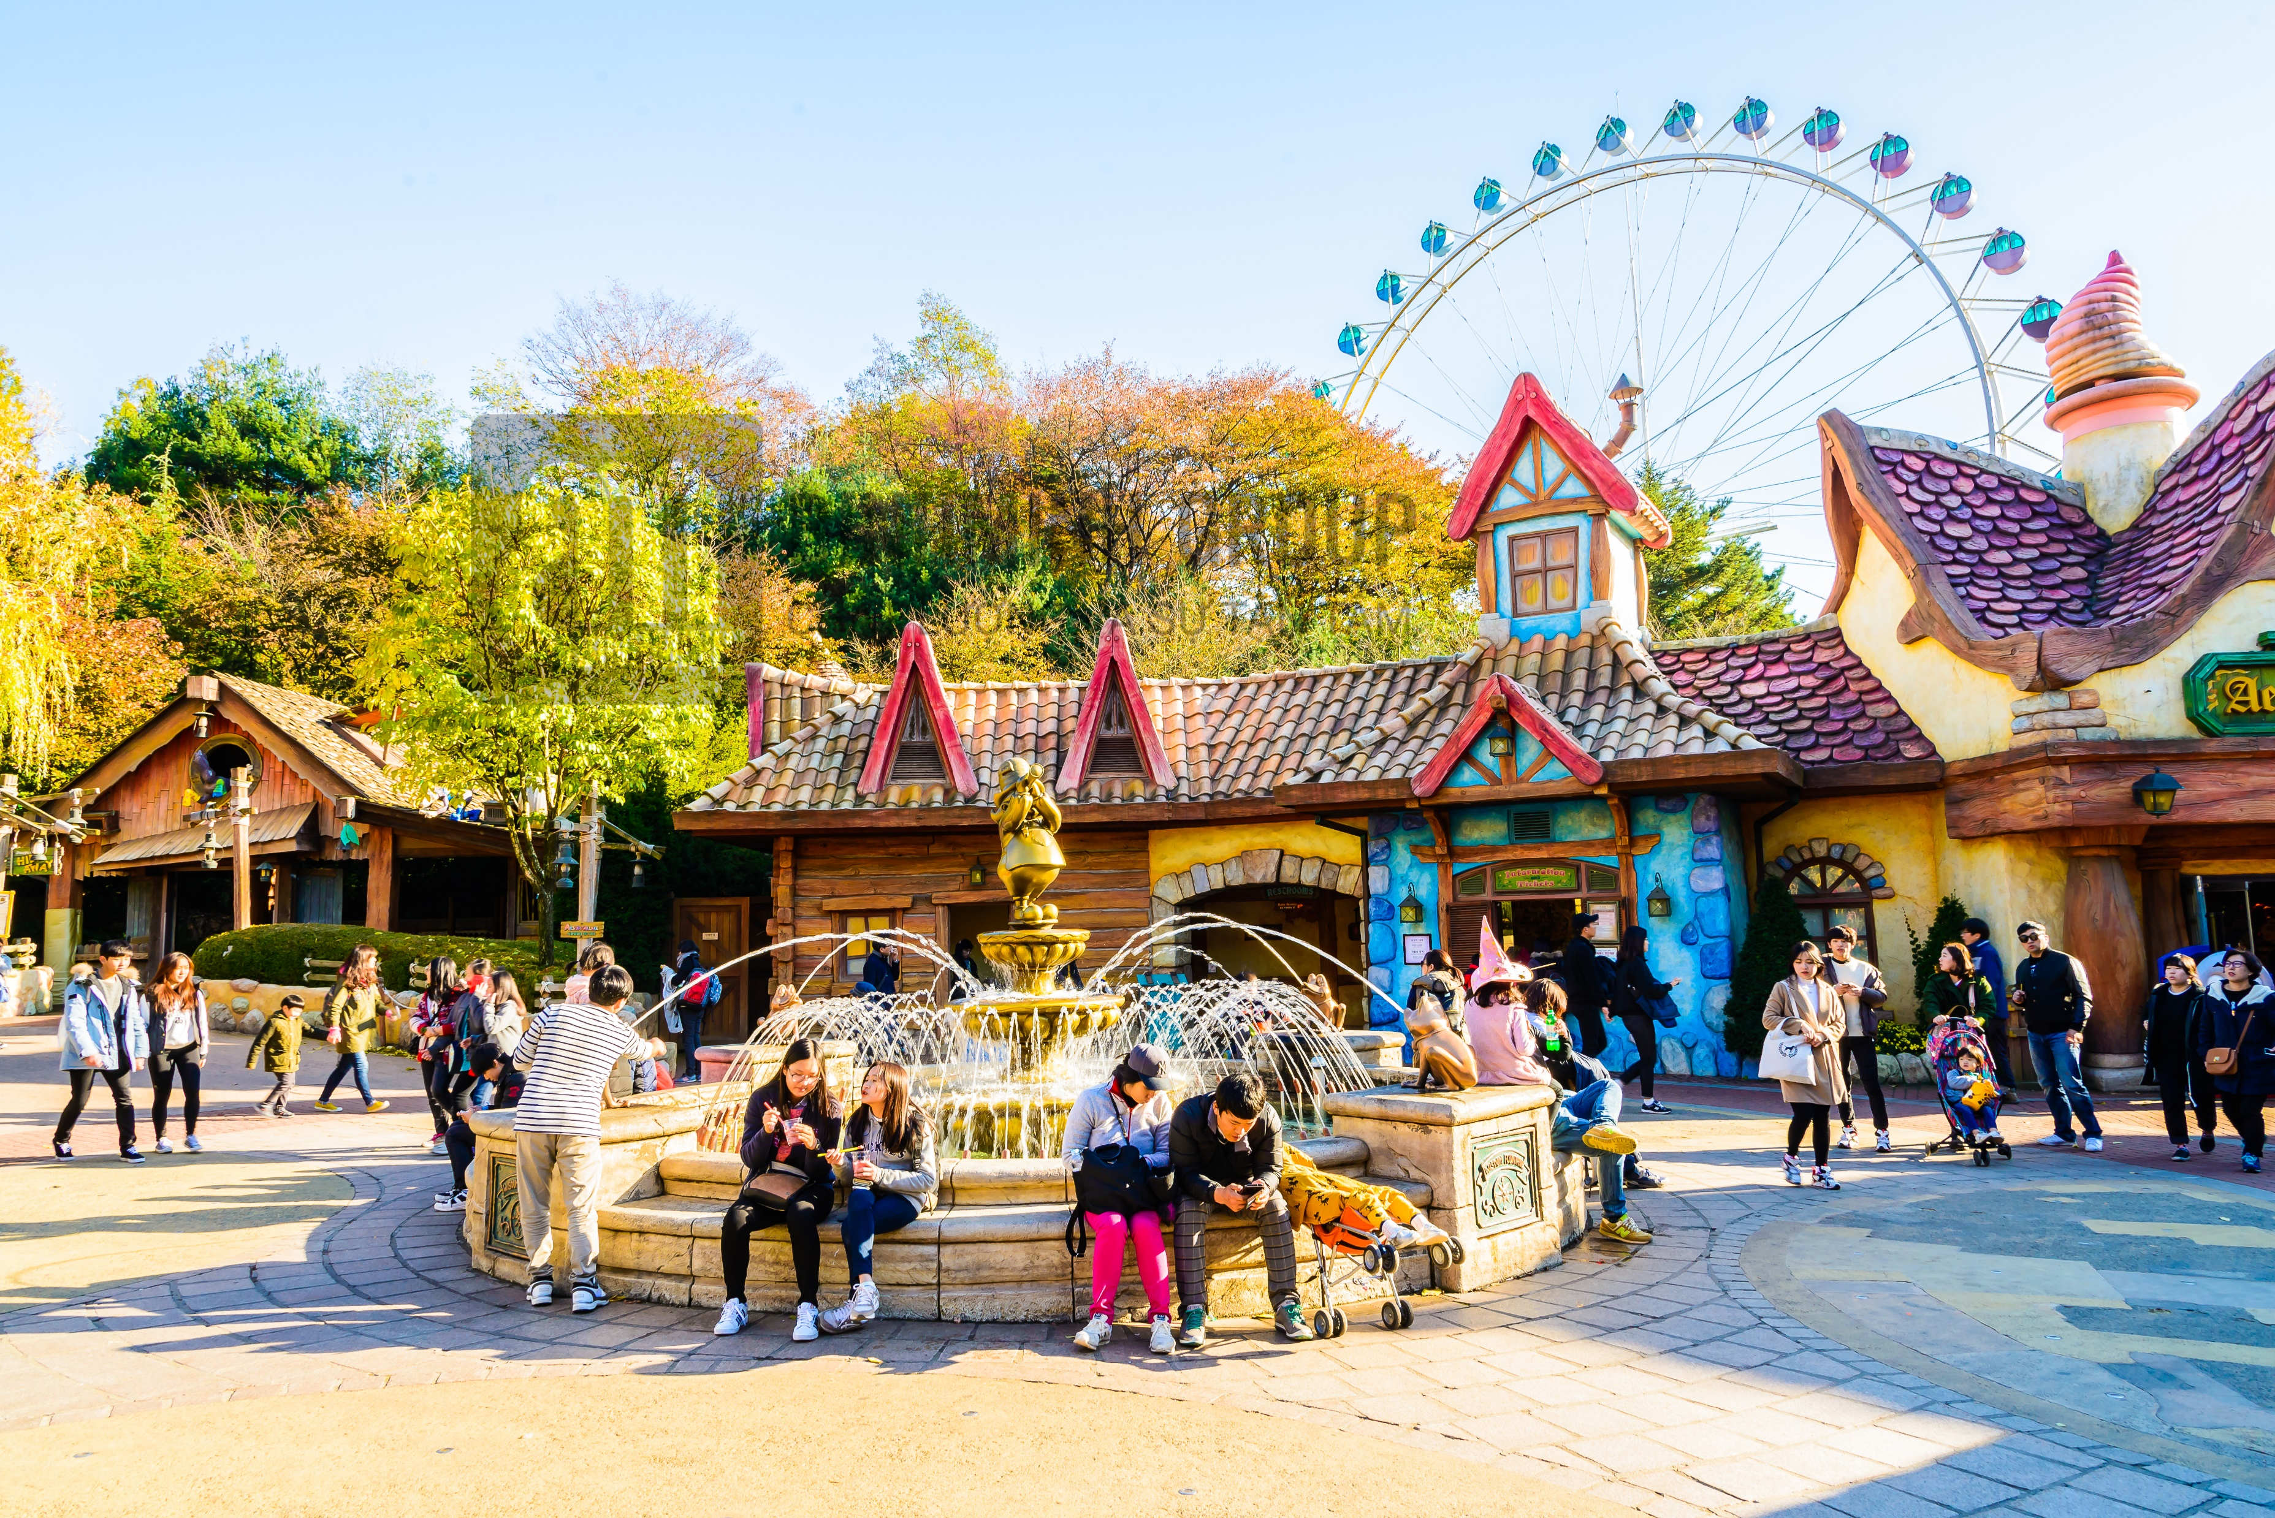

1 Listen and read. Where do Irina and Mia choose to go?
Mia: Hey, Irina. Let’s go to the amusement park to go on some rides.
Irina: No, thanks. I’m always scared of the rides!
Mia: Well, how about going to the cinema then? There’s a new scary film about monsters.
Irina: Oh no. Not a scary film! Hmm..
Mia: OK, then ... how about watching a cartoon at home?
Irina: That’s boring! I want to go out, Mia!
Mia: Let’s go to the bookshop then. Oops… But I don’t need any books.
Irina: How about going to the sports centre?
Mia: Great idea! We need to ask Mum first!
Irina: You’re right !
Mia: Mum, can we go to the sports centre now?
Mum: Of course, you can.

Slide 14
Where do Irina and Mia choose to go?
They want to go to the sports centre.

Slide 15


amusement park
/əˈmjuːz.mən pɑːk/

Slide 16
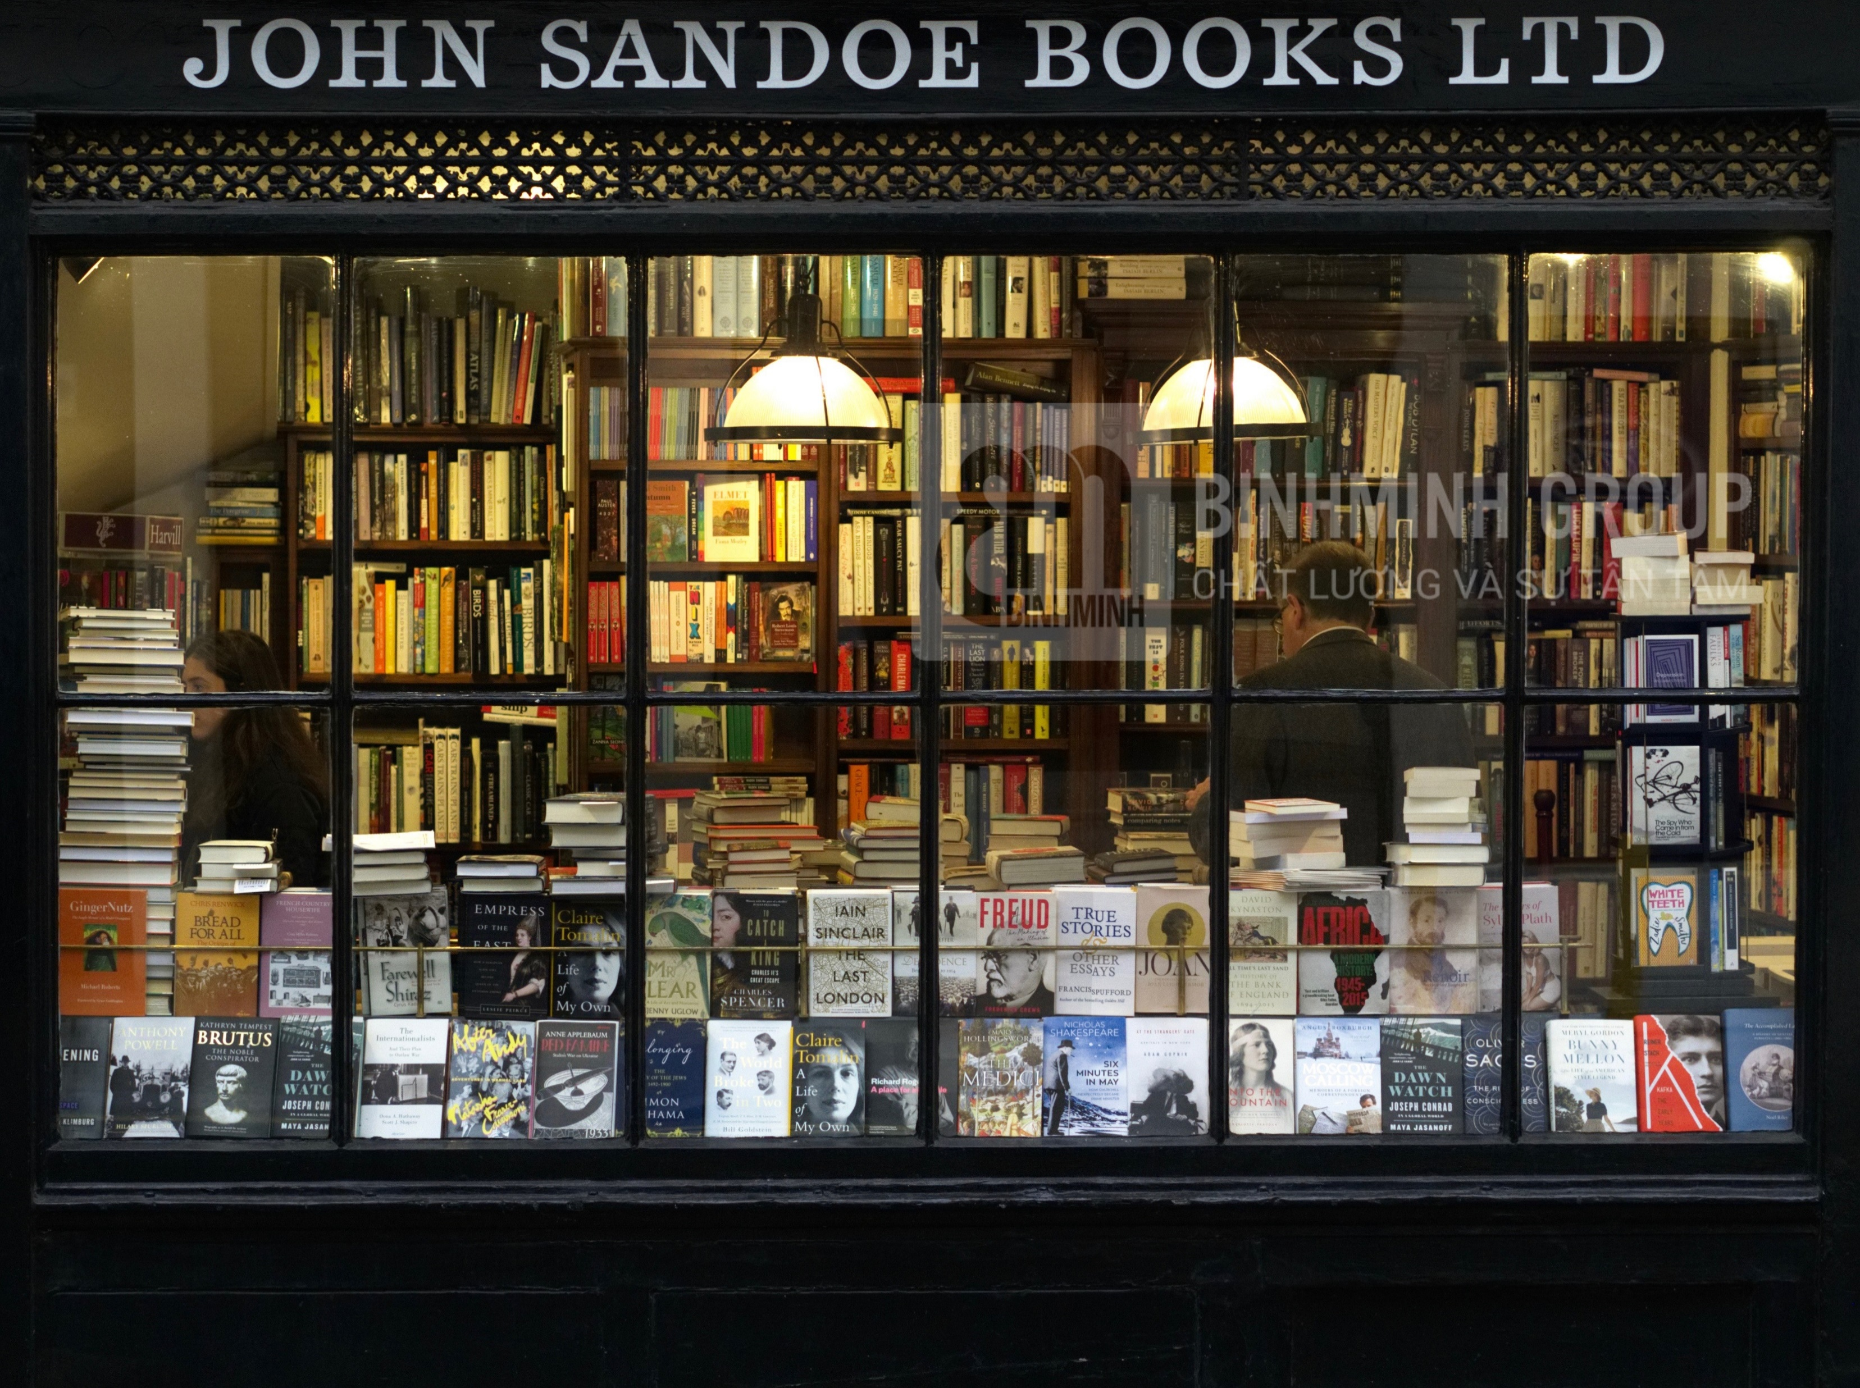
bookshop
/ˈbʊk.ʃɒp/

Slide 17
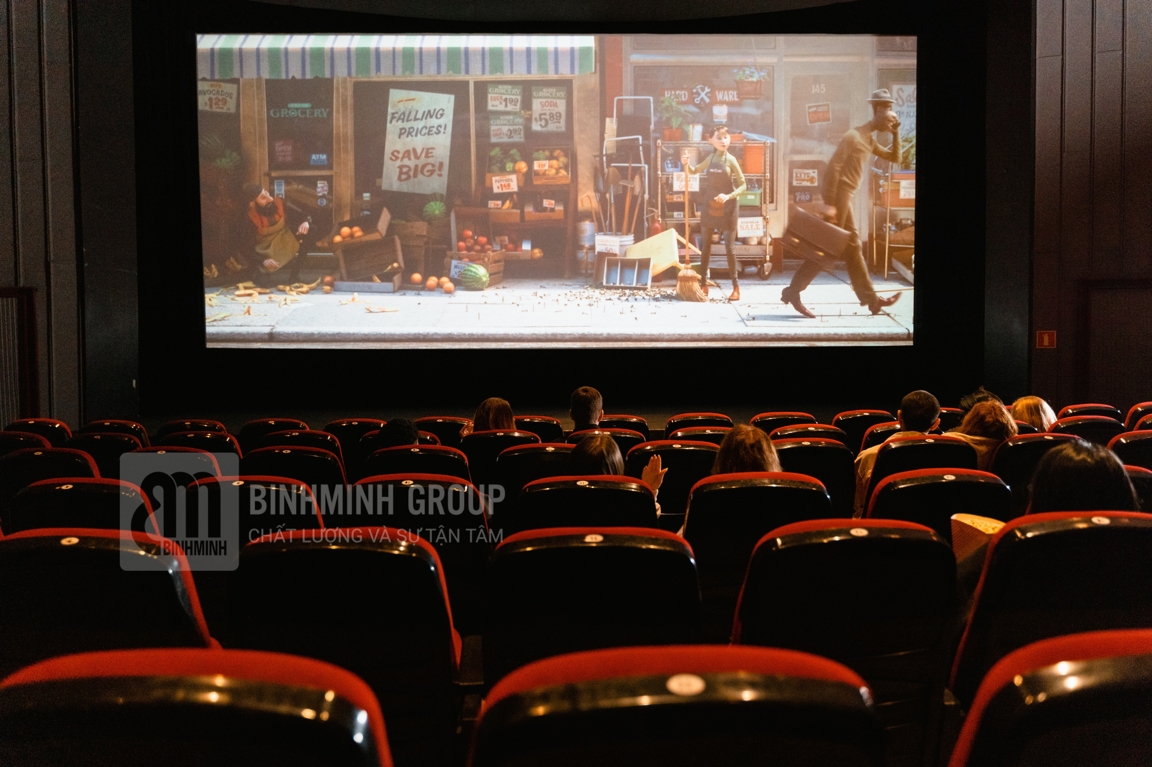
cinema
/ˈsɪn.ə.mɑː/

Slide 18
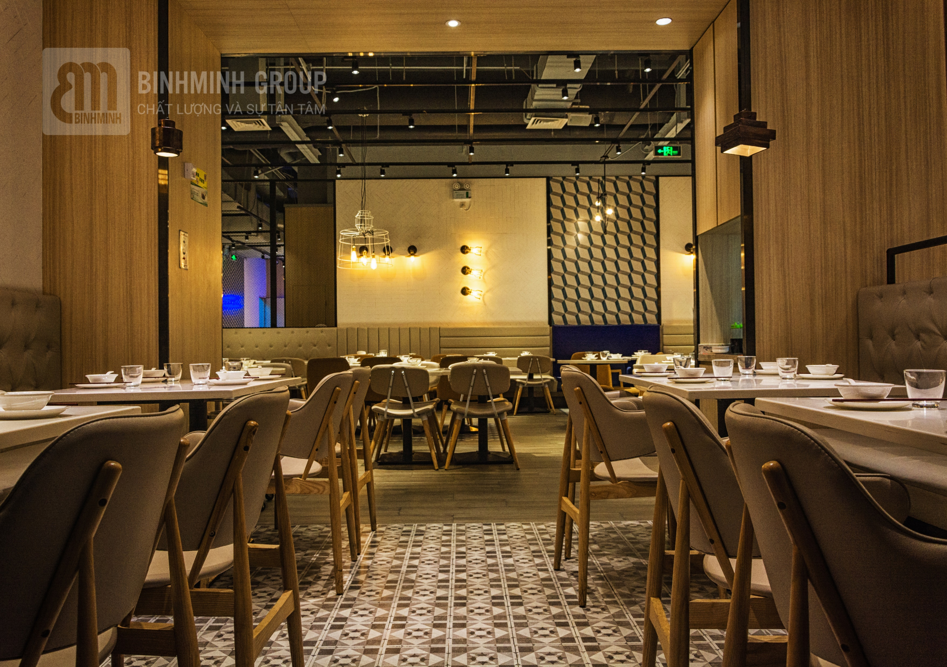
restaurant
/ˈres.tə.rɑːnt/

Slide 19
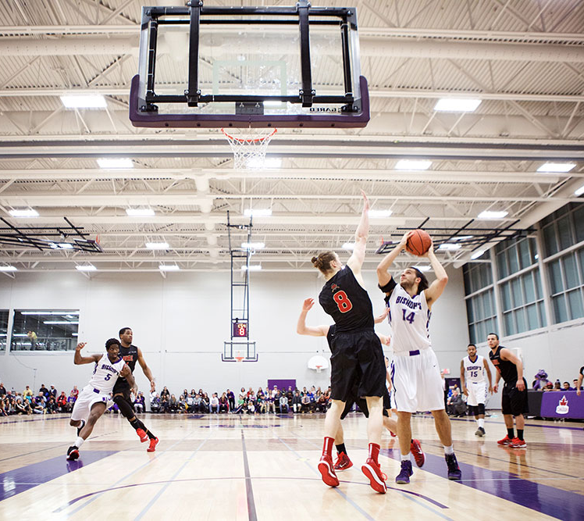
sports centre
/ˈspɔːts ˌsen.tər/

Slide 20




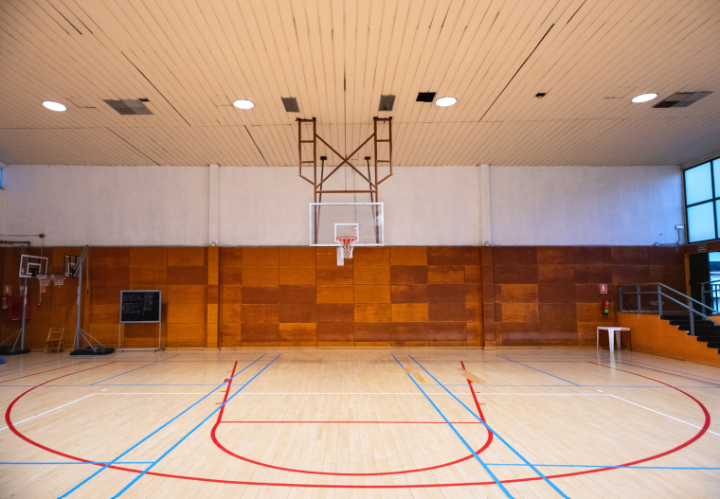

VOCABULARY
2 Listen, point and repeat
amusement park
bookshop
cinema
restaurant
sports centre

Slide 21
Practice
03

Slide 22
Production
04

Slide 23


Group: …………….
Class:…………..
cinema
places
watch movies

Slide 24
Wrap-up & Assessment
05

Slide 25
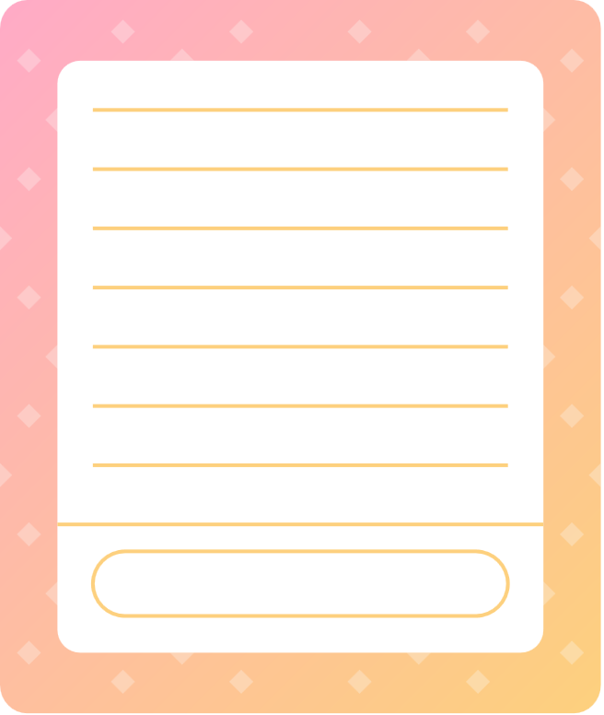


Wrap-up
Vocabulary:
amusement park, restaurant, bookshop, cinema, sports centre
Sentences:
Can I go to the cinema?
Yes, you can.
X No, you can’t.
Unit 4: Free time
Lesson 2 – Part 1,2,3
What have we learnt today?

Slide 26
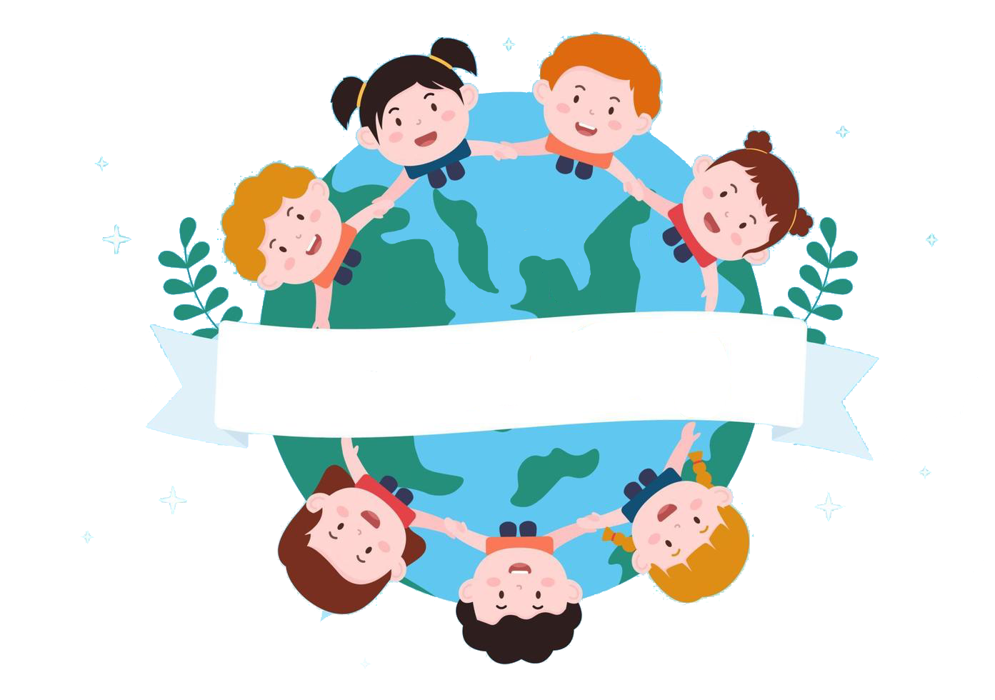
Thank you
& goodbye!

