Slide 1





















Notes:
Để nguyên trang bìa như này, chỉ thay đổi tên bài trong quá trình làm. Logo của sách Wonderful World

Slide 2
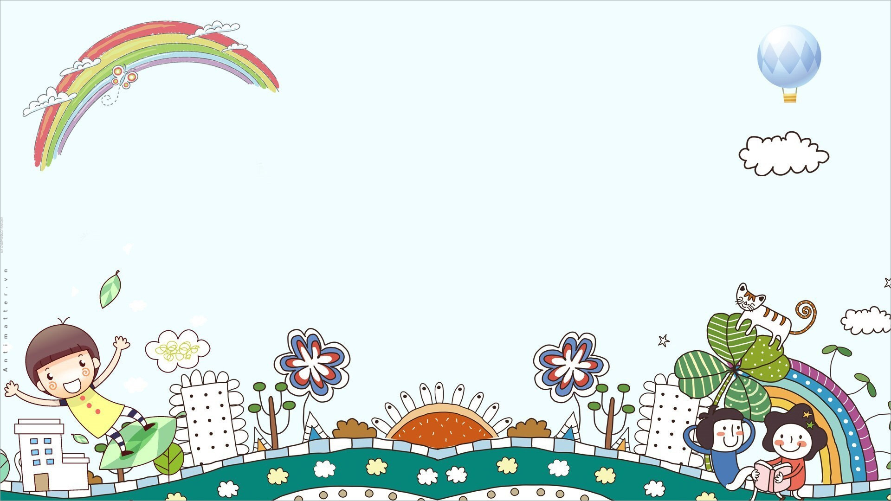




Unit: 4
FREE TIME
Lesson 2: Part 4, 5, 6

Slide 3
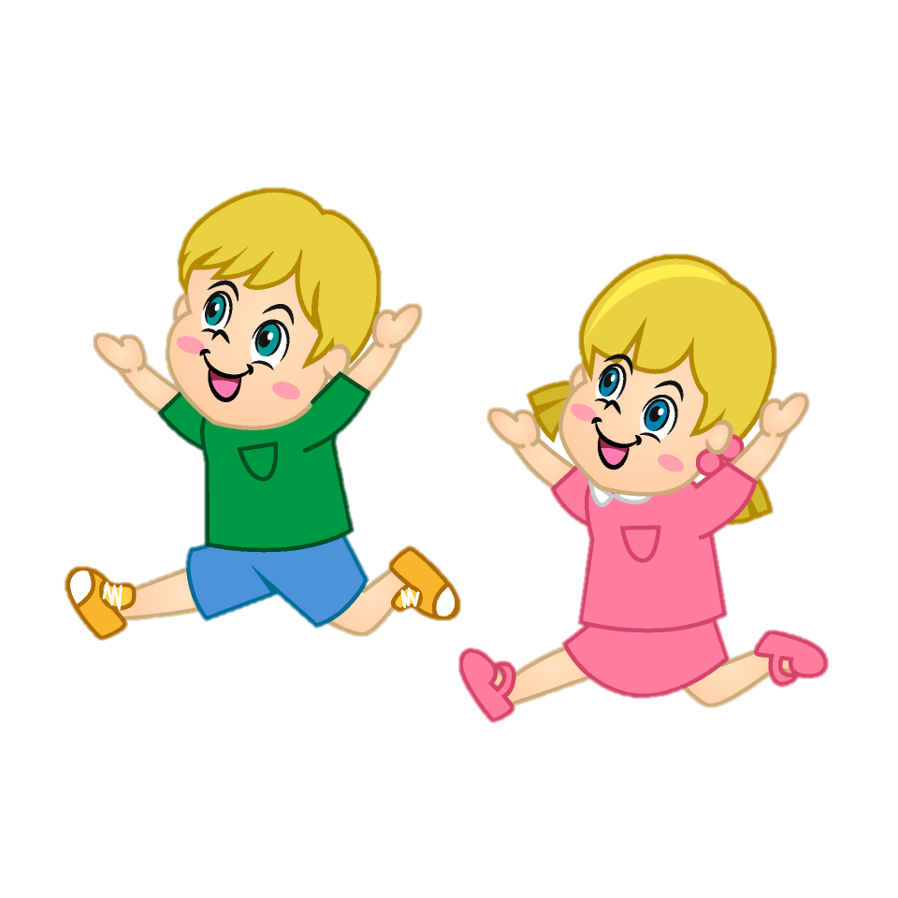
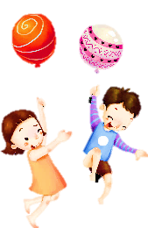




Warm-up
01
Let’s play a game:
“FREEZE”

Slide 4
Presentation
02

Slide 5



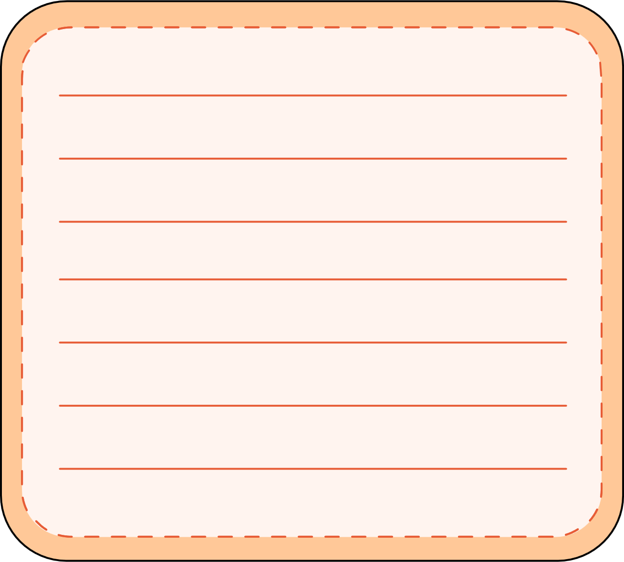


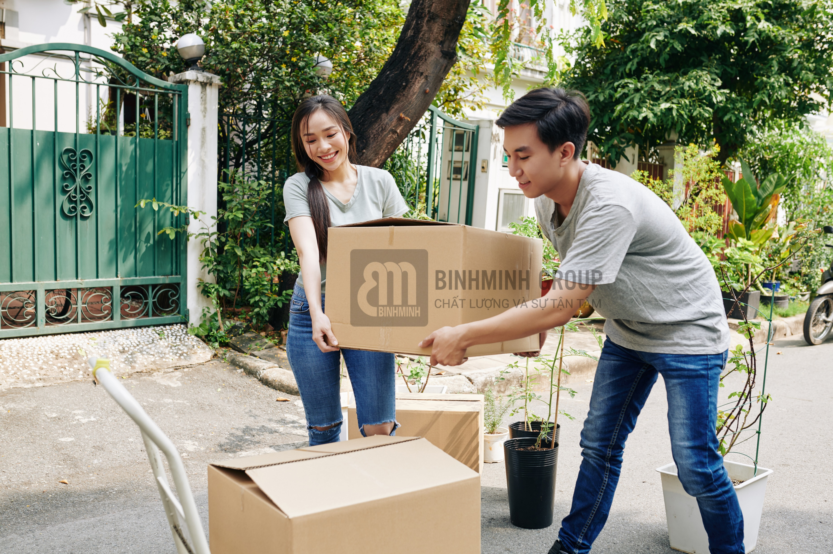

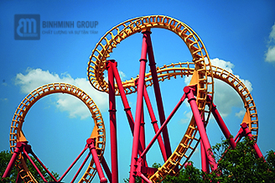
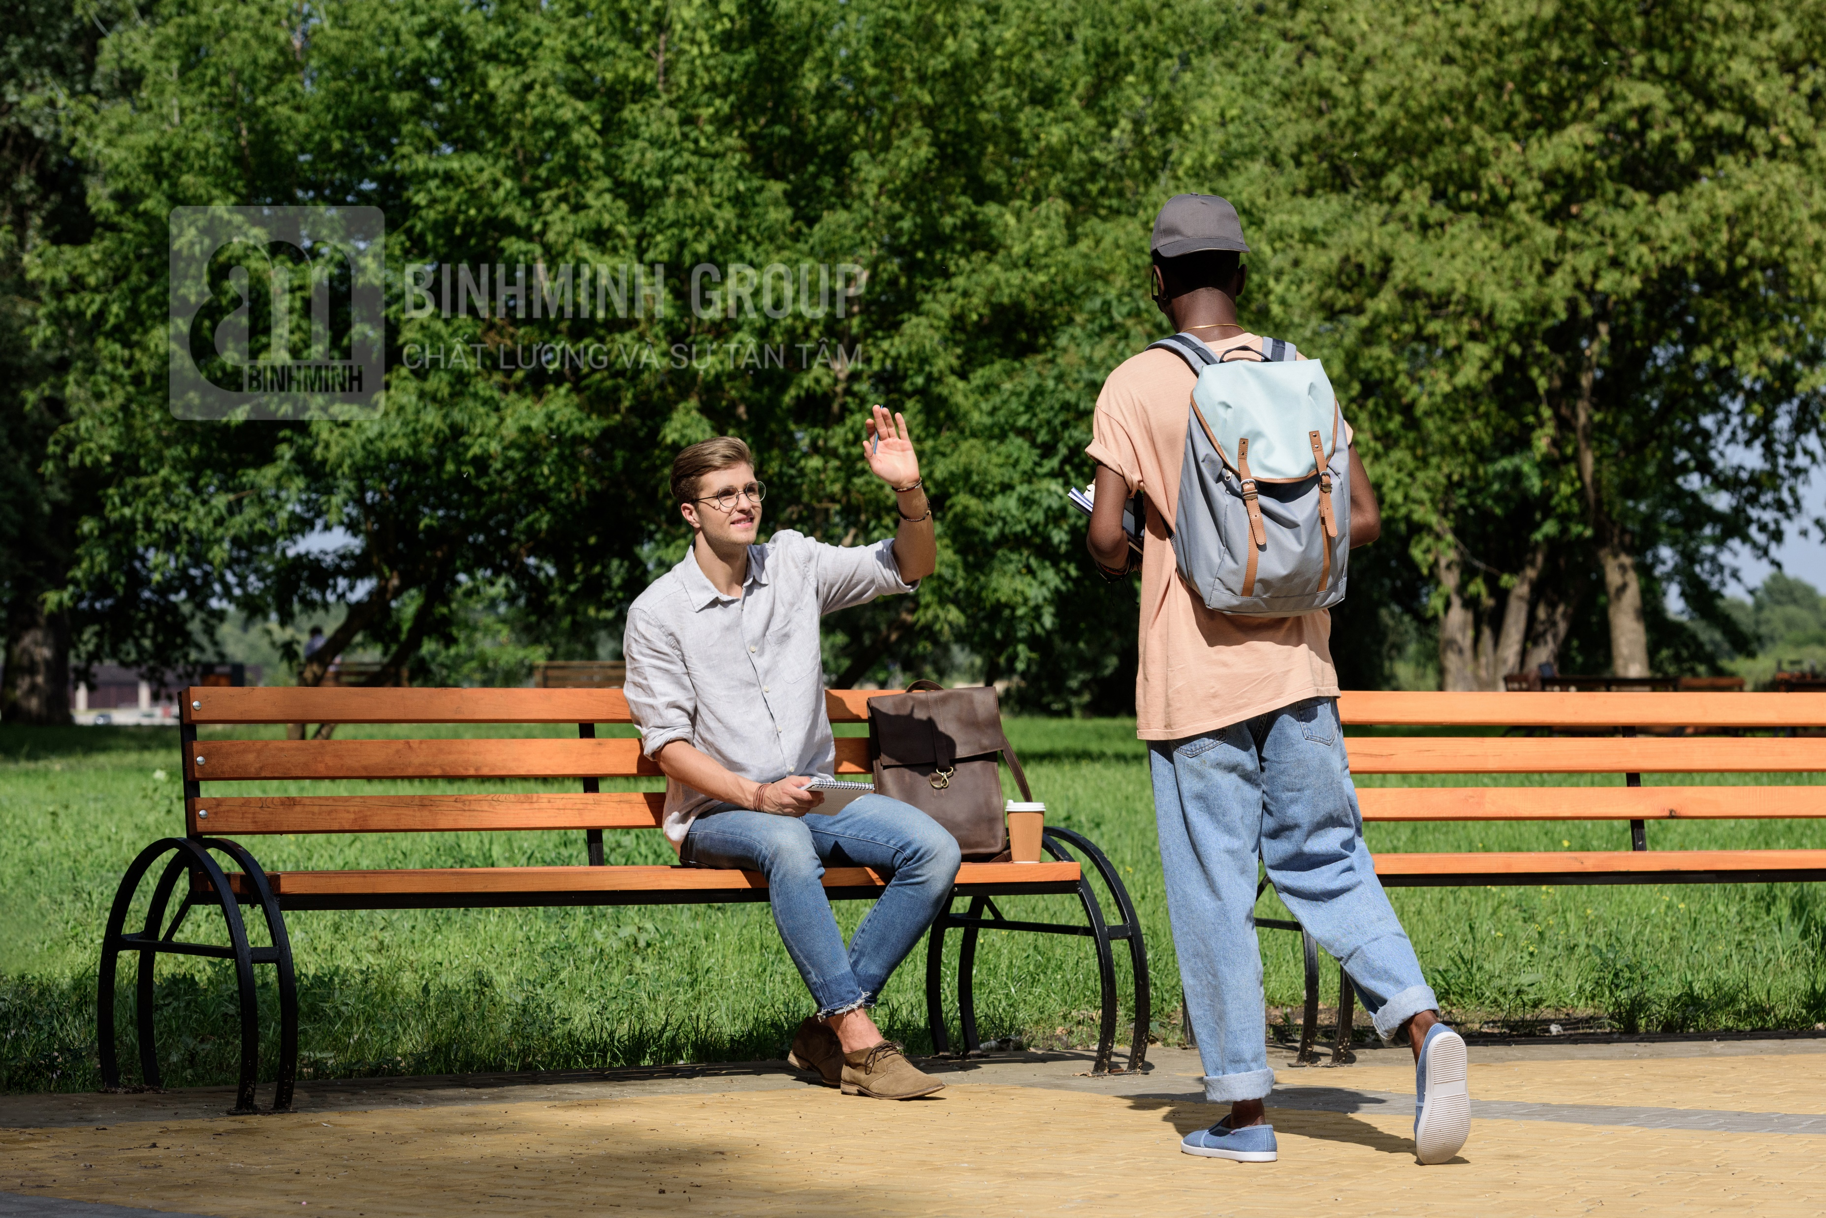

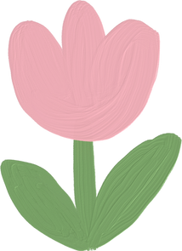
4 Listen and read. Then match and say.

Slide 6


4 Listen and read. Then match and say.
Dad, I need some books. Can I go to the bookshop now?
- Yes, you can.
2 Mum, can we go on a ride?
- No, you can’t. It’s scary.
✓
a
b
✓
3 Excuse me! These boxes are so
heavy. Can we put them here for
a few minutes?
- Yes, of course.
4 Excuse me, can I sit here?
- Sure, go ahead.
c
d
✘
✓

Slide 7






Grammar: can and can’t
“Can” is a modal auxiliary which is used for:
1. ability
Example:
I can go to the bookshop.
S + can/can’t + V infinitive + …
2. polite requests
She can’t swim well.
Can + S + V infinitive +…?
✓ Yes, S + can.
x No, S + can’t.
= cannot.
Can we go on a ride?
Yes, we can.
x No, we can’t.

Slide 8








Practice speaking
Mini-game:
Lucky the colors

Slide 9











Lucky the colors
10 stars
4 stars
2 stars
1 star
20 stars
1 star
15 stars
8 stars
10 stars
1
2
3
4
Notes:
Ấn vào trái tim link với các bức tranh để làm hội thoại.
Bấm vào mũi tên chuyển học phần tiếp theo.

Slide 10
Practice
03

Slide 11



5 Complete with can / can’t.
1 A: Mum, ____ Sarah and Mifa go on a ride with me?
B: No, they ____ . They’re too young.
2 A: Excuse me, ____ I move your bag a little bit, sir?
B: Yes, I’m sorry.
3 A: Oh, no. I don’t have my pencil with me. ____ I borrow
your pencil, Mai?
B: Sure! Here it is.
4 A: Teacher, ____ I go out for 5 minutes?
B: I’m sorry, you ____ .
can
can’t
can
Can
can
can’t

Slide 12
6 Write the correct questions to ask for your mother’s permission.
go to the park go to the bookshop go to the museum
go to the cinema play the piano

Slide 13
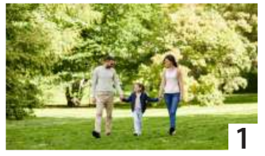

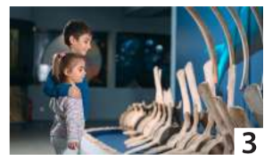
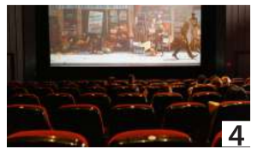
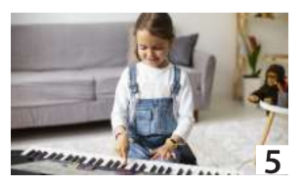
6 Write the correct questions to ask for your mother’s permission.
go to the park go to the bookshop go to the museum
go to the cinema play the piano
Mum, can I go to the museum?
Mum, can I go to the park?
Mum, can I go to the bookshop?
Mum, can I go to the cinema?
Mum, can I play the piano?

Slide 14
Production
04

Slide 15

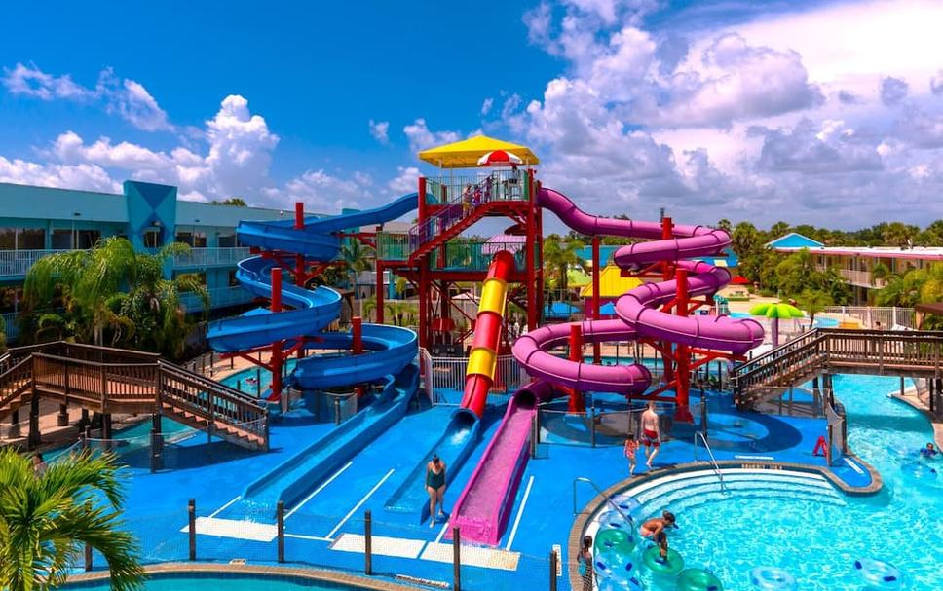
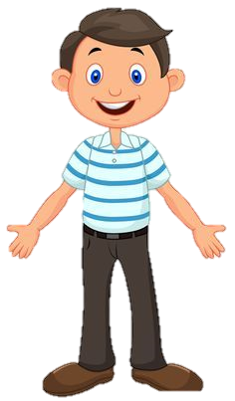
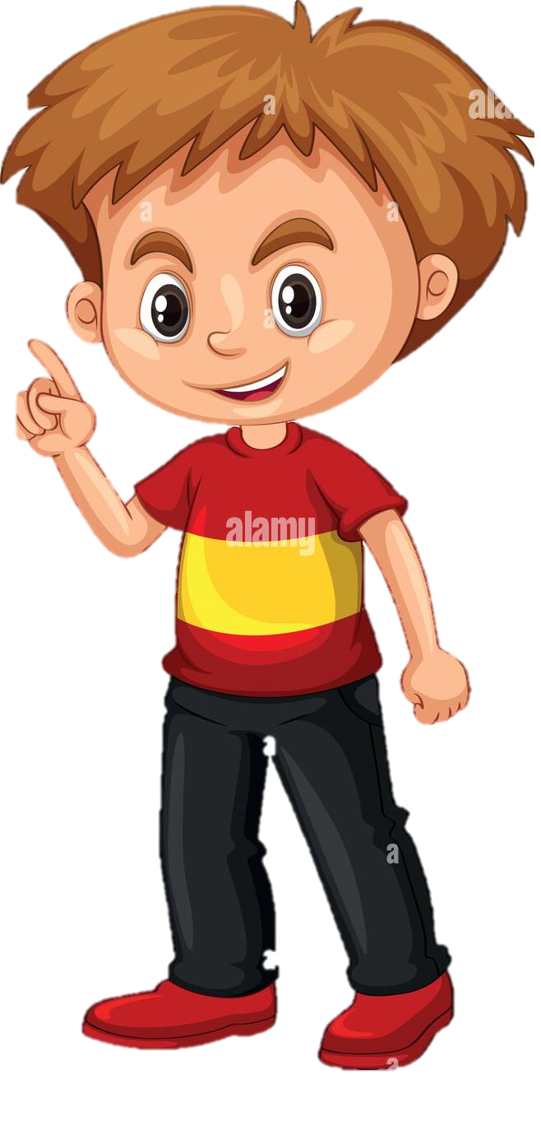
Yes, we can.
Dad, the weather is so hot. Can we go to the water park?

Slide 16
Wrap-up & Assessment
05

Slide 17
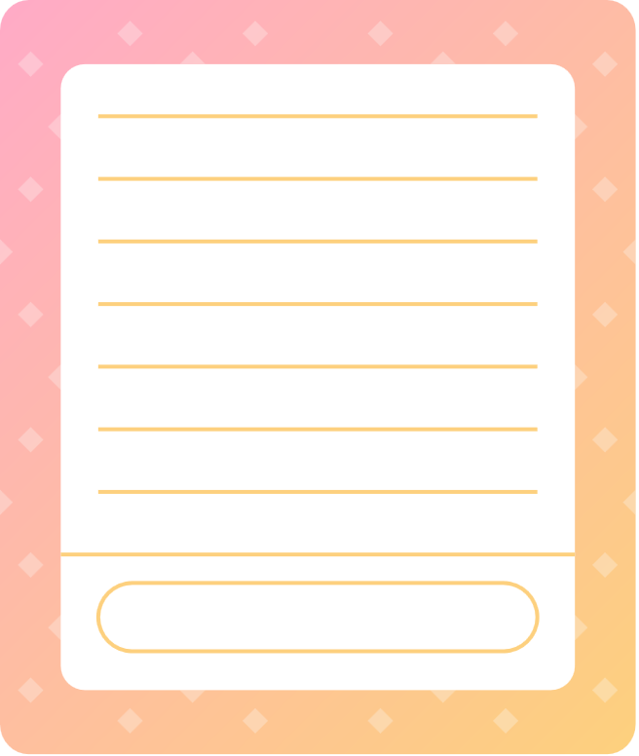


Wrap-up
Vocabulary review:
go to the park
go to the cinema
go to the bookstore
play the piano
go to the museum
Grammar:
can /can’t
Unit 4: Free time Lesson 2 – Part 4,5,6
What have we learnt today?

Slide 18
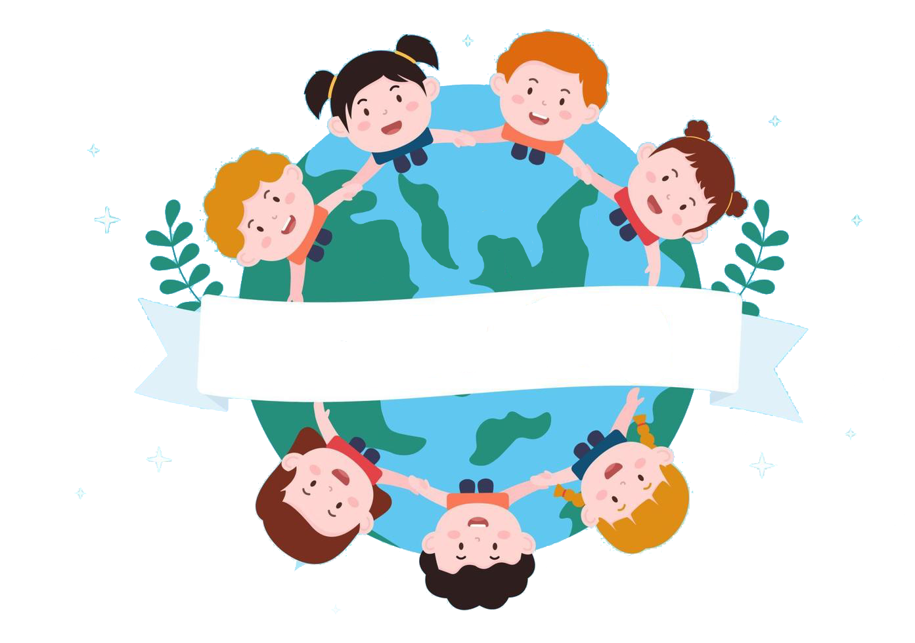
Thank you
& goodbye!

