Slide 1





















Notes:
Để nguyên trang bìa như này, chỉ thay đổi tên bài trong quá trình làm. Logo của sách Wonderful World

Slide 2
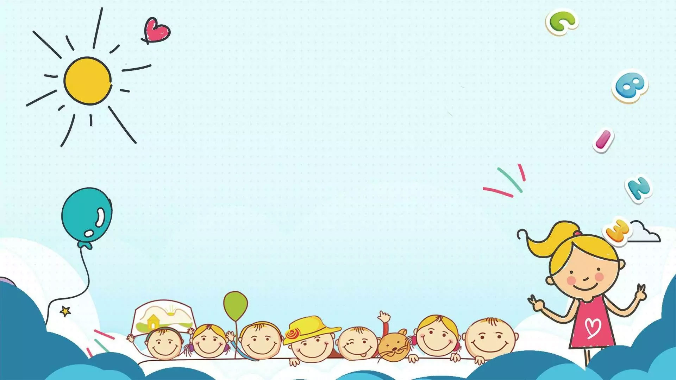



Unit: 4
FREE TIME
Lesson 3: Task 7, 8, 9, 10

Slide 3










Table of contents
01
02
Warm-up
Presentation
04
05
Production
Assessment
03
Practice

Slide 4




Warm-up
01
Let’s sing a song!

Slide 5
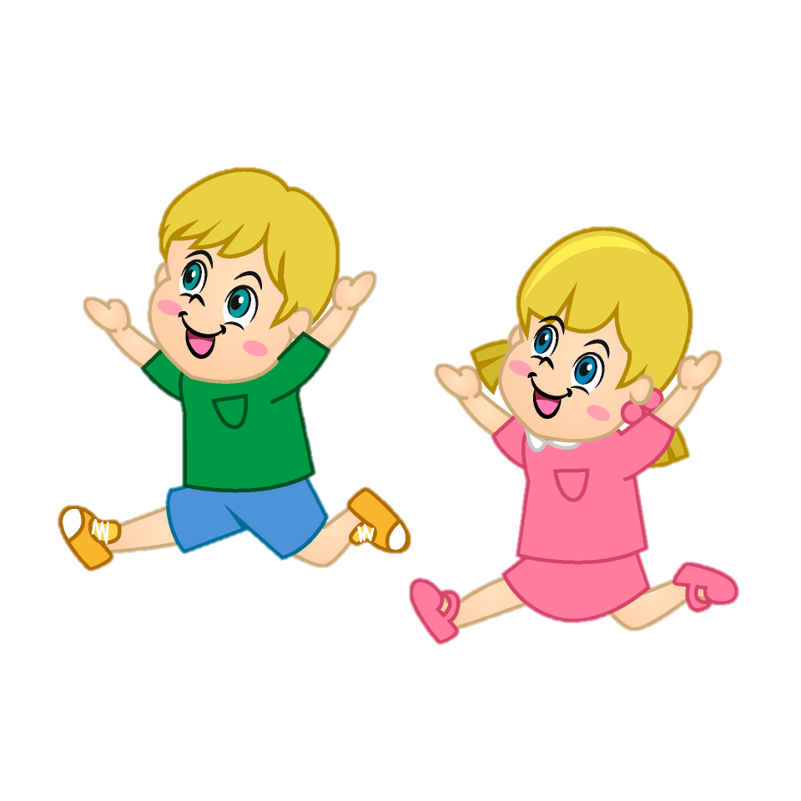
Presentation
02

Slide 6


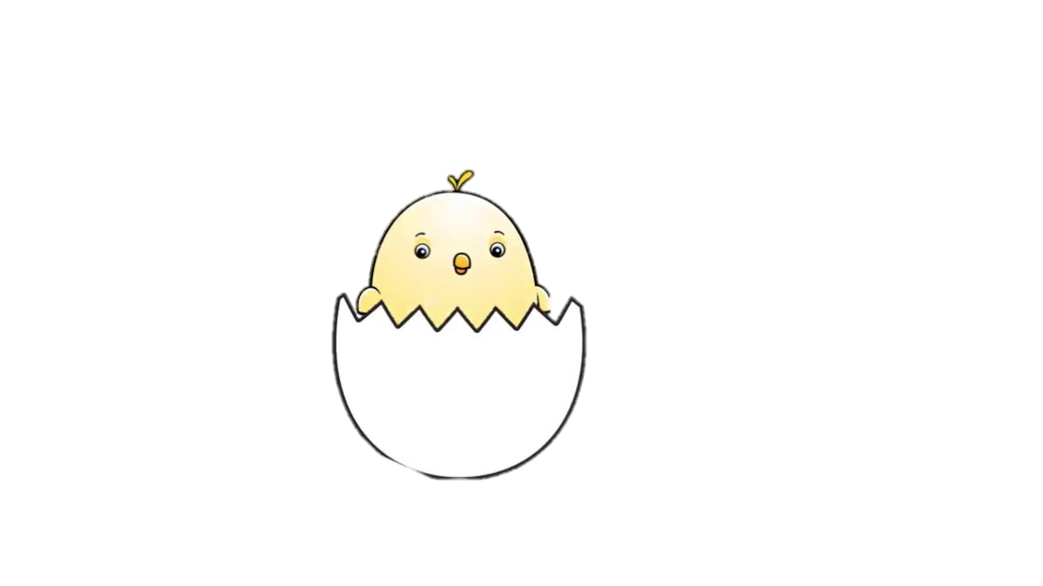


Pronunciation of wh words.
w sound
we
/wi:/
Notes:
Bấm vào từ “we” => sẽ ra cách đọc .

Slide 7


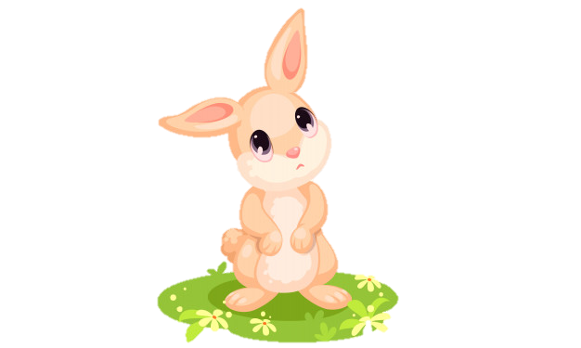
Pronunciation of wh words.
/weə(r)/
where
w sound ?
Notes:
Ấn vào “where” để muốn nghe đọc từ

Slide 8
Pronunciation of wh words.
/hu:/
h sound
who
w sound ?

Slide 9

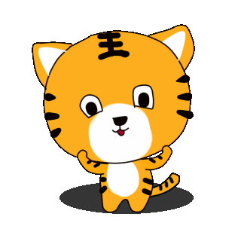
Small activity : Find the words with /w/ and /h/ sounds.
which
whale
who
whose
wet
house
wheel
whom
/w/ | /h/
which
who
Time out
1
5
3
9
8
6
4
2
7
10
whale
whose
wet
house
wheel
whom
Start

Slide 10


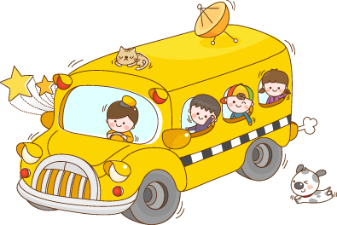

7 Listen and repeat.
when what who whose where
wood walk hobby house we

Slide 11


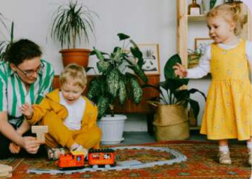


Listen and chant.
Free time, free time, what can we play?
Build things with wood or take a walk today.
Where can we have fun with our hobbies?
At home or in the park, or through stories.
Who loves hobbies? We all do!
Which hobby is best? It’s up to you!
Let’s have fun and celebrate,
Our free time is really great!

Slide 12
Practice
03

Slide 13

8 Read the words aloud. Which two words don’t have a w sound at the beginning? Circle. Then listen and check.
when what who whose where

Slide 14
9 Write S (same) or D (different) in pronunciation for the letters in red. Then listen and check.
1 who, hobby | 4 whose, walk
2 when, house | 5 where, we
3 what, wood
S
D
D
S
S

Slide 15
Production
04

Slide 16

Work in groups to find words that have /w/ sound.
Minh | Trang | Phong | Lan | Hoa
wear | which | whale | wash | what

Slide 17
Wrap-up & Assessment
05

Slide 18
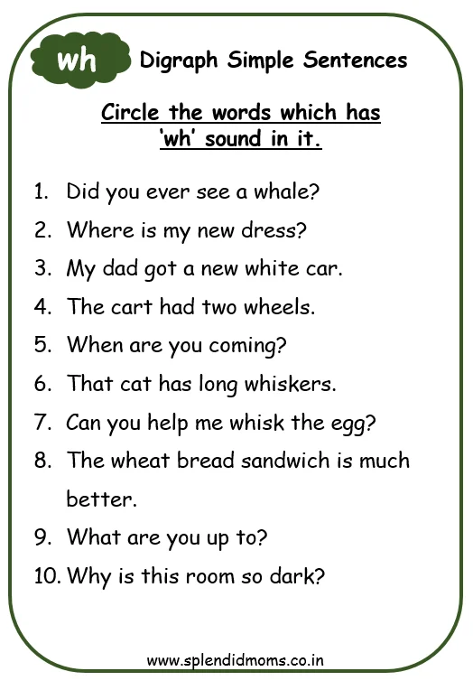


Slide 19



Unit 4: Free time Lesson 3 – Part 7,8,9,10
What have we learnt today?
Contents
Learn phonics “wh”.
Chant and sing.

Slide 20
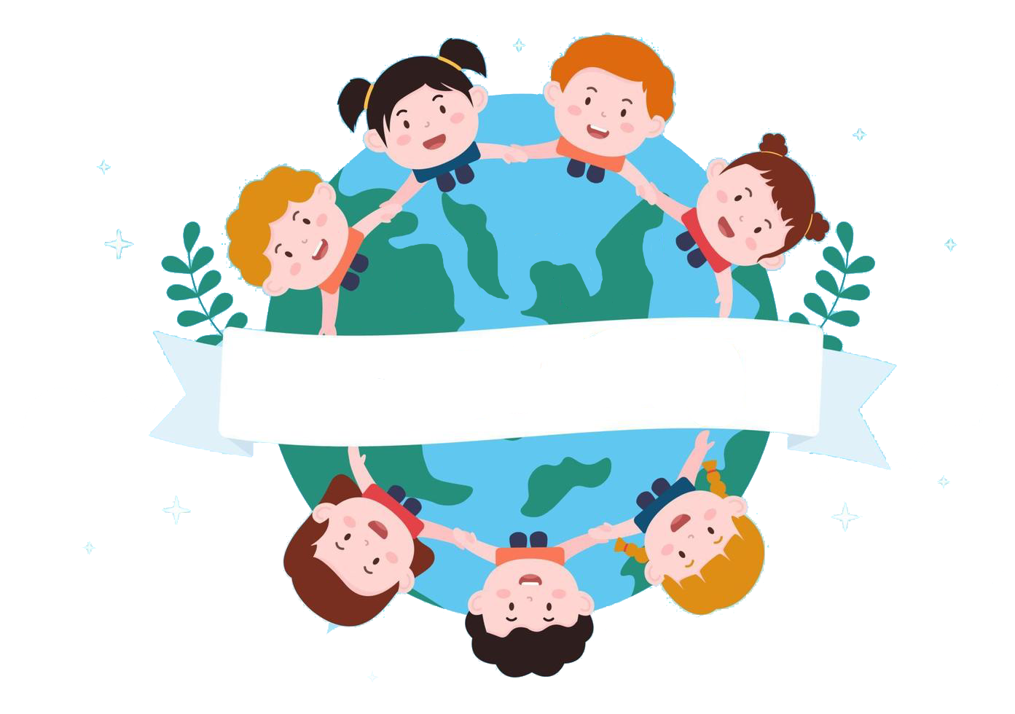
Thank you
& goodbye!

