Slide 1












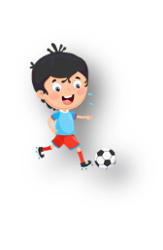


Unit 5: Leisure time
Lesson 3: Task 1, 2, 3

Slide 2


2
Presentation

Slide 3

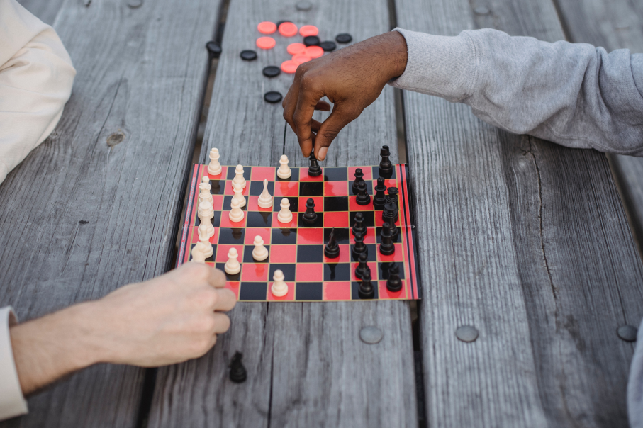
play board games
Notes:
Task 1: Listen and point. Repeat. Track 5.9.
- T asks SS to look at picture and guess what activity it is.
- T plays audio and asks SS to repeat in the chorus.

Slide 4
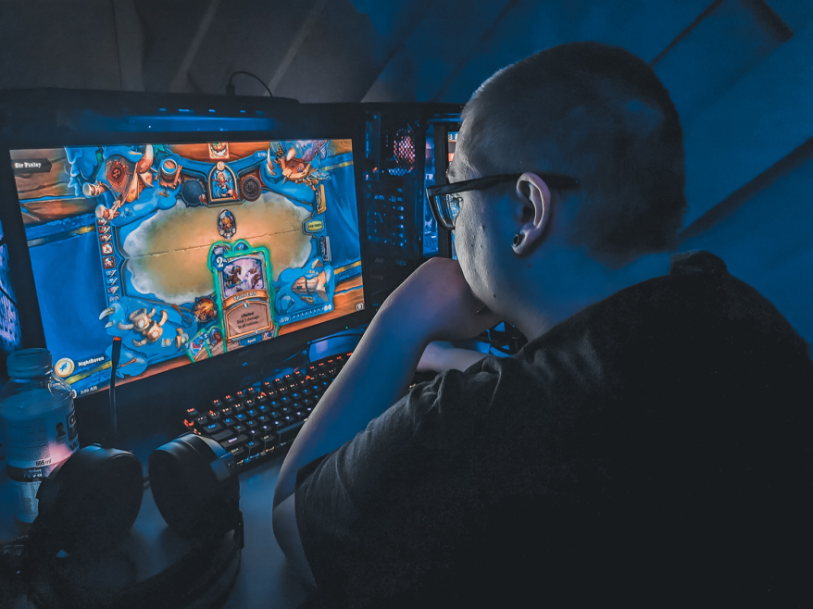
play video games

Slide 5

read a comic book

Slide 6
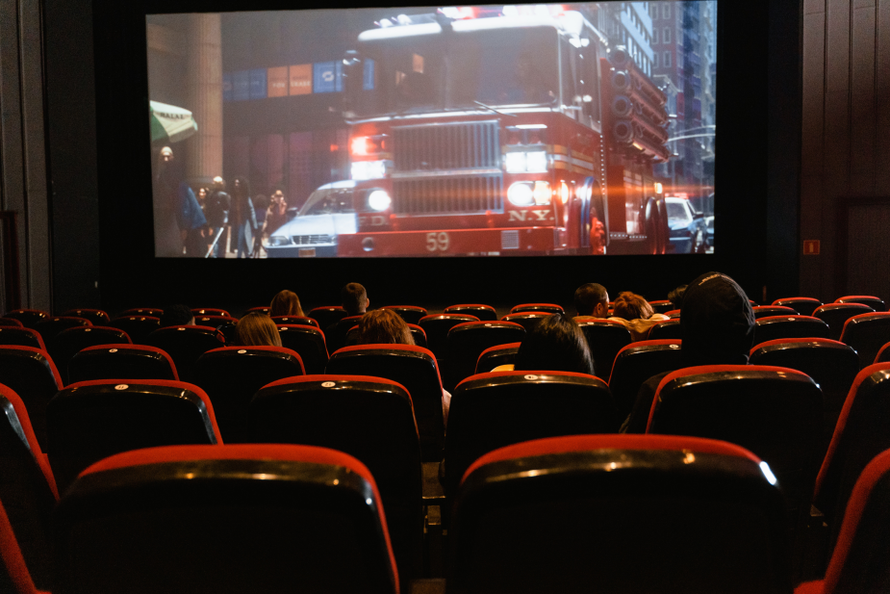
watch a film

Slide 7




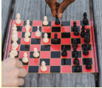
Check vocabulary: Circle
reαd α comic book / wαtch α film
reαd α comic book / wαtch α film
1
2
plαy video gαmes / plαy boαrd gαmes
plαy video gαmes / plαy boαrd gαmes
3
4
Notes:
*Checking vocabulary: Circle.
- T asks SS to look at pictures and words, then choose the word which is suitable to each picture.
- Check SS’answers.

Slide 8

1. Listen αnd point. Repeαt. TR: 5.9
play
board games
play
video games
read
a comic book
watch
a film
Notes:
- Play the track 5.9, say the words for students to listen and repeat in the chorus.
- Say each word for students to repeat then point.

Slide 9
3
Practice

Slide 10

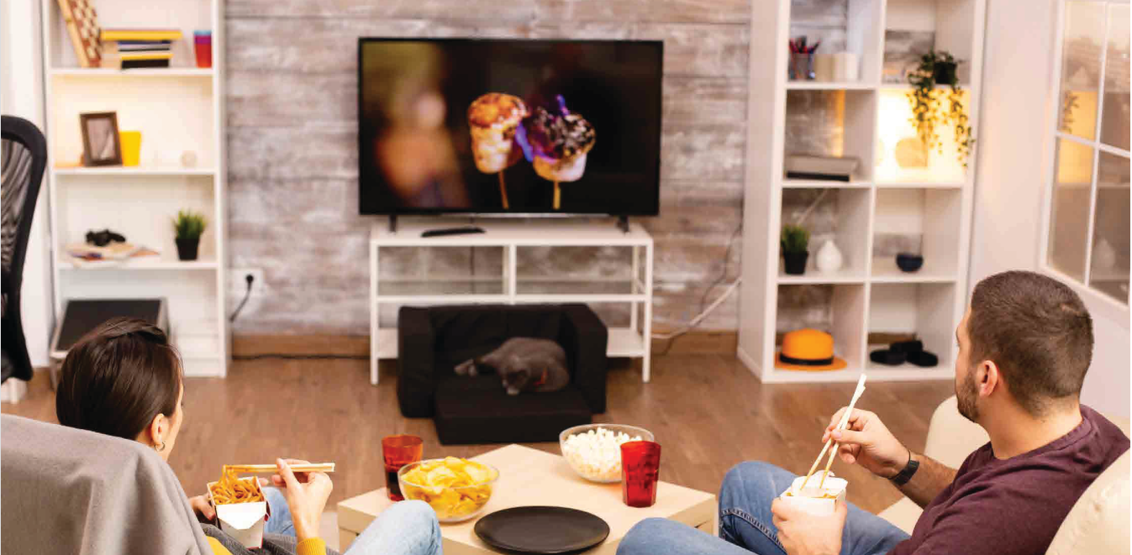
2 Listen αnd tick. TR: 5.10
Notes:
Task 2: Listen and tick. TR: 5.10
- Ask SS to look at the picture and identify what they can see in the picture.
- Ask SS to look at three questions and guess their answer.
- Ask SS to listen and tick a correct answer for each question.
- Check their answers.
- Call SS to read aloud each sentence.

Slide 11


2 Listen αnd tick. TR: 5.10
1 Petra and Alex are
watching TV. playing video games. studying.
2 Petra and Alex are
in the living room. in the bedroom. in the kitchen.
3 Dad and Mum want to
watch a film. play video games. study.

Slide 12
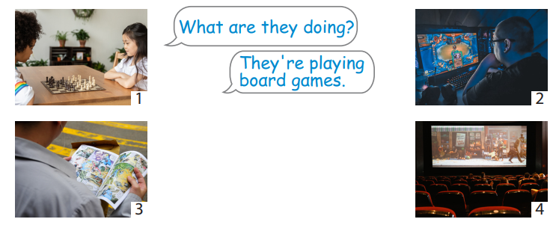
3 Look and say.
Notes:
Task 3: Look and say.
- Ask SS to look at the picture and identify what activity they can see in each picture.
-Ask SS to look at the example and work in pairs to make the sentences in 2 min.
- Call SS to present in front the class.
- Give their feedback.

Slide 13
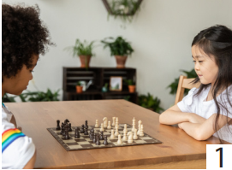
Whαt αre they doing?
They're plαying
boαrd gαmes.

Slide 14
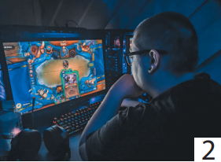
Whαt is he doing?
He’s plαying
video gαmes.

Slide 15
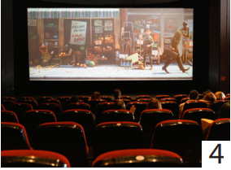
Whαt αre they doing?
They're watching a film.

Slide 16
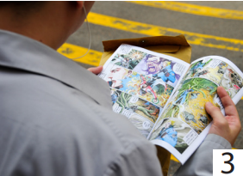
Whαt is he doing?
He’s reading a comic book.

Slide 17
4
Production

Slide 18
Let’s talk!
........
.......
What are you/they doing?
What is he/she doing?
.......
.........
Notes:
Let’s talk
- Ask SS to go around the class and find 4 answers about the leisure activities in 3 min.
- Ask SS to make a mind map and present in front of the class.
- Check and give feedback.

Slide 19
5
Assessment

Slide 20
Cross out the unnecessary words
They’re are playing board games.
David is playing video audio games.
She’s reading a the comic book.
My parents are watching seeing a film on TV.
What’s are Mary doing?

Slide 21
UNIT 5: LEISURE TIME
LESSON 3 – PERIOD 1
What we learnt today
play board games
play video games
read a comic book
watch a film
Vocabulary

Slide 22




Thank you & goodbye!

