Slide 1
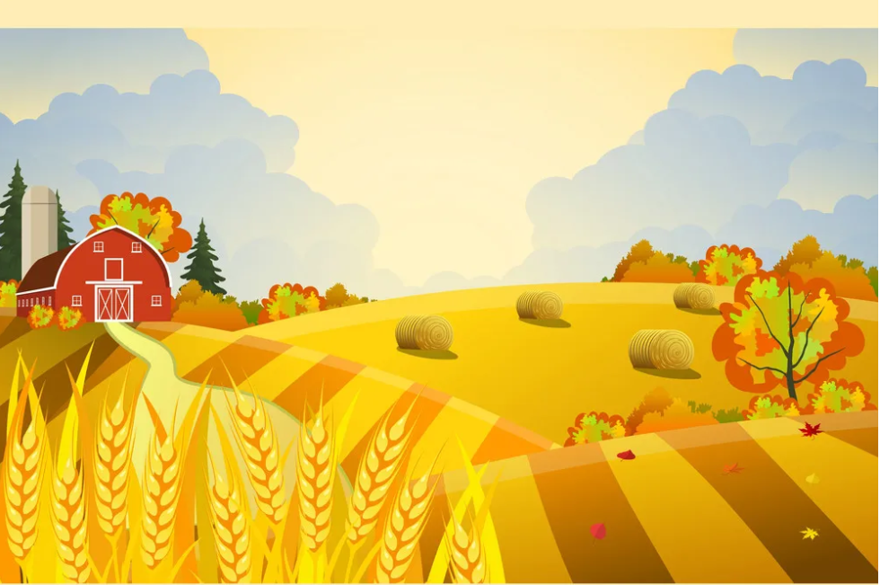

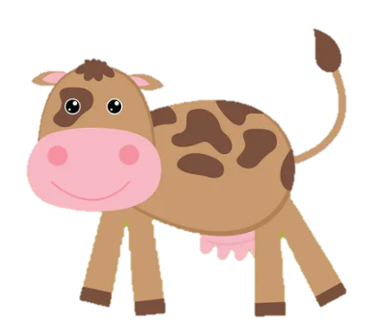
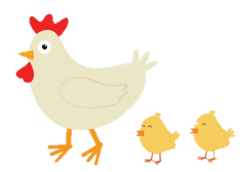
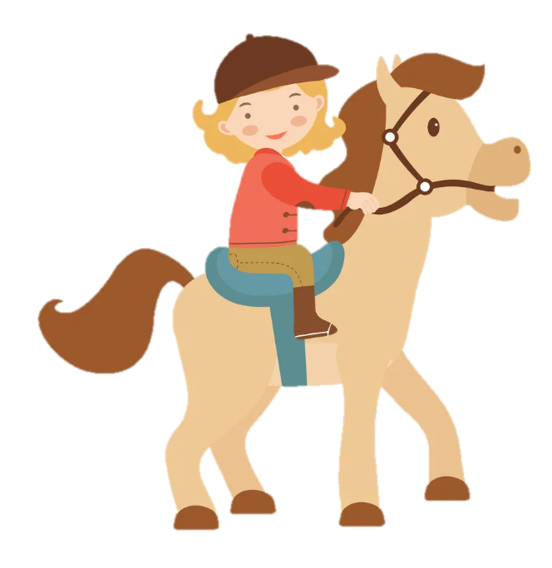
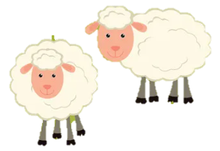
Unit 3: On the farm
Lesson 1. Task 1 2 3

Slide 2
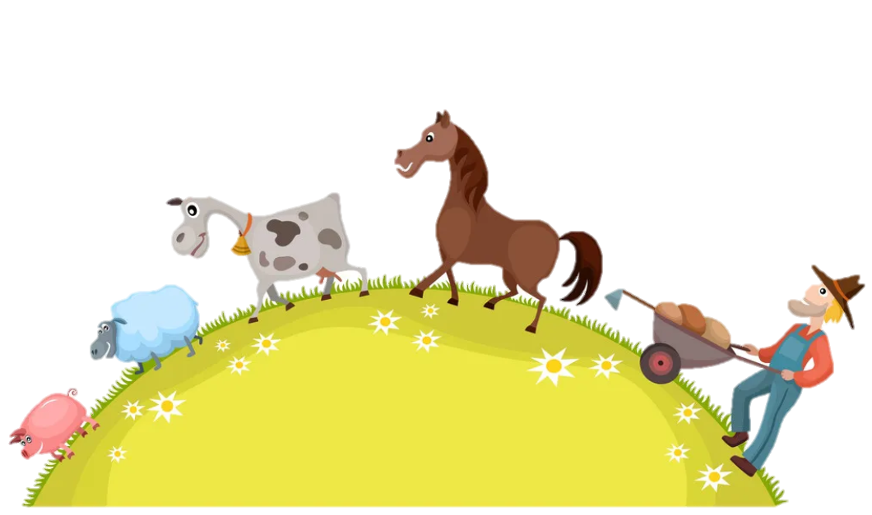


2 Presentation

Slide 3


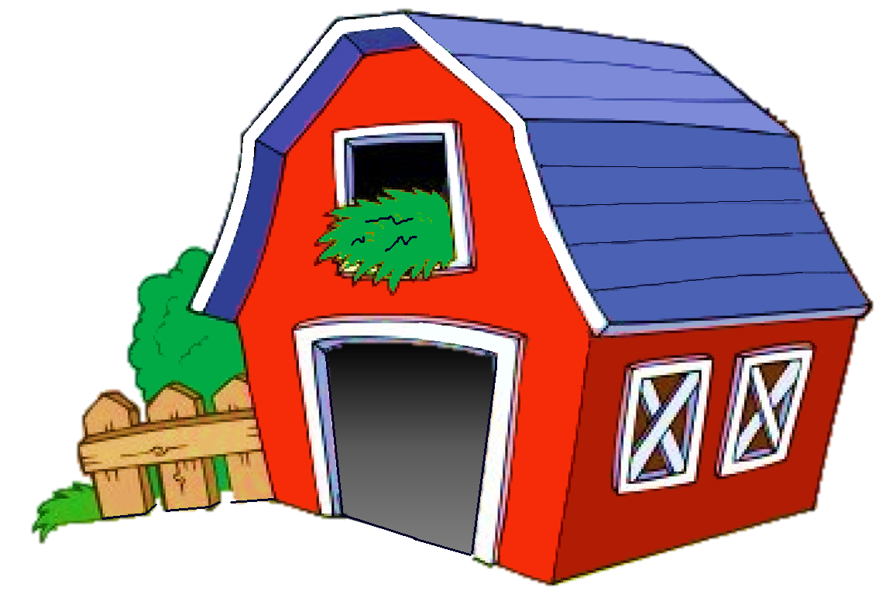
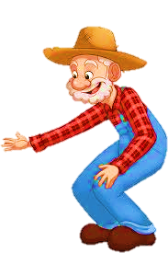
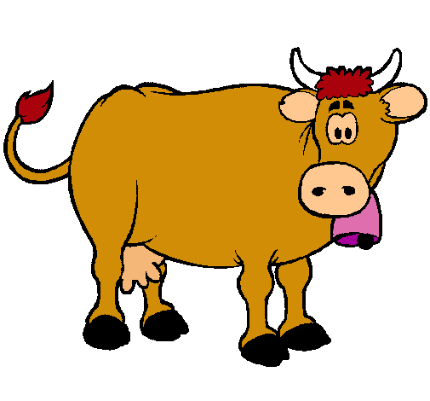
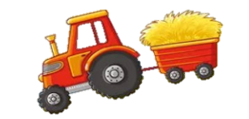
Click on the speaker and guess
NEXT
a goat
a cow
a duck

Slide 4

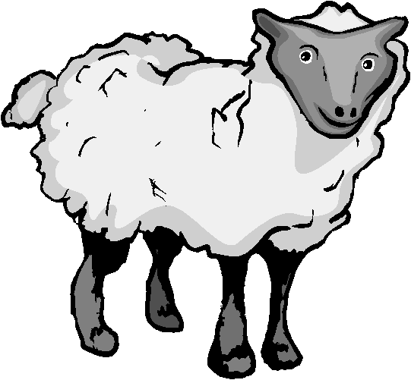
Click on the speaker and guess
NEXT
a sheep
a goat
a duck

Slide 5
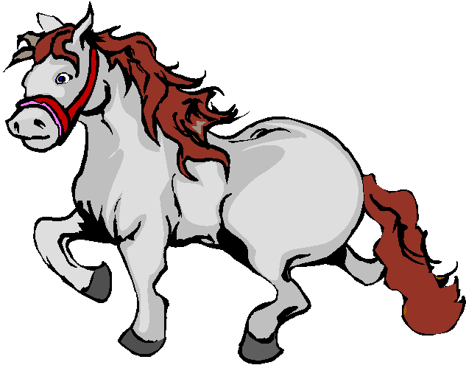
NEXT
a goat
a horse
a donkey

Slide 6
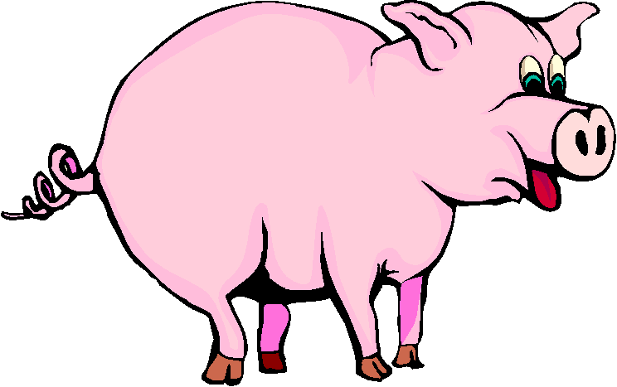
Click on the speaker and guess
NEXT
a duck
a pig
a hen

Slide 7
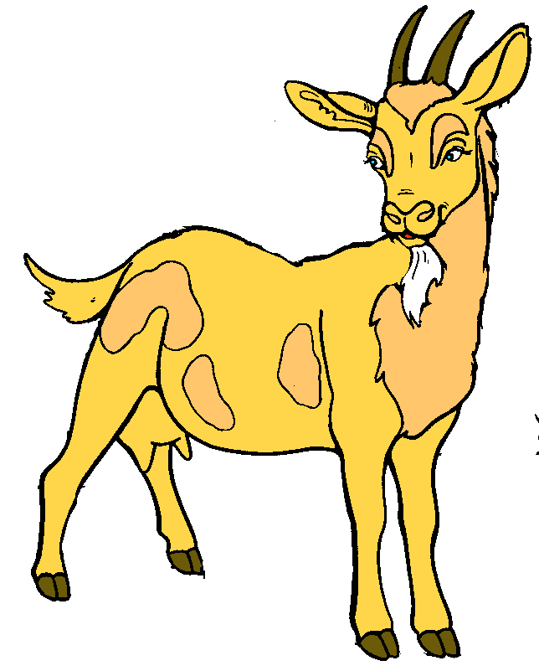
Click on the speaker and guess
NEXT
a hen
a goat
a rabbit

Slide 8
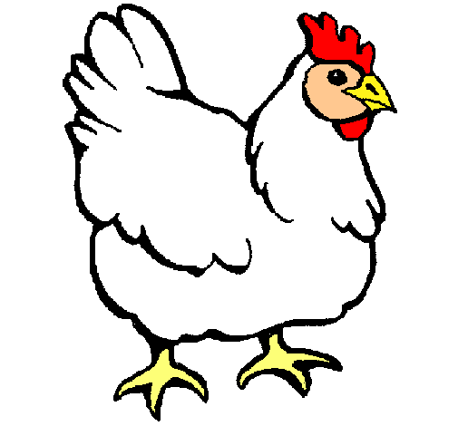
Click on the speaker and guess
chicken
goat
pig

Slide 9
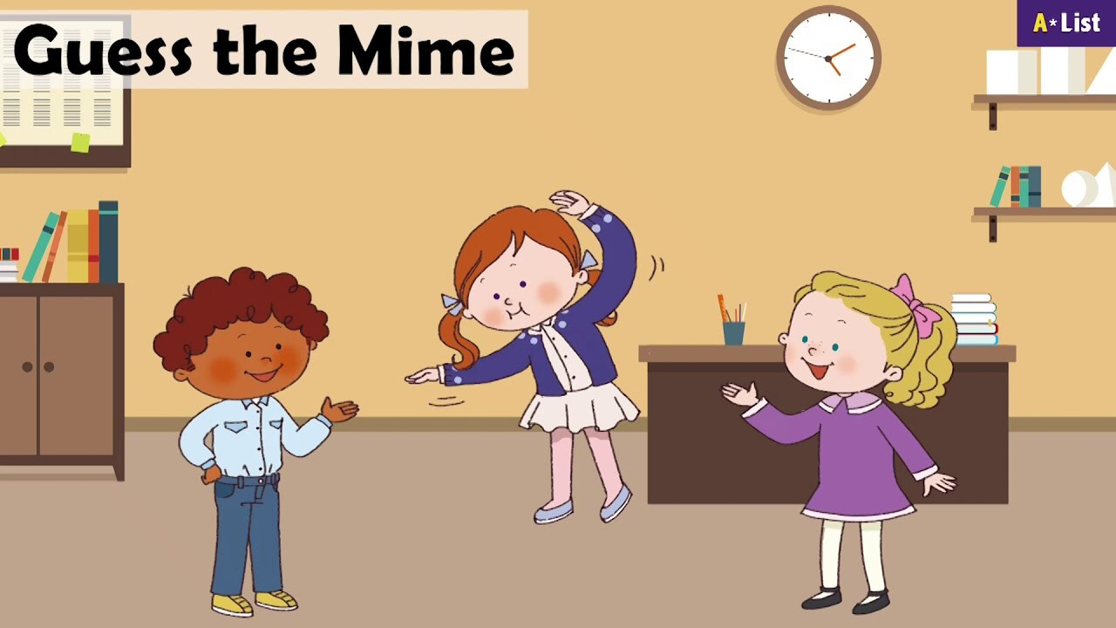

Slide 10




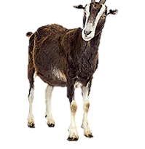
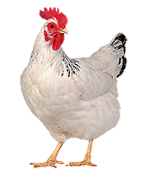
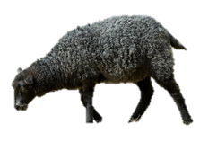
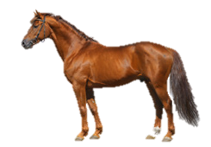
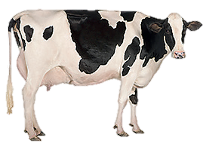
1 Listen and point. Repeat
chicken
goat
sheep
cow
horse

Slide 11
3 Practice

Slide 12
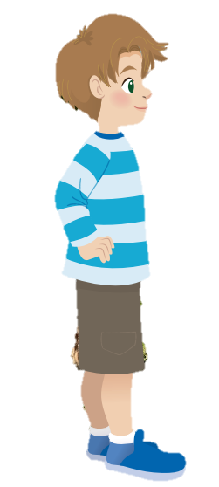
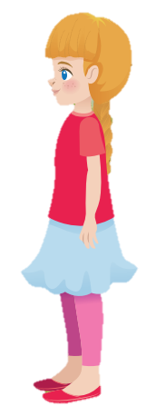
Listen and tick.
My father has got
some sheep some goats
We’ve got
some sheep some cows
✓
✓

Slide 13
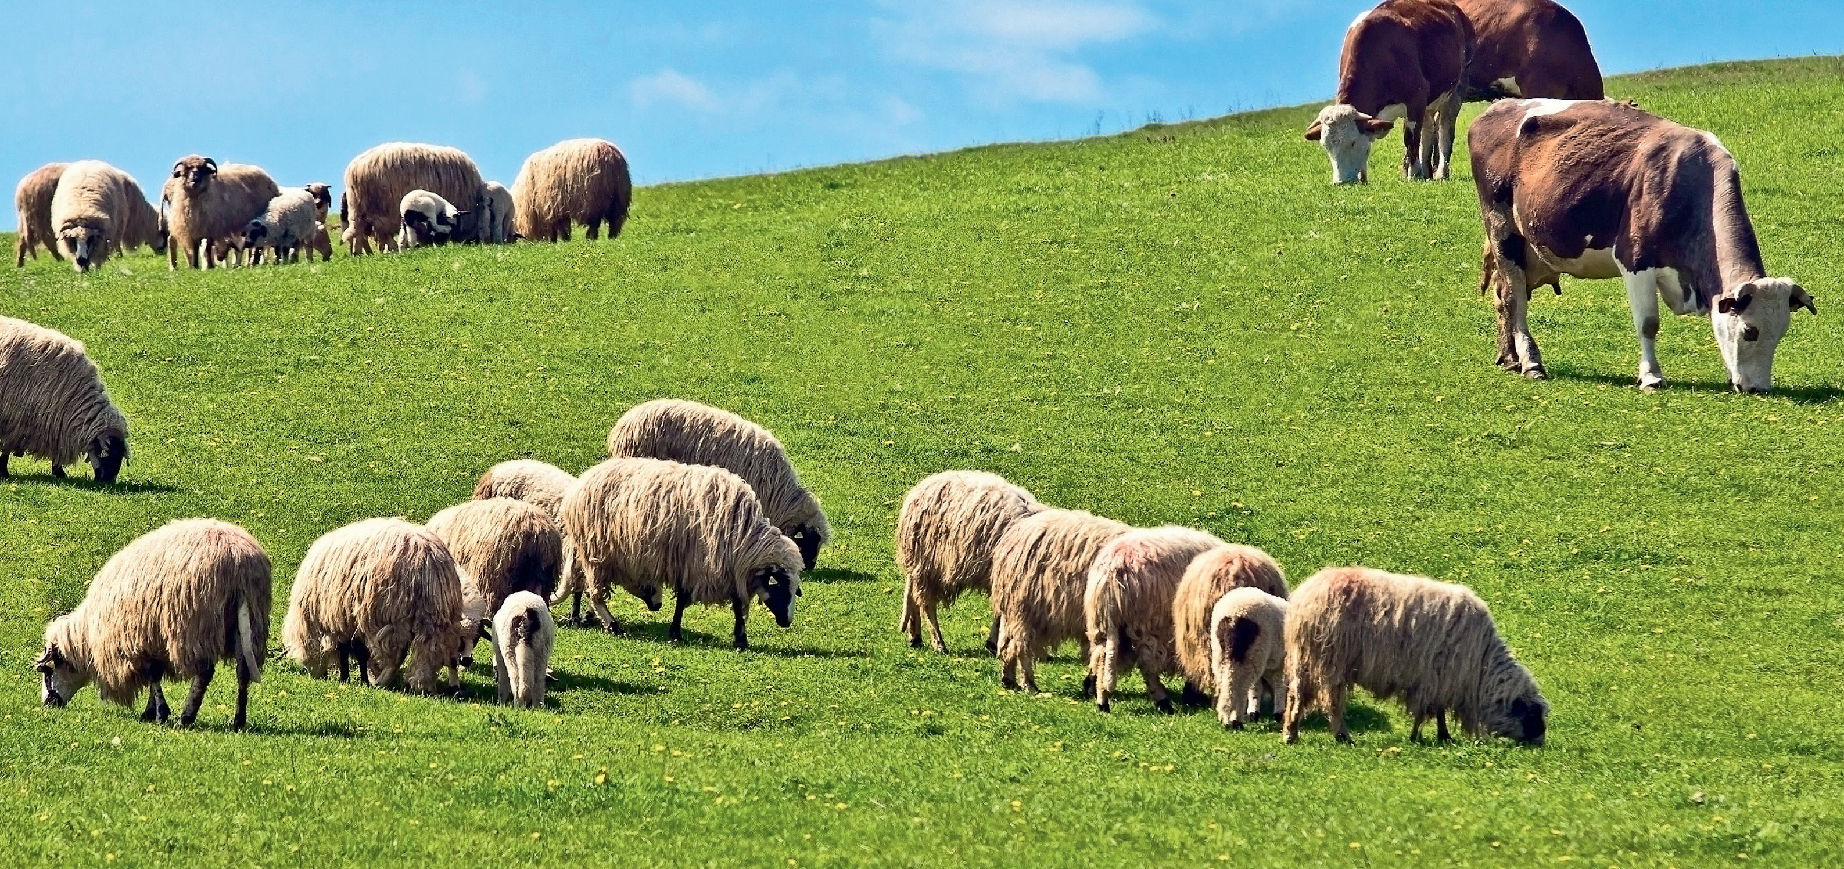
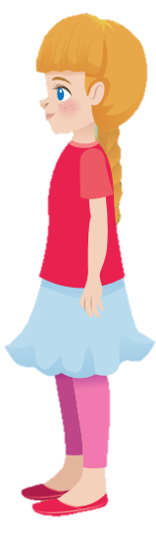
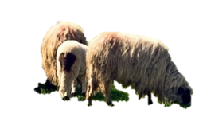
2 Listen and read. Match .
Look! My fαther hαs got some sheep on the fαrm. They’re short αnd smαll.
Great! I like cows, too. .
Cool! We’ve got some cows. They’re big αnd tαll.

Slide 14

2 Listen and read. Match.
1. sheep
a. tall
b. short
d. small
b. short
c. big
2. cows
d. small
a. tall
c. big

Slide 15
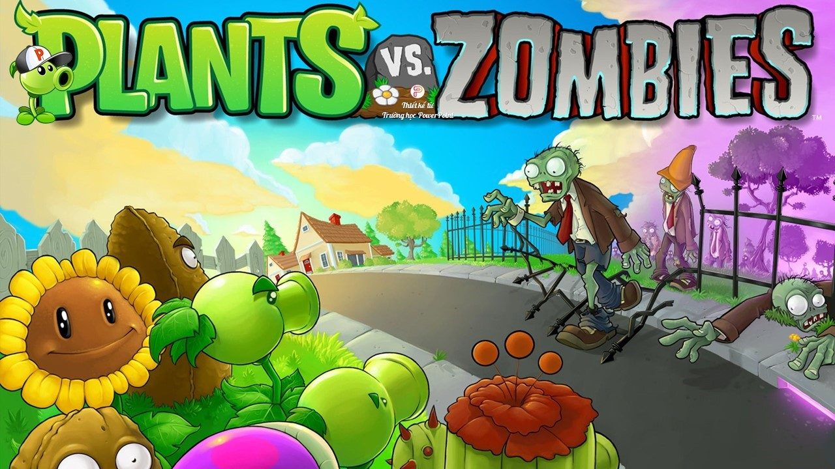


Slide 16
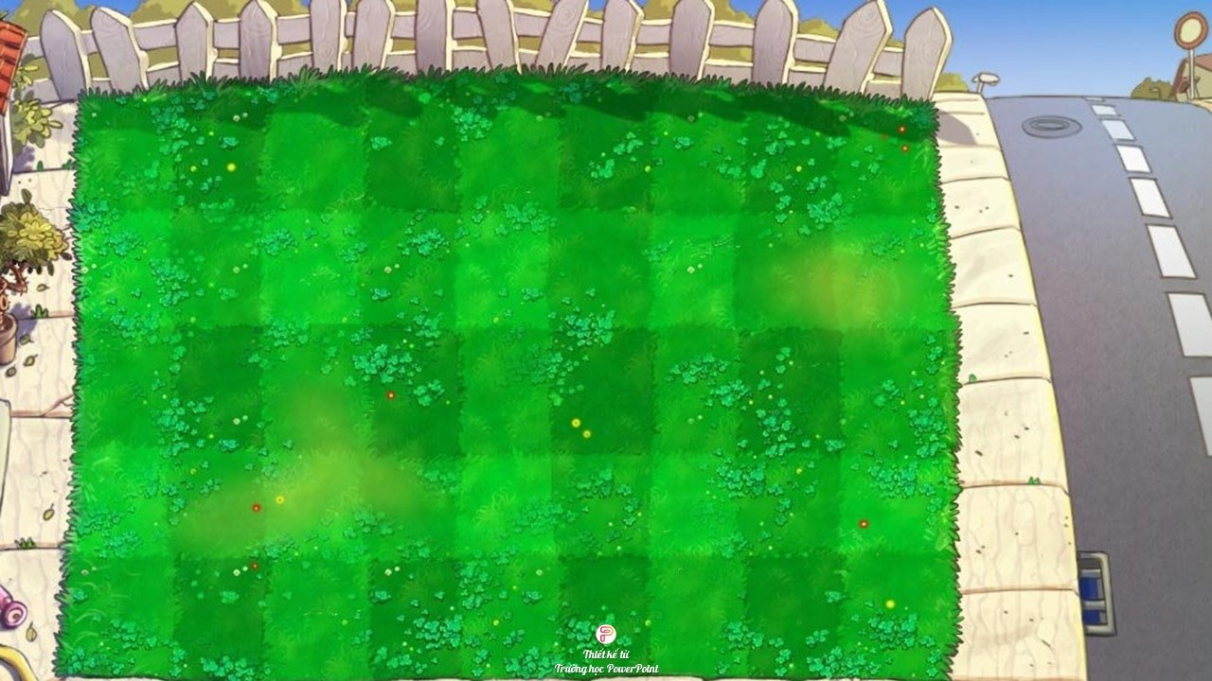



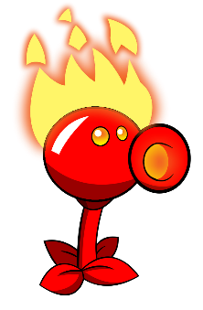
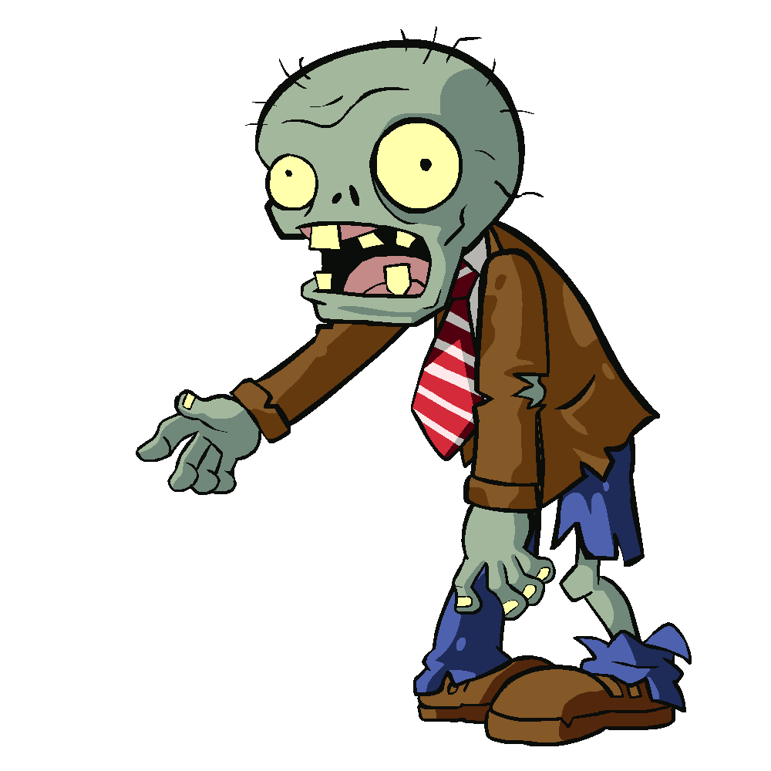

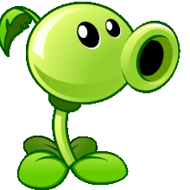

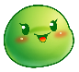


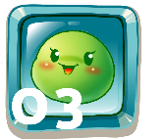


Notes:
-With each correct answer, T clicks on the plant.
-After finishing all the questions, click on the brown board to move to next slide.
( HS lựa chọn số để trả lời câu hỏi tương ứng với hoạt động nghe, nhìn và thức hành cấu trúc. Với mỗi câu trả lời đúng, hs nhấn vào cây nhả đạn để tiêu diệt ZOMBIE.
Sau khi trả lời tất cả các câu hỏi, nhấn vào bảng nâu để chuyển tới slide tiếp theo.

Slide 17
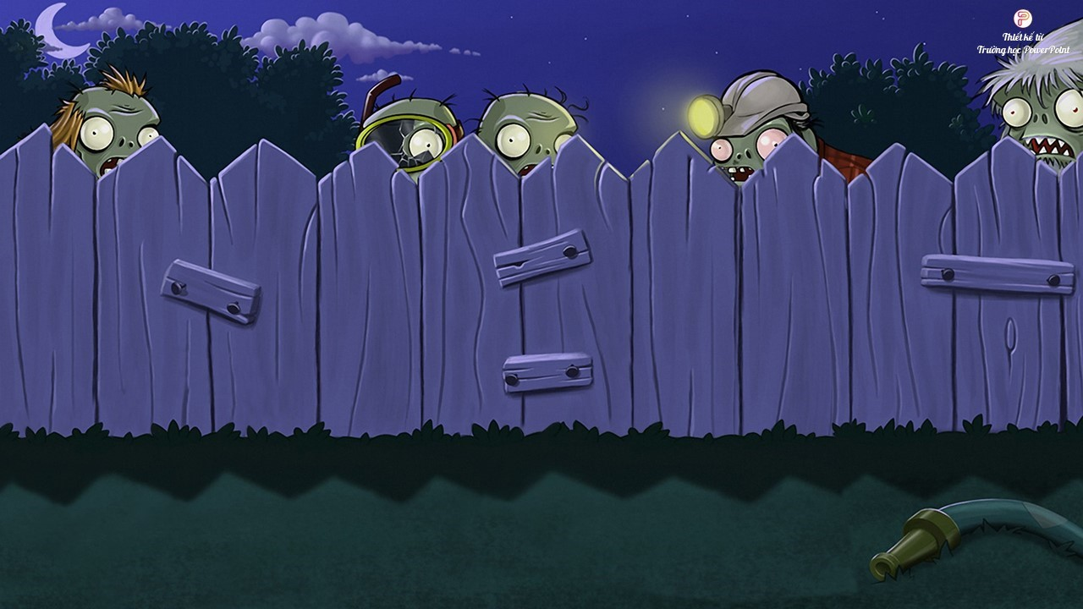
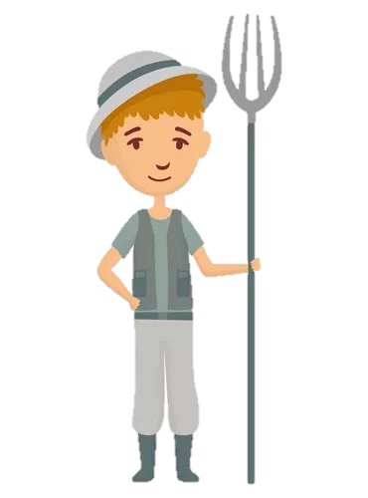
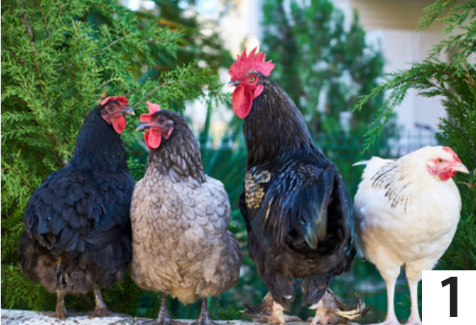
3 Look and say.
1. I’ve got........................….
some chickens.
BACK

Slide 18
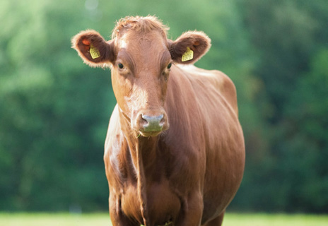
3 Look and say.
2. I’ve got........................….
a cow
BACK

Slide 19
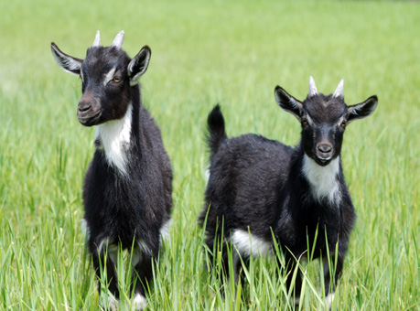
3 Look and say.
3. I’ve got........................….
some goats.
BACK

Slide 20
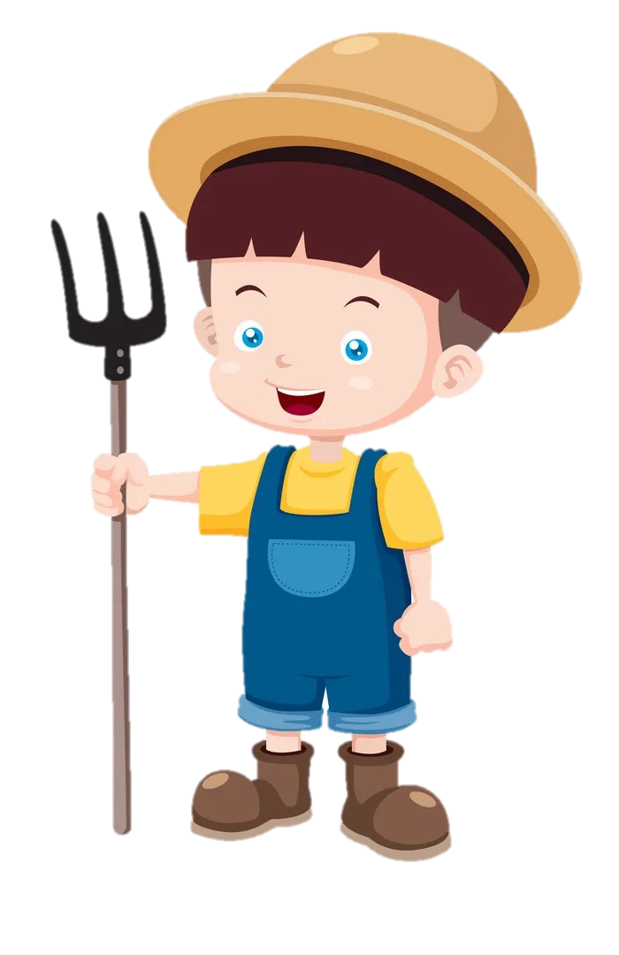
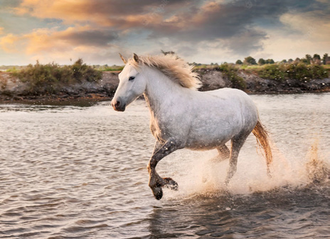
3 Look and say.
4. I’ve got.....................
a horse.
BACK

Slide 21
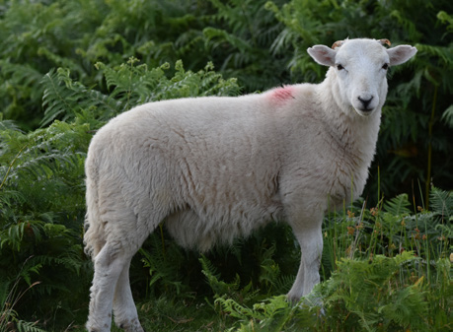
3 Look and say.
5. I’ve got........................….
a sheep.
BACK

Slide 22
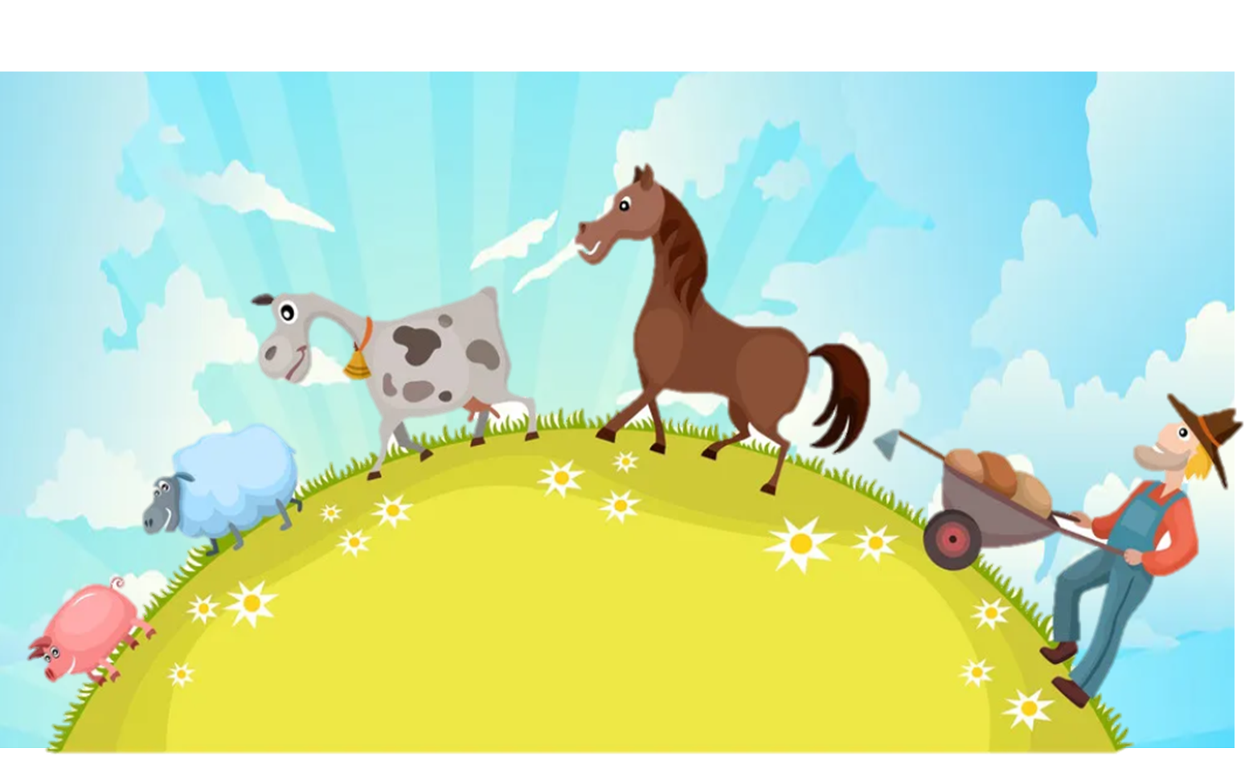

4 Production

Slide 23
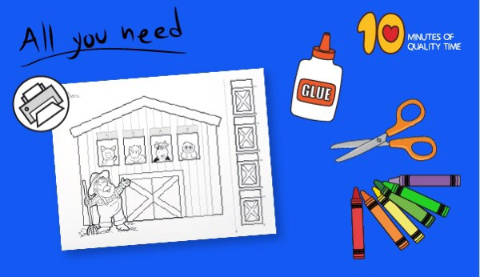
Old Macdonald had a farm craft

Slide 24
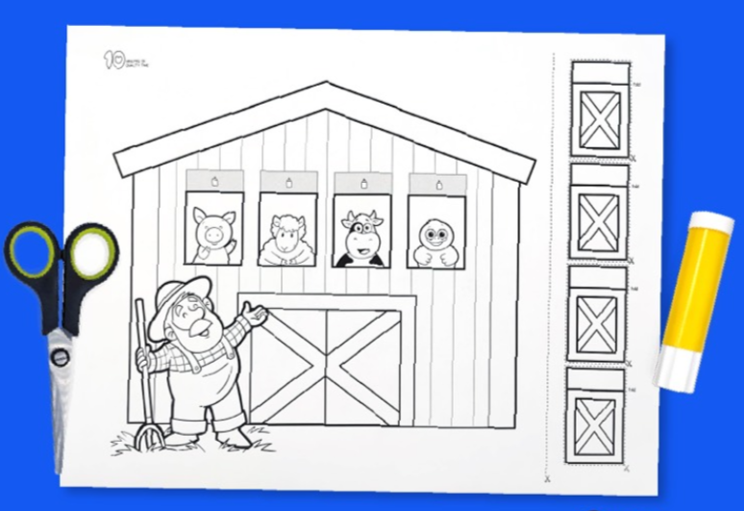
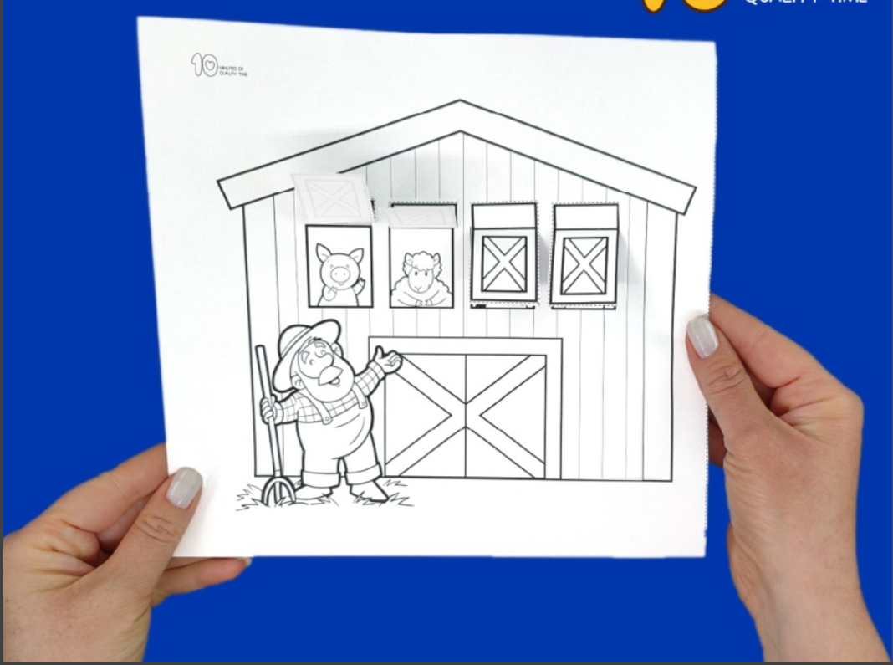

Slide 25
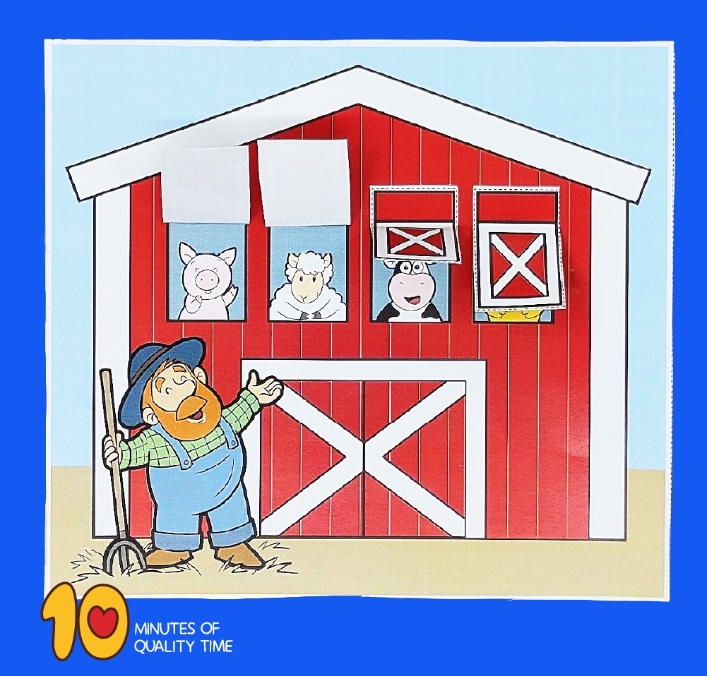
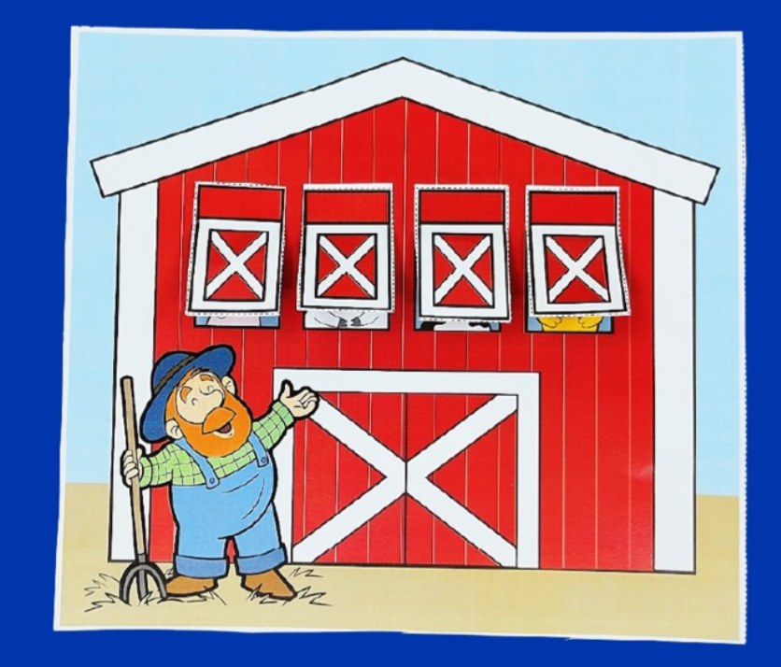

Slide 26
5 Assessment

Slide 27
Look and number
WORD LIST
Cow
Chicken
Sheep
Goat
Horse
2
4
3
1
5

Slide 28

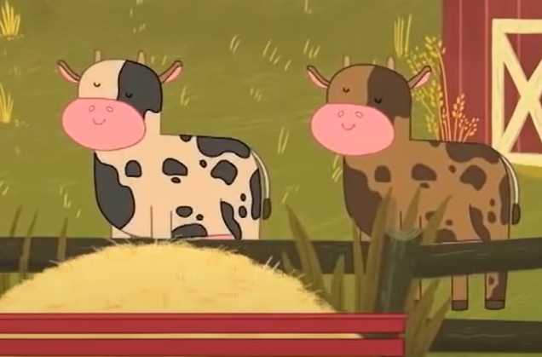
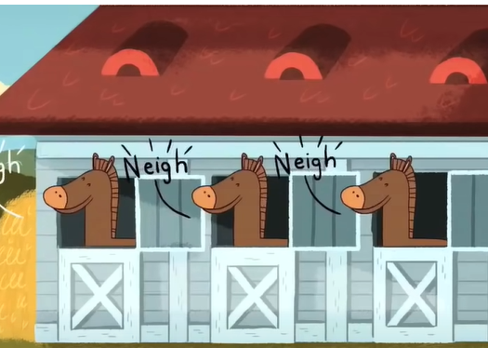
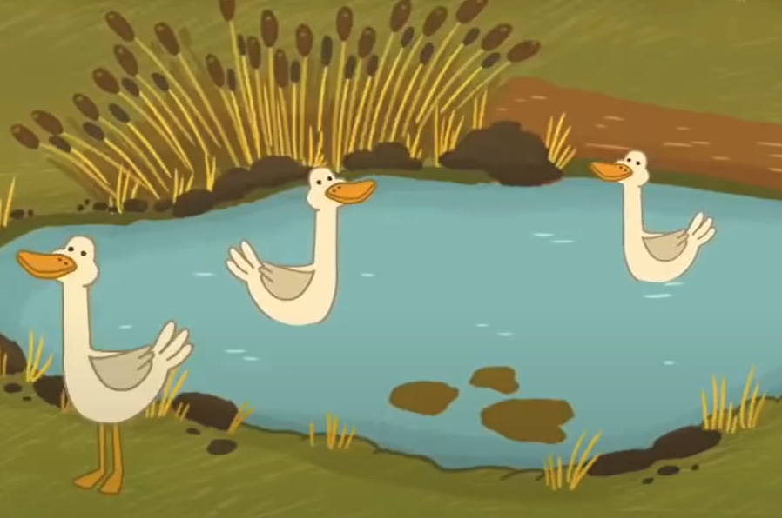

VOCABULARY CHECKING Listen and tick
✓
We’ve got
some…..
✓
My father has got some …
✓

Slide 29





REMEMBER
Vocabulary
Chicken
Cow
Goat
Horse
Sheep
Structures
I’ve got some chickens.

