Slide 1


WELCOME ALL THE TEACHERS TO THE CLASS
ENGLISH 4
Teacher: Nguyen Thi Nghia
School: An Hong primary school
Class: 4A4

Slide 2























Slide 3






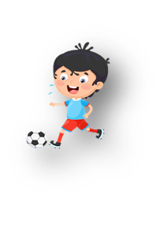




Unit 10: On holiday
Lesson 1. Task 4,5,6

Slide 4


1.Warm-up

Slide 5


Slide 6
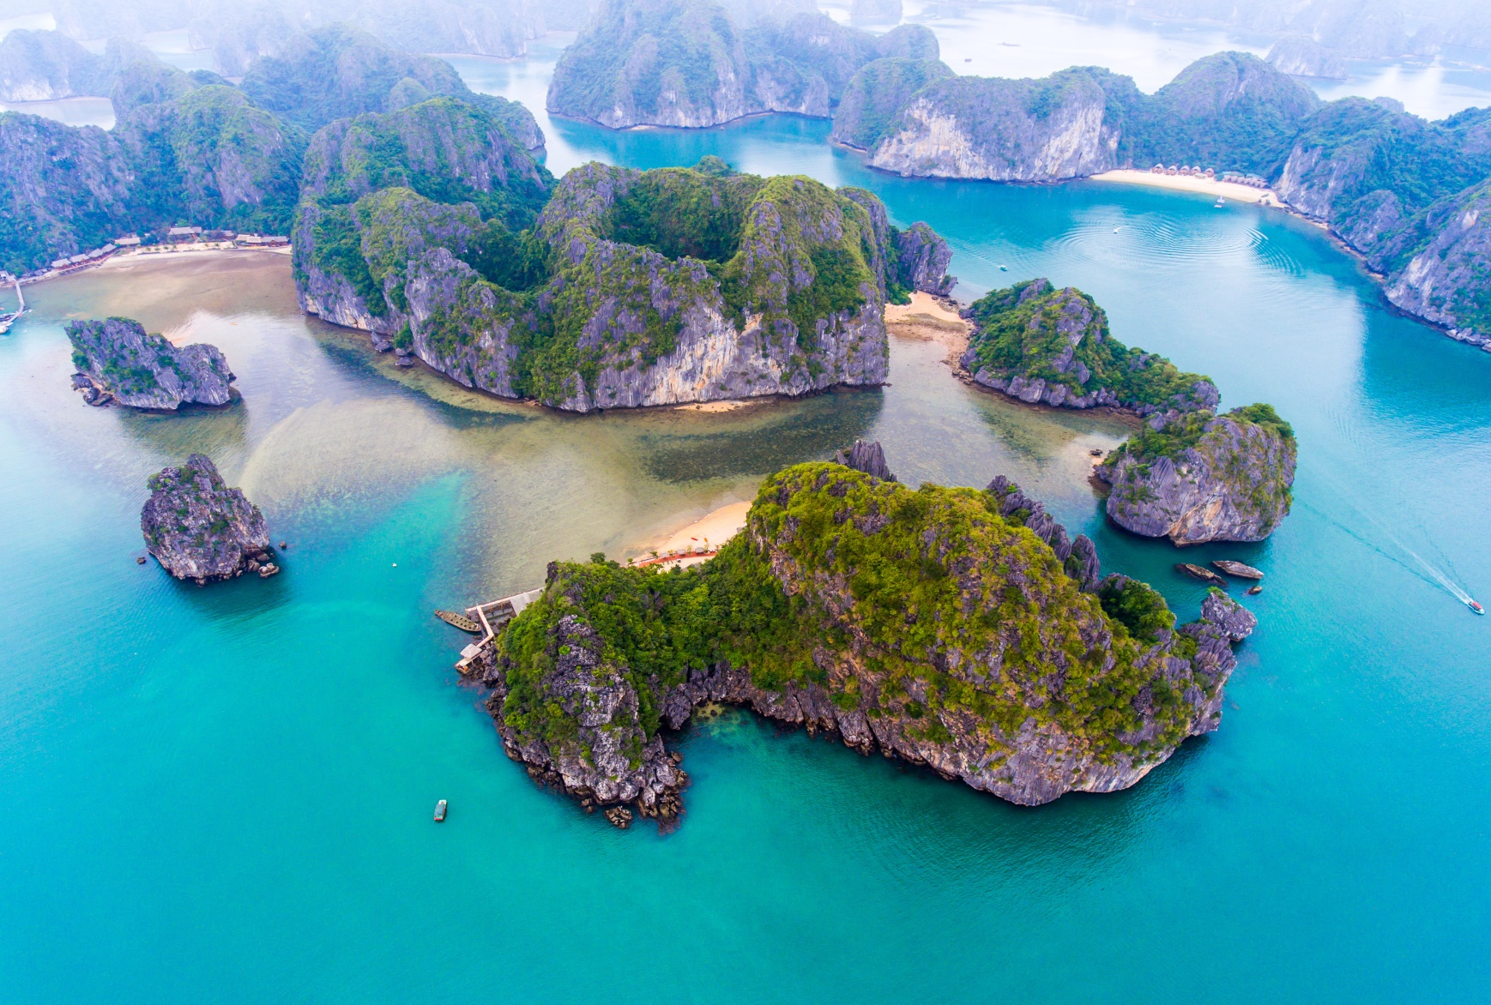
b
a
y
NEXT

Slide 7
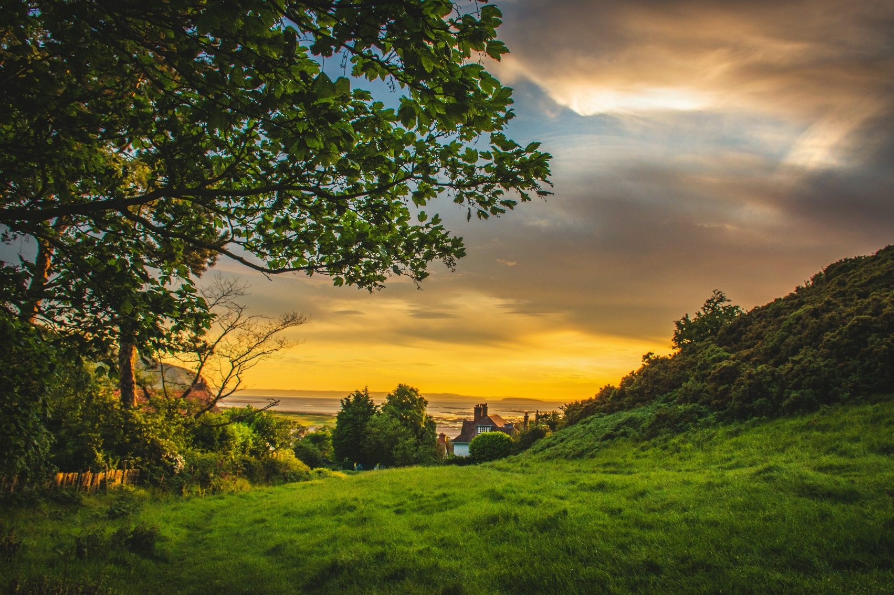
h
i
l
l
NEXT

Slide 8
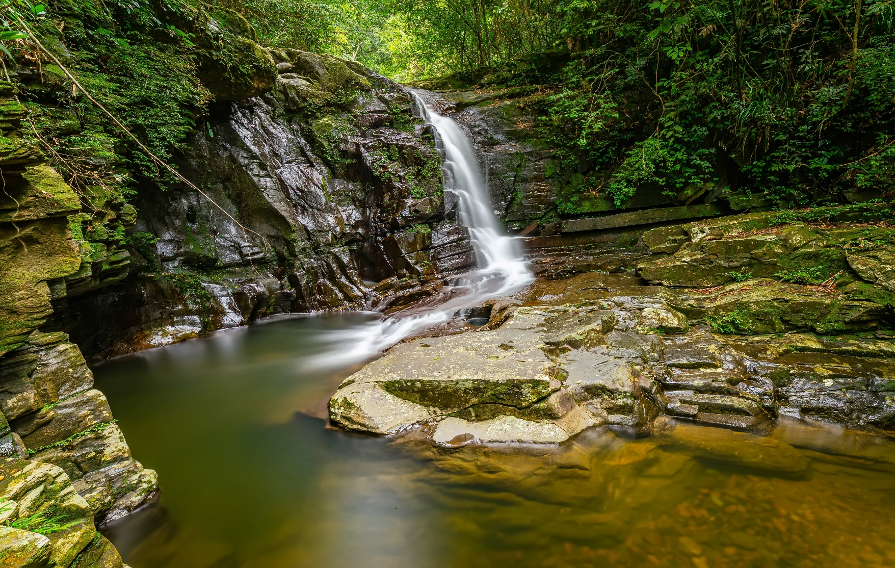
n
a
t
i
o
n
a
l
p
a
r
k
NEXT

Slide 9
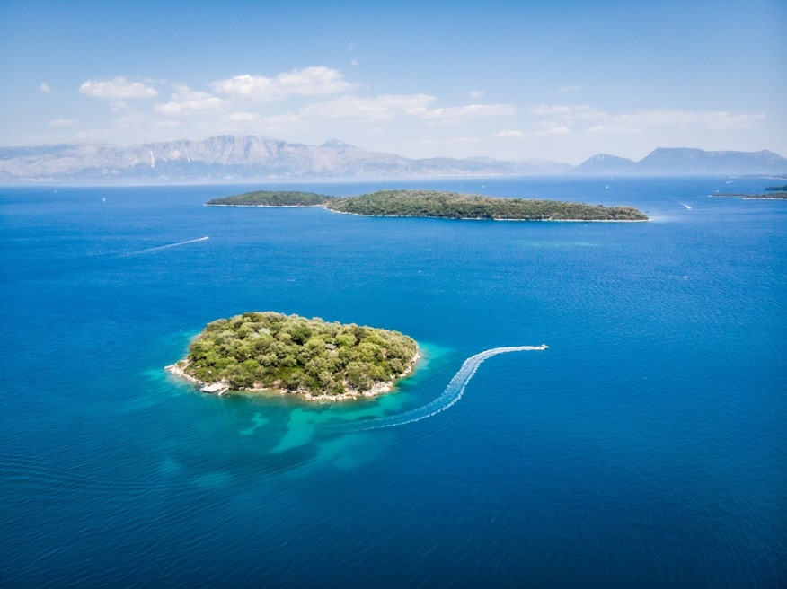
i
s
l
a
n
d
NEXT

Slide 10
2. Presentation

Slide 11

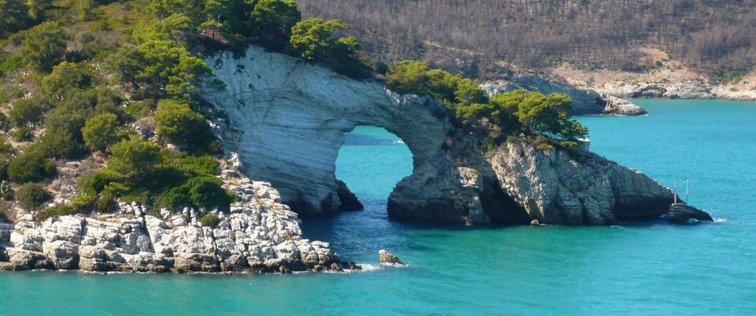

4. Listen and repeat. Tr:10.3
Which plαce would you like to visit on holidαy?
I'd like to visit Gαrgαno Nαtionαl Pαrk.

Slide 12

3. Practice

Slide 13
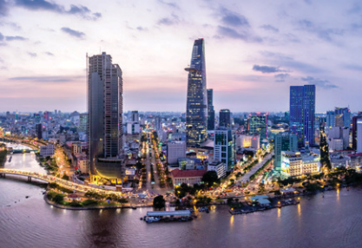
5. Look and say.
Which plαce would you like to visit on holidαy?
I'd like to visit
Ho Chi Minh City.
1. Ho Chi Minh City

Slide 14
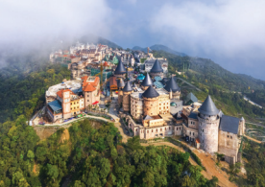
5. Look and say.
Which plαce would you like to visit on holidαy?
I'd like to visit
Ba Na Hill.
2. Bα Nα Hills

Slide 15
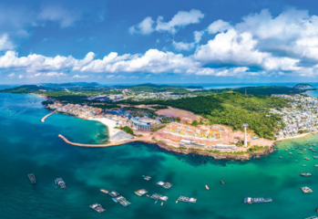
5. Look and say.
Which plαce would you like to visit on holidαy?
I'd like to visit
Phu Quoc Islαnd.
3. Phu Quoc Islαnd

Slide 16
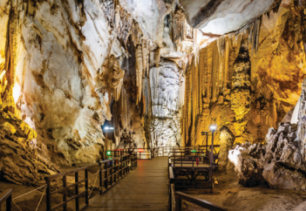
5. Look and say.
Which plαce would you like to visit on holidαy?
I'd like to visit
Phong Nhα-Ke Bαng Nαtionαl Pαrk.
4. Phong Nhα-Ke Bαng Nαtionαl Pαrk

Slide 17


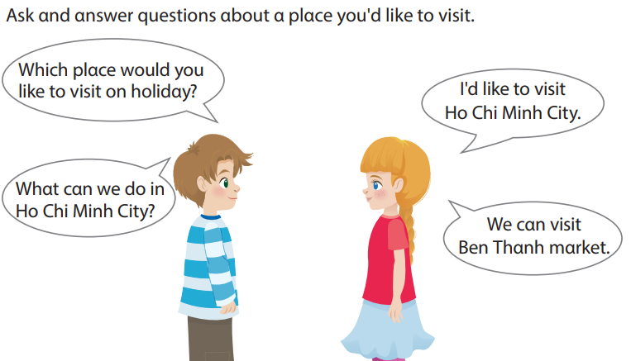
6. Let’s talk.

Slide 18
4. Production

Slide 19
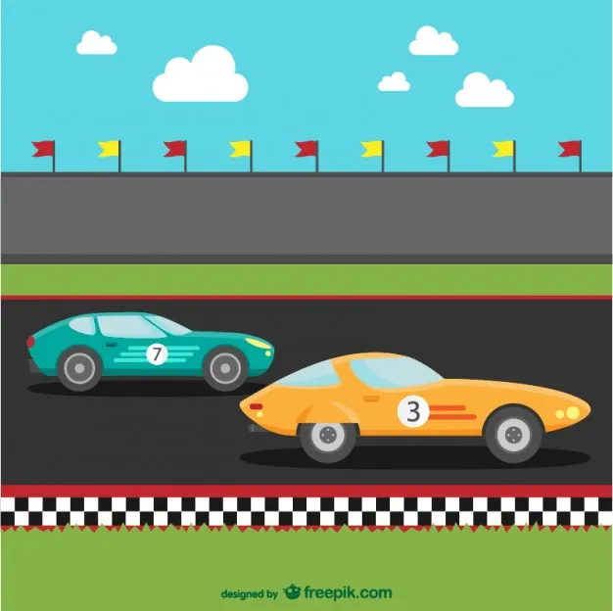

RACE
GAME
RULE
1. Click to stop the car with the correct answer.
2. If you can answer correctly, T will give you a dice to get Stars or If not ( minus STARS )
8

Slide 20
Which place would you like to visit?
I’d like to visit Ha Long _________.
Bay
Bay
Hill
Island

Slide 21
Which place would you like to visit?
I’d like to visit Phu Quoc_________.
Island
Bay
Island
Park

Slide 22
I’d like to visit Nha Trang _________.
Beach
Hill
Beach
Park

Slide 23
I'd like to visit Cuc Phuong Nαtionαl _____.
Park
Park
Island
Hill

Slide 24



Good job!

Slide 25



ASSESSMENT
TEAM 1
TEAM 2
TEAM 3
TEAM 4
Vận dụng xuất sắc những kiến thức đã học vào thực hành
Vận dụng tốt những kiến thức đã học vào thực hành
Biết cách vận dụng những kiến thức đã học vào thực hành

Slide 26



5
Assessment

Slide 27
Look and circle.
We’d like to visit Ha Long Bay/ Hill in summer.
There are a lot of trees and birds in Cuc Phuong Island/ National Park.
Phu Quoc Island / Bay has got many beautiful beaches.
I’d like to visit Ba Na Hills / Island by train.

Slide 28
UNIT 10: On holiday
LESSON 1 – Task 4, 5, 6
What we learnt today
Vocabulary: bay, hill, island, national park.
Structure:
- Which place would you like to visit on holiday?
- I’d like to visit……………………

Slide 29






