Slide 1


WELCOME ALL THE TEACHERS TO THE CLASS
ENGLISH 4
Teacher: Nguyen Thi Nghia
School: An Hong primary school
Class: 4A1

Slide 2








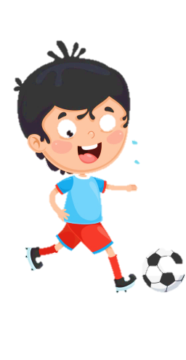


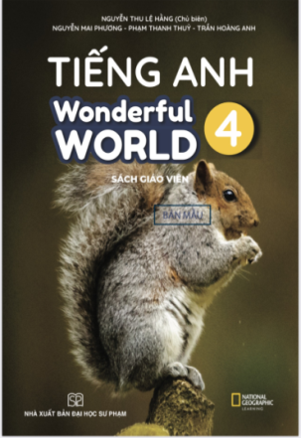








Slide 3




Unit 8 - Lesson 1– Period 2

Slide 4


Presentation
4
Listen and repeat.

Slide 5

Frequency Adverbs
Always
Sometimes

Slide 6

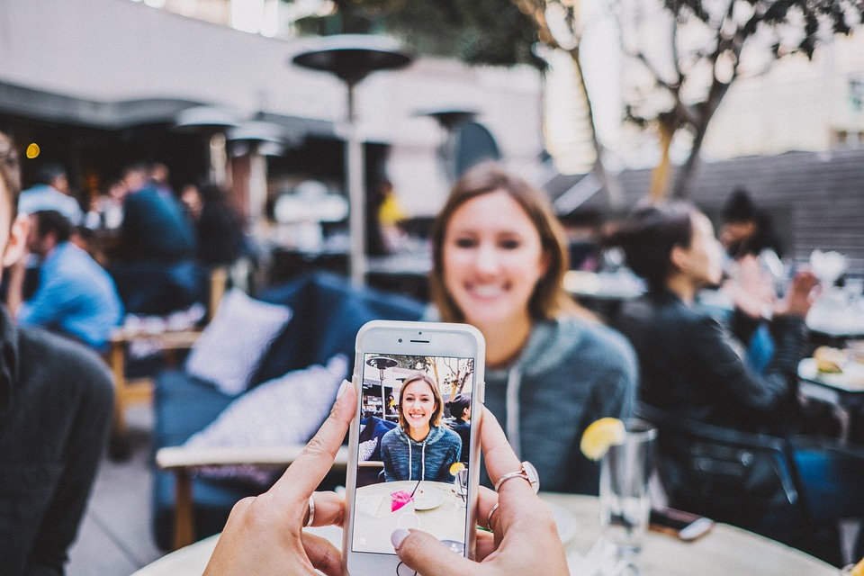
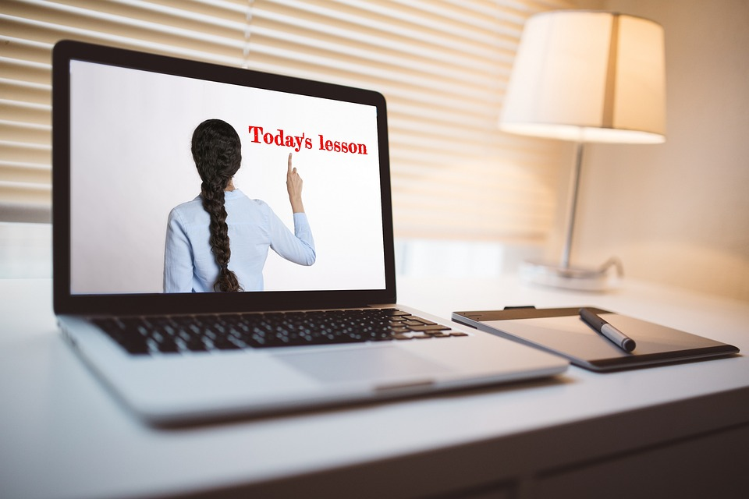
Choose correct answer
1
What can she do?
2
He ____ learns English.
A. She can make videos.
A. sometimes
B. She can write emails.
B. never
C. She can learn English.
C. always

Slide 7


4
Listen and repeat.
1
She sometimes makes videos on her smartphone.

Slide 8

2
He always learns English on his computer.

Slide 9

Practice
5
Look and say.

Slide 10


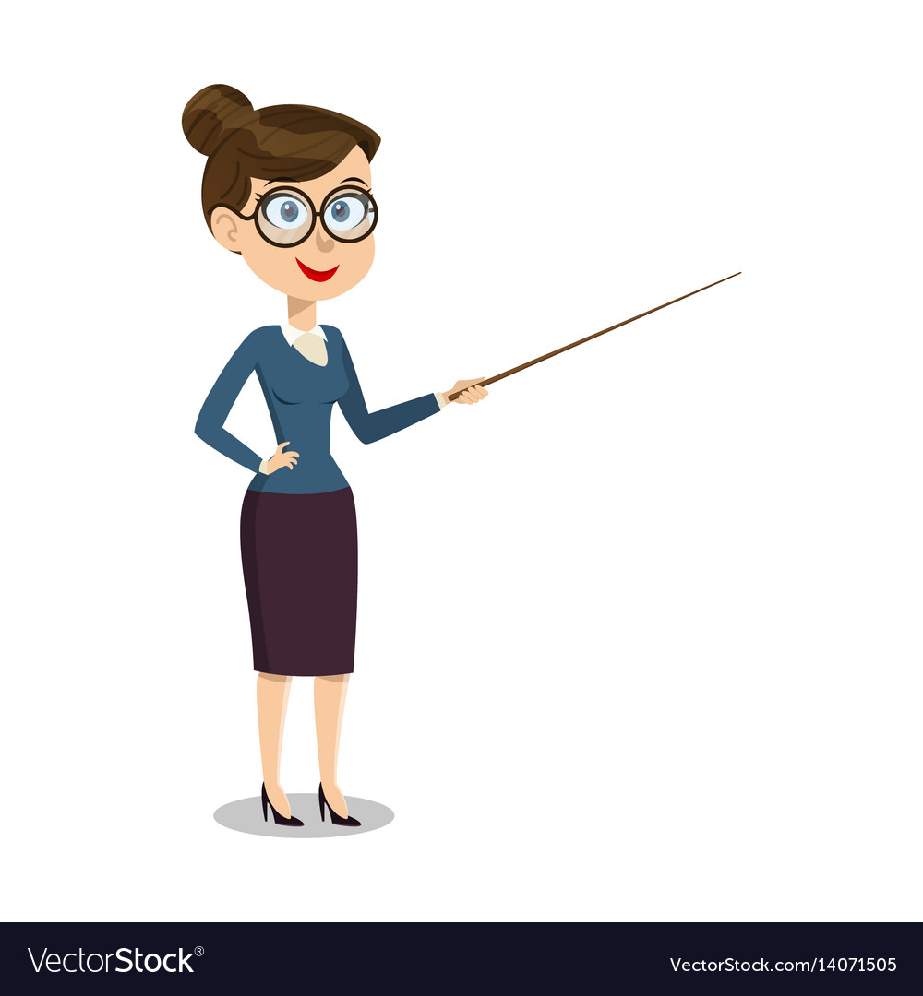


5
Look and say.
Linda/write emails
Linda sometimes writes emails on her computer.

Slide 11

My brother/ make videos
My brother always makes videos on his computer.

Slide 12
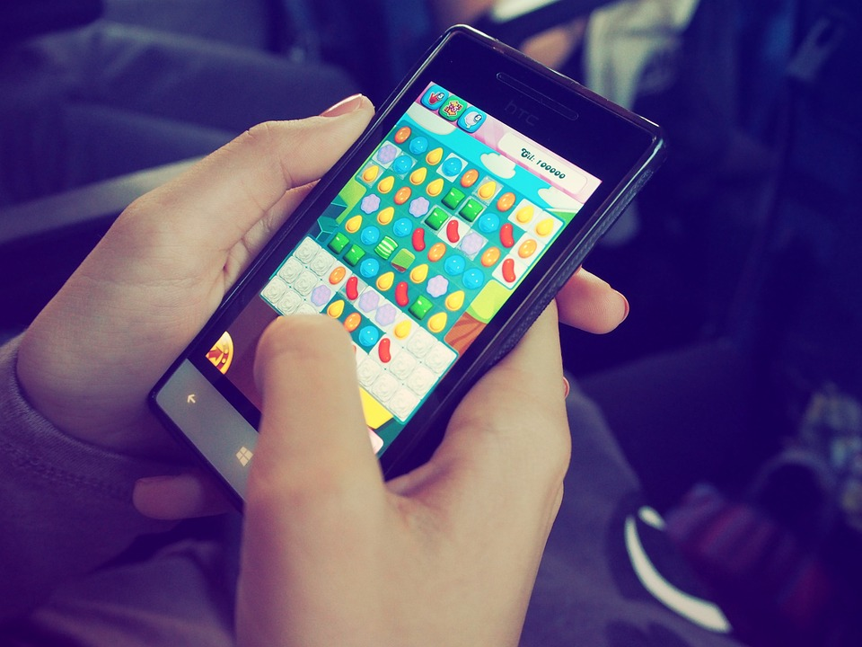

Richard/ play games
Richard sometimes plays games on his smartphone.

Slide 13
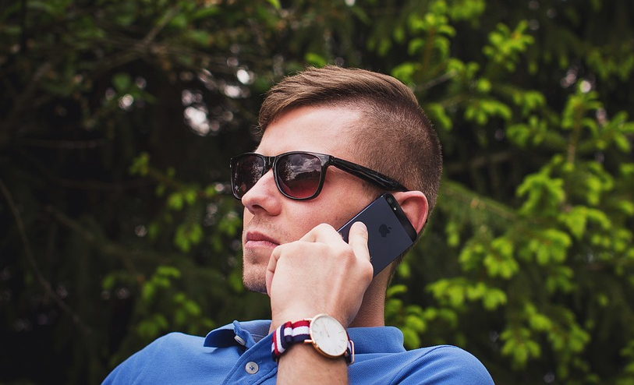
Uncle Mark/
make phone calls
Uncle Mark sometimes makes phone calls on his smartphone.

Slide 14
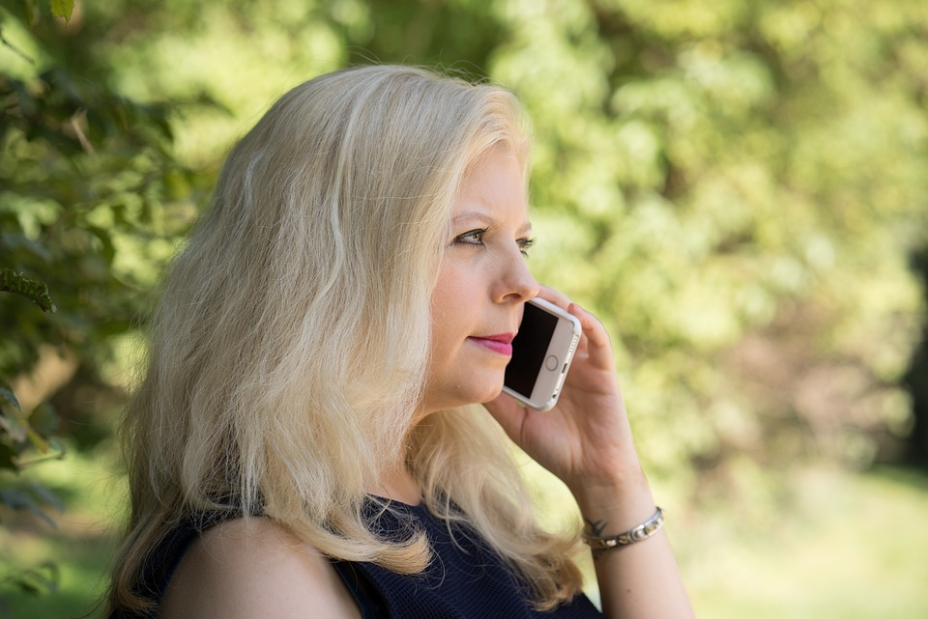

Frequency adverbs practice
always
usually
often
sometimes
never

Slide 15

Production
6
Let’s talk.

Slide 16

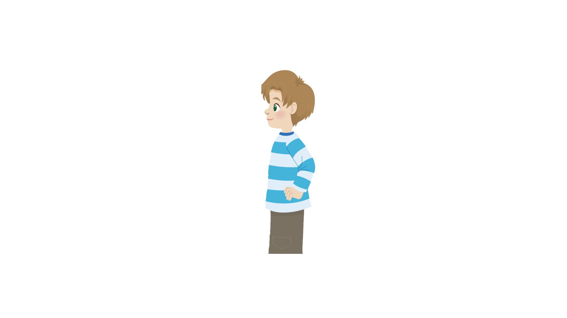
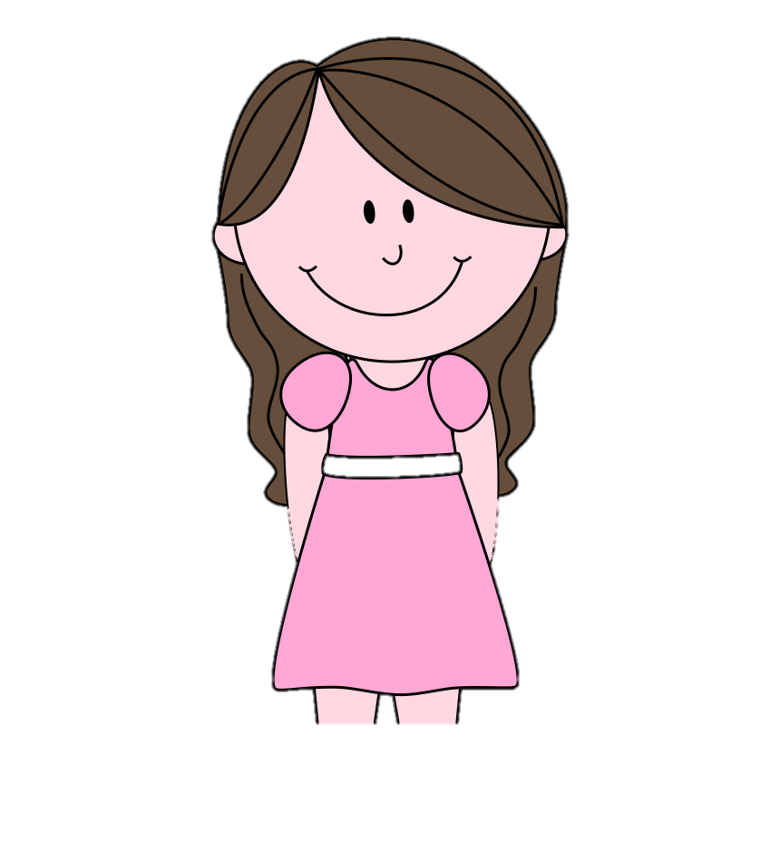
6
Let’s talk
I always learn English on my smartphone.
That’s cool! I sometimes play video games on my smart phone.
Sam
Andy

Slide 17
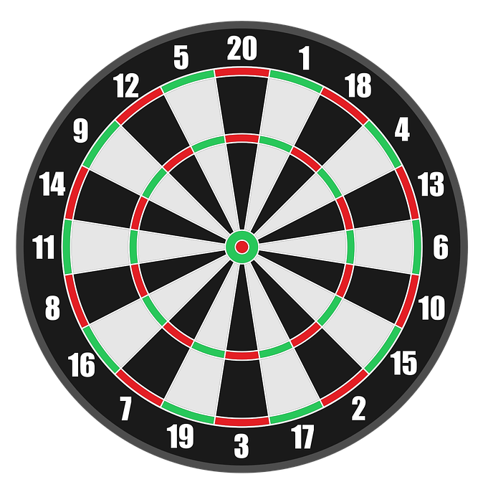


Game :Dart Board
Look and answer
1
3
5
2
4
Next

Slide 18




+ 3
I sometimes write emails.
Back
I always write emails.
Abc.xyz789

Slide 19
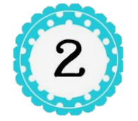

We ____ learn English
on our computers.
+5
always
sometimes
Back
Abc.xyz789

Slide 20

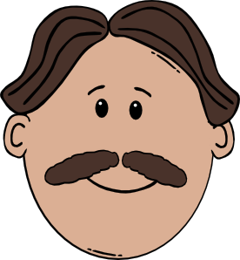
3
I _______ make phone calls on my _______.
+8
Sometimes/ smartphone
Sometimes/
computer
Back
Abc.xyz789

Slide 21

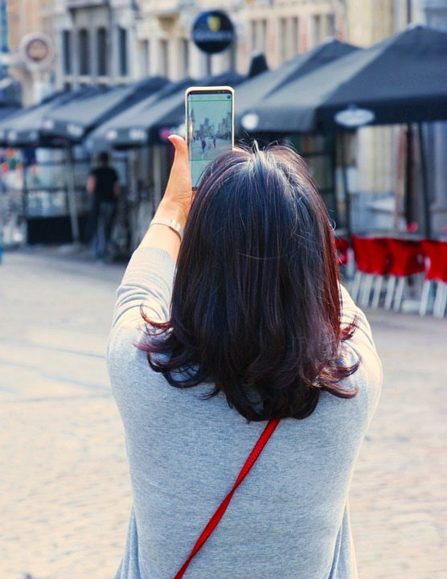
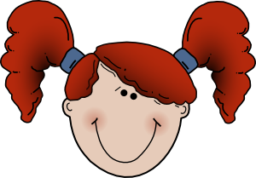
+ 6
I always take photos.
Back
I sometimes take photos.
Abc.xyz789

Slide 22


That’s cool! I ____ make videos on my computer.
+4
never
always
Back
Abc.xyz789

Slide 23

Assessment

Slide 24


Choose the correct answers.
1. I ______ learn English on my smartphone.
A. always
B. alway
C. allways
D. awway
2. They can ________emails on their computer.
A. eat
B. hit
C. leave
D. write
3. What can you do on your _______?
A. I
B. we
C. phone
D. he
4. Aunt Trang sometimes ____ phone calls.
A. made
B. makes
C. make
D. makees
Notes:
HOẠT ĐỘNG TƯƠNG TÁC

Slide 25


Wrap up

Slide 26

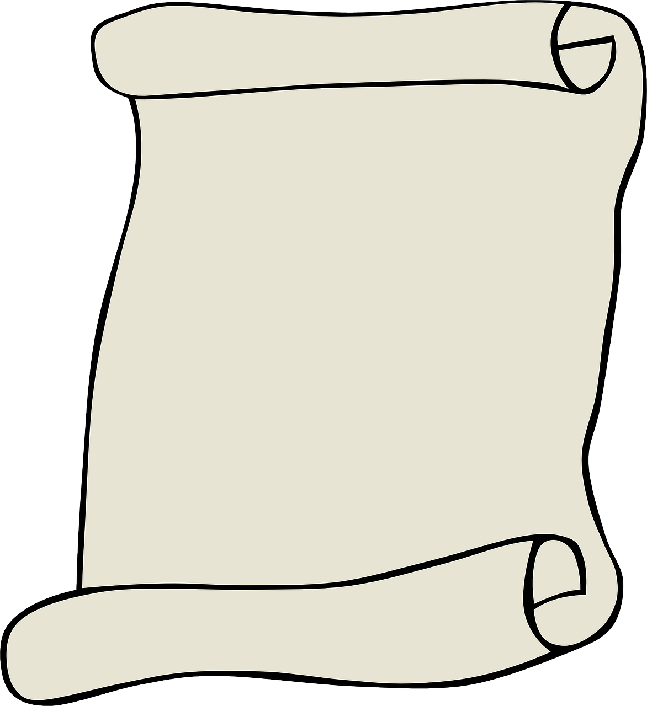
REMEMBER
VOCABULARY:
Sometimes: đôi khi
Always: luôn luôn
STRUCTURE:
I/We/ They sometimes/always + V
He/She sometimes/always + Vs/es

Slide 27




Thank you & goodbye!

